Slide 1
The African Monsoon Recent Evolution and Current Status Include Week-1 and Week-2 Outlooks
Update prepared by
1 August 2022
For more information, visit:
http://www.cpc.ncep.noaa.gov/products/Global_Monsoons/African_Monsoons/precip_monitoring.shtml

Slide 2
Outline
Highlights
Recent Evolution and Current Conditions
NCEP GEFS Forecasts
Summary

Slide 3
Highlights: Last 7 Days
During the past 7 days, in East Africa, rainfall was above-average over much of South Sudan, parts of southern and eastern Sudan, northern Uganda, Eritrea and northern Ethiopia. Below-average rainfall was observed over pockets of southern Ethiopia and western Kenya. In Central Africa, rainfall was above-average over southern Chad and northern DRC. Below-average rainfall was observed over much of CAR and parts of western DRC. In West Africa, above-average rainfall was observed over portions of southern Mauritania, southern Ghana, northern Benin and pockets of central Nigeria. In contrast, parts of Senegal, Guinea, central and southern Mali, Sierra Leone, Liberia, Cote d’Ivoire, Burkina Faso, parts of southern Niger and northern Nigeria received below-average rainfall.
Week-1 and week-2 outlooks call for an increased chance for below-average rainfall along the Gulf of Guinea-coast. In contrast, there is an increased chance for above-average rainfall, across the eastern portion of the Sahel region, parts of Sudan, South Sudan, western Ethiopia and Eritrea.

Slide 4
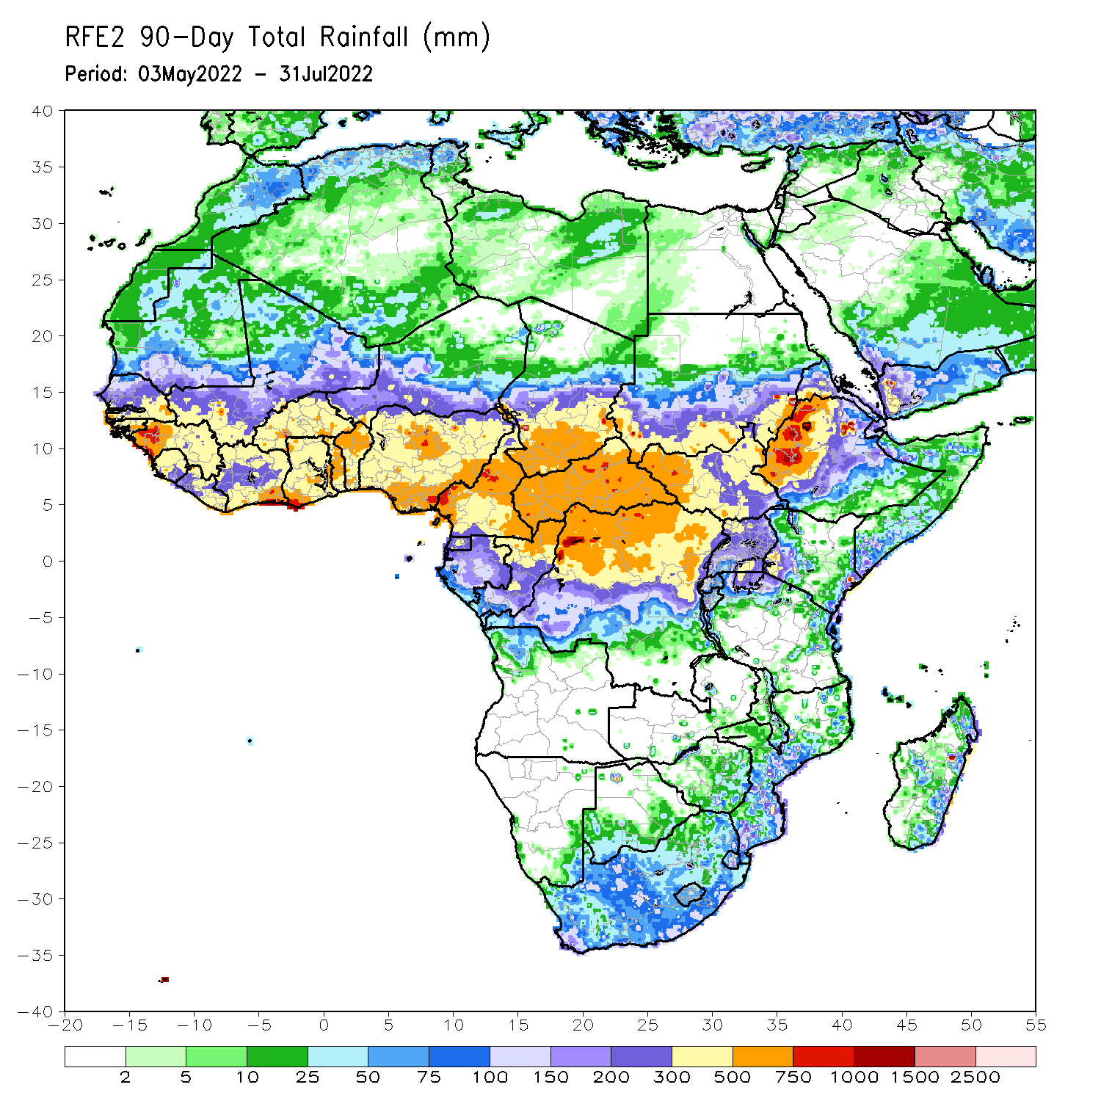
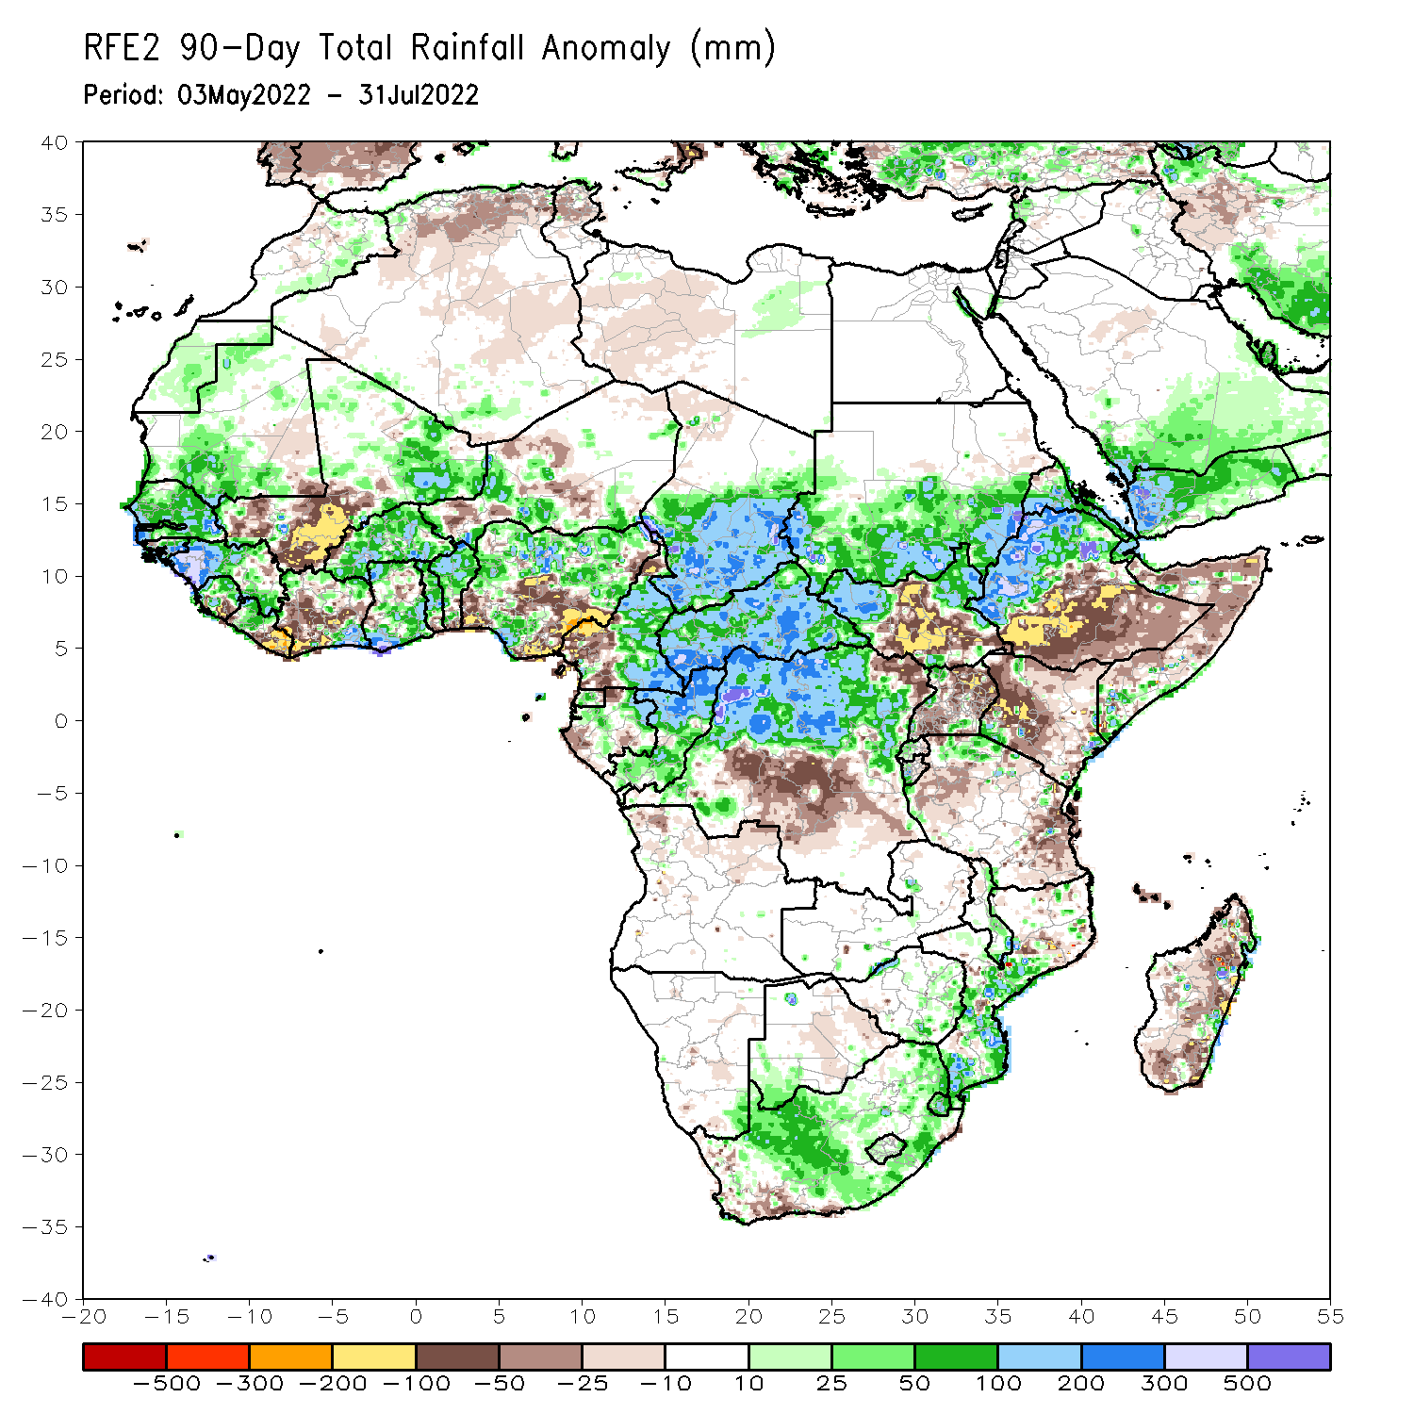
Rainfall Patterns: Last 90 Days
Over the past 90 days, in East Africa, above-average rainfall was observed over southern and eastern Sudan, the western and eastern portions of South Sudan, western Ethiopia, and parts of southern Somalia. Rainfall was below-average over southern and eastern Ethiopia, central and southern South Sudan, much of Kenya, central and northern Somalia, Uganda, as well as parts of Tanzania. In southern Africa, above-average rainfall was observed over parts of South Africa and Mozambique. Below-average rainfall was observed over pockets of Botswana and much of Madagascar. In Central Africa, rainfall was above-average over central and eastern Cameroon, much of CAR, northern and eastern Gabon, Congo, and northern DRC. Rainfall was below-average over pockets of western Cameroon, parts of central DRC, and pockets of Gabon. In West Africa, rainfall was above-average over southern Mauritania, Senegal, Guinea-Bissau, Guinea, Sierra Leone, western Liberia, eastern Mali, Burkina Faso, parts of Ghana, Togo, Benin, and parts of Niger and western and northern Nigeria. In contrast, below-average rainfall was observed over central Mali, eastern Liberia, parts of Cote D’Ivoire, pockets of northeastern Ghana, and parts of central and southern Nigeria.
Notes:
4

Slide 5
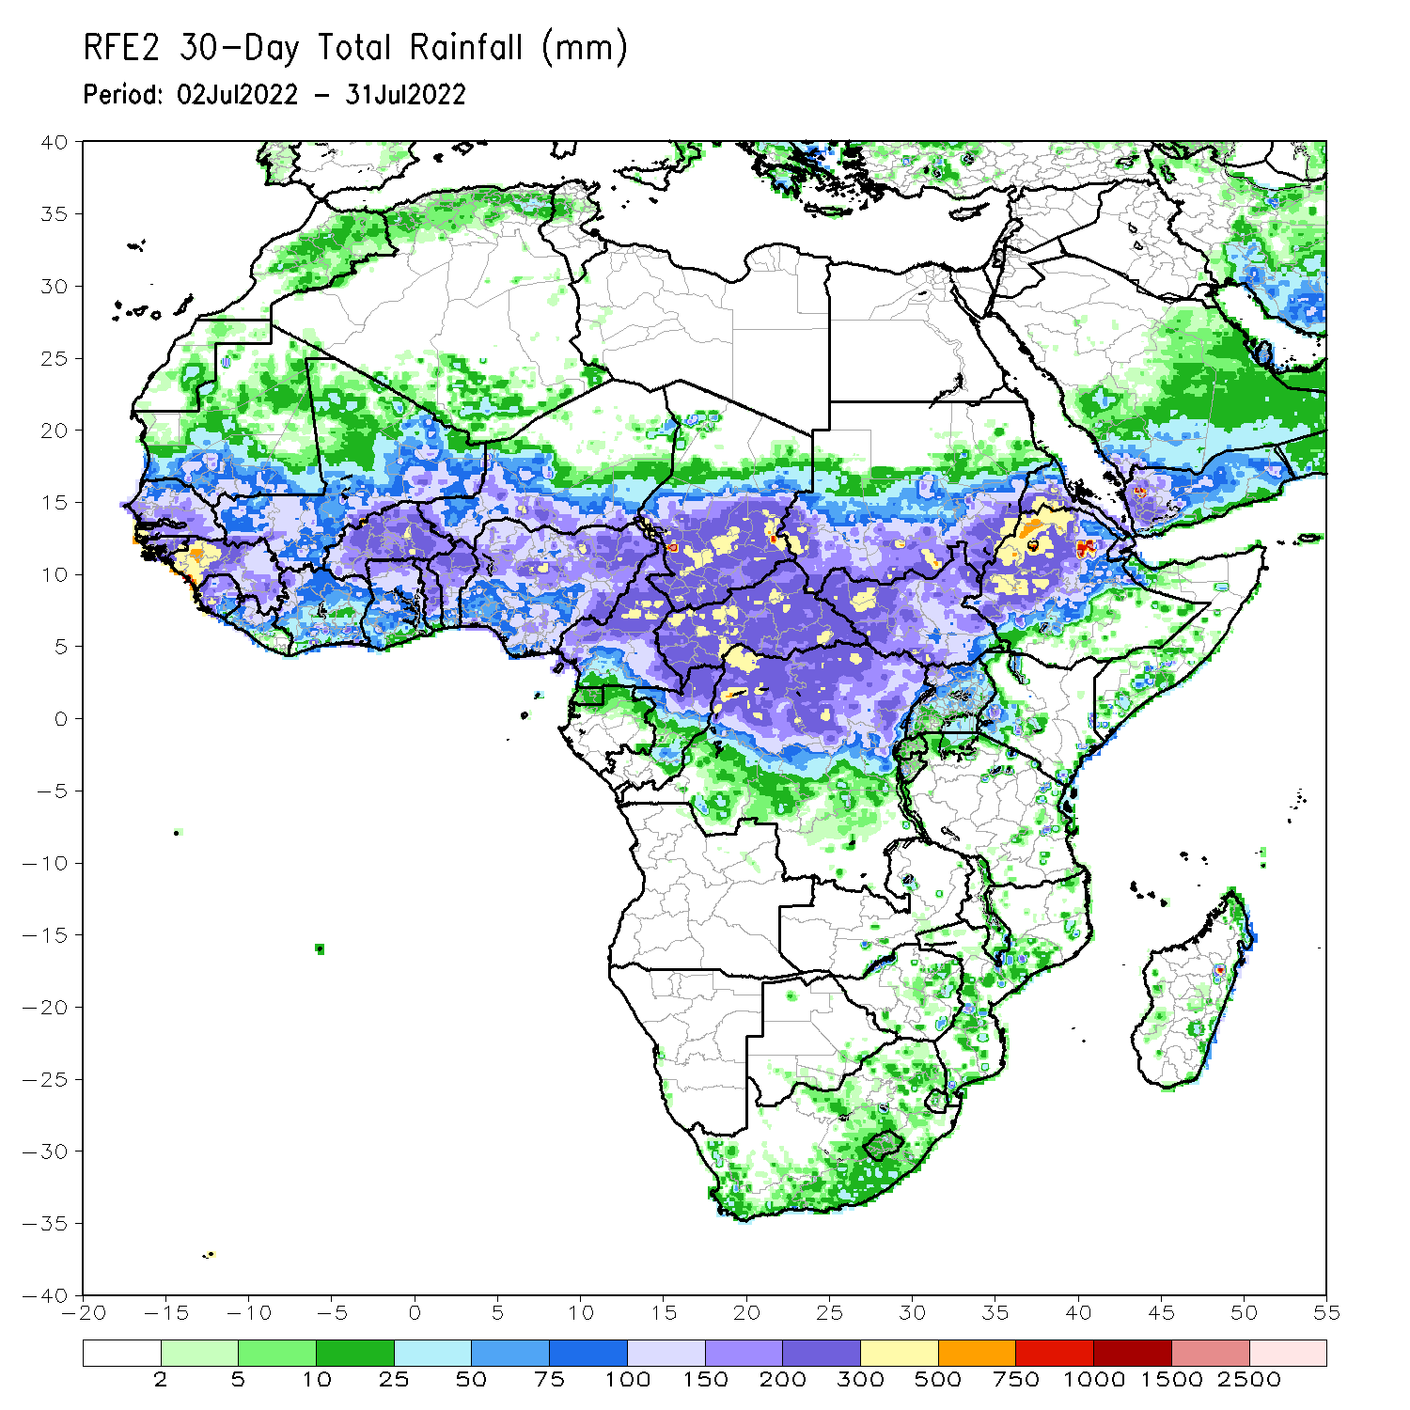
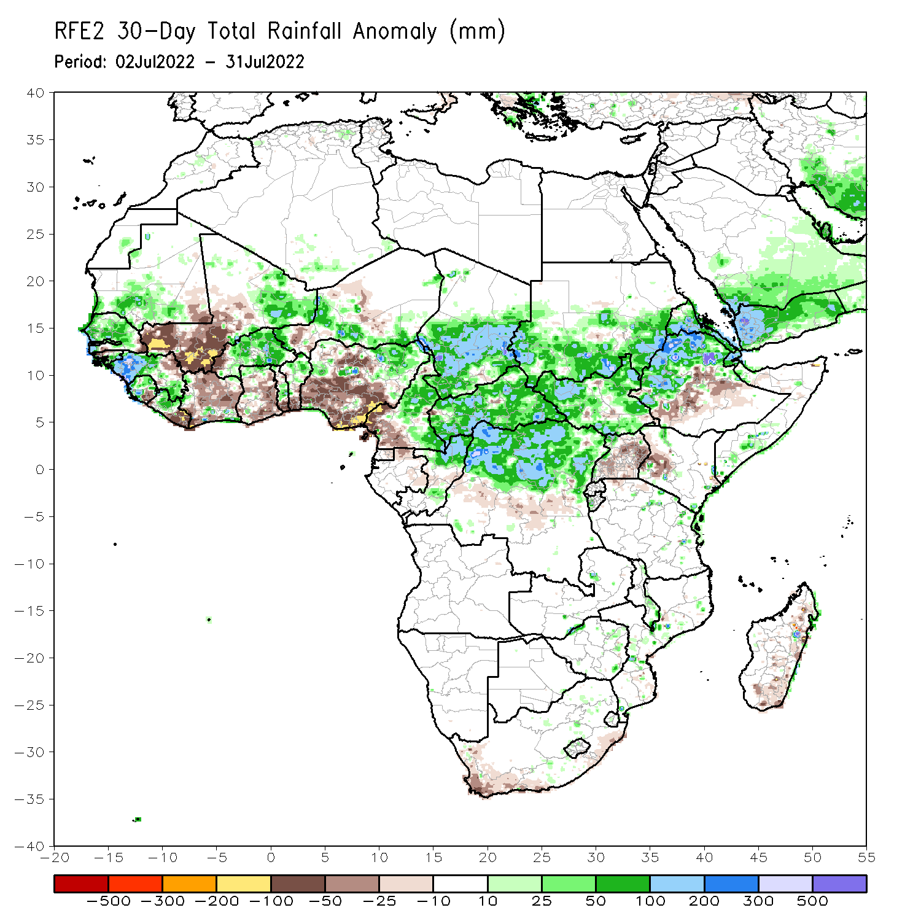
Rainfall Patterns: Last 30 Days
During the past 30 days, in East Africa, above-average rainfall was observed over southern and eastern Sudan, parts of western and eastern South Sudan, and the western, central and northern portions of Ethiopia. Rainfall was below-average over pockets of central and southern South Sudan, Uganda, parts of central and southern Ethiopia, western Kenya and Uganda. In Central Africa, rainfall was above-average over parts of northern and eastern Cameroon, northern Congo, much of CAR, southern Chad and northern DRC. Rainfall was below-average over Equatorial Guinea, southern Cameroon, and pockets of central DRC. In West Africa, rainfall was above-average over Senegal, Guinea, Sierra Leone, western Liberia, Burkina Faso, parts of southern Niger and northern Nigeria. In contrast, central and southern Mali, eastern Liberia, Cote D’ivoire, southern Ghana, southern Togo, southern Benin, parts of western Niger, and southern Nigeria received below-average rainfall.
Notes:
5

Slide 6
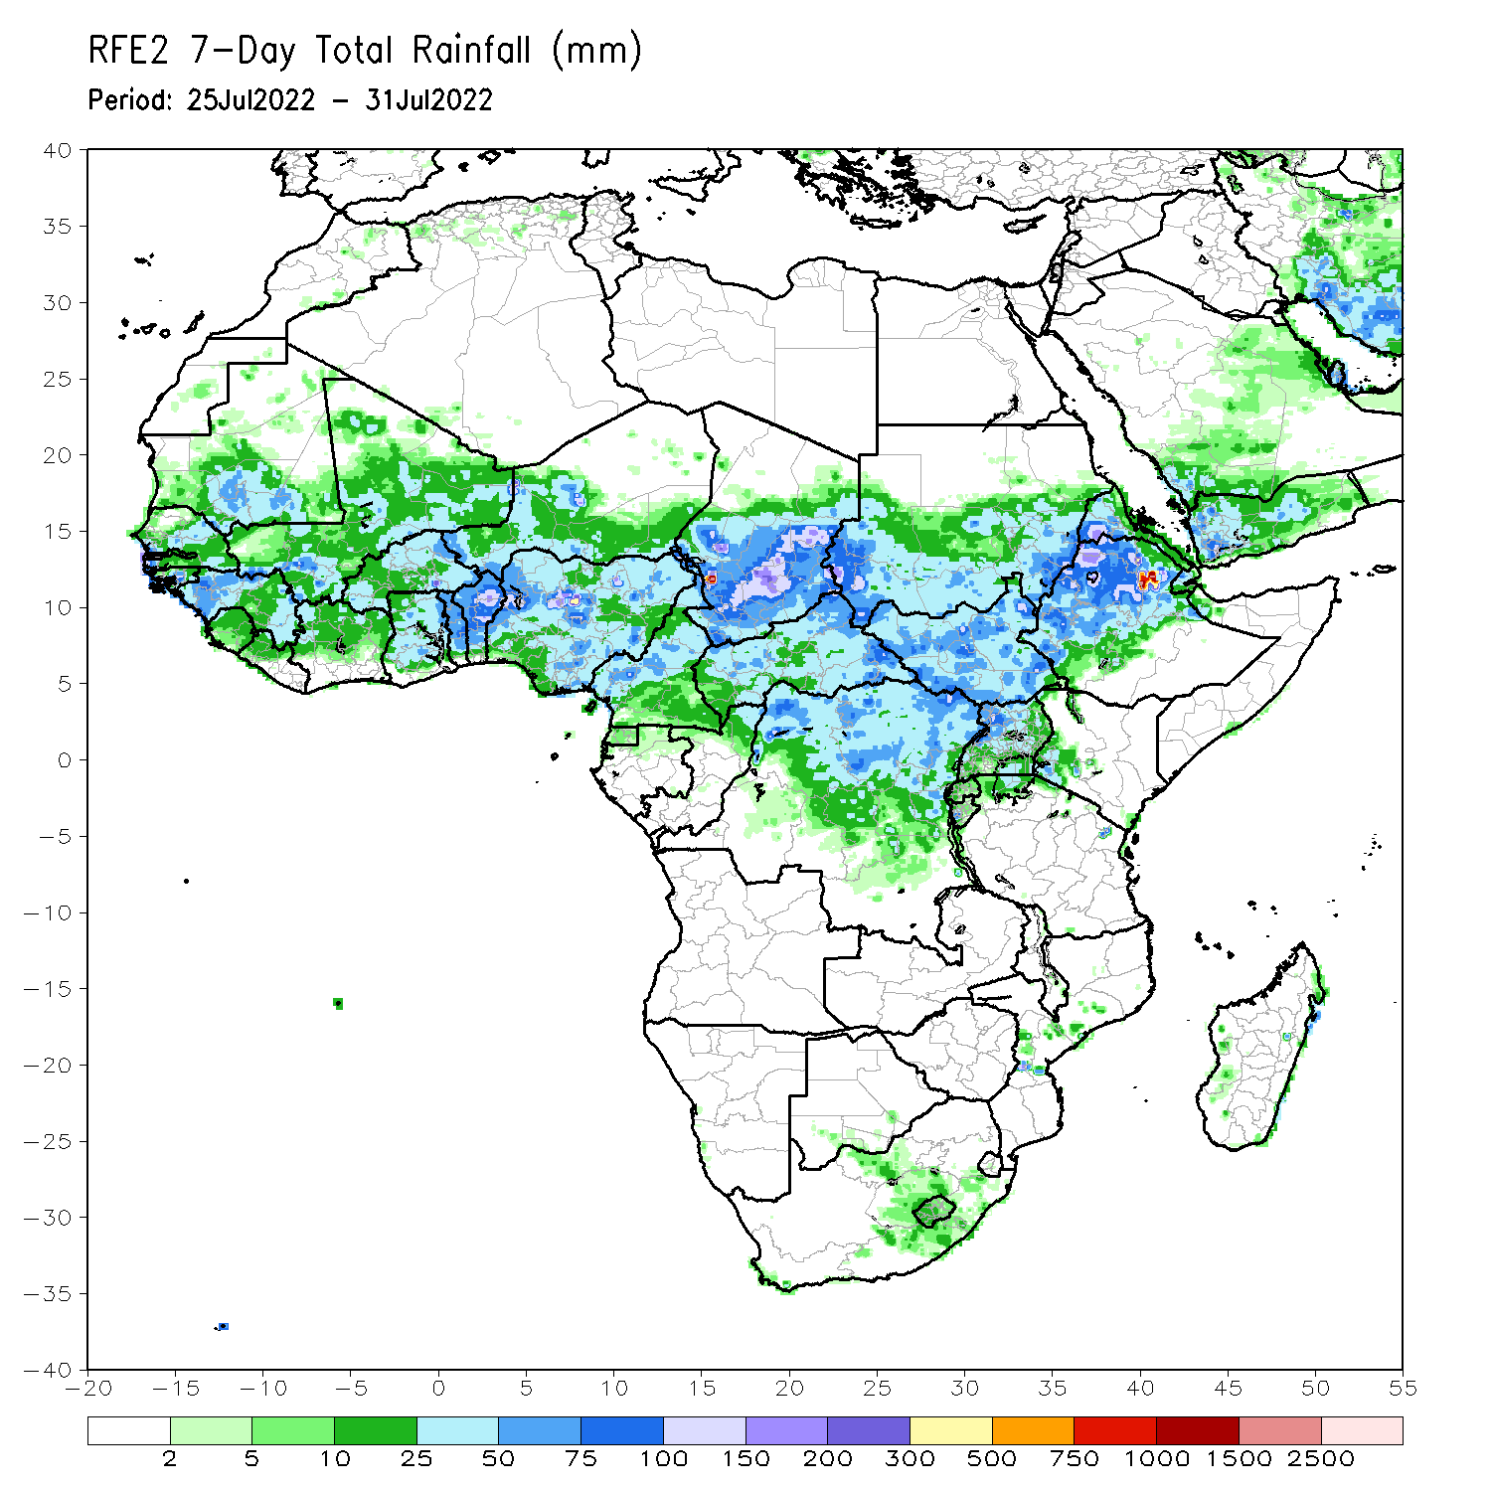
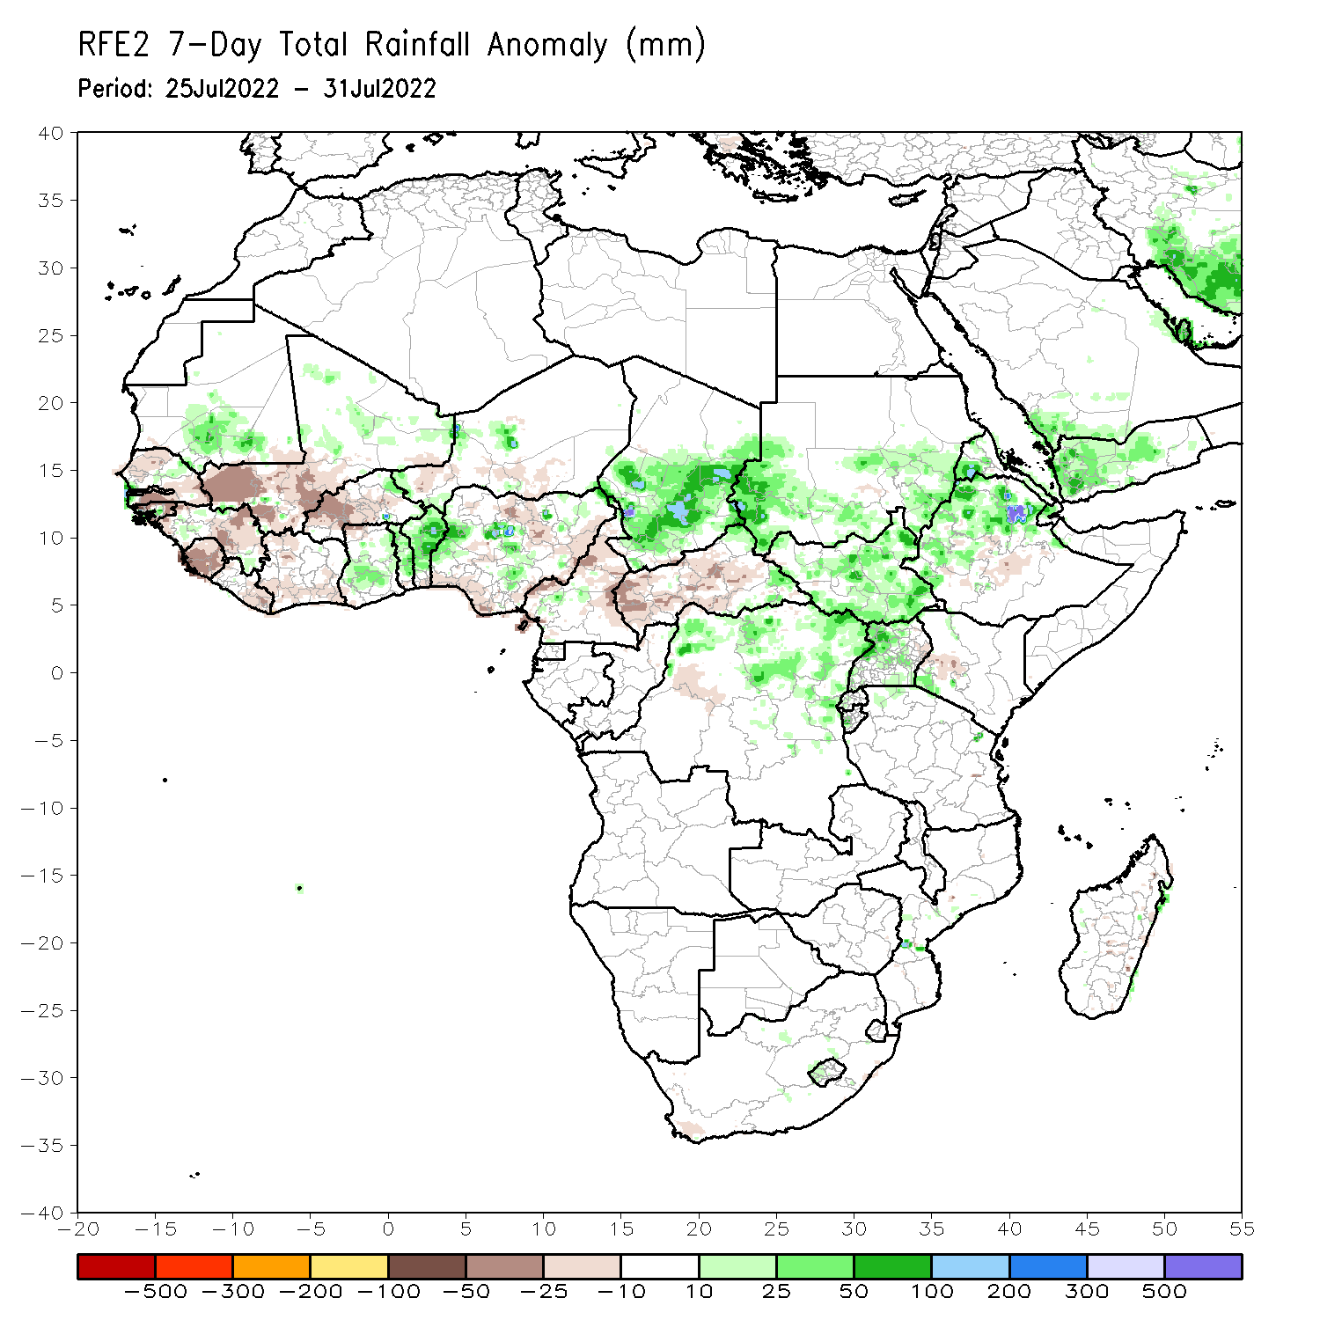
Rainfall Patterns: Last 7 Days
During the past 7 days, in East Africa, rainfall was above-average over much of South Sudan, parts of southern and eastern Sudan, northern Uganda, Eritrea and northern Ethiopia. Below-average rainfall was observed over pockets of southern Ethiopia and western Kenya. In Central Africa, rainfall was above-average over southern Chad and northern DRC. Below-average rainfall was observed over much of CAR and parts of western DRC. In West Africa, above-average rainfall was observed over portions of southern Mauritania, southern Ghana, northern Benin and pockets of central Nigeria. In contrast, parts of Senegal, Guinea, central and southern Mali, Sierra Leone, Liberia, Cote d’Ivoire, Burkina Faso, parts of southern Niger and northern Nigeria received below-average rainfall.

Slide 7
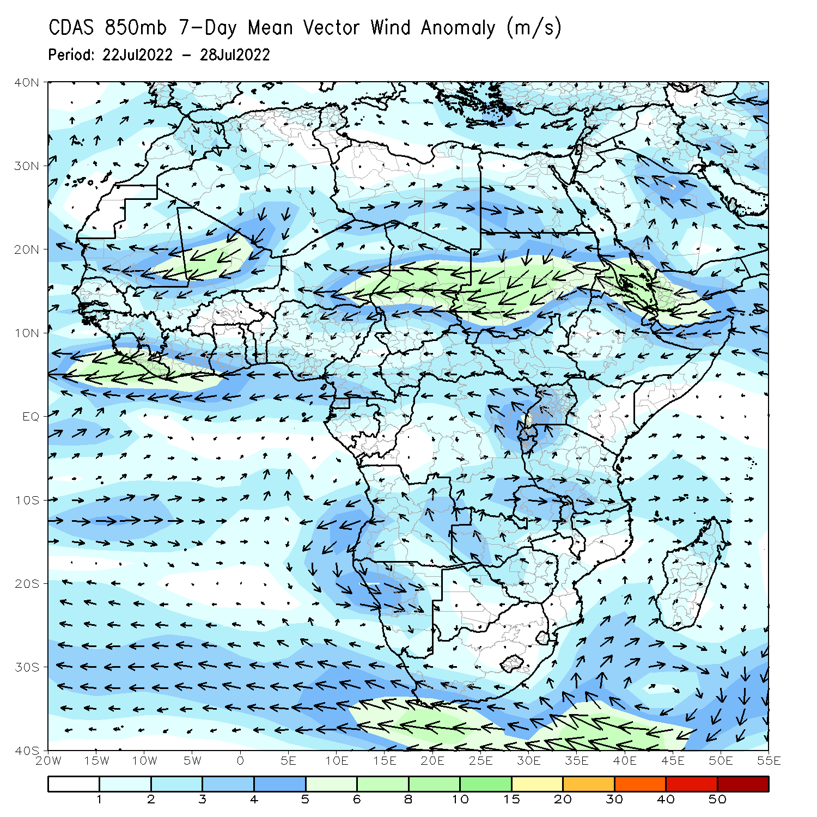
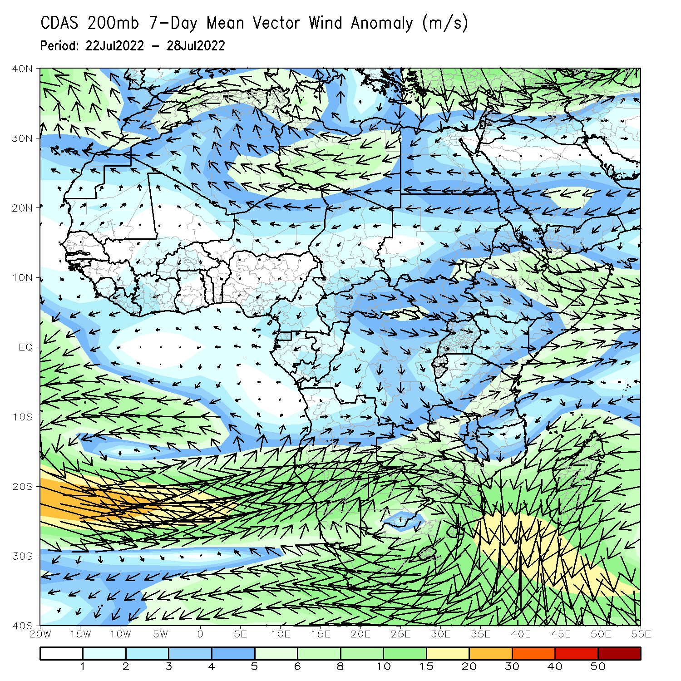
Atmospheric Circulation: Last 7 Days
At 700-hPa level (left panel), a broad area of anomalous easterly flow was observed across much of the Sudano-Sahelian region.

Slide 8
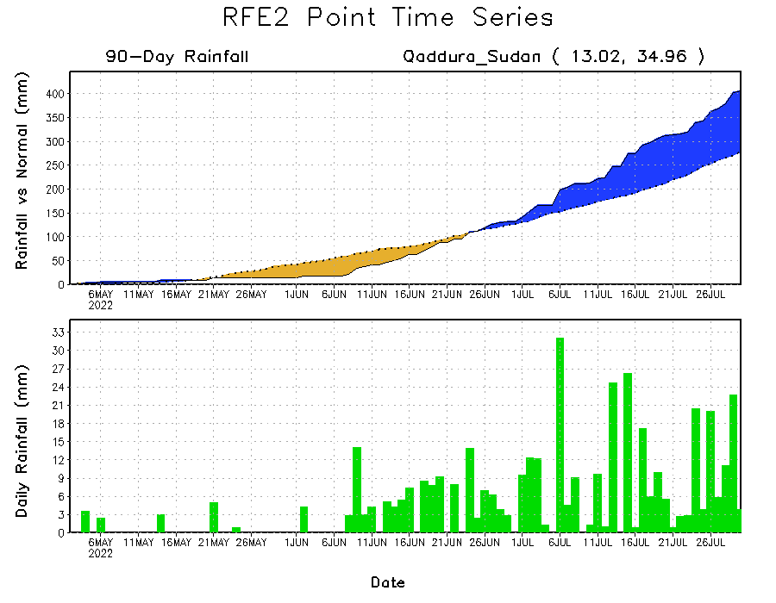
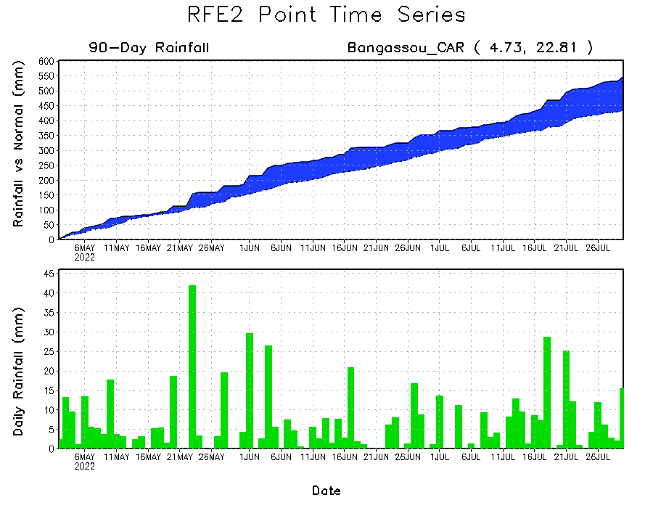
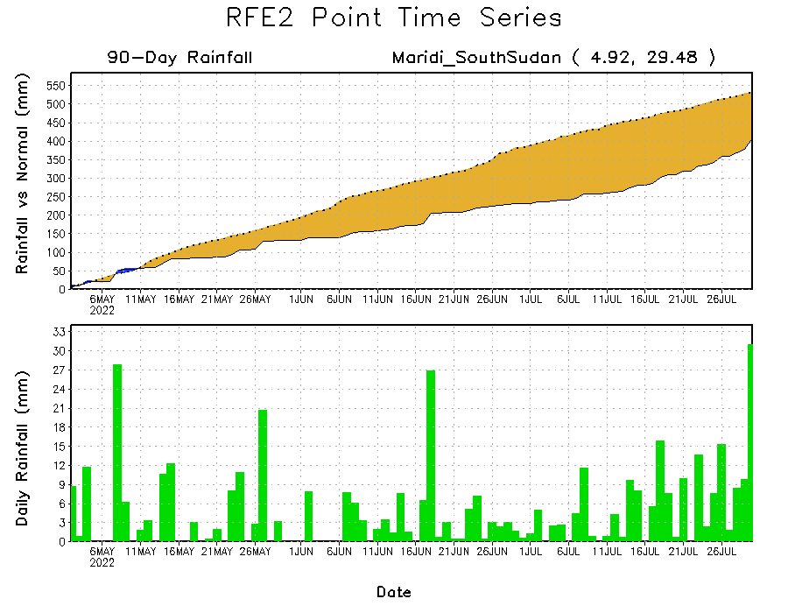
Rainfall Evolution
Daily evolution of rainfall over the last 90 days at selected locations shows increasing moisture deficits over parts of South Sudan (bottom right). Consistent heavy rains have kept significant moisture surpluses over parts of Central African Republic (bottom left) and eastern Sudan (top right).

Slide 9
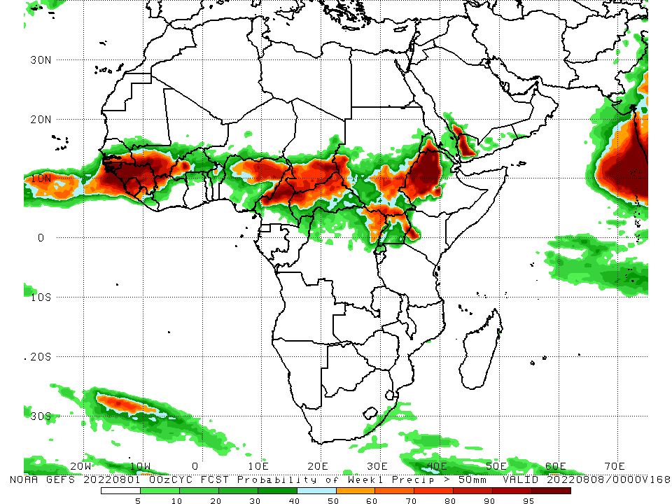
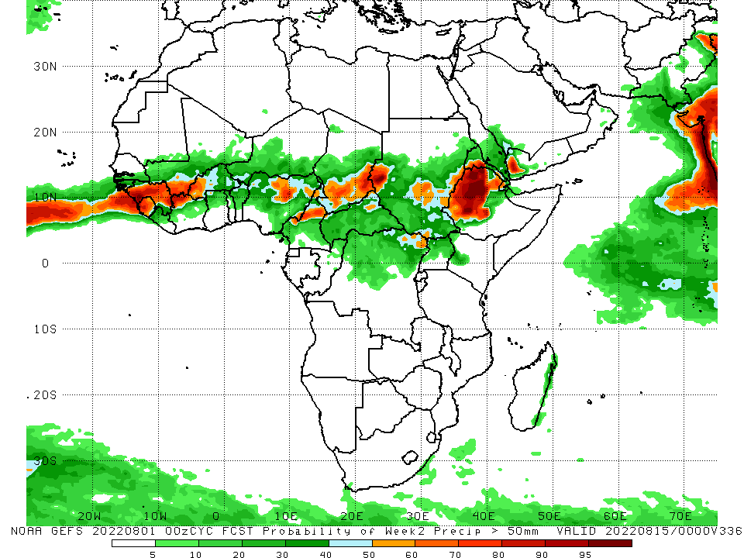
NCEP GEFS Model Forecasts Non-Bias Corrected Probability of precipitation exceedance
Week-1, Valid: 2 – 8 August, 2022
Week-2, Valid: 9 – 15 August, 2022
For week-1 (left panel) and week-2 (right panel) the NCEP GEFS indicates a moderate to high chance (over 70%) for rainfall to exceed 50 mm over the western and eastern portions of the Gulf of Guinea region, parts of central Africa and western Ethiopia.
Notes:
9

Slide 10
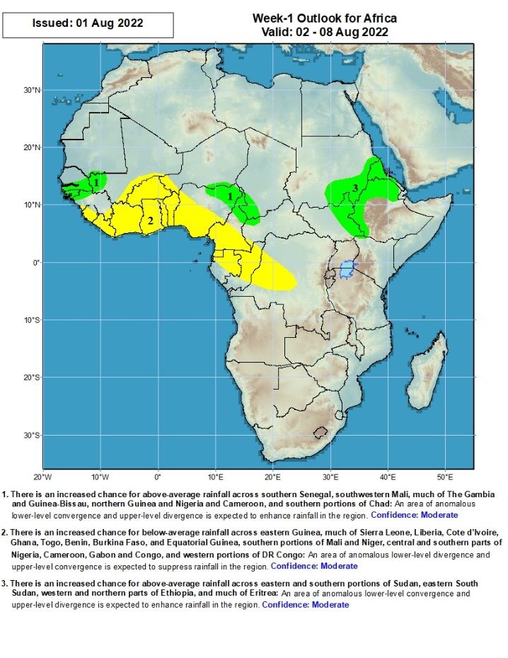
Week-1 Precipitation Outlooks
2 - 8 August, 2022
There is an increased chance for above-average rainfall across southern Senegal, southwestern Mali, much of The Gambia and Guinea-Bissau, northern Guinea and Nigeria and Cameroon, and southern portions of Chad: An area of anomalous lower-level convergence and upper-level divergence is expected to enhance rainfall in the region. Confidence: Moderate
There is an increased chance for below-average rainfall across eastern Guinea, much of Sierra Leone, Liberia, Cote d’Ivoire, Ghana, Togo, Benin, Burkina Faso, and Equatorial Guinea, southern portions of Mali and Niger, central and southern parts of Nigeria, Cameroon, Gabon and Congo, and western portions of DR Congo: An area of anomalous lower-level divergence and upper-level convergence is expected to suppress rainfall in the region. Confidence: Moderate
There is an increased chance for above-average rainfall across eastern and southern portions of Sudan, eastern South Sudan, western and northern parts of Ethiopia, and much of Eritrea: An area of anomalous lower-level convergence and upper-level divergence is expected to enhance rainfall in the region. Confidence: Moderate
Notes:
10

Slide 11
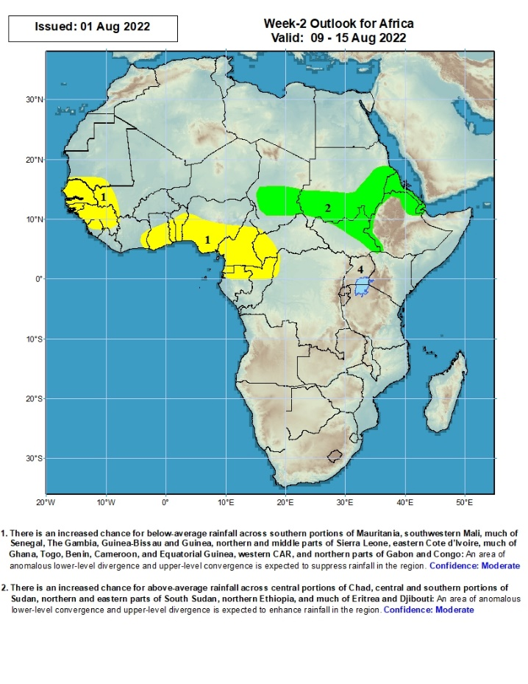
Week-2 Precipitation Outlooks
9 - 15 August, 2022
There is an increased chance for below-average rainfall across southern portions of Mauritania, southwestern Mali, much of Senegal, The Gambia, Guinea-Bissau and Guinea, northern and middle parts of Sierra Leone, eastern Cote d’Ivoire, much of Ghana, Togo, Benin, Cameroon, and Equatorial Guinea, western CAR, and northern parts of Gabon and Congo: An area of anomalous lower-level divergence and upper-level convergence is expected to suppress rainfall in the region. Confidence: Moderate
There is an increased chance for above-average rainfall across central portions of Chad, central and southern portions of Sudan, northern and eastern parts of South Sudan, northern Ethiopia, and much of Eritrea and Djibouti: An area of anomalous lower-level convergence and upper-level divergence is expected to enhance rainfall in the region. Confidence: Moderate
Notes:
11

Slide 12
Summary
During the past 30 days, in East Africa, above-average rainfall was observed over southern and eastern Sudan, parts of western and eastern South Sudan, and the western, central and northern portions of Ethiopia. Rainfall was below-average over pockets of central and southern South Sudan, Uganda, parts of central and southern Ethiopia, western Kenya and Uganda. In Central Africa, rainfall was above-average over parts of northern and eastern Cameroon, northern Congo, much of CAR, southern Chad and northern DRC. Rainfall was below-average over Equatorial Guinea, southern Cameroon, and pockets of central DRC. In West Africa, rainfall was above-average over Senegal, Guinea, Sierra Leone, western Liberia, Burkina Faso, parts of southern Niger and northern Nigeria. In contrast, central and southern Mali, eastern Liberia, Cote D’ivoire, southern Ghana, southern Togo, southern Benin, parts of western Niger, and southern Nigeria received below-average rainfall.
During the past 7 days, in East Africa, rainfall was above-average over much of South Sudan, parts of southern and eastern Sudan, northern Uganda, Eritrea and northern Ethiopia. Below-average rainfall was observed over pockets of southern Ethiopia and western Kenya. In Central Africa, rainfall was above-average over southern Chad and northern DRC. Below-average rainfall was observed over much of CAR and parts of western DRC. In West Africa, above-average rainfall was observed over portions of southern Mauritania, southern Ghana, northern Benin and pockets of central Nigeria. In contrast, parts of Senegal, Guinea, central and southern Mali, Sierra Leone, Liberia, Cote d’Ivoire, Burkina Faso, parts of southern Niger and northern Nigeria received below-average rainfall.
Week-1 and week-2 outlooks call for an increased chance for below-average rainfall along the Gulf of Guinea-coast. In contrast, there is an increased chance for above-average rainfall, across the eastern portion of the Sahel region, parts of Sudan, South Sudan, western Ethiopia and Eritrea.

