Slide 1
The African Monsoon Recent Evolution and Current Status Include Week-1 and Week-2 Outlooks
Update prepared by
29 August 2022
For more information, visit:
http://www.cpc.ncep.noaa.gov/products/Global_Monsoons/African_Monsoons/precip_monitoring.shtml

Slide 2
Outline
Highlights
Recent Evolution and Current Conditions
NCEP GEFS Forecasts
Summary

Slide 3
Highlights: Last 7 Days
During the past 7 days, in East Africa, rainfall was above-average over the northern portion of South Sudan, many parts of Sudan, Eritrea, northern Ethiopia, and pockets of southern Somalia. In Central Africa, rainfall was above-average over the far eastern Cameroon, Chad, CAR, and parts of DRC. Below-average rainfall was observed over western Cameroon, and parts of northern DRC. In West Africa, above-average rainfall was observed over central Mali, Liberia, Cote d’Ivoire, Ghana, Togo, Benin, pockets of Niger, and central and northern Nigeria. In contrast, parts of Senegal, central Guinea, Burkina Faso and portions of Nigeria received below-average rainfall.
Week-1 and week-2 outlooks call for an increased chance for above-average rainfall over the western and eastern portions of the Sahel region, parts of Central Africa, the southern portion of Sudan, much of South Sudan and western Ethiopia. In contrast, there is an increased chance for below-average rainfall along the Gulf Guinea coast.

Slide 4
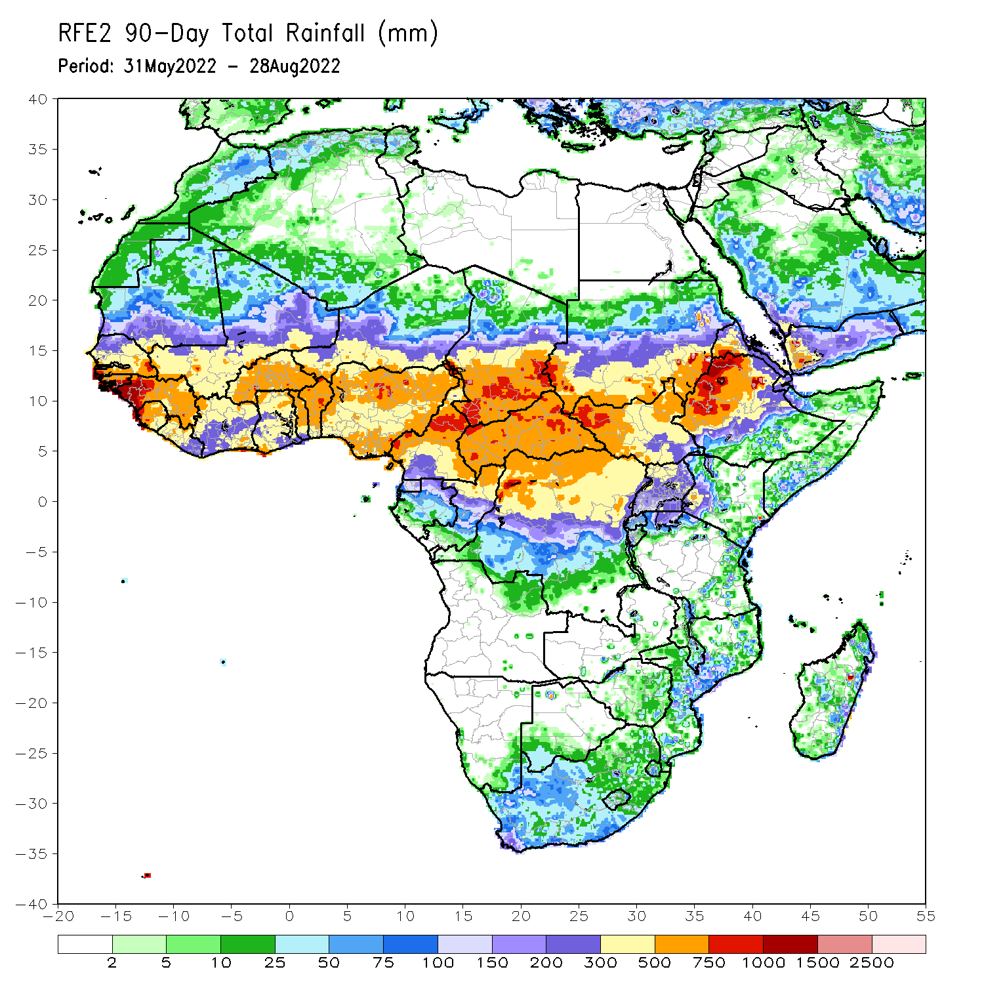
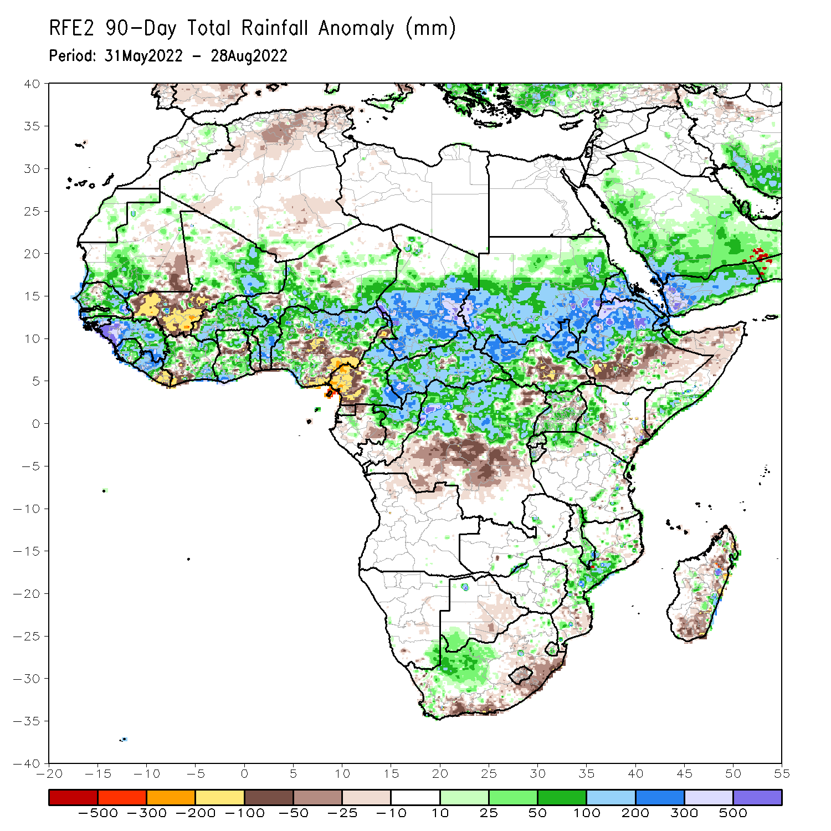
Rainfall Patterns: Last 90 Days
Over the past 90 days, in East Africa, above-average rainfall was observed over southern and eastern Sudan, the western and eastern portions of South Sudan, western, central and northern Ethiopia, Uganda, parts of southern Somalia, western Kenya, northern Tanzania and much of Eritrea. Rainfall was below-average over southern Ethiopia, central and southern South Sudan, and parts of northern Somalia and Kenya. In southern Africa, above-average rainfall was observed over parts of South Africa and Mozambique. Below-average rainfall was observed over pockets of coastal South Africa and southern Madagascar. In Central Africa, rainfall was above-average over eastern Cameroon, much of CAR, northeastern Gabon, northern Congo, and northern DRC. Rainfall was below-average over western Cameroon, pockets of Gabon, southern Congo, and parts of central DRC. In West Africa, rainfall was above-average over southern Mauritania, Senegal, Guinea-Bissau, Guinea, Sierra Leone, western Liberia, northeastern Mali, Burkina Faso, parts of Ghana, Togo, Benin, and parts of Niger and western and northern Nigeria. In contrast, below-average rainfall was observed over western and central Mali, eastern Liberia, parts of southern Cote d’Ivoire, and parts of central and southern Nigeria.
Notes:
4

Slide 5
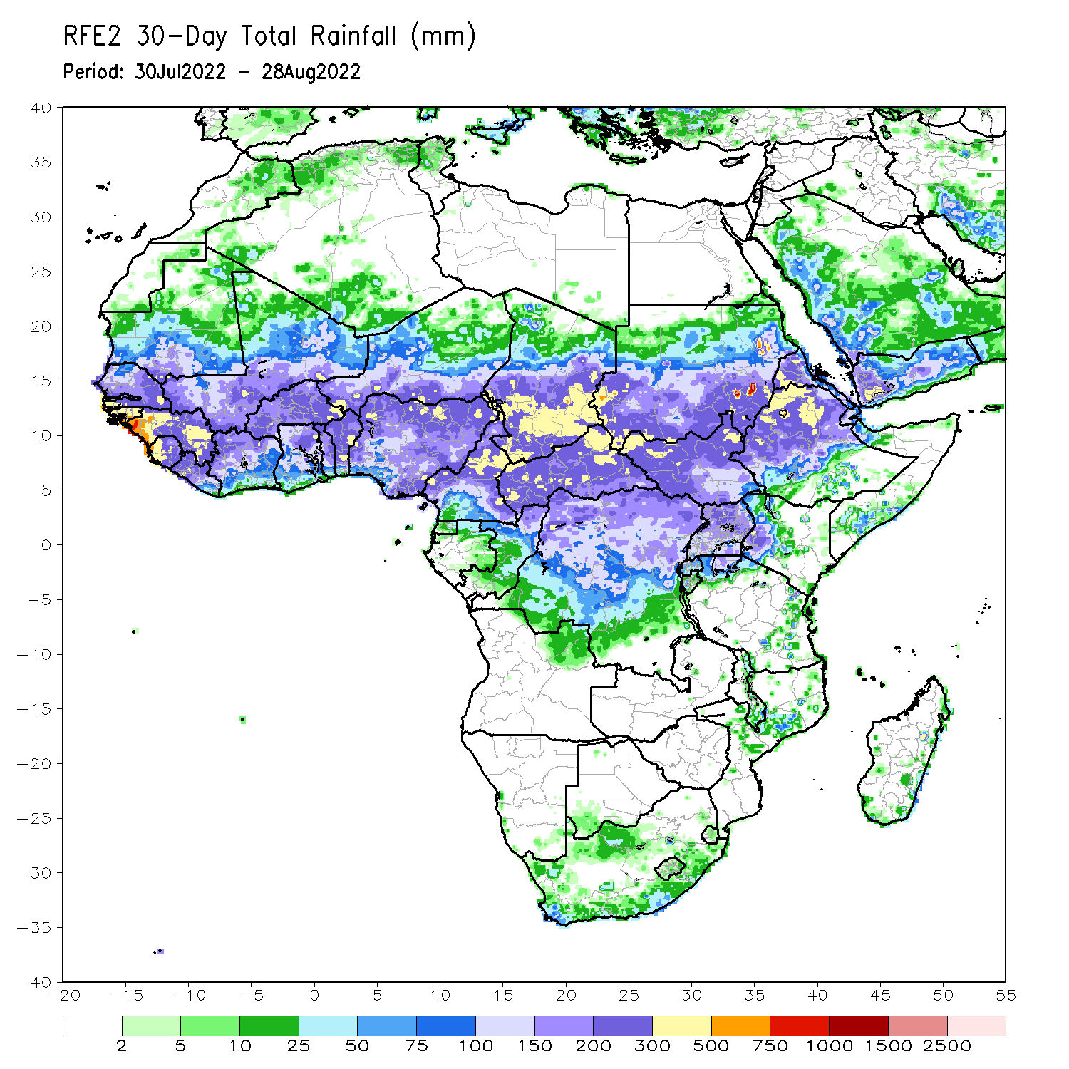
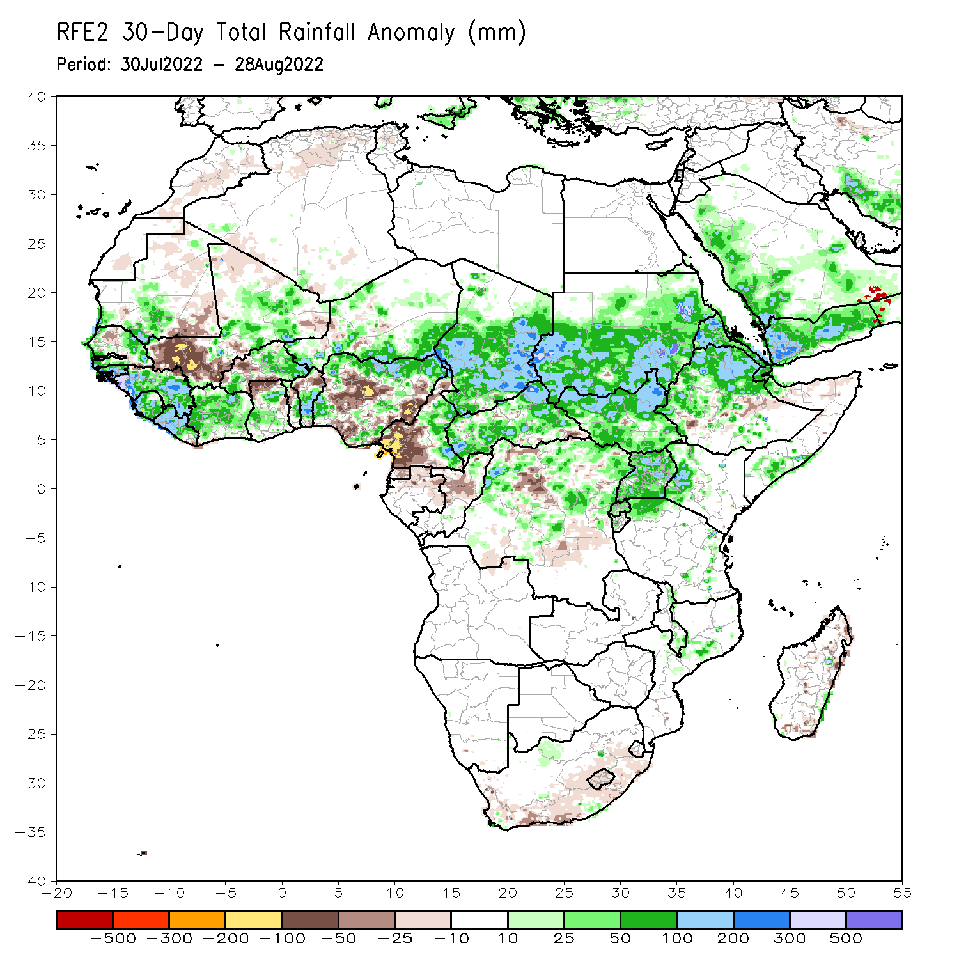
Rainfall Patterns: Last 30 Days
During the past 30 days, in East Africa, above-average rainfall was observed over southern and eastern Sudan, much of South Sudan, Eritrea, and central and northern Ethiopia. Rainfall was below-average over pockets of eastern Ethiopia. In Central Africa, rainfall was above-average over parts of northern and eastern Cameroon, northern Congo, much of CAR, central and southern Chad, and northern DRC. Rainfall was below-average over Equatorial Guinea, western Cameroon, central Congo and pockets of central DRC. In West Africa, rainfall was above-average over southern Mauritania, parts of Senegal, Guinea-Bissau, Guinea, Sierra Leone, western Liberia, Burkina Faso, Ghana, Togo, Benin, parts of Niger and Nigeria. In contrast, central and southern Mali, and parts of Nigeria received below-average rainfall.
Notes:
5

Slide 6
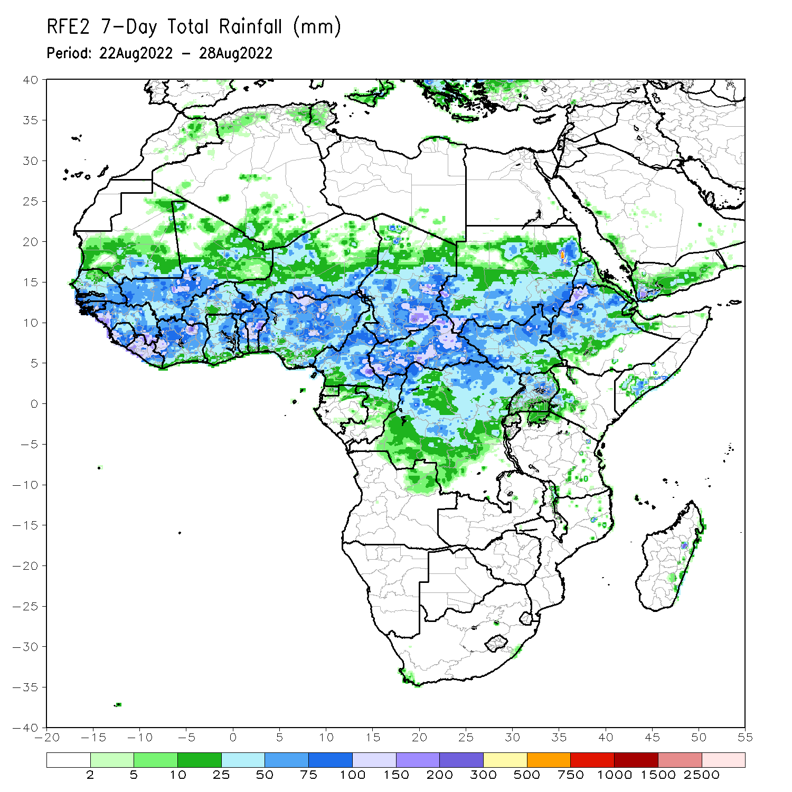
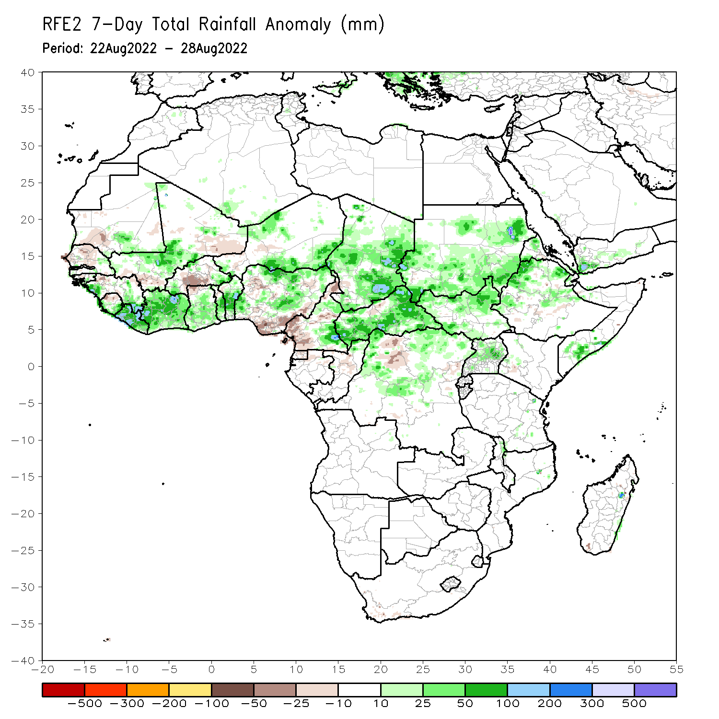
Rainfall Patterns: Last 7 Days
During the past 7 days, in East Africa, rainfall was above-average over the northern portion of South Sudan, many parts of Sudan, Eritrea, northern Ethiopia, and pockets of southern Somalia. In Central Africa, rainfall was above-average over the far eastern Cameroon, Chad, CAR, and parts of DRC. Below-average rainfall was observed over western Cameroon, and parts of northern DRC. In West Africa, above-average rainfall was observed over central Mali, Liberia, Cote d’Ivoire, Ghana, Togo, Benin, pockets of Niger, and central and northern Nigeria. In contrast, parts of Senegal, central Guinea, Burkina Faso and portions of Nigeria received below-average rainfall.

Slide 7
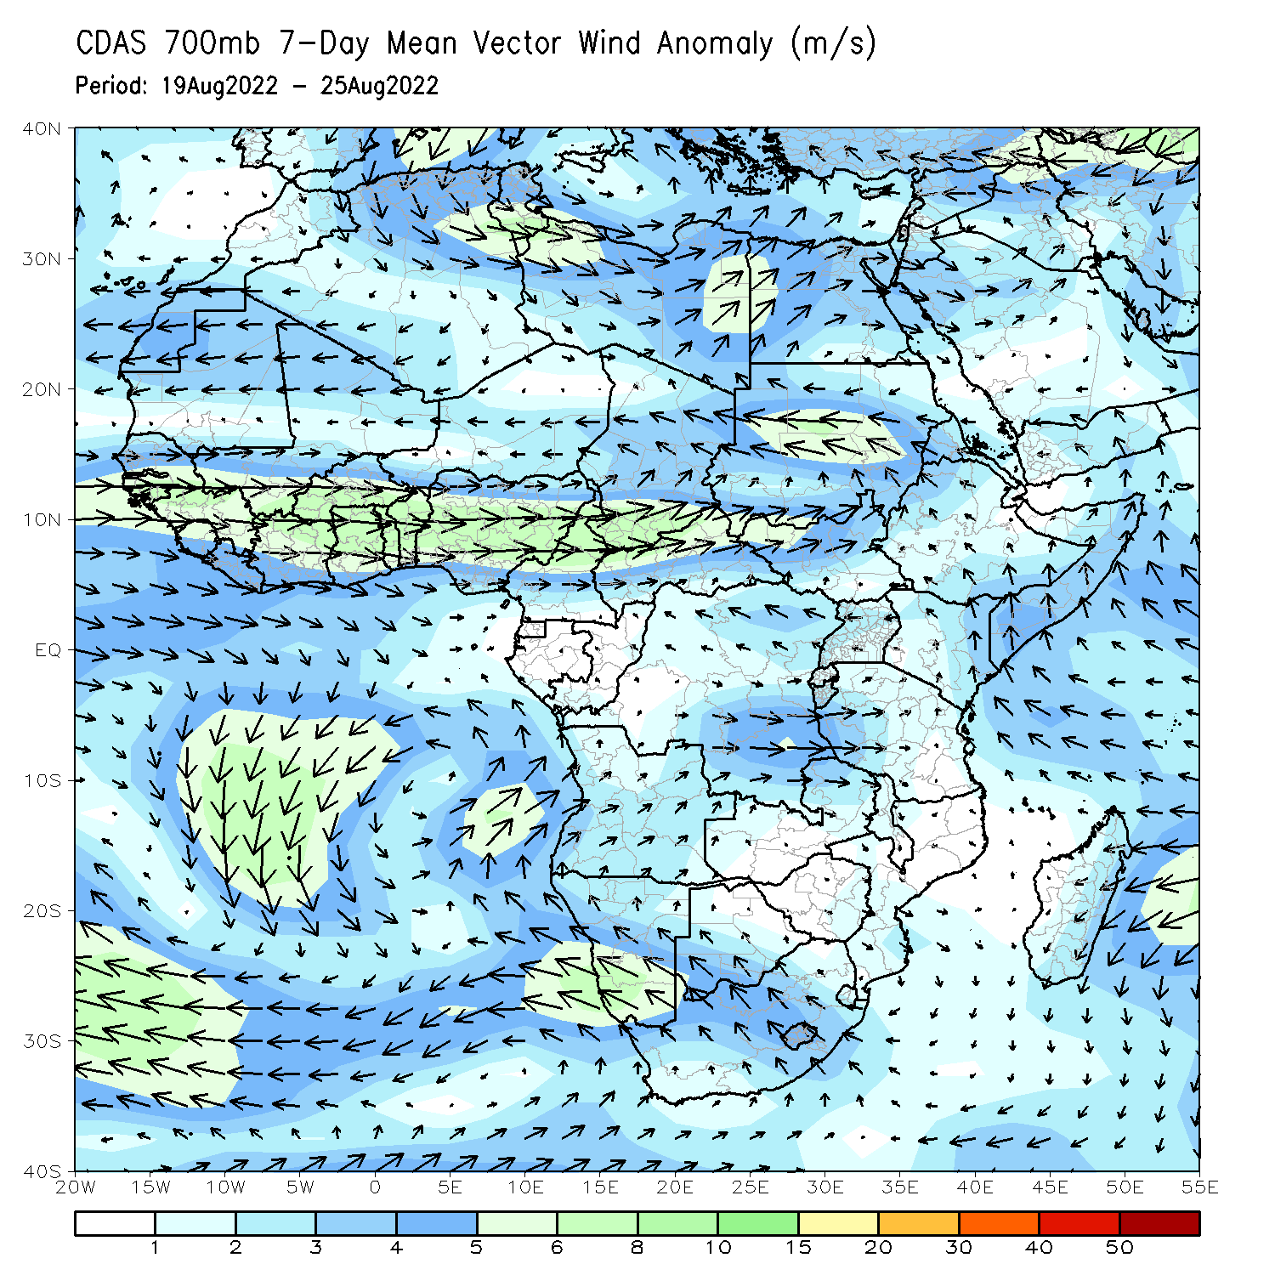
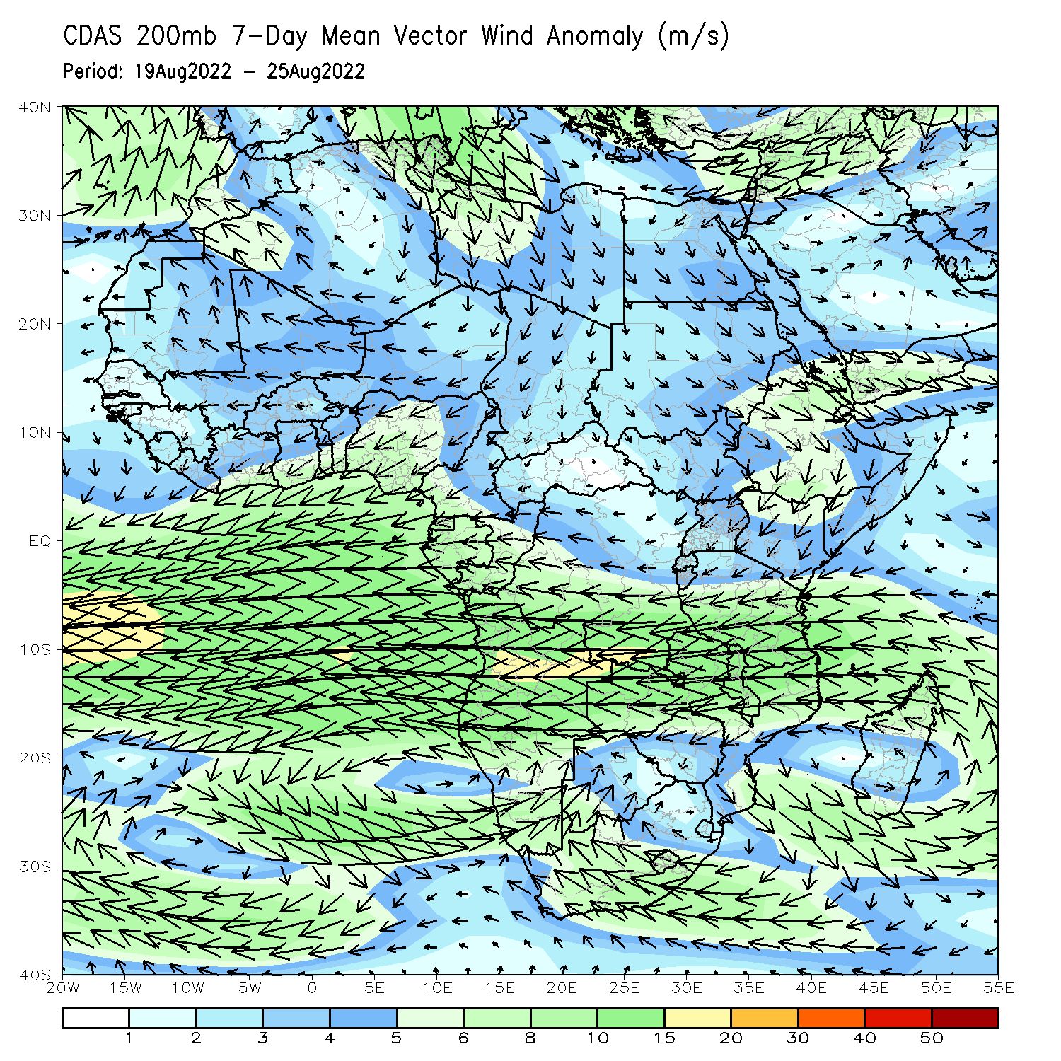
Atmospheric Circulation: Last 7 Days
At 700-hPa level (left panel), a broad area of anomalous cyclonic flow was observed across the eastern portion of the Sahel, including Sudan. At 200-hPa (right panel), anomalous upper-level speed divergence is observed over parts of West Africa, and near Sudan/Ethiopia border.

Slide 8
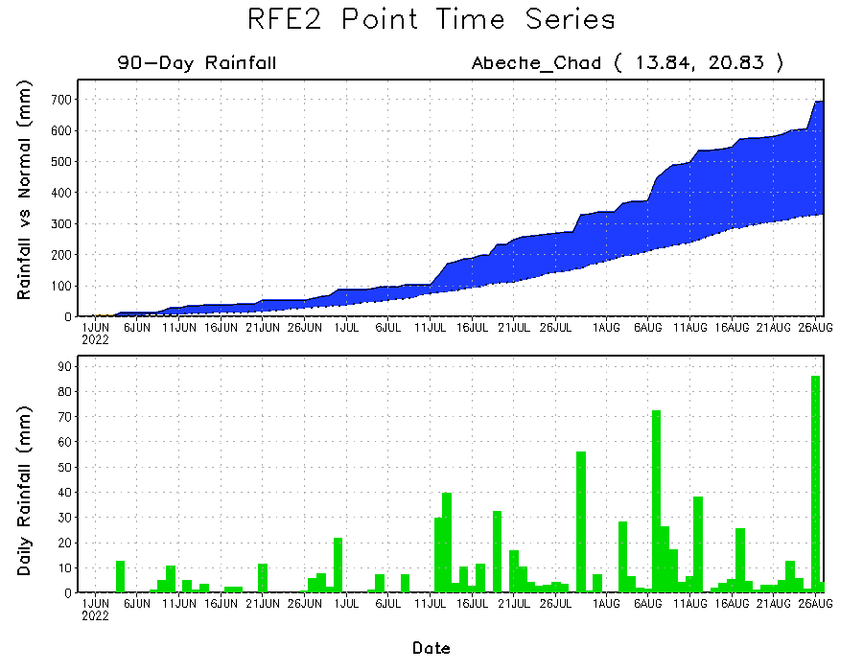
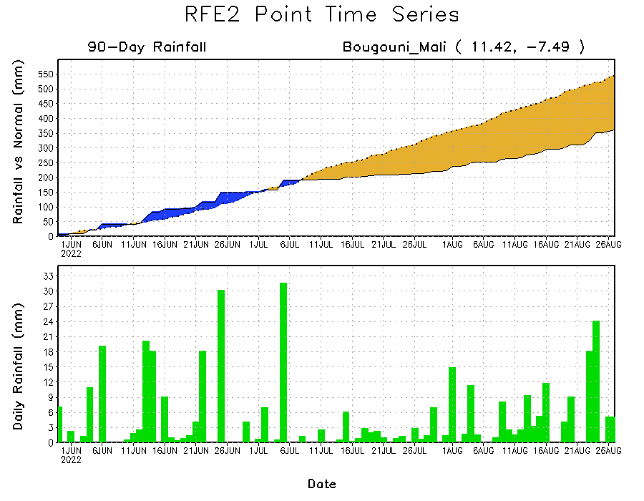
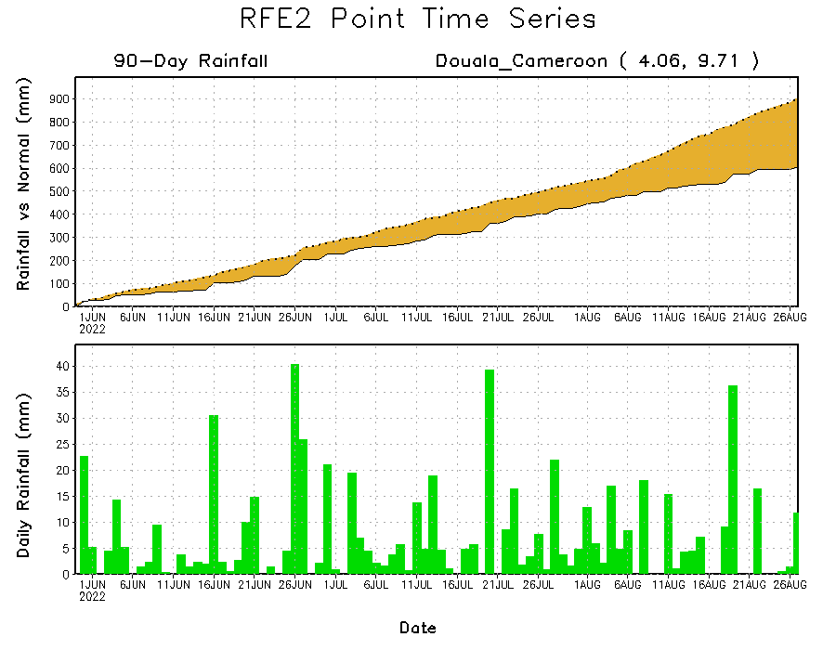
Rainfall Evolution
Daily evolution of rainfall over the last 90 days at selected locations shows increasing moisture deficits over parts of central and southern Mali (bottom left) and western Cameroon (bottom right). Consistent heavy rains have kept significant moisture surpluses over parts of Chad (top right).

Slide 9
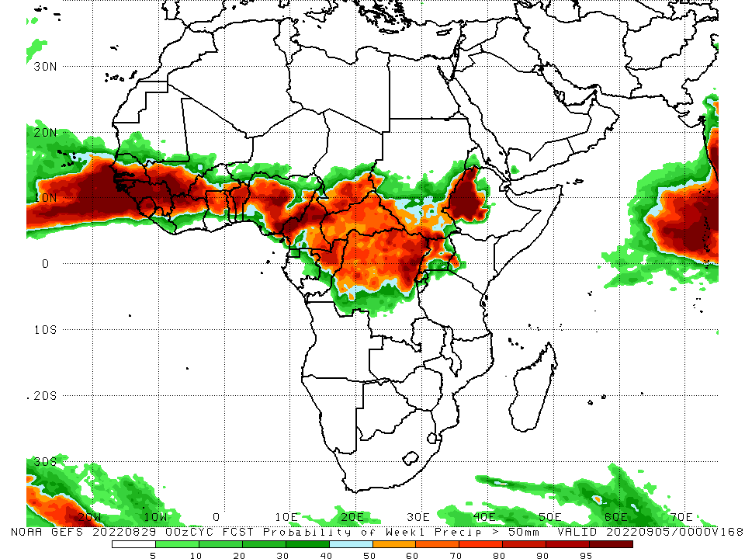
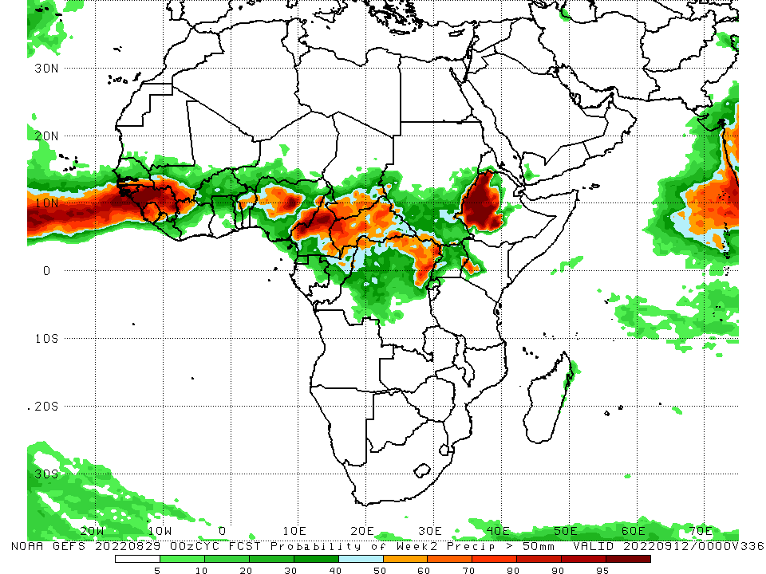
NCEP GEFS Model Forecasts Non-Bias Corrected Probability of precipitation exceedance
Week-1, Valid: 30 Aug – 5 September, 2022
Week-2, Valid: 6 – 12 September, 2022
For week-1 (left panel) and week-2 (right panel) the NCEP GEFS indicates a moderate to high chance (over 70%) for rainfall to exceed 50 mm over parts of West and Central Africa, and western Ethiopia.
Notes:
9

Slide 10
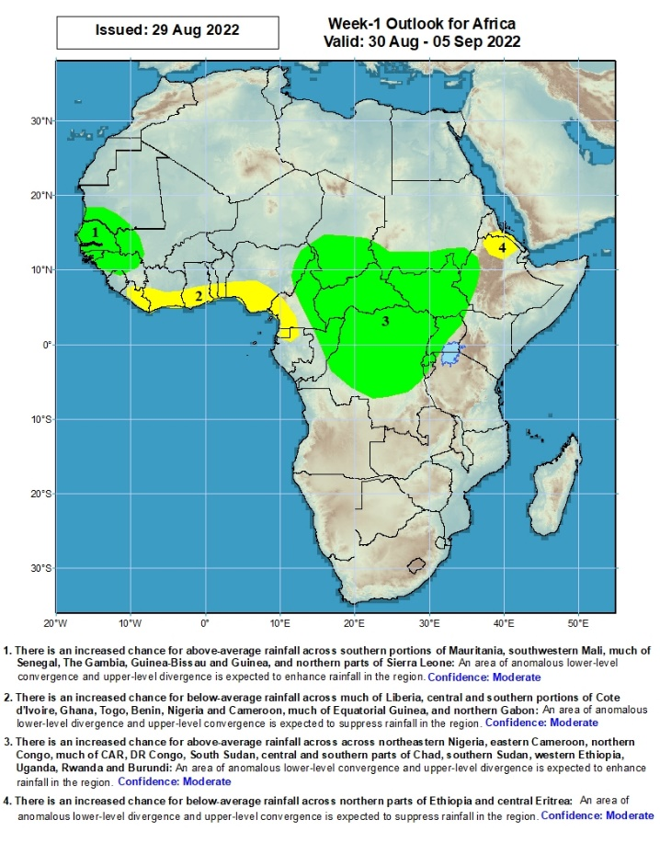
Week-1 Precipitation Outlooks
30 Aug – 5 September, 2022
There is an increased chance for above-average rainfall across southern portions of Mauritania, southwestern Mali, much of Senegal, The Gambia, Guinea-Bissau and Guinea, and northern parts of Sierra Leone: An area of anomalous lower-level convergence and upper-level divergence is expected to enhance rainfall in the region. Confidence: Moderate
There is an increased chance for below-average rainfall across much of Liberia, central and southern portions of Cote d’Ivoire, Ghana, Togo, Benin, Nigeria and Cameroon, much of Equatorial Guinea, and northern Gabon: An area of anomalous lower-level divergence and upper-level convergence is expected to suppress rainfall in the region. Confidence: Moderate
There is an increased chance for above-average rainfall across northeastern Nigeria, eastern Cameroon, northern Congo, much of CAR, DR Congo, South Sudan, central and southern parts of Chad, southern Sudan, western Ethiopia, Uganda, Rwanda and Burundi: An area of anomalous lower-level convergence and upper-level divergence is expected to enhance rainfall in the region. Confidence: Moderate
There is an increased chance for below-average rainfall across northern parts of Ethiopia and central Eritrea: An area of anomalous lower-level divergence and upper-level convergence is expected to suppress rainfall in the region. Confidence: Moderate
Notes:
10

Slide 11
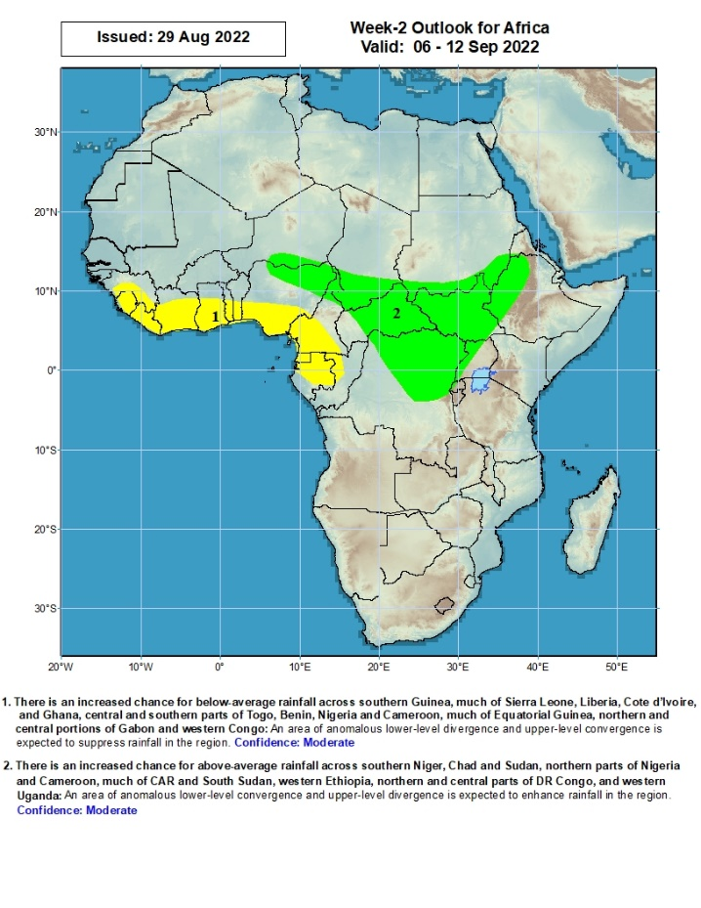
Week-2 Precipitation Outlooks
06 - 12 September, 2022
There is an increased chance for below-average rainfall across southern Guinea, much of Sierra Leone, Liberia, Cote d’Ivoire, and Ghana, central and southern parts of Togo, Benin, Nigeria and Cameroon, much of Equatorial Guinea, northern and central portions of Gabon and western Congo: An area of anomalous lower-level divergence and upper-level convergence is expected to suppress rainfall in the region. Confidence: Moderate
There is an increased chance for above-average rainfall across southern Niger, Chad and Sudan, northern parts of Nigeria and Cameroon, much of CAR and South Sudan, western Ethiopia, northern and central parts of DR Congo, and western Uganda: An area of anomalous lower-level convergence and upper-level divergence is expected to enhance rainfall in the region. Confidence: Moderate
Notes:
11

Slide 12
Summary
During the past 30 days, in East Africa, above-average rainfall was observed over southern and eastern Sudan, much of South Sudan, Eritrea, and central and northern Ethiopia. Rainfall was below-average over pockets of eastern Ethiopia. In Central Africa, rainfall was above-average over parts of northern and eastern Cameroon, northern Congo, much of CAR, central and southern Chad, and northern DRC. Rainfall was below-average over Equatorial Guinea, western Cameroon, central Congo and pockets of central DRC. In West Africa, rainfall was above-average over southern Mauritania, parts of Senegal, Guinea-Bissau, Guinea, Sierra Leone, western Liberia, Burkina Faso, Ghana, Togo, Benin, parts of Niger and Nigeria. In contrast, central and southern Mali, and parts of Nigeria received below-average rainfall.
During the past 7 days, in East Africa, rainfall was above-average over the northern portion of South Sudan, many parts of Sudan, Eritrea, northern Ethiopia, and pockets of southern Somalia. In Central Africa, rainfall was above-average over the far eastern Cameroon, Chad, CAR, and parts of DRC. Below-average rainfall was observed over western Cameroon, and parts of northern DRC. In West Africa, above-average rainfall was observed over central Mali, Liberia, Cote d’Ivoire, Ghana, Togo, Benin, pockets of Niger, and central and northern Nigeria. In contrast, parts of Senegal, central Guinea, Burkina Faso and portions of Nigeria received below-average rainfall.
Week-1 and week-2 outlooks call for an increased chance for above-average rainfall over the western and eastern portions of the Sahel region, parts of Central Africa, the southern portion of Sudan, much of South Sudan and western Ethiopia. In contrast, there is an increased chance for below-average rainfall along the Gulf Guinea coast.

