Slide 1
The African Monsoon Recent Evolution and Current Status Include Week-1 and Week-2 Outlooks
Update prepared by
07 November 2022
For more information, visit:
http://www.cpc.ncep.noaa.gov/products/Global_Monsoons/African_Monsoons/precip_monitoring.shtml

Slide 2
Outline
Highlights
Recent Evolution and Current Conditions
NCEP GEFS Forecasts
Summary

Slide 3
Highlights: Last 7 Days
During the past 7 days, in East Africa, rainfall was above-average over pockets of southern South Sudan and central Kenya. Below-average rainfall was observed over southern Ethiopia, much of South Sudan, Kenya, Somalia, Uganda, Rwanda, Burundi and Tanzania. In Central Africa, rainfall was above-average over southern Cameroon, Equatorial Guinea, much of Gabon, Congo, and pockets of northern and eastern DRC. Below-average rainfall was observed over the far southern Gabon, northern Cameroon, CAR, and many parts of DRC. In West Africa, above-average rainfall was observed over Liberia and coastal Cote d’Ivoire. Rainfall was slightly below-average over much of the Gulf of Guinea region. In southern Africa, rainfall was above-average over parts of northwestern and southeastern Angola, western Zambia, pockets of eastern Namibia, Botswana, Zimbabwe, central and eastern South Africa, southern Mozambique and central Madagascar. In contrast, rainfall was below average in pockets of central and northern Angola, eastern Zambia, and the far northern Madagascar.
Week-1 outlooks call for an increased chance for below-normal rainfall over southern Guinea, much of Sierra Leone, western Liberia and Cote d’Ivoire, central portions of Cameroon, western Angola, eastern Kenya, southern Somalia, northeastern parts of Tanzania, and eastern Madagascar. In contrast, the forecasts call for an increased chance for above-normal rainfall over northeastern and southern DRC, eastern Angola, western Zambia, Botswana, western Zimbabwe, eastern South Africa, and western Madagascar. Week-2 outlooks call for an increased chance for below-normal rainfall over southern Cameroon, northern Congo, western and northern DRC and western Angola. In contrast, there is an increased chance for above-normal rainfall over northeastern DRC, Uganda, Rwanda, Burundi, eastern South Africa, Lesotho, Eswatini, and central Madagascar.

Slide 4
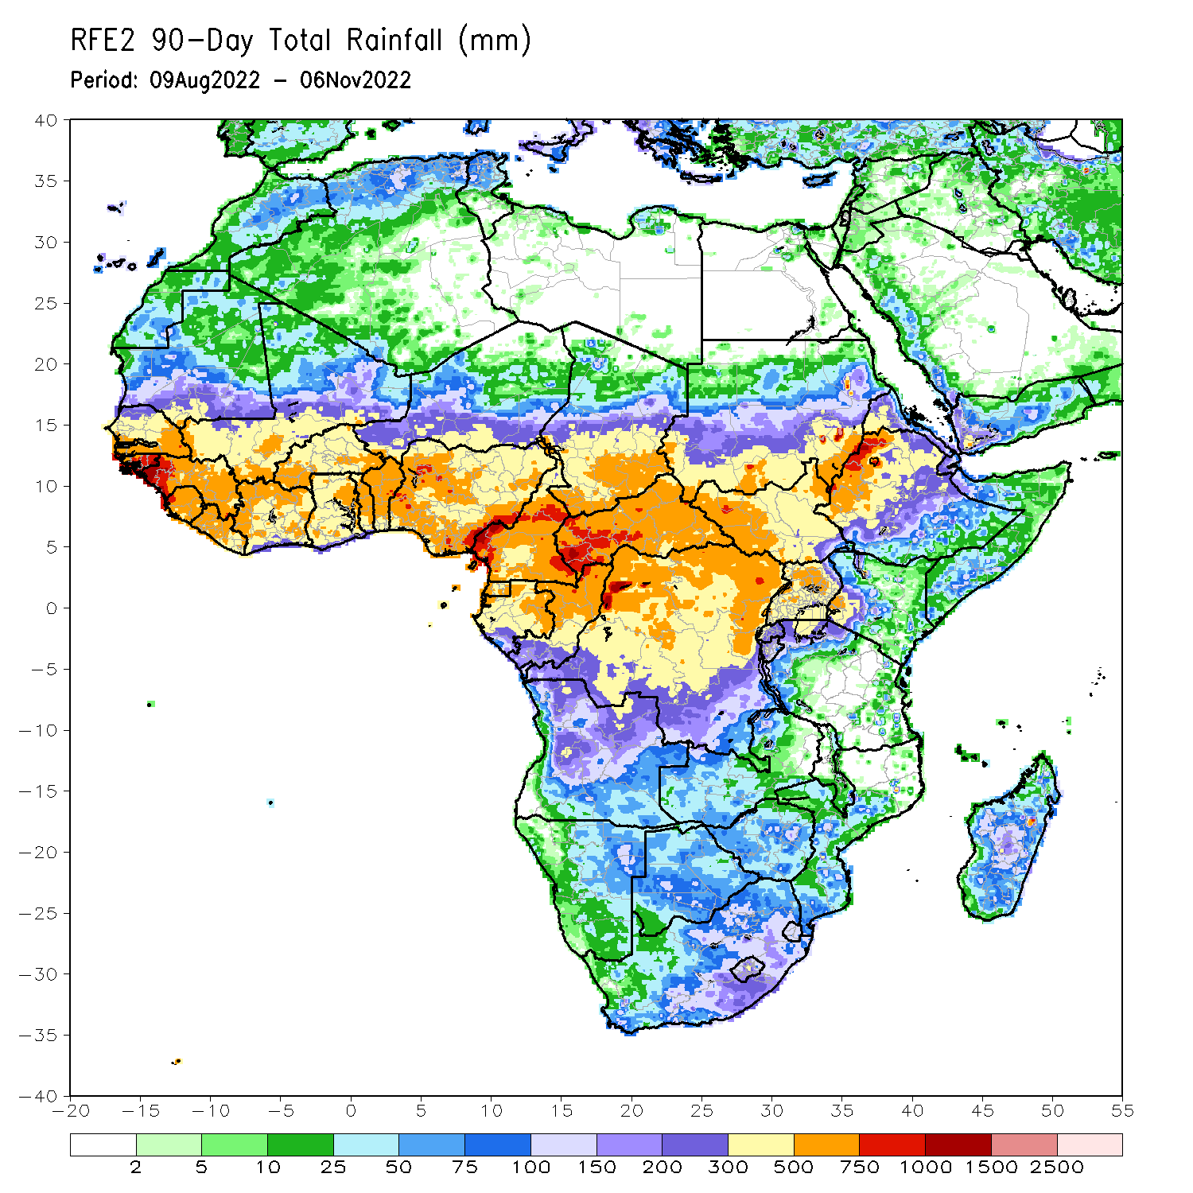
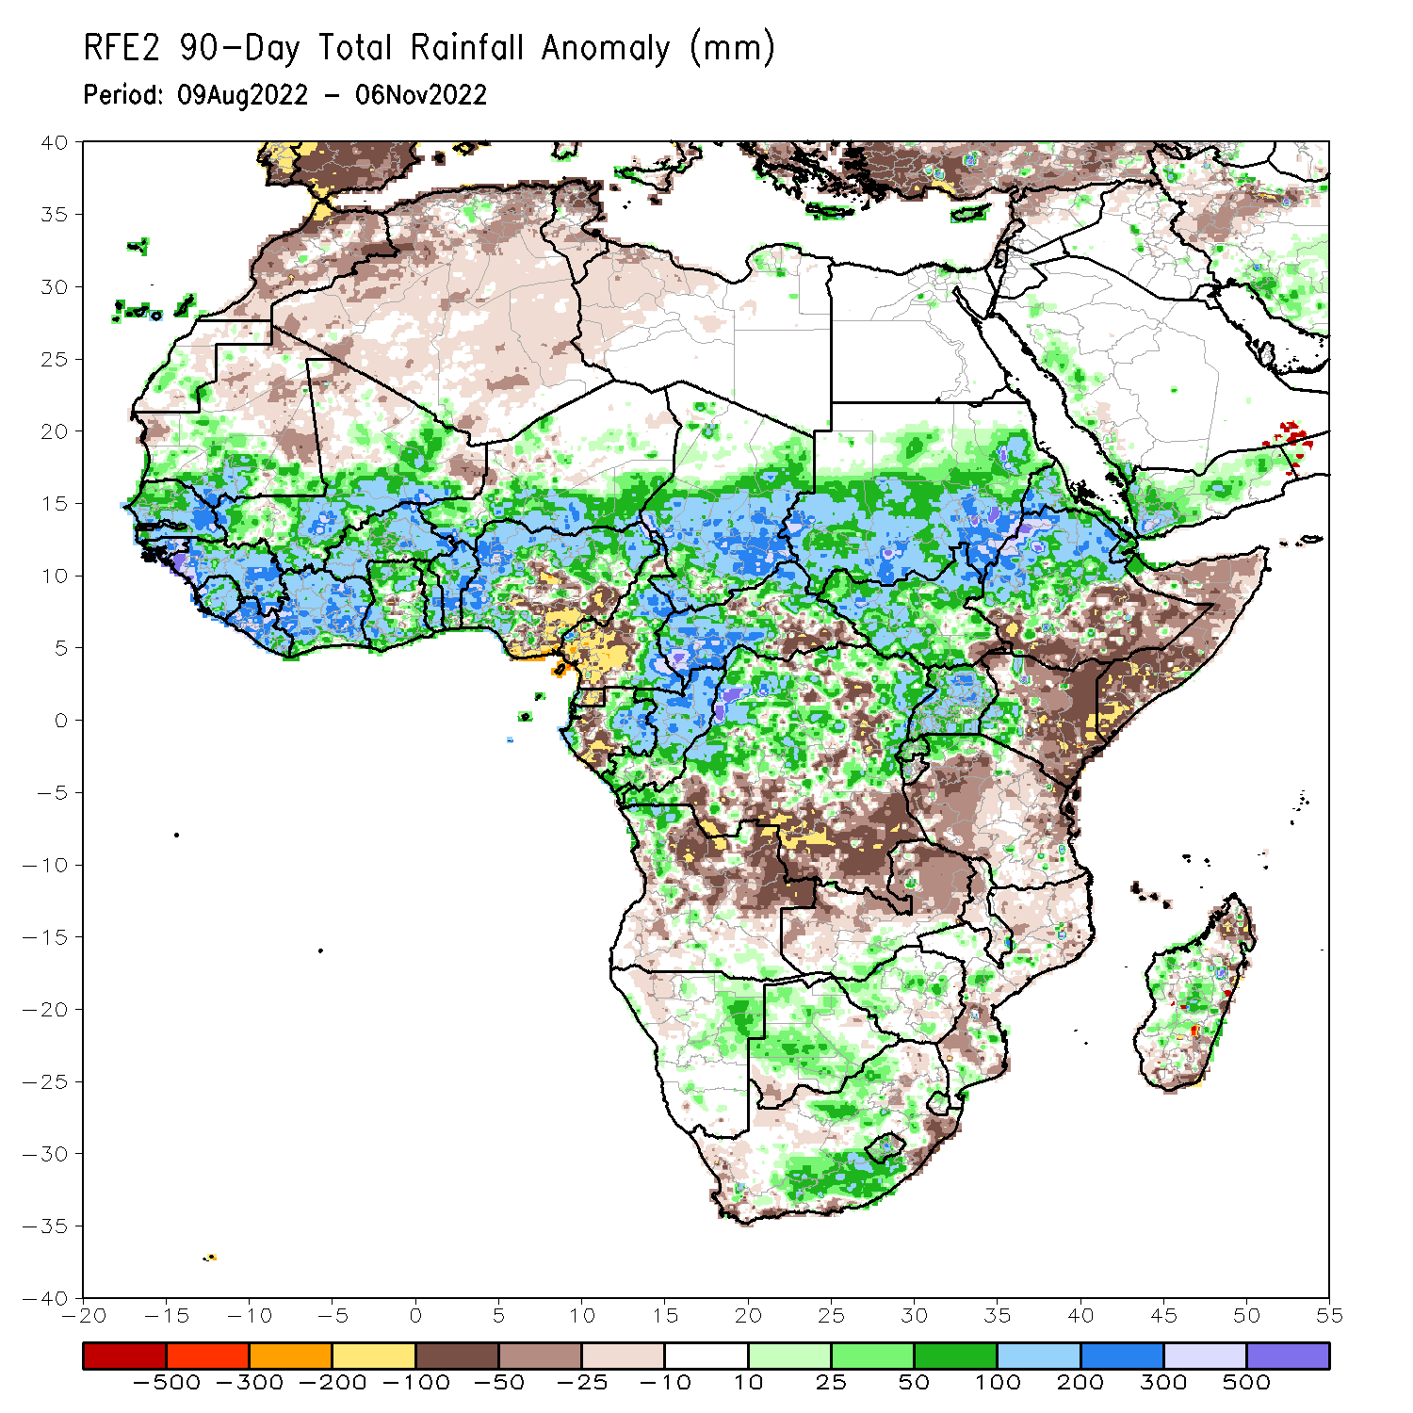
Rainfall Patterns: Last 90 Days
Over the past 90 days, in East Africa, above-average rainfall was observed over the southern and central parts of Sudan, much of South Sudan, central and northern Ethiopia, Eritrea, Djibouti, Uganda, Rwanda, Burundi, northern Tanzania, and western Kenya. Rainfall was below-average over southern and southeastern Ethiopia, throughout much of Somalia, central and eastern Kenya, and many parts of Tanzania. In southern Africa, above-average rainfall was observed over southern South Africa, northwestern Angola, northeastern Namibia, and pockets of Botswana, Zimbabwe and Madagascar. Below-average rainfall was observed over central and eastern Angola, Zambia, parts of Mozambique and eastern South Africa, and pockets of Madagascar. In Central Africa, rainfall was above-average over northern and eastern Cameroon, southern and central Chad, CAR, eastern Gabon, much of Congo, and central and northern DRC. Rainfall was below-average over western Cameroon, western Gabon, Equatorial Guinea, and southern DRC. In West Africa, rainfall was above-average over southern Mauritania, Senegal, Gambia, Guinea-Bissau, Guinea, Sierra Leone, Liberia, Cote D’Ivoire, much of Ghana, Togo, Benin, Burkina Faso, eastern and southern portions of Mali, southern Niger, and western and northern Nigeria. In contrast, below-average rainfall was observed over northern Mauritania, pockets of northern Mali, and parts of central and southeastern Nigeria.
Notes:
4

Slide 5
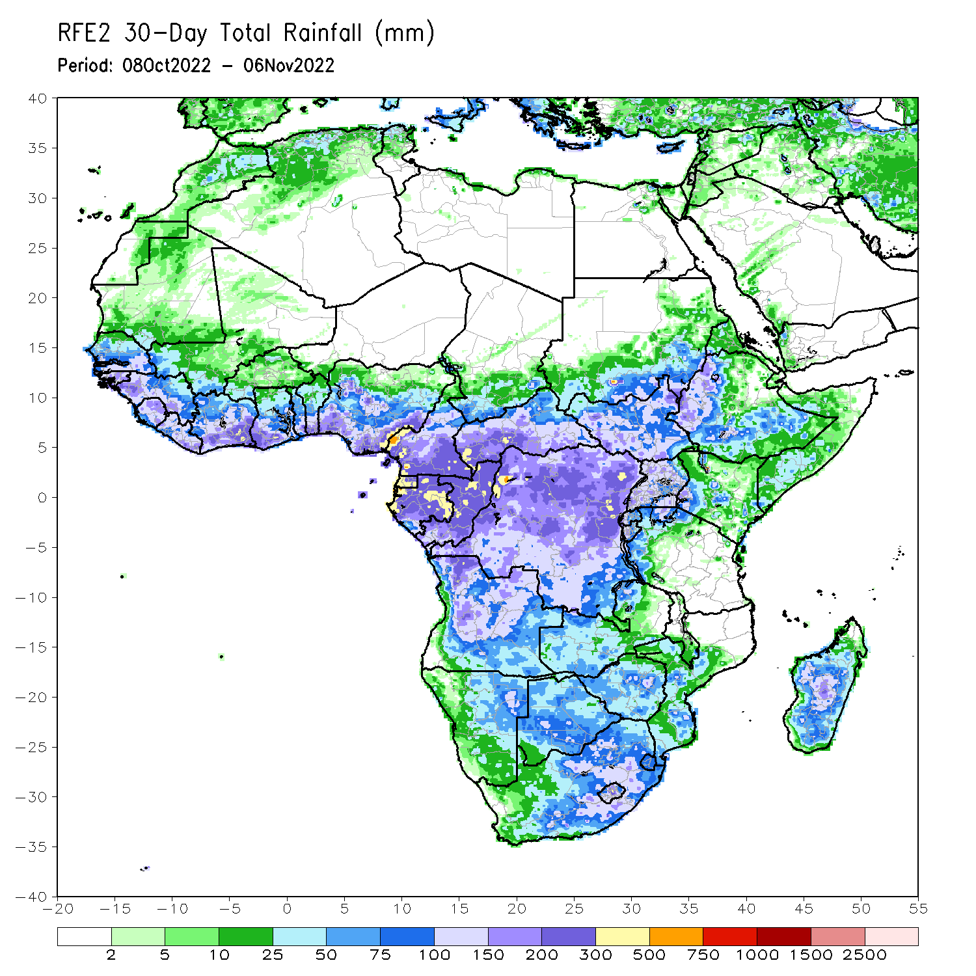
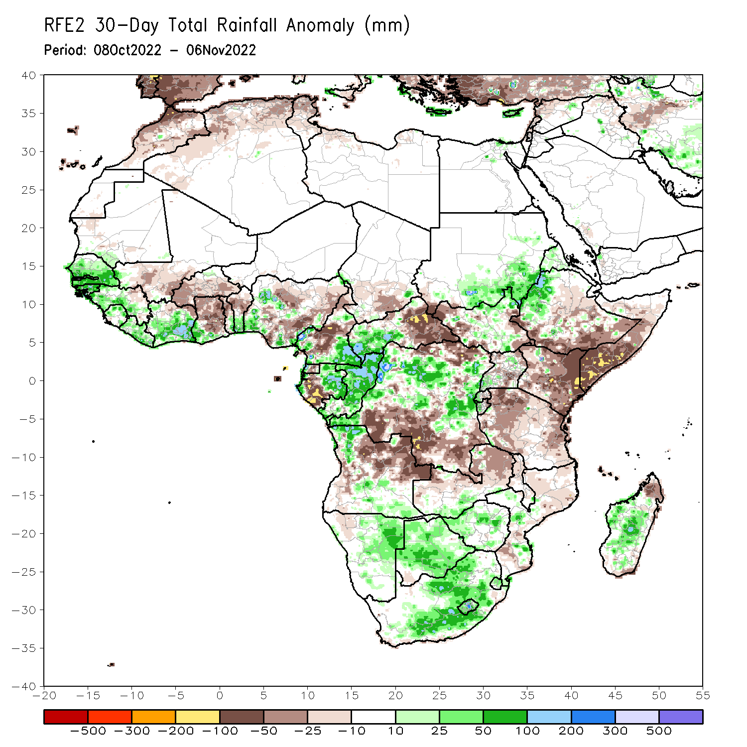
Rainfall Patterns: Last 30 Days
During the past 30 days, in East Africa, above-average rainfall was observed over southern and eastern Sudan, parts of South Sudan, western Ethiopia, and pockets of northern Uganda. Rainfall was below-average over southern Ethiopia, much of Somalia, Kenya, Tanzania, and pockets of Uganda. In Central Africa, rainfall was above-average over parts of western and eastern Cameroon, much of Congo, western CAR, and parts of central and northern DRC. Rainfall was below-average over Equatorial Guinea, northwestern Cameroon, and southern DRC. In West Africa, rainfall was above-average over Senegal, Guinea-Bissau, western Guinea, Sierra Leone, Liberia, much of Cote d’Ivoire, southwestern Ghana, southern Togo, southern Benin, and pockets of western and southeastern Nigeria. In contrast, southern Mali, central and northern Ghana, Burkina Faso, northern Togo, northern Benin, and many parts of Nigeria received below-average rainfall. In southern Africa, above-average rainfall was observed over northwestern and southern Angola, eastern Namibia, Botswana, Zimbabwe, South Africa and central Madagascar. Below normal precipitation was observed in central and northeastern Angola, northern Zambia, Malawi, northern Mozambique and the far northern Madagascar.
Notes:
5

Slide 6
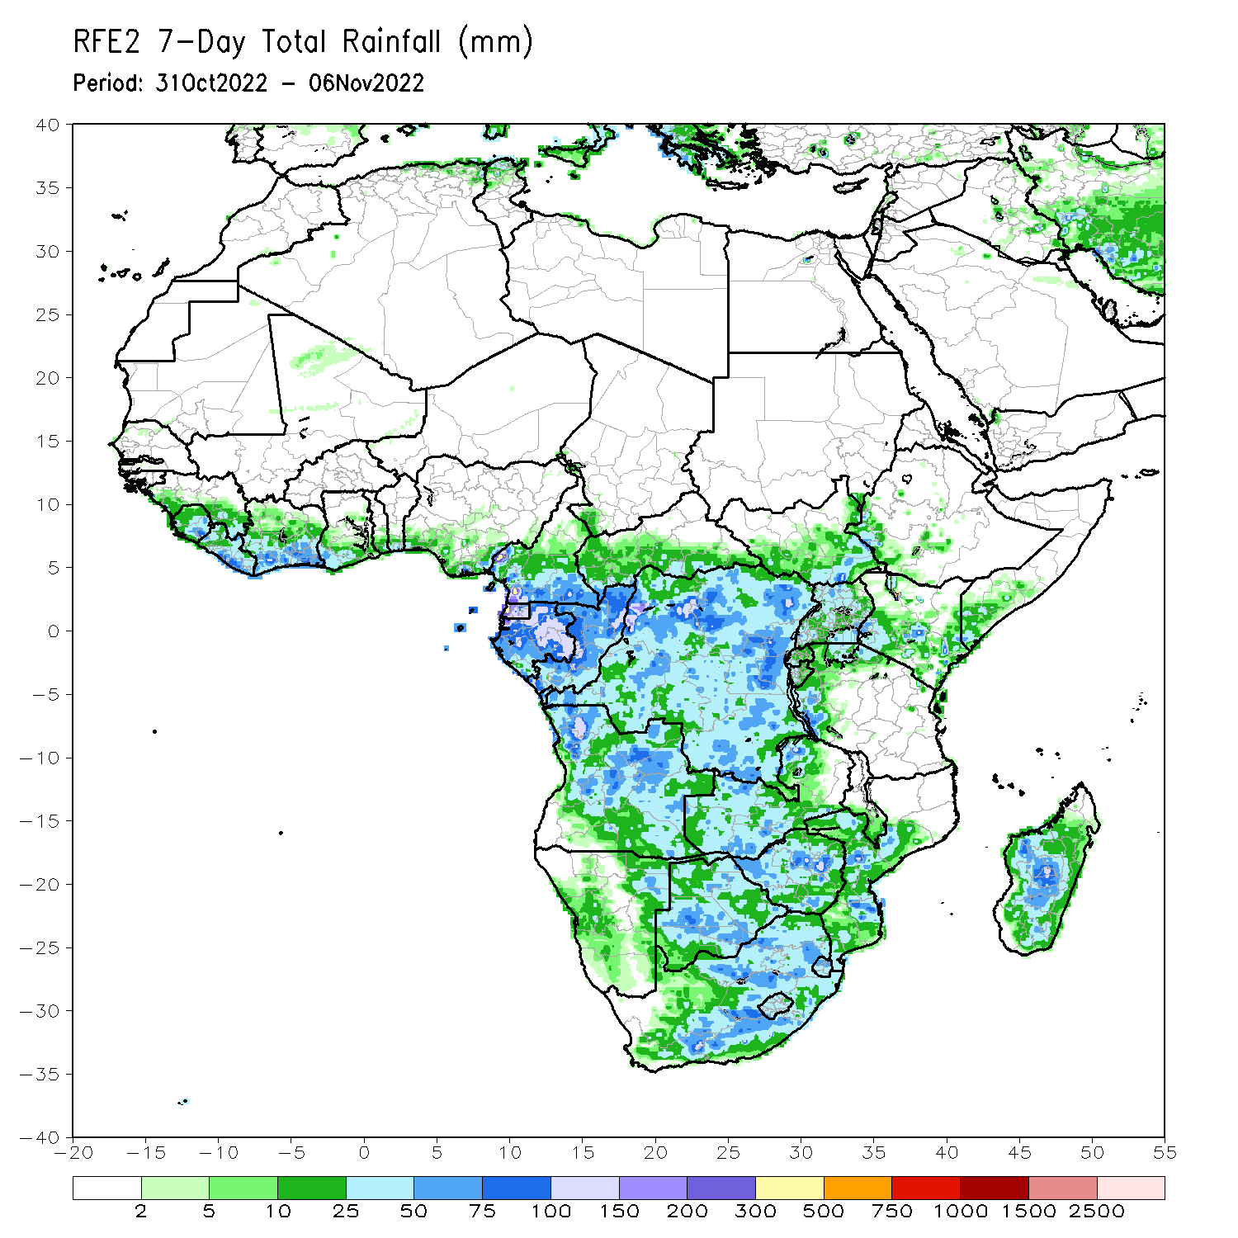
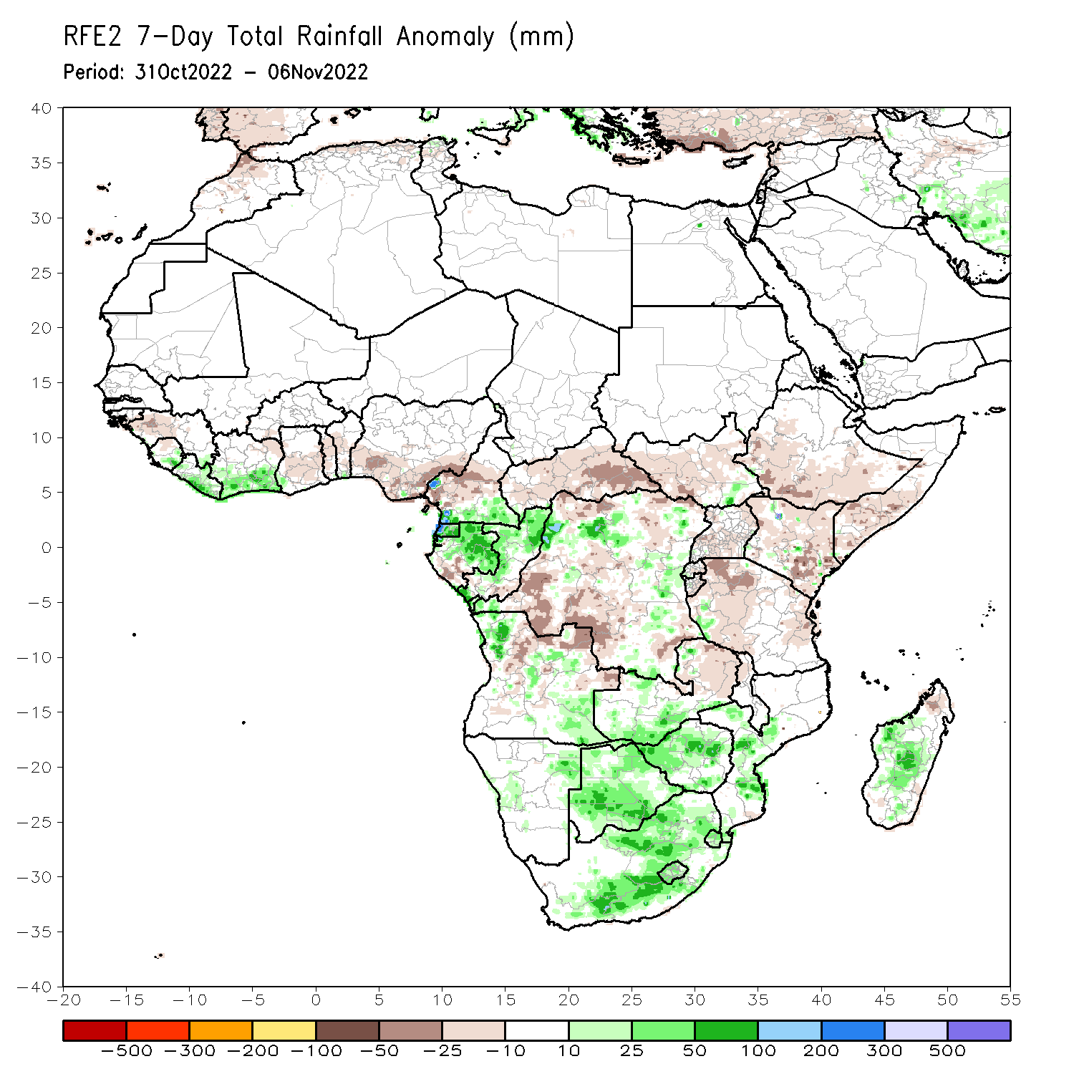
Rainfall Patterns: Last 7 Days
During the past 7 days, in East Africa, rainfall was above-average over pockets of southern South Sudan and central Kenya. Below-average rainfall was observed over southern Ethiopia, much of South Sudan, Kenya, Somalia, Uganda, Rwanda, Burundi and Tanzania. In Central Africa, rainfall was above-average over southern Cameroon, Equatorial Guinea, much of Gabon, Congo, and pockets of northern and eastern DRC. Below-average rainfall was observed over the far southern Gabon, northern Cameroon, CAR, and many parts of DRC. In West Africa, above-average rainfall was observed over Liberia and coastal Cote d’Ivoire. Rainfall was slightly below-average over much of the Gulf of Guinea region. In southern Africa, rainfall was above-average over parts of northwestern and southeastern Angola, western Zambia, pockets of eastern Namibia, Botswana, Zimbabwe, central and eastern South Africa, southern Mozambique and central Madagascar. In contrast, rainfall was below average in pockets of central and northern Angola, eastern Zambia, and the far northern Madagascar.

Slide 7
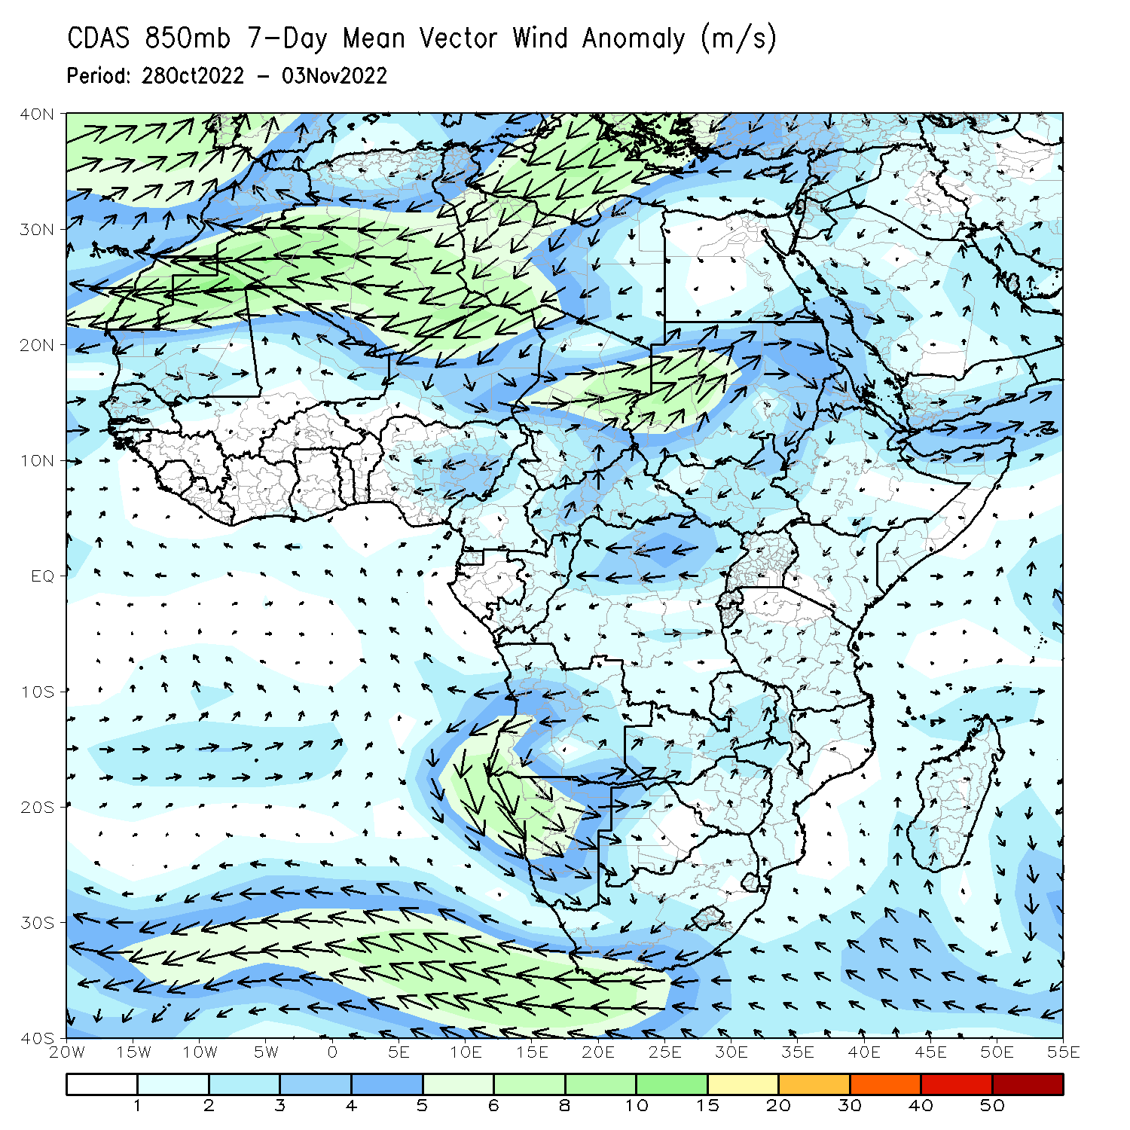
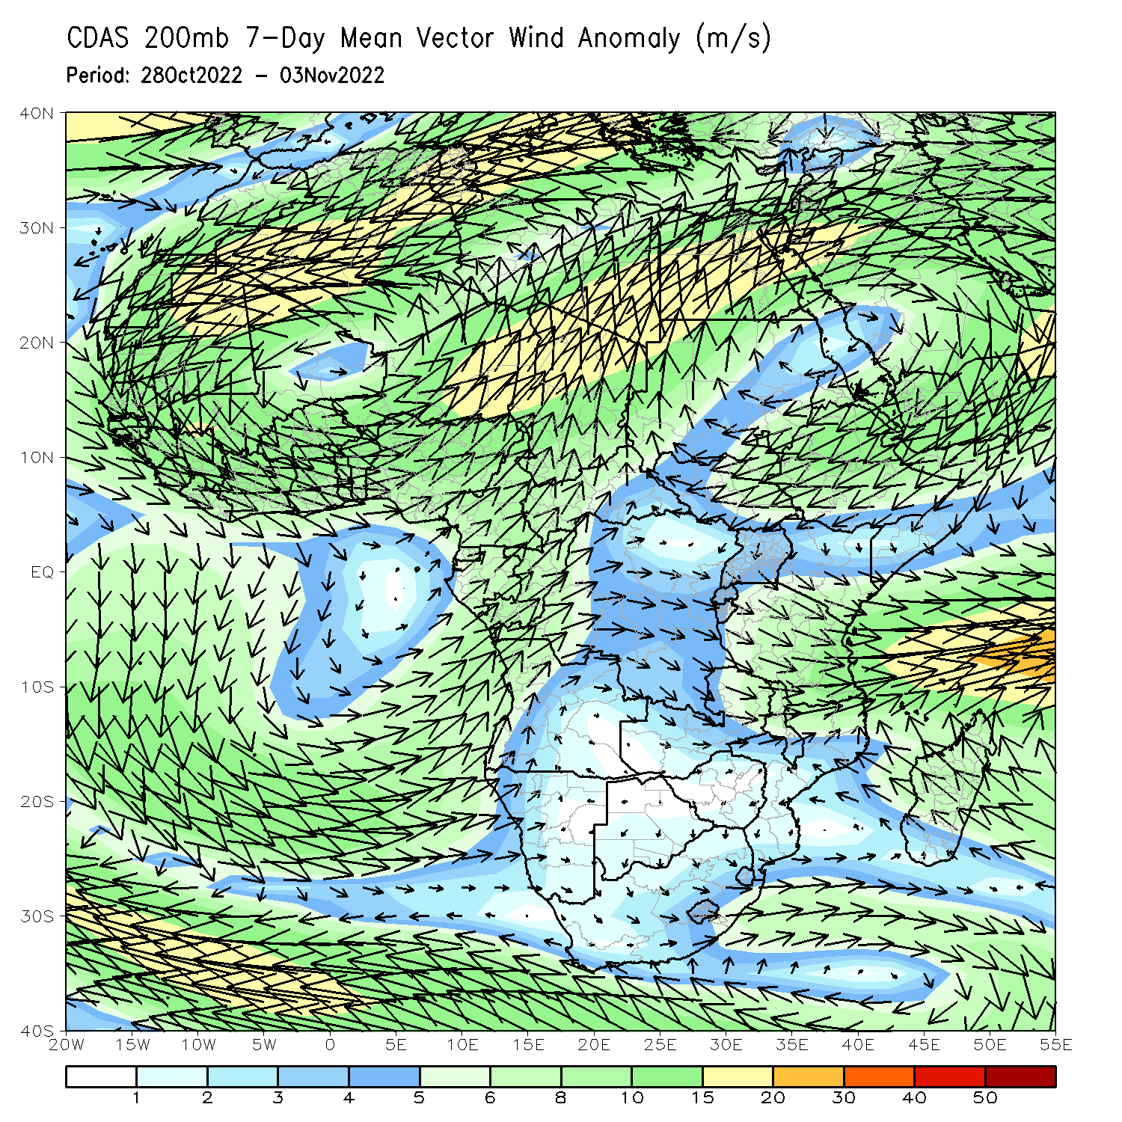
Atmospheric Circulation: Last 7 Days
At 850-hPa level (left panel), anomalous anti-cyclonic flow was observed across the western portion of Southern Africa, while the lower-level circulation anomaly was cyclonic across Madagascar and the neighboring areas.

Slide 8
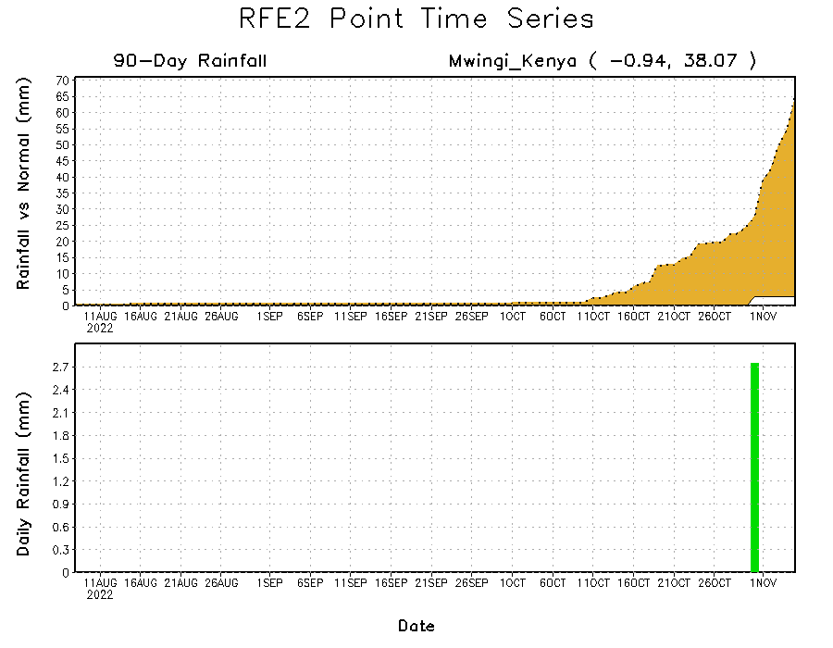
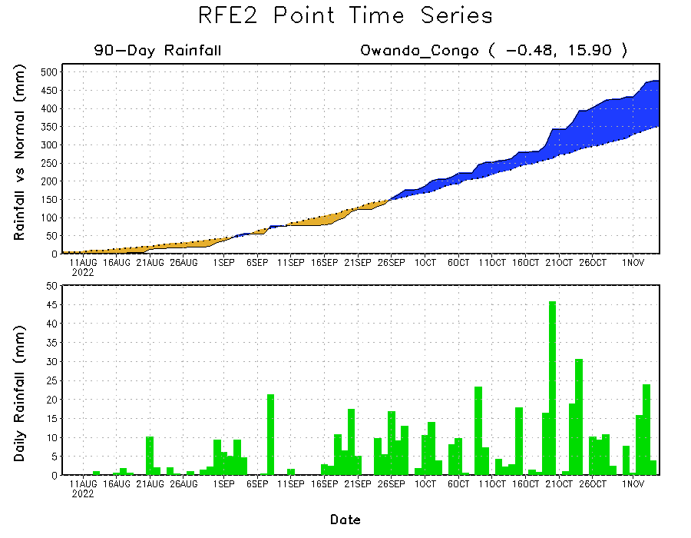
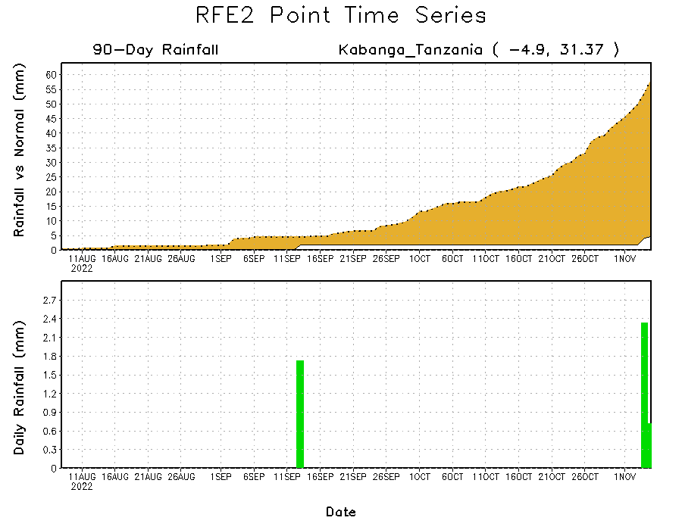
Rainfall Evolution
Daily evolution of rainfall over the last 90 days at selected locations shows continuing moisture surpluses over parts of Congo (bottom left). Rainfall deficits continue in many parts of Kenya (top right) and western Tanzania (bottom right).

Slide 9
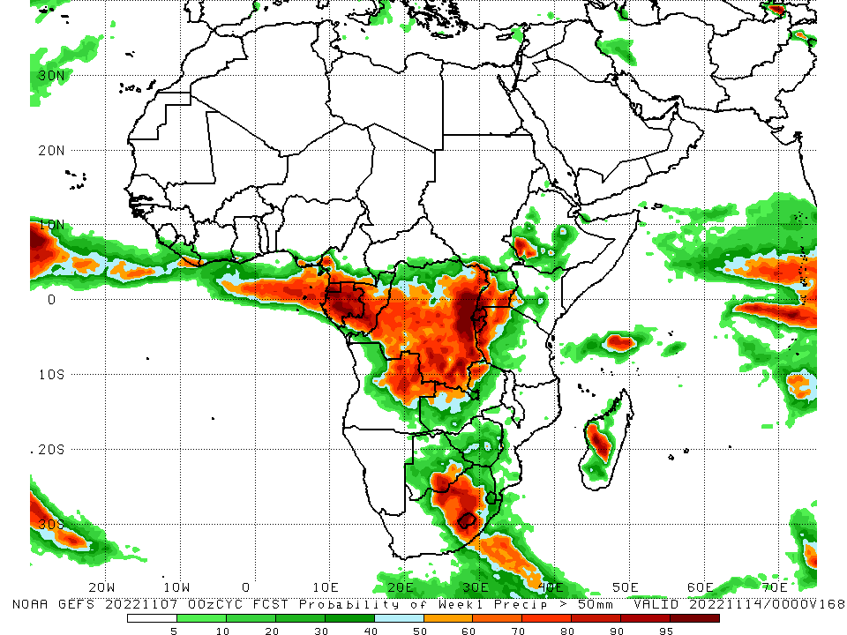
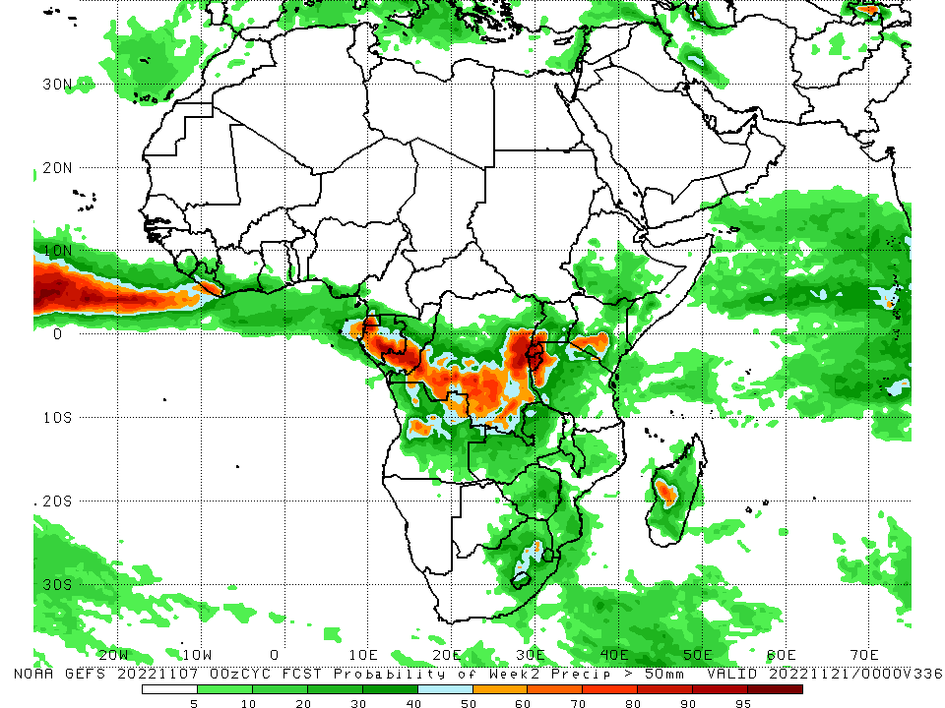
NCEP GEFS Model Forecasts Non-Bias Corrected Probability of precipitation exceedance
Week-1, Valid: 08 – 14 November, 2022
Week-2, Valid: 15 – 21 November, 2022
For week-1 (left panel), the NCEP GEFS forecasts indicate a moderate to high chance (over 70%) for rainfall to exceed 50 mm over many places in Central Africa, and the eastern portion South Africa. For week-2 (right panel), the forecasts indicate a moderate to high probability of exceedance over Equatorial Africa, southern Gabon, southern Congo, northern Angola, southern and eastern DRC, Rwanda, Burundi, western Tanzania, southern Kenya and central Madagascar.
Notes:
9

Slide 10
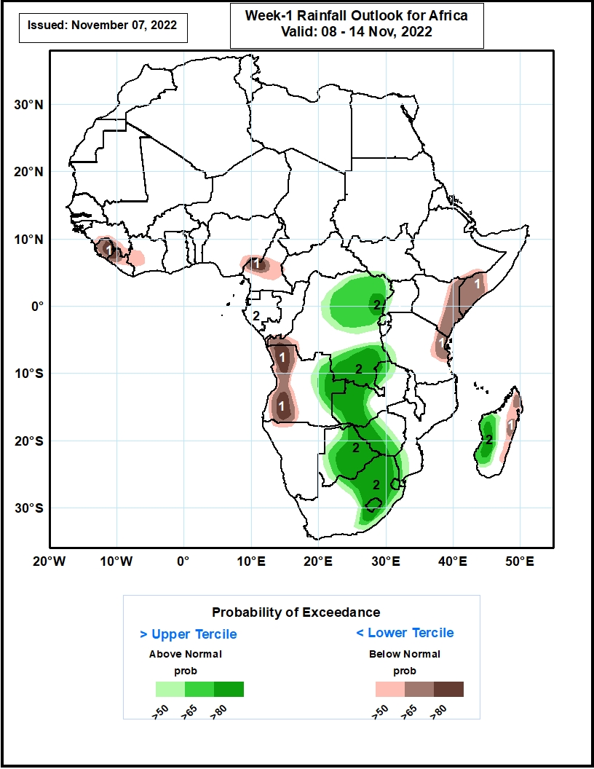
Week-1 Precipitation Outlooks
08 - 14 October, 2022
The consolidated probabilistic forecasts call for above 50% chance for weekly total rainfall to be below-normal (below the lower tercile) over southern Guinea, much of Sierra Leone, western Liberia and Cote d’Ivoire, central portions of Cameroon, western Angola, eastern Kenya, southern Somalia and northeastern parts of Tanzania. In particular, there is above 80% chance for rainfall to be below normal over central parts of Sierra Leone and Cameroon, and northwestern and southwestern portions of Angola.
The forecasts also call for above 50% chance for weekly rainfall to be above-normal (above the upper tercile) over northern and southern portions of DR Congo. In particular, there is above 80% chance for rainfall to be above-normal over northeastern and southern parts of DR Congo, eastern Angola, western Zambia and Zimbabwe, much of Botswana, Lesotho, western Eswatini, central and eastern portions of South Africa, and western parts of Madagascar.
Notes:
10

Slide 11
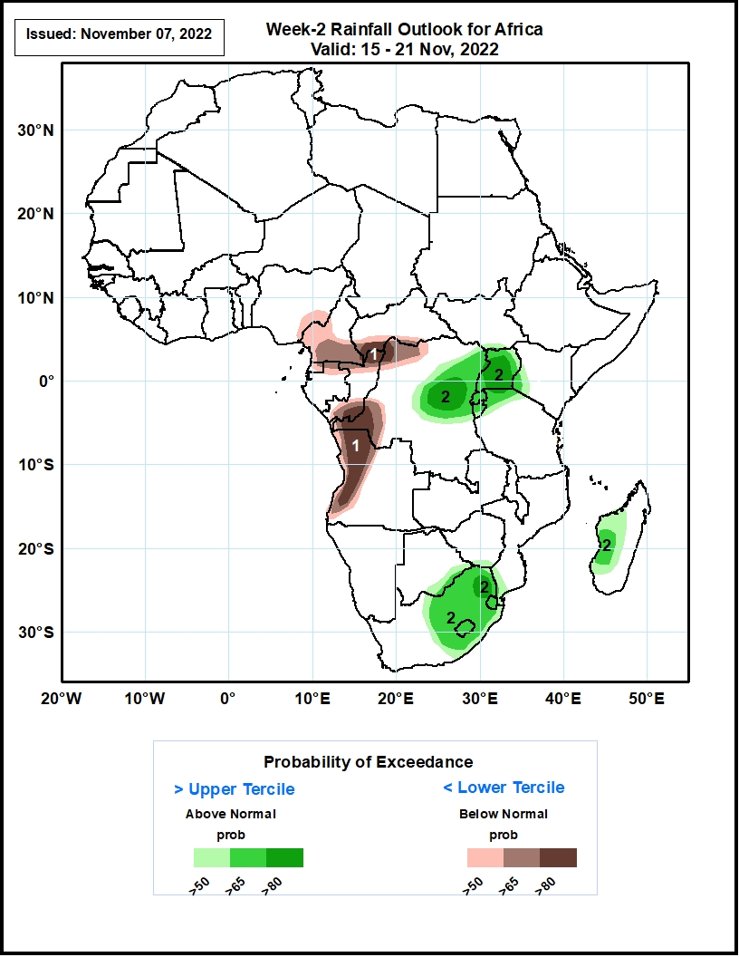
Week-2 Precipitation Outlooks
15 - 21 November, 2022
The consolidated probabilistic forecasts also call for above 50% chance for weekly total rainfall to be below-normal (below the lower tercile) over southern parts of Cameroon, northwestern DR Congo and southwestern CAR. In particular, there is above 80% chance for rainfall to be below normal northern Congo, western DR Congo, and western parts of Angola.
The forecasts also call for above 50% chance for weekly rainfall to be above-normal (above the upper tercile) over eastern DR Congo, central and eastern parts of South Africa including Lesotho and Eswatini, and western parts of Madagascar. In particular, there is above 80% chance for rainfall to be above-normal over central DR Congo, much of Uganda, and northeastern South Africa
Notes:
11

Slide 12
Summary
During the past 30 days, in East Africa, above-average rainfall was observed over southern and eastern Sudan, parts of South Sudan, western Ethiopia, and pockets of northern Uganda. Rainfall was below-average over southern Ethiopia, much of Somalia, Kenya, Tanzania, and pockets of Uganda. In Central Africa, rainfall was above-average over parts of western and eastern Cameroon, much of Congo, western CAR, and parts of central and northern DRC. Rainfall was below-average over Equatorial Guinea, northwestern Cameroon, and southern DRC. In West Africa, rainfall was above-average over Senegal, Guinea-Bissau, western Guinea, Sierra Leone, Liberia, much of Cote d’Ivoire, southwestern Ghana, southern Togo, southern Benin, and pockets of western and southeastern Nigeria. In contrast, southern Mali, central and northern Ghana, Burkina Faso, northern Togo, northern Benin, and many parts of Nigeria received below-average rainfall. In southern Africa, above-average rainfall was observed over northwestern and southern Angola, eastern Namibia, Botswana, Zimbabwe, South Africa and central Madagascar. Below normal precipitation was observed in central and northeastern Angola, northern Zambia, Malawi, northern Mozambique and the far northern Madagascar.
During the past 7 days, in East Africa, rainfall was above-average over pockets of southern South Sudan and central Kenya. Below-average rainfall was observed over southern Ethiopia, much of South Sudan, Kenya, Somalia, Uganda, Rwanda, Burundi and Tanzania. In Central Africa, rainfall was above-average over southern Cameroon, Equatorial Guinea, much of Gabon, Congo, and pockets of northern and eastern DRC. Below-average rainfall was observed over the far southern Gabon, northern Cameroon, CAR, and many parts of DRC. In West Africa, above-average rainfall was observed over Liberia and coastal Cote d’Ivoire. Rainfall was slightly below-average over much of the Gulf of Guinea region. In southern Africa, rainfall was above-average over parts of northwestern and southeastern Angola, western Zambia, pockets of eastern Namibia, Botswana, Zimbabwe, central and eastern South Africa, southern Mozambique and central Madagascar. In contrast, rainfall was below average in pockets of central and northern Angola, eastern Zambia, and the far northern Madagascar.
Week-1 outlooks call for an increased chance for below-normal rainfall over southern Guinea, much of Sierra Leone, western Liberia and Cote d’Ivoire, central portions of Cameroon, western Angola, eastern Kenya, southern Somalia, northeastern parts of Tanzania, and eastern Madagascar. In contrast, the forecasts call for an increased chance for above-normal rainfall over northeastern and southern DRC, eastern Angola, western Zambia, Botswana, western Zimbabwe, eastern South Africa, and western Madagascar. Week-2 outlooks call for an increased chance for below-normal rainfall over southern Cameroon, northern Congo, western and northern DRC and western Angola. In contrast, there is an increased chance for above-normal rainfall over northeastern DRC, Uganda, Rwanda, Burundi, eastern South Africa, Lesotho, Eswatini, and central Madagascar.

