Slide 1
The African Monsoon Recent Evolution and Current Status Include Week-1 and Week-2 Outlooks
Update prepared by
21 November 2022
For more information, visit:
http://www.cpc.ncep.noaa.gov/products/Global_Monsoons/African_Monsoons/precip_monitoring.shtml

Slide 2
Outline
Highlights
Recent Evolution and Current Conditions
NCEP GEFS Forecasts
Summary

Slide 3
Highlights: Last 7 Days
During the past 7 days, in East Africa, rainfall was above-average over much Uganda, pockets of western Ethiopia, southern Somalia, southern Kenya, Tanzania, Rwanda and Burundi. Below-average rainfall was observed over parts of South Sudan and southwestern Ethiopia. In Central Africa, rainfall was above-average over central Congo, and parts of western and eastern DRC. Below-average rainfall was observed over much of Cameroon, Equatorial Guinea, western Gabon, the far southern and northern Congo, and central and northern DRC. In West Africa, above-average rainfall was observed over eastern Guinea, and eastern Liberia. Rainfall was below-average over southeastern Nigeria. In southern Africa, rainfall was above-average over pockets of northeastern Angola and western Zambia, eastern Zimbabwe, central Mozambique, and central Madagascar. In contrast, rainfall was below average over many parts of Angola, Zambia, Botswana, South Africa and southern Mozambique.
Week-1 outlooks call for an increased chance for below-normal rainfall along the Gulf of Guinea coast, northern Congo, eastern Angola, northwestern and southern DRC, Zambia, Malawi, Zimbabwe, parts of Botswana, eastern South Africa and much of Mozambique. In contrast, there is an increased chance for above-normal rainfall over eastern DRC, Rwanda, Burundi, Uganda, northern Tanzania and southern Kenya. Week-2 outlooks call for an increased chance for below-normal rainfall over southern and eastern DRC, Zambia, western and southern Tanzania, Malawi, northern Mozambique and eastern Madagascar. In contrast, the forecasts call for an increased chance for above-normal rainfall over southern Gabon, much of Congo, northern DRC, western Angola, and eastern South Africa.

Slide 4
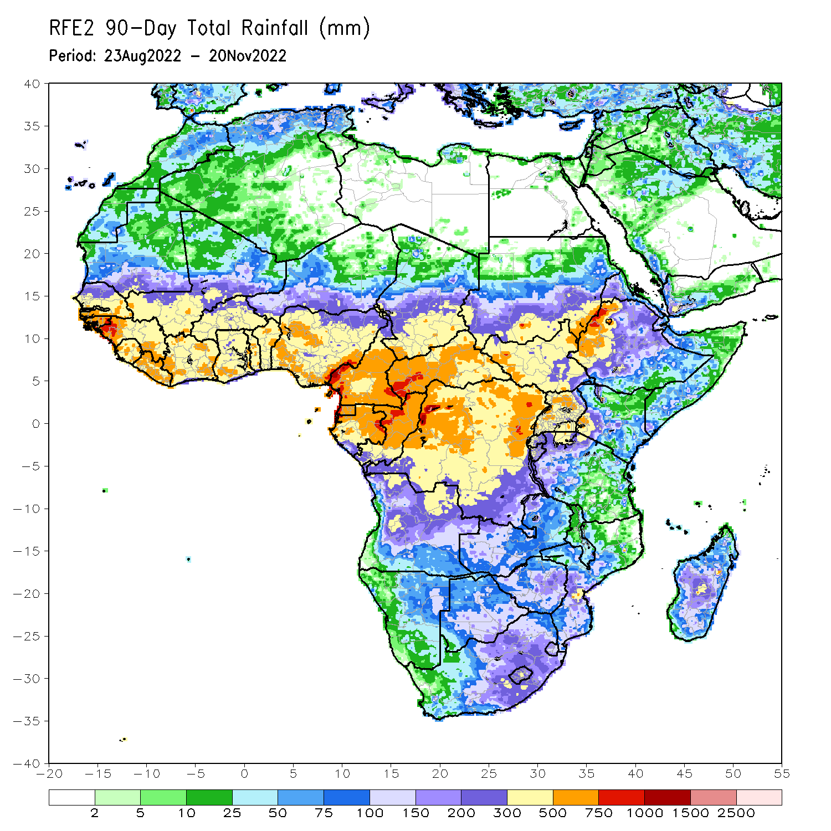
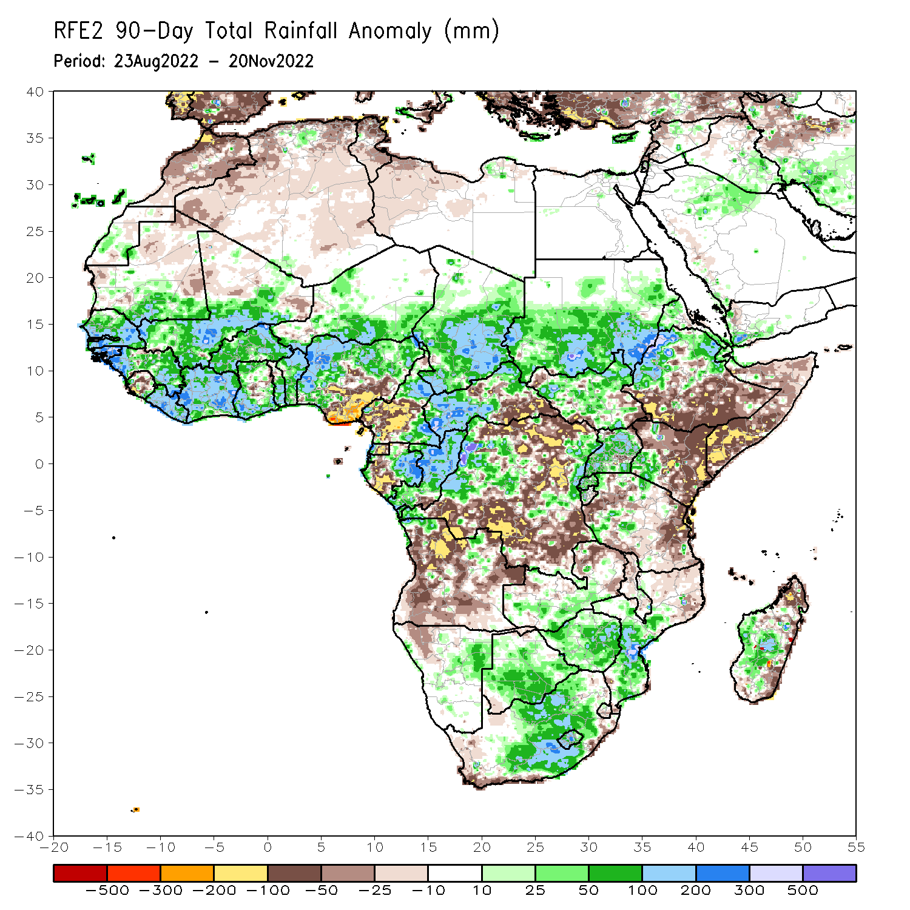
Rainfall Patterns: Last 90 Days
Over the past 90 days, in East Africa, above-average rainfall was observed over the southern and central parts of Sudan, much of South Sudan, central and northern Ethiopia, Eritrea, Djibouti, Uganda, Rwanda, Burundi, the far northern Tanzania, and western Kenya. Rainfall was below-average over southern and southeastern Ethiopia, throughout much of Somalia, central and eastern Kenya, and many parts of Tanzania. In southern Africa, above-average rainfall was observed over southern Zambia, pockets of northern Angola, northeastern Namibia, much of Botswana, Zimbabwe, central and eastern South Africa, southern Mozambique, and central and southern Madagascar. Below-average rainfall was observed over many parts of Angola, western Namibia, central and northern Zambia, western South Africa, and northern Mozambique and northern and the far southern Madagascar. In Central Africa, rainfall was above-average over northern and eastern Cameroon, southern and central Chad, western and northern CAR, eastern Gabon, much of Congo, and central and parts of northern DRC. Rainfall was below-average over western Cameroon, western Gabon, Equatorial Guinea, and portions of eastern and southern DRC. In West Africa, rainfall was above-average over southern Mauritania, Senegal, Gambia, Guinea-Bissau, Guinea, Liberia, Cote D’Ivoire, much of Ghana, Togo, Benin, Burkina Faso, eastern and southern portions of Mali, southern Niger, and western and northern Nigeria. In contrast, below-average rainfall was observed over northern Mauritania, Sierra Leone, pockets of northern Mali, and parts of central and southeastern Nigeria.
Notes:
4

Slide 5
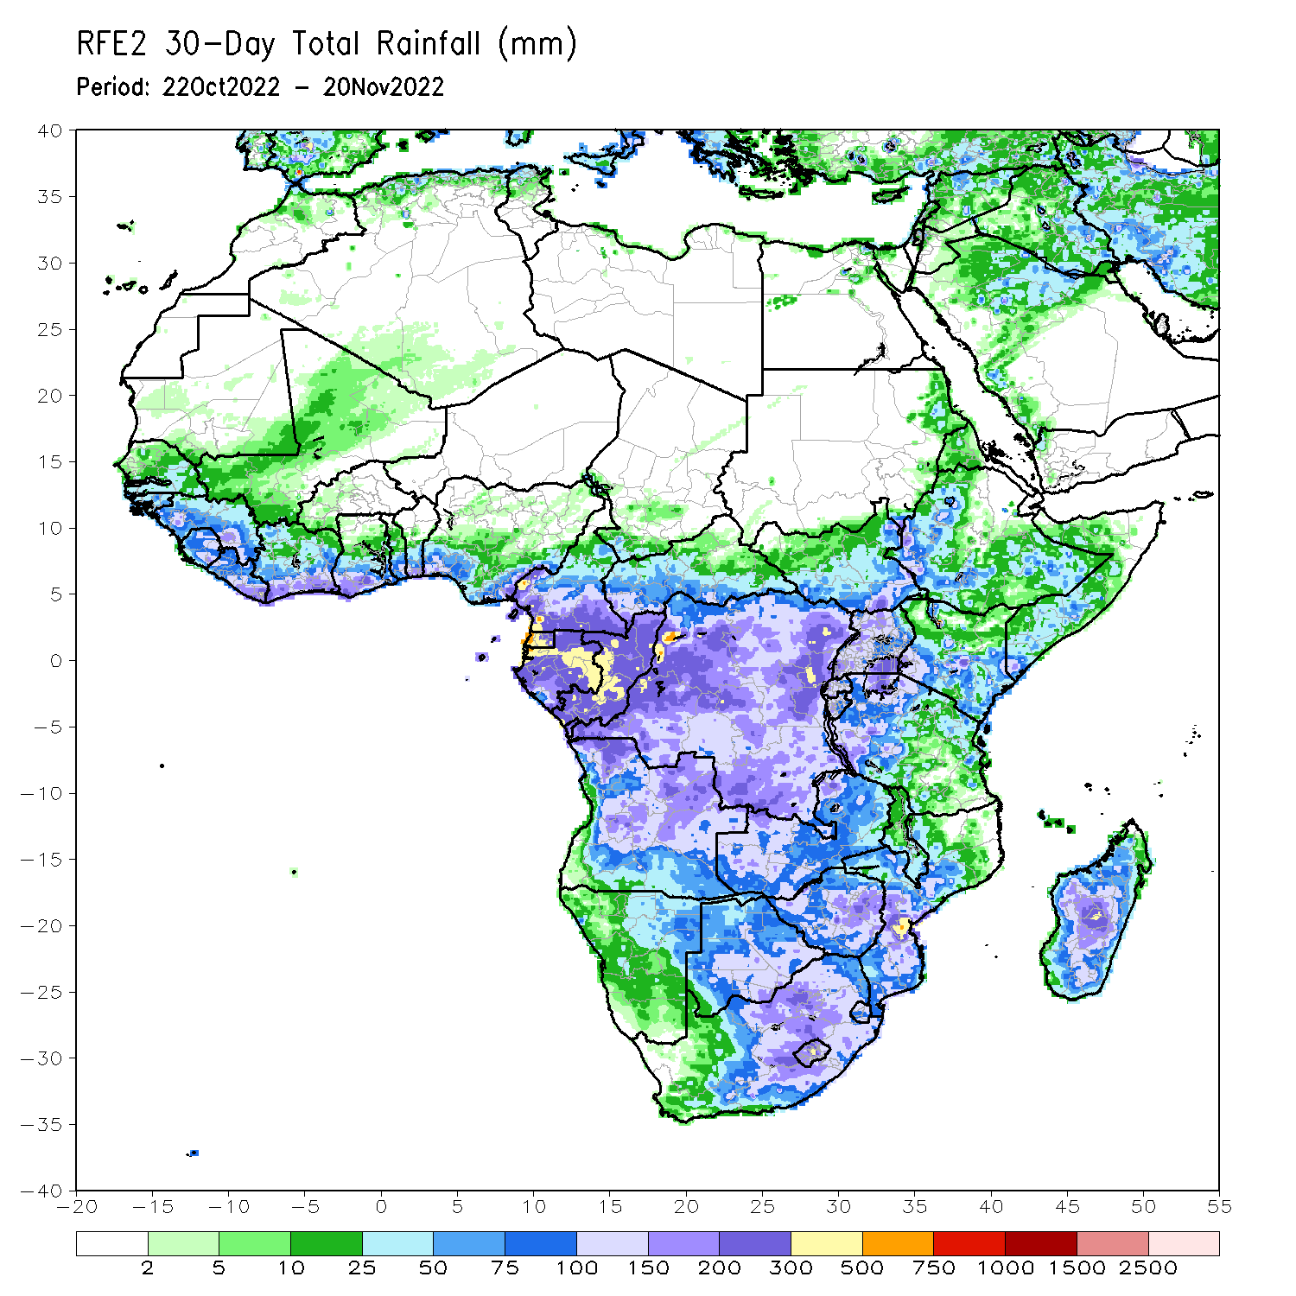
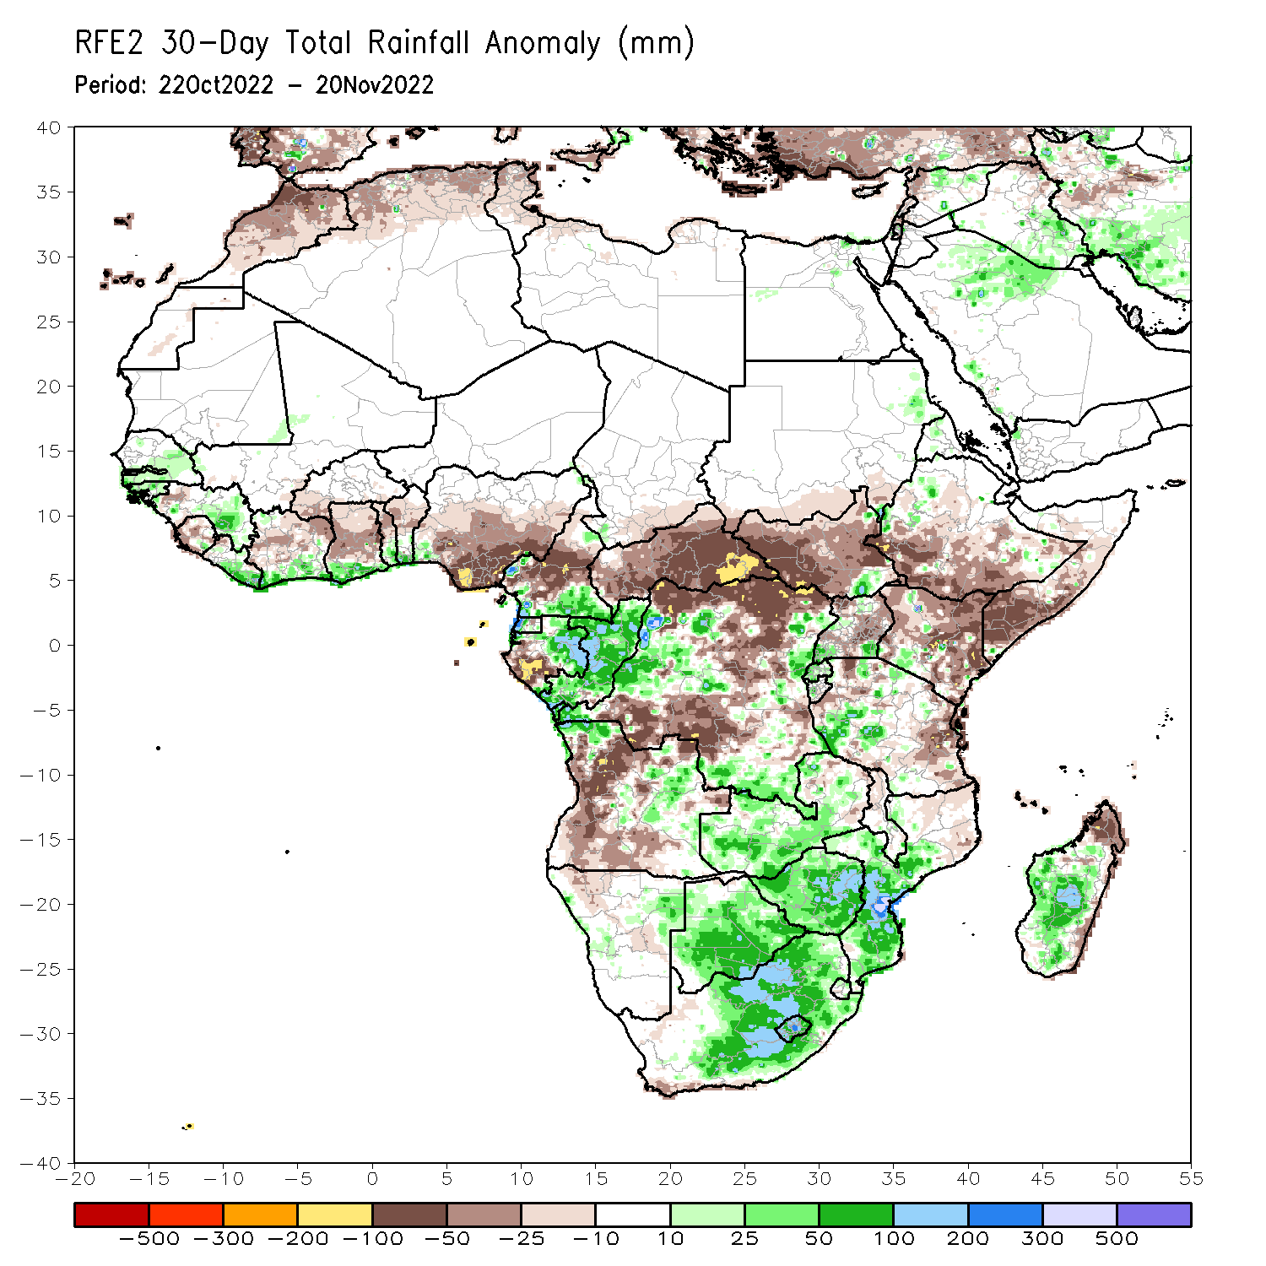
Rainfall Patterns: Last 30 Days
During the past 30 days, in East Africa, above-average rainfall was observed over pockets of western Ethiopia and western Tanzania. Rainfall was below-average over much of South Sudan, central and southern Ethiopia, Somalia, Kenya, parts of Uganda, and eastern Tanzania. In Central Africa, rainfall was above-average over parts of southeastern Cameroon, Equatorial Guinea, central and eastern Gabon, much of Congo, and parts of western and eastern DRC. Rainfall was below-average over southwestern Gabon, western and northwestern Cameroon, CAR, and northern and southwestern DRC. In West Africa, rainfall was above-average over parts of Senegal, Guinea-Bissau, portions of Guinea, Liberia, southern Cote d’Ivoire, and southern Ghana. In contrast, northern Cote d’Ivoire, central and northern Ghana, parts of Burkina Faso, Togo, Benin, and Nigeria received below-average rainfall. In southern Africa, above-average rainfall was observed over northwestern and southeastern Angola, the far eastern Namibia, Botswana, many parts of Zambia, Zimbabwe, South Africa, Lesotho, Eswatini, southern Mozambique, and central and southern Madagascar. Below normal precipitation was observed over many parts of Angola, pockets of eastern Zambia, Malawi, northern Mozambique and the far northern Madagascar.
Notes:
5

Slide 6
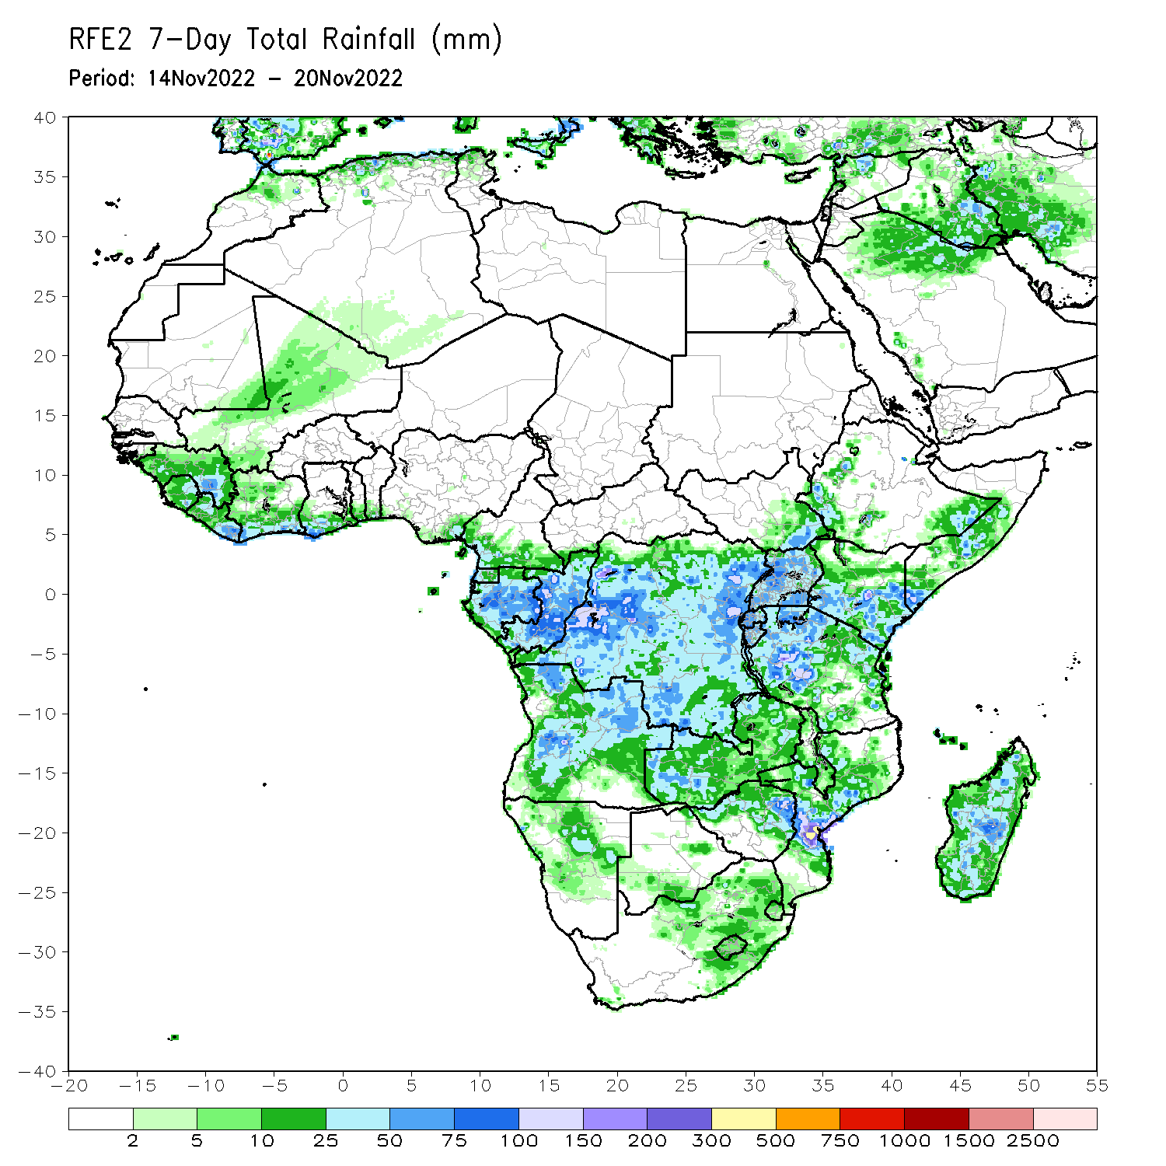
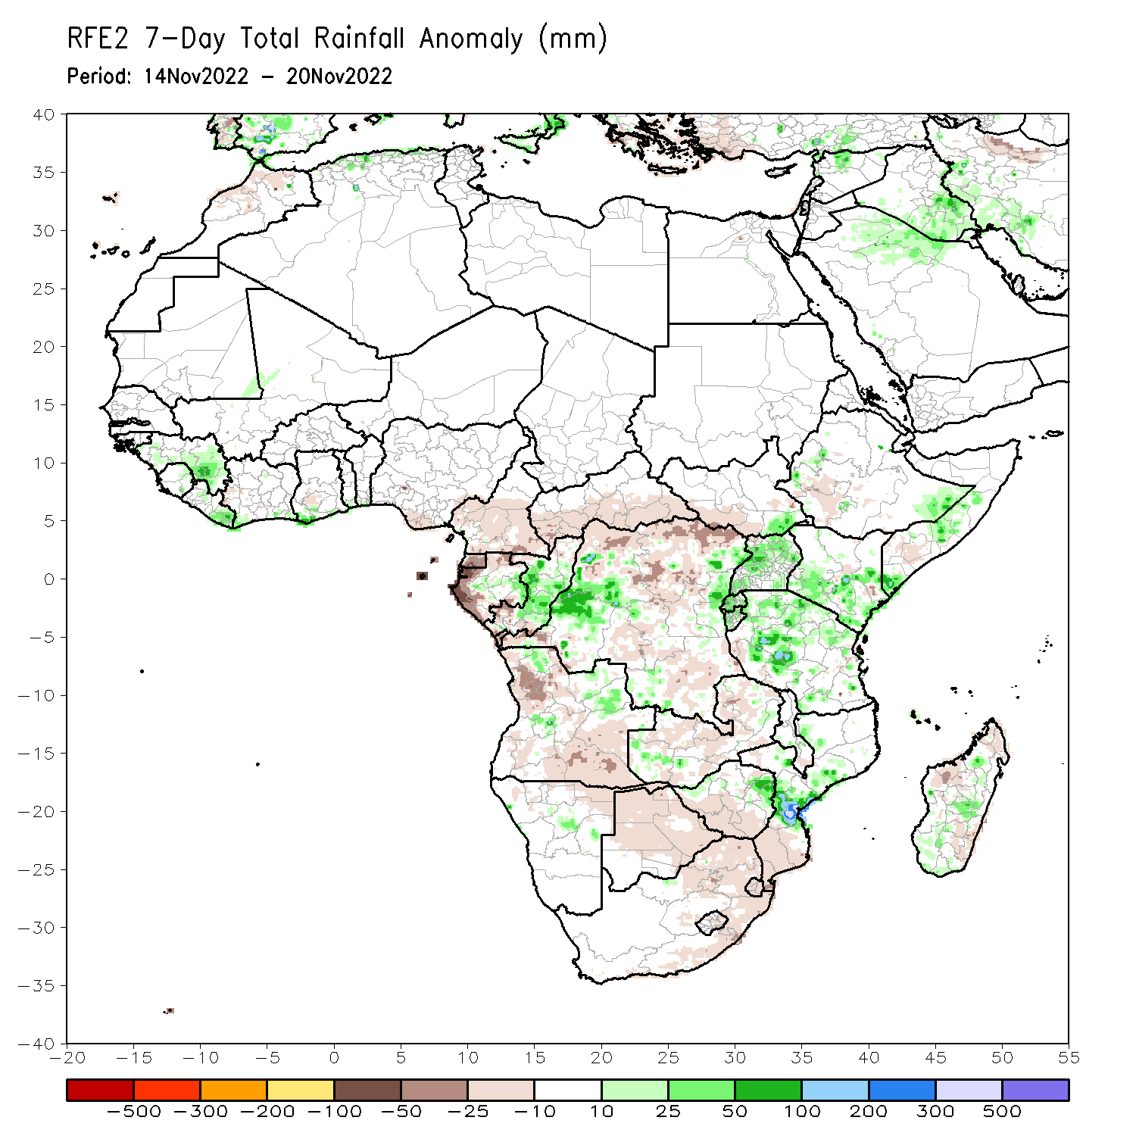
Rainfall Patterns: Last 7 Days
During the past 7 days, in East Africa, rainfall was above-average over much Uganda, pockets of western Ethiopia, southern Somalia, southern Kenya, Tanzania, Rwanda and Burundi. Below-average rainfall was observed over parts of South Sudan and southwestern Ethiopia. In Central Africa, rainfall was above-average over central Congo, and parts of western and eastern DRC. Below-average rainfall was observed over much of Cameroon, Equatorial Guinea, western Gabon, the far southern and northern Congo, and central and northern DRC. In West Africa, above-average rainfall was observed over eastern Guinea, and eastern Liberia. Rainfall was below-average over southeastern Nigeria. In southern Africa, rainfall was above-average over pockets of northeastern Angola and western Zambia, eastern Zimbabwe, central Mozambique, and central Madagascar. In contrast, rainfall was below average over many parts of Angola, Zambia, Botswana, South Africa and southern Mozambique.
.

Slide 7
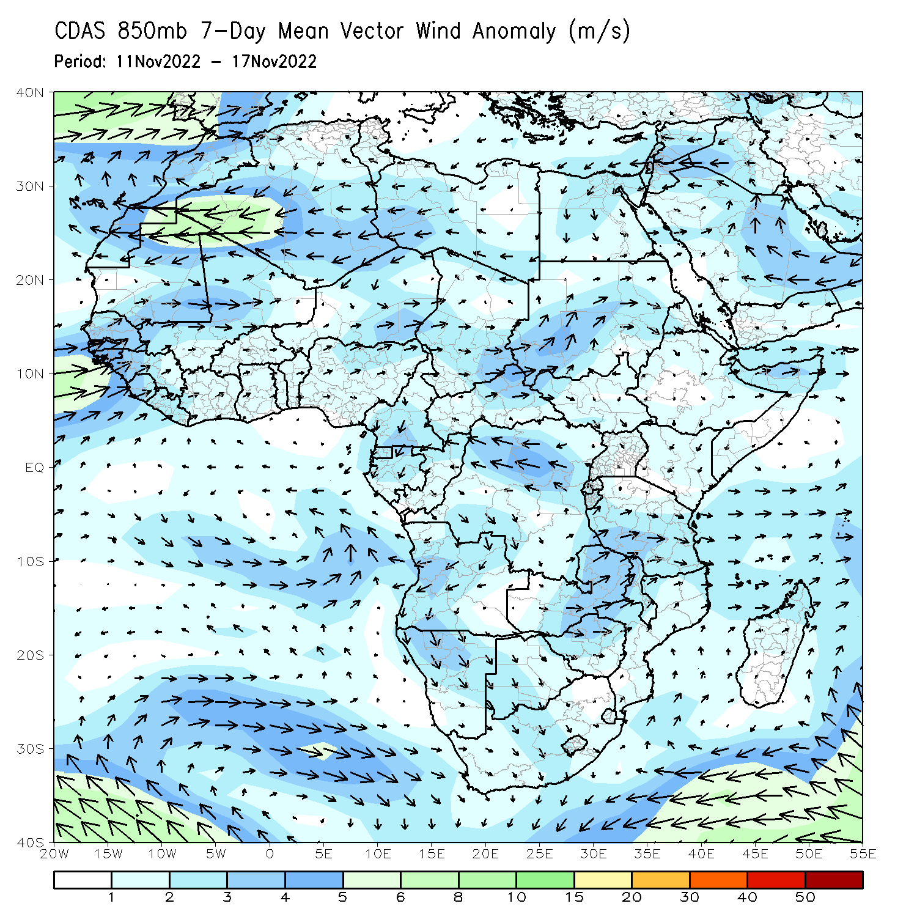
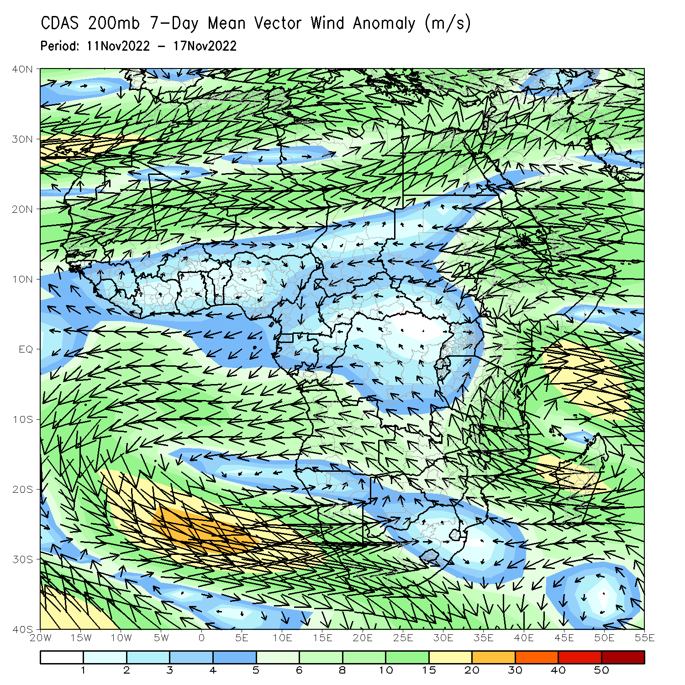
Atmospheric Circulation: Last 7 Days
At 200-hPa level (right panel), the upper-level anomalies were cyclonic over across western Indian Ocean and the neighboring areas of East Africa.

Slide 8
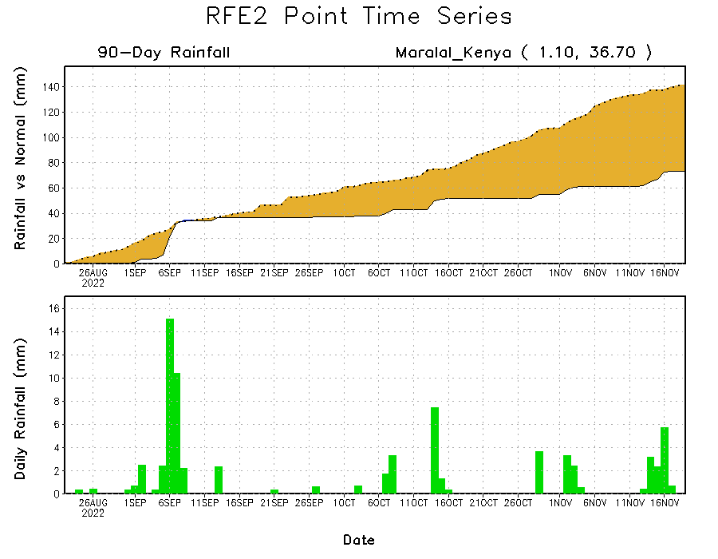
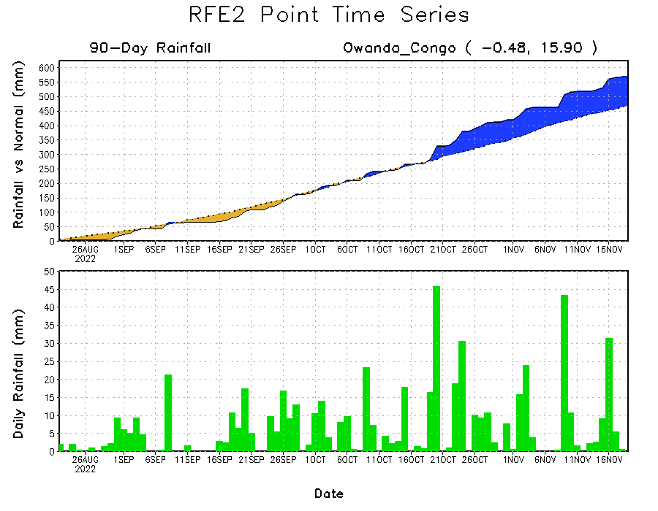
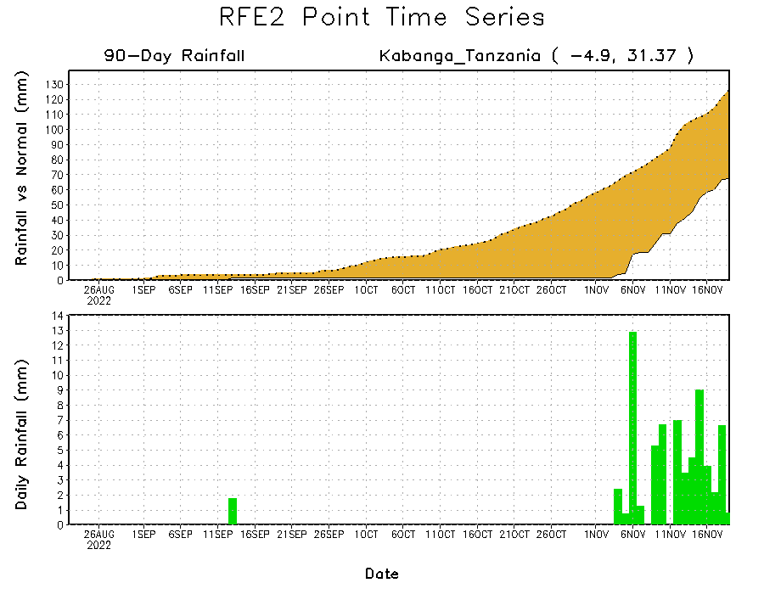
Rainfall Evolution
Daily evolution of rainfall over the last 90 days at selected locations shows continuing moisture surpluses over parts of Congo (bottom left). Rainfall deficits continue in many parts of Kenya (top right) and western Tanzania (bottom right).

Slide 9
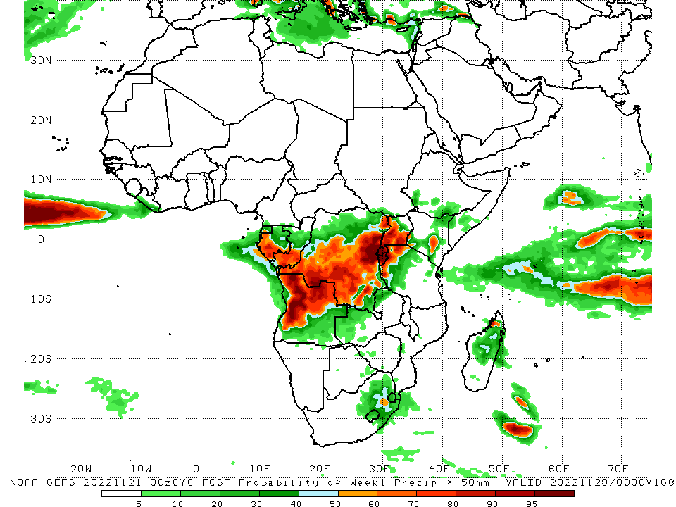
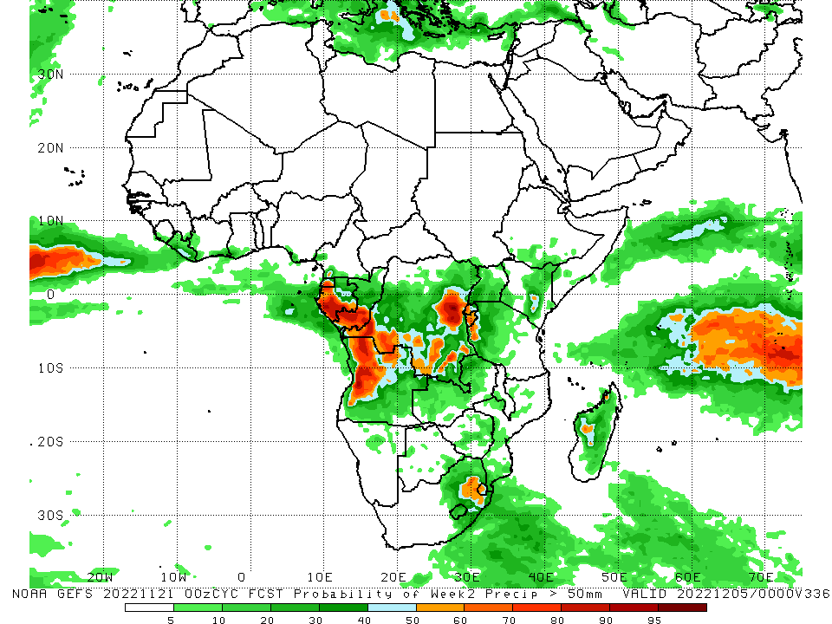
NCEP GEFS Model Forecasts Non-Bias Corrected Probability of precipitation exceedance
Week-1, Valid: 22 – 28 November, 2022
Week-2, Valid: 29 Nov – 05 Dec 2022
For week-1 (left panel) and week-2 (right panel), the NCEP GEFS forecasts indicate a moderate to high chance (over 70%) for rainfall to exceed 50 mm over Equatorial Guinea, Gabon, southern Congo, portions of DRC, northern Angola, and the Lake Victoria region.
Notes:
9

Slide 10
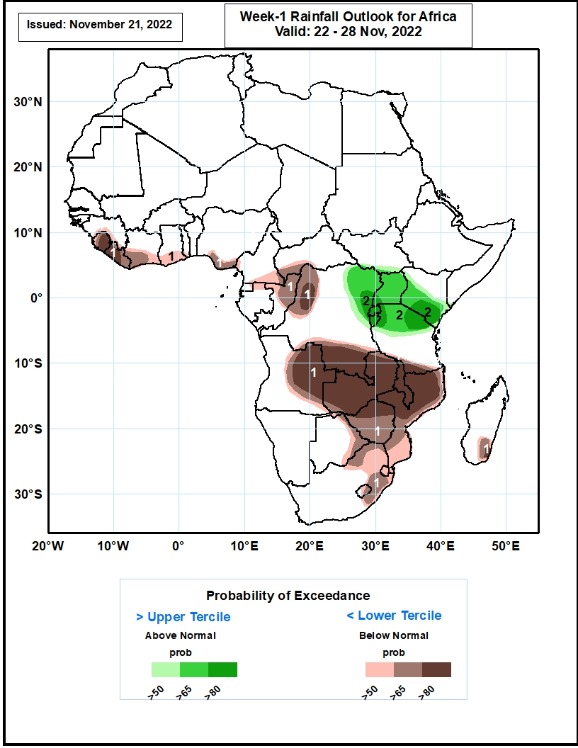
Week-1 Precipitation Outlooks
22 – 28 November, 2022
The consolidated probabilistic forecasts call above 50% chance for weekly total rainfall to be below-normal (below the lower tercile) over southern Guinea, much of Sierra Leone and Liberia, southern Cote d’Ivoire, Ghana, Togo, Nigeria and Cameroon, southwestern CAR, northern portions of Gabon and Congo, northwestern and southern parts of DR Congo, central and eastern parts of Angola, eastern portions of the southern Africa region, and southeastern Madagascar. In particular, there is above 80% chance for rainfall to be below normal over much of Sierra Leone, western Liberia, northwestern and southern parts of DR Congo, eastern Angola, much of Zambia and Malawi, northern Mozambique and Zimbabwe.
The forecasts suggest above 50% chance for weekly rainfall to be above-normal (above the upper tercile) over eastern DR Congo, much of Uganda, Rwanda and Burundi, central and southern parts of Kenya, and northern parts of Tanzania. In particular, there is above 80% chance for rainfall to be above-normal over northeastern DR Congo, much of Rwanda and Burundi, southern Kenya, and northern parts of Tanzania.
Notes:
10

Slide 11
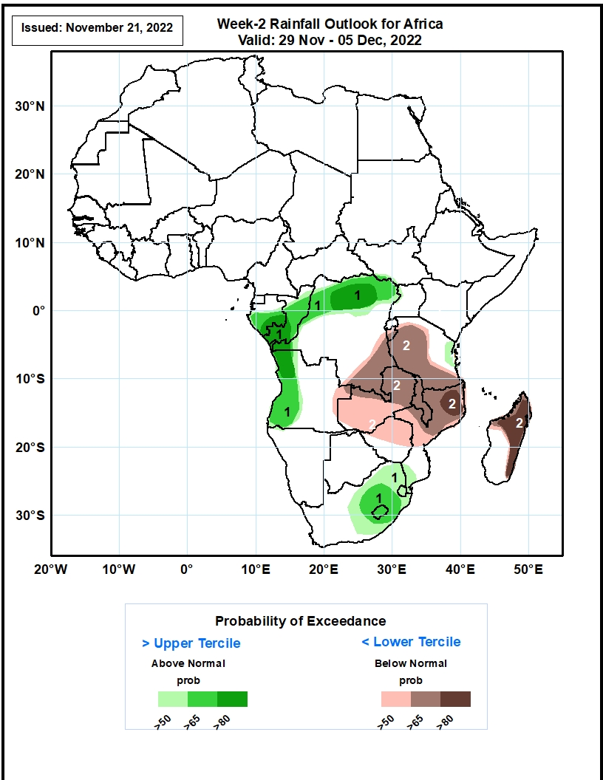
Week-2 Precipitation Outlooks
29 Nov – 05 Dec, 2022
The consolidated probabilistic forecasts call for above 50% chance for weekly rainfall to be above-normal (above the upper tercile) over southern Gabon, much of Congo, northern portions of DR Congo, western Angola, east coast of Tanzania, central and eastern parts of South Africa, much of Lesotho and Eswatini. In particular, there is above 80% chance for rainfall to be above-normal over southern Gabon and Congo, northern and western parts of DR Congo, and northwestern Angola.
The forecasts call above 50% chance for weekly total rainfall to be below-normal (below the lower tercile) over southern DR Congo, western and central parts of Tanzania, much of Zambia and Malawi, northern and central parts of Mozambique and Zimbabwe, northern and eastern parts of Madagascar. In particular, there is above 80% chance for rainfall to be below normal over northern Mozambique, and northern and eastern parts of Madagascar.
Notes:
11

Slide 12
Summary
During the past 30 days, in East Africa, above-average rainfall was observed over pockets of western Ethiopia and western Tanzania. Rainfall was below-average over much of South Sudan, central and southern Ethiopia, Somalia, Kenya, parts of Uganda, and eastern Tanzania. In Central Africa, rainfall was above-average over parts of southeastern Cameroon, Equatorial Guinea, central and eastern Gabon, much of Congo, and parts of western and eastern DRC. Rainfall was below-average over southwestern Gabon, western and northwestern Cameroon, CAR, and northern and southwestern DRC. In West Africa, rainfall was above-average over parts of Senegal, Guinea-Bissau, portions of Guinea, Liberia, southern Cote d’Ivoire, and southern Ghana. In contrast, northern Cote d’Ivoire, central and northern Ghana, parts of Burkina Faso, Togo, Benin, and Nigeria received below-average rainfall. In southern Africa, above-average rainfall was observed over northwestern and southeastern Angola, the far eastern Namibia, Botswana, many parts of Zambia, Zimbabwe, South Africa, Lesotho, Eswatini, southern Mozambique, and central and southern Madagascar. Below normal precipitation was observed over many parts of Angola, pockets of eastern Zambia, Malawi, northern Mozambique and the far northern Madagascar.
During the past 7 days, in East Africa, rainfall was above-average over much Uganda, pockets of western Ethiopia, southern Somalia, southern Kenya, Tanzania, Rwanda and Burundi. Below-average rainfall was observed over parts of South Sudan and southwestern Ethiopia. In Central Africa, rainfall was above-average over central Congo, and parts of western and eastern DRC. Below-average rainfall was observed over much of Cameroon, Equatorial Guinea, western Gabon, the far southern and northern Congo, and central and northern DRC. In West Africa, above-average rainfall was observed over eastern Guinea, and eastern Liberia. Rainfall was below-average over southeastern Nigeria. In southern Africa, rainfall was above-average over pockets of northeastern Angola and western Zambia, eastern Zimbabwe, central Mozambique, and central Madagascar. In contrast, rainfall was below average over many parts of Angola, Zambia, Botswana, South Africa and southern Mozambique.
Week-1 outlooks call for an increased chance for below-normal rainfall along the Gulf of Guinea coast, northern Congo, eastern Angola, northwestern and southern DRC, Zambia, Malawi, Zimbabwe, parts of Botswana, eastern South Africa and much of Mozambique. In contrast, there is an increased chance for above-normal rainfall over eastern DRC, Rwanda, Burundi, Uganda, northern Tanzania and southern Kenya. Week-2 outlooks call for an increased chance for below-normal rainfall over southern and eastern DRC, Zambia, western and southern Tanzania, Malawi, northern Mozambique and eastern Madagascar. In contrast, the forecasts call for an increased chance for above-normal rainfall over southern Gabon, much of Congo, northern DRC, western Angola, and eastern South Africa.

