Slide 1
The African Monsoon Recent Evolution and Current Status Include Week-1 and Week-2 Outlooks
Update prepared by
19 December 2022
For more information, visit:
http://www.cpc.ncep.noaa.gov/products/Global_Monsoons/African_Monsoons/precip_monitoring.shtml

Slide 2
Outline
Highlights
Recent Evolution and Current Conditions
NCEP GEFS Forecasts
Summary

Slide 3
Highlights: Last 7 Days
During the past 7 days, in East Africa, rainfall was above-average over pockets of central Ethiopia, southeast Kenya and northwest and western Tanzania, and Uganda. Below-average rainfall was observed over pockets of central Kenya and central, northeast and southern Tanzania. In Central Africa, rainfall was above-average over Equatorial Guinea, northern and eastern Gabon, southern Cameroon, southwest CAR, and many parts of Congo and DRC. Below-average rainfall was observed over pockets of central Congo and central and southeast DRC. In West Africa, above-average rainfall was observed over pockets of southern Cote D’Ivoire and southwest Ghana. In southern Africa, rainfall was above-average over northeast and southern Angola, northern, northeast and central Namibia, much of Botswana, South Africa, Lesotho and Eswatini, southern Mozambique, northern Zambia, central and eastern Madagascar. In contrast, rainfall was below-average over Zimbabwe, western, southern and central Zambia, pockets of central and southeast Angola, central and northern Mozambique, many parts of Malawi, and northern and northwest Madagascar.
Week-1 outlook calls for an increased chance for above-average rainfall over Equatorial Guinea, Gabon, Congo, western, central, southern and eastern DRC, Rwanda, Burundi, Tanzania, southern parts of Uganda and Kenya, northeast Angola, Malawi, central Mozambique, and central, southern and eastern Madagascar. In contrast, there is an increased chance for below-average rainfall over Zimbabwe, Botswana, western and southern Angola, northeast Namibia, western, central, northern and eastern South Africa, Lesotho, Eswatini, southern Mozambique, Liberia, and southern parts of Cote D’Ivoire and Ghana. Week-2 outlook suggests an increased chance for above-average rainfall over Equatorial Guinea, Gabon, southern Congo, southern and southeast DRC, Rwanda, Burundi, western and central Tanzania, northern Angola, central Namibia, southwest Botswana, western, central and eastern South Africa, and Lesotho, while below-average rainfall is likely over the central DRC, central and eastern Kenya, eastern Tanzania, southern Angola, western, southern and central Zambia, northern and eastern Botswana, Zimbabwe, central and southern Mozambique, Malawi, southern, eastern and northern Madagascar, Liberia, and southern parts of Cote D’Ivoire and Ghana.

Slide 4
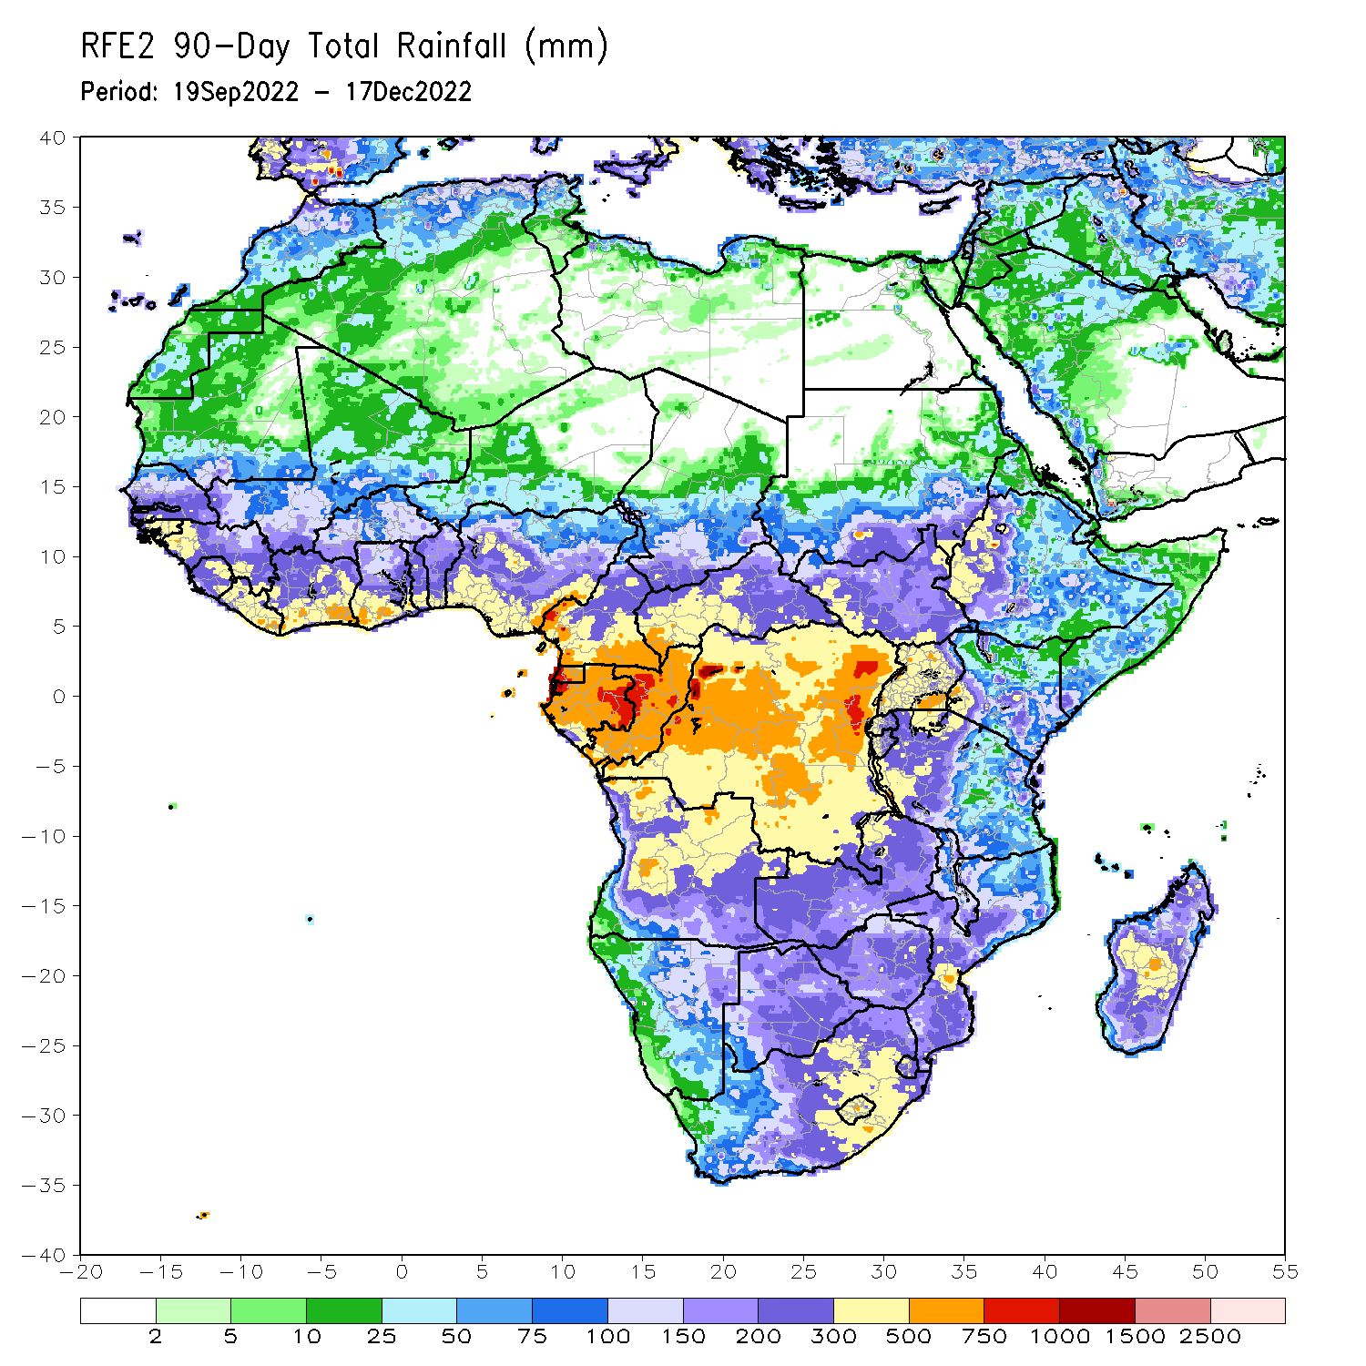
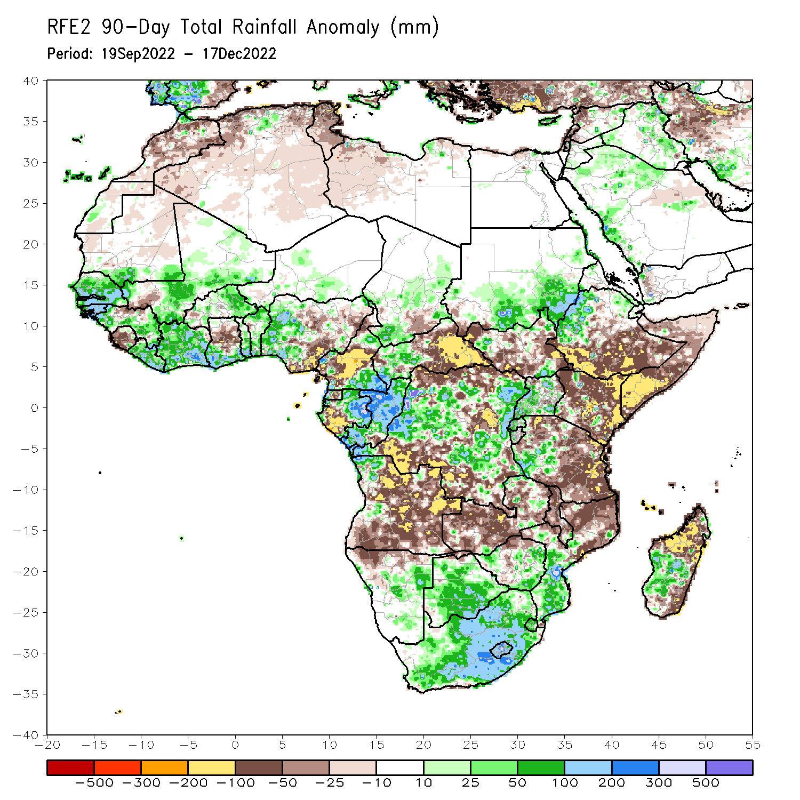
Rainfall Patterns: Last 90 Days
Over the past 90 days, in East Africa, above-average rainfall was observed over the southern and southeast parts of Sudan, pockets of northeast and southeast South Sudan, western Ethiopia, southern and northern Eritrea, western, northern and southern Uganda, Rwanda, and southwest Tanzania. Rainfall was below-average over southern and eastern Ethiopia, throughout much of Somalia, much of Kenya, and central, southern, northern and eastern Tanzania. In southern Africa, above-average rainfall was observed over Botswana, South Africa, Lesotho, Eswatini, southwest, southeast and eastern Zimbabwe, southern Mozambique, northwest Angola, eastern Namibia, and southwest and central parts of Madagascar. Below-average rainfall was observed over many parts of Angola and Zambia, northern parts of Namibia, Zimbabwe, and Mozambique, Malawi, and northwest and eastern Madagascar. In Central Africa, rainfall was above-average over southeast Cameroon, southern and central parts of Chad, western CAR, eastern and northern Gabon, much of Congo, and parts of western and eastern DRC. Rainfall was below-average over western Cameroon, western Gabon, Equatorial Guinea, eastern CAR, and parts of northern, central and southern DRC. In West Africa, rainfall was above-average over southern Mauritania, Senegal, Gambia, Guinea-Bissau, western, southern and eastern Guinea, Liberia, Cote D’Ivoire, southern Ghana, Togo, Benin, eastern Burkina Faso, eastern and southern portions of Mali, southern Niger, and western Nigeria. In contrast, below-average rainfall was observed over northern Mauritania, northeast Guinea, pockets of western Mali, Sierra Leone, central Ghana, and parts of central and southeastern Nigeria.
Notes:
4

Slide 5
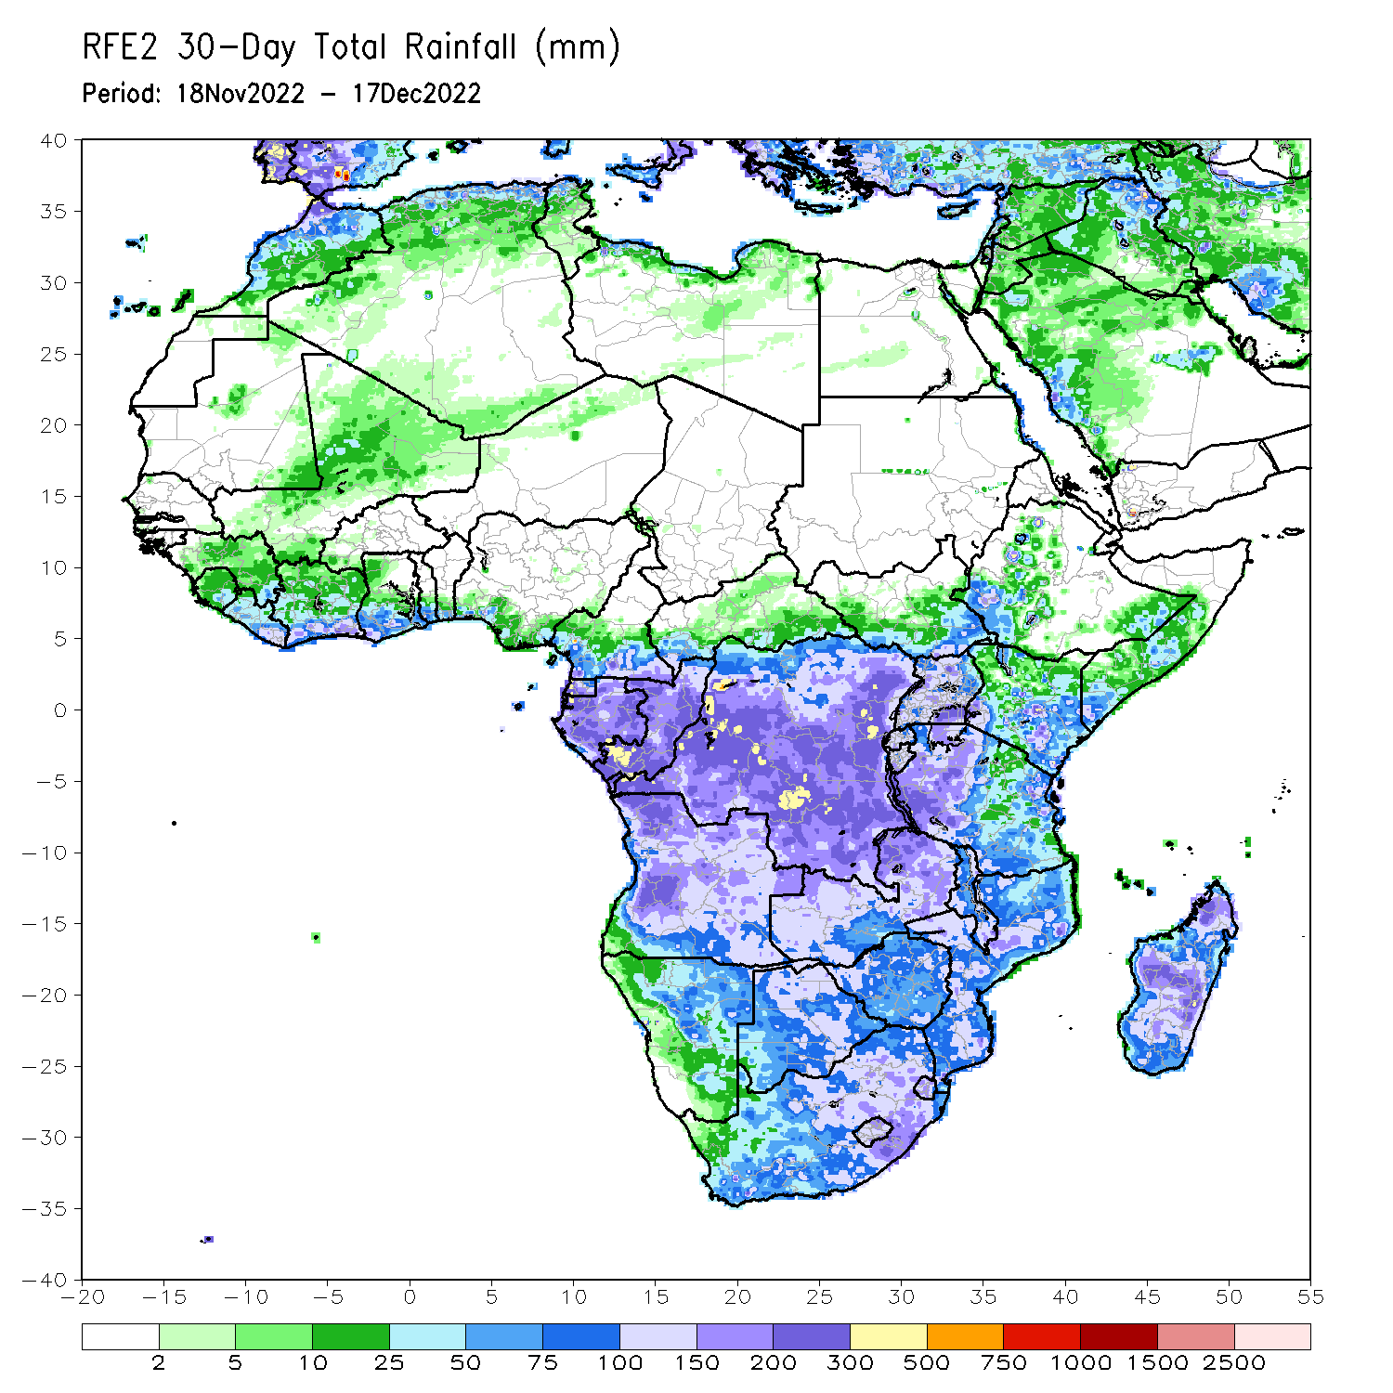
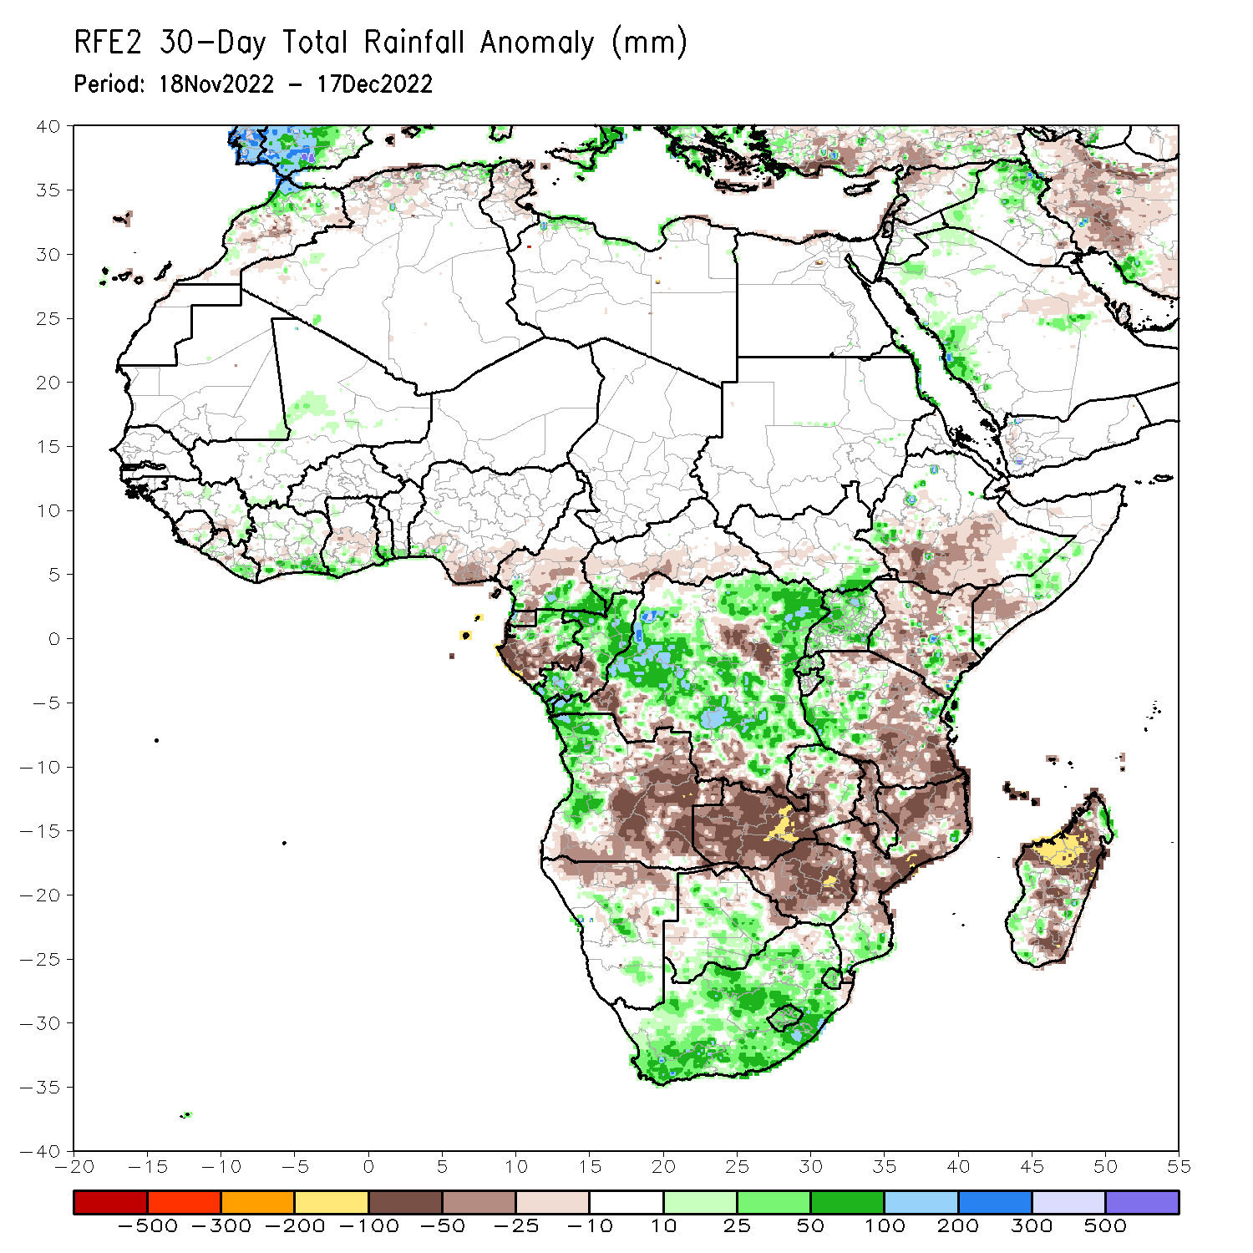
Rainfall Patterns: Last 30 Days
During the past 30 days, in East Africa, above-average rainfall was observed over Uganda, pockets of central Kenya and Somalia, and southwest Ethiopia, western and northeast Tanzania, Rwanda, Burundi, and southeast South Sudan. Rainfall was below-average over central South Sudan, central and southern Ethiopia, southern Somalia, many parts of Kenya, and parts of central, northern, and southern Tanzania. In Central Africa, rainfall was above-average over northeast Gabon, southeast Cameroon, many parts of Congo and DRC. Rainfall was below-average over western and southern Gabon, eastern Equatorial Guinea, western and central Cameroon, southern CAR, pockets of central Congo, and pockets of central and in for southern DRC. In West Africa, rainfall was above-average over eastern Liberia, southern parts of Cote d’Ivoire, Ghana, Togo and Benin, and pockets of central Mali. In contrast, below-average rainfall was observed over southern Nigeria and central parts of Ghana and Liberia and pockets of southeast Guinea. In southern Africa, above-average rainfall was observed over northwestern and western Angola, South Africa, Lesotho, Eswatini, pockets of central Namibia, southern Mozambique, northern Zambia and southwest Madagascar, and central and southern Botswana. Below normal precipitation was observed over central, eastern and southern Angola, northern Namibia, western, central and southern Zambia, Malawi, Zimbabwe, central and northern Mozambique and northwest, central and southeast Madagascar.
Notes:
5

Slide 6
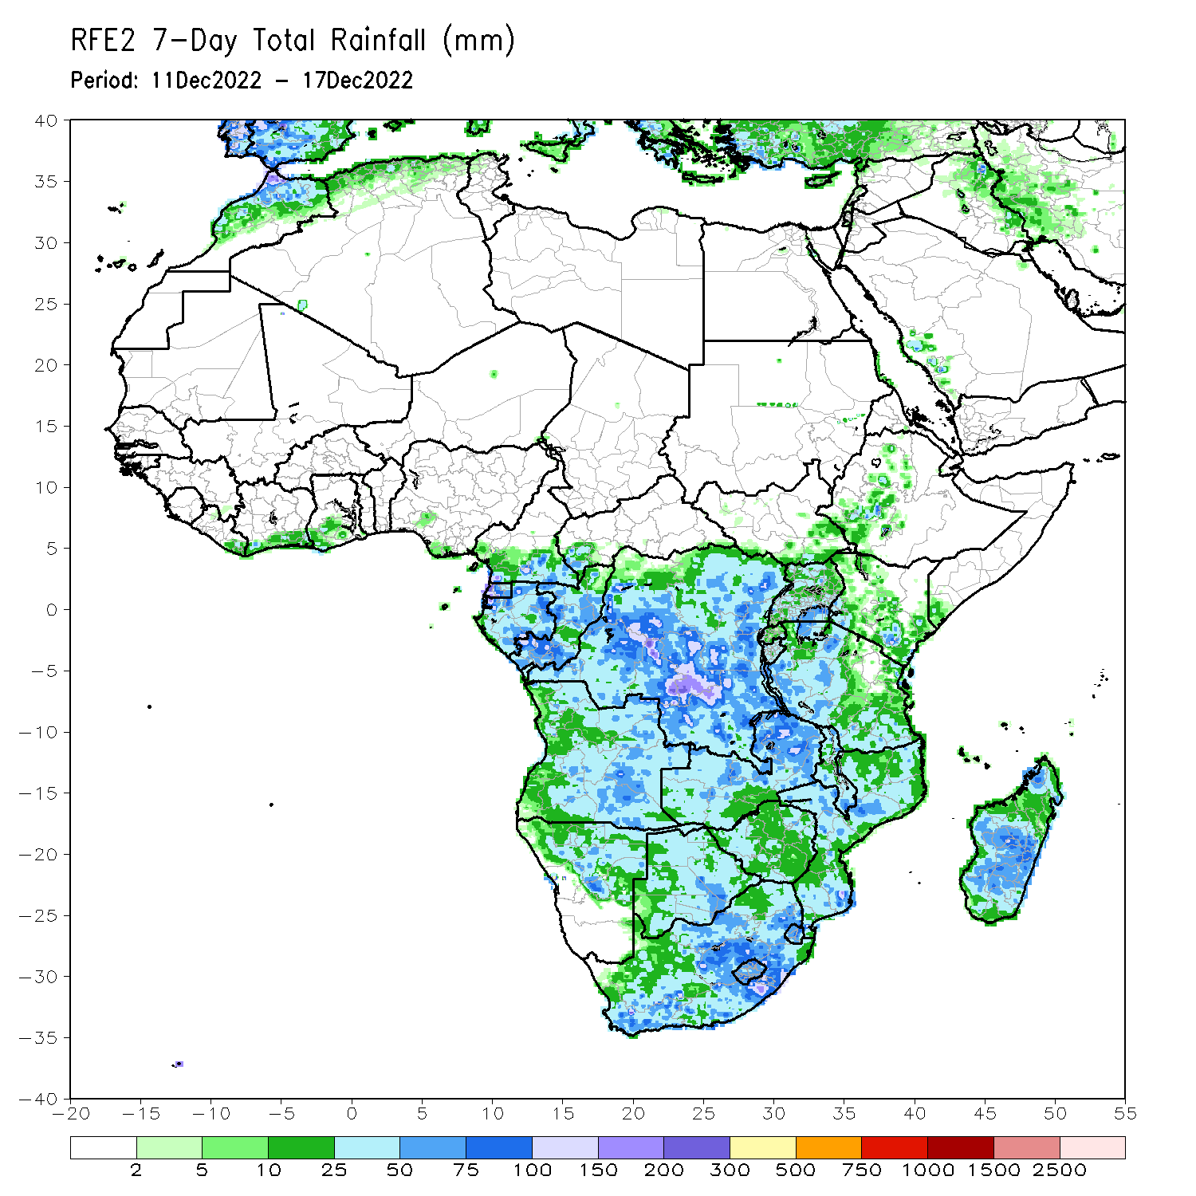
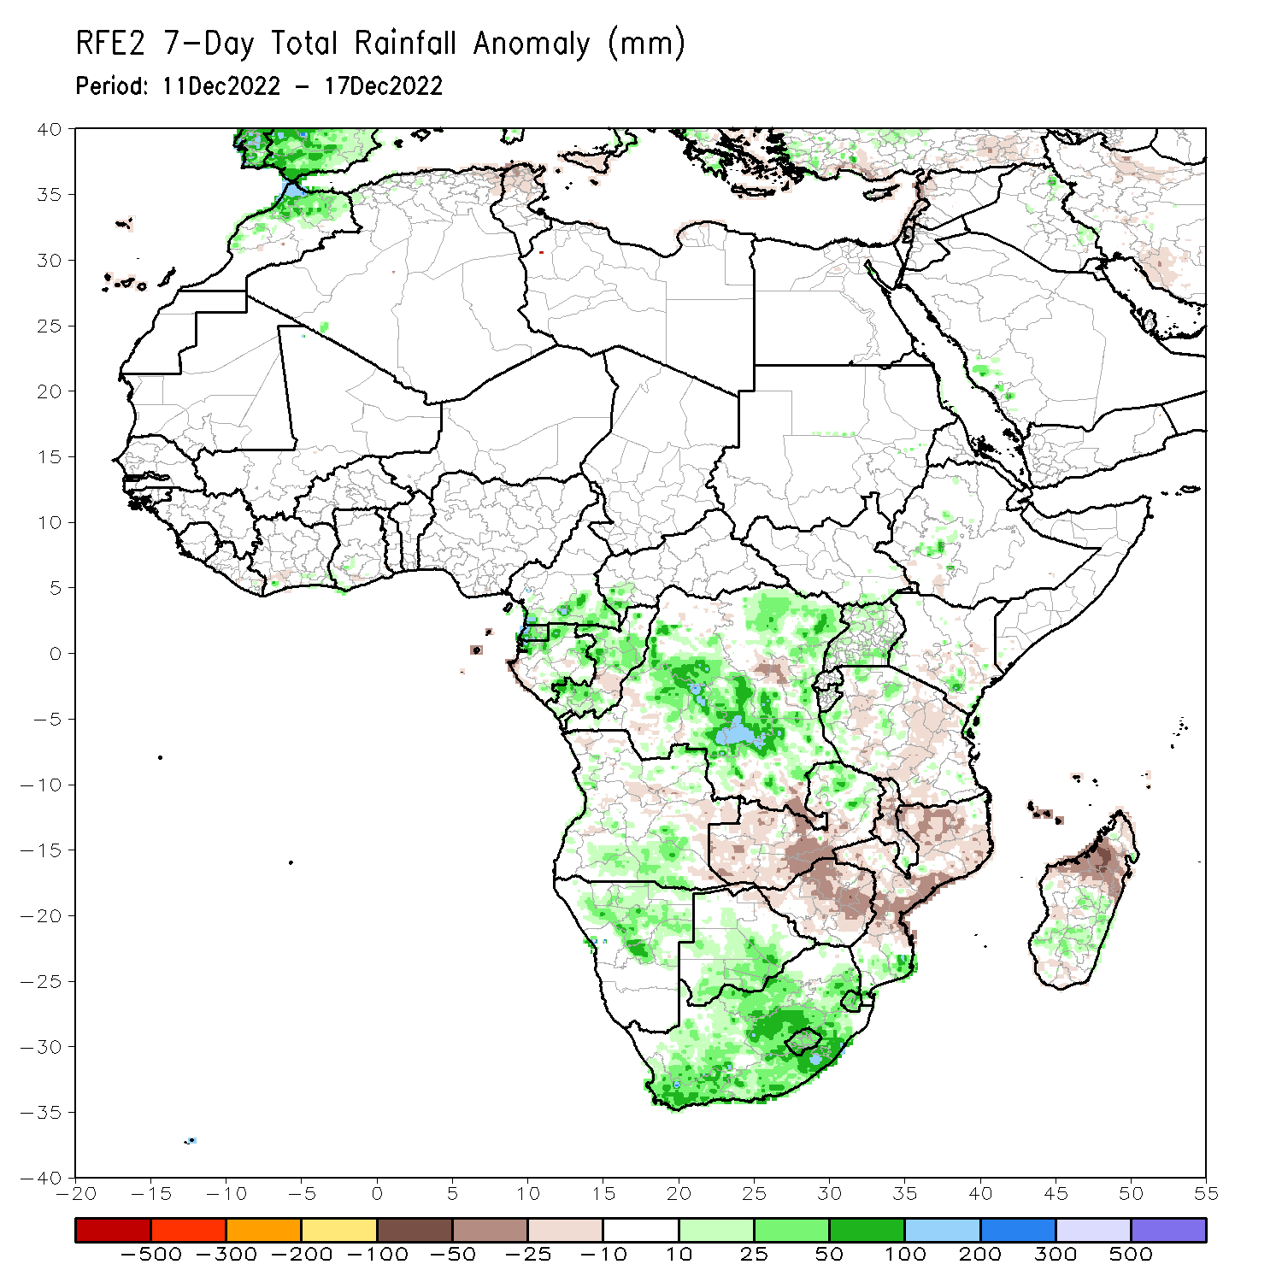
Rainfall Patterns: Last 7 Days
During the past 7 days, in East Africa, rainfall was above-average over pockets of central Ethiopia, southeast Kenya and northwest and western Tanzania, and Uganda. Below-average rainfall was observed over pockets of central Kenya and central, northeast and southern Tanzania. In Central Africa, rainfall was above-average over Equatorial Guinea, northern and eastern Gabon, southern Cameroon, southwest CAR, and many parts of Congo and DRC. Below-average rainfall was observed over pockets of central Congo and central and southeast DRC. In West Africa, above-average rainfall was observed over pockets of southern Cote D’Ivoire and southwest Ghana. In southern Africa, rainfall was above-average over northeast and southern Angola, northern, northeast and central Namibia, much of Botswana, South Africa, Lesotho and Eswatini, southern Mozambique, northern Zambia, central and eastern Madagascar. In contrast, rainfall was below-average over Zimbabwe, western, southern and central Zambia, pockets of central and southeast Angola, central and northern Mozambique, many parts of Malawi, and northern and northwest Madagascar.

Slide 7
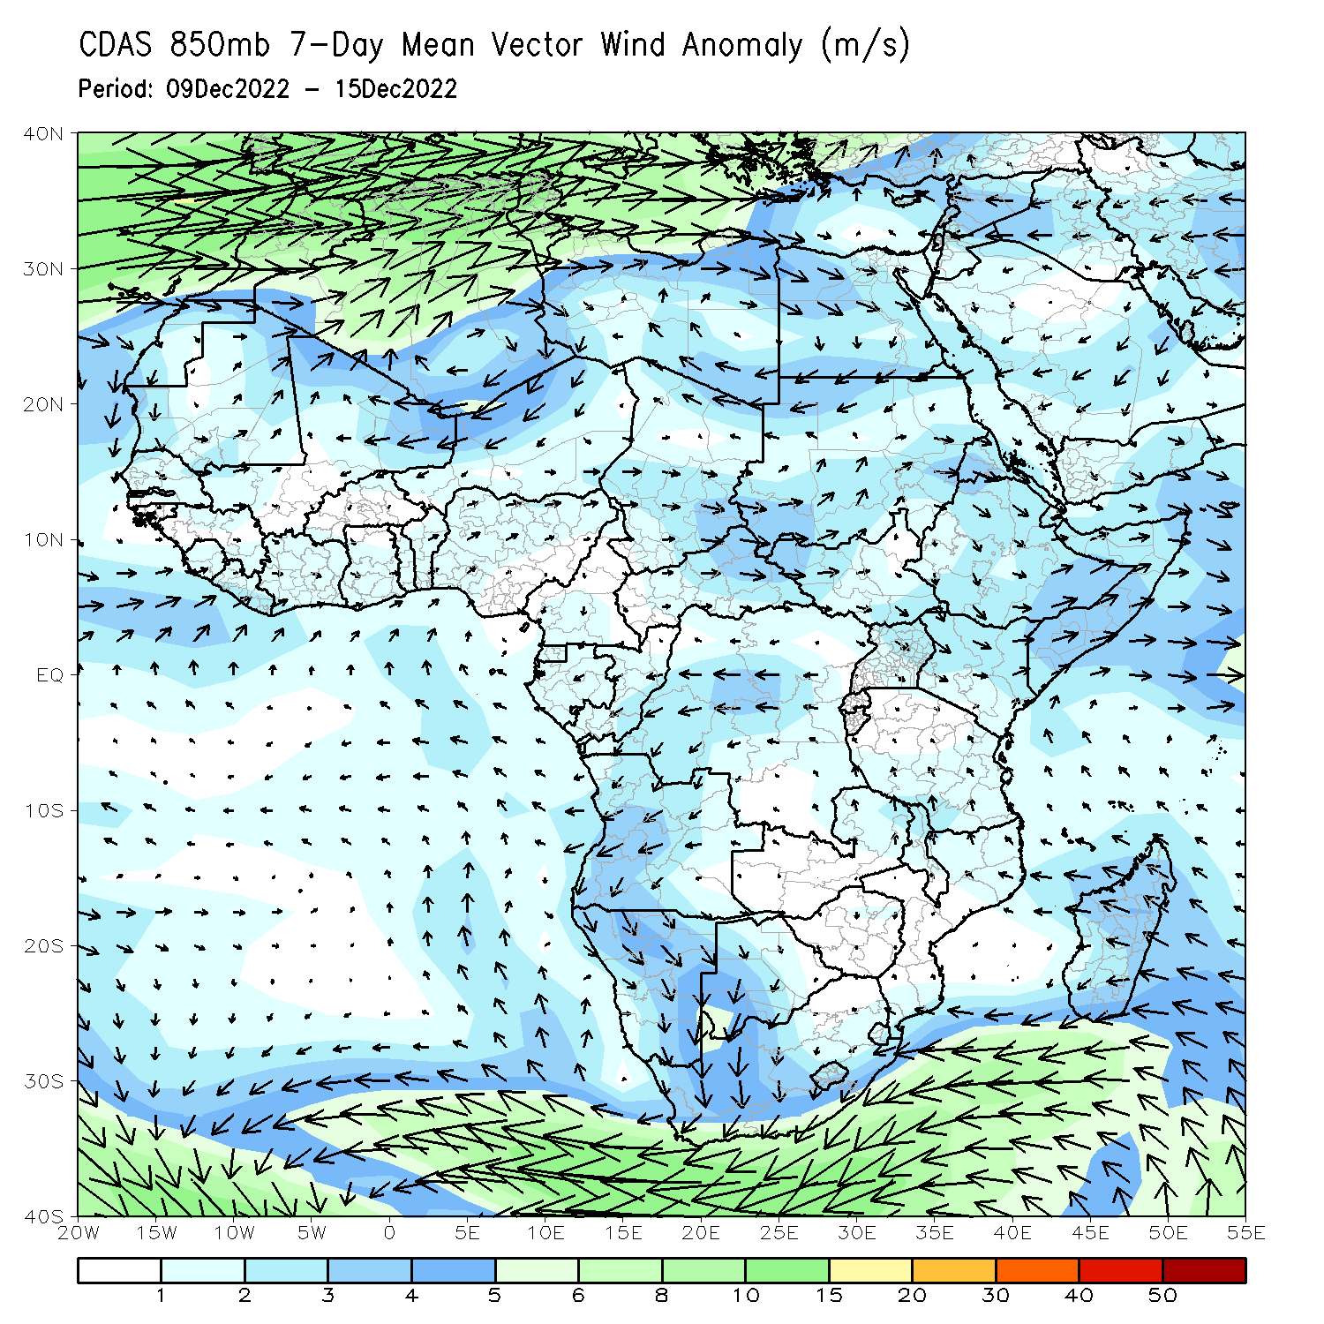
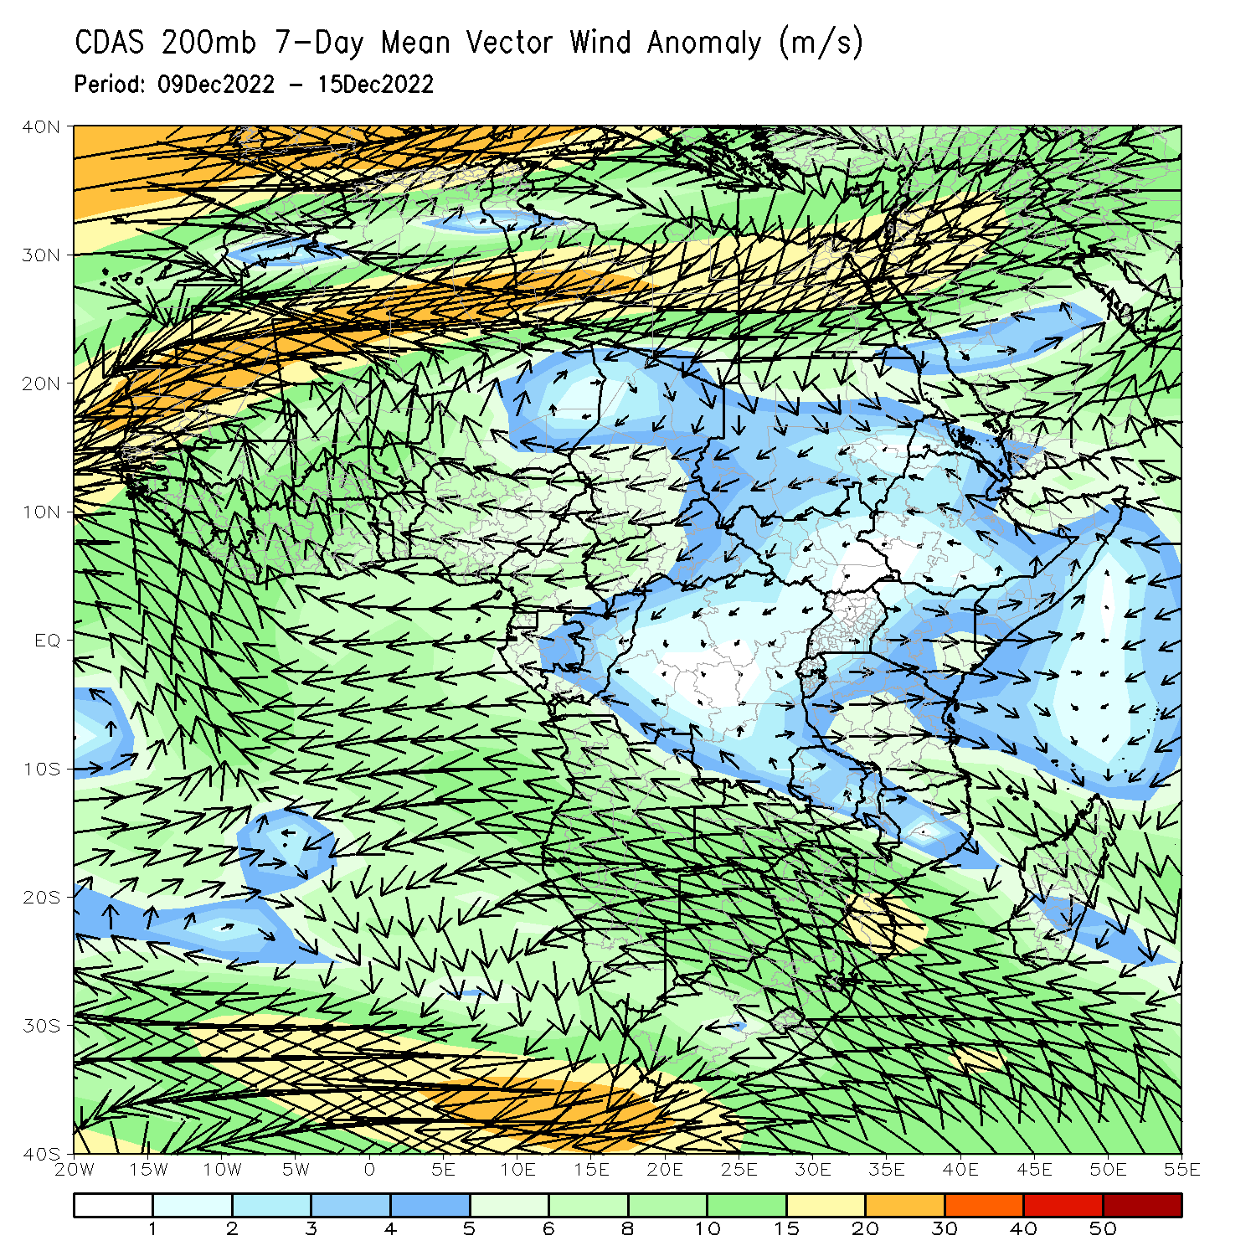
Atmospheric Circulation: Last 7 Days
At 850-hPa level (right panel), anomalous wind convergence may have contributed to the observed rainfall increases across South Africa and anomalous easterly flow was observed across Madagascar.

Slide 8
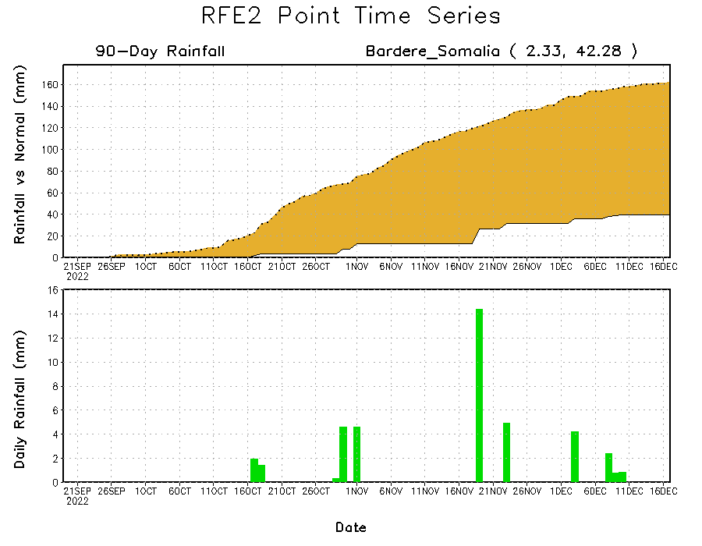
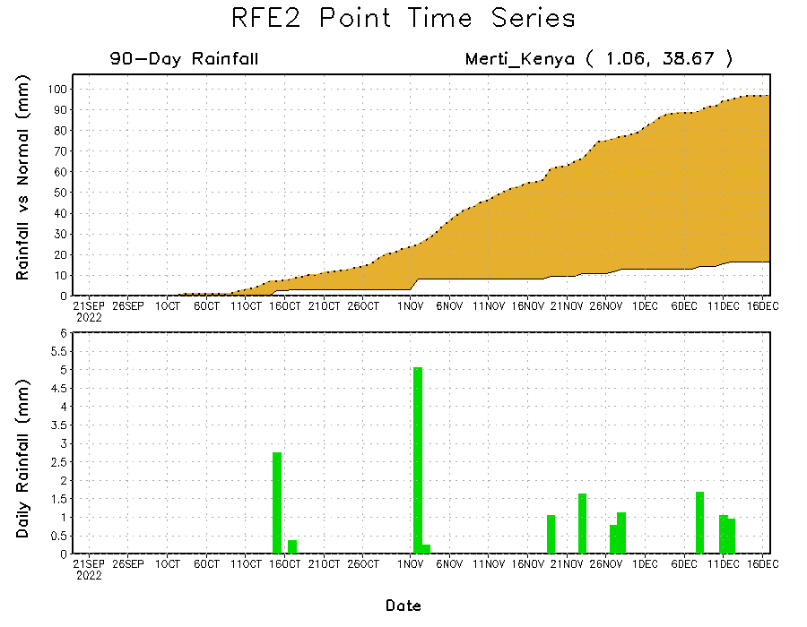
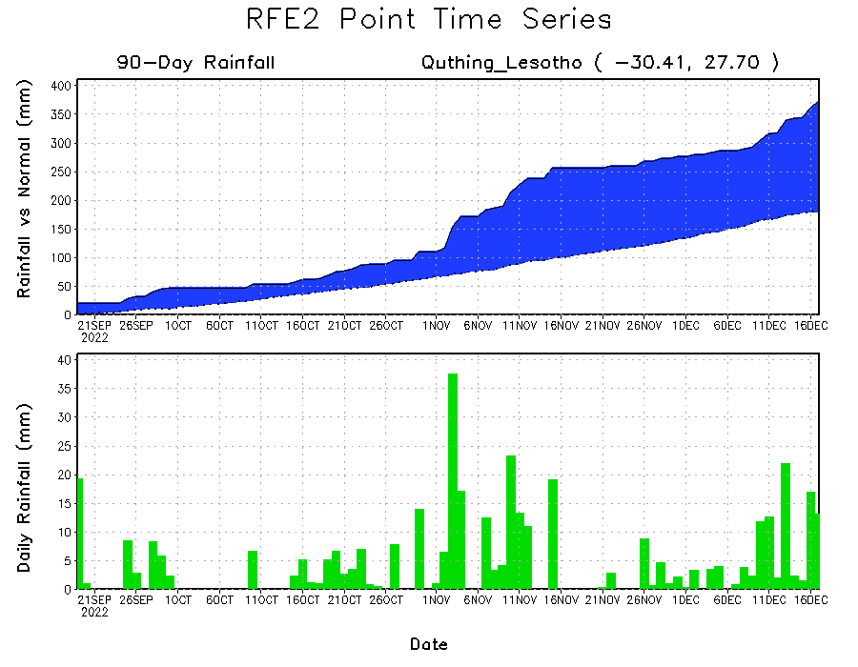
Rainfall Evolution
Daily evolution of rainfall over the last 90 days at selected locations shows continuing moisture surpluses over parts of Lesotho (bottom left). Rainfall deficits continue over eastern Kenya (bottom right) and southern Somalia (top right).

Slide 9
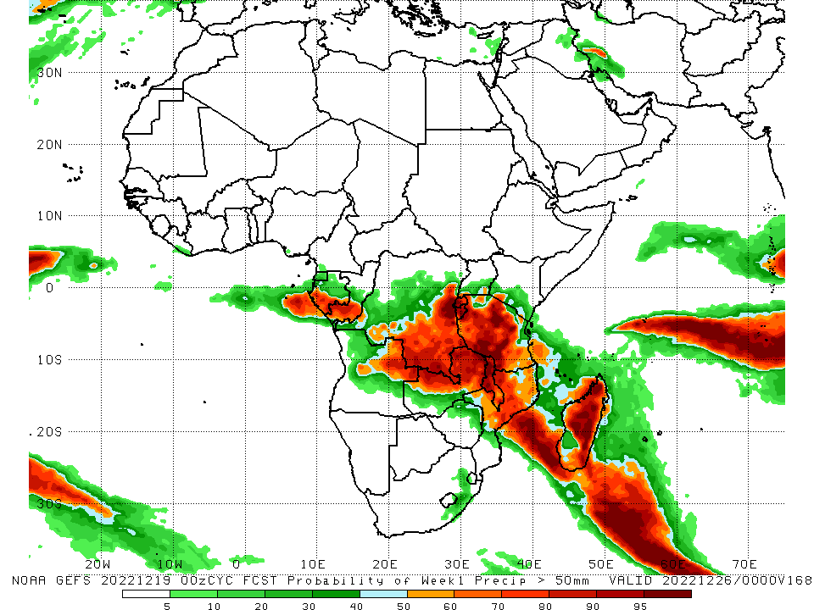
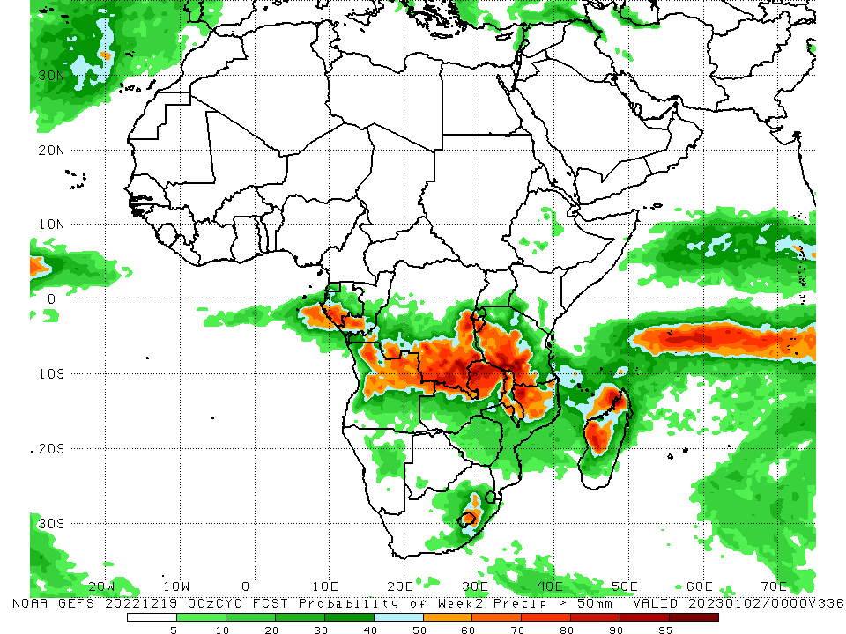
NCEP GEFS Model Forecasts Non-Bias Corrected Probability of precipitation exceedance
Week-1, Valid: 20 – 26 Dec 2022
Week-2, Valid: 27 Dec 2022 – 02 Jan 2023
For week-1 (left panel), the NCEP GEFS forecasts indicate a moderate to high chance (over 70%) for rainfall to exceed 50 mm over southern parts of Gabon and Congo, southern and eastern DRC, Rwanda, Burundi, much of Tanzania, Malawi, central Mozambique, northeast Angola, northwest and northern Zambia, and northern, central and eastern Madagascar. For week-2 (right panel), the NCEP GEFS forecasts indicate a moderate to high chance (over 70%) for rainfall to exceed 50 mm over southern parts of Gabon and Congo, southern and southeast DRC, Burundi, western and southern Tanzania, northeast Angola, northern parts of Zambia and Malawi, northwest Mozambique, and western and northwest Madagascar.
Notes:
9

Slide 10
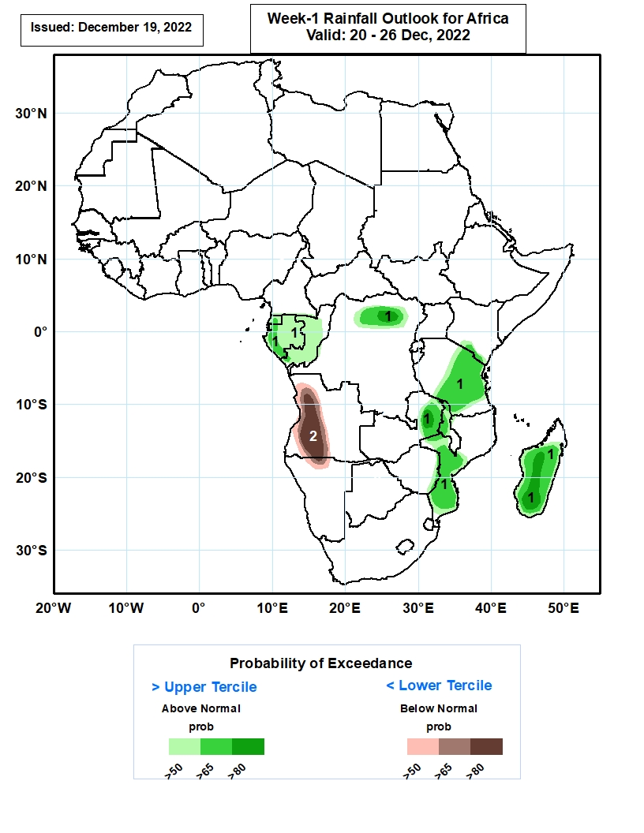
Week-1 Precipitation Outlooks
20 - 26 Dec 2022
The forecasts suggest above 50% chance for weekly rainfall to be above-normal (above the upper tercile) over much of Equatorial Guinea, Gabon and Congo, northern portions of DR Congo, southern parts of Kenya, central and eastern portions of Tanzania, northern Zambia, northern and middle portions of Malawi, middle and southern portions of Mozambique, and much of Madagascar. In particular, there is above 80% chance for rainfall to be above-normal over northern DR Congo and Zambia, and central portions of Madagascar.
The consolidated probabilistic forecasts suggest above 50% chance for weekly total rainfall to be below-normal (below the lower tercile) over western and central parts of Angola, and north-central Namibia. In particular, there is above 80% chance for rainfall to be below normal over western Angola.
Notes:
10

Slide 11
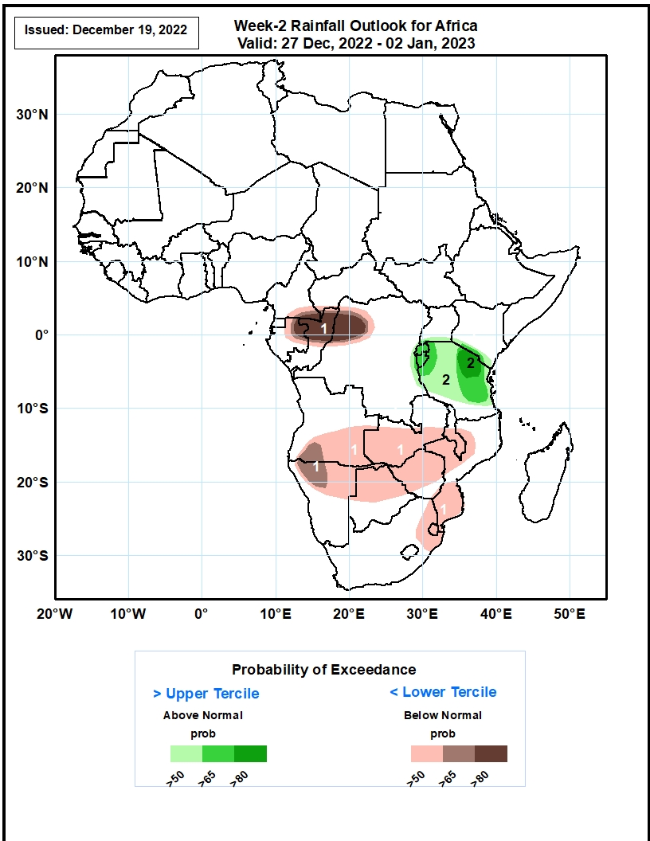
Week-2 Precipitation Outlooks
27 Dec 2022 – 02 Jan, 2023
The consolidated probabilistic forecasts suggest above 50% chance for weekly total rainfall to be below-normal (below the lower tercile) over southern Cameroon, southwestern CAR, eastern Gabon, northern and central portions of Congo, northwestern DR Congo, southern and eastern portions of Angola, central and southern parts of Zambia and Malawi, northern parts of Namibia, northern and central parts of Botswana and Zimbabwe, northern and southern parts of Mozambique, northern South Africa, and much of Eswatini. In particular, there is above 80% chance for rainfall to be below normal over northeastern Gabon, northern Congo, and northwestern DR Congo.
The forecasts suggest above 50% chance for weekly rainfall to be above-normal (above the upper tercile) over southern portions of Uganda and Kenya, eastern DR Congo, much of Rwanda, Burundi and Tanzania. In particular, there is above 80% chance for rainfall to be above-normal over south-central Kenya, and northern Tanzania.
Notes:
11

Slide 12
Summary
During the past 30 days, in East Africa, above-average rainfall was observed over Uganda, pockets of central Kenya and Somalia, and southwest Ethiopia, western and northeast Tanzania, Rwanda, Burundi, and southeast South Sudan. Rainfall was below-average over central South Sudan, central and southern Ethiopia, southern Somalia, many parts of Kenya, and parts of central, northern, and southern Tanzania. In Central Africa, rainfall was above-average over northeast Gabon, southeast Cameroon, many parts of Congo and DRC. Rainfall was below-average over western and southern Gabon, eastern Equatorial Guinea, western and central Cameroon, southern CAR, pockets of central Congo, and pockets of central and in for southern DRC. In West Africa, rainfall was above-average over eastern Liberia, southern parts of Cote d’Ivoire, Ghana, Togo and Benin, and pockets of central Mali. In contrast, below-average rainfall was observed over southern Nigeria and central parts of Ghana and Liberia and pockets of southeast Guinea. In southern Africa, above-average rainfall was observed over northwestern and western Angola, South Africa, Lesotho, Eswatini, pockets of central Namibia, southern Mozambique, northern Zambia and southwest Madagascar, and central and southern Botswana. Below normal precipitation was observed over central, eastern and southern Angola, northern Namibia, western, central and southern Zambia, Malawi, Zimbabwe, central and northern Mozambique and northwest, central and southeast Madagascar.
During the past 7 days, in East Africa, rainfall was above-average over pockets of central Ethiopia, southeast Kenya and northwest and western Tanzania, and Uganda. Below-average rainfall was observed over pockets of central Kenya and central, northeast and southern Tanzania. In Central Africa, rainfall was above-average over Equatorial Guinea, northern and eastern Gabon, southern Cameroon, southwest CAR, and many parts of Congo and DRC. Below-average rainfall was observed over pockets of central Congo and central and southeast DRC. In West Africa, above-average rainfall was observed over pockets of southern Cote D’Ivoire and southwest Ghana. In southern Africa, rainfall was above-average over northeast and southern Angola, northern, northeast and central Namibia, much of Botswana, South Africa, Lesotho and Eswatini, southern Mozambique, northern Zambia, central and eastern Madagascar. In contrast, rainfall was below-average over Zimbabwe, western, southern and central Zambia, pockets of central and southeast Angola, central and northern Mozambique, many parts of Malawi, and northern and northwest Madagascar.
Week-1 outlook calls for an increased chance for above-average rainfall over Equatorial Guinea, Gabon, Congo, western, central, southern and eastern DRC, Rwanda, Burundi, Tanzania, southern parts of Uganda and Kenya, northeast Angola, Malawi, central Mozambique, and central, southern and eastern Madagascar. In contrast, there is an increased chance for below-average rainfall over Zimbabwe, Botswana, western and southern Angola, northeast Namibia, western, central, northern and eastern South Africa, Lesotho, Eswatini, southern Mozambique, Liberia, and southern parts of Cote D’Ivoire and Ghana. Week-2 outlook suggests an increased chance for above-average rainfall over Equatorial Guinea, Gabon, southern Congo, southern and southeast DRC, Rwanda, Burundi, western and central Tanzania, northern Angola, central Namibia, southwest Botswana, western, central and eastern South Africa, and Lesotho, while below-average rainfall is likely over the central DRC, central and eastern Kenya, eastern Tanzania, southern Angola, western, southern and central Zambia, northern and eastern Botswana, Zimbabwe, central and southern Mozambique, Malawi, southern, eastern and northern Madagascar, Liberia, and southern parts of Cote D’Ivoire and Ghana.

