Slide 1
The African Monsoon Recent Evolution and Current Status Include Week-1 and Week-2 Outlooks
Update prepared by
27 December 2022
For more information, visit:
http://www.cpc.ncep.noaa.gov/products/Global_Monsoons/African_Monsoons/precip_monitoring.shtml

Slide 2
Outline
Highlights
Recent Evolution and Current Conditions
NCEP GEFS Forecasts
Summary

Slide 3
Highlights: Last 7 Days
During the past 7 days, in East Africa, rainfall was above-average over pockets of southwest Ethiopia, northern Sudan and southwest Kenya, southern Uganda, and northeast, southern, and eastern Tanzania. Below-average rainfall was observed over pockets of southeast Kenya. In Central Africa, rainfall was above-average over eastern Gabon, central and southern parts of Congo, pockets of western, central and southeast DRC. Below-average rainfall was observed over pockets of southeast Gabon and southwest and eastern DRC. In West Africa, above-average rainfall was observed over pockets of eastern Liberia. In southern Africa, rainfall was above-average over pockets of northeast Angola, central Namibia, eastern Eswatini, and central and northeast Africa, Malawi, northern and central Mozambique, northwest, central and eastern Zambia, and southern, eastern and northern Madagascar. In contrast, rainfall was below-average over northern, western and southern Angola, northeast Namibia, southwest Zambia, northern, central and eastern Botswana, western, central and eastern Zimbabwe, northwest and northern South Africa, southern Mozambique, and western Madagascar.
Week-1 outlook calls for an increased chance for above-average rainfall over southern Congo, southwest, southern and eastern DRC, Rwanda, Burundi, western Tanzania, southern Uganda, northern Zambia, northern and northeast Angola, central and southeast Namibia, central and eastern South Africa, and Lesotho. In contrast, there is an increased chance for below-average rainfall over Equatorial Guinea, northern and eastern Gabon, central Congo, western DRC, northeast and eastern Tanzania, southeast Angola, northeast Namibia, southern Zambia, northern and eastern Botswana, Zimbabwe, central and southern Mozambique, and northern and eastern Madagascar. Week-2 outlook suggests an increased chance for above-average rainfall over Equatorial Guinea, Gabon, Congo, western and central DRC, Angola, northern and eastern Namibia, Botswana, Zimbabwe, southern Mozambique, northern, central and eastern South Africa, Eswatini, Lesotho, and southeast Kenya, while below-average rainfall is likely over northern Mozambique, Malawi, Tanzania, Burundi, and northern Madagascar.

Slide 4
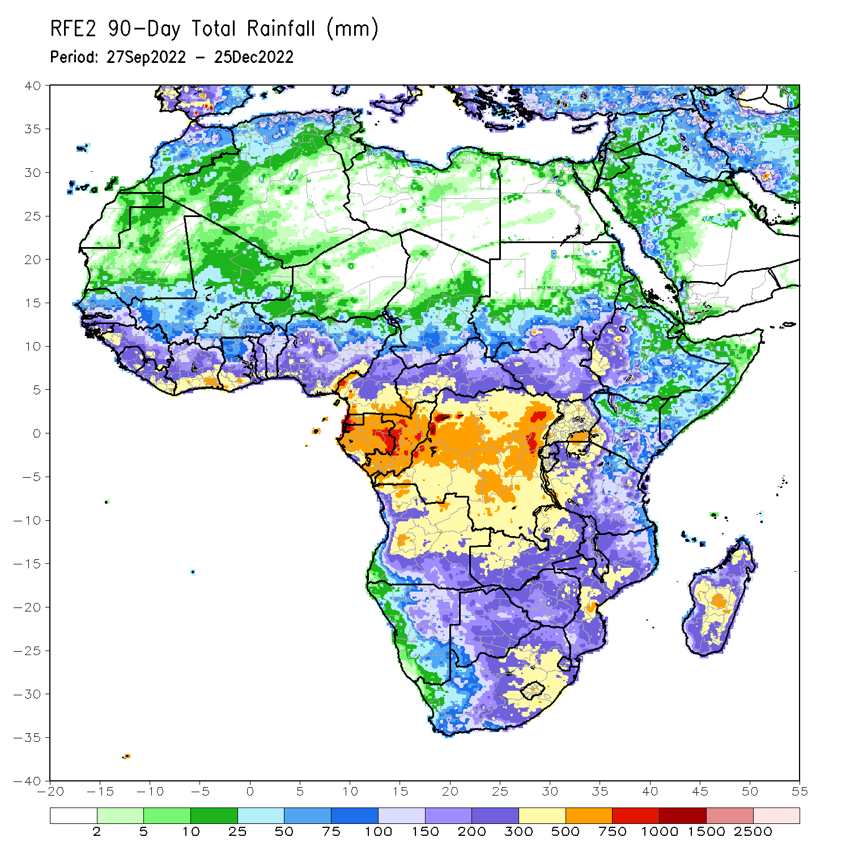
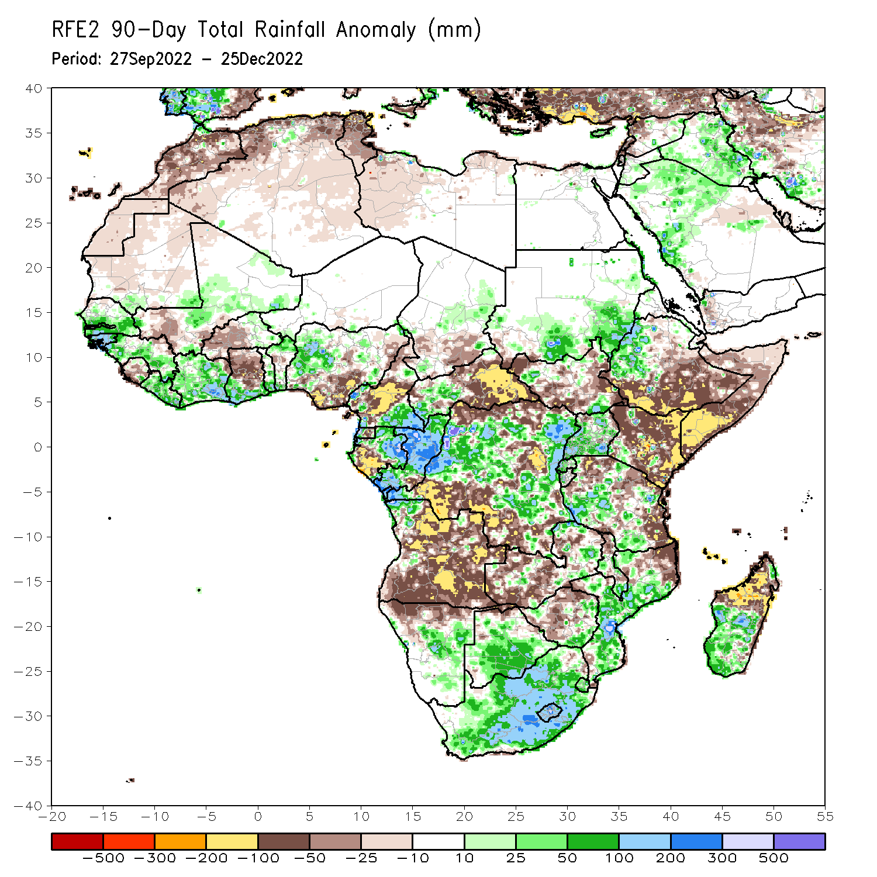
Rainfall Patterns: Last 90 Days
Over the past 90 days, in East Africa, above-average rainfall was observed over the southern and southeast parts of Sudan, pockets of western and southeast South Sudan, western Ethiopia, southern and northern Eritrea, many parts of Uganda, Rwanda, and pockets of southwest and southern Tanzania. Rainfall was below-average over southern and eastern Ethiopia, throughout much of Somalia, much of Kenya, northwest, southwest, central and eastern South Sudan, and northern and eastern Tanzania. In southern Africa, above-average rainfall was observed over central and southern Botswana, South Africa, Lesotho, Eswatini, southern and eastern Zimbabwe, eastern Zambia, central and southern Mozambique, northwest Angola, central Namibia, and southwest and central parts of Madagascar. Below-average rainfall was observed over many parts of Angola and Zambia, northern Namibia, western and northern Zimbabwe, northeast Mozambique, northern Malawi, and northwest and northern Madagascar. In Central Africa, rainfall was above-average over southeast Cameroon, central Chad, western CAR, eastern and northern Gabon, much of Congo, and parts of western and eastern DRC. Rainfall was below-average over western Cameroon and Gabon, eastern CAR, southern Chad, and parts of northern, central and southwest DRC. In West Africa, rainfall was above-average over southern Mauritania, southern and eastern Senegal, Gambia, Guinea-Bissau, western, southern and eastern Guinea, Liberia, Cote D’Ivoire, southern parts of Ghana and Togo, southern and northern Benin, eastern Burkina Faso, central Mali, and western Nigeria. In contrast, below-average rainfall was observed over northern Mauritania, northeast Guinea, western Mali, Sierra Leone, central and northern Ghana, western Burkina Faso, and southeastern Nigeria.
Notes:
4

Slide 5
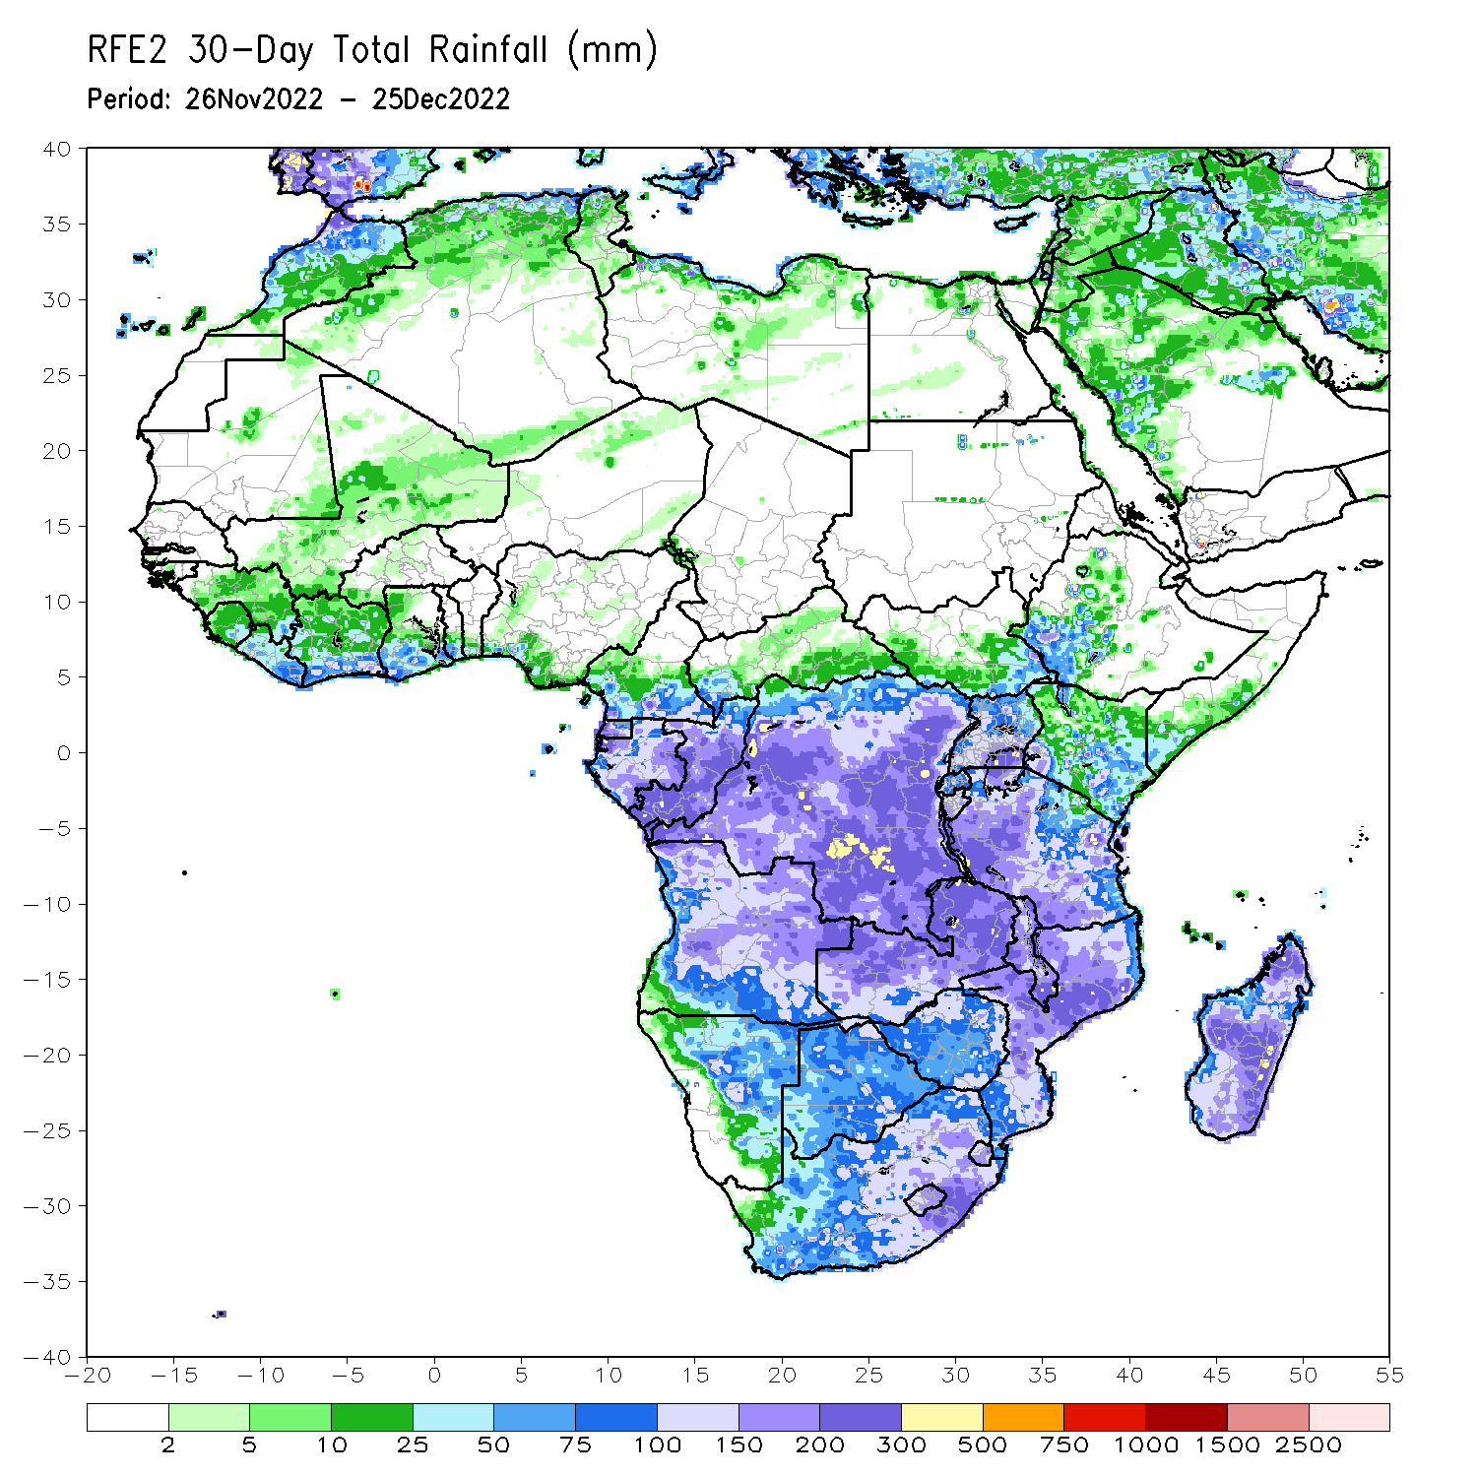
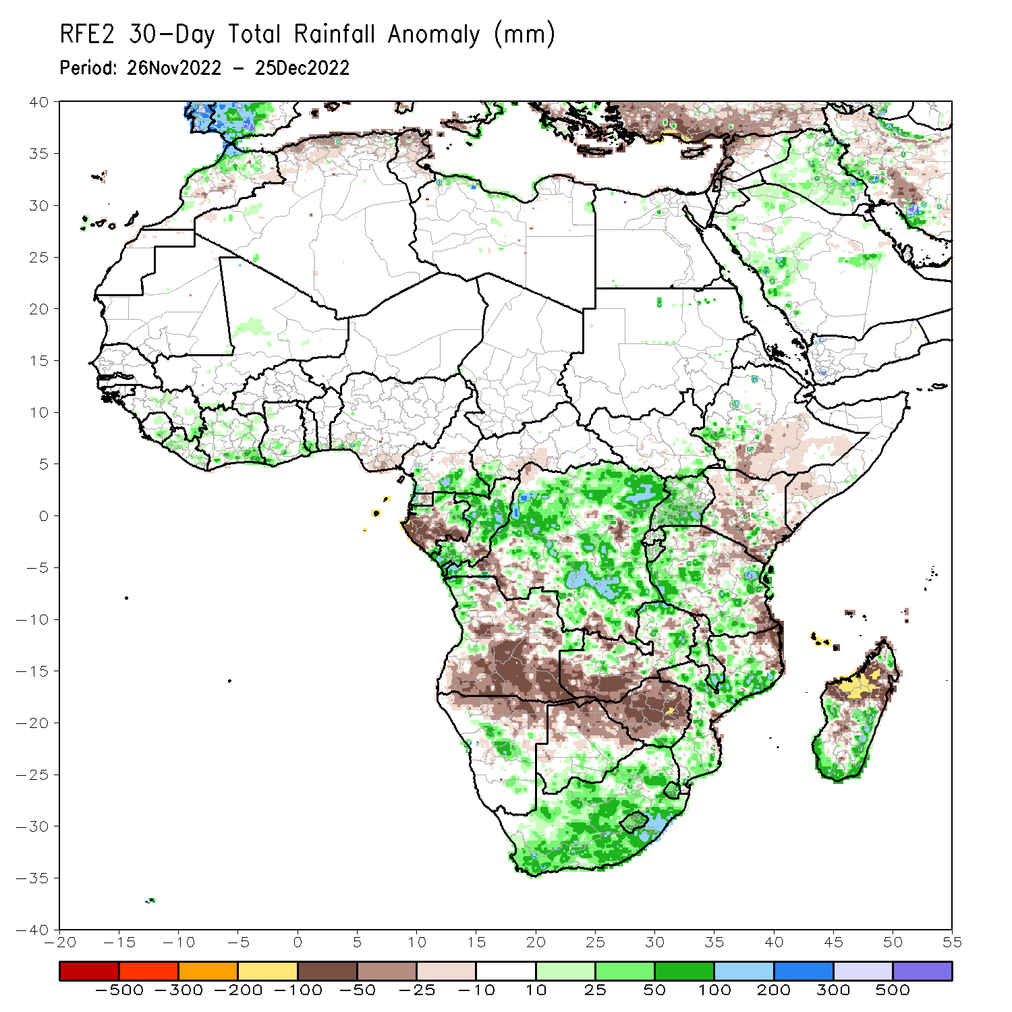
Rainfall Patterns: Last 30 Days
During the past 30 days, in East Africa, above-average rainfall was observed over Uganda, pockets of central Kenya and southwest Ethiopia, western, southern and northeast Tanzania, Rwanda, Burundi, and southeast South Sudan. Rainfall was below-average over southern and southeast Ethiopia, southern Somalia, many parts of Kenya, and parts of northeast and southeast Tanzania. In Central Africa, rainfall was above-average over northeast Gabon, southeast Cameroon, many parts of Congo and DRC. Rainfall was below-average over western and southern Gabon, eastern Equatorial Guinea, central Cameroon, southern CAR, pockets of central Congo, and pockets of central and southwest DRC. In West Africa, rainfall was above-average over Liberia, many parts of Cote d’Ivoire, southern parts of Ghana and Togo, eastern parts of Sierra Leone and Guinea, and pockets of central Mali. In contrast, below-average rainfall was observed over southeast Nigeria. In southern Africa, above-average rainfall was observed over northwest Angola, South Africa, Lesotho, Eswatini, pockets of central Namibia, central and southern Mozambique and Malawi, northern Zambia, southern Botswana, and southern and eastern Madagascar. Below normal precipitation was observed over central, eastern and southern Angola, northern Namibia, western and southern Zambia, northeast parts of Malawi and Mozambique, many parts of Zimbabwe, northern and eastern Botswana, and northwest, northern and central Madagascar.
Notes:
5

Slide 6
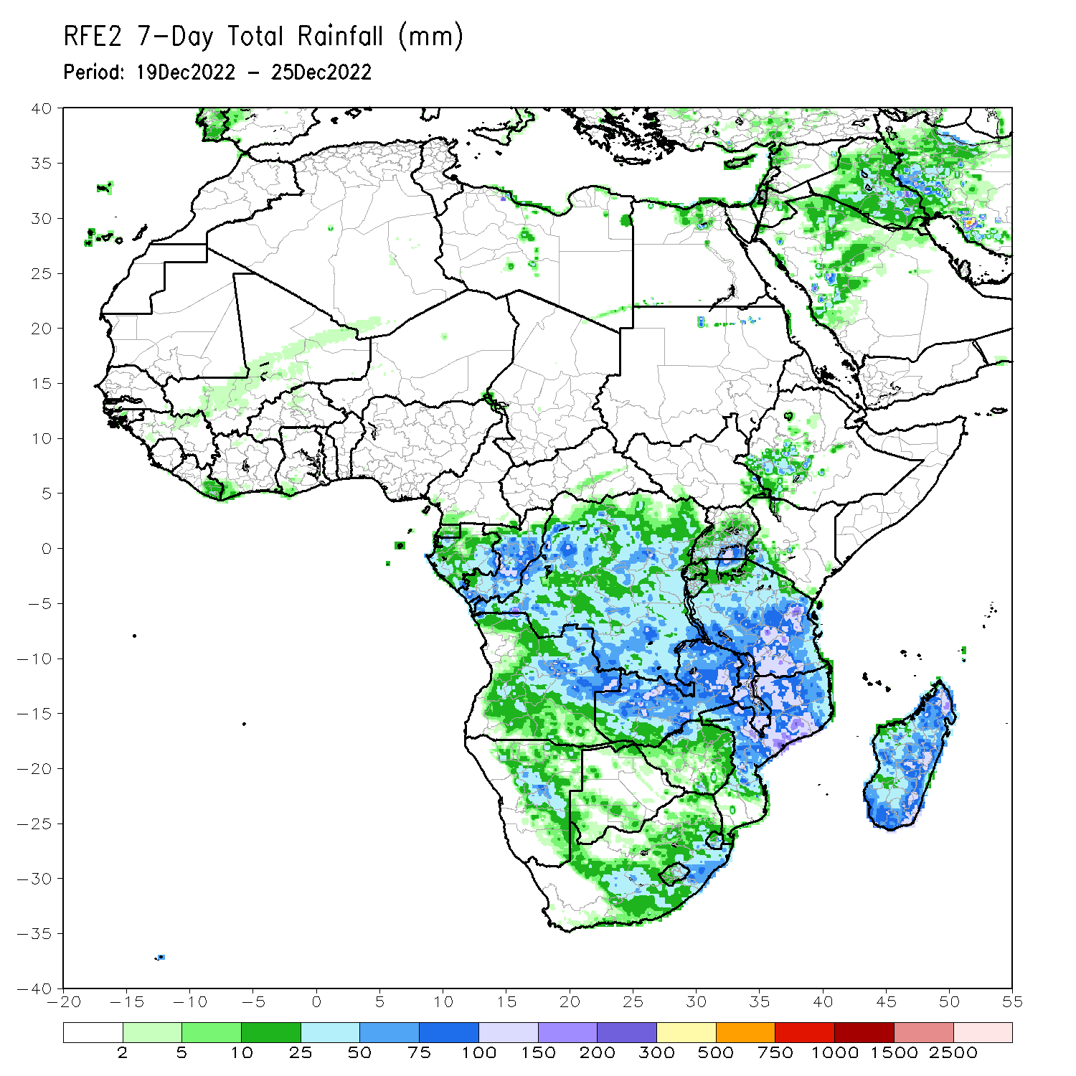
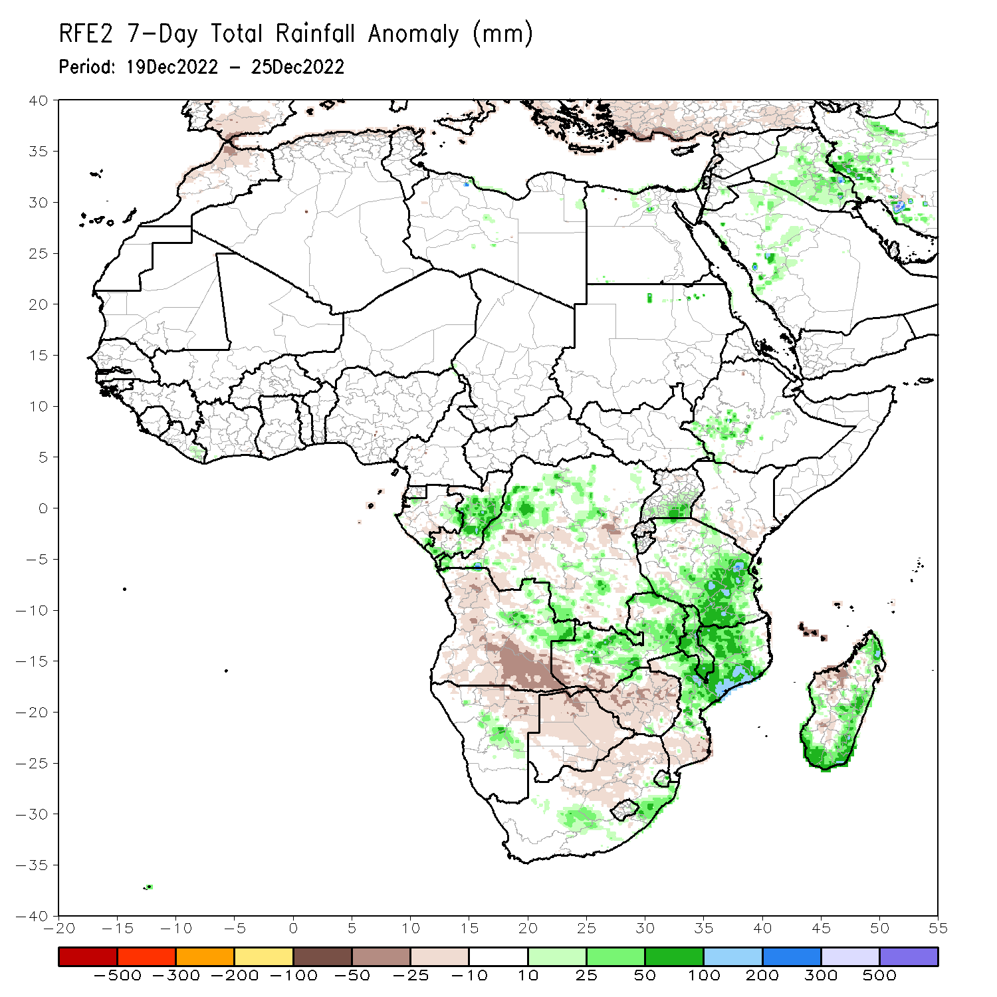
Rainfall Patterns: Last 7 Days
During the past 7 days, in East Africa, rainfall was above-average over pockets of southwest Ethiopia, northern Sudan and southwest Kenya, southern Uganda, and northeast, southern, and eastern Tanzania. Below-average rainfall was observed over pockets of southeast Kenya. In Central Africa, rainfall was above-average over eastern Gabon, central and southern parts of Congo, pockets of western, central and southeast DRC. Below-average rainfall was observed over pockets of southeast Gabon and southwest and eastern DRC. In West Africa, above-average rainfall was observed over pockets of eastern Liberia. In southern Africa, rainfall was above-average over pockets of northeast Angola, central Namibia, eastern Eswatini, and central and northeast Africa, Malawi, northern and central Mozambique, northwest, central and eastern Zambia, and southern, eastern and northern Madagascar. In contrast, rainfall was below-average over northern, western and southern Angola, northeast Namibia, southwest Zambia, northern, central and eastern Botswana, western, central and eastern Zimbabwe, northwest and northern South Africa, southern Mozambique, and western Madagascar.

Slide 7
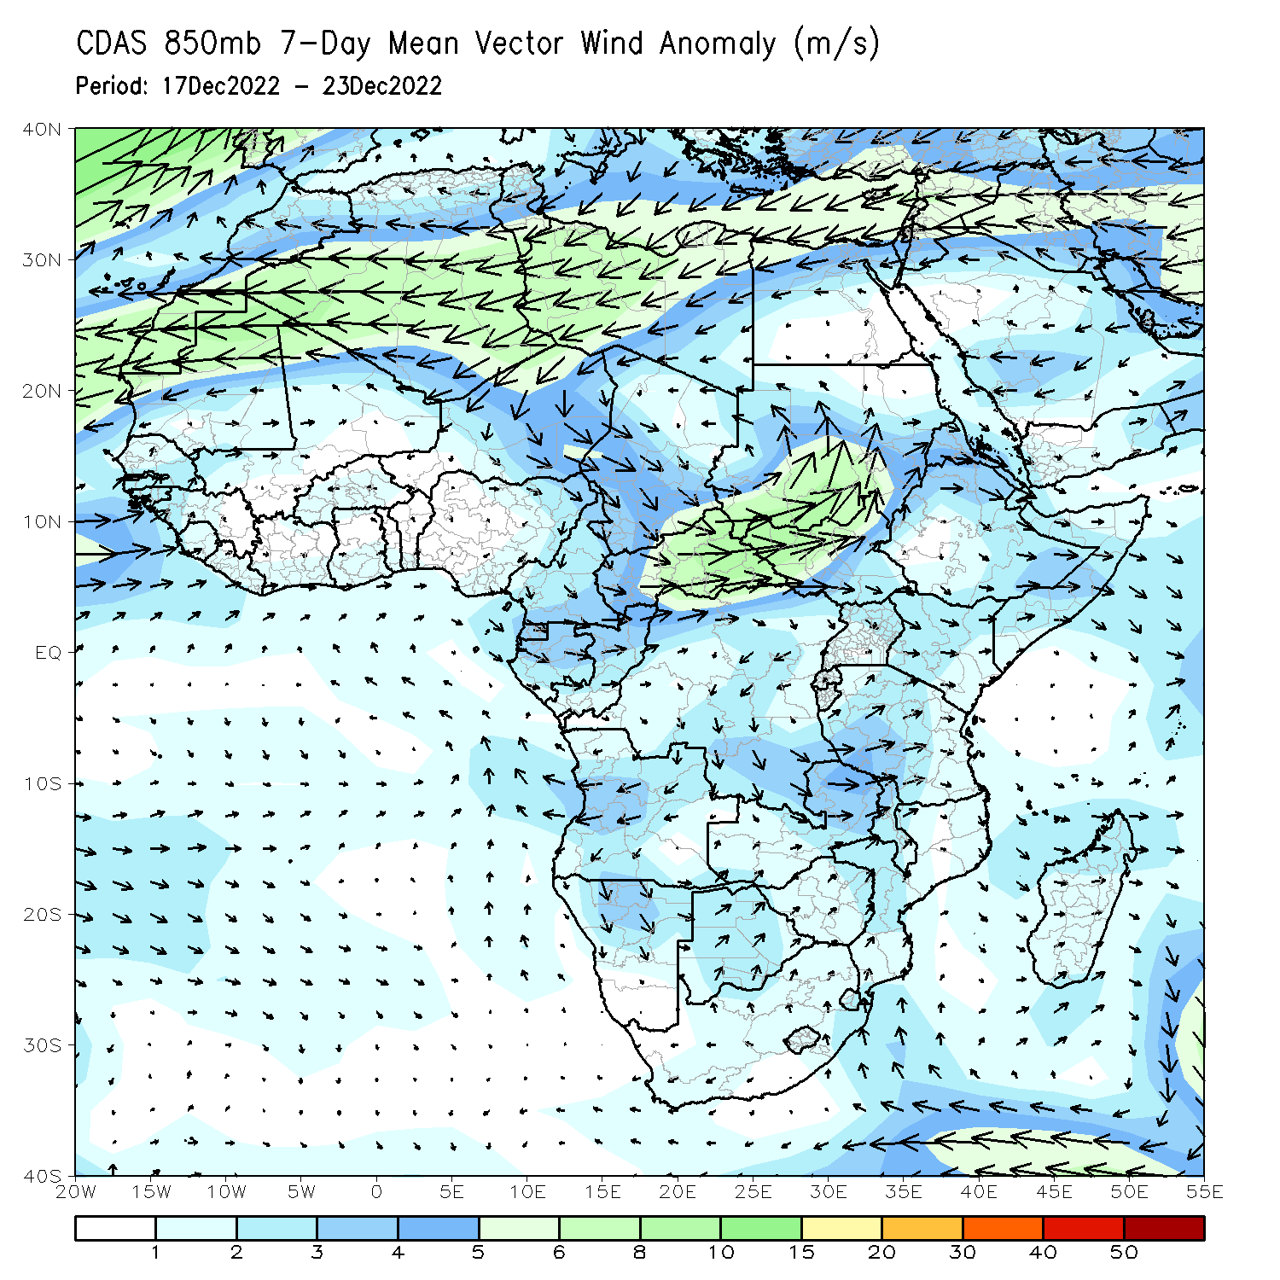
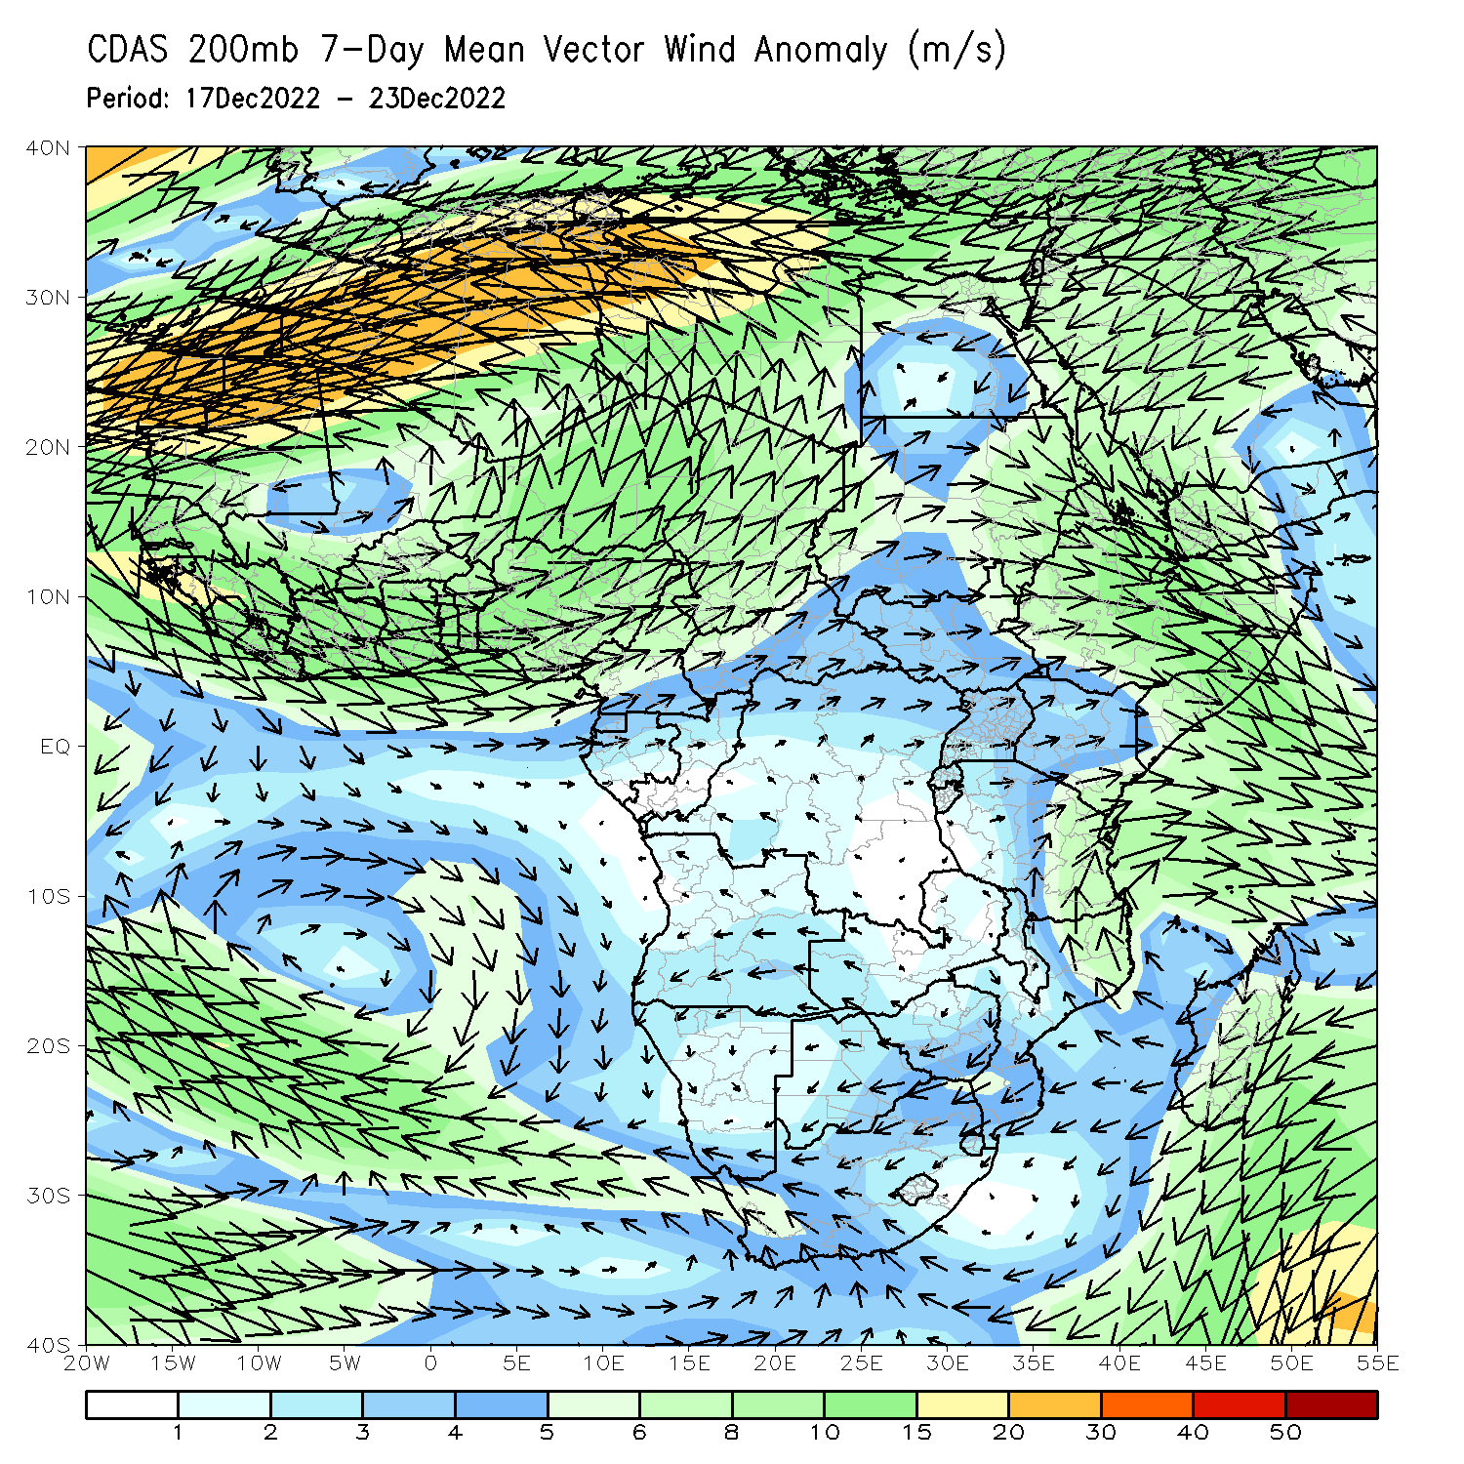
Atmospheric Circulation: Last 7 Days
At 850-hPa level (right panel), anomalous wind convergence may have contributed to the observed rainfall increases across northern Zambia, Malawi, southern Tanzania, and central and northern Mozambique, and anomalous westerly flow was observed across Madagascar.

Slide 8
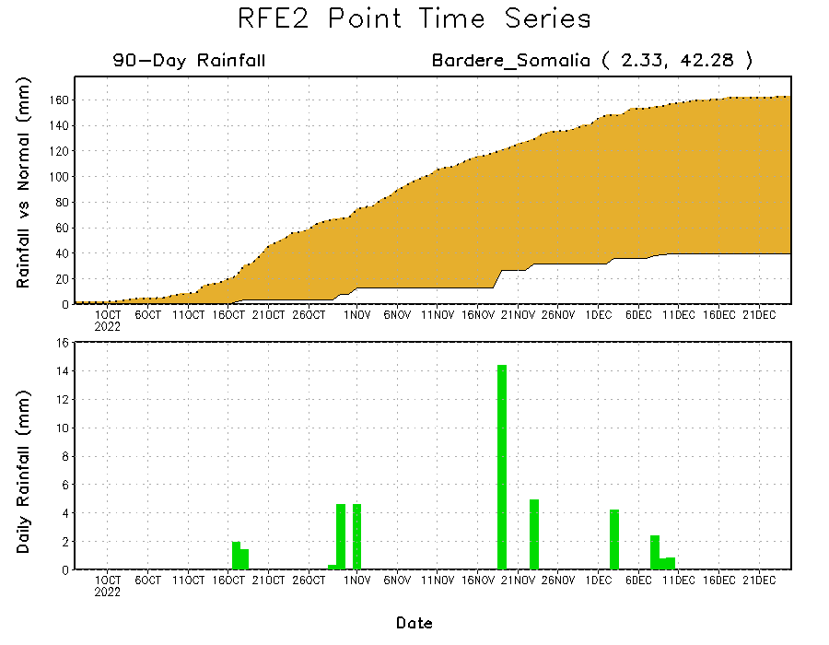
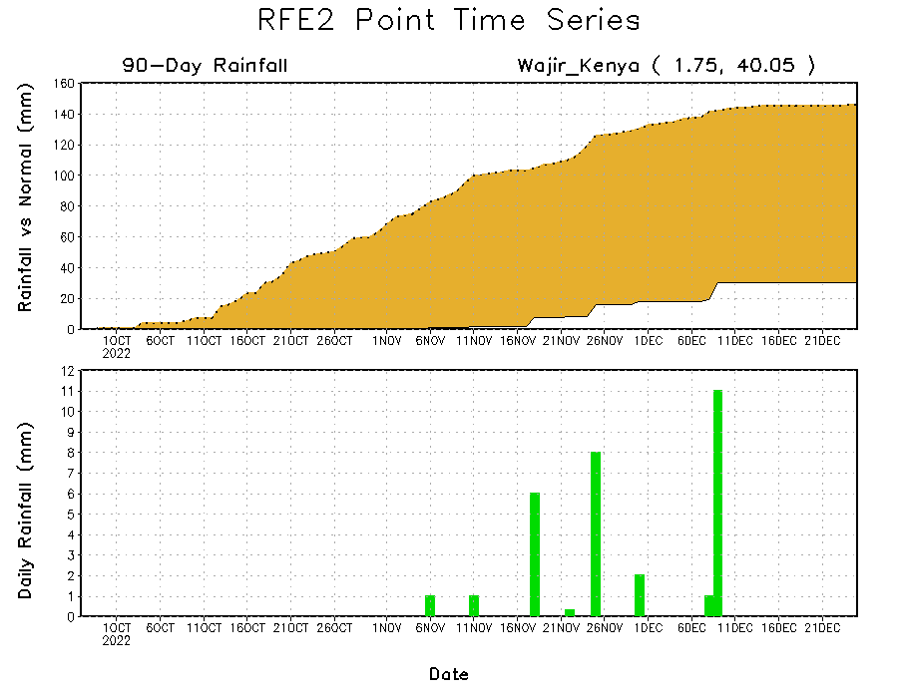
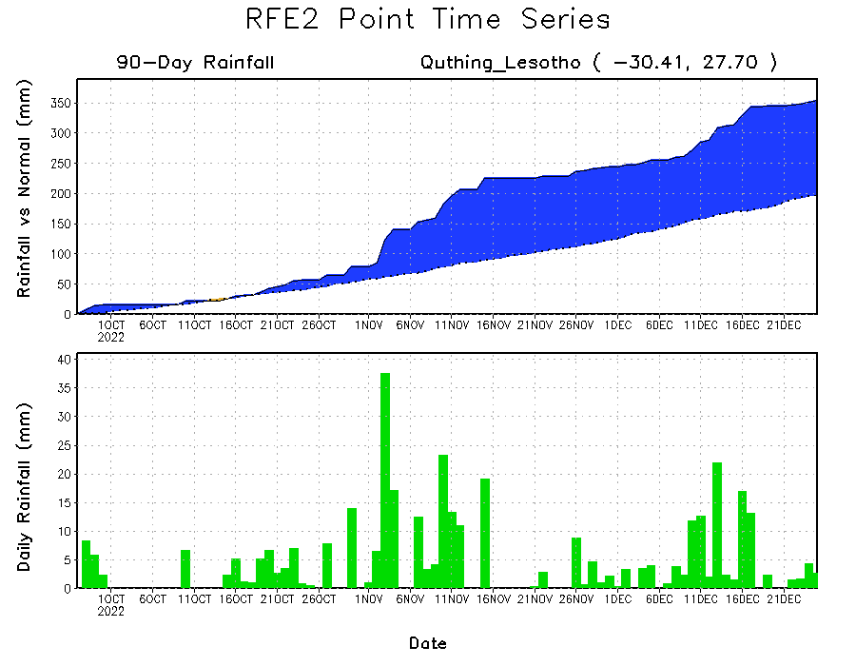
Rainfall Evolution
Daily evolution of rainfall over the last 90 days at selected locations shows continuing moisture surpluses over parts of Lesotho (bottom left). Rainfall deficits continue over eastern Kenya (bottom right) and southern Somalia (top right).

Slide 9
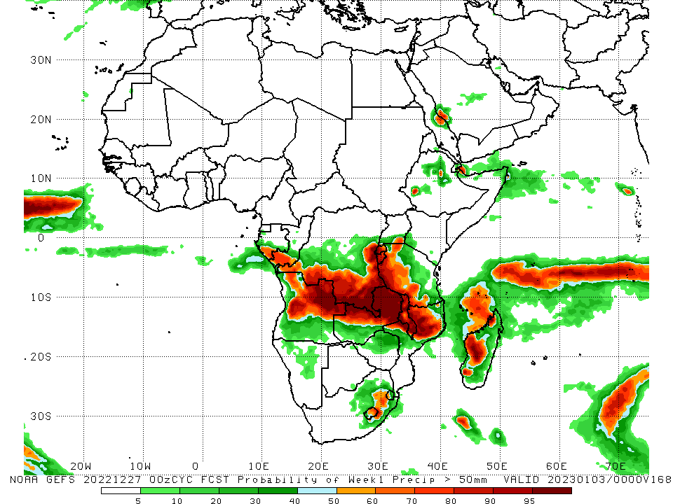
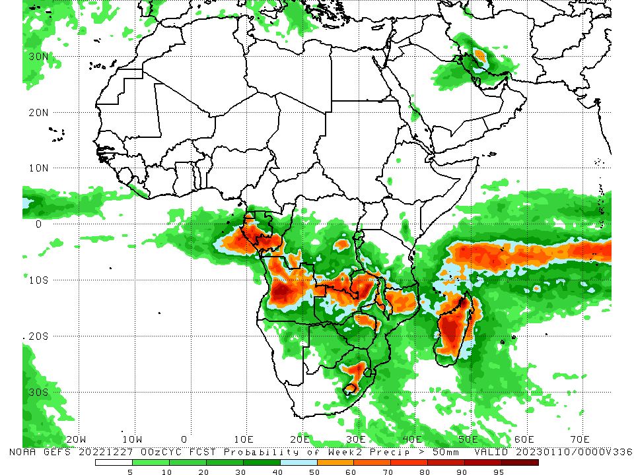
NCEP GEFS Model Forecasts Non-Bias Corrected Probability of precipitation exceedance
Week-1, Valid: 28 Dec 2022 – 03 Jan 2023
Week-2, Valid: 04 – 10 Jan 2023
For week-1 (left panel), the NCEP GEFS forecasts indicate a moderate to high chance (over 70%) for rainfall to exceed 50 mm over southern parts of Gabon and Congo, southern and eastern DRC, Rwanda, Burundi, western Tanzania, Malawi, parts of central and northwest Mozambique, northeast and central Angola, northwest, central, and northern Zambia, and western Madagascar. For week-2 (right panel), the NCEP GEFS forecasts indicate a moderate to high chance (over 70%) for rainfall to exceed 50 mm over southern parts of Gabon and Congo, southeast DRC, central Angola, northern parts of Zambia, and central, western and northwest parts of Madagascar.
Notes:
9

Slide 10
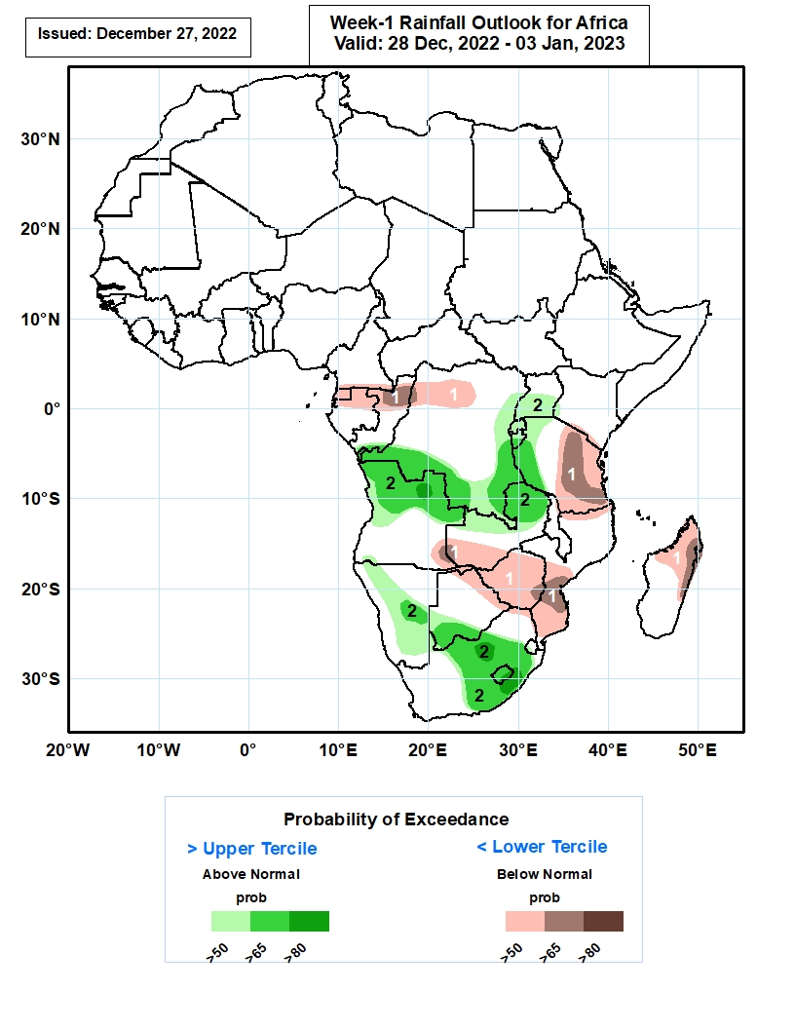
Week-1 Precipitation Outlooks
28 Dec 2022 - 03 Jan 2022
The consolidated probabilistic forecasts suggest above 50% chance for weekly total rainfall to be below-normal (below the lower tercile) over much of Equatorial Guinea, northern parts of Gabon and Congo, northern portions of DR Congo, southern parts of Kenya, central and eastern parts of Tanzania, southeastern Angola, southern Zambia, northern and eastern portions of Botswana, much of Zimbabwe, northern and southern parts of Mozambique, and northern and eastern portions of Madagascar. In particular, there is above 65% chance for rainfall to be below normal over northern Congo, central parts of Tanzania, southeastern Angola, southern parts of Mozambique and eastern coast of Madagascar.
The forecasts suggest above 50% chance for weekly rainfall to be above-normal (above the upper tercile) over southern Congo, western, southern and eastern parts of DR Congo, northern and central parts of Angola, northern parts of Zambia, central and southern parts of Uganda, much of Rwanda and Burundi, western Tanzania, central and eastern parts of Namibia, southwestern Botswana, central and eastern parts of South Africa, much of Lesotho and western Eswatini. In particular, there is above 80% chance for rainfall to be above-normal over northern Angola, northern and southern parts of South Africa, and southern parts of Lesotho.
Notes:
10

Slide 11
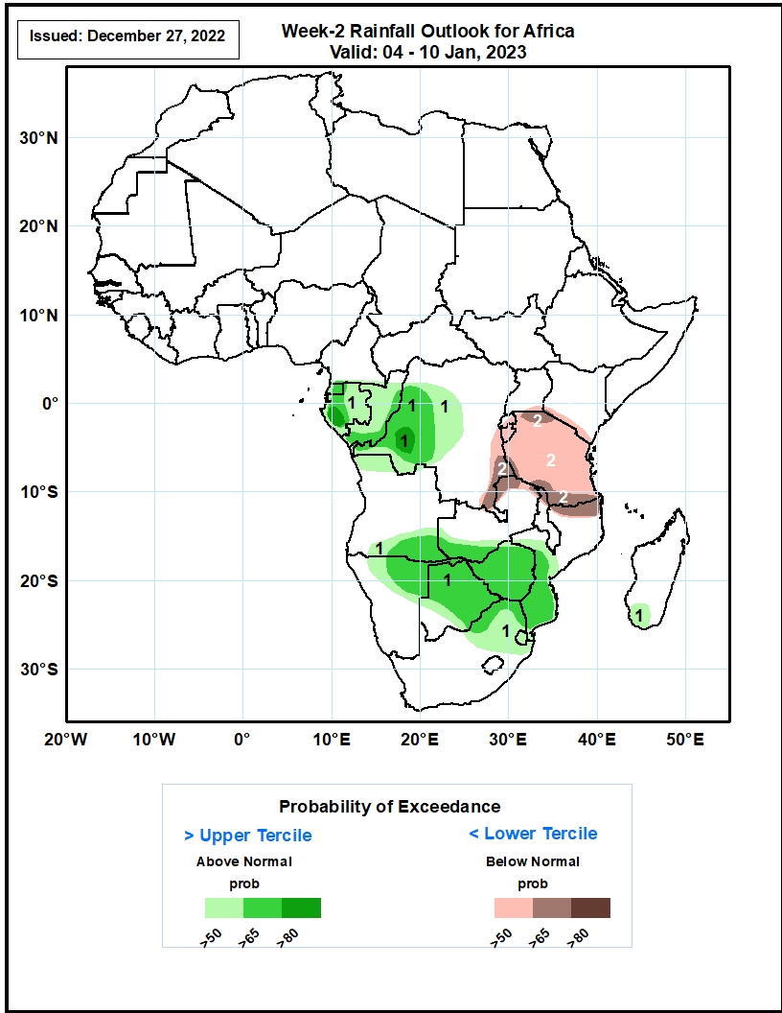
Week-2 Precipitation Outlooks
04 – 10 Jan, 2023
The forecasts suggest above 50% chance for weekly rainfall to be above-normal (above the upper tercile) over much of Equatorial Guinea, Gabon, Congo, western and central parts of DR Congo, southeastern Angola, southern Zambia, northern and eastern parts of Namibia, much of Botswana and Zimbabwe, central and southern parts of Mozambique, northern parts of South Africa, much of Eswatini, and southwestern Madagascar. In particular, there is above 80% chance for rainfall to be above-normal over western Gabon and DR Congo.
The consolidated probabilistic forecasts suggest above 50% chance for weekly total rainfall to be below-normal (below the lower tercile) over western and southern parts of Tanzania, much of Rwanda, Burundi and Tanzania, southeastern Uganda, southern parts of Kenya, northern portions of Zambia, Malawi and Mozambique. In particular, there is above 65% chance for rainfall to be below normal over southern DR Congo, northern Zambia, northern and southern parts of Tanzania, and northern portions of Mozambique.
Notes:
11

Slide 12
Summary
During the past 30 days, in East Africa, above-average rainfall was observed over Uganda, pockets of central Kenya and southwest Ethiopia, western, southern and northeast Tanzania, Rwanda, Burundi, and southeast South Sudan. Rainfall was below-average over southern and southeast Ethiopia, southern Somalia, many parts of Kenya, and parts of northeast and southeast Tanzania. In Central Africa, rainfall was above-average over northeast Gabon, southeast Cameroon, many parts of Congo and DRC. Rainfall was below-average over western and southern Gabon, eastern Equatorial Guinea, central Cameroon, southern CAR, pockets of central Congo, and pockets of central and southwest DRC. In West Africa, rainfall was above-average over Liberia, many parts of Cote d’Ivoire, southern parts of Ghana and Togo, eastern parts of Sierra Leone and Guinea, and pockets of central Mali. In contrast, below-average rainfall was observed over southeast Nigeria. In southern Africa, above-average rainfall was observed over northwest Angola, South Africa, Lesotho, Eswatini, pockets of central Namibia, central and southern Mozambique and Malawi, northern Zambia, southern Botswana, and southern and eastern Madagascar. Below normal precipitation was observed over central, eastern and southern Angola, northern Namibia, western and southern Zambia, northeast parts of Malawi and Mozambique, many parts of Zimbabwe, northern and eastern Botswana, and northwest, northern and central Madagascar.
During the past 7 days, in East Africa, rainfall was above-average over pockets of southwest Ethiopia, northern Sudan and southwest Kenya, southern Uganda, and northeast, southern, and eastern Tanzania. Below-average rainfall was observed over pockets of southeast Kenya. In Central Africa, rainfall was above-average over eastern Gabon, central and southern parts of Congo, pockets of western, central and southeast DRC. Below-average rainfall was observed over pockets of southeast Gabon and southwest and eastern DRC. In West Africa, above-average rainfall was observed over pockets of eastern Liberia. In southern Africa, rainfall was above-average over pockets of northeast Angola, central Namibia, eastern Eswatini, and central and northeast Africa, Malawi, northern and central Mozambique, northwest, central and eastern Zambia, and southern, eastern and northern Madagascar. In contrast, rainfall was below-average over northern, western and southern Angola, northeast Namibia, southwest Zambia, northern, central and eastern Botswana, western, central and eastern Zimbabwe, northwest and northern South Africa, southern Mozambique, and western Madagascar.
Week-1 outlook calls for an increased chance for above-average rainfall over southern Congo, southwest, southern and eastern DRC, Rwanda, Burundi, western Tanzania, southern Uganda, northern Zambia, northern and northeast Angola, central and southeast Namibia, central and eastern South Africa, and Lesotho. In contrast, there is an increased chance for below-average rainfall over Equatorial Guinea, northern and eastern Gabon, central Congo, western DRC, northeast and eastern Tanzania, southeast Angola, northeast Namibia, southern Zambia, northern and eastern Botswana, Zimbabwe, central and southern Mozambique, and northern and eastern Madagascar. Week-2 outlook suggests an increased chance for above-average rainfall over Equatorial Guinea, Gabon, Congo, western and central DRC, Angola, northern and eastern Namibia, Botswana, Zimbabwe, southern Mozambique, northern, central and eastern South Africa, Eswatini, Lesotho, and southeast Kenya, while below-average rainfall is likely over northern Mozambique, Malawi, Tanzania, Burundi, and northern Madagascar.

