Slide 1
The African Monsoon Recent Evolution and Current Status Include Week-1 and Week-2 Outlooks
Update prepared
15 May 2023
For more information, visit:
http://www.cpc.ncep.noaa.gov/products/Global_Monsoons/African_Monsoons/precip_monitoring.shtml

Slide 2
Outline
Highlights
Recent Evolution and Current Conditions
NCEP GEFS Forecasts
Summary

Slide 3
Highlights: Last 7 Days
During the past 7 days, in East Africa, rainfall was above-average over parts of central and eastern Ethiopia. Below-average rainfall was observed over much of South Sudan, Uganda, western Kenya, western and southern Ethiopia, and southern Somalia. In Central Africa, rainfall was above-average over the far northern CAR. Below-average rainfall was observed over much of Cameroon, Equatorial Guinea, Gabon, Congo, many parts of CAR, and DRC. In West Africa, above-average rainfall was observed over parts of Guinea, southwestern Mali and southern Cote d’Ivoire. Below-average rainfall was observed over Togo, Benin, and Nigeria. In Southern Africa, above-average rainfall was observed over the coastal areas of South Africa.
The Week-1 outlook calls for below-normal rainfall over much of Guinea, northern Sierra Leone, southern Cameroon, much of Equatorial Guinea, northern Gabon, southern Sudan, northern South Sudan, western and eastern parts of Ethiopia, northeastern DR Congo, much of Uganda, eastern Kenya and Tanzania, and much of Somalia. In contrast, there is an increased chance for above-normal rainfall over much of Liberia, Cote d’Ivoire, Ghana, and Togo, western Benin, northern Nigeria and Cameroon, central portions of Ethiopia, southern South Africa and Lesotho. For week-2, there is an increased chance for below-normal rainfall over much of Guinea and Sierra Leone, northwestern Liberia, southern Mali, southwestern Burkina Faso, northwestern Cote d’Ivoire, southeastern Nigeria, central parts of Cameroon, south-central CAR, southern South Sudan, western Ethiopia, northeastern DR Congo, northern Rwanda, much of Uganda, and western Kenya. In contrast, there is an increased chance for above-normal rainfall over southeastern Burkina Faso, northern Benin and Nigeria, southern Chad, southwestern Sudan, central Gabon, southern Congo, western DR Congo, and central portions of Ethiopia.

Slide 4
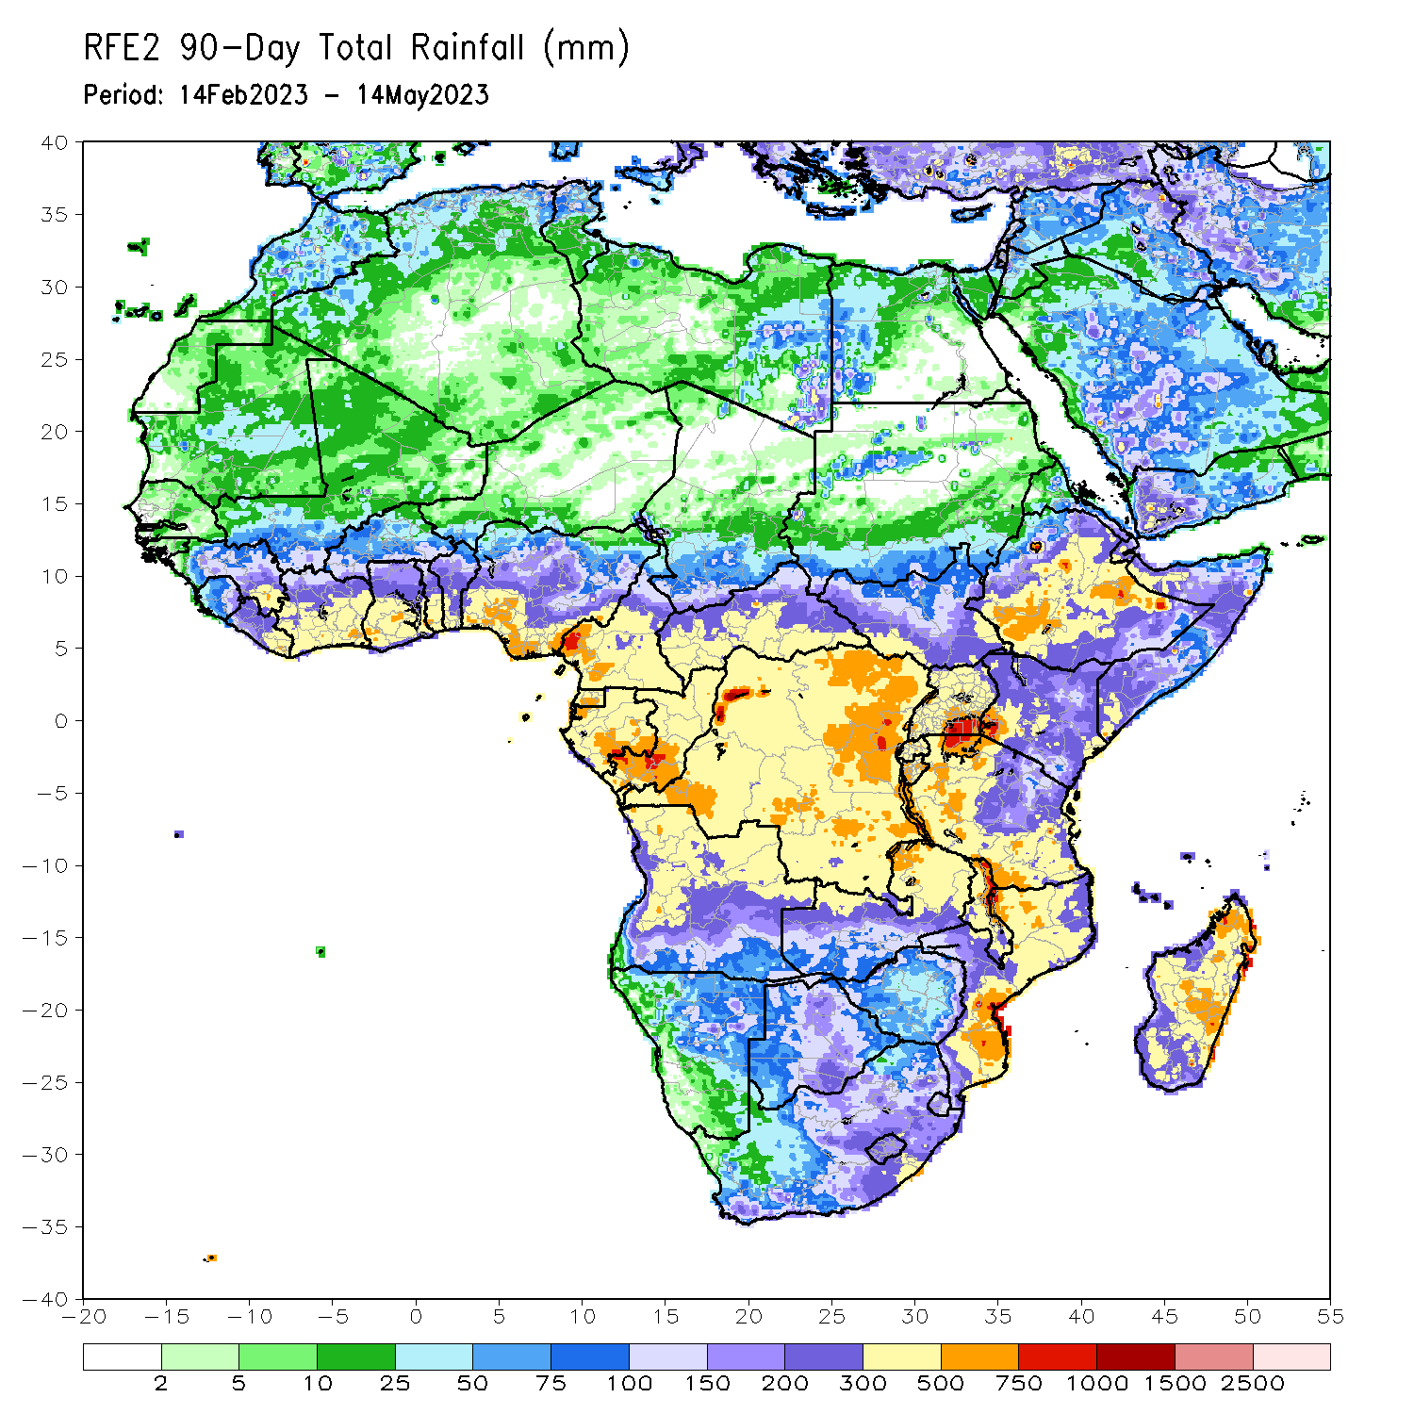
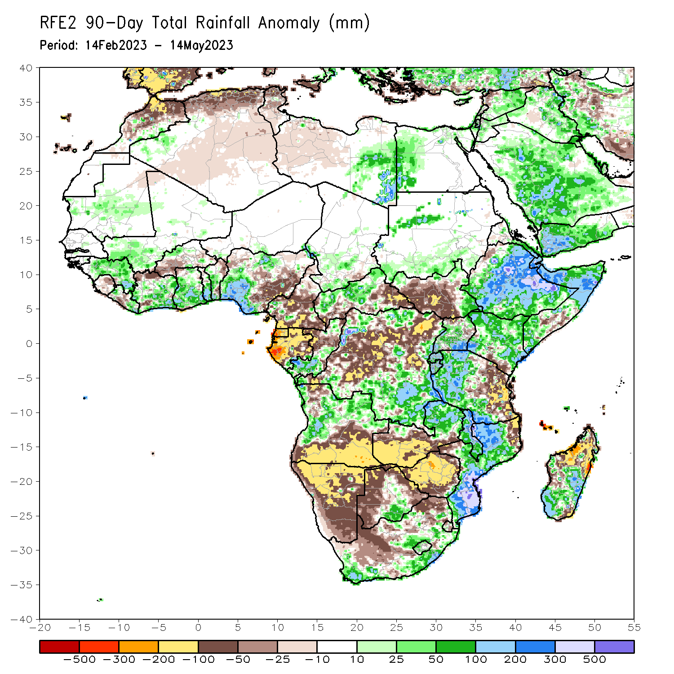
Rainfall Patterns: Last 90 Days
Over the past 90 days, in East Africa, above-average rainfall was observed over much Ethiopia, many parts of Somalia and Kenya, Djibouti, parts of Eritrea, Uganda, western Tanzania, Burundi, Rwanda, and the far northern and southeastern South Sudan. Rainfall was below-average over many parts of South Sudan, parts of southern Somalia, the far southern Kenya and eastern Tanzania. In southern Africa, above-average rainfall was observed over western and northern Angola, eastern Zambia, the far southern Botswana, parts of eastern and southern South Africa, Lesotho, Eswatini, much of Mozambique, and central and southern Madagascar. Below-average rainfall was observed over southern Angola, western and southern Zambia, much of Namibia, western and northern Botswana, western South Africa, Zimbabwe, pockets of northeastern Mozambique and northern Madagascar. In Central Africa, rainfall was above-average over pockets of Cameroon, western and central CAR, much of Congo, and northern and southern DRC. Rainfall was below-average over portions of Cameroon, Equatorial Guuinea, Gabon, parts of eastern and southern CAR, and western and central DRC. In West Africa, rainfall was above-average over much of Guinea, eastern Liberia, parts of Cote d’Ivoire, Ghana, Togo, Benin, and western and northern Nigeria. Below-average rainfall was observed over parts of Sierra Leone, western Liberia, the far northern Cote d’Ivoire, parts of Burkina Faso and southeastern Nigeria.
Notes:
4

Slide 5
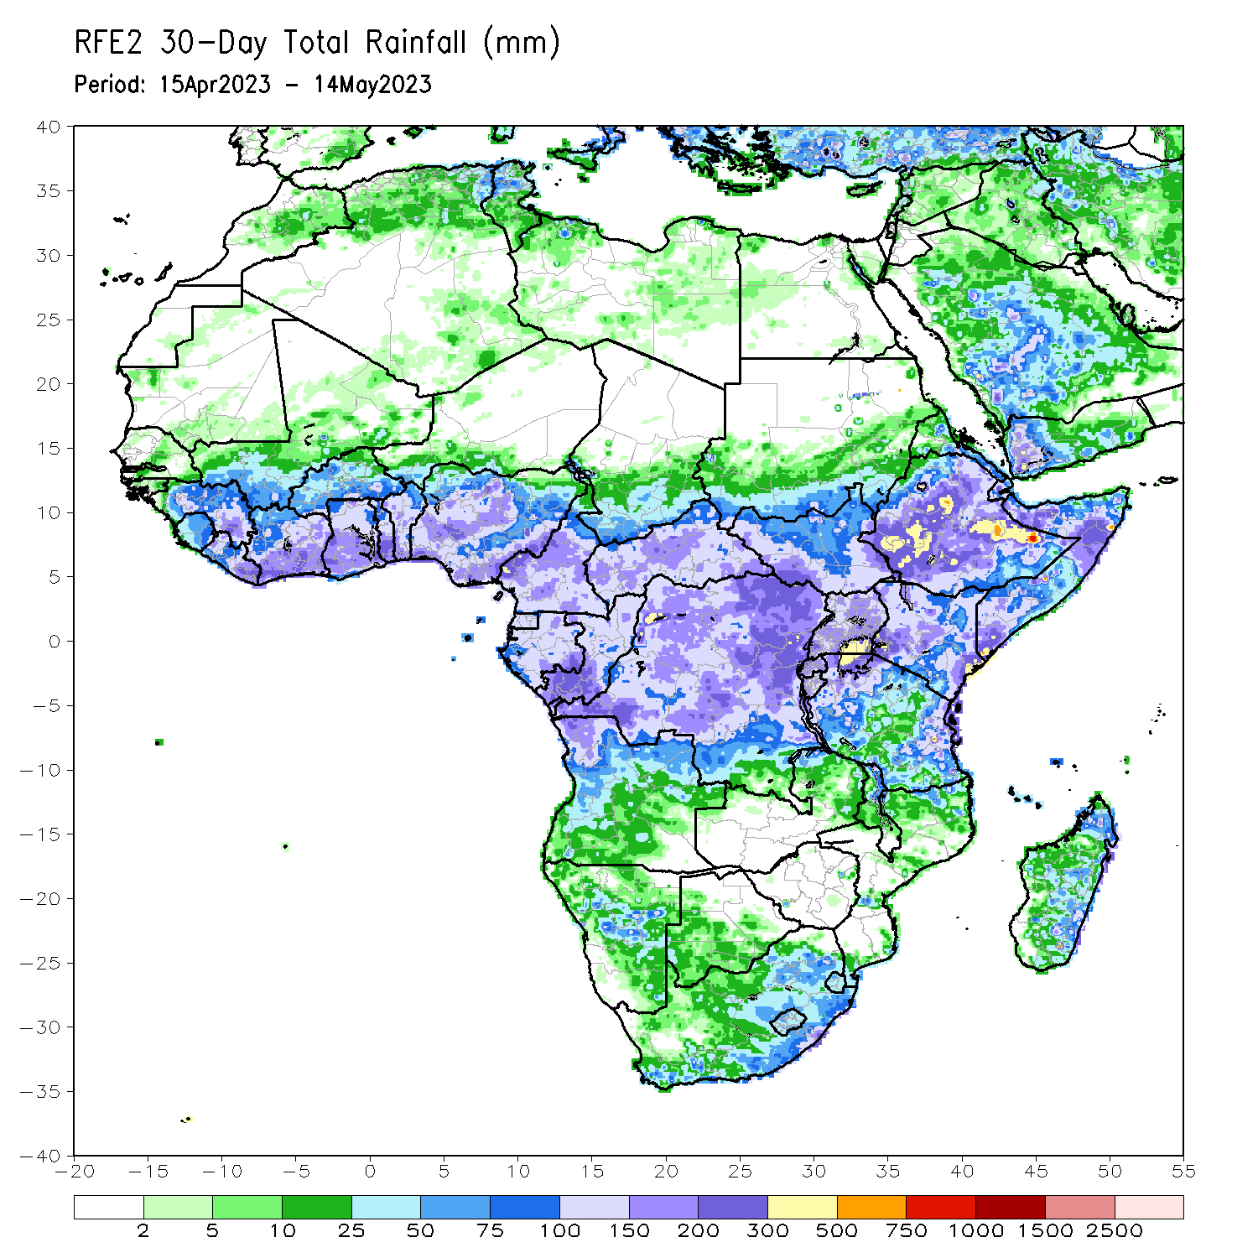
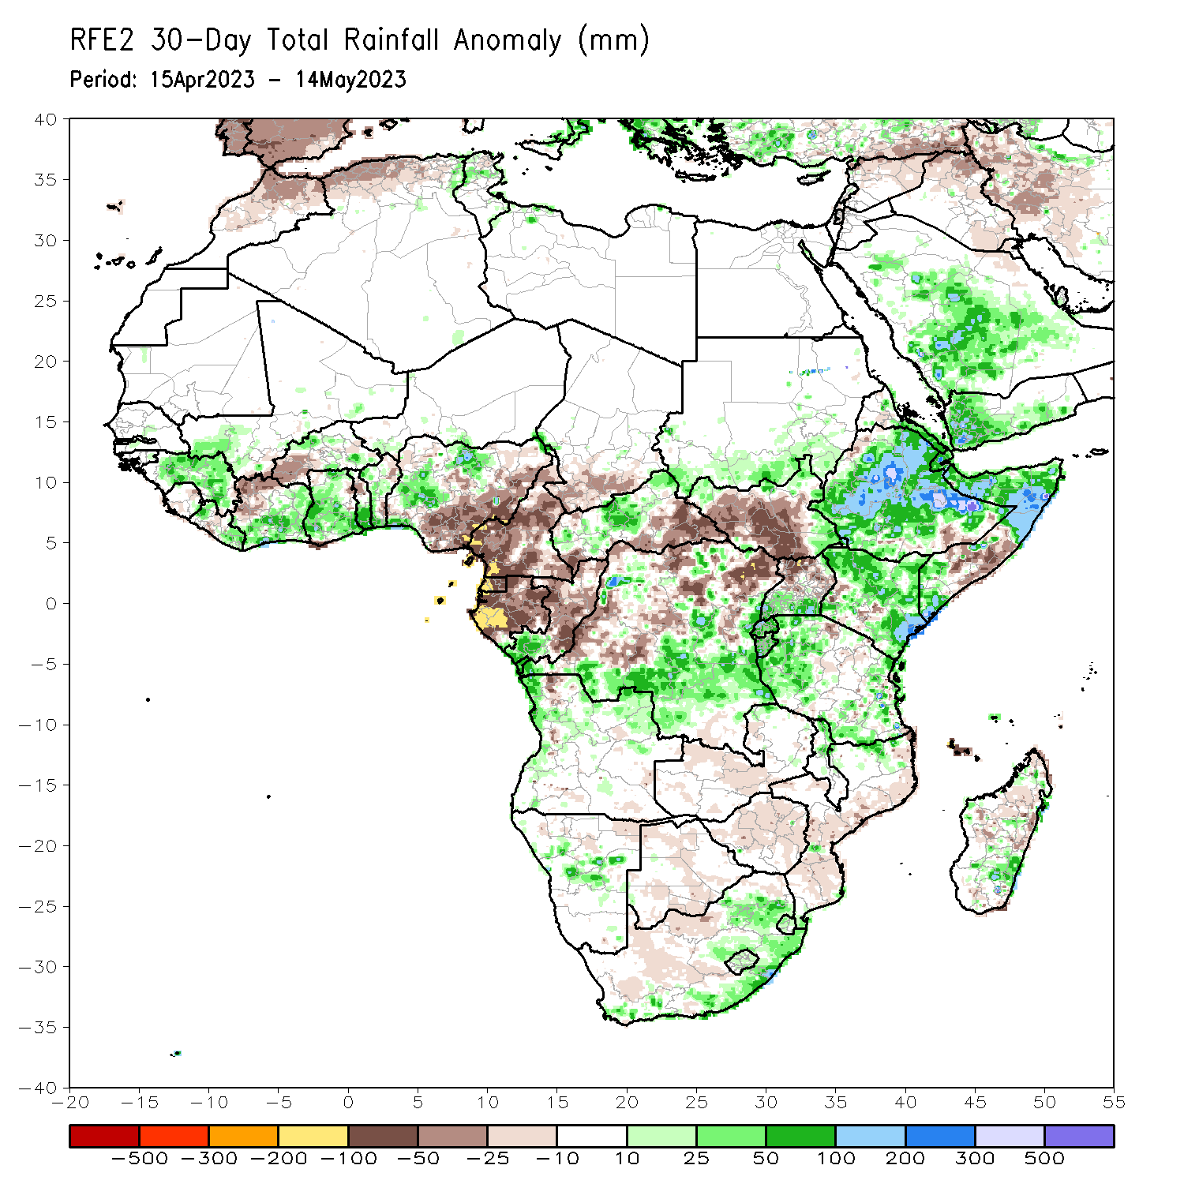
Rainfall Patterns: Last 30 Days
Over the past 30 days, in East Africa, above-average rainfall was observed over much Ethiopia and Kenya, Djibouti, northern and central Somalia, pockets of Eritrea, Kenya, southern Uganda, parts Tanzania, Burundi, Rwanda, and pockets of South Sudan. Rainfall was below-average over many parts of South Sudan, pockets of southeastern Ethiopia and central Somalia, and central Tanzania. In southern Africa, rainfall was slightly above-average over parts of western and northern Angola, central Namibia, southern and eastern South Africa and southeastern Madagascar. Slightly below-average rainfall was observed over southern Angola, much of Zambia, Botswana, Zimbabwe, western South Africa, Mozambique and portions of Madagascar. In Central Africa, rainfall was above-average over the far southern Congo, western CAR, and southern and eastern DRC. Below-average rainfall was observed over much of Cameroon, Equatorial Guinea, Gabon, parts of western and northern DRC, and southeastern CAR. In West Africa, rainfall was above-average over much of Guinea, southern Cote d’Ivoire, Ghana, Togo, Benin and western and northern Nigeria. Below-average rainfall was observed over central Liberia, western and northern Cote d’Ivoire, western Burkina Faso and southeastern Nigeria.
Notes:
5

Slide 6
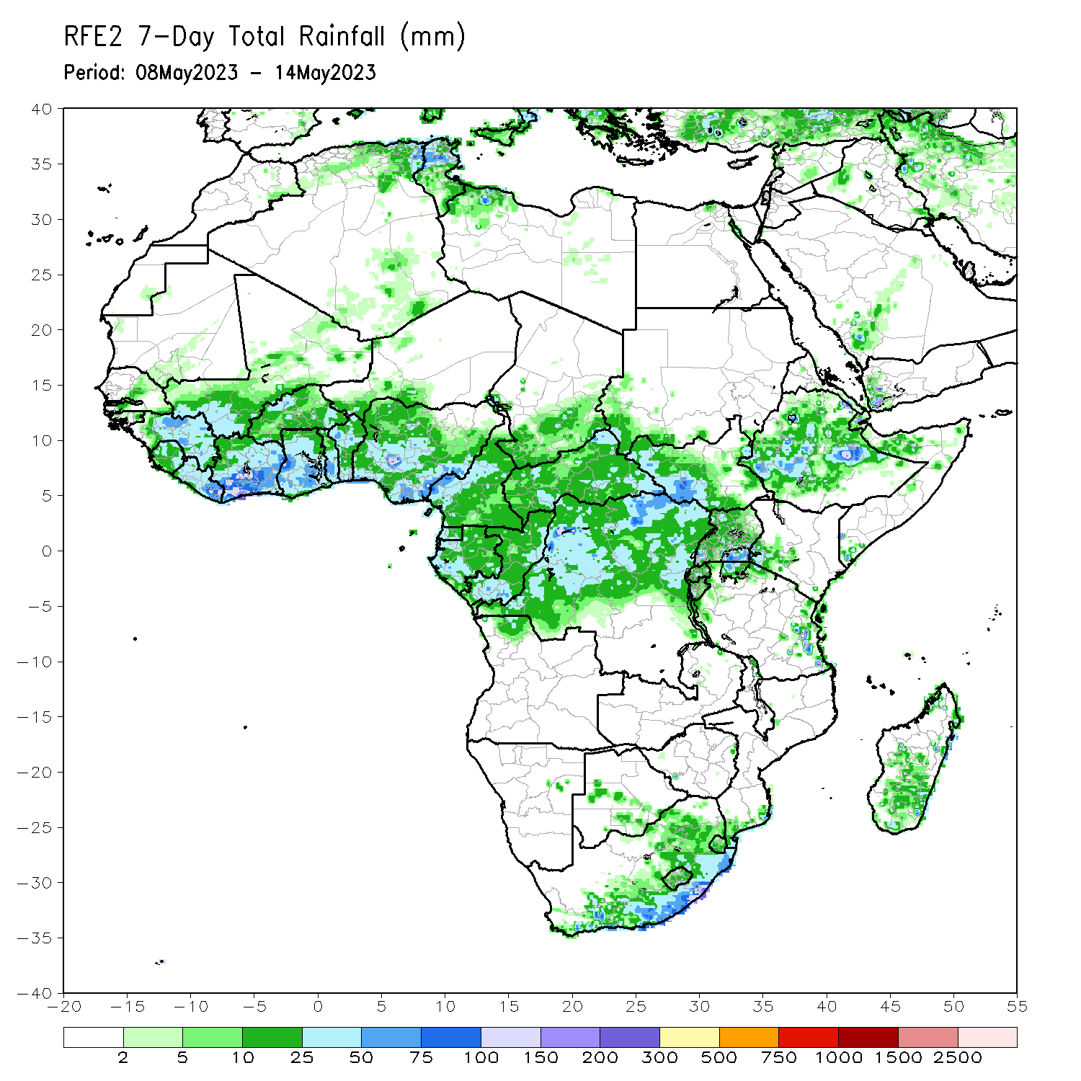
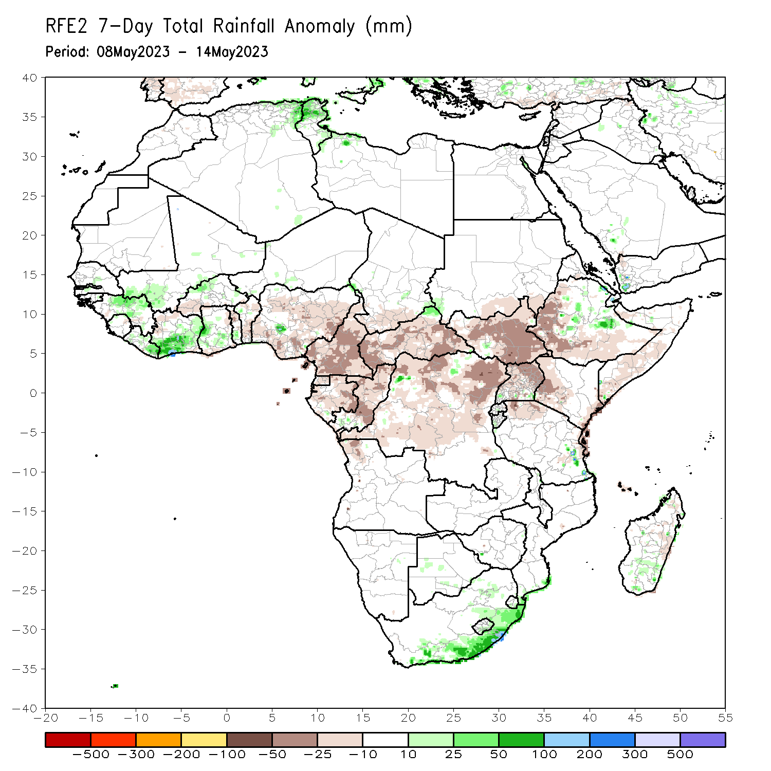
Rainfall Patterns: Last 7 Days
During the past 7 days, in East Africa, rainfall was above-average over parts of central and eastern Ethiopia. Below-average rainfall was observed over much of South Sudan, Uganda, western Kenya, western and southern Ethiopia, and southern Somalia. In Central Africa, rainfall was above-average over the far northern CAR. Below-average rainfall was observed over much of Cameroon, Equatorial Guinea, Gabon, Congo, many parts of CAR, and DRC. In West Africa, above-average rainfall was observed over parts of Guinea, southwestern Mali and southern Cote d’Ivoire. Below-average rainfall was observed over Togo, Benin, and Nigeria. In Southern Africa, above-average rainfall was observed over the coastal areas of South Africa.

Slide 7
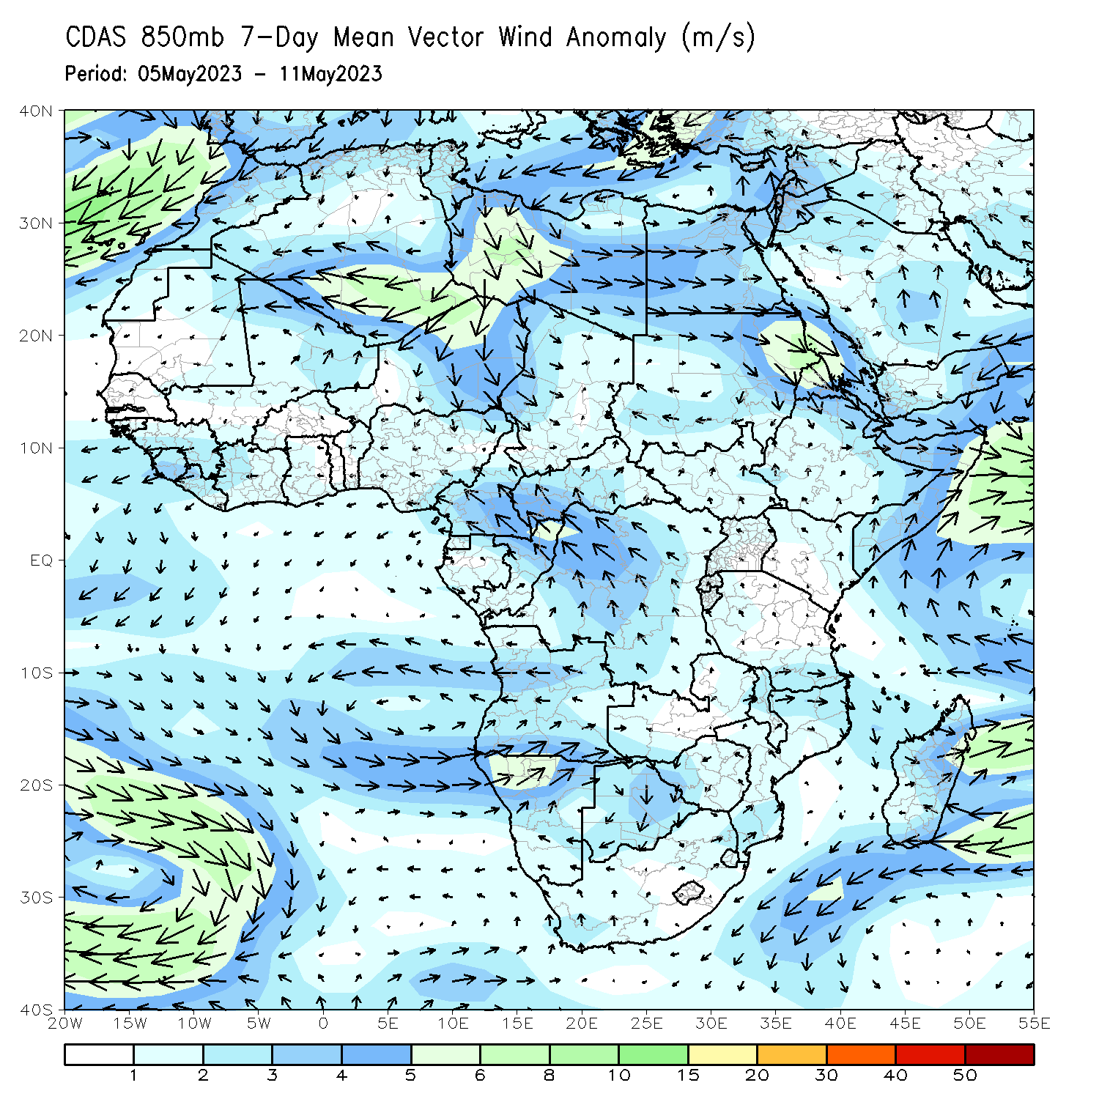
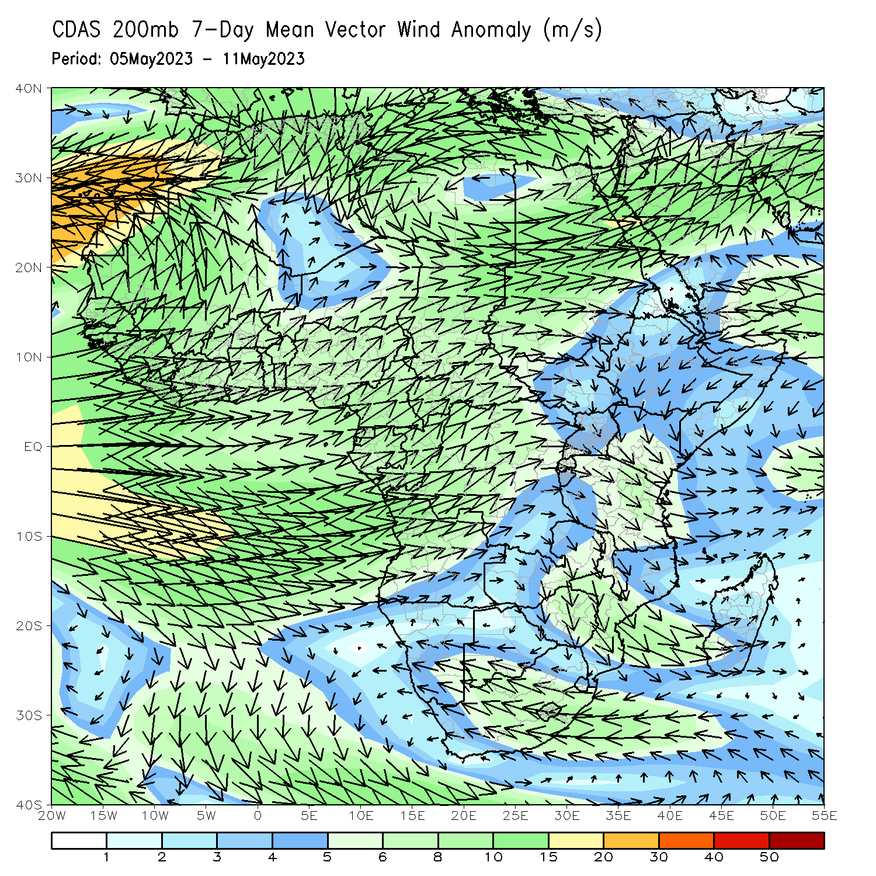
Atmospheric Circulation: Last 7 Days
At 200-hPa level (right panel), an area of anomalous upper-level wind convergence was observed near the Lake Victoria region, which may have contributed to the observed below-average rainfall in the region.

Slide 8
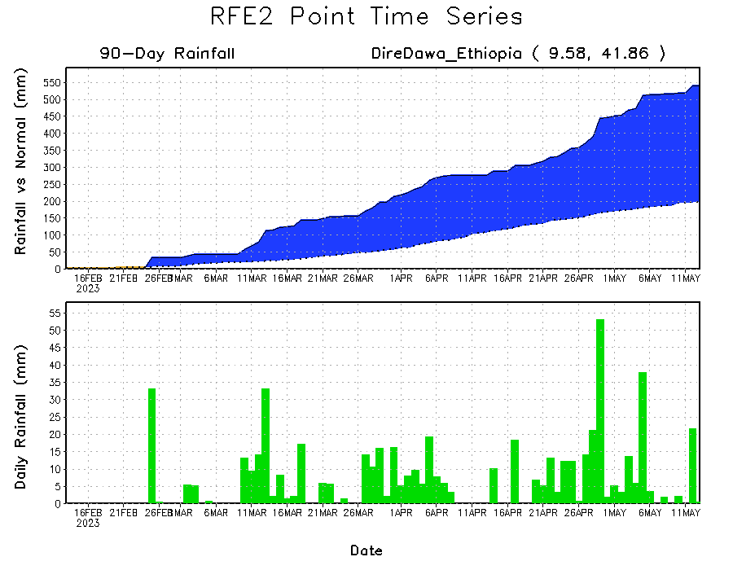
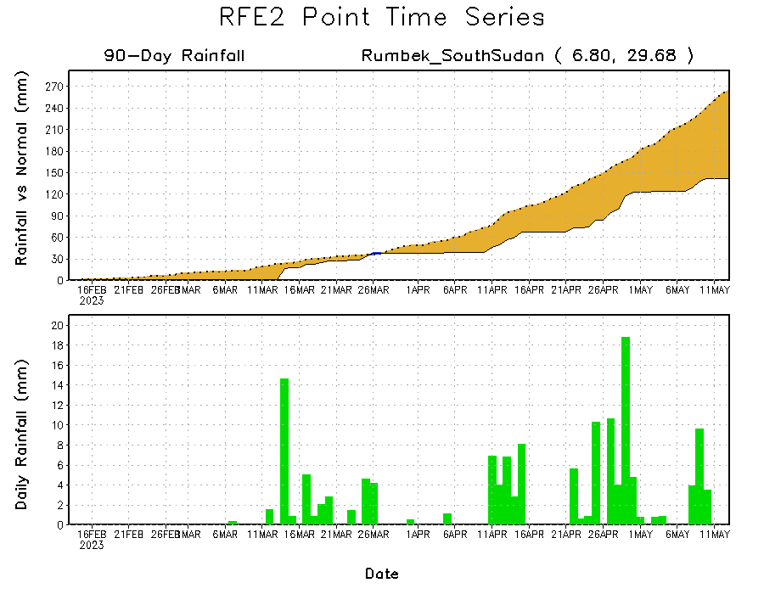
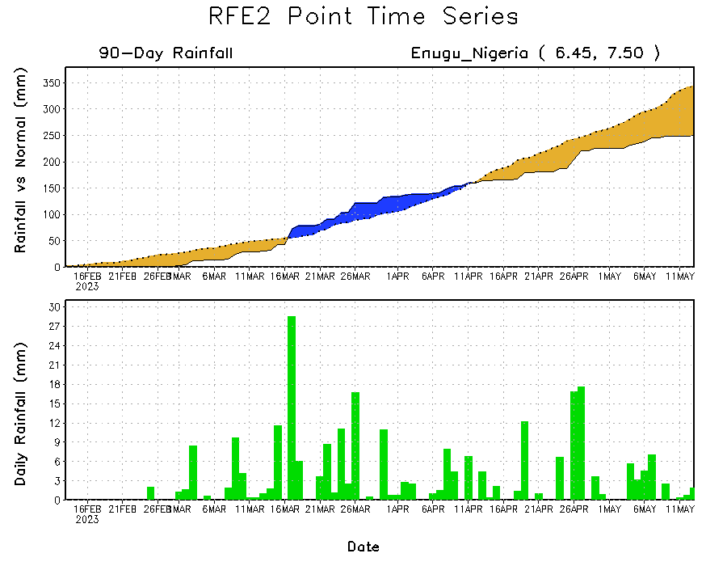
Rainfall Evolution
Daily evolution of rainfall over the last 90 days at selected locations shows a growing dryness over parts of southeastern Nigeria (bottom left) and South Sudan (bottom right). The seasonal total rainfall remained below-average over parts of central DRC (bottom right). Moderate to local heavy rainfall sustained moisture surpluses over parts of eastern Ethiopia (top right).

Slide 9
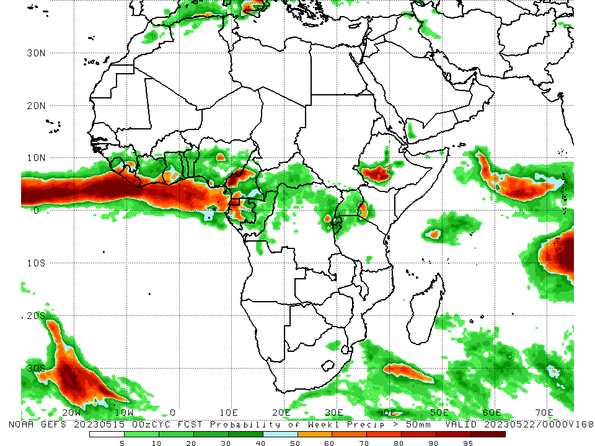
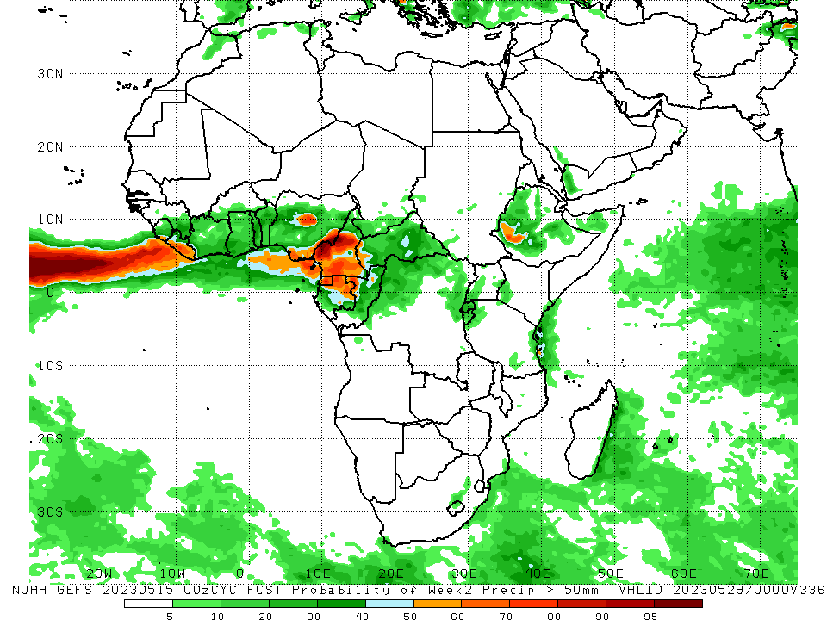
NCEP GEFS Model Forecasts Non-Bias Corrected Probability of precipitation exceedance
Week-1, Valid: 16 – 22 May 2023
Week-2, Valid: 23 – 29 May 2023
For week-1 (left panel) and week-2 (right panel), the GEFS forecasts indicate a moderate to high chance (over 70%) for rainfall to exceed 50 mm over parts of Liberia, pockets of Nigeria, Cameroon, Equatorial Guinea, Gabon and southwestern Ethiopia.
Notes:
9

Slide 10
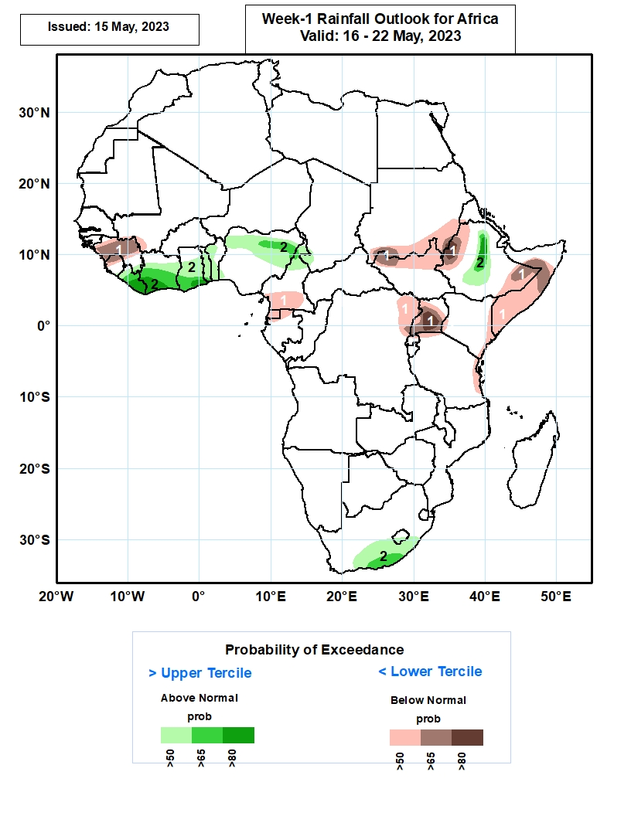
Week-1 Precipitation Outlooks
16 – 22 May 2023
The forecasts call for above 50% chance for weekly total rainfall to be below-normal (below the lower tercile) over much of Guinea, northern Sierra Leone, southern Cameroon, much of Equatorial Guinea, northern Gabon, southern Sudan, northern South Sudan, western and eastern parts of Ethiopia, northeastern DR Congo, much of Uganda, eastern Kenya and Tanzania, and much of Somalia. In particular, there is above 80% chance for rainfall to be below-normal over western Ethiopia, and southern Uganda.
The probabilistic forecasts call for above 50% chance for weekly rainfall to be above-normal (above the upper tercile) over much of Liberia, Cote d’Ivoire, Ghana, and Togo, western Benin, northern Nigeria and Cameroon, central portions of Ethiopia, southern South Africa and Lesotho. In particular, there is above 80% chance for rainfall to be above-normal over southern Liberia, Cote d’Ivoire, and Ghana, and central portions of Ethiopia.
Notes:
10

Slide 11
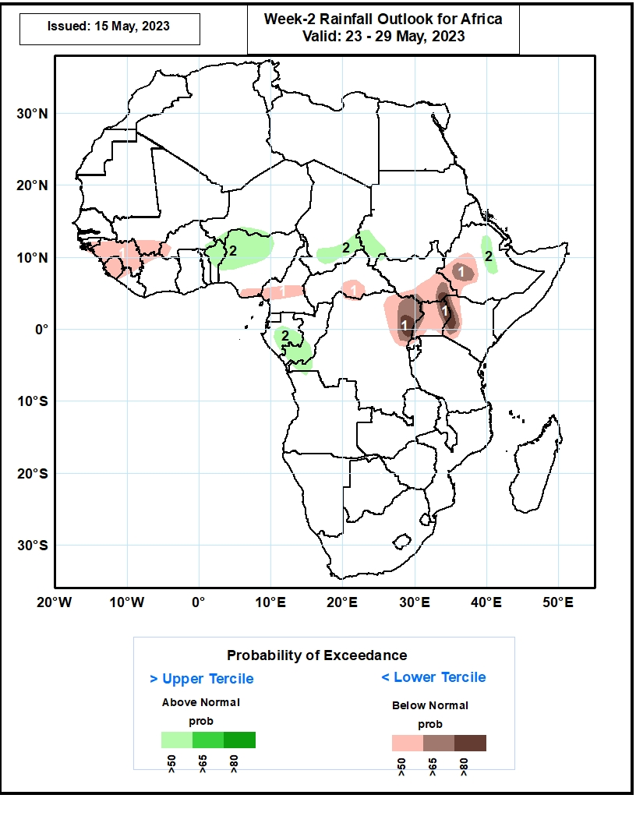
Week-2 Precipitation Outlooks
23 – 29 May 2023
The forecasts call for above 50% chance for weekly total rainfall to be below-normal (below the lower tercile) over much of Guinea and Sierra Leone, northwestern Liberia, southern Mali, southwestern Burkina Faso, northwestern Cote d’Ivoire, southeastern Nigeria, central parts of Cameroon, south-central CAR, southern South Sudan, western Ethiopia, northeastern DR Congo, northern Rwanda, much of Uganda, and western Kenya. In particular, there is above 80% chance for rainfall to be below-normal over northeastern DR Congo, eastern Uganda, and western Kenya.
The probabilistic forecasts call for above 50% chance for weekly rainfall to be above-normal (above the upper tercile) over southeastern Burkina Faso, northern Benin and Nigeria, southern Chad, southwestern Sudan, central Gabon, southern Congo, western DR Congo, and central portions of Ethiopia.
Notes:
11

Slide 12
Summary
Over the past 30 days, in East Africa, above-average rainfall was observed over much Ethiopia, Djibouti, many parts of Somalia, pockets of Eritrea, Kenya, southern Uganda, many parts Tanzania, Burundi, Rwanda, and northern and eastern South Sudan. Rainfall was below-average over the southern portion of South Sudan, pockets of southeastern Ethiopia and central Somalia and central Tanzania. In southern Africa, above-average rainfall was observed over parts of western and northern Angola, northeastern Zambia, northern Mozambique and eastern Madagascar. Below-average rainfall was observed over southern Angola, southern and western Zambia, much of Namibia, Botswana, Zimbabwe, South Africa, Lesotho, Eswatini, and central and southern Mozambique and western Madagascar. In Central Africa, rainfall was above-average over pockets of Cameroon, western and central CAR, the far southern and northern Congo, and many parts of DRC. Below-average rainfall was observed over southwestern Cameroon, Gabon, parts of western and northern DRC, and eastern CAR. In West Africa, rainfall was above-average over parts of Guinea and Liberia, southeastern Cote d’Ivoire, Ghana, Togo, Benin and western and northern Nigeria. Below-average rainfall was observed over western and central Cote d’Ivoire and southeastern Nigeria.
During the past 7 days, in East Africa, rainfall was above-average over parts of central and eastern Ethiopia. Below-average rainfall was observed over much of South Sudan, Uganda, western Kenya, western and southern Ethiopia, and southern Somalia. In Central Africa, rainfall was above-average over the far northern CAR. Below-average rainfall was observed over much of Cameroon, Equatorial Guinea, Gabon, Congo, many parts of CAR, and DRC. In West Africa, above-average rainfall was observed over parts of Guinea, southwestern Mali and southern Cote d’Ivoire. Below-average rainfall was observed over Togo, Benin, and Nigeria. In Southern Africa, above-average rainfall was observed over the coastal areas of South Africa.
The Week-1 outlook calls for below-normal rainfall over much of Guinea, northern Sierra Leone, southern Cameroon, much of Equatorial Guinea, northern Gabon, southern Sudan, northern South Sudan, western and eastern parts of Ethiopia, northeastern DR Congo, much of Uganda, eastern Kenya and Tanzania, and much of Somalia. In contrast, there is an increased chance for above-normal rainfall over much of Liberia, Cote d’Ivoire, Ghana, and Togo, western Benin, northern Nigeria and Cameroon, central portions of Ethiopia, southern South Africa and Lesotho. For week-2, there is an increased chance for below-normal rainfall over much of Guinea and Sierra Leone, northwestern Liberia, southern Mali, southwestern Burkina Faso, northwestern Cote d’Ivoire, southeastern Nigeria, central parts of Cameroon, south-central CAR, southern South Sudan, western Ethiopia, northeastern DR Congo, northern Rwanda, much of Uganda, and western Kenya. In contrast, there is an increased chance for above-normal rainfall over southeastern Burkina Faso, northern Benin and Nigeria, southern Chad, southwestern Sudan, central Gabon, southern Congo, western DR Congo, and central portions of Ethiopia.

