Slide 1
The African Monsoon Recent Evolution and Current Status Include Week-1 and Week-2 Outlooks
Update prepared
17 July 2023
For more information, visit:
http://www.cpc.ncep.noaa.gov/products/Global_Monsoons/African_Monsoons/precip_monitoring.shtml

Slide 2
Outline
Highlights
Recent Evolution and Current Conditions
NCEP GEFS Forecasts
Summary

Slide 3
Highlights: Last 7 Days
During the past 7 days, in East Africa, rainfall was above-average over southeastern and parts of south-central Sudan, west-central and northern Ethiopia, northeastern South Sudan, and northwestern Uganda. Rainfall was below average over east-central and southwestern Sudan, western and southeastern South Sudan, southwestern and parts of central Ethiopia, western Eritrea, and parts of southwestern Kenya. In Central Africa, rainfall was above-average over parts of southwestern CAR, parts of northern Congo, and parts of northeastern and central DRC. Below-average rainfall was observed over Cameroon, southeastern most of western, northern, and eastern CAR, and southern Chad. In West Africa, above-average rainfall was observed over western and southeastern Guinea, eastern Senegal, central Sierra Leone, northeastern Liberia, eastern Cote d’Ivoire, parts of western Nigeria, Ghana, Togo, Benin, southwestern and southeastern Mali, and southwestern Niger. Rainfall was below-average over parts of western Sierra Leone, central and northeastern Guinea, western Burkina Faso, south-central Mali, and most of eastern and southern Nigeria. In Southern Africa, rainfall was above average in parts of southern and eastern South Africa, Eswatini, parts of southern and central Mozambique, and parts of eastern Madagascar.
The Week-1 outlook calls for above-normal rainfall over parts of the Gulf of Guinea and western Sahel regions, including western and northern Senegal, Guinea-Bissau, western and southeastern Guinea, western and central Sierra Leone, Liberia, central Cote d’Ivoire, northern Benin, much of Nigeria, western Cameroon, parts of central and southeastern Mali, eastern Burkina Faso, and western Niger. Rainfall is also expected to be above average in southern Botswana, north-central and eastern South Africa, Lesotho, Eswatini, southern Mozambique, and northeastern Madagascar. In contrast, there is an increased chance for below-normal rainfall over central and eastern Africa, including southwestern Chad, northern and eastern CAR, southern Sudan, South Sudan, northeastern DRC, Uganda, southwestern Kenya, western Eritrea, northern, parts of central, western Ethiopia, and parts of southeastern Madagascar. For week-2, there is an increased chance for above-normal rainfall over western and southeastern Guinea, Sierra Leone, Liberia, parts of western Cote d’Ivoire, and central Ethiopia. In contrast, there is an increased chance for below-normal rainfall over much of eastern Nigeria, Cameroon, southern Chad, southeastern Sudan, eastern South Sudan, Uganda, southwestern Kenya, Eritrea, northeastern and southwestern Ethiopia, and southeastern Madagascar.

Slide 4
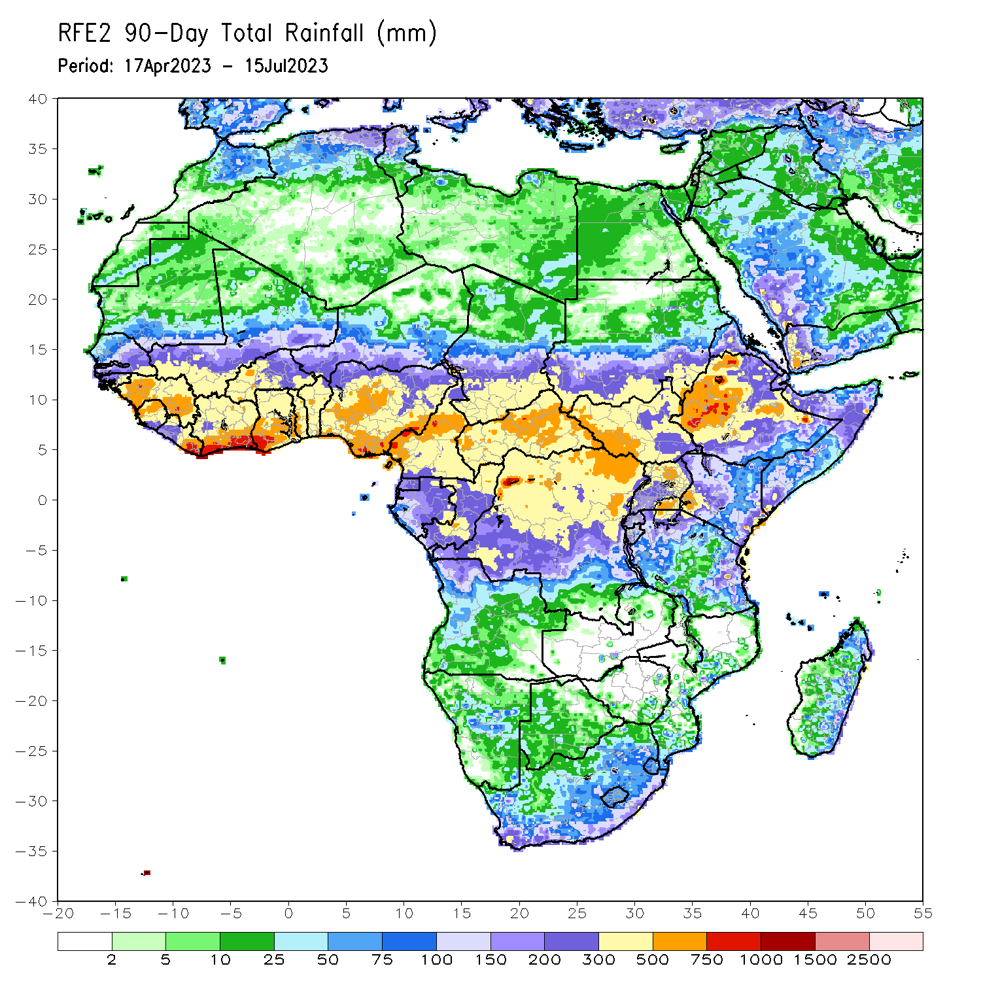
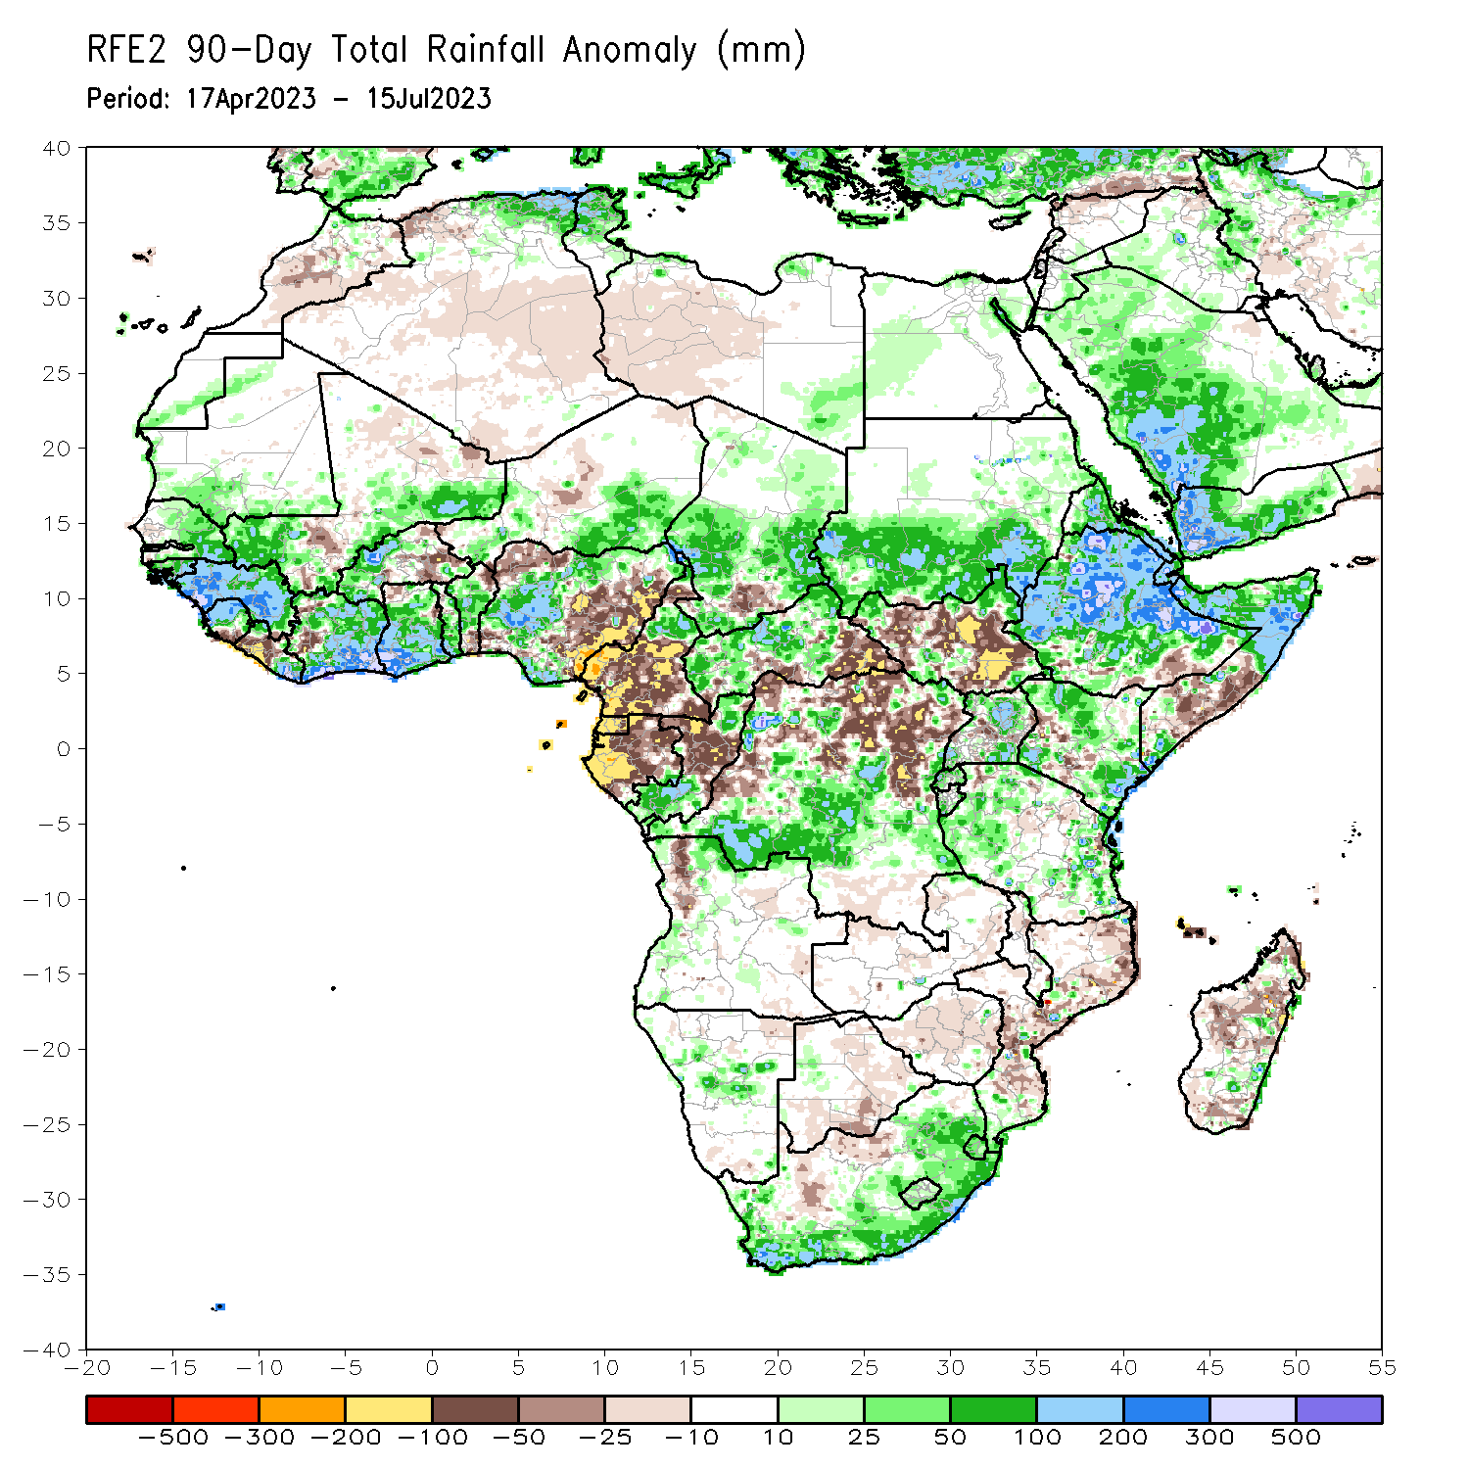
Rainfall Patterns: Last 90 Days
Over the past 90 days, in East Africa, above-average rainfall was observed over much of Eritrea, Ethiopia (outside of southern portions), northern and parts of far southern Somalia, northern, southwestern, and eastern Kenya, Djibouti, northern and southern Uganda, western and eastern Tanzania, Burundi, Rwanda, southern and eastern Sudan, and far northwestern and northeastern South Sudan. Rainfall was below-average over much of central South Sudan, parts of central and southern Somalia, parts of western Kenya, parts of central Uganda, and parts of southern Ethiopia. In southern Africa, above-average rainfall was observed over parts of northern Angola, parts of eastern, western, and southern South Africa, Lesotho, Eswatini, parts of central Namibia, and parts of central and southeastern Madagascar. Below-average rainfall was observed over a small portion of northwestern Angola, southern and eastern Botswana, north-central South Africa, Zimbabwe, southern, central, and northeastern Mozambique, and parts of northern, central, and southern Madagascar. In Central Africa, rainfall was above-average over parts of northern Cameroon, western, central, and northeastern CAR, southern and northern Congo, much of southern and central Chad, and southwestern, parts of central, parts of northwestern, and parts of southeastern DRC. Rainfall was below-average over parts of central and southern Cameroon, Equatorial Guinea, much of Gabon, central Congo, parts of southeastern and south-central CAR, and parts of central and north-central DRC. In West Africa, rainfall was above-average over parts of eastern and southern Senegal, much of Guinea, Guinea-Bissau, northern and central Sierra Leone, northwestern and eastern Liberia, most of Cote d’Ivoire, southern Mali, western and southeastern Burkina Faso, central and southern Ghana, Togo, central and northwestern Benin, southeastern and southwestern Niger, and south-central, west-central, and north-central Nigeria. Below-average rainfall was observed over parts of eastern Burkina Faso, northwestern and much of eastern Nigeria, northeastern and southern Benin, northwestern Ghana, west-central Cote d’Ivoire, central and southwestern Liberia, and southern Sierra Leone.
Notes:
4

Slide 5
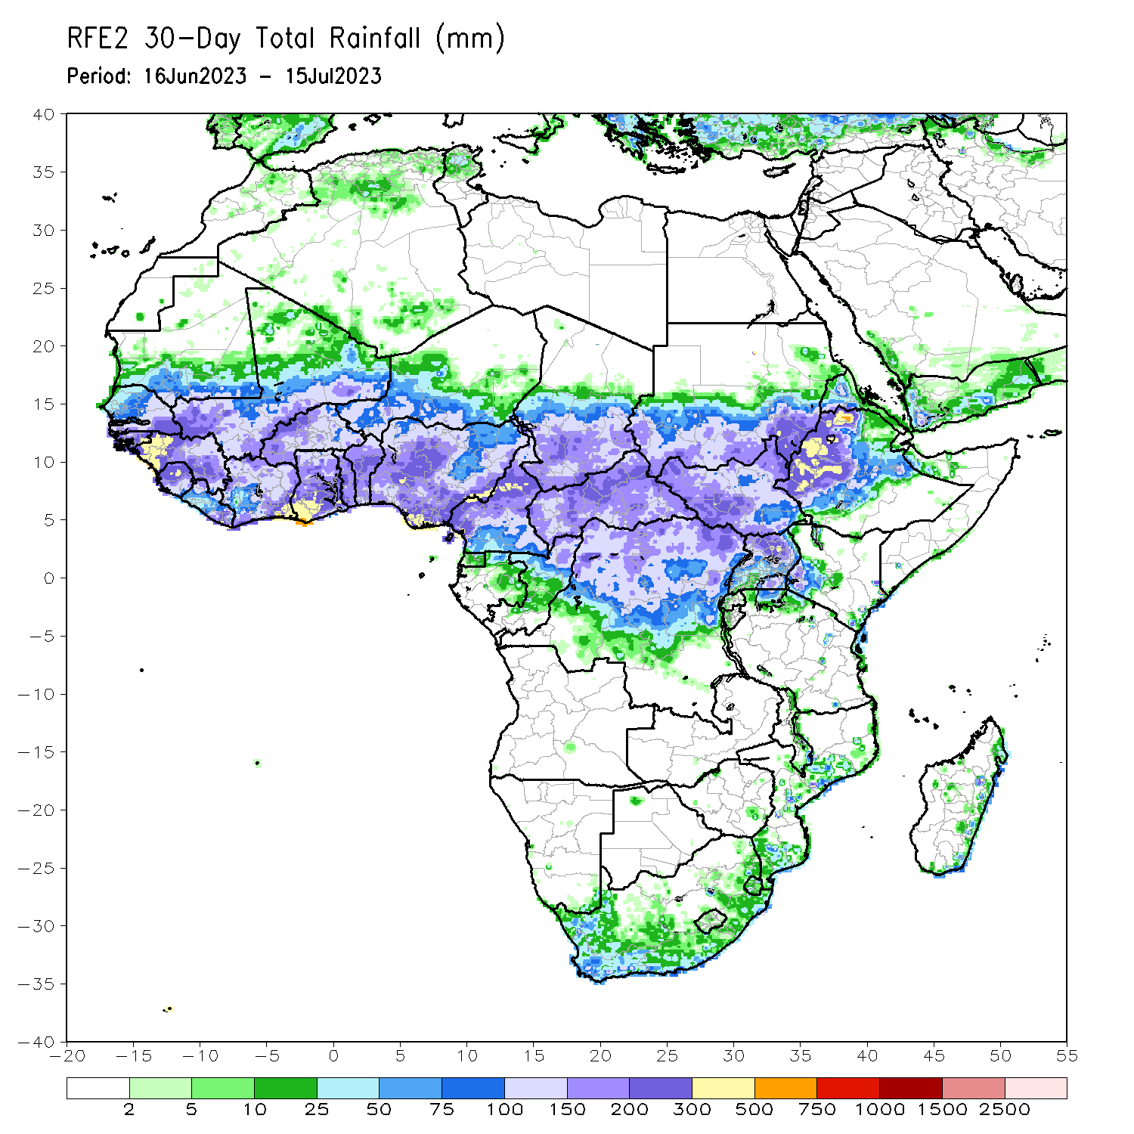
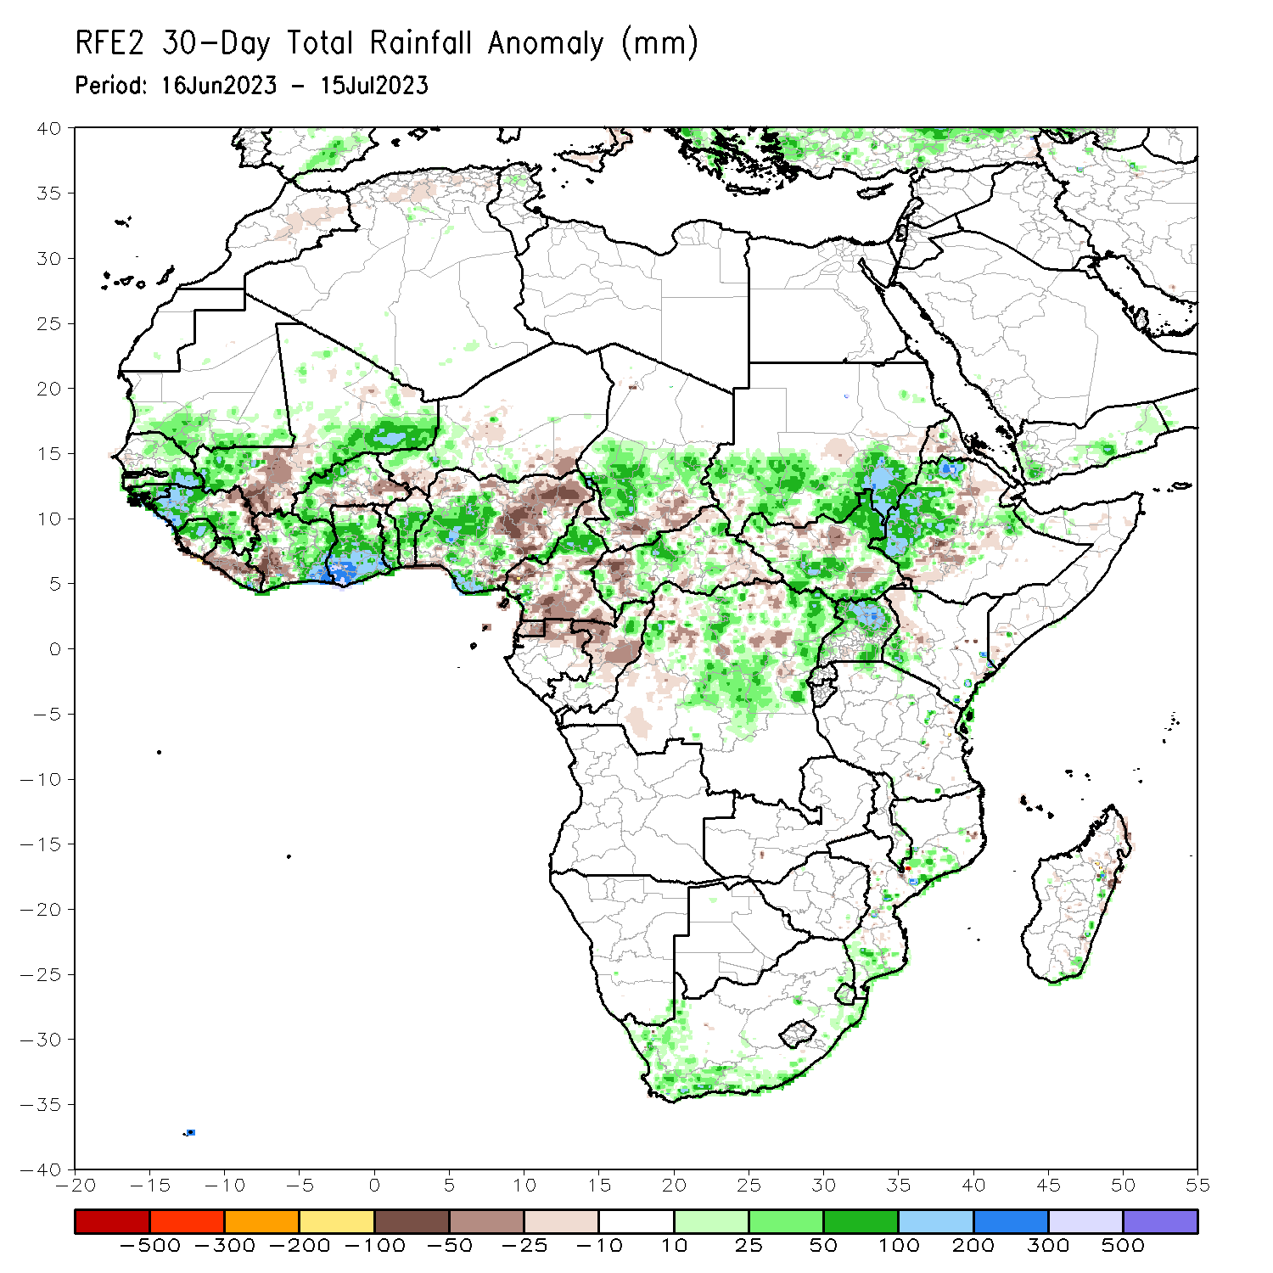
Rainfall Patterns: Last 30 Days
Over the past 30 days, in East Africa, above-average rainfall was observed over southern Sudan, north-central, western, and east-central Ethiopia, southern, eastern, and western South Sudan, southwestern Kenya, and northern, western, and eastern Uganda. Rainfall was below-average over north-central and part of southeastern South Sudan, as well as parts of central Ethiopia and western Eritrea. In southern Africa, rainfall was above-average over southern, western, and eastern South Africa, parts of southern and central Mozambique, and parts of southeastern Madagascar. In Central Africa, rainfall was above-average over parts of northern Cameroon, northern Congo, parts of western and central CAR, central Chad, and northeastern, parts of northwestern, and central DRC. Below-average rainfall was observed over pockets of southern and central Cameroon, northern Gabon, Equatorial Guinea, pockets of central and northern DRC, southern Chad, central Congo, and parts of western and southeastern CAR. In West Africa, rainfall was above-average over southern and eastern Senegal, western and southeastern Guinea, Guinea-Bissau, southeastern and southwestern Mali, northern and eastern Sierra Leone, eastern and northwestern Liberia, southern, eastern, and north-central Cote d’Ivoire, western and northern Burkina Faso, most of Ghana, southern and west-central Nigeria, central and southern Togo, central and southern Benin, and parts of western Niger. Below-average rainfall was observed over southwestern and central Liberia, parts of west-central and northwestern Cote d’Ivoire, southeastern Burkina Faso, northern Togo, northern and southern Benin, northeastern Ghana, coastal Sierra Leone, northeastern Guinea, south-central Mali, southeastern and southwestern Niger, and parts of northwestern, southwestern, and much of eastern Nigeria.
Notes:
5

Slide 6
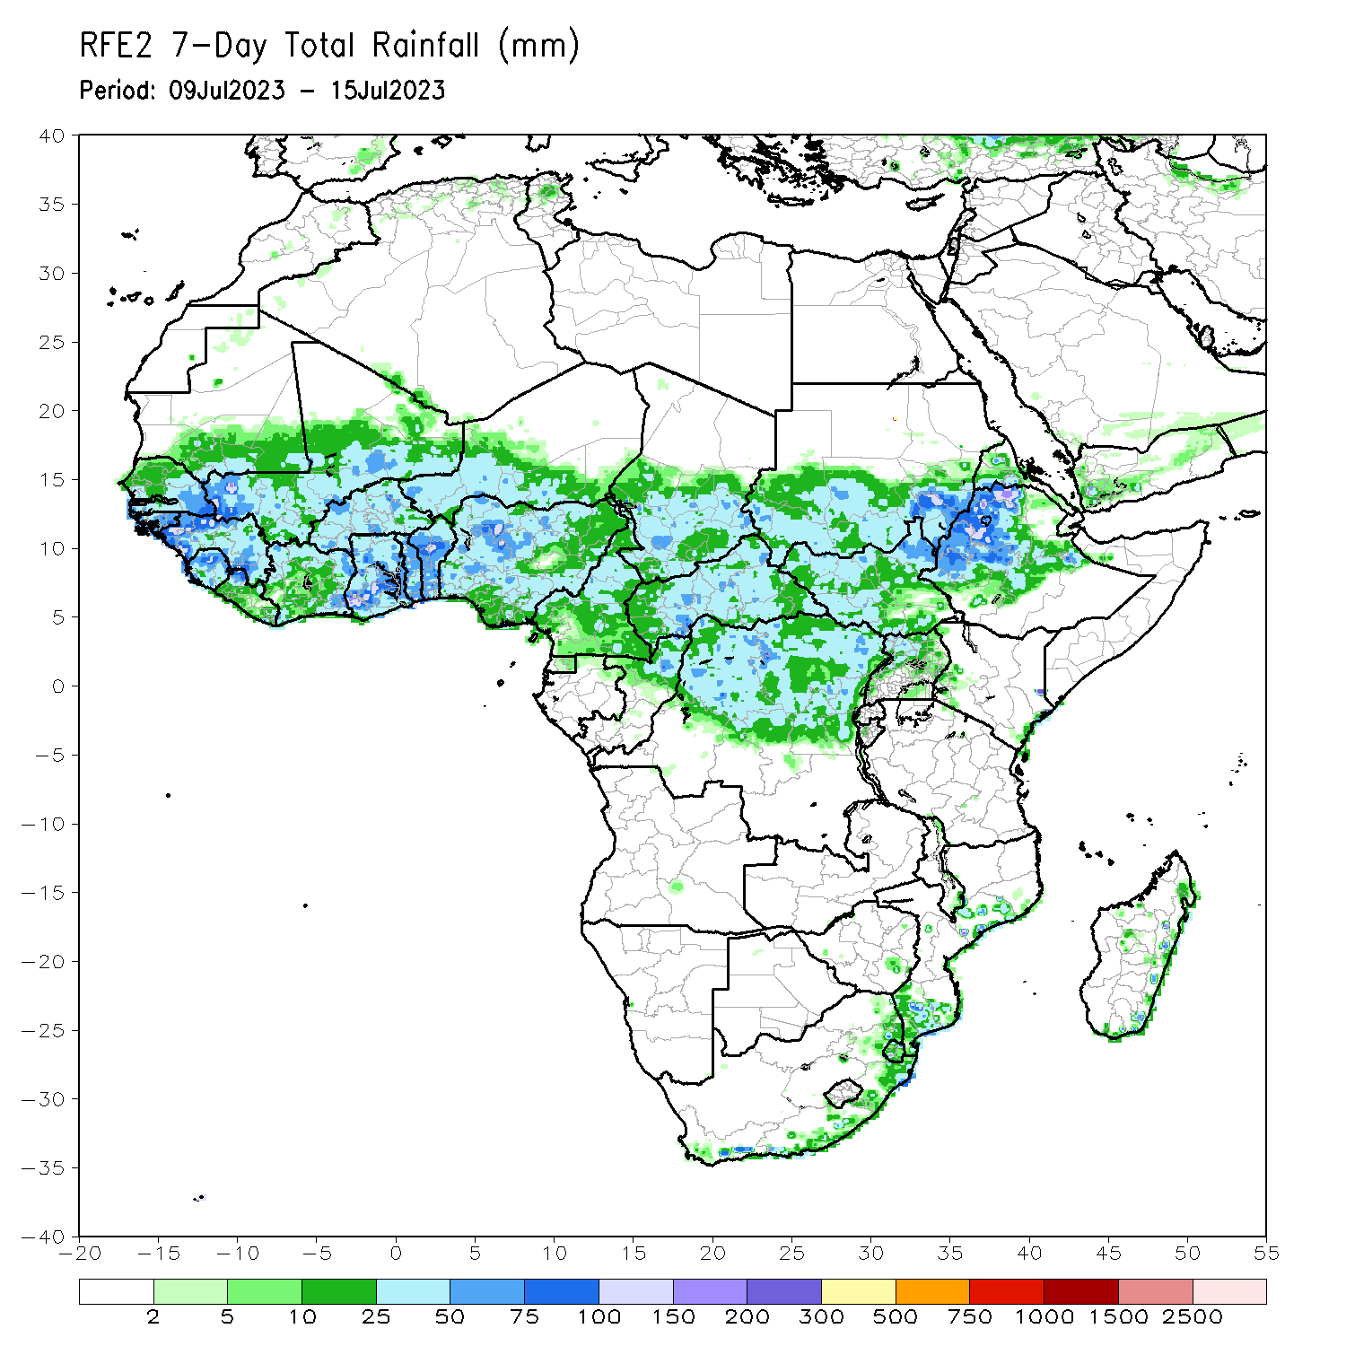
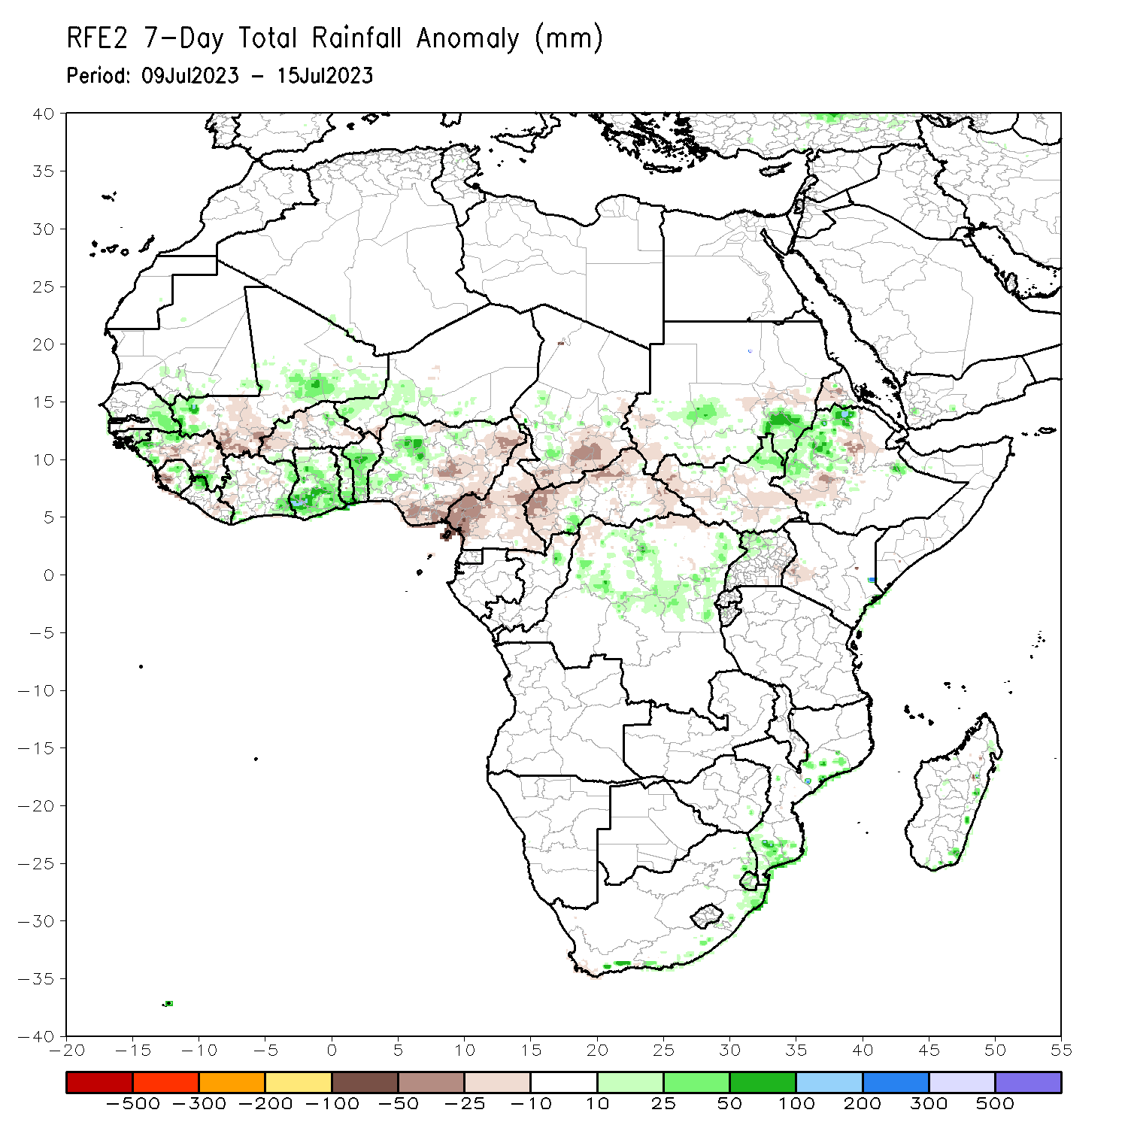
Rainfall Patterns: Last 7 Days
During the past 7 days, in East Africa, rainfall was above-average over southeastern and parts of south-central Sudan, west-central and northern Ethiopia, northeastern South Sudan, and northwestern Uganda. Rainfall was below average over east-central and southwestern Sudan, western and southeastern South Sudan, southwestern and parts of central Ethiopia, western Eritrea, and parts of southwestern Kenya. In Central Africa, rainfall was above-average over parts of southwestern CAR, parts of northern Congo, and parts of northeastern and central DRC. Below-average rainfall was observed over Cameroon, southeastern most of western, northern, and eastern CAR, and southern Chad. In West Africa, above-average rainfall was observed over western and southeastern Guinea, eastern Senegal, central Sierra Leone, northeastern Liberia, eastern Cote d’Ivoire, parts of western Nigeria, Ghana, Togo, Benin, southwestern and southeastern Mali, and southwestern Niger. Rainfall was below-average over parts of western Sierra Leone, central and northeastern Guinea, western Burkina Faso, south-central Mali, and most of eastern and southern Nigeria. In Southern Africa, rainfall was above average in parts of southern and eastern South Africa, Eswatini, parts of southern and central Mozambique, and parts of eastern Madagascar.

Slide 7
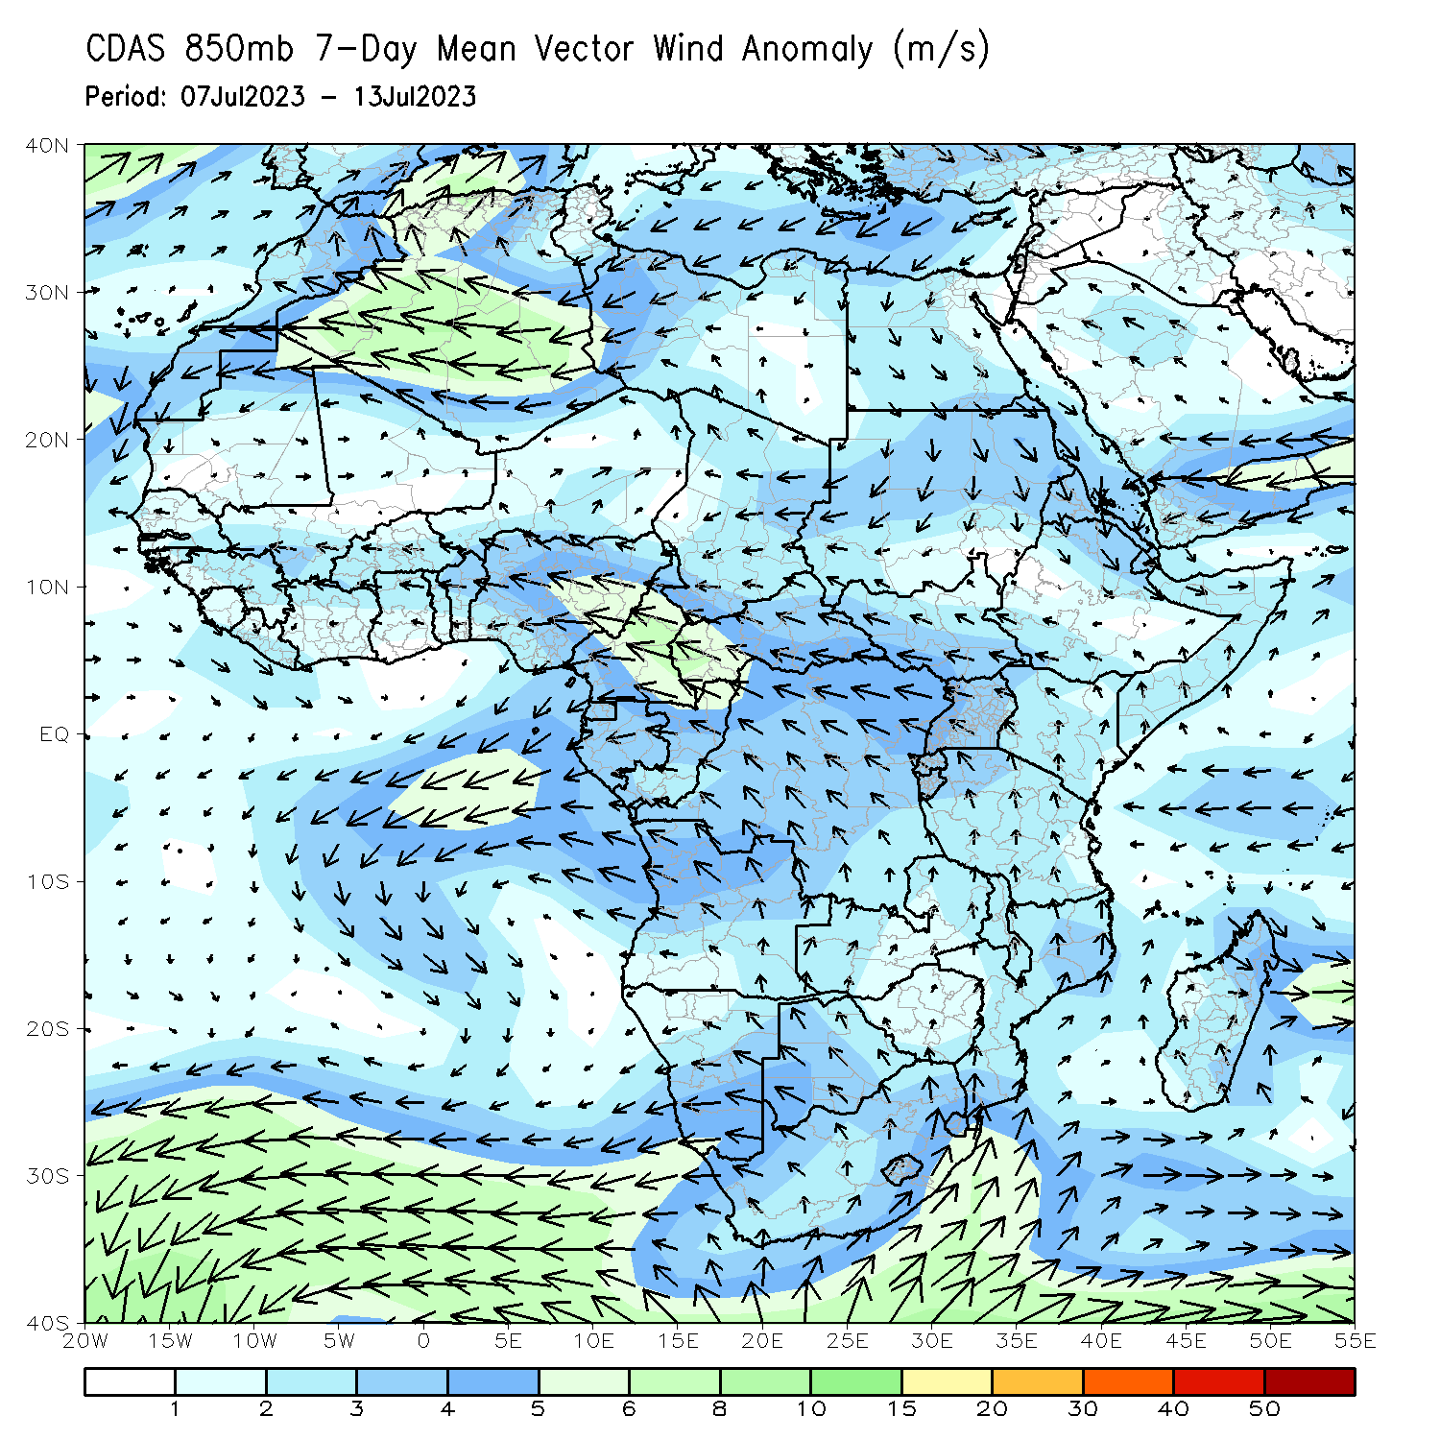
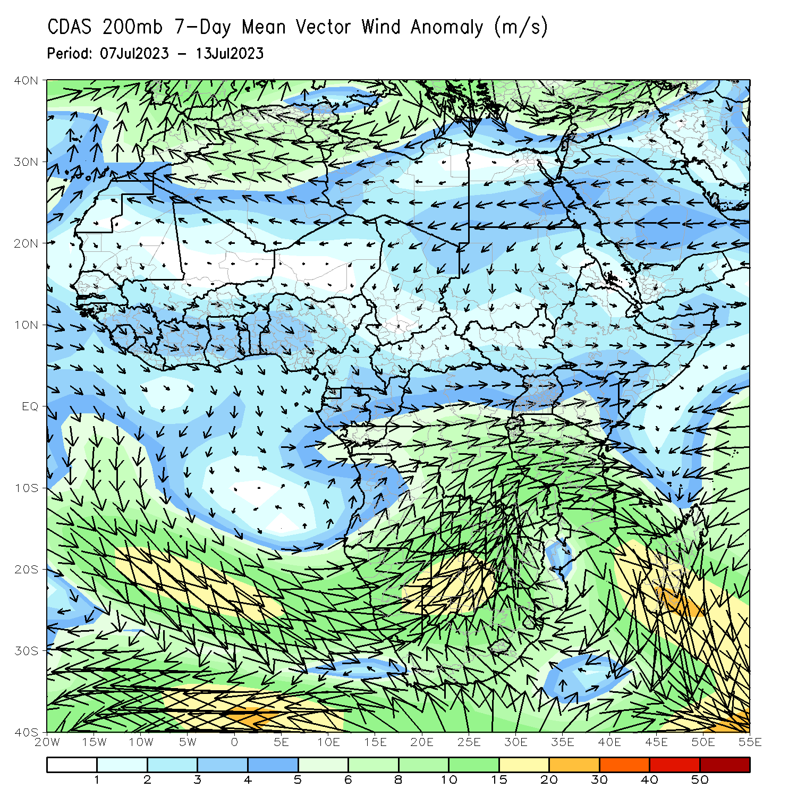
Atmospheric Circulation: Last 7 Days
At 850-hPa (left panel), anomalous lower-level convergence in southeastern Sudan and northern Ethiopia may have contributed to the observed above-average rainfall in the region. On-shore flow and convergence may have contributed to the observed above-average rainfall in Ghana/Togo/Benin. At 200-hPa (right panel), anomalous divergence near Ghana/Togo/Benin may have contributed to above-average rainfall.

Slide 8
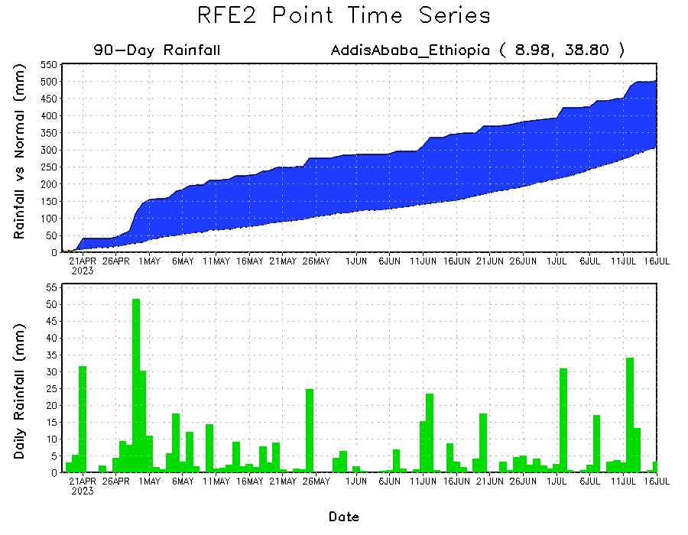
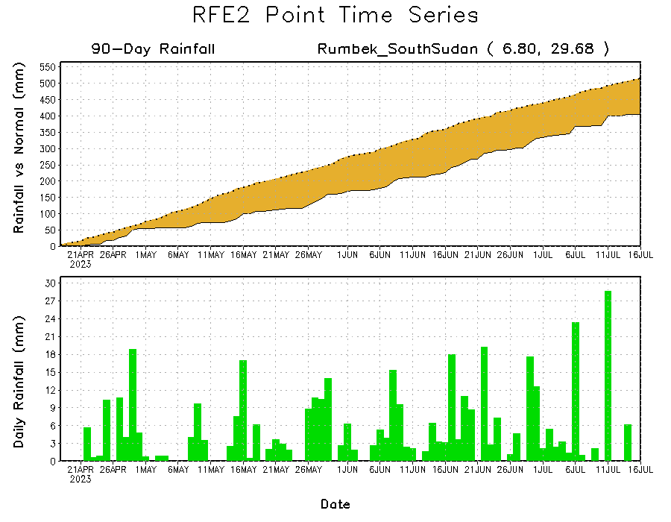
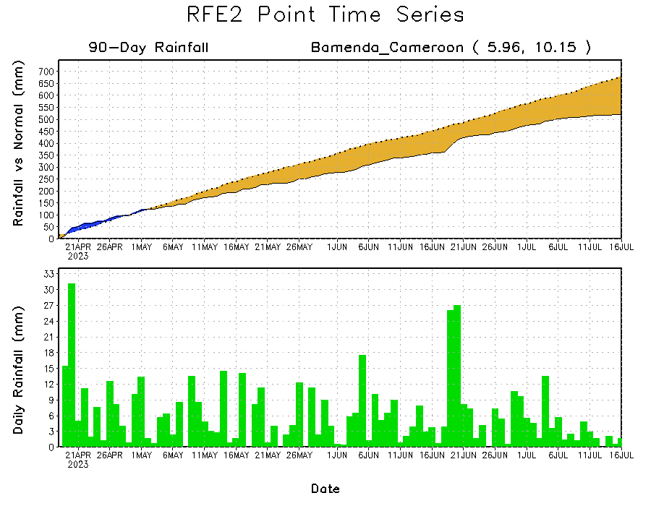
Rainfall Evolution
Daily evolution of rainfall over the last 90 days at selected locations shows light to moderate rainfall maintained moisture surpluses over parts of Ethiopia (top right). Light rain maintained rainfall deficits in western Cameroon (bottom left). Seasonal total rainfall remained below-average over parts of South Sudan (bottom right) despite heavier rainfall around 11 July.

Slide 9
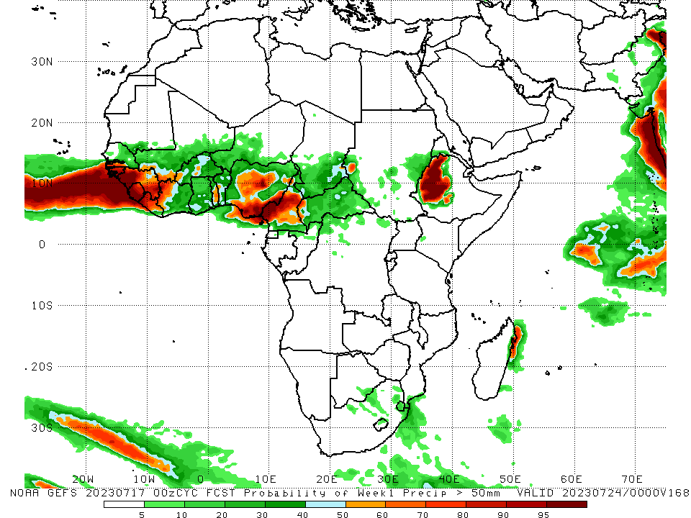
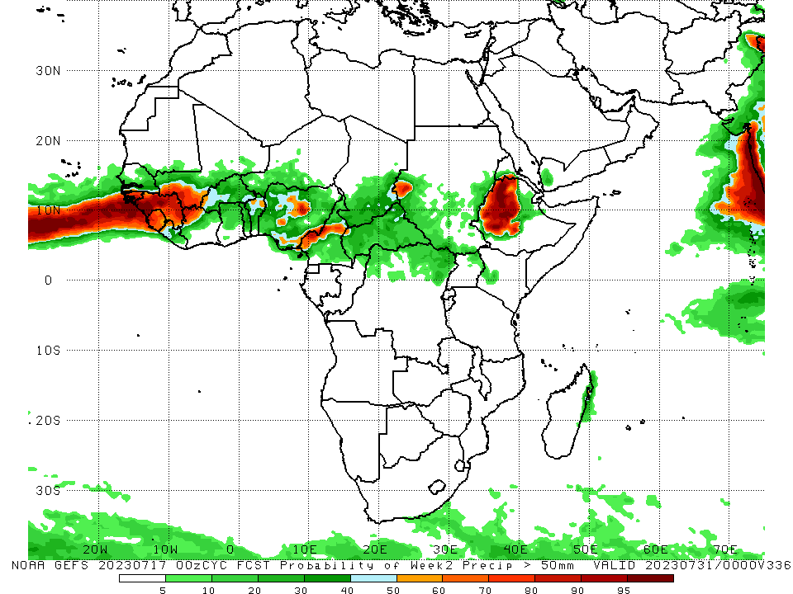
NCEP GEFS Model Forecasts Non-Bias Corrected Probability of precipitation exceedance
Week-1, Valid: 18 – 24 July 2023
Week-2, Valid: 25 – 31 July 2023
For week-1 (left panel), the GEFS forecasts indicate a moderate to high chance (over 70%) for rainfall to exceed 50 mm over much of southwestern Senegal, western and southeastern Guinea, Guinea-Bissau, Sierra Leone, western and central Liberia, northwestern Cote d’Ivoire, parts of central, south-central, and southeastern Nigeria, central and southwestern Cameroon, and western Ethiopia. For week-2 (right panel), the GEFS forecasts indicate a moderate to high chance (over 70%) for rainfall to exceed 50 mm over much of Guinea, Guinea-Bissau, northwestern Cote d’Ivoire, western Sierra Leone, southwestern Mali, parts of central and southeastern Nigeria, west-central Cameroon, parts of southwestern Sudan, and western and central Ethiopia.
Notes:
9

Slide 10
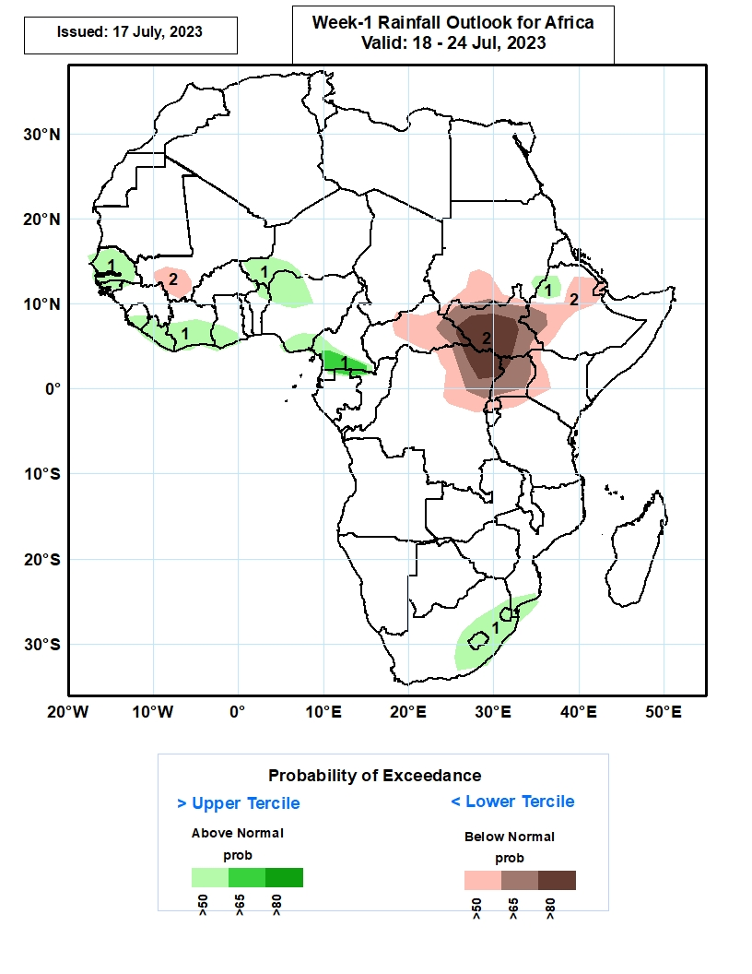
Week-1 Precipitation Outlooks
18 – 24 July 2023
1. The probabilistic forecasts call for above 50% chance for weekly rainfall to be above-normal (above the upper tercile) over much of Senegal, Sierra Leone, Liberia, southern Cote d’Ivoire, western Niger, southern Ghana, northwestern and southeastern Nigeria, southern Cameroon, and parts of northwestern Ethiopia and eastern South Africa, including Lesotho and Eswatini. There is above 65% chance for rainfall to be above-normal over southern Cameroon.
2. The forecasts call for above 50% chance for weekly total rainfall to be below-normal (below the lower tercile) over southwestern Mali, eastern CAR, southern Sudan, much of South Sudan, southwestern, central and northeastern Ethiopia, northeastern DRC, Uganda and western Kenya. There is above 80% chance for rainfall to be below-normal across northeastern DRC and South Sudan.
Notes:
10

Slide 11
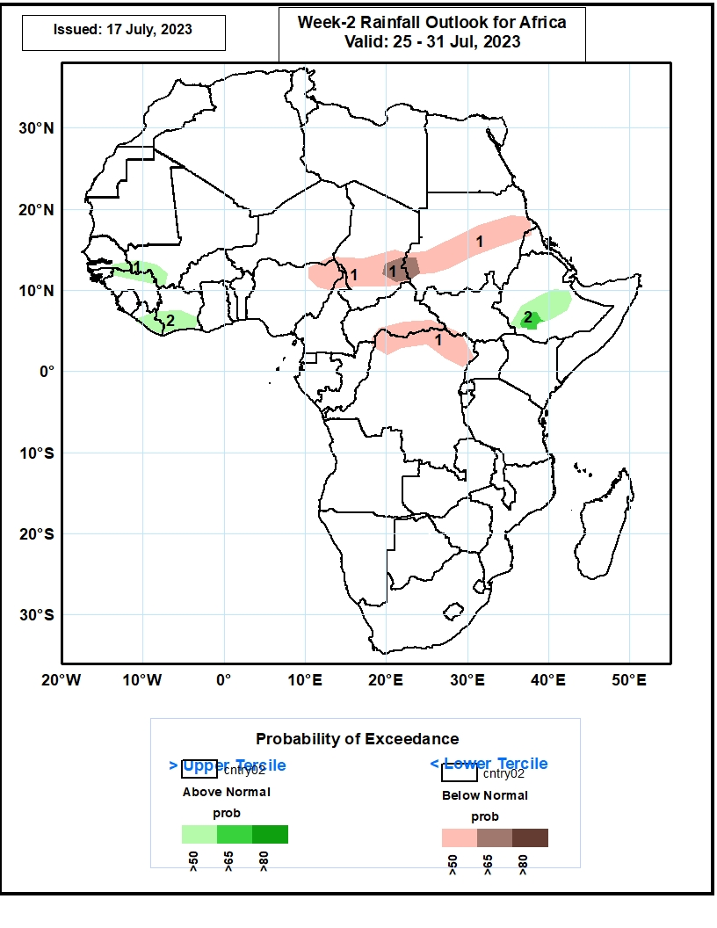
Week-2 Precipitation Outlooks
25 – 31 July 2023
1. The consolidated probabilistic forecasts call for above 50% chance for weekly rainfall to be above-normal (above the upper tercile) over southeastern Senegal, southwestern Mali, Liberia, southern Cote d’Ivoire, and southwestern central and end eastern Ethiopia. There is above 65% chance for rainfall to be above-normal over part of southwestern Ethiopia,
2. The forecasts call for above 50% chance for weekly total rainfall to be below-normal (below the lower tercile) northeastern Nigeria, southern Chad, parts of Sudan, and the far northern DRC. There is above 65% chance for rainfall to be below-normal over the far eastern Chad, and the neighboring areas of western Sudan.
Notes:
11

Slide 12
Summary
Over the past 30 days, in East Africa, above-average rainfall was observed over southern Sudan, north-central, western, and east-central Ethiopia, southern, eastern, and western South Sudan, southwestern Kenya, and northern, western, and eastern Uganda. Rainfall was below-average over north-central and part of southeastern South Sudan, as well as parts of central Ethiopia and western Eritrea. In southern Africa, rainfall was above-average over southern, western, and eastern South Africa, parts of southern and central Mozambique, and parts of southeastern Madagascar. In Central Africa, rainfall was above-average over parts of northern Cameroon, northern Congo, parts of western and central CAR, central Chad, and northeastern, parts of northwestern, and central DRC. Below-average rainfall was observed over pockets of southern and central Cameroon, northern Gabon, Equatorial Guinea, pockets of central and northern DRC, southern Chad, central Congo, and parts of western and southeastern CAR. In West Africa, rainfall was above-average over southern and eastern Senegal, western and southeastern Guinea, Guinea-Bissau, southeastern and southwestern Mali, northern and eastern Sierra Leone, eastern and northwestern Liberia, southern, eastern, and north-central Cote d’Ivoire, western and northern Burkina Faso, most of Ghana, southern and west-central Nigeria, central and southern Togo, central and southern Benin, and parts of western Niger. Below-average rainfall was observed over southwestern and central Liberia, parts of west-central and northwestern Cote d’Ivoire, southeastern Burkina Faso, northern Togo, northern and southern Benin, northeastern Ghana, coastal Sierra Leone, northeastern Guinea, south-central Mali, southeastern and southwestern Niger, and parts of northwestern, southwestern, and much of eastern Nigeria.
During the past 7 days, in East Africa, rainfall was above-average over southeastern and parts of south-central Sudan, west-central and northern Ethiopia, northeastern South Sudan, and northwestern Uganda. Rainfall was below average over east-central and southwestern Sudan, western and southeastern South Sudan, southwestern and parts of central Ethiopia, western Eritrea, and parts of southwestern Kenya. In Central Africa, rainfall was above-average over parts of southwestern CAR, parts of northern Congo, and parts of northeastern and central DRC. Below-average rainfall was observed over Cameroon, southeastern most of western, northern, and eastern CAR, and southern Chad. In West Africa, above-average rainfall was observed over western and southeastern Guinea, eastern Senegal, central Sierra Leone, northeastern Liberia, eastern Cote d’Ivoire, parts of western Nigeria, Ghana, Togo, Benin, southwestern and southeastern Mali, and southwestern Niger. Rainfall was below-average over parts of western Sierra Leone, central and northeastern Guinea, western Burkina Faso, south-central Mali, and most of eastern and southern Nigeria. In Southern Africa, rainfall was above average in parts of southern and eastern South Africa, Eswatini, parts of southern and central Mozambique, and parts of eastern Madagascar.
The Week-1 outlook calls for above-normal rainfall over parts of the Gulf of Guinea and western Sahel regions, including western and northern Senegal, Guinea-Bissau, western and southeastern Guinea, western and central Sierra Leone, Liberia, central Cote d’Ivoire, northern Benin, much of Nigeria, western Cameroon, parts of central and southeastern Mali, eastern Burkina Faso, and western Niger. Rainfall is also expected to be above average in southern Botswana, north-central and eastern South Africa, Lesotho, Eswatini, southern Mozambique, and northeastern Madagascar. In contrast, there is an increased chance for below-normal rainfall over central and eastern Africa, including southwestern Chad, northern and eastern CAR, southern Sudan, South Sudan, northeastern DRC, Uganda, southwestern Kenya, western Eritrea, northern, parts of central, western Ethiopia, and parts of southeastern Madagascar. For week-2, there is an increased chance for above-normal rainfall over western and southeastern Guinea, Sierra Leone, Liberia, parts of western Cote d’Ivoire, and central Ethiopia. In contrast, there is an increased chance for below-normal rainfall over much of eastern Nigeria, Cameroon, southern Chad, southeastern Sudan, eastern South Sudan, Uganda, southwestern Kenya, Eritrea, northeastern and southwestern Ethiopia, and southeastern Madagascar.

