Slide 1
The African Monsoon Recent Evolution and Current Status Include Week-1 and Week-2 Outlooks
Update prepared
24 July 2023
For more information, visit:
http://www.cpc.ncep.noaa.gov/products/Global_Monsoons/African_Monsoons/precip_monitoring.shtml

Slide 2
Outline
Highlights
Recent Evolution and Current Conditions
NCEP GEFS Forecasts
Summary

Slide 3
Highlights: Last 7 Days
During the past 7 days, in East Africa, rainfall was above-average over parts of southeastern and parts of southwestern Sudan, west-central and northern Ethiopia, southwestern Eritrea, and a small portion of northeastern South Sudan. Rainfall was below average over east-central and south-central Sudan, throughout most of South Sudan, southwestern and parts of central and southwestern Ethiopia, northwestern Eritrea, Uganda, and parts of southwestern Kenya. In Central Africa, rainfall was above-average over parts of northeastern and central CAR, parts of central Congo, parts of southeastern and south-central Chad, a small portion of west-central Cameroon, and parts of northwestern DRC. Below-average rainfall was observed over most of Cameroon, parts of western, central, and southeastern CAR, northern Congo, and southwestern and west-central Chad. In West Africa, above-average rainfall was observed over western Guinea, eastern most of Senegal, southern Mauritania, Sierra Leone, eastern and western Liberia, southern Cote d’Ivoire, parts of western Nigeria, southern Ghana, central Benin, southwestern Mali, southeastern Burkina Faso, and parts of south-central Niger. Rainfall was below-average over parts of eastern Guinea, western Burkina Faso, south-central Mali, northeastern Cote d’Ivoire, northern Ghana, northern Togo, northern Benin, most of southern Niger, and most of eastern and parts of south-central Nigeria. In Southern Africa, rainfall was above average in parts of northeastern South Africa and parts of northeastern Madagascar.
The Week-1 outlook calls for above-normal rainfall over parts of the western Gulf of Guinea and western portions of central Africa, including western Guinea-Bissau, western Guinea, southeastern Nigeria, central and southern Cameroon, northern Congo, and parts of western and central CAR. Rainfall is also expected to be above normal over portions of west-central Ethiopia, southern and western South Africa, and Lesotho. In contrast, there is an increased chance for below-normal rainfall over the Sahel, most of the Gulf of Guinea, and eastern Africa, including southern Mali, eastern Guinea, southern Liberia, Burkina Faso, southern and northern Cote d’Ivoire, Ghana, Togo, Benin, southern Niger, central, northern, and southwestern Nigeria, central and southern Chad, southern Sudan, eastern South Sudan, Uganda, northern and central Ethiopia, Eritrea, southwestern Kenya, and east-central DRC. Rainfall is also expected to be below average over eastern Madagascar. For week-2, there is an increased chance for above-normal rainfall over the Gulf of Guinea region, parts of central Africa, and parts of eastern Africa. This includes southern Guinea, Sierra Leone, Liberia, Cote d’Ivoire, Ghana, southern Togo, southern Benin, central and southern Nigeria, southern Cameroon, northern Congo, northern DRC, western CAR, western South Sudan, southwestern Sudan, and northwestern Ethiopia. Rainfall is also expected to be above average over eastern Madagascar. In contrast, there is an increased chance for below-normal rainfall over much of the Sahel, including Senegal, The Gambia, Guinea-Bissau, northern Guinea, southern Mali, southern Niger, central Chad, and Eritrea. Rainfall is also expected to be below average over Uganda and southwestern Kenya.

Slide 4
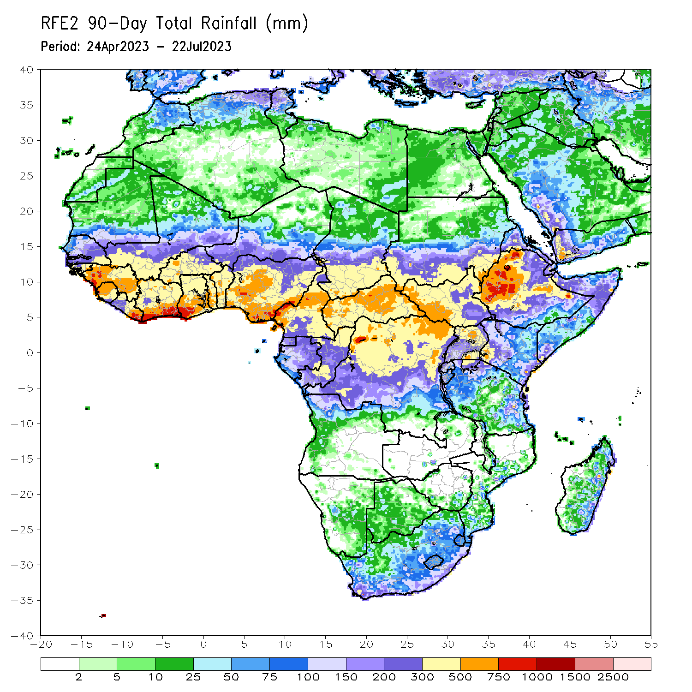
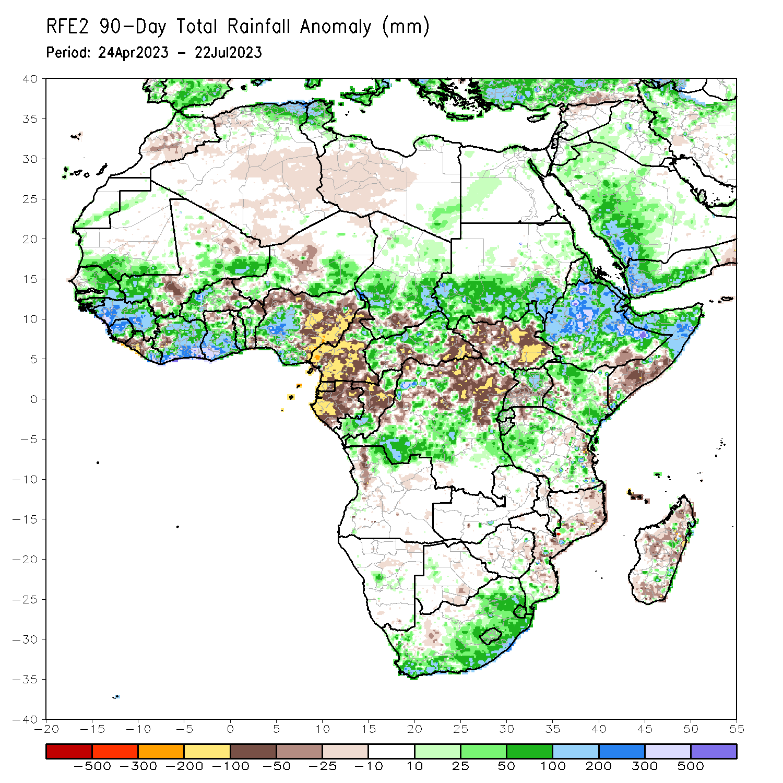
Rainfall Patterns: Last 90 Days
Over the past 90 days, in East Africa, above-average rainfall was observed over much of Eritrea (outside of far western portions), Ethiopia (outside of southern portions), northern and parts of far southeastern Somalia, northwestern, far southwestern, and southeastern Kenya, Djibouti, northern and parts of southern Uganda, western and parts of eastern Tanzania, Burundi, Rwanda, southern and eastern Sudan, and far northwestern, northeastern, and southwestern South Sudan. Rainfall was below-average over much of central and southeastern South Sudan, parts of central and southern Somalia, parts of west-central Kenya, parts of central Uganda, parts of southern Ethiopia, and east-central Tanzania. In southern Africa, above-average rainfall was observed over parts of northern Angola, parts of eastern, western, and southern South Africa, Lesotho, Eswatini, parts of central Namibia, and parts of eastern Madagascar. Below-average rainfall was observed over a small portion of northwestern Angola, south-central Botswana, north-central South Africa, east-central Zimbabwe, southern, central, and northeastern Mozambique, and parts of northern, central, and southern Madagascar. In Central Africa, rainfall was above-average over parts of northern Cameroon, western, central, and northeastern CAR, southern and northern Congo, much of southeastern, southwestern, and central Chad, and southwestern, parts of central, parts of northwestern, and parts of eastern DRC. Rainfall was below-average over parts of central and southern Cameroon, Equatorial Guinea, much of Gabon, central Congo, parts of southeastern and south-central CAR, and parts of central and northern DRC. In West Africa, rainfall was above-average over most of Senegal, much of Guinea, Guinea-Bissau, northern and central Sierra Leone, northwestern and eastern Liberia, most of Cote d’Ivoire, southeastern and southwestern Mali, western and southeastern Burkina Faso, The Gambia, southern Mauritania, central and southern Ghana, Togo, central and northwestern Benin, southeastern and southwestern Niger, and south-central, west-central, and northeastern Nigeria. Below-average rainfall was observed over parts of eastern Burkina Faso, northwestern and much of eastern Nigeria, northeastern and southern Benin, northwestern Ghana, west-central Cote d’Ivoire, central and southwestern Liberia, southern Sierra Leone, and south-central Mali.
Notes:
4

Slide 5
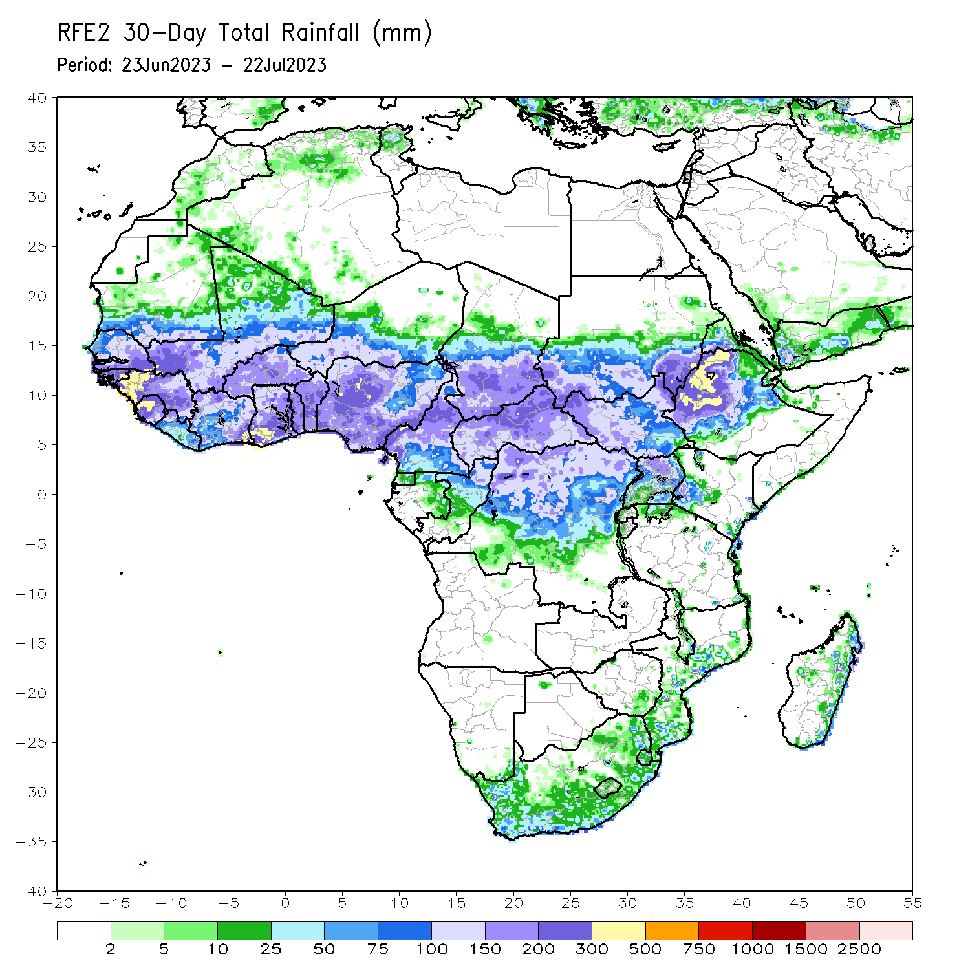
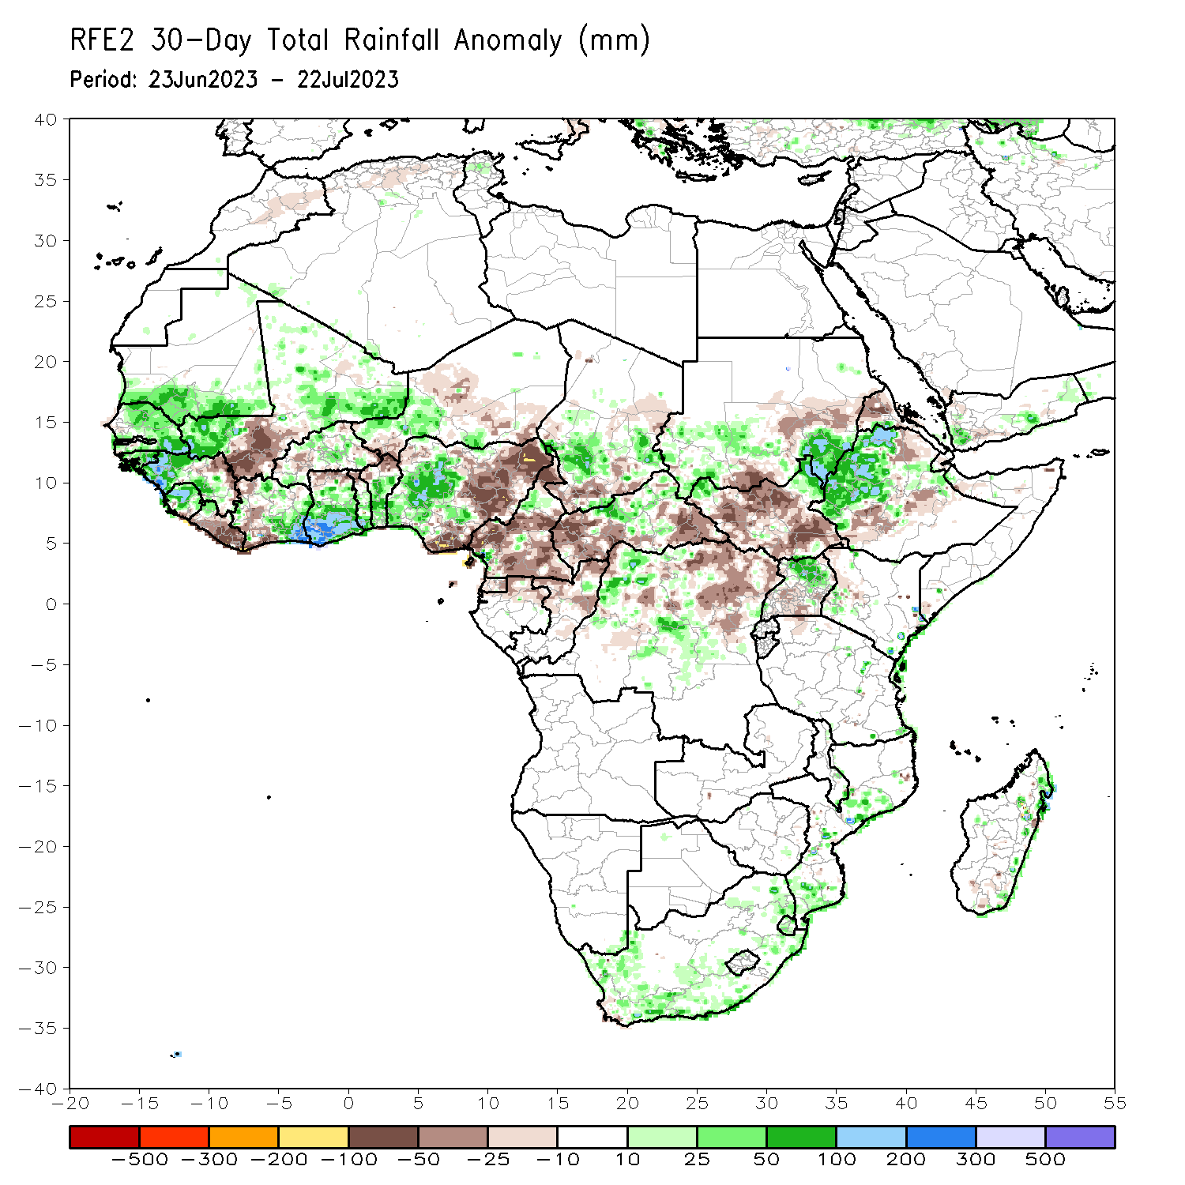
Rainfall Patterns: Last 30 Days
Over the past 30 days, in East Africa, above-average rainfall was observed over southeastern and southwestern Sudan, north-central, western, and east-central Ethiopia, northeastern and northwestern South Sudan, southwestern Kenya, and northern Uganda. Rainfall was below-average over north-central and parts of southern South Sudan, central Ethiopia, western Eritrea, and south-central Uganda. In southern Africa, rainfall was above-average over southern, western, and eastern South Africa, parts of southern and central Mozambique, and parts of eastern Madagascar. In Central Africa, rainfall was above-average over parts of north-central Cameroon, parts of north-central CAR, central Chad, and northwestern and central DRC. Below-average rainfall was observed over pockets of southern, central, and far northern Cameroon, northern Gabon, Equatorial Guinea, pockets of central and northeastern DRC, southern Chad, central and northern Congo, and parts of western and southeastern CAR. In West Africa, rainfall was above-average over Senegal, western and southeastern Guinea, Guinea-Bissau, southeastern and southwestern Mali, northern and eastern Sierra Leone, northwestern Liberia, eastern and north-central Cote d’Ivoire, parts of western and central Burkina Faso, southern and central Ghana, southwestern and west-central Nigeria, central and southern Togo, central and southern Benin, parts of western Niger, and southern Mauritania. Below-average rainfall was observed over southwestern, central, and eastern Liberia, parts of western Cote d’Ivoire, west-central and eastern Burkina Faso, northern Togo, northern Benin, northern Ghana, southern Sierra Leone, northeastern Guinea, south-central Mali, central, southeastern, and southwestern Niger, and parts of northwestern and much of eastern Nigeria.
Notes:
5

Slide 6
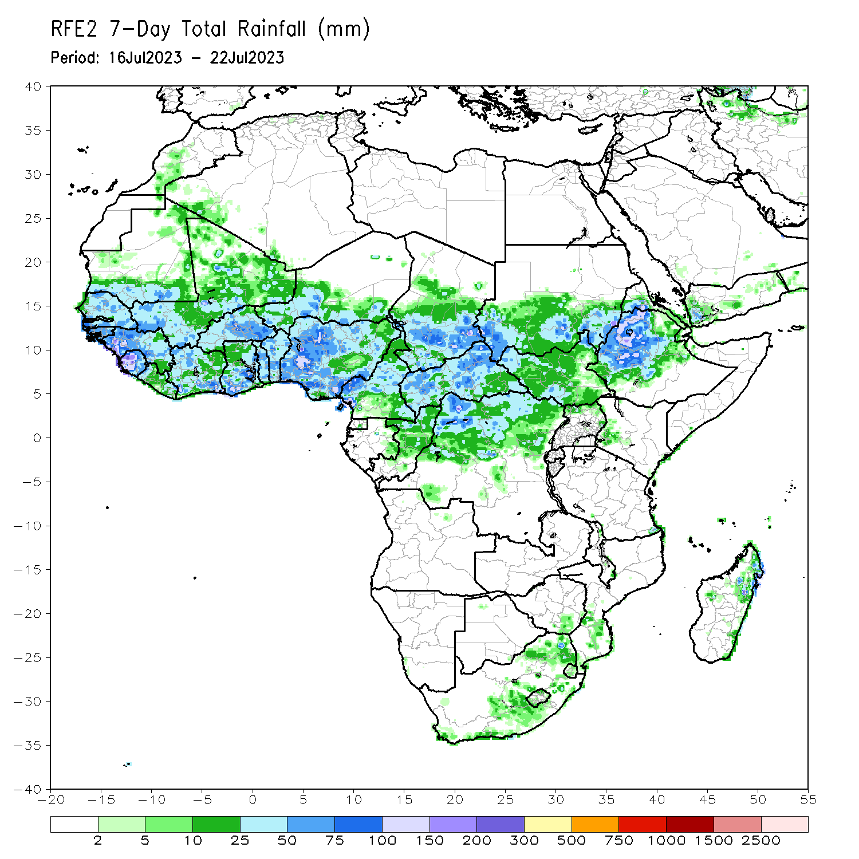
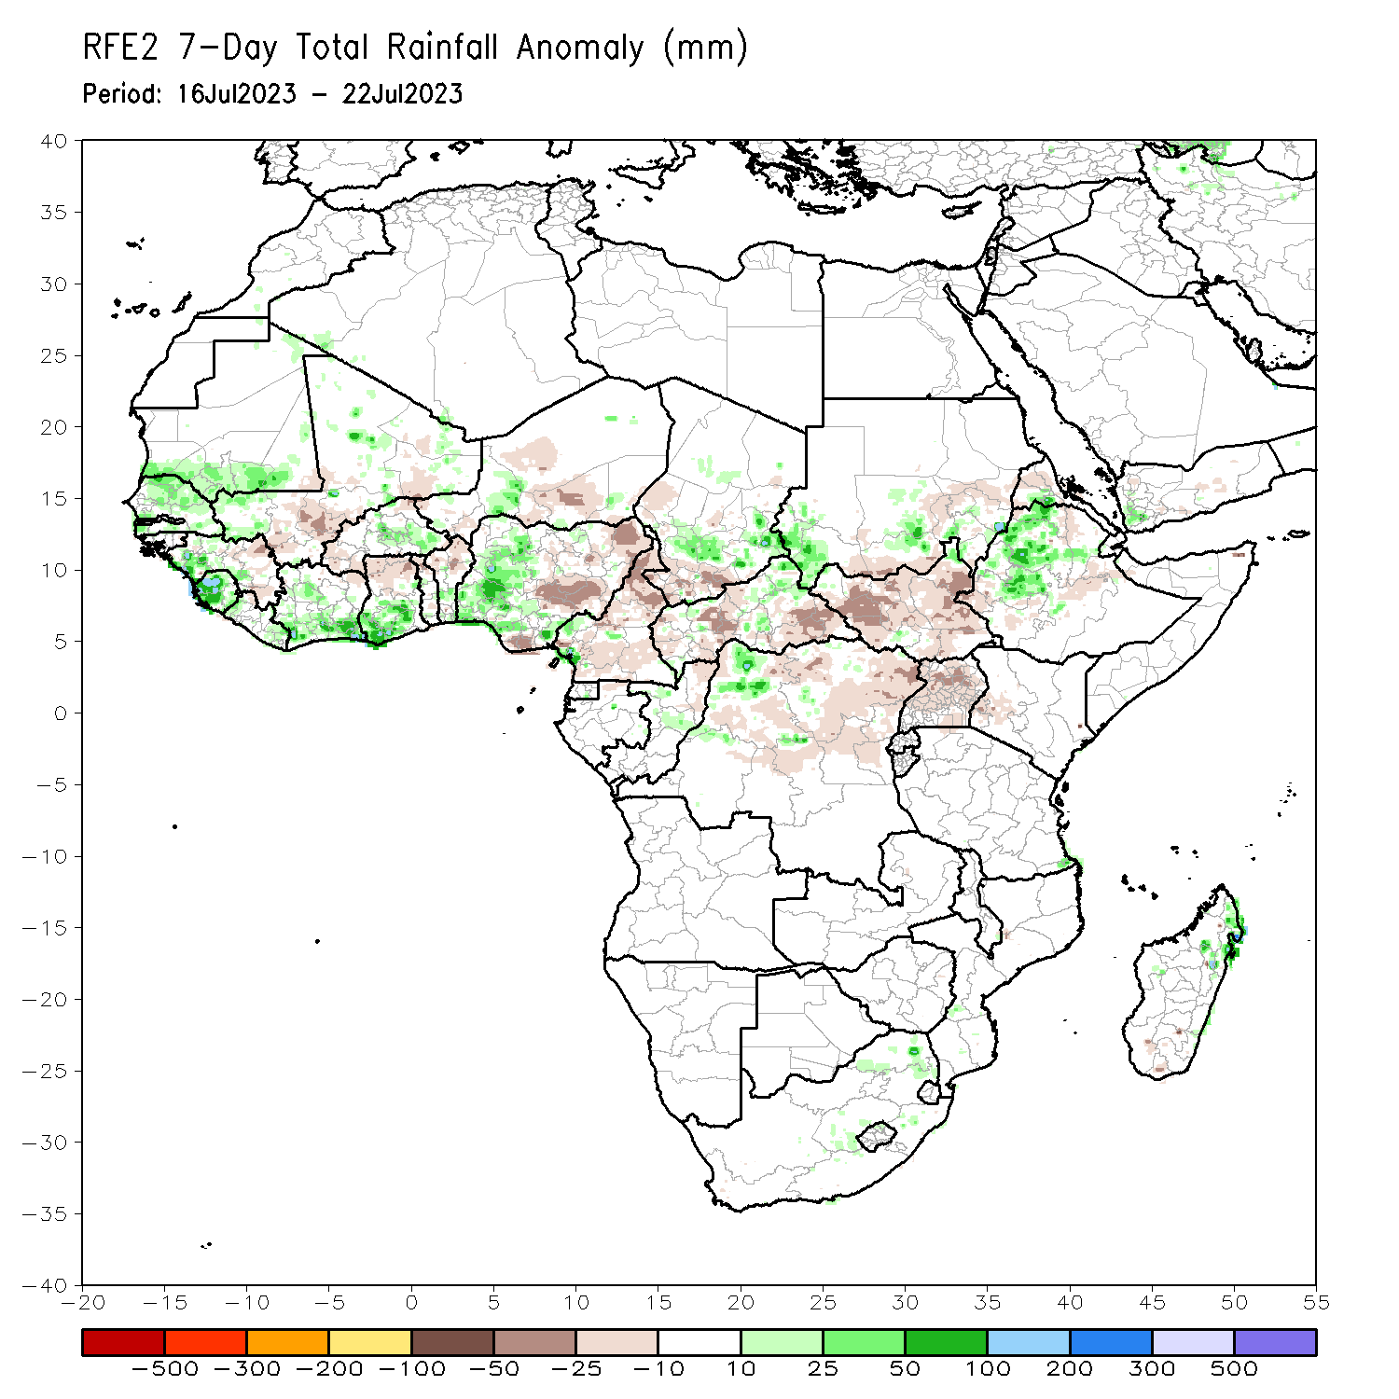
Rainfall Patterns: Last 7 Days
During the past 7 days, in East Africa, rainfall was above-average over parts of southeastern and parts of southwestern Sudan, west-central and northern Ethiopia, southwestern Eritrea, and a small portion of northeastern South Sudan. Rainfall was below average over east-central and south-central Sudan, throughout most of South Sudan, southwestern and parts of central and southwestern Ethiopia, northwestern Eritrea, Uganda, and parts of southwestern Kenya. In Central Africa, rainfall was above-average over parts of northeastern and central CAR, parts of central Congo, parts of southeastern and south-central Chad, a small portion of west-central Cameroon, and parts of northwestern DRC. Below-average rainfall was observed over most of Cameroon, parts of western, central, and southeastern CAR, northern Congo, and southwestern and west-central Chad. In West Africa, above-average rainfall was observed over western Guinea, eastern most of Senegal, southern Mauritania, Sierra Leone, eastern and western Liberia, southern Cote d’Ivoire, parts of western Nigeria, southern Ghana, central Benin, southwestern Mali, southeastern Burkina Faso, and parts of south-central Niger. Rainfall was below-average over parts of eastern Guinea, western Burkina Faso, south-central Mali, northeastern Cote d’Ivoire, northern Ghana, northern Togo, northern Benin, most of southern Niger, and most of eastern and parts of south-central Nigeria. In Southern Africa, rainfall was above average in parts of northeastern South Africa and parts of northeastern Madagascar.

Slide 7
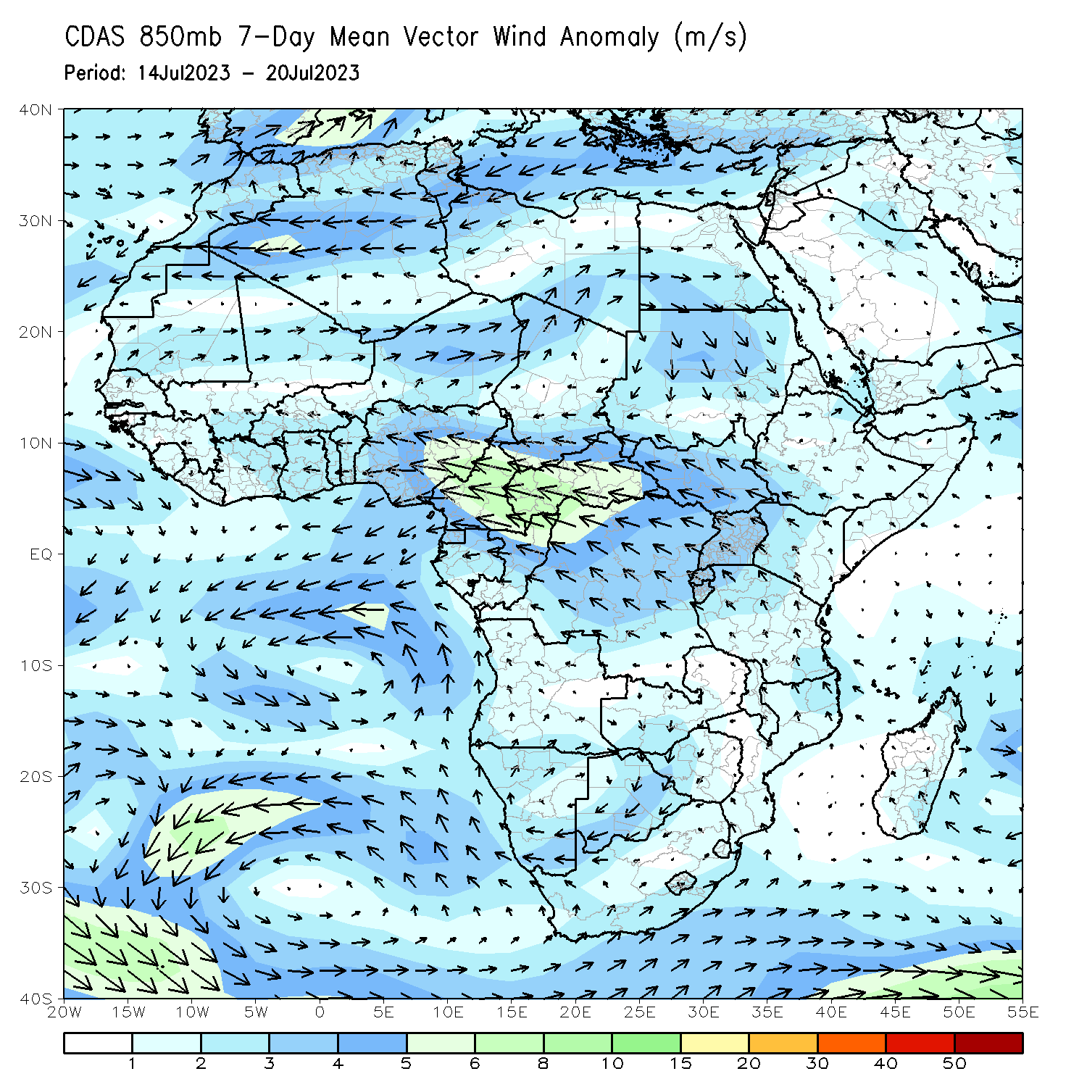
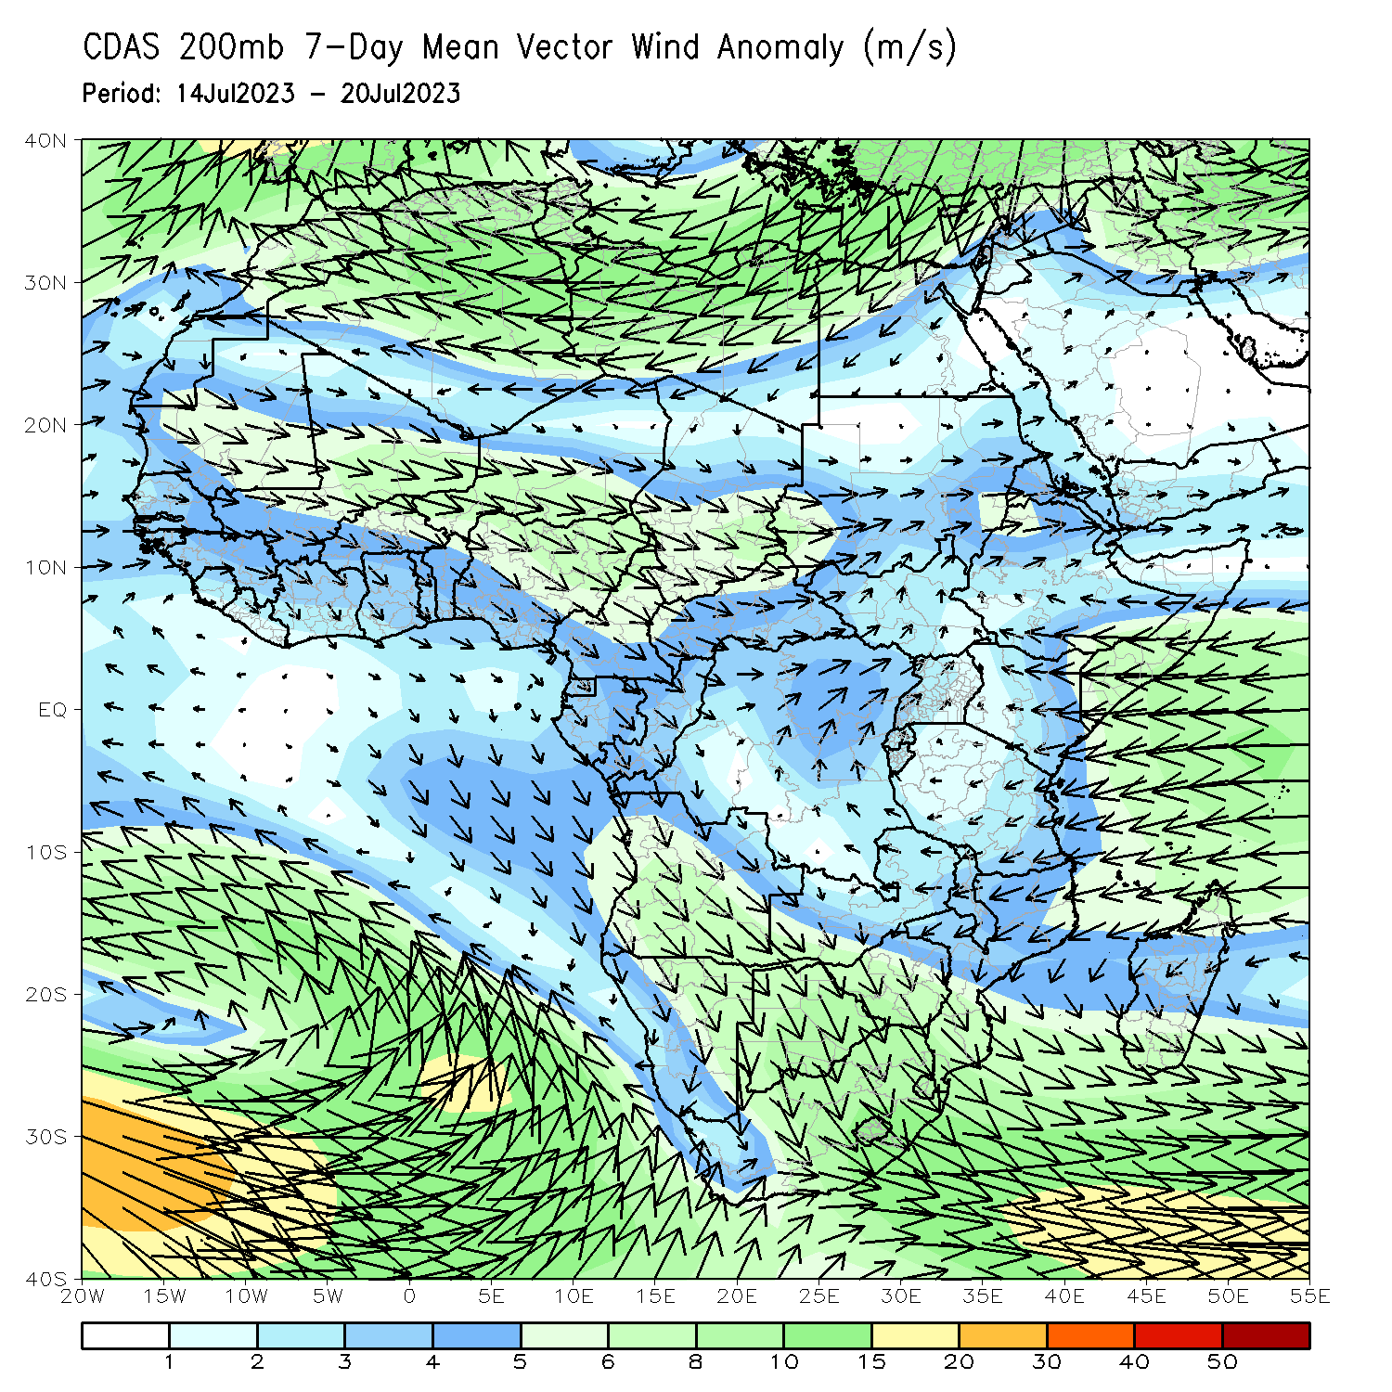
Atmospheric Circulation: Last 7 Days
At 850-hPa (left panel), anomalous lower-level convergence (and slightly anomalous on-shore flow) in the central and eastern Gulf of Guinea region may have contributed to the observed above-average rainfall in the region. Convergence may have contributed to the observed above-average rainfall in Ethiopia as well. At 200-hPa (right panel), anomalous convergence near South Sudan/Uganda/northeastern DRC may have contributed to below-average rainfall.

Slide 8
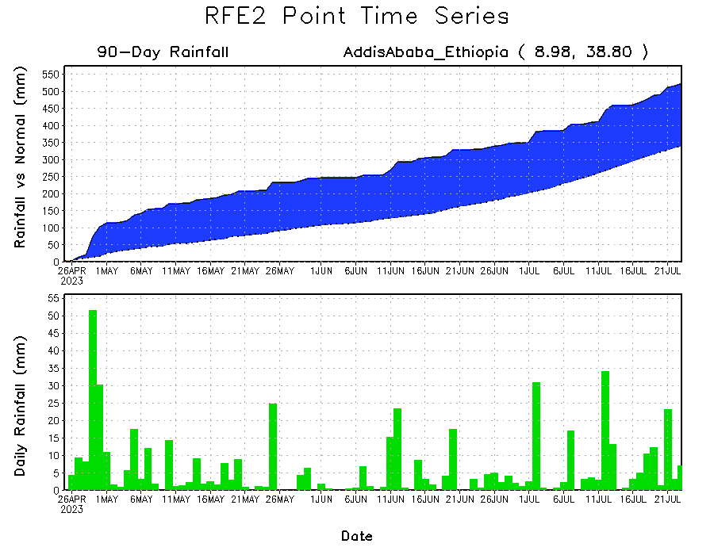
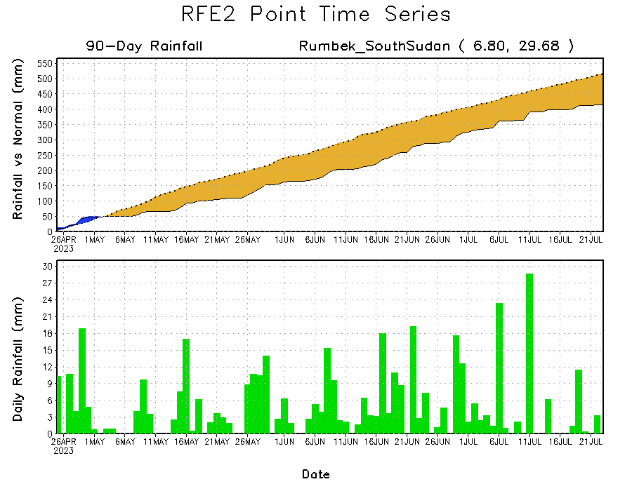
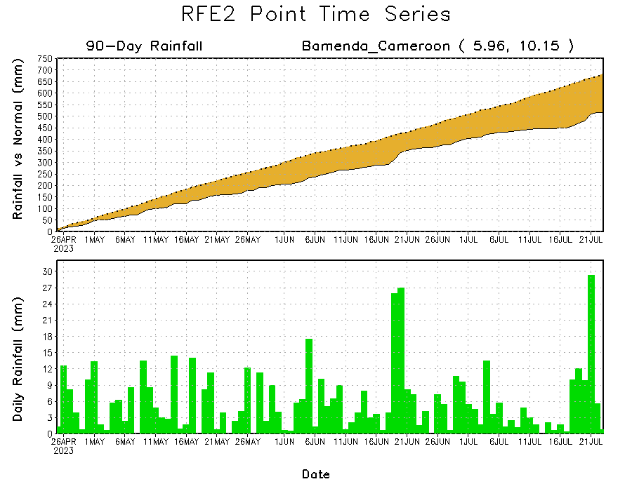
Rainfall Evolution
Daily evolution of rainfall over the last 90 days at selected locations shows light to moderate rainfall maintained moisture surpluses over parts of Ethiopia (top right). Moderate rainfall cut into the deficits slightly in western Cameroon (bottom left). Seasonal total rainfall remained below-average over parts of central South Sudan (bottom right) due to the trace amounts of rainfall this past week.

Slide 9
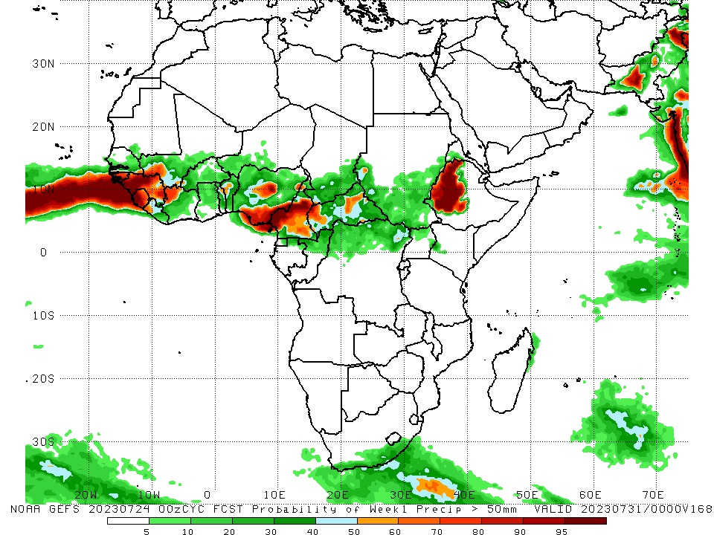
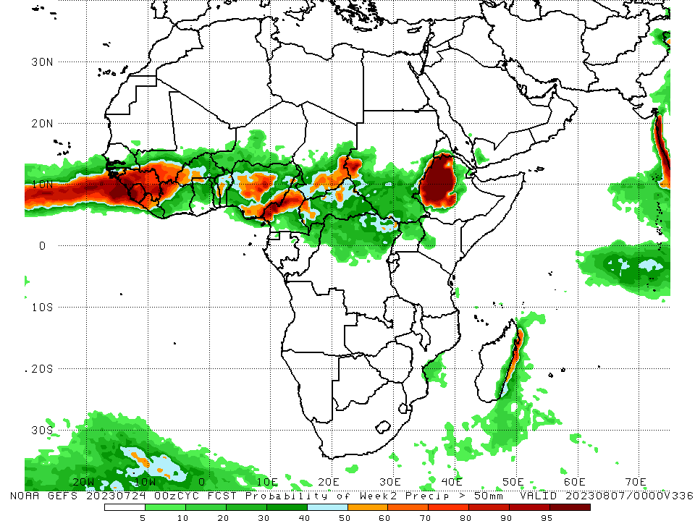
NCEP GEFS Model Forecasts Non-Bias Corrected Probability of precipitation exceedance
Week-1, Valid: 25 – 31 July 2023
Week-2, Valid: 01 – 07 August 2023
For week-1 (left panel), the GEFS forecasts indicate a moderate to high chance (over 70%) for rainfall to exceed 50 mm over much of western and southeastern Guinea, Guinea-Bissau, Sierra Leone, southwestern Mali, northwestern Cote d’Ivoire, parts of central, south-central, and southeastern Nigeria, central and southwestern Cameroon, northwestern CAR, and western and northern Ethiopia. For week-2 (right panel), the GEFS forecasts indicate a moderate to high chance (over 70%) for rainfall to exceed 50 mm over much of Guinea, southern Guinea-Bissau, northwestern Cote d’Ivoire, Sierra Leone, southwestern Mali, parts of central and southeastern Nigeria, western Burkina Faso, central and southwestern Cameroon, southeastern Chad, northwestern CAR, parts of southwestern Sudan, western, central, and northern Ethiopia, parts of southwestern Eritrea, and parts of northeastern Madagascar.
Notes:
9

Slide 10
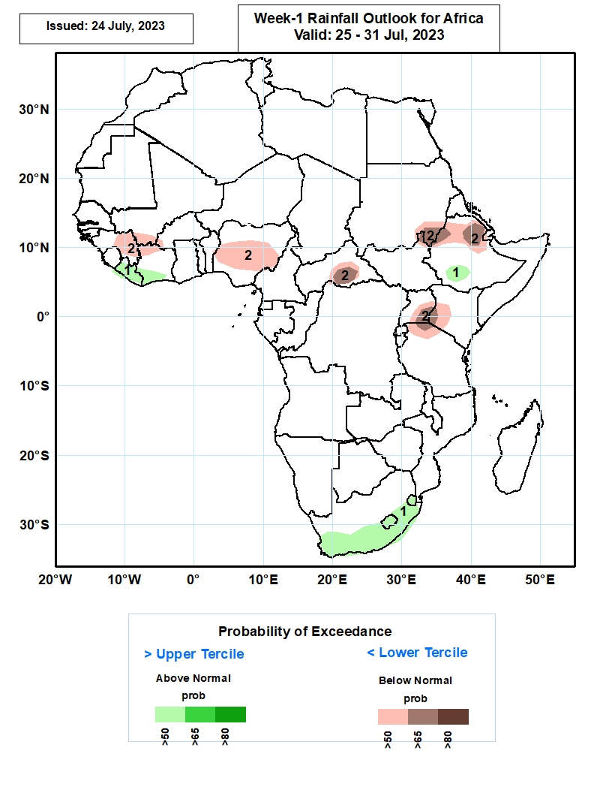
Week-1 Precipitation Outlooks
25 – 31 July 2023
1. The probabilistic forecasts call for above 50% chance for weekly rainfall to be above-normal (above the upper tercile) over Liberia, southwestern Cot d’Ivoire, southern Ethiopia, and the southern and eastern parts of South Africa, including Lesotho and Eswatini.
2. The forecasts call for above 50% chance for weekly total rainfall to be below-normal (below the lower tercile) over astern Guina, the far southern Mali, northwestern Cot d’Ivoir, central and southern Nigeria, southern CAR, southastrn Sudan, northern Ethiopia, and near Uganda/Tanzania/Kenya tri-border. There is above 65% chance for rainfall to be below-normal over part of southern CAR. Southeastern Sudan, northeastern Ethiopia, and near Uganda/Tanzania/Kenya tri-border.
Notes:
10

Slide 11
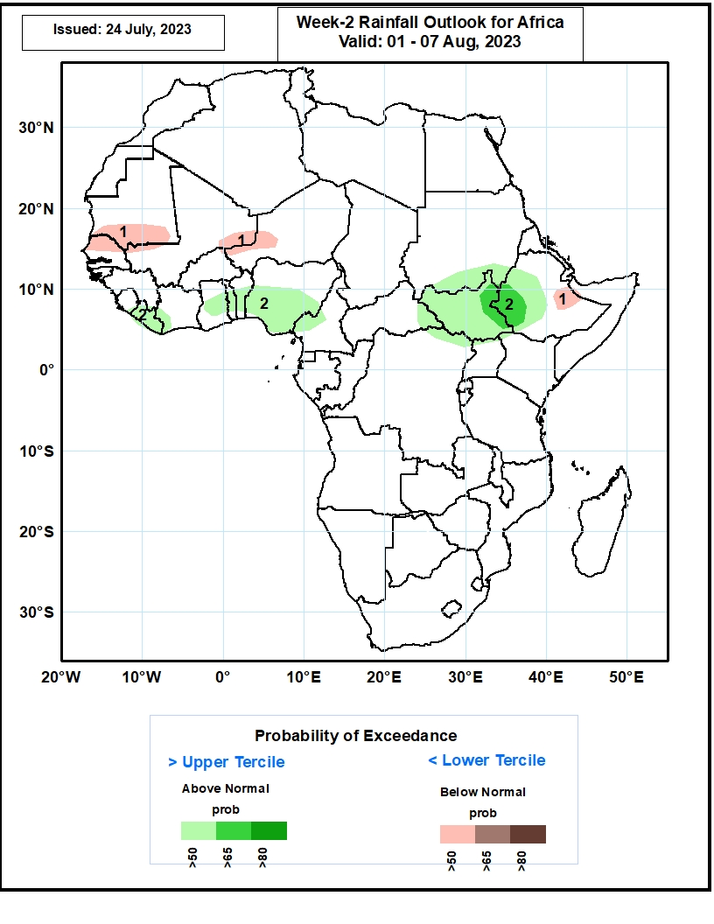
Week-2 Precipitation Outlooks
01 – 07 August 2023
1. The consolidated probabilistic forecasts call for above 50% chance for weekly total rainfall to be below-normal (below the lower tercile) over southern Mauritania, northern Senegal, northeastern Mali and the neighboring areas of Niger, and the far eastern Ethiopia.
2. The forecasts call for above 50% chance for weekly rainfall to be above-normal (above the upper tercile) over Liberia, central Ghana, Togo, Benin, southern Nigeria, much of South Sudan and the neighboring areas of Sudan and CAR,, and southwestern and central Ethiopia.
Notes:
11

Slide 12
Summary
Over the past 30 days, in East Africa, above-average rainfall was observed over southeastern and southwestern Sudan, north-central, western, and east-central Ethiopia, northeastern and northwestern South Sudan, southwestern Kenya, and northern Uganda. Rainfall was below-average over north-central and parts of southern South Sudan, central Ethiopia, western Eritrea, and south-central Uganda. In southern Africa, rainfall was above-average over southern, western, and eastern South Africa, parts of southern and central Mozambique, and parts of eastern Madagascar. In Central Africa, rainfall was above-average over parts of north-central Cameroon, parts of north-central CAR, central Chad, and northwestern and central DRC. Below-average rainfall was observed over pockets of southern, central, and far northern Cameroon, northern Gabon, Equatorial Guinea, pockets of central and northeastern DRC, southern Chad, central and northern Congo, and parts of western and southeastern CAR. In West Africa, rainfall was above-average over Senegal, western and southeastern Guinea, Guinea-Bissau, southeastern and southwestern Mali, northern and eastern Sierra Leone, northwestern Liberia, eastern and north-central Cote d’Ivoire, parts of western and central Burkina Faso, southern and central Ghana, southwestern and west-central Nigeria, central and southern Togo, central and southern Benin, parts of western Niger, and southern Mauritania. Below-average rainfall was observed over southwestern, central, and eastern Liberia, parts of western Cote d’Ivoire, west-central and eastern Burkina Faso, northern Togo, northern Benin, northern Ghana, southern Sierra Leone, northeastern Guinea, south-central Mali, central, southeastern, and southwestern Niger, and parts of northwestern and much of eastern Nigeria.
During the past 7 days, in East Africa, rainfall was above-average over parts of southeastern and parts of southwestern Sudan, west-central and northern Ethiopia, southwestern Eritrea, and a small portion of northeastern South Sudan. Rainfall was below average over east-central and south-central Sudan, throughout most of South Sudan, southwestern and parts of central and southwestern Ethiopia, northwestern Eritrea, Uganda, and parts of southwestern Kenya. In Central Africa, rainfall was above-average over parts of northeastern and central CAR, parts of central Congo, parts of southeastern and south-central Chad, a small portion of west-central Cameroon, and parts of northwestern DRC. Below-average rainfall was observed over most of Cameroon, parts of western, central, and southeastern CAR, northern Congo, and southwestern and west-central Chad. In West Africa, above-average rainfall was observed over western Guinea, eastern most of Senegal, southern Mauritania, Sierra Leone, eastern and western Liberia, southern Cote d’Ivoire, parts of western Nigeria, southern Ghana, central Benin, southwestern Mali, southeastern Burkina Faso, and parts of south-central Niger. Rainfall was below-average over parts of eastern Guinea, western Burkina Faso, south-central Mali, northeastern Cote d’Ivoire, northern Ghana, northern Togo, northern Benin, most of southern Niger, and most of eastern and parts of south-central Nigeria. In Southern Africa, rainfall was above average in parts of northeastern South Africa and parts of northeastern Madagascar.
The Week-1 outlook calls for above-normal rainfall over parts of the western Gulf of Guinea and western portions of central Africa, including western Guinea-Bissau, western Guinea, southeastern Nigeria, central and southern Cameroon, northern Congo, and parts of western and central CAR. Rainfall is also expected to be above normal over portions of west-central Ethiopia, southern and western South Africa, and Lesotho. In contrast, there is an increased chance for below-normal rainfall over the Sahel, most of the Gulf of Guinea, and eastern Africa, including southern Mali, eastern Guinea, southern Liberia, Burkina Faso, southern and northern Cote d’Ivoire, Ghana, Togo, Benin, southern Niger, central, northern, and southwestern Nigeria, central and southern Chad, southern Sudan, eastern South Sudan, Uganda, northern and central Ethiopia, Eritrea, southwestern Kenya, and east-central DRC. Rainfall is also expected to be below average over eastern Madagascar. For week-2, there is an increased chance for above-normal rainfall over the Gulf of Guinea region, parts of central Africa, and parts of eastern Africa. This includes southern Guinea, Sierra Leone, Liberia, Cote d’Ivoire, Ghana, southern Togo, southern Benin, central and southern Nigeria, southern Cameroon, northern Congo, northern DRC, western CAR, western South Sudan, southwestern Sudan, and northwestern Ethiopia. Rainfall is also expected to be above average over eastern Madagascar. In contrast, there is an increased chance for below-normal rainfall over much of the Sahel, including Senegal, The Gambia, Guinea-Bissau, northern Guinea, southern Mali, southern Niger, central Chad, and Eritrea. Rainfall is also expected to be below average over Uganda and southwestern Kenya.

