Slide 1
The African Monsoon Recent Evolution and Current Status Include Week-1 and Week-2 Outlooks
Update prepared
16 October 2023
For more information, visit:
http://www.cpc.ncep.noaa.gov/products/Global_Monsoons/African_Monsoons/precip_monitoring.shtml

Slide 2
Outline
Highlights
Recent Evolution and Current Conditions
NCEP GEFS Forecasts
Summary

Slide 3
Highlights: Last 7 Days
During the past 7 days, in East Africa, rainfall was above-average over parts of western and southern Ethiopia, southern Sudan, western and southern South Sudan, much of Uganda, southwestern Kenya, western Burundi, and parts of northwestern and southeastern Tanzania. Below-average rainfall was observed over southern Somalia, eastern Kenya, and northeastern South Sudan. In central Africa, above-average rainfall was observed over parts of south-central Chad, northwestern, southern, and eastern CAR, much of DRC, southern and eastern Congo, parts of western and eastern Gabon, and southwestern Cameroon. Rainfall was below-average over parts of southwestern CAR, central and northwestern Congo, northern and southeastern Gabon, Equatorial Guinea, and much of Cameroon. In West Africa, above-average rainfall was observed over parts of northwestern and southern Senegal, Guinea-Bissau, western and central Guinea, northern and central Sierra Leone, southern, central, and northeastern Cote d’Ivoire, parts of central Burkina Faso, southern and central Ghana, Togo, central and southern Benin, parts of southern and central Nigeria, and parts of southwestern Mali. Below-average rainfall was observed over parts of southwestern Mali, southern Sierra Leone, much of Liberia, northwestern Cote d’Ivoire, northeastern Benin, southwestern Burkina Faso, and central Nigeria. In southern Africa, rainfall was above-average over parts of south-central and central South Africa, Lesotho, northeastern and central Angola, northern Zambia, southern Zimbabwe, and parts of southern Mozambique.
The Week-1 outlook calls for above-normal rainfall in most of central and eastern Africa, as well as in parts of southern Africa (northeastern Angola, Zambia, Zimbabwe, Mozambique, central and southeastern Madagascar, and parts of southeastern South Africa). In contrast, there is an increased chance for below-normal rainfall across the western and central Gulf of Guinea region, northern Cameroon, southern Chad, northern CAR, southwestern Gabon, southern Congo, parts of western Angola, parts of eastern and southern Tanzania, Lesotho, Eswatini, parts of central and southern South Africa, and northeastern Madagascar. For Week-2, there is an increased chance for above-normal rainfall across most of central and northern parts of eastern Africa (Ethiopia, Somalia, and northeastern Kenya), southern Zimbabwe, and parts of central Madagascar. In contrast, there is an increased chance for below-normal rainfall in the western and central Gulf of Guinea region, east-central DRC, most of the southern portion of eastern Africa (southern Uganda, southwestern Kenya, and Tanzania), Lesotho, southern and central South Africa, and northeastern Madagascar.

Slide 4
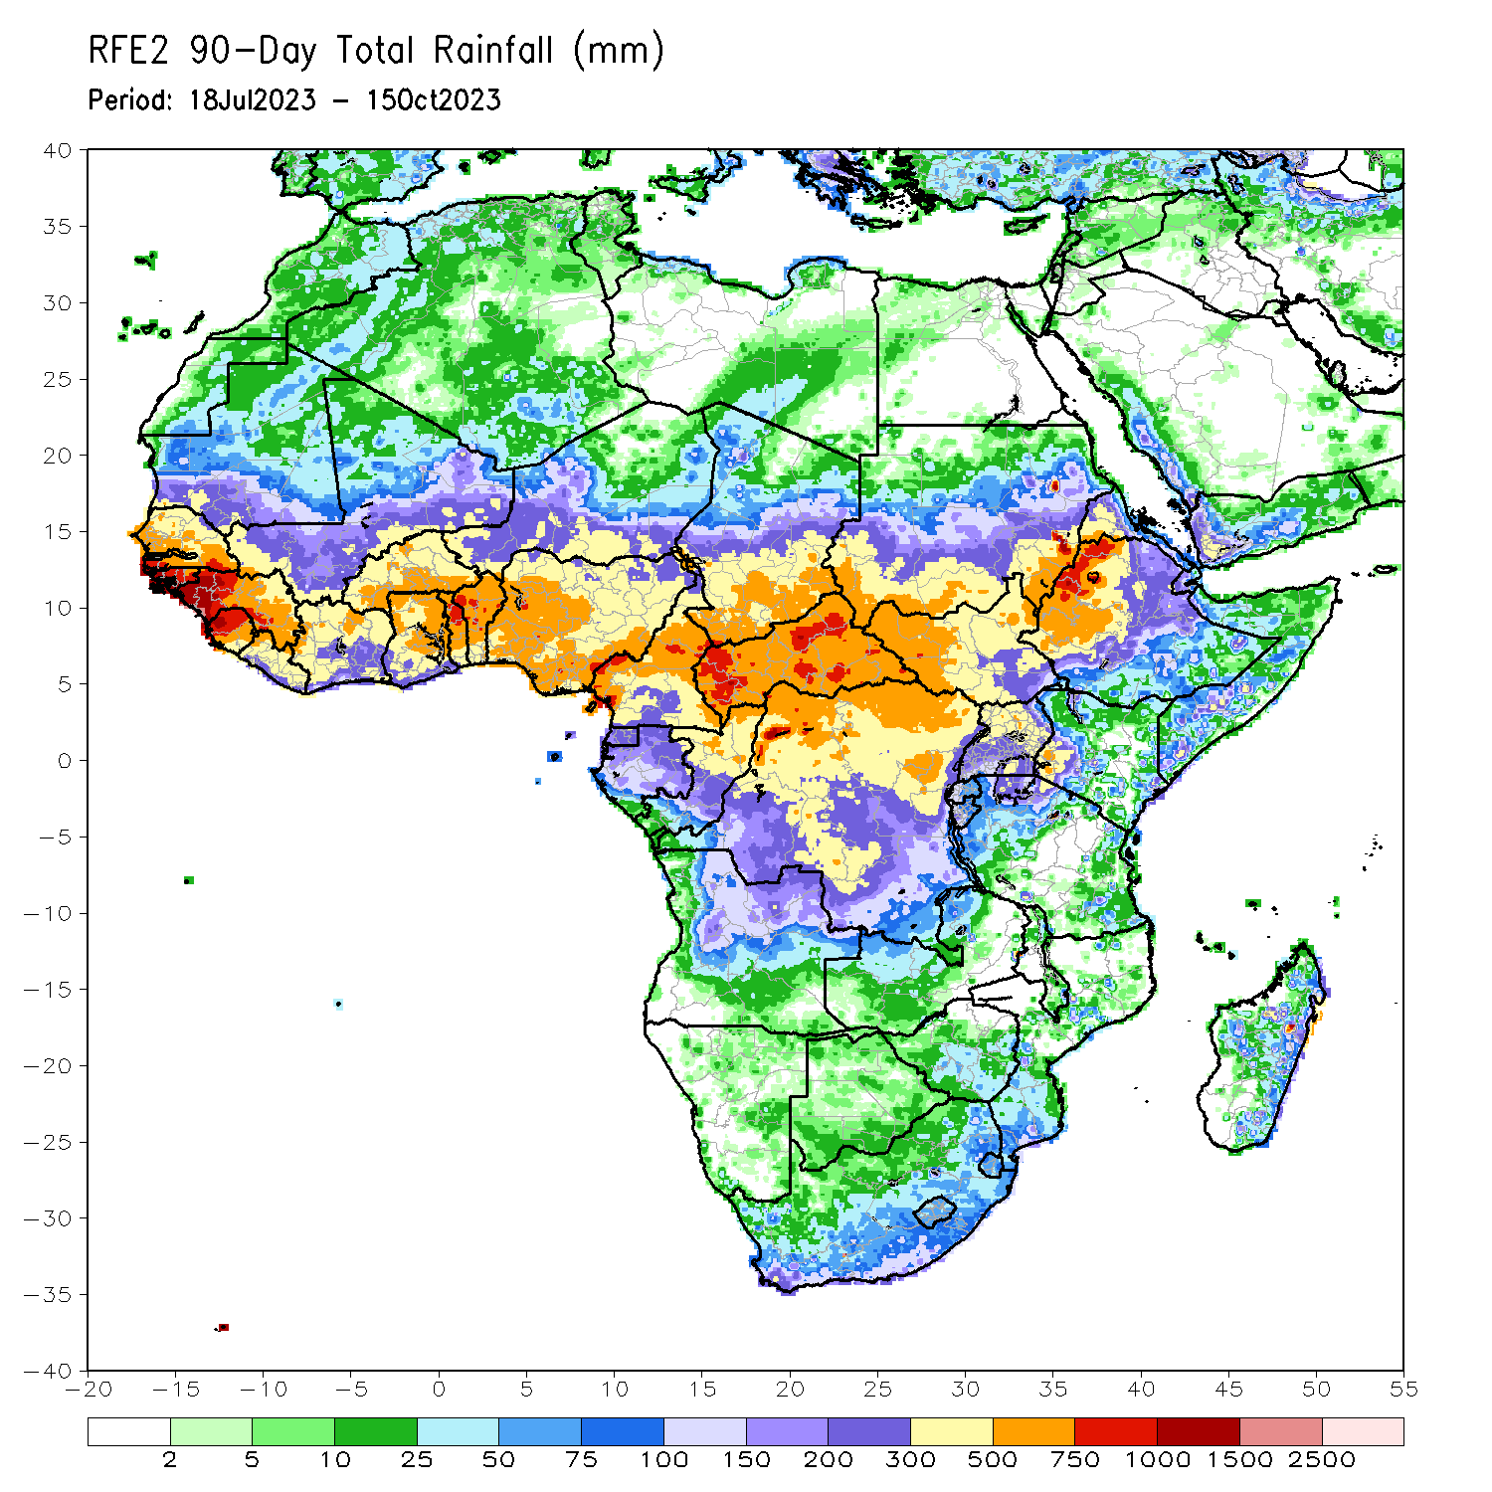
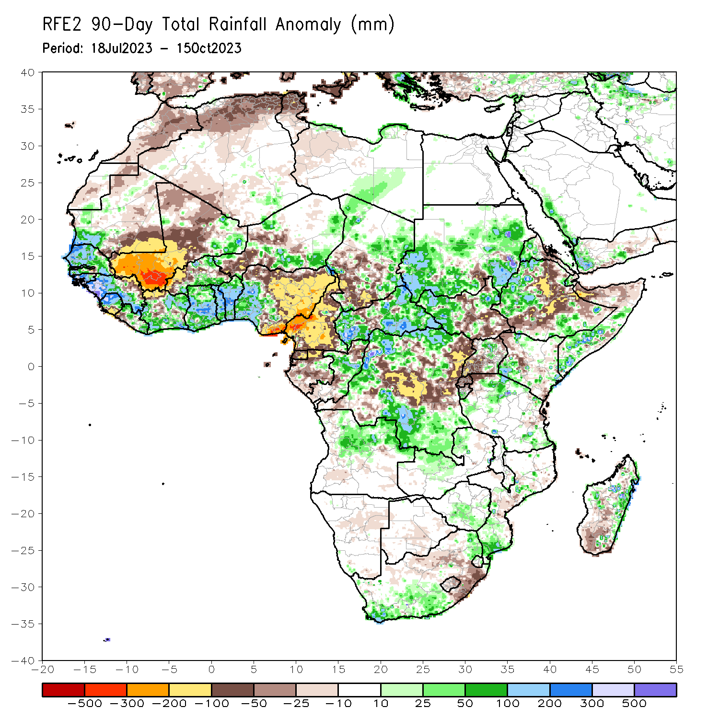
Rainfall Patterns: Last 90 Days
Over the past 90 days, in East Africa, above-average rainfall was observed over many parts of Sudan, western and parts of far southern Ethiopia, most of western and northeastern South Sudan, a part of north-central Uganda, western Eritrea, western Djibouti, parts of southern and central Somalia, parts of north-central Tanzania, southern Burundi, and southwestern and southeastern Kenya. Rainfall was below-average over central and southeastern South Sudan, a small part of south-central Sudan, eastern, central, and southern Ethiopia, parts of northern Somalia, pockets of west-central and northwestern Kenya, Rwanda, northern Burundi, northwestern Tanzania, central Eritrea, and most of Uganda. In southern Africa, above-average rainfall was observed over south-central, southwestern, and northeastern South Africa, parts of northern and eastern Eswatini, southern and parts of central Mozambique, much of northern Angola, northern Zambia, and parts of eastern and central Madagascar. Below-average rainfall was observed over southeastern and parts of central South Africa, Lesotho, and pockets of southwestern and central Madagascar. In Central Africa, rainfall was above-average over many parts of CAR, eastern and northwestern Chad, much of central Congo, northeastern Gabon, far southeastern Cameroon, and northern, west-central, south-central, and southeastern DRC. Rainfall was below-average over much of Cameroon, Equatorial Guinea, most of Gabon, northern and southern Congo, parts of central, northeastern, and southwestern DRC, pockets of central CAR, and central and southwestern Chad. In West Africa, rainfall was above-average over much of Senegal, southwestern Mauritania, The Gambia, Guinea-Bissau, western and southern Guinea, northern and central Sierra Leone, eastern and northwestern Liberia, eastern Mali, much of Cote d’Ivoire, southern and northeastern Burkina Faso, much of Ghana, Togo, Benin, parts of northwestern and southeastern Niger, and western Nigeria. Below-average rainfall was observed over western, central, and northern Mali, much of eastern Guinea, southern Sierra Leone, southwestern Liberia, northwestern Cote d’Ivoire, western and central Burkina Faso, parts of southwestern and central Niger, southeastern Mauritania, and central, northern, and eastern Nigeria.
Notes:
4

Slide 5
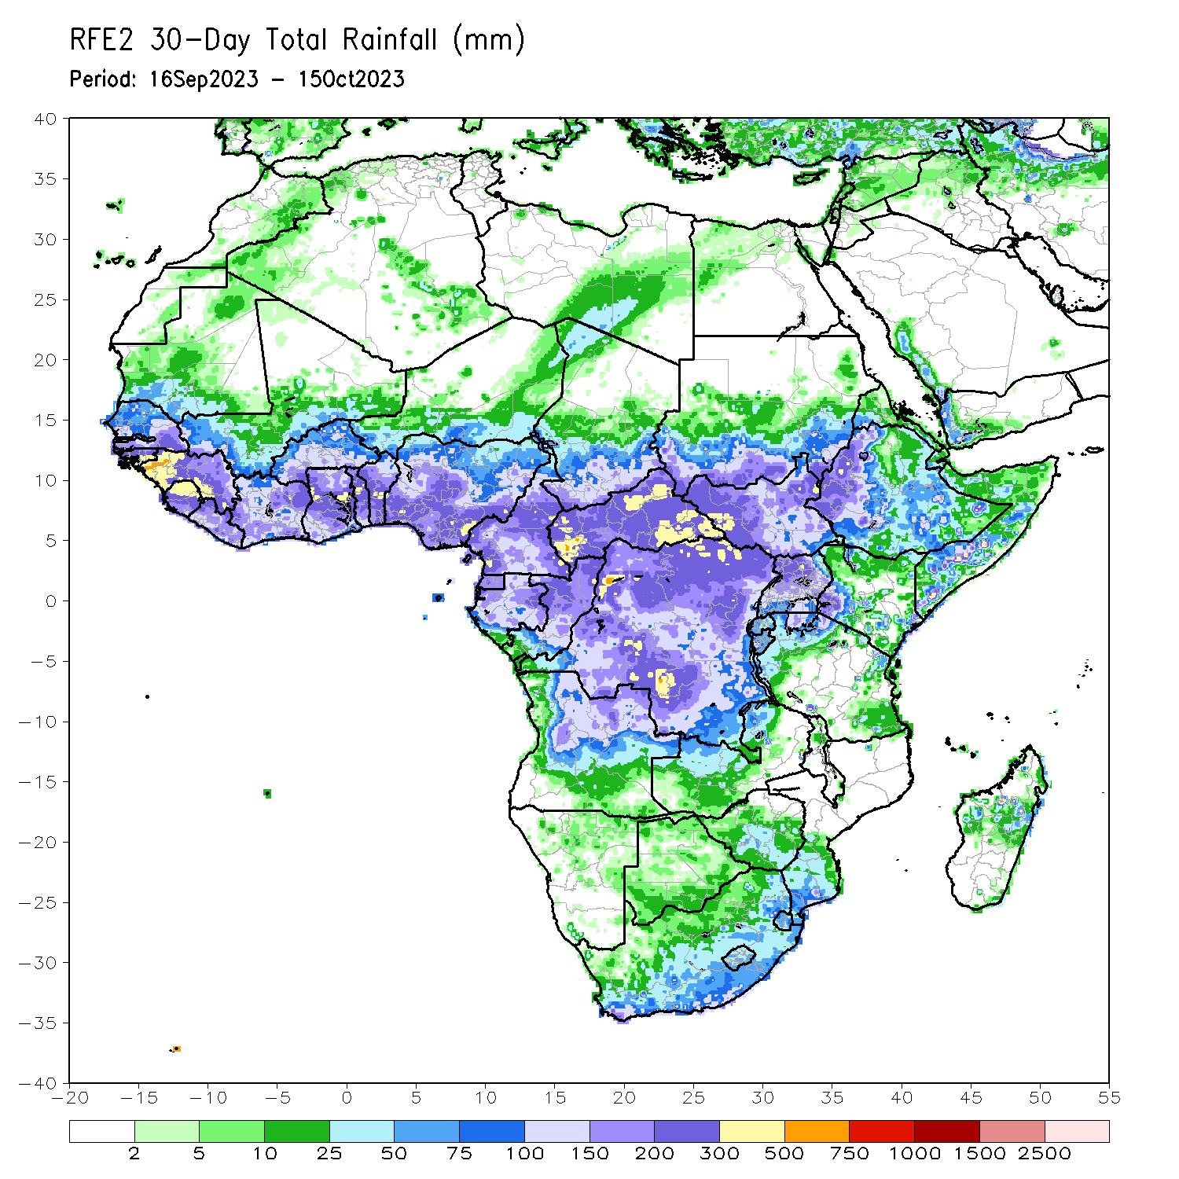
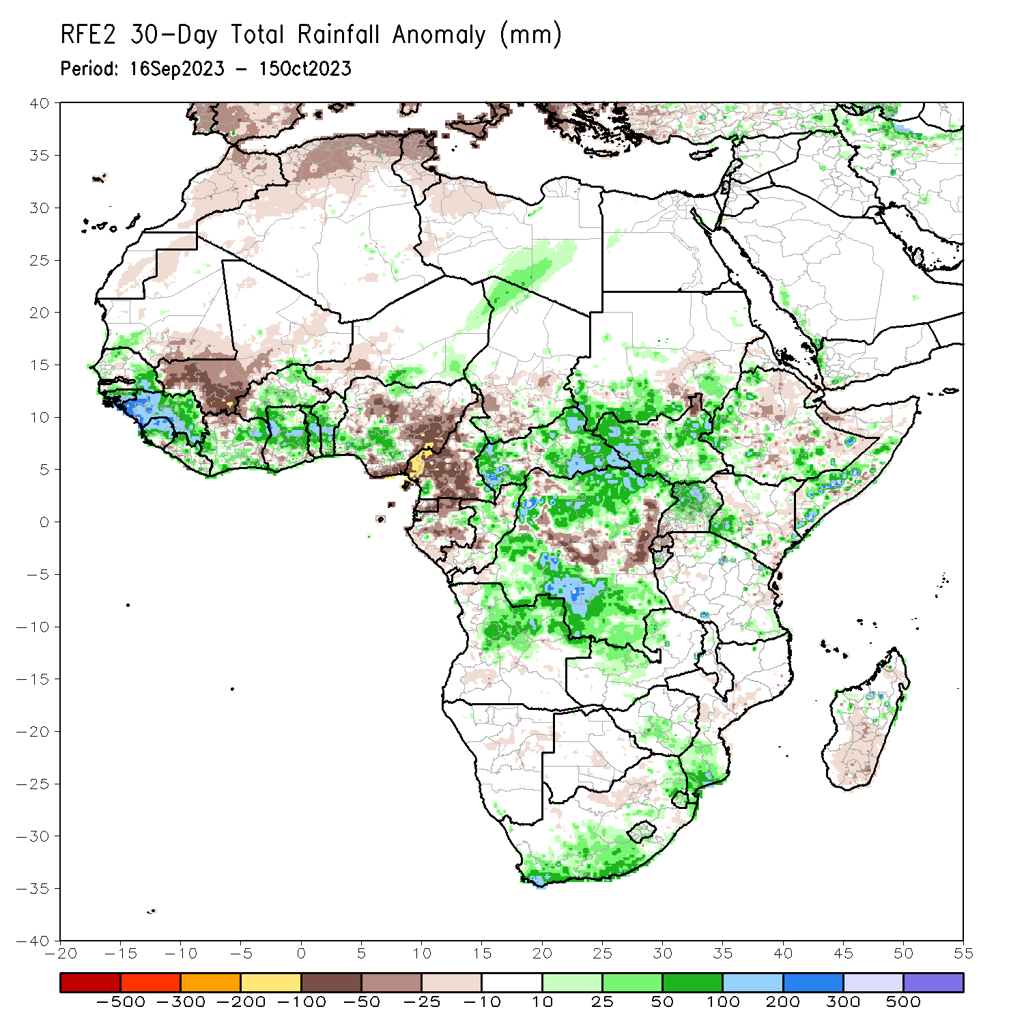
Rainfall Patterns: Last 30 Days
Over the past 30 days, in East Africa, above-average rainfall was observed over many parts of southern Sudan, most of western, eastern, and southern South Sudan, southwestern Eritrea, western Djibouti, pockets of northern, western, and south-central Ethiopia, northern and central Uganda, southwestern and parts of southeastern Kenya, parts of southern and central Somalia, western Burundi, and parts of northern Tanzania. Rainfall was below-average over much of central and southern Ethiopia, southwestern Uganda, Rwanda, northern Somalia, eastern Djibouti, pockets of south-central Sudan, and parts of northeastern South Sudan. In Central Africa, rainfall was above-average over central and northern Congo, parts of eastern and southwestern Cameroon, parts of southeastern, southwestern, and northwestern Chad, parts of eastern Gabon, much of CAR, and southeastern, south-central, west-central, and northeastern DRC. Below-average rainfall was observed over much of Cameroon, Equatorial Guinea, northern, central, and western Gabon, parts of northwestern and southwestern Congo, pockets of central and south-central Chad, central CAR, and central and northwestern DRC. In West Africa, rainfall was above-average over pockets of northern and southern Senegal, Guinea, Guinea-Bissau, northern and central Sierra Leone, northwestern and parts of central Liberia, northeastern, central, and southern Cote d’Ivoire, northeastern and much of southern Burkina Faso, parts of southeastern Mali, most of Ghana, Togo, most of Benin, parts of southwestern and north-central Nigeria, south-central and northeastern Niger, and southwestern Mauritania. Below-average rainfall was observed over southeastern Mauritania, southwestern and central Mali, parts of southern Sierra Leone, northwestern Cote d’Ivoire, western Burkina Faso, western Niger, parts of southwestern Ghana, and central and eastern Nigeria.
Notes:
5

Slide 6
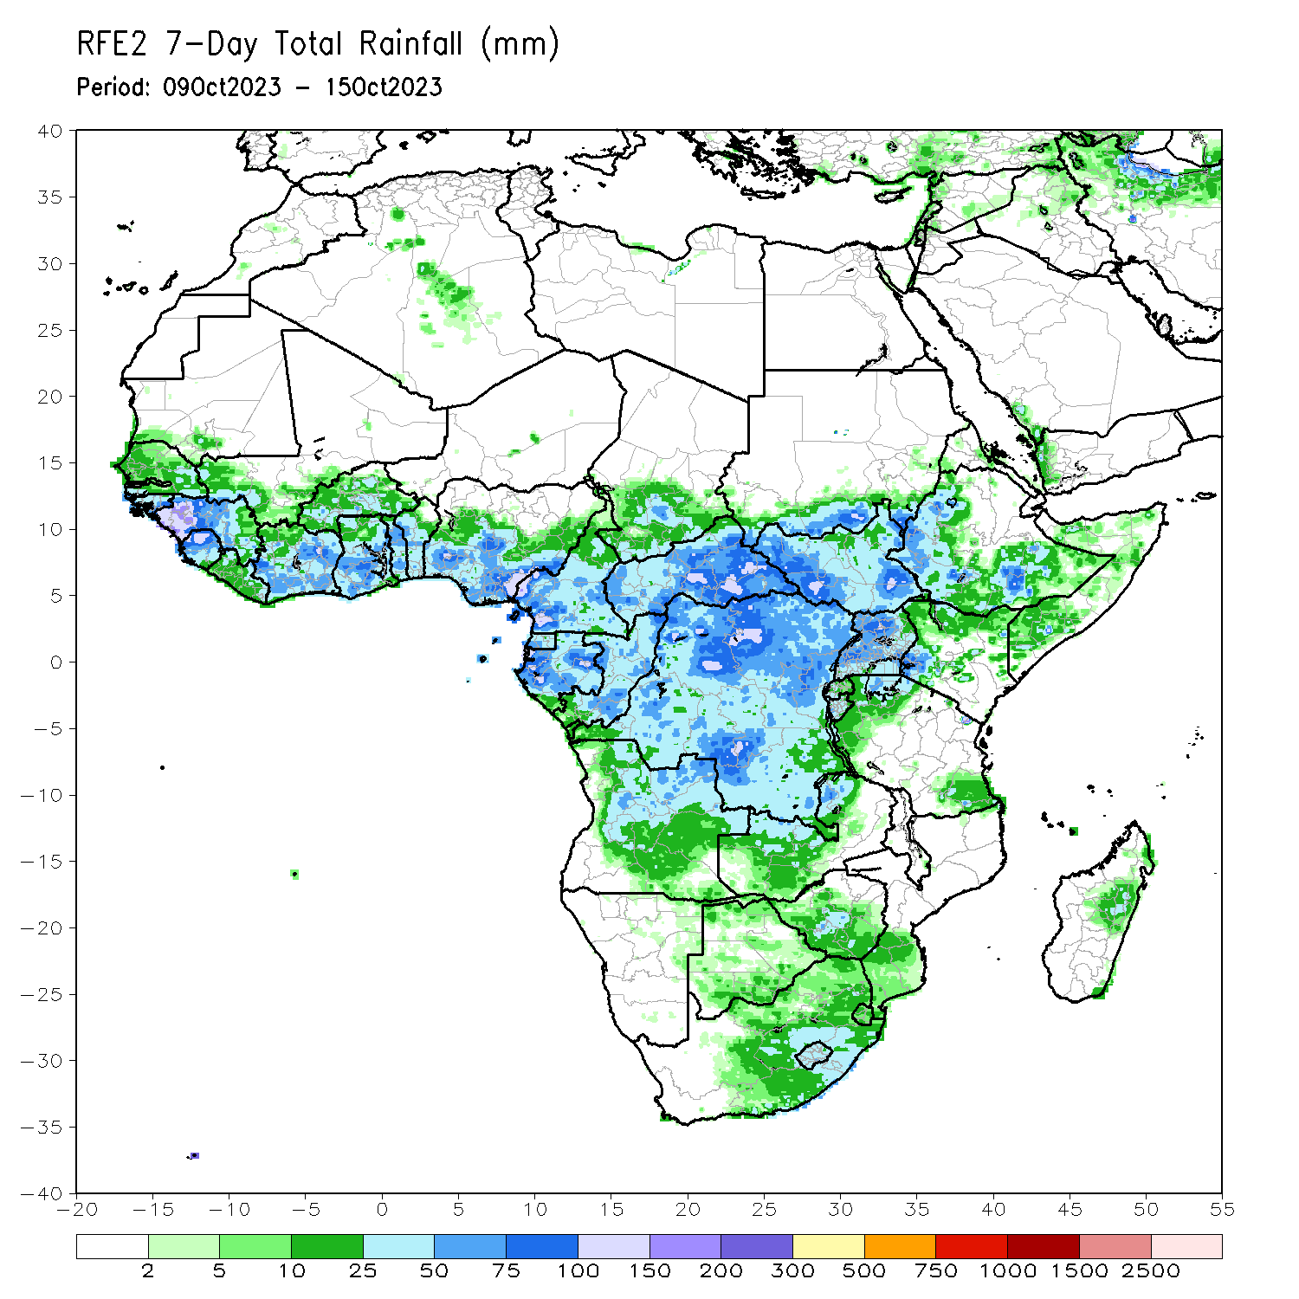
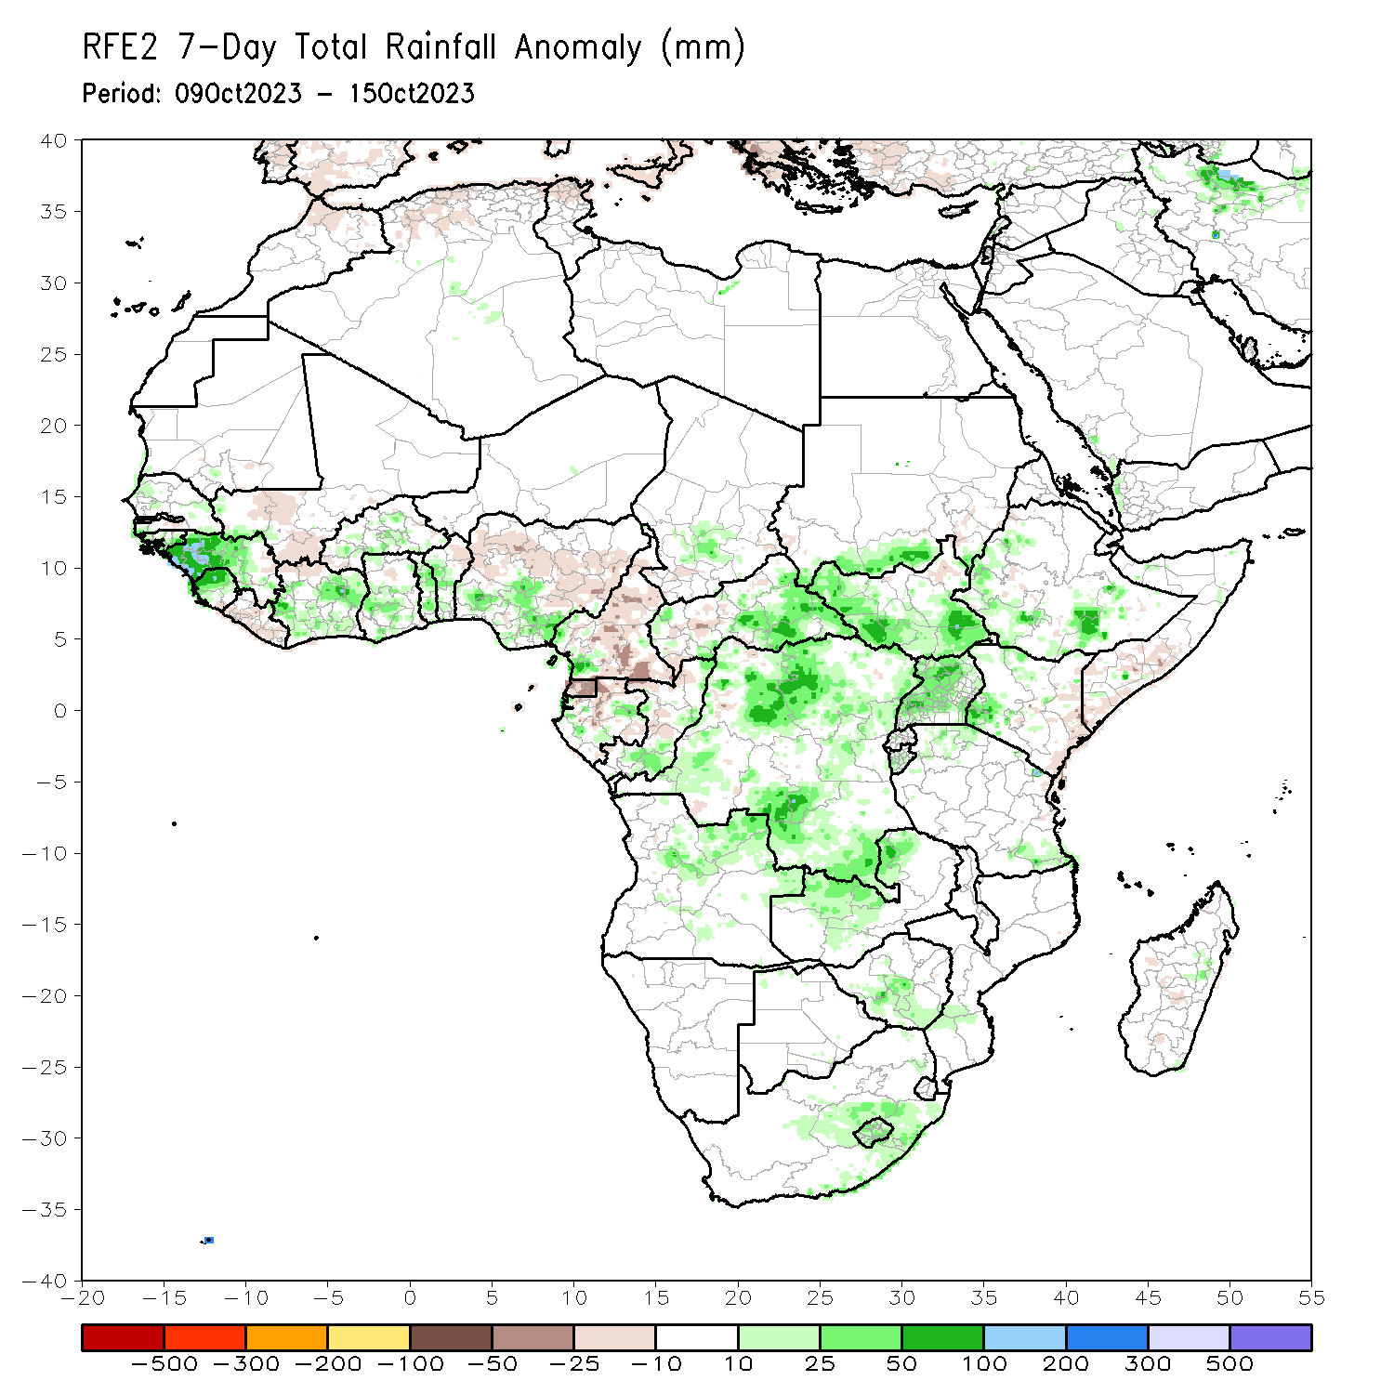
Rainfall Patterns: Last 7 Days
During the past 7 days, in East Africa, rainfall was above-average over parts of western and southern Ethiopia, southern Sudan, western and southern South Sudan, much of Uganda, southwestern Kenya, western Burundi, and parts of northwestern and southeastern Tanzania. Below-average rainfall was observed over southern Somalia, eastern Kenya, and northeastern South Sudan. In central Africa, above-average rainfall was observed over parts of south-central Chad, northwestern, southern, and eastern CAR, much of DRC, southern and eastern Congo, parts of western and eastern Gabon, and southwestern Cameroon. Rainfall was below-average over parts of southwestern CAR, central and northwestern Congo, northern and southeastern Gabon, Equatorial Guinea, and much of Cameroon. In West Africa, above-average rainfall was observed over parts of northwestern and southern Senegal, Guinea-Bissau, western and central Guinea, northern and central Sierra Leone, southern, central, and northeastern Cote d’Ivoire, parts of central Burkina Faso, southern and central Ghana, Togo, central and southern Benin, parts of southern and central Nigeria, and parts of southwestern Mali. Below-average rainfall was observed over parts of southwestern Mali, southern Sierra Leone, much of Liberia, northwestern Cote d’Ivoire, northeastern Benin, southwestern Burkina Faso, and central Nigeria. In southern Africa, rainfall was above-average over parts of south-central and central South Africa, Lesotho, northeastern and central Angola, northern Zambia, southern Zimbabwe, and parts of southern Mozambique.

Slide 7
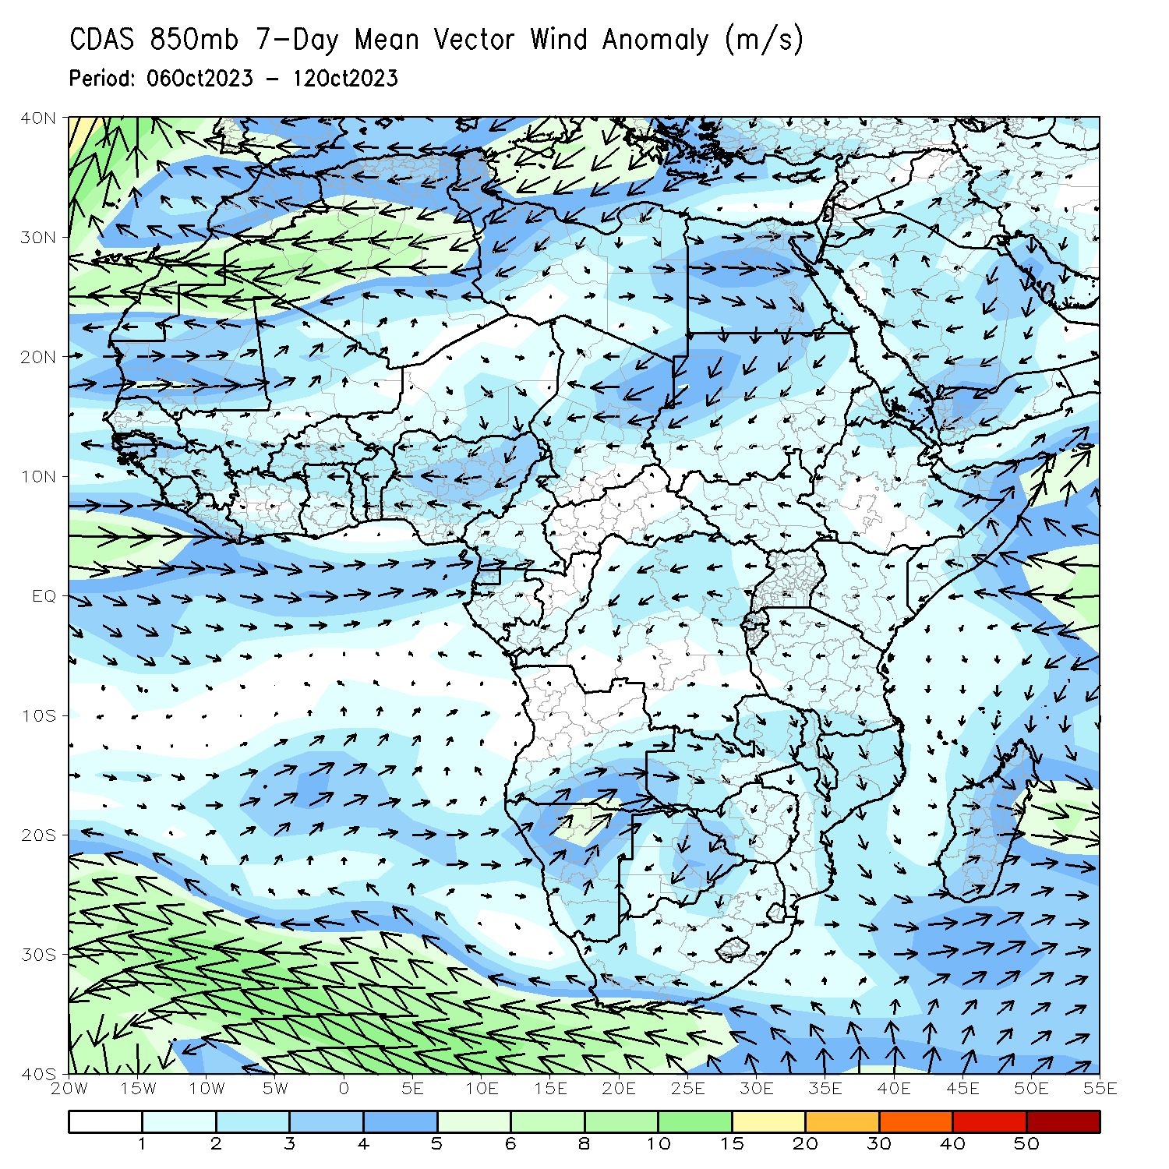
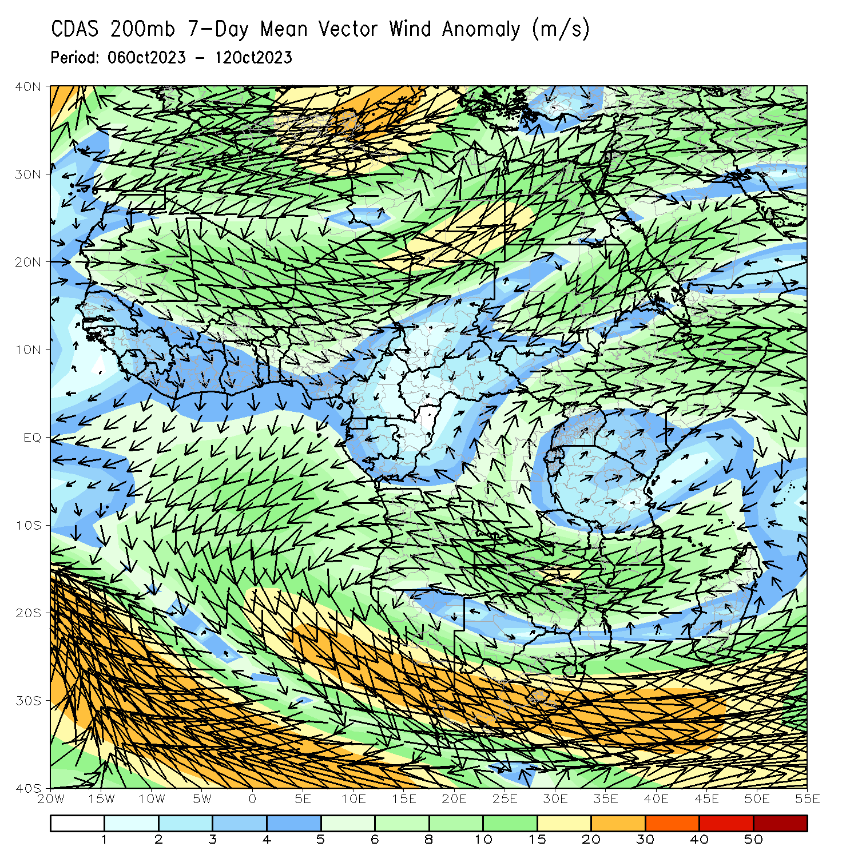
Atmospheric Circulation: Last 7 Days
At 850-hPa level (left panel), anomalous onshore flow was observed over the western Gulf of Guinea region, which may have contributed to the observed above-average rainfall in the region. Anomalous lower-level convergence was present across Zambia and Zimbabwe, likely contributing to the above-average precipitation in that regions. At 200-hPa, anomalous upper level divergence likely contributed to the above average precipitation in the western Gulf of Guinea region, while upper level convergence likely contributed to below-average precipitation in western Nigeria and central Cameroon.

Slide 8
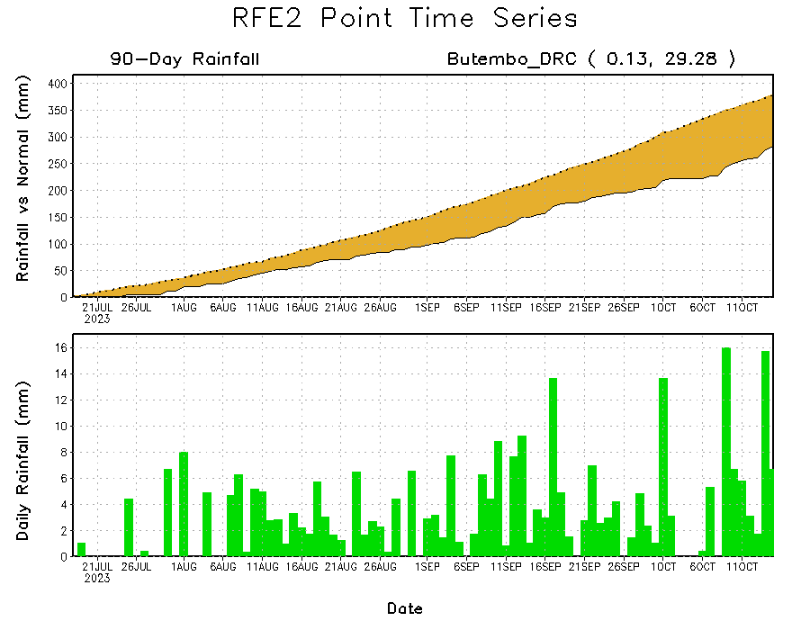
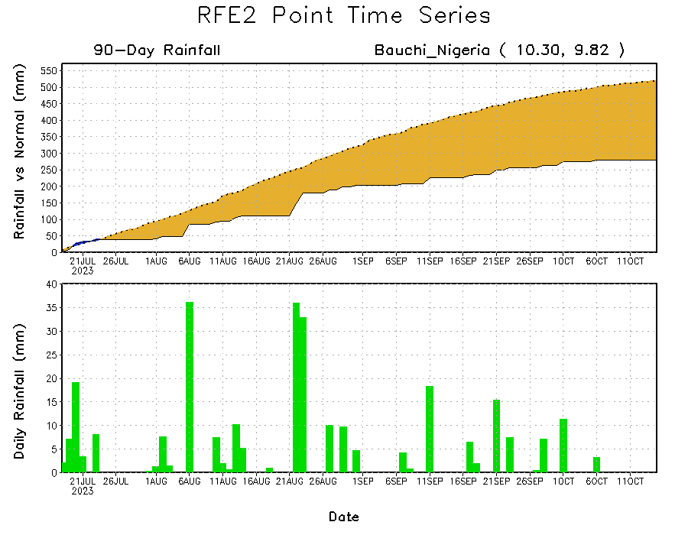
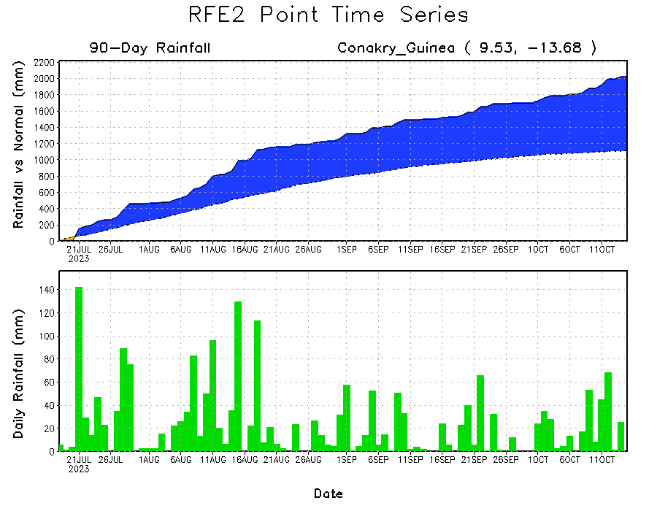
Rainfall Evolution
Daily evolution of rainfall over the last 90 days at selected locations shows moderate rainfall increased moisture surpluses over parts of Guinea (bottom left). Seasonal total rainfall remained below-average over northeastern DRC despite recent above average rainfall (top right). Seasonal rainfall deficits also increased over eastern Nigeria (bottom right).

Slide 9
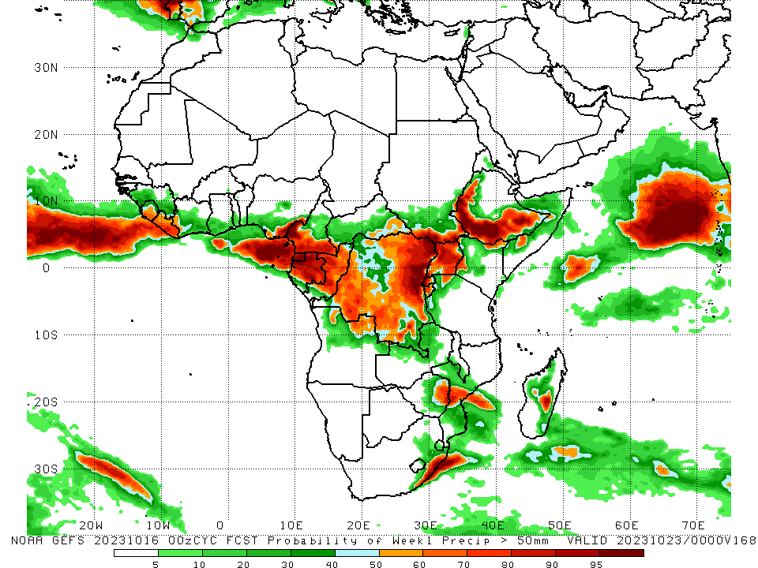
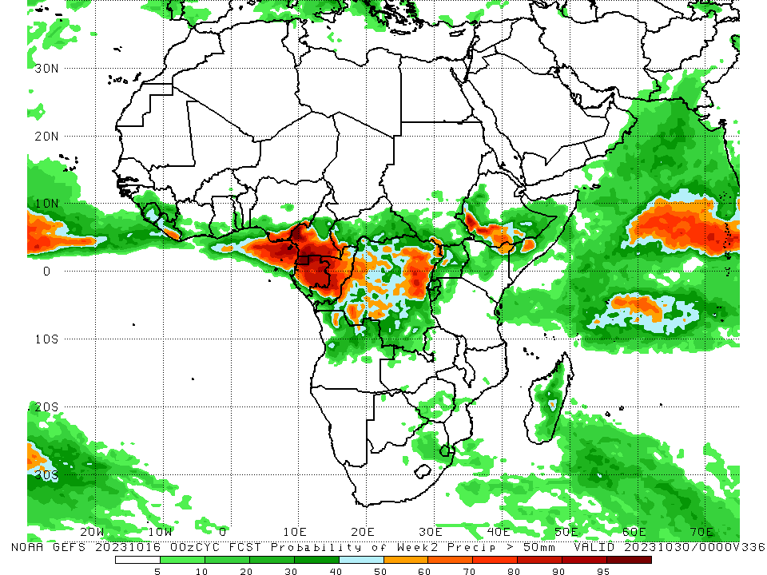
NCEP GEFS Model Forecasts Non-Bias Corrected Probability of precipitation exceedance
Week-1, Valid: 17 – 23 Oct 2023
Week-2, Valid: 24 – 30 Oct 2023
For week-1 (left panel) the GEFS forecasts indicate a moderate to high chance (over 70%) for rainfall to exceed 50 mm over the western and eastern Gulf of Guinea regions (southern Sierra Leone, Liberia, southeastern Nigeria, southern Cameroon to Gabon), northern and central Congo, much of western, south-central, and northeastern DRC, Uganda, southern and northeastern South Sudan, western and southern Ethiopia, parts of southern Somalia, southwestern and northeastern Kenya, western Rwanda, western Burundi, parts of northwestern Tanzania, eastern Zimbabwe, northeastern Angola, parts of central Mozambique, southeastern South Africa, and parts of central Madagascar. For week-2 (right panel), the GEFS forecasts indicate a moderate to high chance (over 70%) for rainfall to exceed 50 mm over southeastern Liberia, southeastern Nigeria, Equatorial Guinea, much of Gabon, central Congo, parts of west-central, southwestern, northeastern, and east-central DRC, and southwestern Ethiopia.
Notes:
9

Slide 10
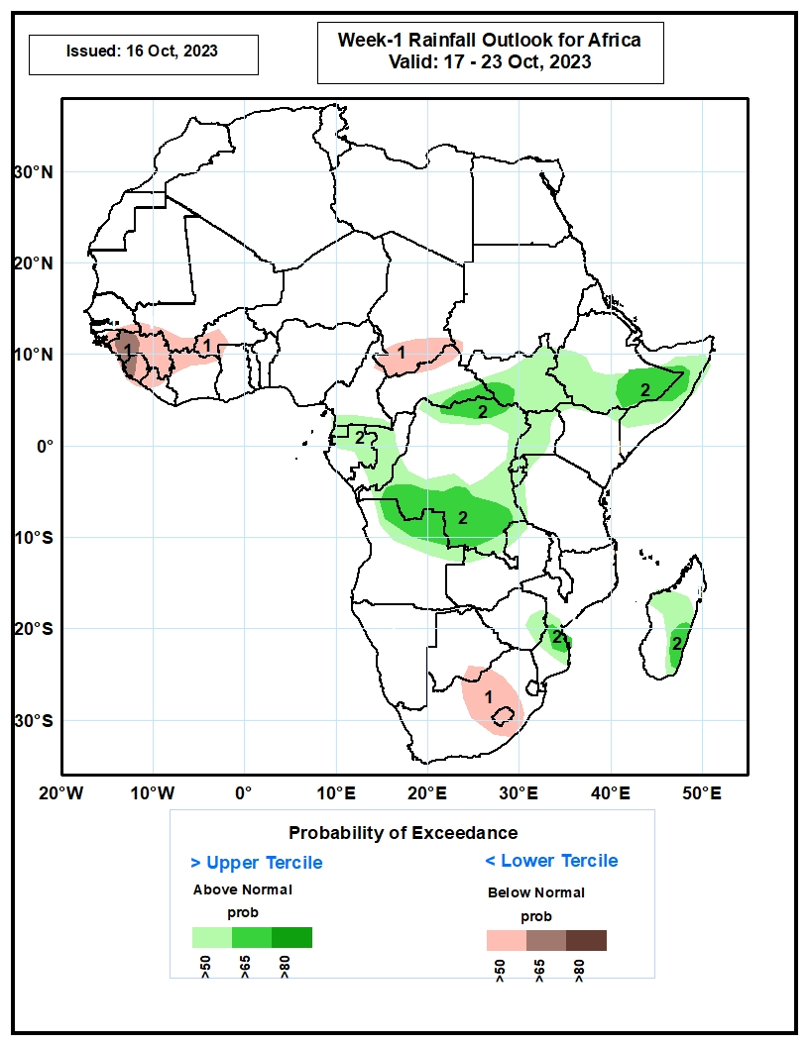
Week-1 Precipitation Outlooks
17 – 23 Oct 2023
The probabilistic forecasts call for below 50% chance for weekly rainfall to be above-normal (below the upper tercile) over much of Guuinea, Sierra Leone, western Liberia, northern Cote d’Ivoire, southwestern Mali, western Burkina Faso, southern Chad, eastern South Africa and Lesotho. There is above 65% chance for the rainfall to be below-normal over western Guinea.
The forecasts call for above 50% chance for weekly total rainfall to be above-normal (above the lower tercile) over Equatorial Guinea, northern Gabon, Congo, southern, eastern and northern DRC, South Sudan, Uganda, Rwanda, Burundi, southern Ethiopia, Somalia, central Mozambique and parts of Madagascar. There is above 65% chance for rainfall to be above-normal over the far northern and southern DRC, northern Angola, southeastern Ethiopia, central Somalia, central Mozambique and eastern Madagascar.
Notes:
10

Slide 11
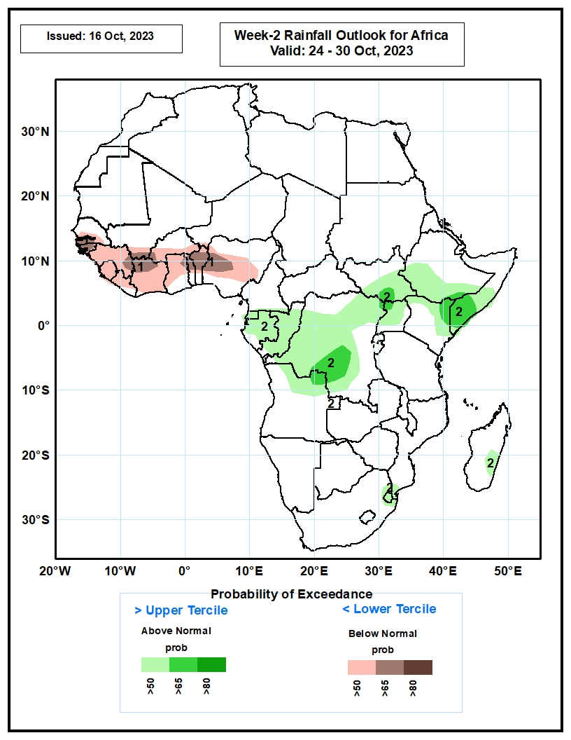
Week-2 Precipitation Outlooks
24 – 30 Oct 2023
The probabilistic forecasts call for above 50% chance for weekly rainfall to be below-normal (below the lower tercile) across much of the Gulf of Guinea region. There is above 65% chance for rainfall to be below-normal over Guinea-Bissau, northern Cote d’Ivoire, northern Benin and northwestern Nigeria.
The forecasts call for above 50% chance for weekly total rainfall to be above-normal (above the upper tercile) over Equatorial Guinea, Gabon, Congo, DRC, Uganda, southern South Sudan, southern Ethiopia, eastern Kenya, and southern Somalia. There is above 65% chance for rainfall to be above-average over parts of southwestern DRC and southern Somalia.
Notes:
11

Slide 12
Summary
Over the past 30 days, in East Africa, above-average rainfall was observed over many parts of southern Sudan, most of western, eastern, and southern South Sudan, southwestern Eritrea, western Djibouti, pockets of northern, western, and south-central Ethiopia, northern and central Uganda, southwestern and parts of southeastern Kenya, parts of southern and central Somalia, western Burundi, and parts of northern Tanzania. Rainfall was below-average over much of central and southern Ethiopia, southwestern Uganda, Rwanda, northern Somalia, eastern Djibouti, pockets of south-central Sudan, and parts of northeastern South Sudan. In Central Africa, rainfall was above-average over central and northern Congo, parts of eastern and southwestern Cameroon, parts of southeastern, southwestern, and northwestern Chad, parts of eastern Gabon, much of CAR, and southeastern, south-central, west-central, and northeastern DRC. Below-average rainfall was observed over much of Cameroon, Equatorial Guinea, northern, central, and western Gabon, parts of northwestern and southwestern Congo, pockets of central and south-central Chad, central CAR, and central and northwestern DRC. In West Africa, rainfall was above-average over pockets of northern and southern Senegal, Guinea, Guinea-Bissau, northern and central Sierra Leone, northwestern and parts of central Liberia, northeastern, central, and southern Cote d’Ivoire, northeastern and much of southern Burkina Faso, parts of southeastern Mali, most of Ghana, Togo, most of Benin, parts of southwestern and north-central Nigeria, south-central and northeastern Niger, and southwestern Mauritania. Below-average rainfall was observed over southeastern Mauritania, southwestern and central Mali, parts of southern Sierra Leone, northwestern Cote d’Ivoire, western Burkina Faso, western Niger, parts of southwestern Ghana, and central and eastern Nigeria.
During the past 7 days, in East Africa, rainfall was above-average over parts of western and southern Ethiopia, southern Sudan, western and southern South Sudan, much of Uganda, southwestern Kenya, western Burundi, and parts of northwestern and southeastern Tanzania. Below-average rainfall was observed over southern Somalia, eastern Kenya, and northeastern South Sudan. In central Africa, above-average rainfall was observed over parts of south-central Chad, northwestern, southern, and eastern CAR, much of DRC, southern and eastern Congo, parts of western and eastern Gabon, and southwestern Cameroon. Rainfall was below-average over parts of southwestern CAR, central and northwestern Congo, northern and southeastern Gabon, Equatorial Guinea, and much of Cameroon. In West Africa, above-average rainfall was observed over parts of northwestern and southern Senegal, Guinea-Bissau, western and central Guinea, northern and central Sierra Leone, southern, central, and northeastern Cote d’Ivoire, parts of central Burkina Faso, southern and central Ghana, Togo, central and southern Benin, parts of southern and central Nigeria, and parts of southwestern Mali. Below-average rainfall was observed over parts of southwestern Mali, southern Sierra Leone, much of Liberia, northwestern Cote d’Ivoire, northeastern Benin, southwestern Burkina Faso, and central Nigeria. In southern Africa, rainfall was above-average over parts of south-central and central South Africa, Lesotho, northeastern and central Angola, northern Zambia, southern Zimbabwe, and parts of southern Mozambique.
The Week-1 outlook calls for above-normal rainfall in most of central and eastern Africa, as well as in parts of southern Africa (northeastern Angola, Zambia, Zimbabwe, Mozambique, central and southeastern Madagascar, and parts of southeastern South Africa). In contrast, there is an increased chance for below-normal rainfall across the western and central Gulf of Guinea region, northern Cameroon, southern Chad, northern CAR, southwestern Gabon, southern Congo, parts of western Angola, parts of eastern and southern Tanzania, Lesotho, Eswatini, parts of central and southern South Africa, and northeastern Madagascar. For Week-2, there is an increased chance for above-normal rainfall across most of central and northern parts of eastern Africa (Ethiopia, Somalia, and northeastern Kenya), southern Zimbabwe, and parts of central Madagascar. In contrast, there is an increased chance for below-normal rainfall in the western and central Gulf of Guinea region, east-central DRC, most of the southern portion of eastern Africa (southern Uganda, southwestern Kenya, and Tanzania), Lesotho, southern and central South Africa, and northeastern Madagascar.

