Slide 1
The African Monsoon Recent Evolution and Current Status Include Week-1 and Week-2 Outlooks
Update prepared
23 October 2023
For more information, visit:
http://www.cpc.ncep.noaa.gov/products/Global_Monsoons/African_Monsoons/precip_monitoring.shtml

Slide 2
Outline
Highlights
Recent Evolution and Current Conditions
NCEP GEFS Forecasts
Summary

Slide 3
Highlights: Last 7 Days
During the past 7 days, in East Africa, rainfall was above-average over parts of western, southern, and eastern Ethiopia, central, western and southern Somalia, eastern Sudan, northern Eritrea, western, southern, eastern and central parts of South Sudan, Uganda, many parts of Kenya, eastern parts of Rwanda and Burundi, and western and eastern parts of Tanzania. Below-average rainfall was observed over southern Sudan and pockets of northeast South Sudan. In central Africa, above-average rainfall was observed over parts of western, southeast and northeastern DRC, eastern CAR, central and southern Congo, and eastern Gabon. Rainfall was below-average over parts western, central and northern CAR, many parts of Cameroon, Equatorial Guinea, western and southern Gabon, northern Congo, southern Chad, and northern and central-eastern parts of DRC. In West Africa, above-average rainfall was observed over parts of western and southeast Guinea, central and northern Sierra Leone, northern Liberia, many parts of Cote d’Ivoire, southwest Ghana, and pockets of southern and northwestern Burkina Faso, central Togo and southwest Nigeria. Below-average rainfall was observed over parts of eastern Senegal, western and southern Mali, eastern Liberia, central and southern Benin, and central, eastern and southern parts of Nigeria. In southern Africa, rainfall was above-average over parts of eastern, central-eastern and northeastern South Africa, Lesotho, Eswatini, central, southern and western Mozambique, central and southern Malawi, central, northern and eastern parts of Zimbabwe and Zambia, and pockets of northwest Angola. Below-average rainfall was observed over northeastern, central-eastern and southwestern Angola, and pockets of northern Namibia, eastern Botswana and western South Africa.
The Week-1 outlook calls for above-average rainfall in much of DRC, CAR and South Sudan, western, central and southern parts of Ethiopia, northern parts of Somalia and Kenya, southern Cameroon, Equatorial Guinea, Gabon, Congo, eastern parts of Angola and Botswana, western Zambia, central and southern Zimbabwe, southern Mozambique, northern and central-eastern South Africa, Lesotho, Eswatini, and western-central Madagascar. In contrast, there is an increased chance for below-average in many parts of Gulf of Guinea region, northern Cameroon, southeast Somalia, northwest and southern Tanzania, Rwanda, Burundi, western Angola, central-eastern Namibia, southwest Botswana, southeast South Africa, and south-central Madagascar. The Week-2 outlook calls for above-normal rainfall in most of central and eastern Africa, Gulf of Guinea region, and northeastern Angola, Zambia, Zimbabwe, Mozambique, Malawi, central-eastern South Africa, Lesotho, eastern and southern Madagascar. In contrast, there is an increased chance for below-average in southern Angola, northeast Namibia, eastern Botswana, northern South Africa, western Madagascar, southeastern Tanzania, and southern parts of Sierra Leone and Burkina Faso.

Slide 4
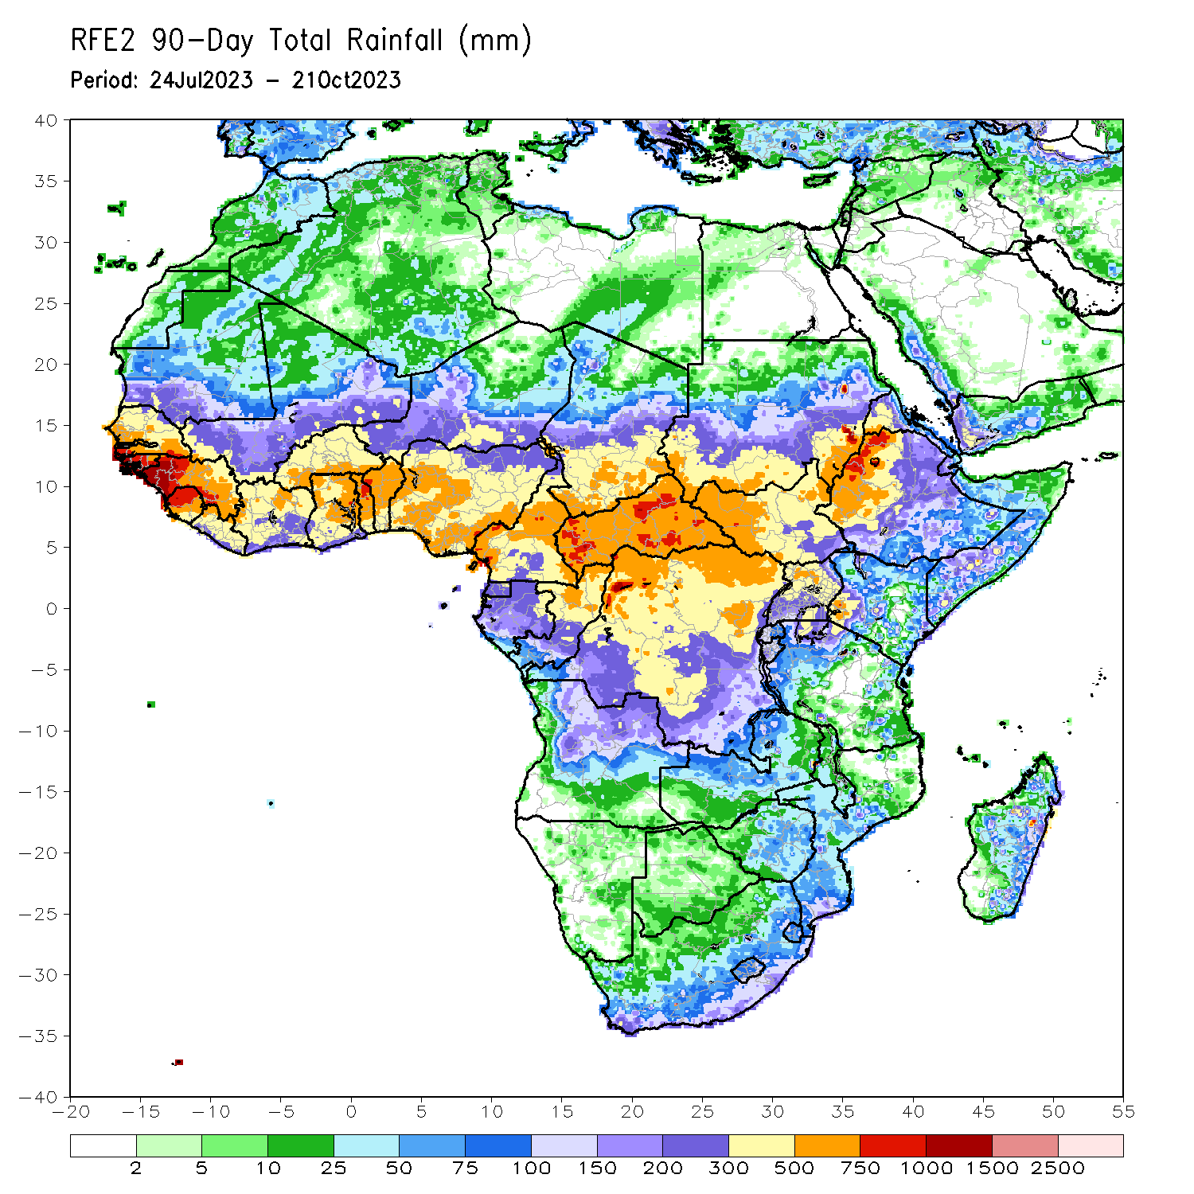
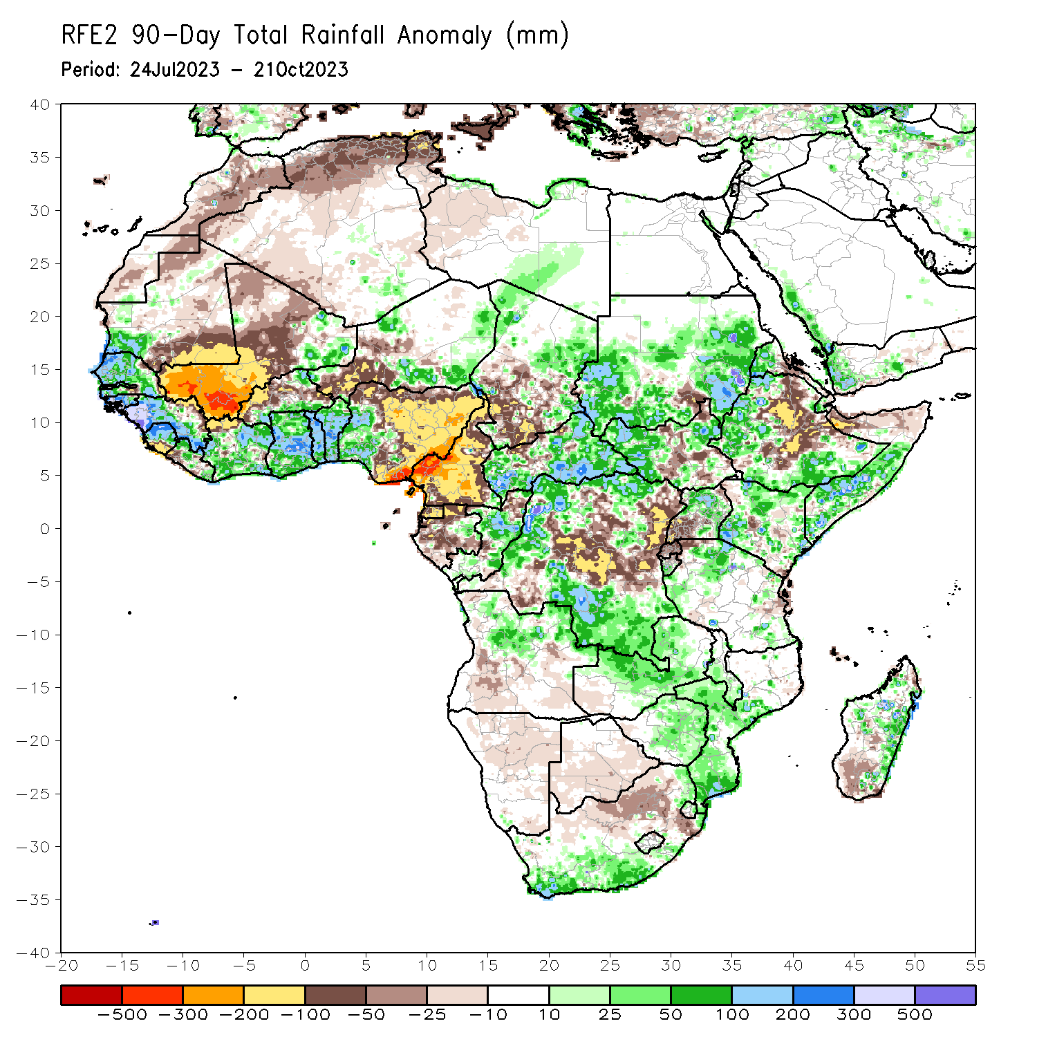
Rainfall Patterns: Last 90 Days
Over the past 90 days, in East Africa, above-average rainfall was observed over western, southern, eastern and central Sudan, western, northwest and northeast South Sudan, western and southern Ethiopia, northwest Eritrea, southern Djibouti, central, western and southern Somalia, northern and central-eastern Uganda, northern, southwest and eastern Kenya, northern, southwest and southeast Tanzania, and southern Burundi. Rainfall was below-average over northeast, central and central-eastern Ethiopia, northern Somalia, central Eritrea, central South Sudan, pockets of southeastern Sudan, central Kenya and southwest Uganda, Rwanda, and pockets of northwest and eastern Tanzania. In southern Africa, above-average rainfall was observed over southeastern and northeastern South Africa, northern Eswatini, central and southern parts of Mozambique and Malawi, central, northern, eastern and southern parts of Zimbabwe, central and northern Zambia, central and northeast Angola, and central and eastern Madagascar. Below-average rainfall was observed over western and central-eastern South Africa, northern Lesotho, southwest Madagascar, western, southern and eastern Botswana, northern and central-eastern Namibia, southern and southeast Angola, and southwest Zambia. In Central Africa, rainfall was above-average over western, southern, central and eastern CAR, northern, western and southern DRC, eastern and northwest Chad, central and eastern Congo, and pockets of eastern Gabon. Rainfall was below-average over much of Cameroon, Equatorial Guinea, northern, western, central and southern Gabon, northern Congo, parts of central, eastern and southwestern DRC, pockets of central CAR, and central and southern Chad. In West Africa, rainfall was above-average over much of Senegal, southwestern Mauritania, Gambia, Guinea-Bissau, western, northwest and southern Guinea, northern and central Sierra Leone, eastern and northwestern Liberia, eastern Mali, western, southern, eastern and northeast Cote d’Ivoire, much of Ghana, Togo and Benin, southern and northeastern Burkina Faso, parts of northwestern, eastern and southeastern Niger, and southwest Nigeria. Below-average rainfall was observed over western, central, and northern Mali, pockets of eastern Guinea, southern Sierra Leone, southwestern Liberia, northwestern Cote d’Ivoire, southeastern Mauritania, western, central and eastern Burkina Faso, parts of southwestern Niger, and central, northern, eastern and southeast Nigeria.
Notes:
4

Slide 5
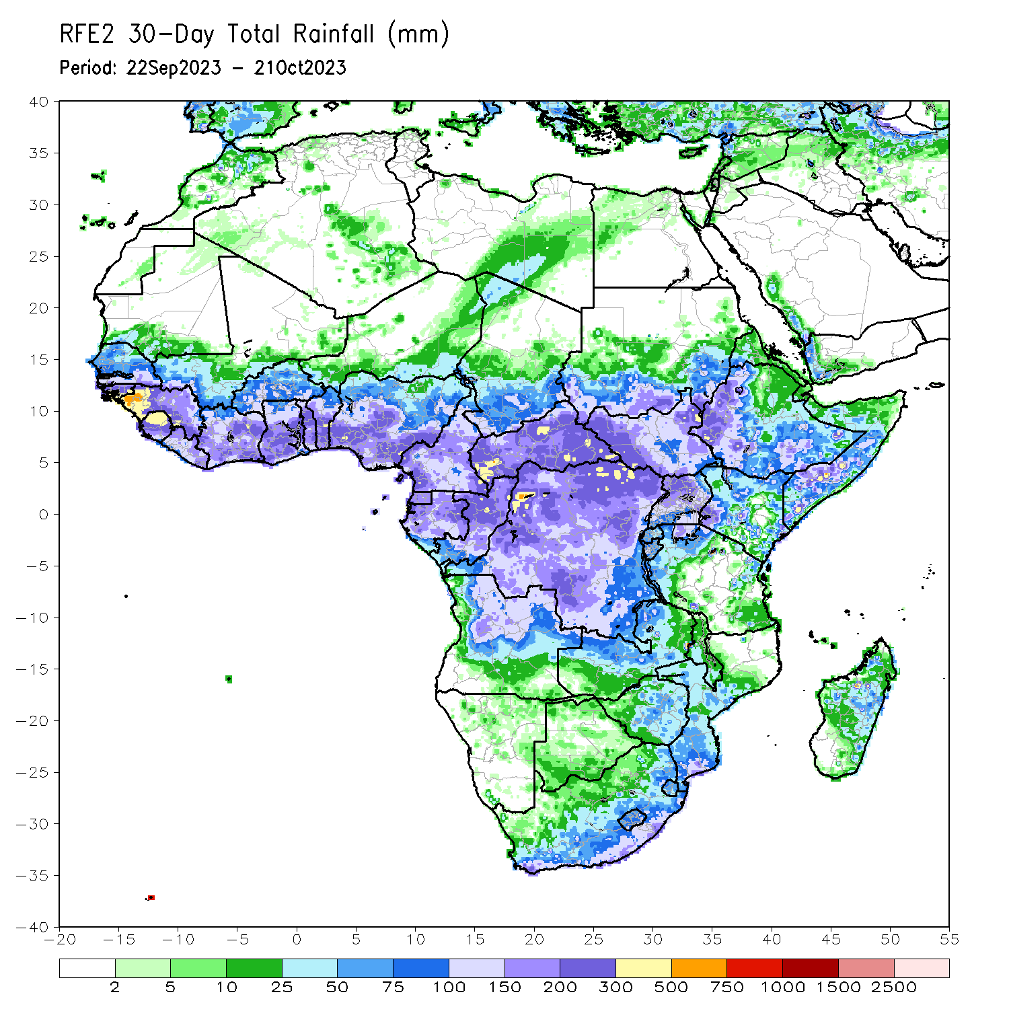
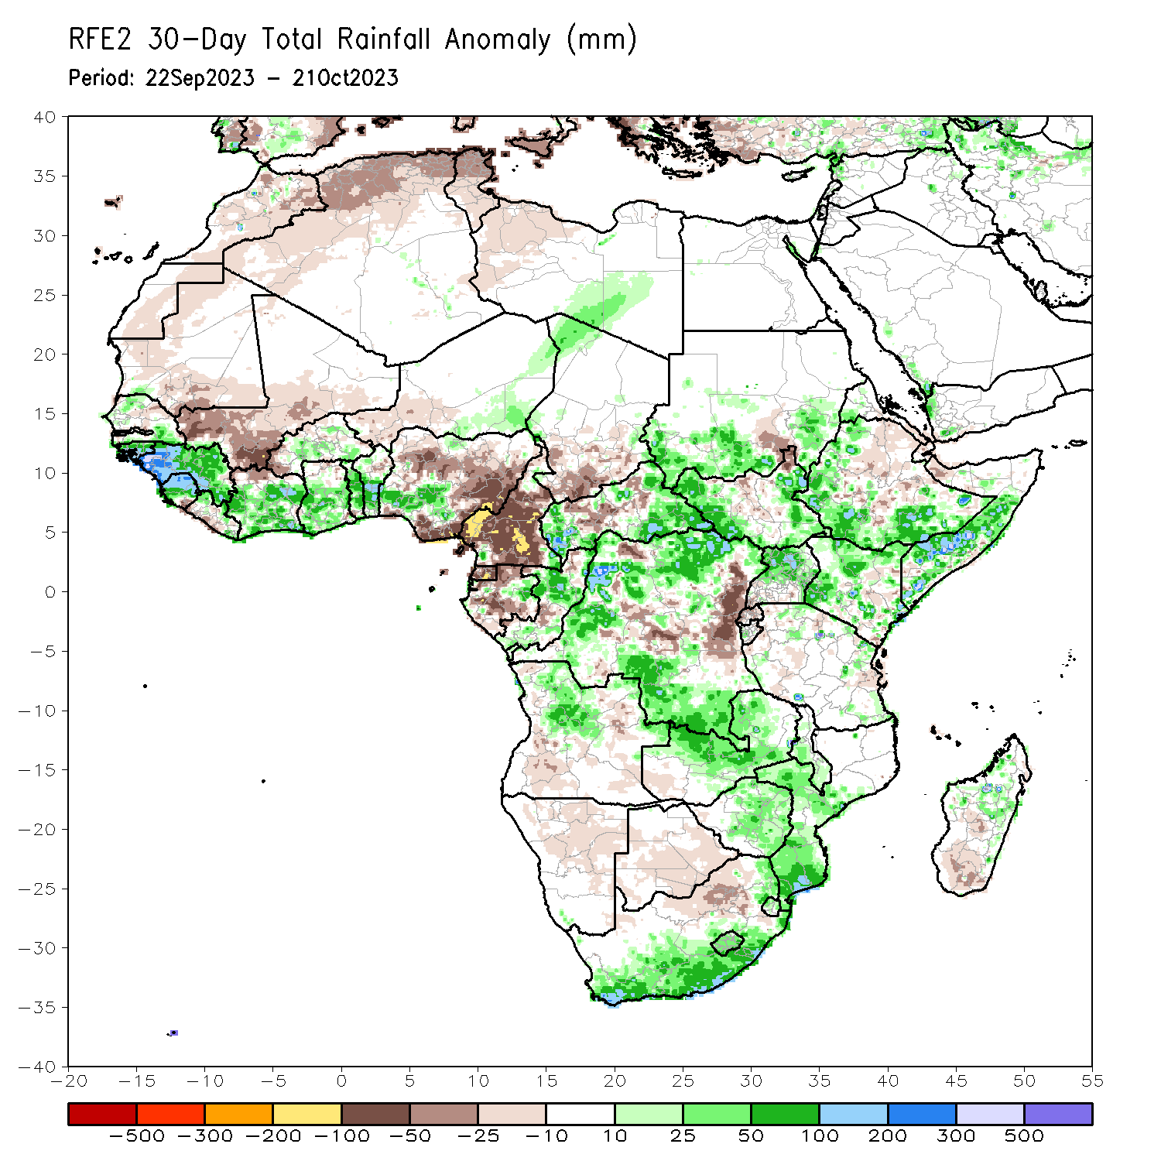
Rainfall Patterns: Last 30 Days
Over the past 30 days, in East Africa, above-average rainfall was observed over western, southern and eastern parts of South Sudan, southwest, southern and eastern Sudan, western, southern and southeast Ethiopia, central, western and southern Somalia, central and northern Uganda, western, northern and central Kenya, and pockets of northern, northeast and southeast Tanzania. Rainfall was below-average over pockets of southeast Sudan and northeast South Sudan, central and eastern Ethiopia, southern Eritrea, Djibouti, northwest Somalia, northern-central South Sudan, southern Uganda, Rwanda, eastern Kenya, and western-central and eastern Tanzania. In southern Africa, above-average rainfall was observed over southeastern and northeastern South Africa, Lesotho, northern Eswatini, central and southern parts of Mozambique and Malawi, central, northern, eastern and southern parts of Zimbabwe, central and northern Zambia, central and northeast Angola, and central and eastern Madagascar. Below-average rainfall was observed over western and central South Africa, southern Madagascar, western, southern and eastern Botswana, northern and central-eastern Namibia, southern and eastern Angola, and southwest Zambia. In Central Africa, rainfall was above-average over central, southeast and northeastern Congo, eastern Gabon, western, eastern and southeast CAR, western, northern and southern DRC, and northwest Chad. Below-average rainfall was observed over much of Cameroon, Equatorial Guinea, northern, central, and western Gabon, western-central Congo, southern Chad, north-central CAR, and central and eastern DRC. In West Africa, rainfall was above-average over pockets of northern and southern Senegal, Guinea, Guinea-Bissau, northern and central Sierra Leone, northwestern and parts of eastern Liberia, western, central, eastern and southern Cote d’Ivoire and Ghana, central and southern Burkina Faso, Togo, central and southern Benin, parts of southwestern Nigeria, and southeastern and northeastern Niger. Below-average rainfall was observed over southeastern Mauritania, western, southern and central Mali, parts of southeast Sierra Leone, southern Liberia, northern Cote d’Ivoire, western Burkina Faso, western Niger, parts of northern Ghana, and central and eastern Nigeria.
Notes:
5

Slide 6
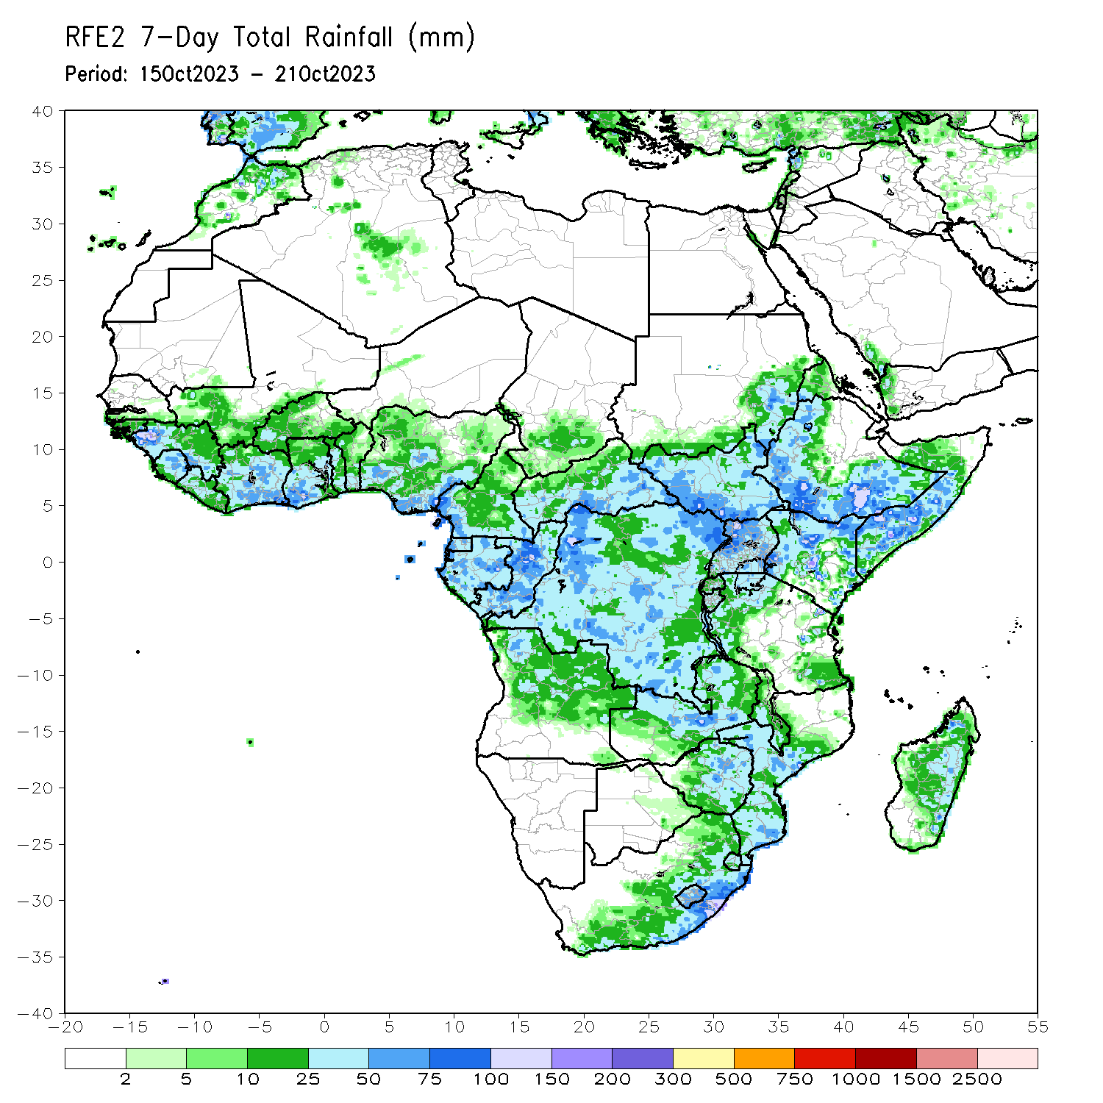
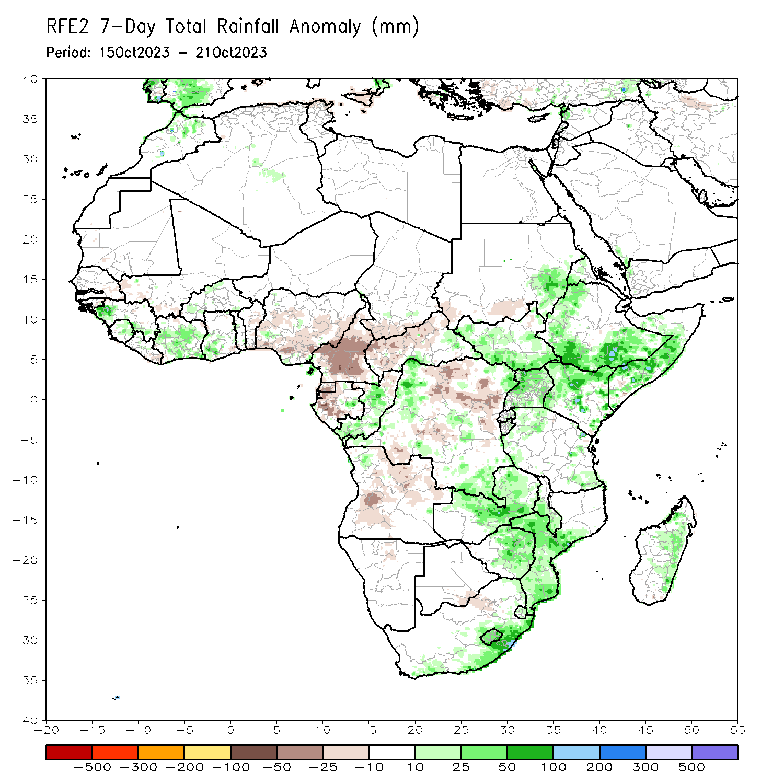
Rainfall Patterns: Last 7 Days
During the past 7 days, in East Africa, rainfall was above-average over parts of western, southern, and eastern Ethiopia, central, western and southern Somalia, eastern Sudan, northern Eritrea, western, southern, eastern and central parts of South Sudan, Uganda, many parts of Kenya, eastern parts of Rwanda and Burundi, and western and eastern parts of Tanzania. Below-average rainfall was observed over southern Sudan and pockets of northeast South Sudan. In central Africa, above-average rainfall was observed over parts of western, southeast and northeastern DRC, eastern CAR, central and southern Congo, and eastern Gabon. Rainfall was below-average over parts western, central and northern CAR, many parts of Cameroon, Equatorial Guinea, western and southern Gabon, northern Congo, southern Chad, and northern and central-eastern parts of DRC. In West Africa, above-average rainfall was observed over parts of western and southeast Guinea, central and northern Sierra Leone, northern Liberia, many parts of Cote d’Ivoire, southwest Ghana, and pockets of southern and northwestern Burkina Faso, central Togo and southwest Nigeria. Below-average rainfall was observed over parts of eastern Senegal, western and southern Mali, eastern Liberia, central and southern Benin, and central, eastern and southern parts of Nigeria. In southern Africa, rainfall was above-average over parts of eastern, central-eastern and northeastern South Africa, Lesotho, Eswatini, central, southern and western Mozambique, central and southern Malawi, central, northern and eastern parts of Zimbabwe and Zambia, and pockets of northwest Angola. Below-average rainfall was observed over northeastern, central-eastern and southwestern Angola, and pockets of northern Namibia, eastern Botswana and western South Africa.

Slide 7
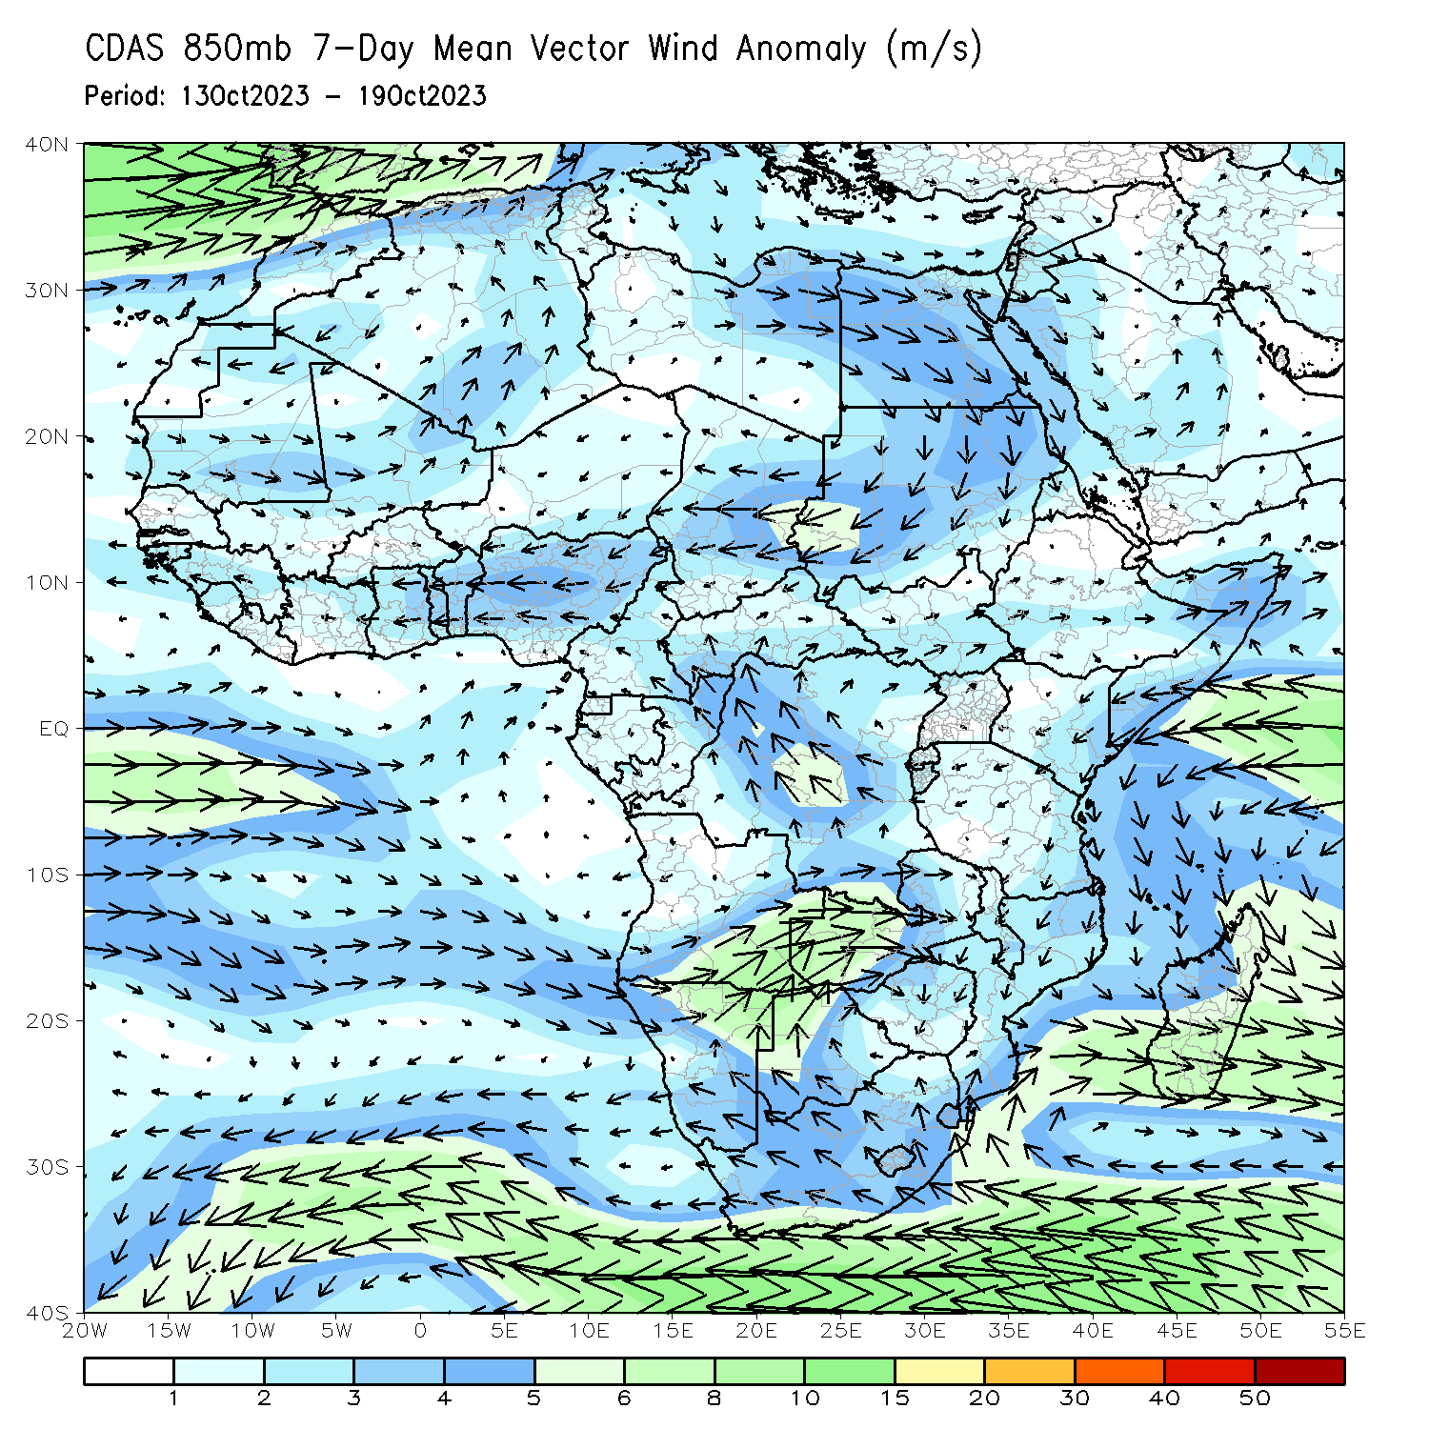
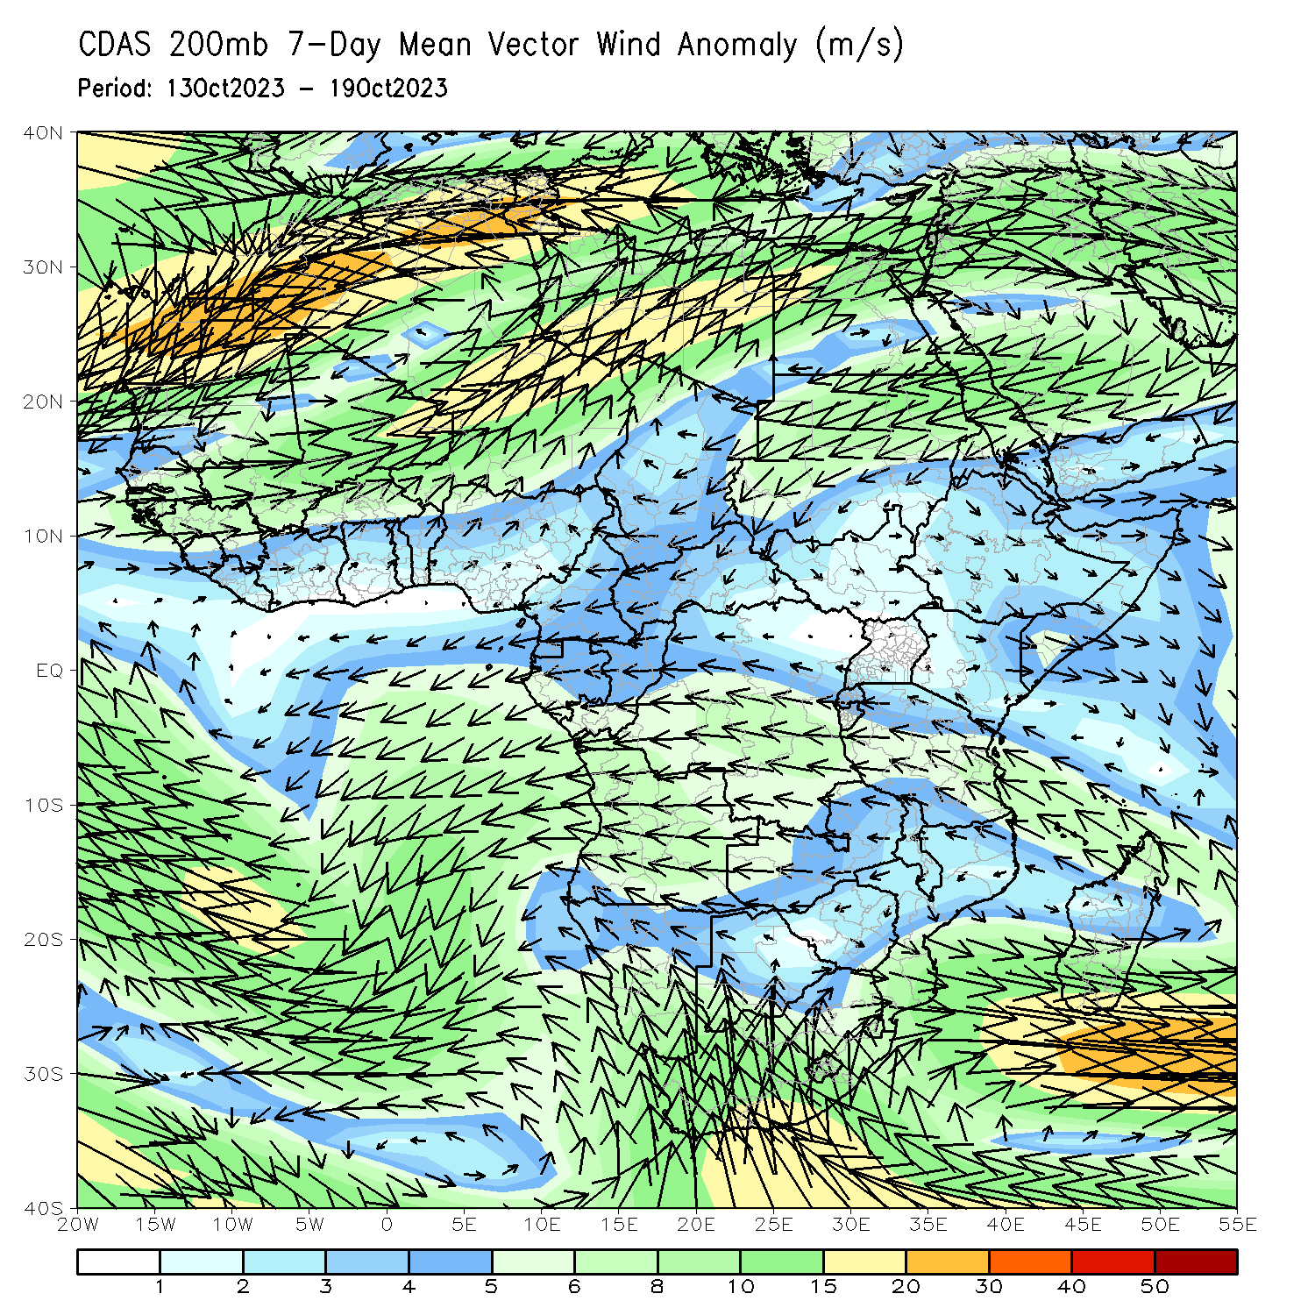
Atmospheric Circulation: Last 7 Days
850-hPa level (left panel), anomalous lower-level cyclonic circulations may have contributed to the observed above-average rainfall across Zambia, Zimbabwe, and central and southern parts of Mozambique and Malawi. Anomalous lower-level convergence was present across central and eastern Madagascar, likely contributing to the above-average precipitation in that regions.

Slide 8
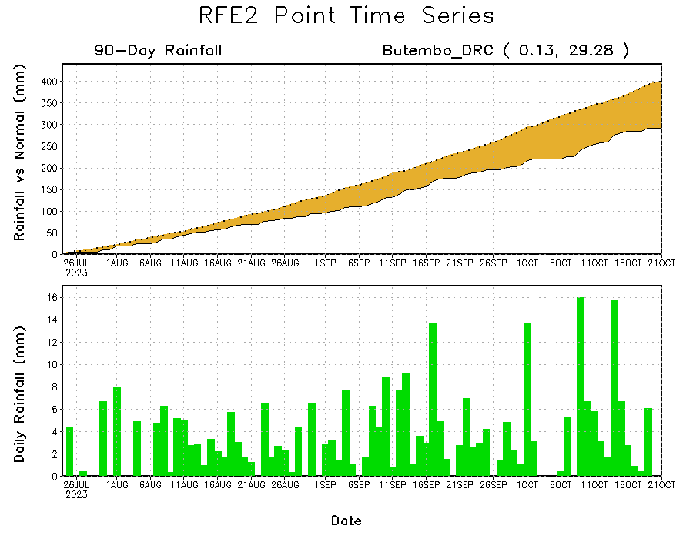
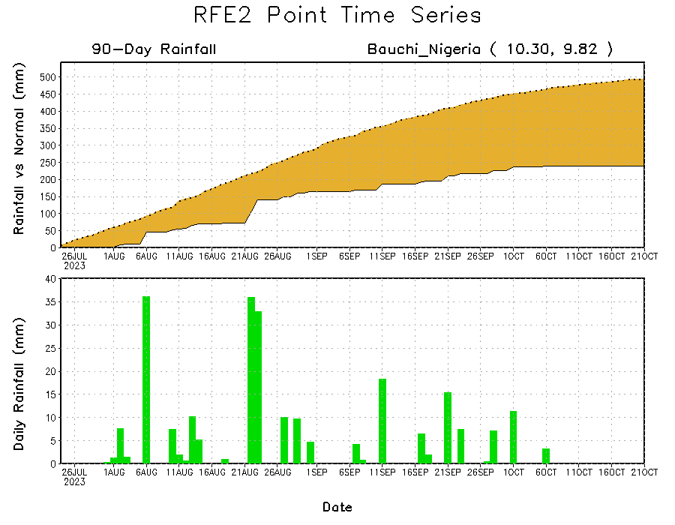
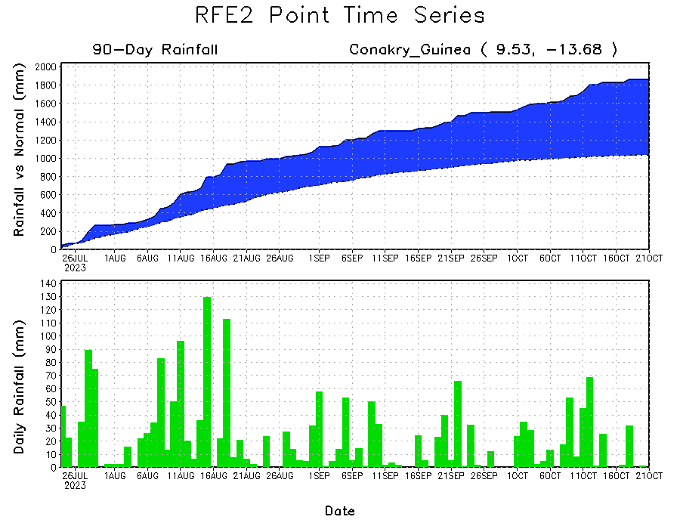
Rainfall Evolution
Daily evolution of rainfall over the last 90 days at selected locations shows moderate rainfall increased moisture surpluses over parts of Guinea (bottom left). Seasonal total rainfall remained below-average over northeastern DRC despite recent above average rainfall (top right). Seasonal rainfall deficits also increased over eastern Nigeria (bottom right).

Slide 9
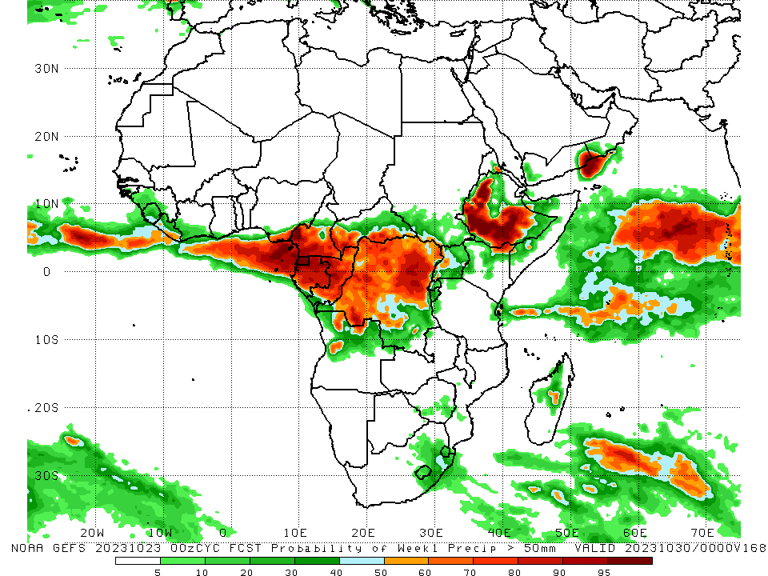
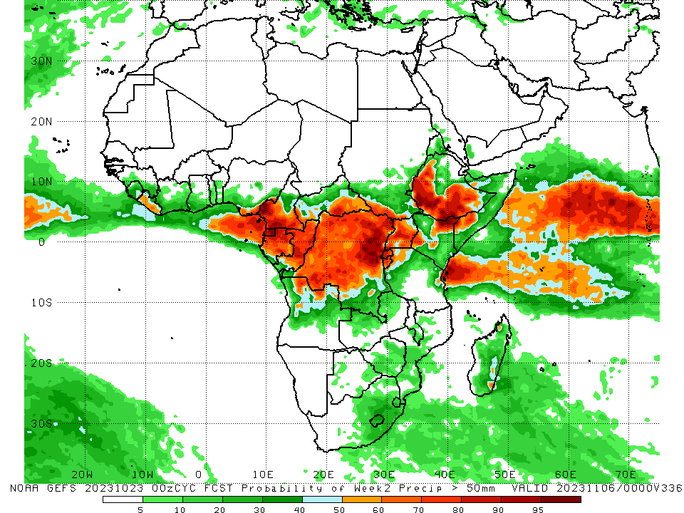
NCEP GEFS Model Forecasts Non-Bias Corrected Probability of precipitation exceedance
Week-1, Valid: 24 – 30 Oct 2023
Week-2, Valid: 31 Oct – 06 Nov 2023
For week-1 (left panel) the GEFS forecasts indicate a moderate to high chance (over 70%) for rainfall to exceed 50 mm over southeast Nigeria, western and southern Cameroon, Equatorial Guinea, many parts of Gabon and Congo, southern CAR, western, central, northern and eastern DRC, northwest Uganda, northeast Angola, western, southern and central Ethiopia, pockets of central Madagascar, and southern Liberia. For week-2 (right panel), the GEFS forecasts indicate a moderate to high chance (over 70%) for rainfall to exceed 50 mm over southeastern Sierra Leone, many parts of Liberia, Gabon and Congo, southeast Nigeria, western and southern Cameroon, Equatorial Guinea, southwest and southeast CAR, pockets of southern South Sudan, western, central, northern and eastern DRC, Rwanda, Burundi, western, central and eastern parts of Uganda, southwest and northeast Kenya, and southwest Somalia.
Notes:
9

Slide 10
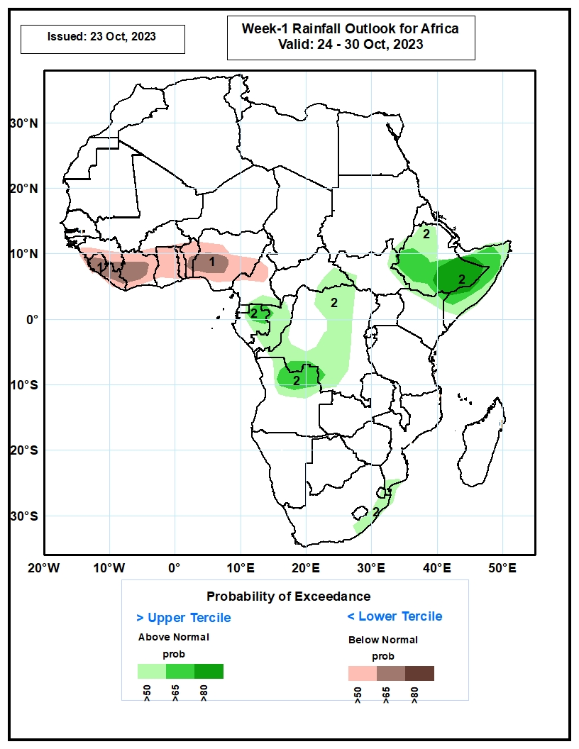
Week-1 Precipitation Outlooks
24 – 30 Oct 2023
The probabilistic forecasts call for below 50% chance for weekly rainfall to be above-normal (below the lower tercile) over much of the Gulf of Guinea region. There is above 65% chance for below-normal rainfall over parts of Sierra Leone, Liberia Cote d’Ivoire, and western Nigeria.
The forecasts call for above 50% chance for weekly total rainfall to be above-normal (above the upper tercile) over eastern Gabon, northern Angola, parts of DRC, northern, western and southern Ethiopia, and Somalia, and coastal South Africa including Eswatini. There is above 80% chance for above-normal rainfall over southeastern Ethiopia.
Notes:
10

Slide 11
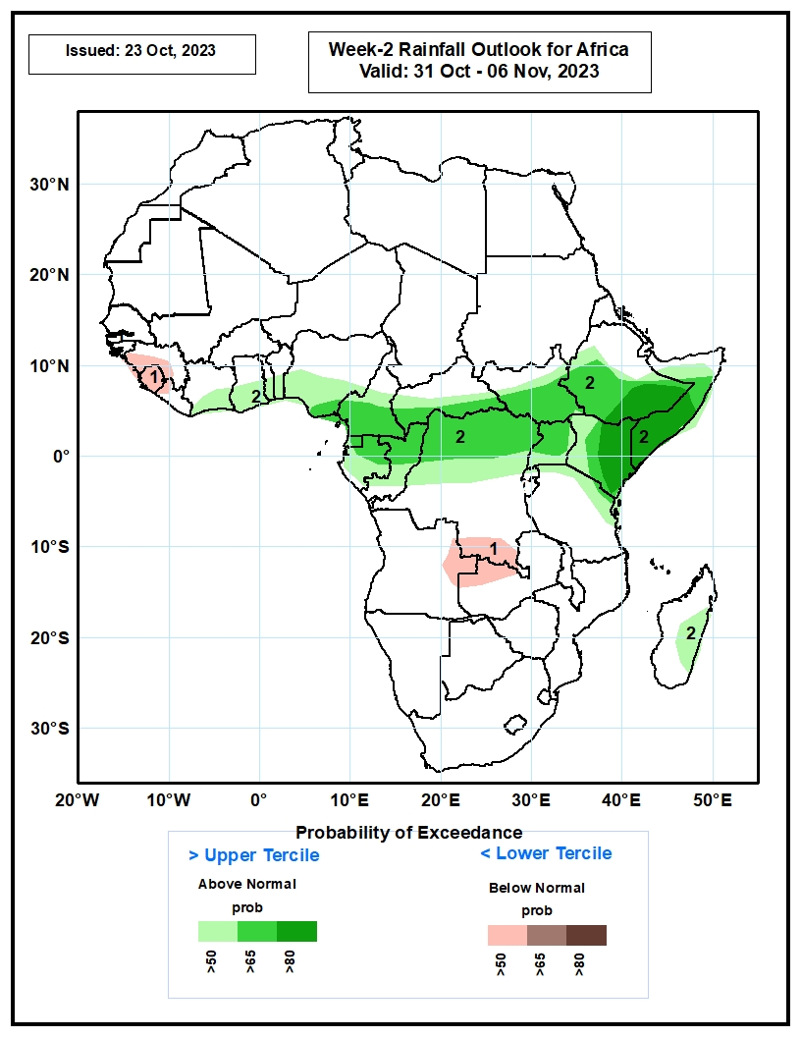
Week-2 Precipitation Outlooks
31 Oct – 06 Nov 2023
The probabilistic forecasts call for above 50% chance for weekly rainfall to be below-normal (below the lower tercile) parts of southern Guinea, Sierra Leone, eastern Angola, southern DRC and northwestern Zambia.
The forecasts call for above 50% chance for weekly total rainfall to be above-normal (above the upper tercile) over equatorial Central and Eastern Africa. There is above 80% chance above-normal rainfall over southeastern Ethiopia, southern Somalia and eastern Kenya.
Notes:
11

Slide 12
Summary
Over the past 30 days, in East Africa, above-average rainfall was observed over western, southern and eastern parts of South Sudan, southwest, southern and eastern Sudan, western, southern and southeast Ethiopia, central, western and southern Somalia, central and northern Uganda, western, northern and central Kenya, and pockets of northern, northeast and southeast Tanzania. Rainfall was below-average over pockets of southeast Sudan and northeast South Sudan, central and eastern Ethiopia, southern Eritrea, Djibouti, northwest Somalia, northern-central South Sudan, southern Uganda, Rwanda, eastern Kenya, and western-central and eastern Tanzania. In southern Africa, above-average rainfall was observed over southeastern and northeastern South Africa, Lesotho, northern Eswatini, central and southern parts of Mozambique and Malawi, central, northern, eastern and southern parts of Zimbabwe, central and northern Zambia, central and northeast Angola, and central and eastern Madagascar. Below-average rainfall was observed over western and central South Africa, southern Madagascar, western, southern and eastern Botswana, northern and central-eastern Namibia, southern and eastern Angola, and southwest Zambia. In Central Africa, rainfall was above-average over central, southeast and northeastern Congo, eastern Gabon, western, eastern and southeast CAR, western, northern and southern DRC, and northwest Chad. Below-average rainfall was observed over much of Cameroon, Equatorial Guinea, northern, central, and western Gabon, western-central Congo, southern Chad, north-central CAR, and central and eastern DRC. In West Africa, rainfall was above-average over pockets of northern and southern Senegal, Guinea, Guinea-Bissau, northern and central Sierra Leone, northwestern and parts of eastern Liberia, western, central, eastern and southern Cote d’Ivoire and Ghana, central and southern Burkina Faso, Togo, central and southern Benin, parts of southwestern Nigeria, and southeastern and northeastern Niger. Below-average rainfall was observed over southeastern Mauritania, western, southern and central Mali, parts of southeast Sierra Leone, southern Liberia, northern Cote d’Ivoire, western Burkina Faso, western Niger, parts of northern Ghana, and central and eastern Nigeria.
During the past 7 days, in East Africa, rainfall was above-average over parts of western, southern, and eastern Ethiopia, central, western and southern Somalia, eastern Sudan, northern Eritrea, western, southern, eastern and central parts of South Sudan, Uganda, many parts of Kenya, eastern parts of Rwanda and Burundi, and western and eastern parts of Tanzania. Below-average rainfall was observed over southern Sudan and pockets of northeast South Sudan. In central Africa, above-average rainfall was observed over parts of western, southeast and northeastern DRC, eastern CAR, central and southern Congo, and eastern Gabon. Rainfall was below-average over parts western, central and northern CAR, many parts of Cameroon, Equatorial Guinea, western and southern Gabon, northern Congo, southern Chad, and northern and central-eastern parts of DRC. In West Africa, above-average rainfall was observed over parts of western and southeast Guinea, central and northern Sierra Leone, northern Liberia, many parts of Cote d’Ivoire, southwest Ghana, and pockets of southern and northwestern Burkina Faso, central Togo and southwest Nigeria. Below-average rainfall was observed over parts of eastern Senegal, western and southern Mali, eastern Liberia, central and southern Benin, and central, eastern and southern parts of Nigeria. In southern Africa, rainfall was above-average over parts of eastern, central-eastern and northeastern South Africa, Lesotho, Eswatini, central, southern and western Mozambique, central and southern Malawi, central, northern and eastern parts of Zimbabwe and Zambia, and pockets of northwest Angola. Below-average rainfall was observed over northeastern, central-eastern and southwestern Angola, and pockets of northern Namibia, eastern Botswana and western South Africa.
The Week-1 outlook calls for above-average rainfall in much of DRC, CAR and South Sudan, western, central and southern parts of Ethiopia, northern parts of Somalia and Kenya, southern Cameroon, Equatorial Guinea, Gabon, Congo, eastern parts of Angola and Botswana, western Zambia, central and southern Zimbabwe, southern Mozambique, northern and central-eastern South Africa, Lesotho, Eswatini, and western-central Madagascar. In contrast, there is an increased chance for below-average in many parts of Gulf of Guinea region, northern Cameroon, southeast Somalia, northwest and southern Tanzania, Rwanda, Burundi, western Angola, central-eastern Namibia, southwest Botswana, southeast South Africa, and south-central Madagascar. The Week-2 outlook calls for above-normal rainfall in most of central and eastern Africa, Gulf of Guinea region, and northeastern Angola, Zambia, Zimbabwe, Mozambique, Malawi, central-eastern South Africa, Lesotho, eastern and southern Madagascar. In contrast, there is an increased chance for below-average in southern Angola, northeast Namibia, eastern Botswana, northern South Africa, western Madagascar, southeastern Tanzania, and southern parts of Sierra Leone and Burkina Faso.

