Slide 1
The African Monsoon Recent Evolution and Current Status Include Week-1 and Week-2 Outlooks
Update prepared
04 December 2023
For more information, visit:
http://www.cpc.ncep.noaa.gov/products/Global_Monsoons/African_Monsoons/precip_monitoring.shtml

Slide 2
Outline
Highlights
Recent Evolution and Current Conditions
NCEP GEFS Forecasts
Summary

Slide 3
Highlights: Last 7 Days
During the past 7 days, in East Africa, rainfall was above-average in many parts of Tanzania and Burundi, southern Rwanda, northwest, western-central and southern Uganda, southwest and southeast Kenya, southeast Somalia, western and eastern South Sudan, and western Ethiopia. Below-average rainfall was observed over southwest Ethiopia, northwest and western-central Kenya, and eastern Uganda. In central Africa, above-average rainfall was observed over parts of western, southern, central and eastern CAR, western, northern, eastern and southern DRC, southern Cameroon, Equatorial Guinea, many parts of Gabon, and northern and southern Congo. Rainfall was below-average over central and pockets of southwest DRC, and pockets of western-central Congo. In West Africa, above-average rainfall was observed over parts of southeast Guinea, Sierra Leone, Liberia, Cote d’Ivoire, central and southern Ghana, Togo, western Benin, and pockets of southeast Nigeria. In southern Africa, rainfall was above-average over parts of western, southern and northeast Angola, northern, central, western and southeast Namibia, southwest Botswana, northern and northeast Zambia, northern and central Malawi, pockets of northwest and eastern Mozambique, northern South Africa, western Eswatini, and northern and eastern Madagascar. Below-average rainfall was observed over western Zambia, northern, central, southern and eastern Botswana, northern, western and central Zimbabwe, southern Malawi, northern, central and southeast Mozambique, central South Africa, western and southern Lesotho, central Angola, eastern Namibia, and western and southwest Madagascar.
The Week-1 outlook calls for above-average rainfall in much of Equatorial Guinea, Gabon, Congo, southern Cameroon, many parts of DRC, Uganda and Tanzania, Rwanda, Burundi, southern Kenya, western Angola, central-eastern South Africa, Eswatini, and central and northern Lesotho. In contrast, there is an increased chance for below-average in Zambia, Botswana, Zimbabwe, Malawi, many parts of Mozambique and Madagascar, northern, central and eastern Namibia, northern, central, southern and eastern Angola, northern, western, central and southeast South Africa, central and southern Ethiopia, southern Somalia, northern and eastern Kenya, Liberia, and southern parts of Cote d’Ivoire and Ghana. The Week-2 outlook calls for above-normal rainfall in central and southern Gabon, southern Congo, many parts of DRC, Rwanda, Burundi, western and northern Tanzania, southern Kenya, northern and central Angola, southern parts of Botswana, Zimbabwe and Mozambique, northern and central South Africa, Lesotho, and Eswatini. In contrast, there is an increased chance for below-average in Zambia, Malawi, northern Mozambique, southern Tanzania, northern and eastern Namibia, northern parts of Zimbabwe and Botswana, western and northern Madagascar, northern Congo, southern Cameroon, pockets of northwest DRC, southern Ethiopia, eastern Uganda, northern and eastern Kenya, Liberia, and southern parts of Cote d’Ivoire and Ghana.

Slide 4
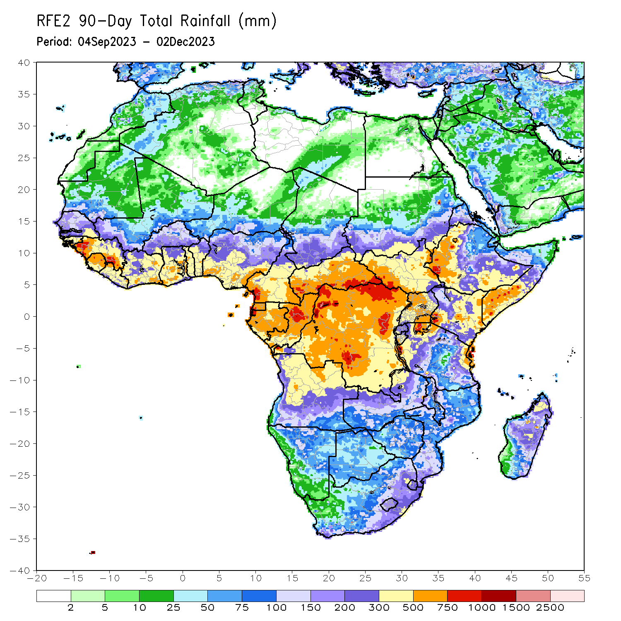
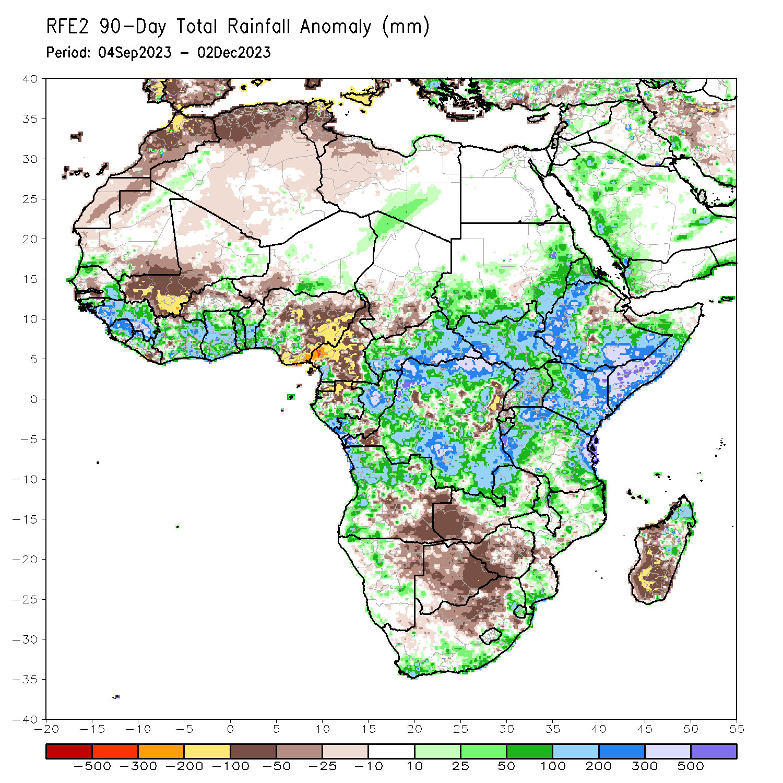
Rainfall Patterns: Last 90 Days
Over the past 90 days, in East Africa, above-average rainfall was observed in many parts of South Sudan, Uganda, Kenya, Tanzania and Burundi, southwest, southern, central and eastern Sudan, northern and central Eritrea, northern, western, southern and eastern Ethiopia, and southern, central, eastern and northwest Somalia. Rainfall was below-average over central Ethiopia, central and northern Burundi, and pockets of southwest Uganda and southern Tanzania. In Central Africa, rainfall was above-average over western, southern, central and eastern CAR, northern and central Cameroon, eastern and southern Gabon, northern, western, southern and southeast DRC, northwest and central-eastern Chad, and pockets of southwest and southeast Cameroon. Rainfall was below-average over northern, central, western and southern Cameroon, southern Equatorial Guinea, northern Gabon, central Congo, western and southern Chad, and pockets of northern CAR and southwest and eastern DRC. In West Africa, rainfall was above-average over northern and southeast Senegal, southwest Mauritania, many parts of Guinea-Bissau, Gabon, Sierra Leone, Cote d’Ivoire, Ghana and Togo, central and northern Liberia, central and southern Benin, northern and southern Burkina Faso, southwest Nigeria, and eastern Mali. Below-average rainfall was observed over southwest Senegal, southeast Mauritania, western Mali, western and eastern Burkina Faso, eastern Liberia, southwest Niger, and central, eastern and southeast Nigeria. In southern Africa, above-average rainfall was observed over northern, western and central-eastern Angola, northern and north-central Namibia, northern and northwest Zambia, central and northern Malawi, northern and southern Mozambique, northern, eastern and southeast South Africa, Eswatini, and northern and central-eastern Madagascar. Below-average rainfall was observed over southeast Angola, northeast Namibia, western and southern Zambia, many parts of Botswana, western, central, southern and eastern Zimbabwe, western and central South Africa, central Mozambique, and western, southern and southeast Madagascar.
Notes:
4

Slide 5
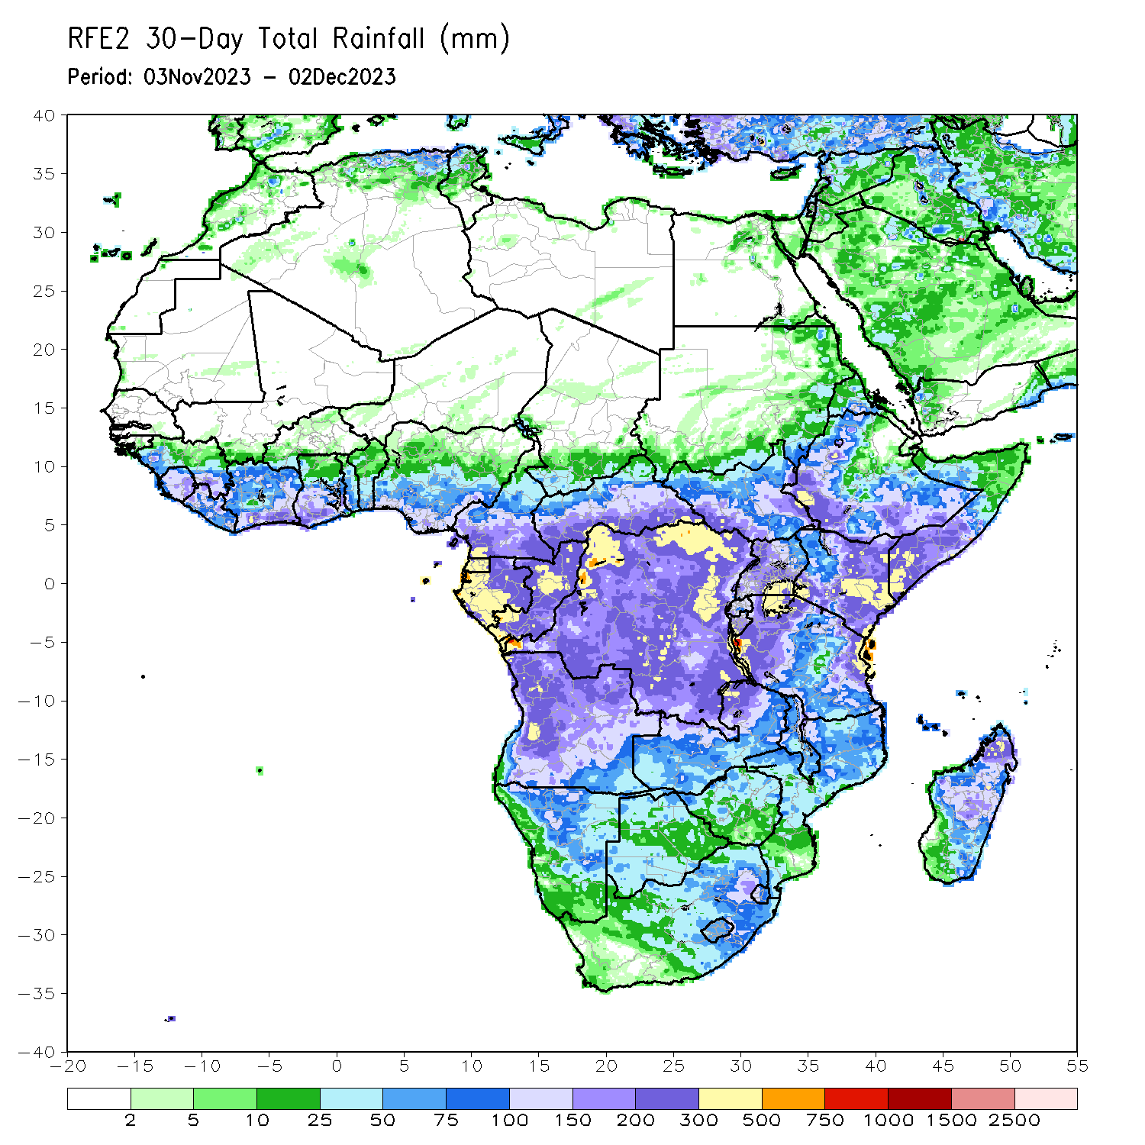
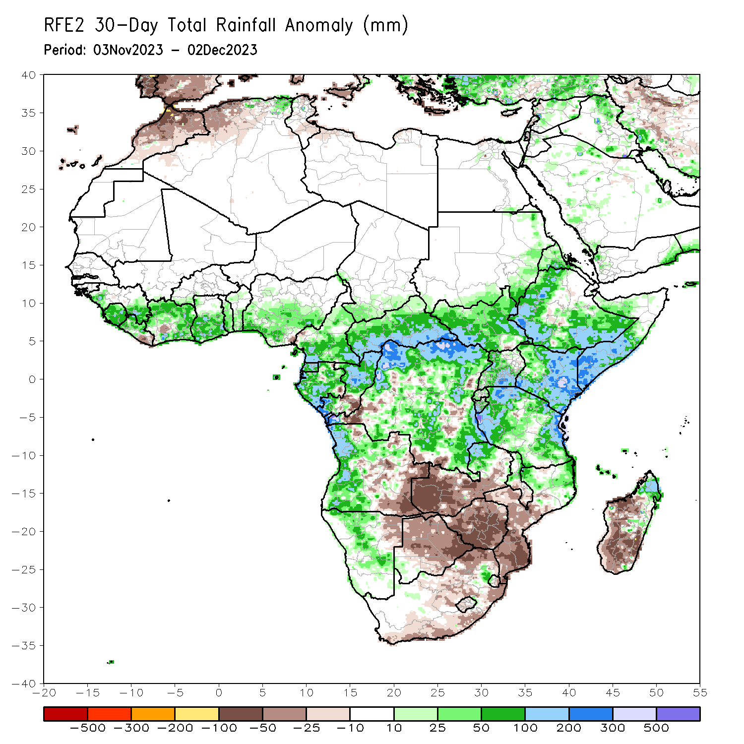
Rainfall Patterns: Last 30 Days
Over the past 30 days, in East Africa, above-average rainfall was observed in many parts of South Sudan, Kenya, Tanzania, Burundi, Rwanda and Uganda, southern and eastern Sudan, northern, western, southern and eastern Ethiopia, northern and central Eritrea, and central, southern and northwest Somalia. Rainfall was below-average over pockets of southern South Sudan and central Ethiopia. In Central Africa, rainfall was above-average across CAR and Equatorial Guinea, many parts of Gabon and Cameroon, southern Chad, northern, eastern and southern Congo, and northern, northwest, central-southern and southeast DRC. Below-average rainfall was observed in central Congo, pockets of southwest, southern and central-eastern DRC, and pockets of southeast Gabon and southwest Cameroon. In West Africa, rainfall was above-average over western and southeast Senegal, Sierra Leone, western and northern Liberia, western, northern, eastern and southern Cote d’Ivoire, central and southern Ghana, southern Burkina Faso, Togo, central and southern Benin, and western, central and southern Nigeria. Below-average rainfall was observed over eastern Liberia and pockets of central Cote d’Ivoire and southeast Nigeria. In southern Africa, above-average rainfall was observed in western, northern and southwest Angola, northern, central and southeast Namibia, northern parts of Zambia, Malawi, Mozambique and Madagascar, southwest Botswana, and near border of western Eswatini and South Africa. Below-average rainfall was observed over central, eastern and southeast Angola, northeast Namibia, western, southern and central Zambia, western, northern, central and eastern Botswana, Zimbabwe, southern Malawi, central and southern Mozambique, northern, western, central and eastern South Africa, central and southern Lesotho, eastern Eswatini, and western, southern and southeast Madagascar.
Notes:
5

Slide 6
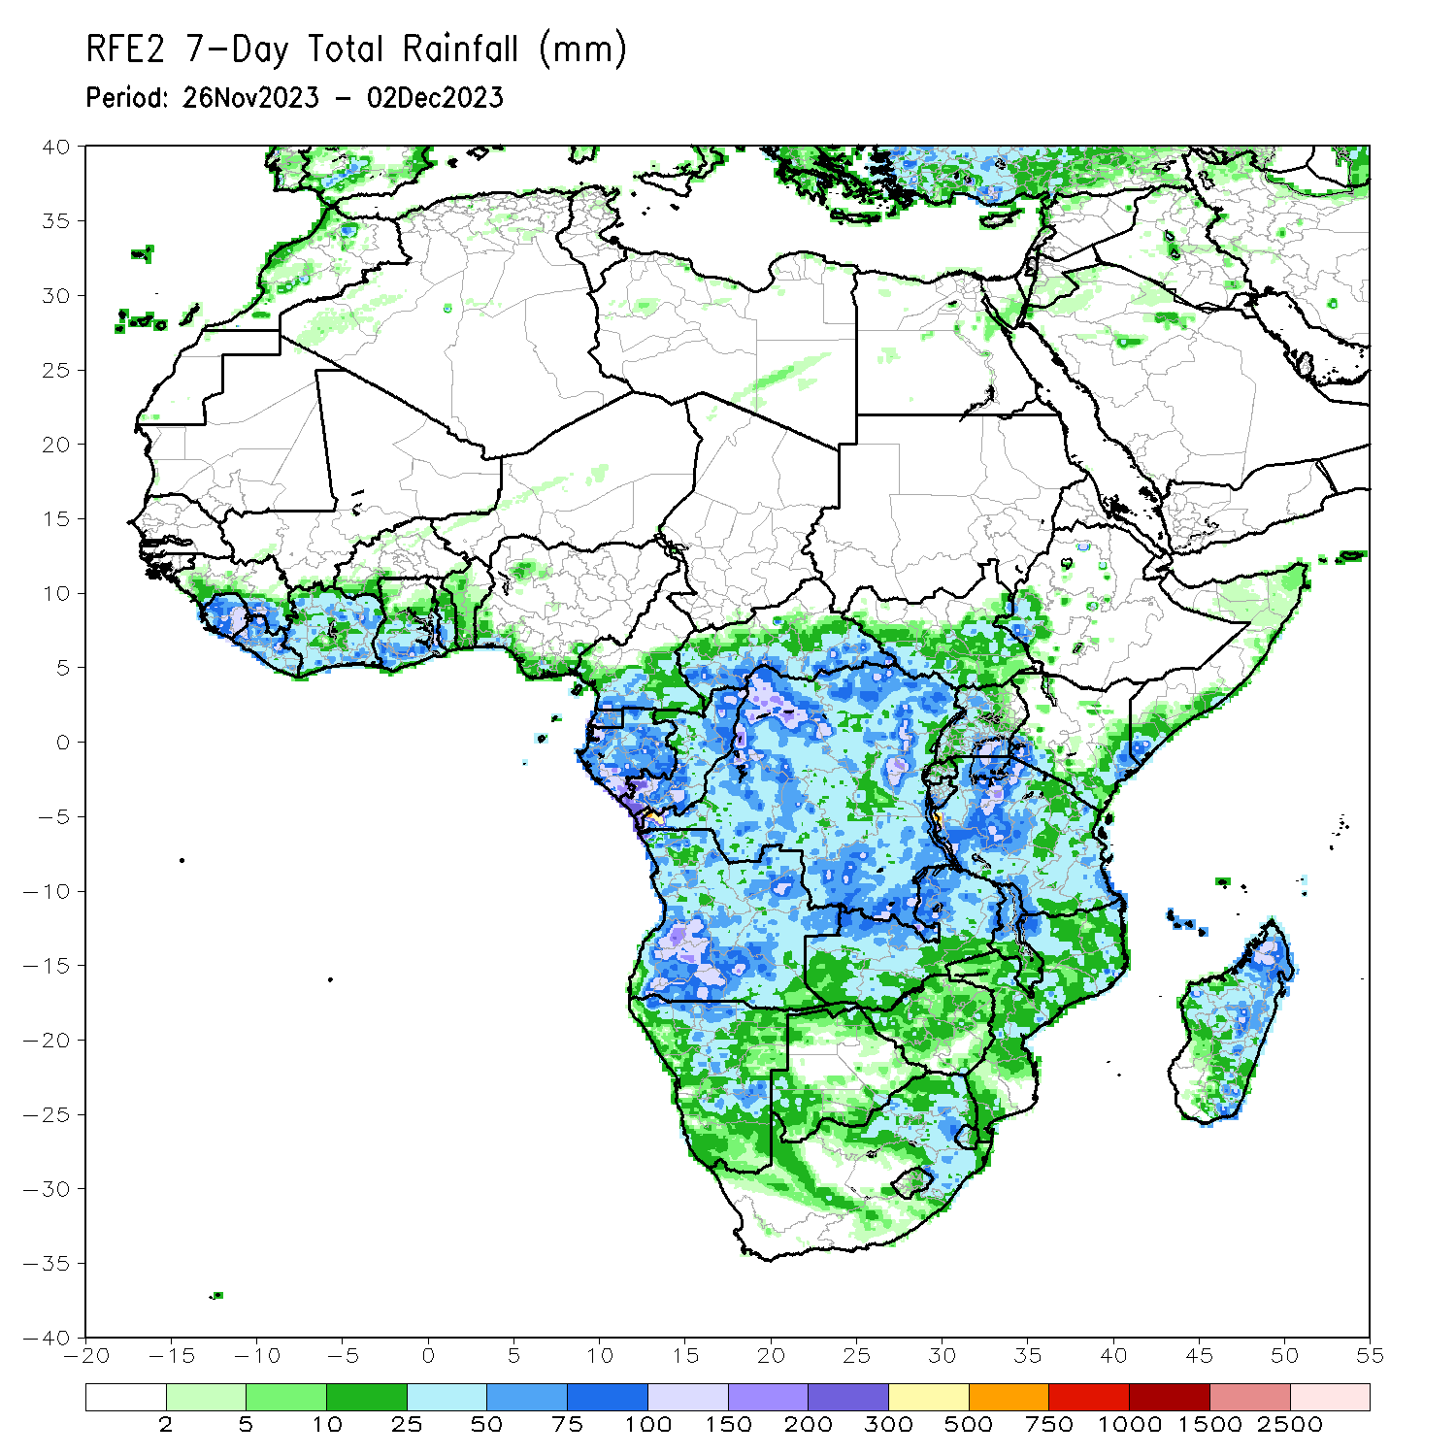
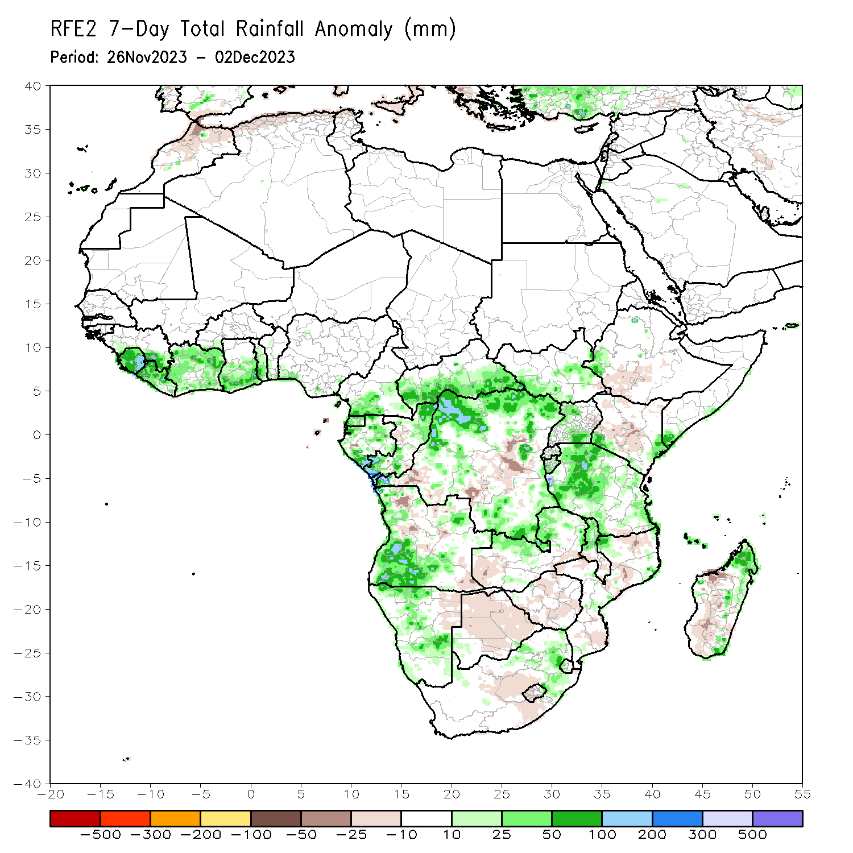
Rainfall Patterns: Last 7 Days
During the past 7 days, in East Africa, rainfall was above-average in many parts of Tanzania and Burundi, southern Rwanda, northwest, western-central and southern Uganda, southwest and southeast Kenya, southeast Somalia, western and eastern South Sudan, and western Ethiopia. Below-average rainfall was observed over southwest Ethiopia, northwest and western-central Kenya, and eastern Uganda. In central Africa, above-average rainfall was observed over parts of western, southern, central and eastern CAR, western, northern, eastern and southern DRC, southern Cameroon, Equatorial Guinea, many parts of Gabon, and northern and southern Congo. Rainfall was below-average over central and pockets of southwest DRC, and pockets of western-central Congo. In West Africa, above-average rainfall was observed over parts of southeast Guinea, Sierra Leone, Liberia, Cote d’Ivoire, central and southern Ghana, Togo, western Benin, and pockets of southeast Nigeria. In southern Africa, rainfall was above-average over parts of western, southern and northeast Angola, northern, central, western and southeast Namibia, southwest Botswana, northern and northeast Zambia, northern and central Malawi, pockets of northwest and eastern Mozambique, northern South Africa, western Eswatini, and northern and eastern Madagascar. Below-average rainfall was observed over western Zambia, northern, central, southern and eastern Botswana, northern, western and central Zimbabwe, southern Malawi, northern, central and southeast Mozambique, central South Africa, western and southern Lesotho, central Angola, eastern Namibia, and western and southwest Madagascar.

Slide 7
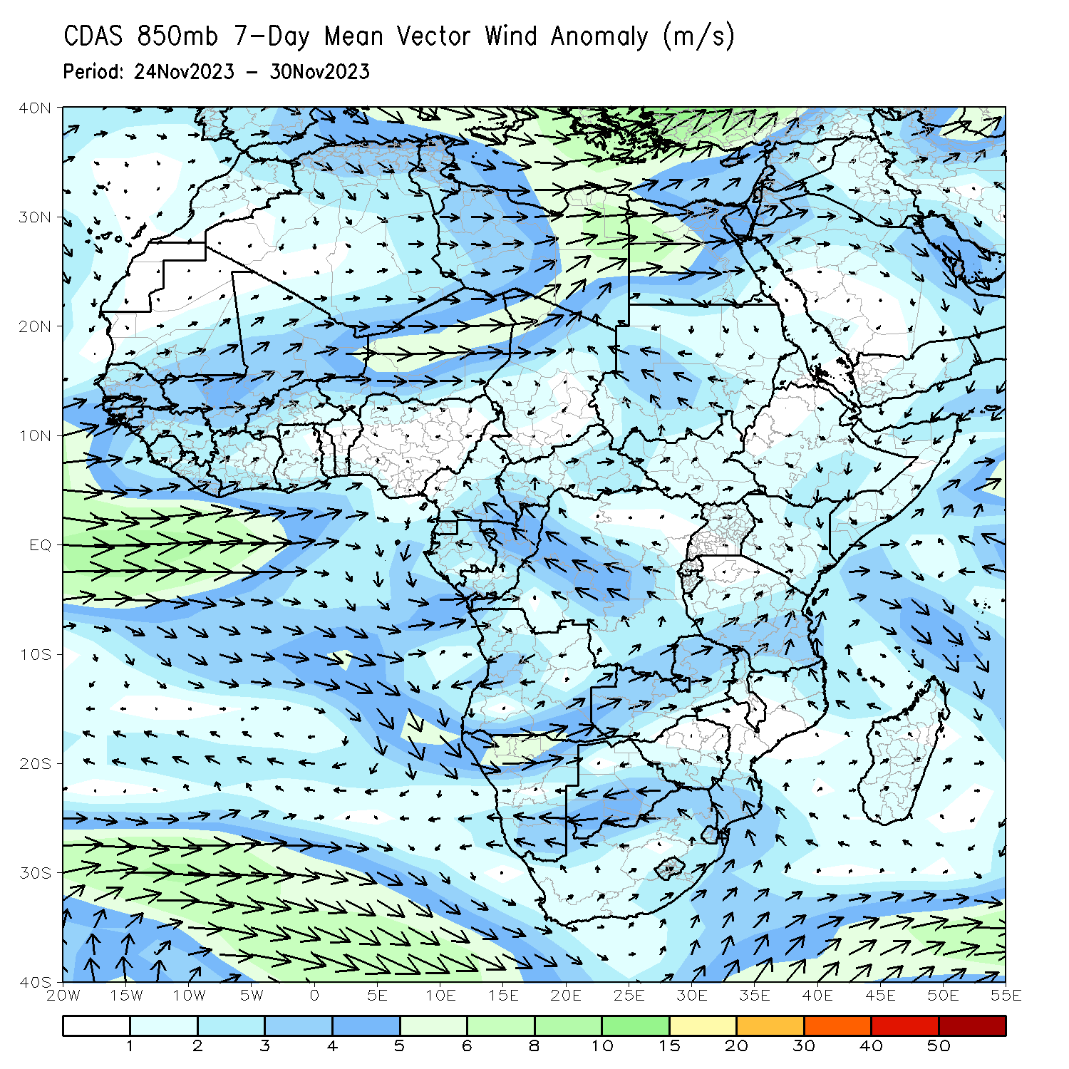
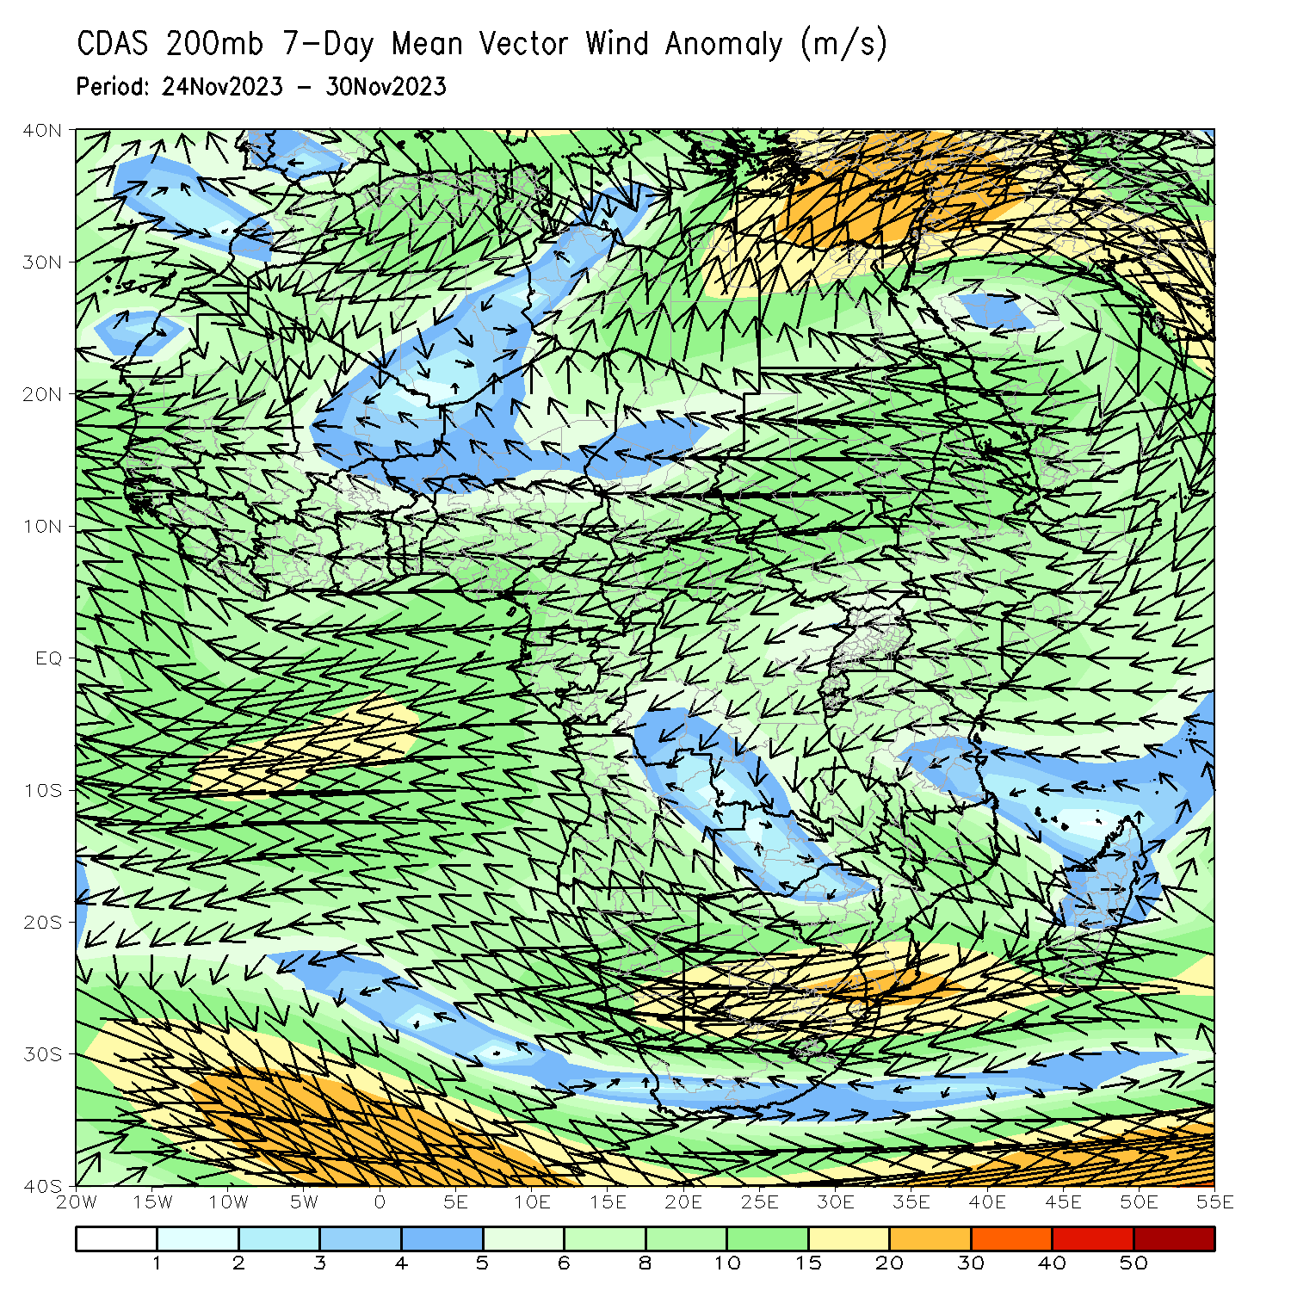
Atmospheric Circulation: Last 7 Days
At 850-hPa level (left panel), anomalous onshore flow was observed over the western Gulf of Guinea region, which may have contributed to the observed above-average rainfall in the region. Anomalous lower-level convergence was present across northern Congo, northwest DRC and southern CAR, likely contributing to the above-average precipitation in that regions.

Slide 8
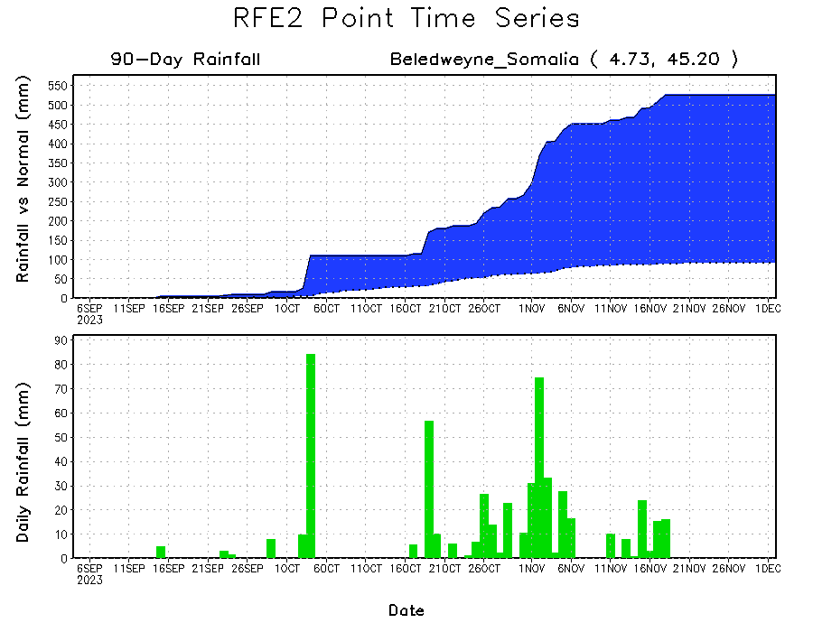
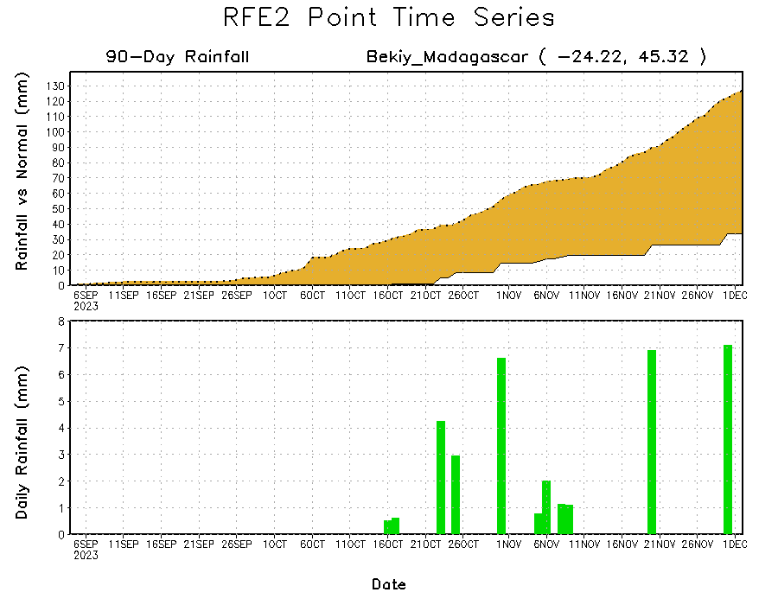
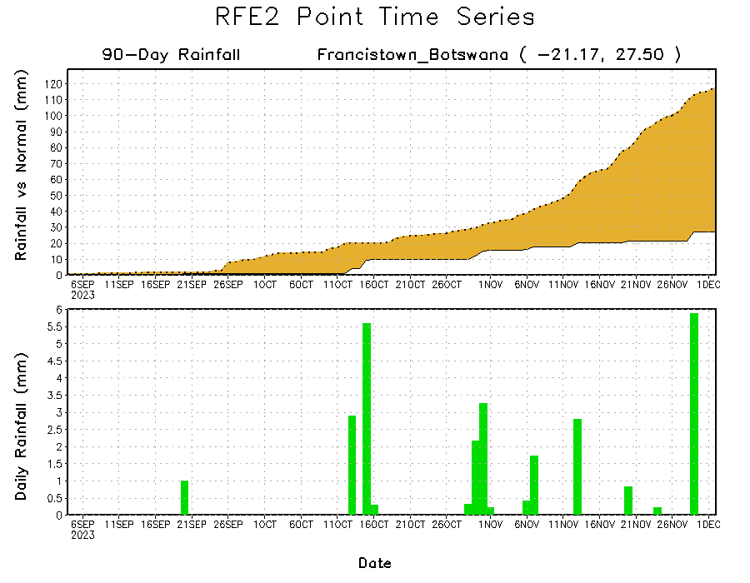
Rainfall Evolution
Daily evolution of rainfall over the last 90 days at selected locations shows a growing dryness over parts of eastern Botswana (bottom left) and southwest Madagascar (bottom right). Seasonal total rainfall remained above-average over southern Somalia due to the moderate to heavy rainfall fell in southern Somalia during mid-October to mid-November 2023 (top right).

Slide 9
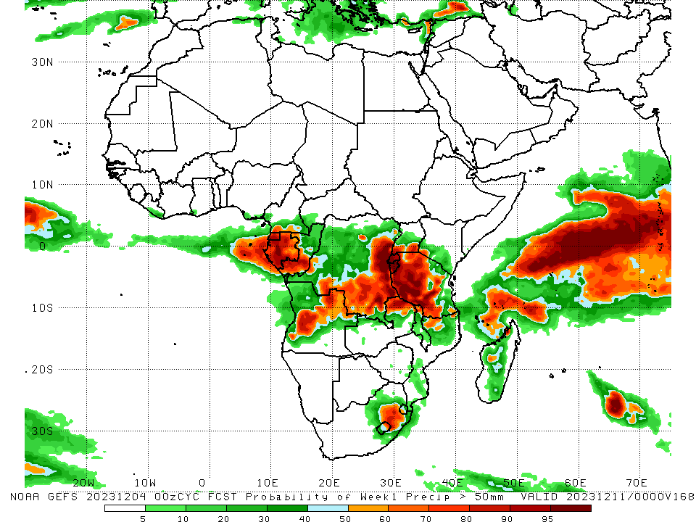
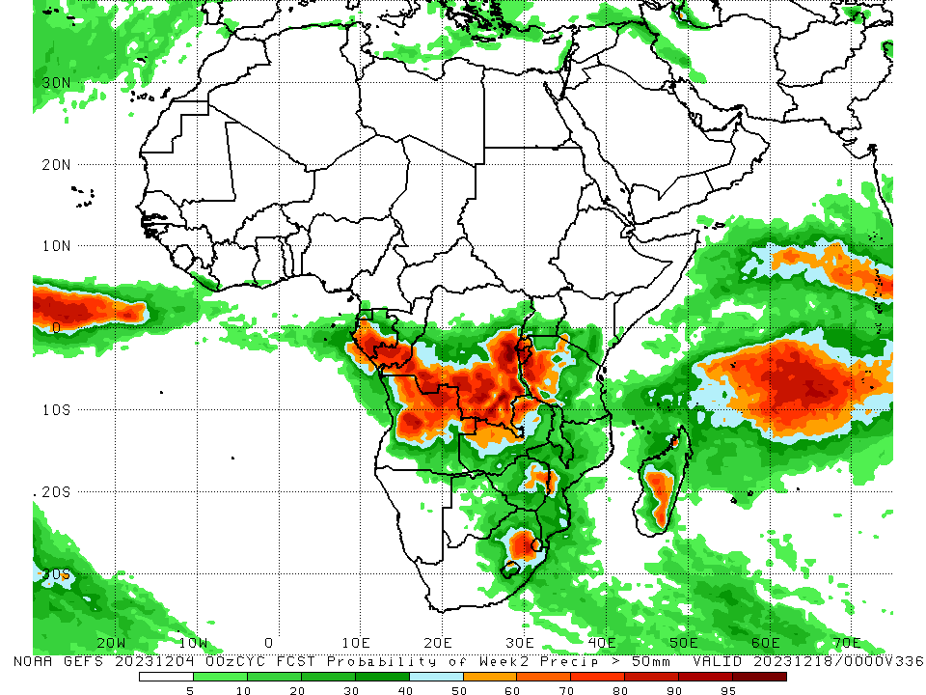
NCEP GEFS Model Forecasts Non-Bias Corrected Probability of precipitation exceedance
Week-1, Valid: 05 – 11 Dec 2023
Week-2, Valid: 12 – 18 Dec 2023
For week-1 (left panel) the GEFS forecasts indicate a moderate to high chance (over 70%) for rainfall to exceed 50 mm over Equatorial Guinea, Gabon, southern Congo, central and northeast Angola, southern and eastern DRC, Rwanda, Burundi, northern, western, central and southern Tanzania, southern Uganda, northern Zambia, and central-eastern South Africa. For week-2 (right panel), the GEFS forecasts indicate a moderate to high chance (over 70%) for rainfall to exceed 50 mm over central and southern Gabon, southern Congo, southwest, southern and eastern DRC, Rwanda, Burundi, western Tanzania, central, northern and northeast Angola, northwest Zambia, near border of Zimbabwe and Mozambique, central-eastern South Africa, and central Madagascar.
Notes:
9

Slide 10
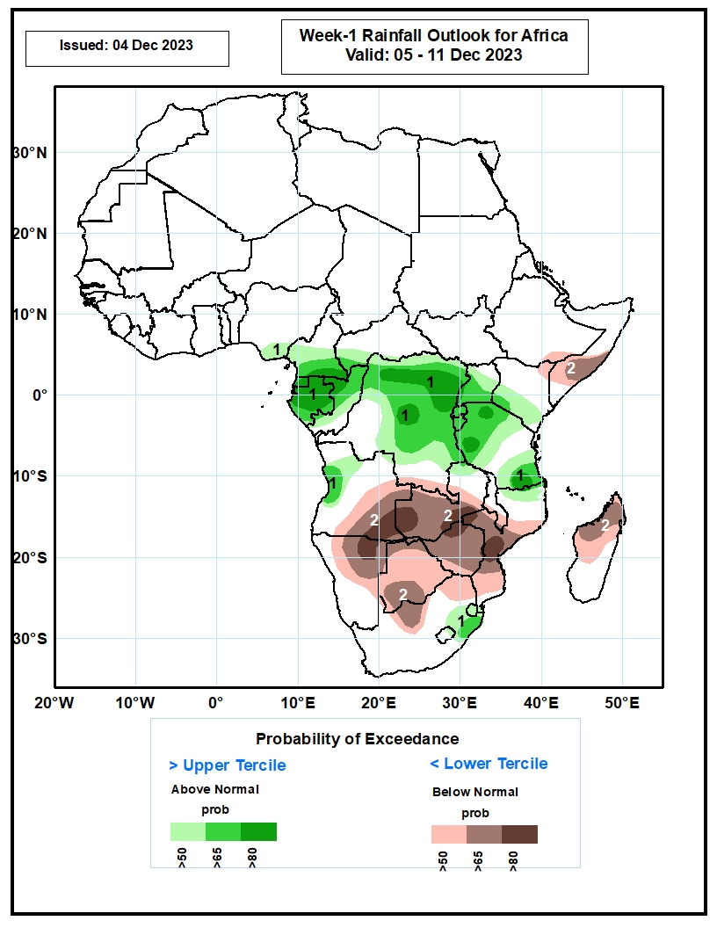
Week-1 Precipitation Outlooks
05 – 11 Dec 2023
The probabilistic forecasts call for above 50% chance for weekly rainfall to be above-average (above the upper tercile) over southeastern Nigeria, central and southern Cameroon, southwestern CAR, Equatorial Guinea, Gabon, much of Congo, much of DR Congo, western Angola, much of Uganda, southern Kenya, Rwanda, Burundi, much of Tanzania, eastern part of South Africa, eastern Lesotho, and Eswatini. There is above 80% chance for above-average rainfall over southern Cameroon, Equatorial Guinea, much of Gabon, northwestern Congo, northern and central parts of DR Congo, and western and southern part of Tanzania.
The probabilistic forecasts call for above 50% chance for weekly total rainfall to be below-average (below the lower tercile) over south-central Ethiopia, northeastern Kenya, southern Somalia, central and eastern Angola, southern part of DR Congo, much of Zambia, southern Malawi, much of Mozambique, northern and eastern Namibia, Botswana, Zimbabwe, northern part of South Africa, and northern and central Madagascar. There is above 80% chance for below-average rainfall over southeastern Angola, western and central parts of Zambia, northeastern Namibia, and central Mozambique.
Notes:
10

Slide 11
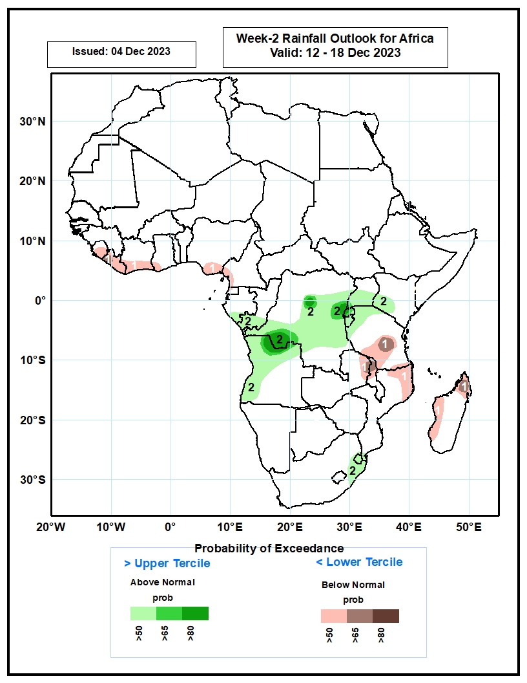
Week-2 Precipitation Outlooks
12 – 18 Dec 2023
The probabilistic forecasts call for above 50% chance for weekly total rainfall to be below-average (below the lower tercile) over much of Sierra Leone, Liberia, southern Cote d’Ivoire, southwestern Ghana, southeastern Nigeria, southwestern Cameroon, central and southern parts of Tanzania, northern part of Zambia, northern Malawi, northern part of Mozambique, and northern and western parts of Madagascar. There is above 65% chance for below-average rainfall over western Liberia, central Tanzania, northern Malawi, and northern Madagascar.
The probabilistic forecasts call for above 50% chance for weekly rainfall to be above-average (above the upper tercile) over southern Gabon, southern Congo, central and southern parts of DR Congo, central and southern Uganda, southwestern Kenya, Rwanda, Burundi, northern part of Tanzania, northern and western Angola, eastern part of South Africa, and Eswatini. There is above 80% chance for above-average rainfall over western and eastern parts of DR Congo, and north-central Angola.
Notes:
11

Slide 12
Summary
Over the past 30 days, in East Africa, above-average rainfall was observed in many parts of South Sudan, Kenya, Tanzania, Burundi, Rwanda and Uganda, southern and eastern Sudan, northern, western, southern and eastern Ethiopia, northern and central Eritrea, and central, southern and northwest Somalia. Rainfall was below-average over pockets of southern South Sudan and central Ethiopia. In Central Africa, rainfall was above-average across CAR and Equatorial Guinea, many parts of Gabon and Cameroon, southern Chad, northern, eastern and southern Congo, and northern, northwest, central-southern and southeast DRC. Below-average rainfall was observed in central Congo, pockets of southwest, southern and central-eastern DRC, and pockets of southeast Gabon and southwest Cameroon. In West Africa, rainfall was above-average over western and southeast Senegal, Sierra Leone, western and northern Liberia, western, northern, eastern and southern Cote d’Ivoire, central and southern Ghana, southern Burkina Faso, Togo, central and southern Benin, and western, central and southern Nigeria. Below-average rainfall was observed over eastern Liberia and pockets of central Cote d’Ivoire and southeast Nigeria. In southern Africa, above-average rainfall was observed in western, northern and southwest Angola, northern, central and southeast Namibia, northern parts of Zambia, Malawi, Mozambique and Madagascar, southwest Botswana, and near border of western Eswatini and South Africa. Below-average rainfall was observed over central, eastern and southeast Angola, northeast Namibia, western, southern and central Zambia, western, northern, central and eastern Botswana, Zimbabwe, southern Malawi, central and southern Mozambique, northern, western, central and eastern South Africa, central and southern Lesotho, eastern Eswatini, and western, southern and southeast Madagascar.
During the past 7 days, in East Africa, rainfall was above-average in many parts of Tanzania and Burundi, southern Rwanda, northwest, western-central and southern Uganda, southwest and southeast Kenya, southeast Somalia, western and eastern South Sudan, and western Ethiopia. Below-average rainfall was observed over southwest Ethiopia, northwest and western-central Kenya, and eastern Uganda. In central Africa, above-average rainfall was observed over parts of western, southern, central and eastern CAR, western, northern, eastern and southern DRC, southern Cameroon, Equatorial Guinea, many parts of Gabon, and northern and southern Congo. Rainfall was below-average over central and pockets of southwest DRC, and pockets of western-central Congo. In West Africa, above-average rainfall was observed over parts of southeast Guinea, Sierra Leone, Liberia, Cote d’Ivoire, central and southern Ghana, Togo, western Benin, and pockets of southeast Nigeria. In southern Africa, rainfall was above-average over parts of western, southern and northeast Angola, northern, central, western and southeast Namibia, southwest Botswana, northern and northeast Zambia, northern and central Malawi, pockets of northwest and eastern Mozambique, northern South Africa, western Eswatini, and northern and eastern Madagascar. Below-average rainfall was observed over western Zambia, northern, central, southern and eastern Botswana, northern, western and central Zimbabwe, southern Malawi, northern, central and southeast Mozambique, central South Africa, western and southern Lesotho, central Angola, eastern Namibia, and western and southwest Madagascar.
The Week-1 outlook calls for above-average rainfall in much of Equatorial Guinea, Gabon, Congo, southern Cameroon, many parts of DRC, Uganda and Tanzania, Rwanda, Burundi, southern Kenya, western Angola, central-eastern South Africa, Eswatini, and central and northern Lesotho. In contrast, there is an increased chance for below-average in Zambia, Botswana, Zimbabwe, Malawi, many parts of Mozambique and Madagascar, northern, central and eastern Namibia, northern, central, southern and eastern Angola, northern, western, central and southeast South Africa, central and southern Ethiopia, southern Somalia, northern and eastern Kenya, Liberia, and southern parts of Cote d’Ivoire and Ghana. The Week-2 outlook calls for above-normal rainfall in central and southern Gabon, southern Congo, many parts of DRC, Rwanda, Burundi, western and northern Tanzania, southern Kenya, northern and central Angola, southern parts of Botswana, Zimbabwe and Mozambique, northern and central South Africa, Lesotho, and Eswatini. In contrast, there is an increased chance for below-average in Zambia, Malawi, northern Mozambique, southern Tanzania, northern and eastern Namibia, northern parts of Zimbabwe and Botswana, western and northern Madagascar, northern Congo, southern Cameroon, pockets of northwest DRC, southern Ethiopia, eastern Uganda, northern and eastern Kenya, Liberia, and southern parts of Cote d’Ivoire and Ghana.

