Slide 1
The African Monsoon Recent Evolution and Current Status Include Week-1 and Week-2 Outlooks
Update prepared
26 December 2023
For more information, visit:
http://www.cpc.ncep.noaa.gov/products/Global_Monsoons/African_Monsoons/precip_monitoring.shtml

Slide 2
Outline
Highlights
Recent Evolution and Current Conditions
NCEP GEFS Forecasts
Summary

Slide 3
Highlights: Last 7 Days
During the past 7 days, in East Africa, rainfall was above-average in pockets of southwest and southeastern Tanzania and pockets of central and central-eastern Kenya. Below-average rainfall was observed over western, central, central-eastern and northeastern Tanzania, Burundi, western and central Rwanda, central and southeastern Uganda, southwestern Kenya and pockets of southwest Ethiopia. In central Africa, above-average rainfall was observed over pockets of southern Gabon and pockets of northwest and northeast DRC. Rainfall was below-average over northern, central, southern and eastern Equatorial Guinea, western, northern and southeast Gabon, eastern and southern Congo, and southwestern, southern, central and southeast DRC. In West Africa, below-average rainfall was observed in pockets of the region in southwest Nigeria. In southern Africa, rainfall was above-average over western and southern Angola, northern Namibia, southern and central Zambia, northwestern Zimbabwe, northwest Mozambique, central and northeast South Africa, Lesotho, western and eastern Eswatini, and central and central-eastern Madagascar. Below-average rainfall was observed over central and eastern Angola, eastern Zambia, central and southern Malawi, central, eastern and southern Mozambique, southern and eastern Zimbabwe, northern South Africa, pockets of western Zambia, and northwest, southwest and southern Madagascar.
The Week-1 outlook calls for above-average rainfall in Gabon, central and southern Congo, western, central, eastern and southern DRC, central and southern parts of Uganda and Kenya, Rwanda, Burundi, northern, western and central Tanzania, northern Angola, central, northern, southern and eastern Zambia, Malawi, central and southern Mozambique, central, northern, eastern and southeastern Zimbabwe, southern Botswana, western, central and eastern South Africa, Lesotho, and central, southern and eastern Madagascar. In contrast, there is an increased chance for below-average across southern and southeast Angola, northern Namibia, western Zambia, northern and eastern Botswana, northern South Africa, southeastern Tanzania, northeastern Mozambique, central, southern and eastern Liberia, and southern parts of Cote d’Ivoire and Ghana. The Week-2 outlook calls for above-normal rainfall in central and eastern DRC, pockets of southern regions of Uganda and Kenya, Rwanda, Burundi, Tanzania, Malawi, northern, central and eastern Zambia, northern Mozambique, southern Botswana, western, central and eastern South Africa, Lesotho, Eswatini, northern, western, central and eastern Madagascar, eastern Sierra Leone, and western Liberia. In contrast, there is an increased chance for below-average in central and southern Gabon, northern, eastern and southern Congo, pockets of southwest DRC, northern, central and southern Angola, northern, central and eastern Namibia, southern Zambia, central and southern parts of Zimbabwe and Mozambique, northern South Africa, pockets of northern and eastern Botswana, southern Madagascar and southeast Kenya.

Slide 4
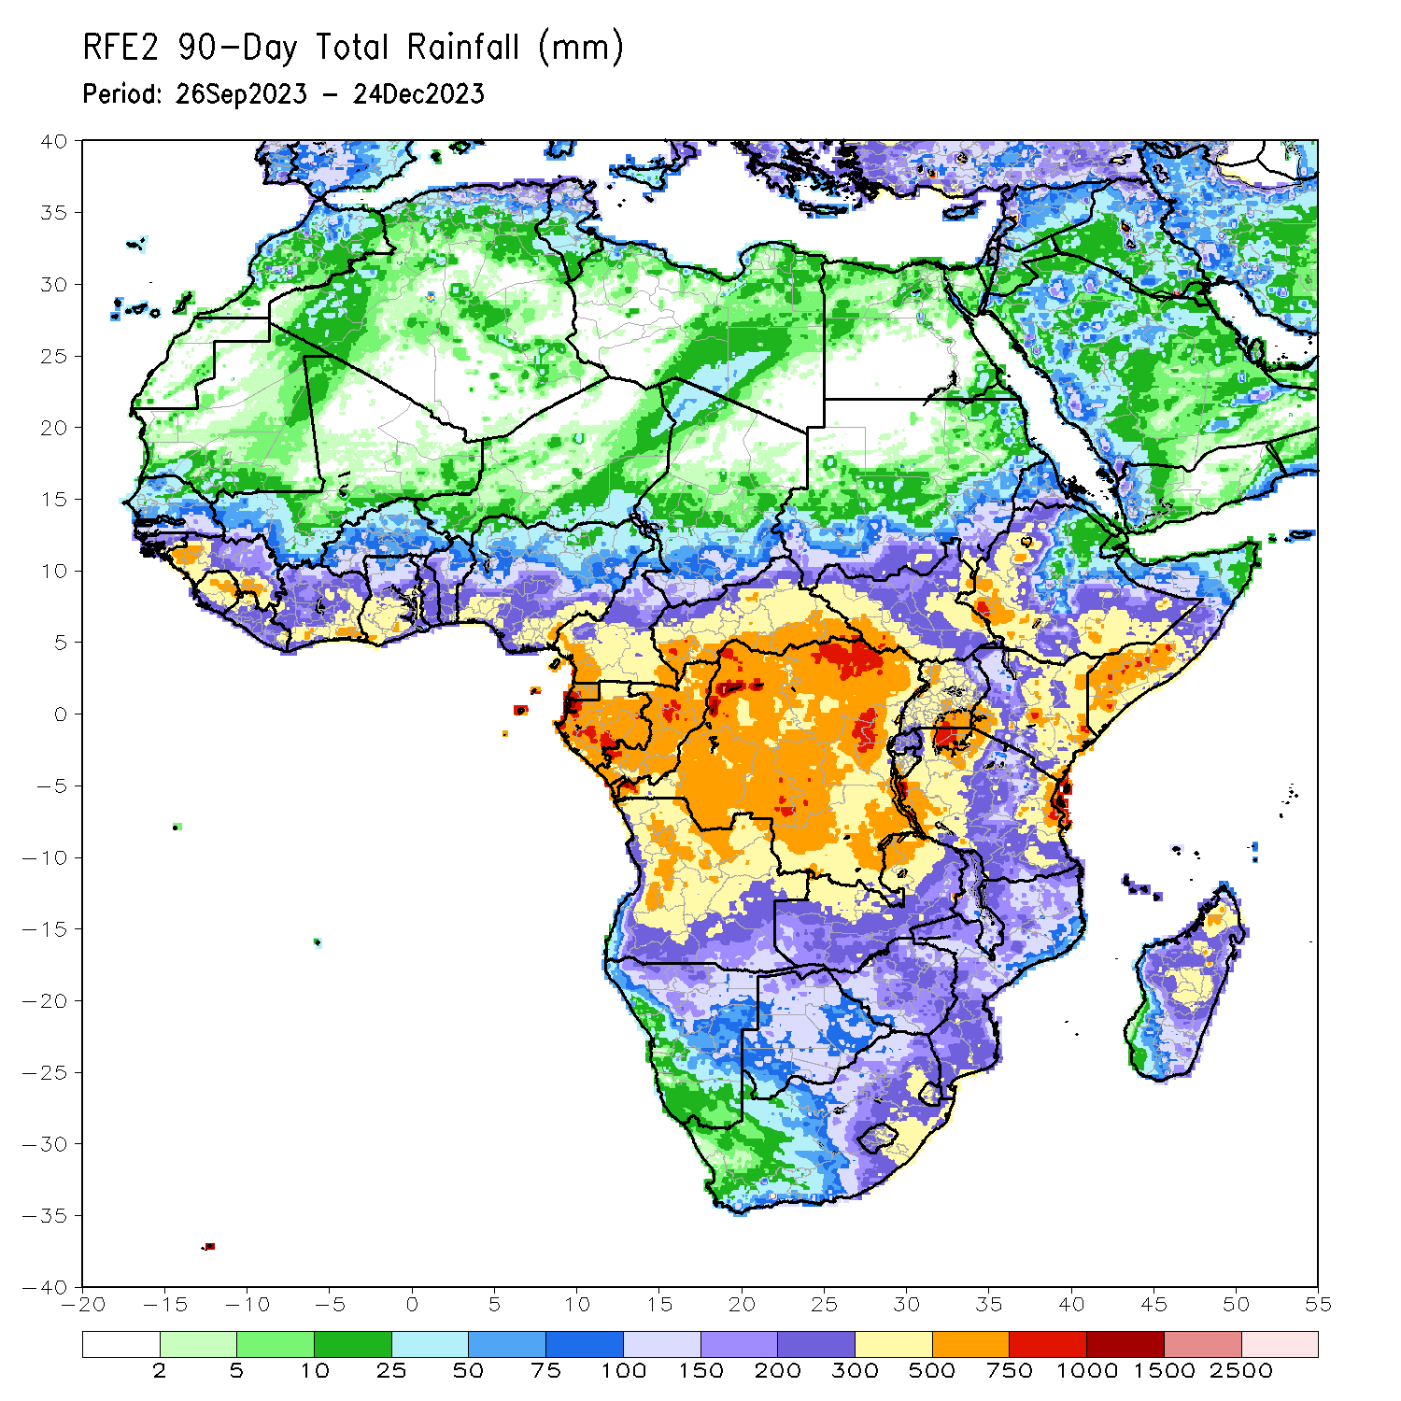
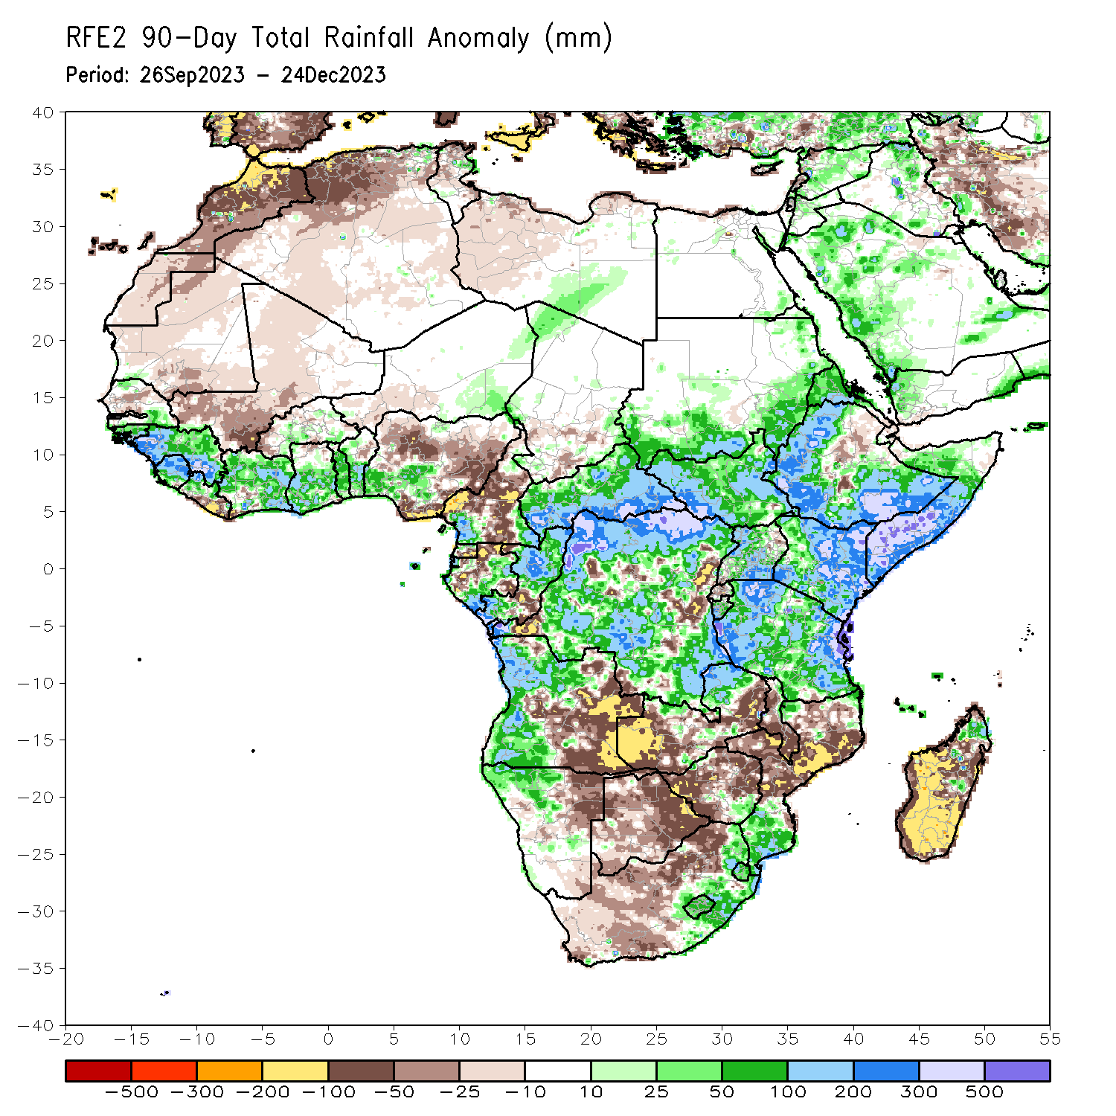
Rainfall Patterns: Last 90 Days
Over the past 90 days, in East Africa, above-average rainfall was observed in many parts of South Sudan, Kenya, Tanzania, Burundi and Uganda, southwest, southern, central and eastern Sudan, northern and central Eritrea, northern, western, southern and eastern Ethiopia, and southern, central, western, eastern and northwest Somalia. Rainfall was below-average over central-eastern Ethiopia, southern Eritrea, northern Djibouti, central and northern Rwanda, and pockets of southwest and northeast Uganda. In Central Africa, rainfall was above-average in many parts of CAR, northern, western, southern and southeast DRC, northern, central and southern Congo, eastern and southern Gabon, northwest Chad, and pockets of southwest and southeast Cameroon. Rainfall was below-average over northern, central, western and southern Cameroon, southern Equatorial Guinea, northern and western-central Gabon, southern-central Congo, southern Chad, pockets of southwest and central DRC, and eastern DRC. In West Africa, rainfall was above-average over northern and southeast Senegal, Guinea-Bissau, Guinea, Sierra Leone, northern Liberia, many parts of Cote d’Ivoire and Togo, central, southern and eastern parts of Ghana and Benin, southern Burkina Faso, southeast and eastern Niger, and southwest Nigeria. Below-average rainfall was observed over central, southwest and northeast Senegal, Gambia, southeast Mauritania, western Mali, western Burkina Faso, southeast Liberia, southwest Niger, and central, eastern, northwest and southeast Nigeria. In southern Africa, above-average rainfall was observed over northwest, western, central and southwest Angola, northwest Namibia, northwest Zambia, southeast Zimbabwe, southern Mozambique, eastern and northeast South Africa, Eswatini, Lesotho, and pockets of northern Madagascar. Below-average rainfall was observed over southeast and eastern Angola, northeast Namibia, western, southern and eastern Zambia, many parts of Botswana, western, northern, central and eastern Zimbabwe, western and southern South Africa, central and northern Mozambique, western, central and southern Malawi, and western, southern, central and eastern Madagascar.
Notes:
4

Slide 5
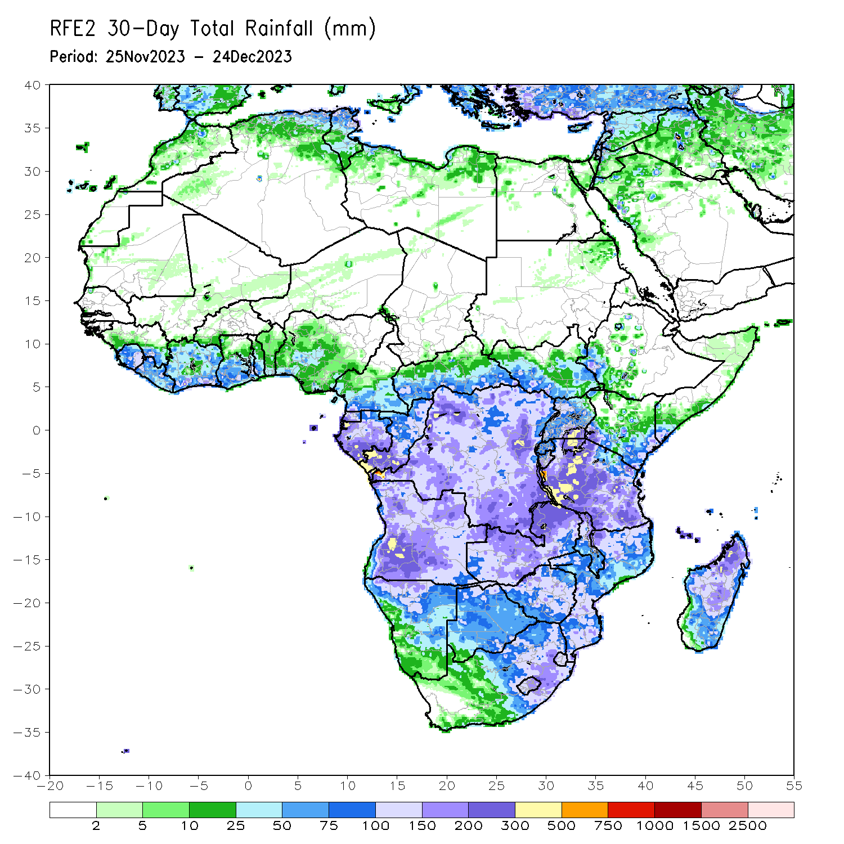
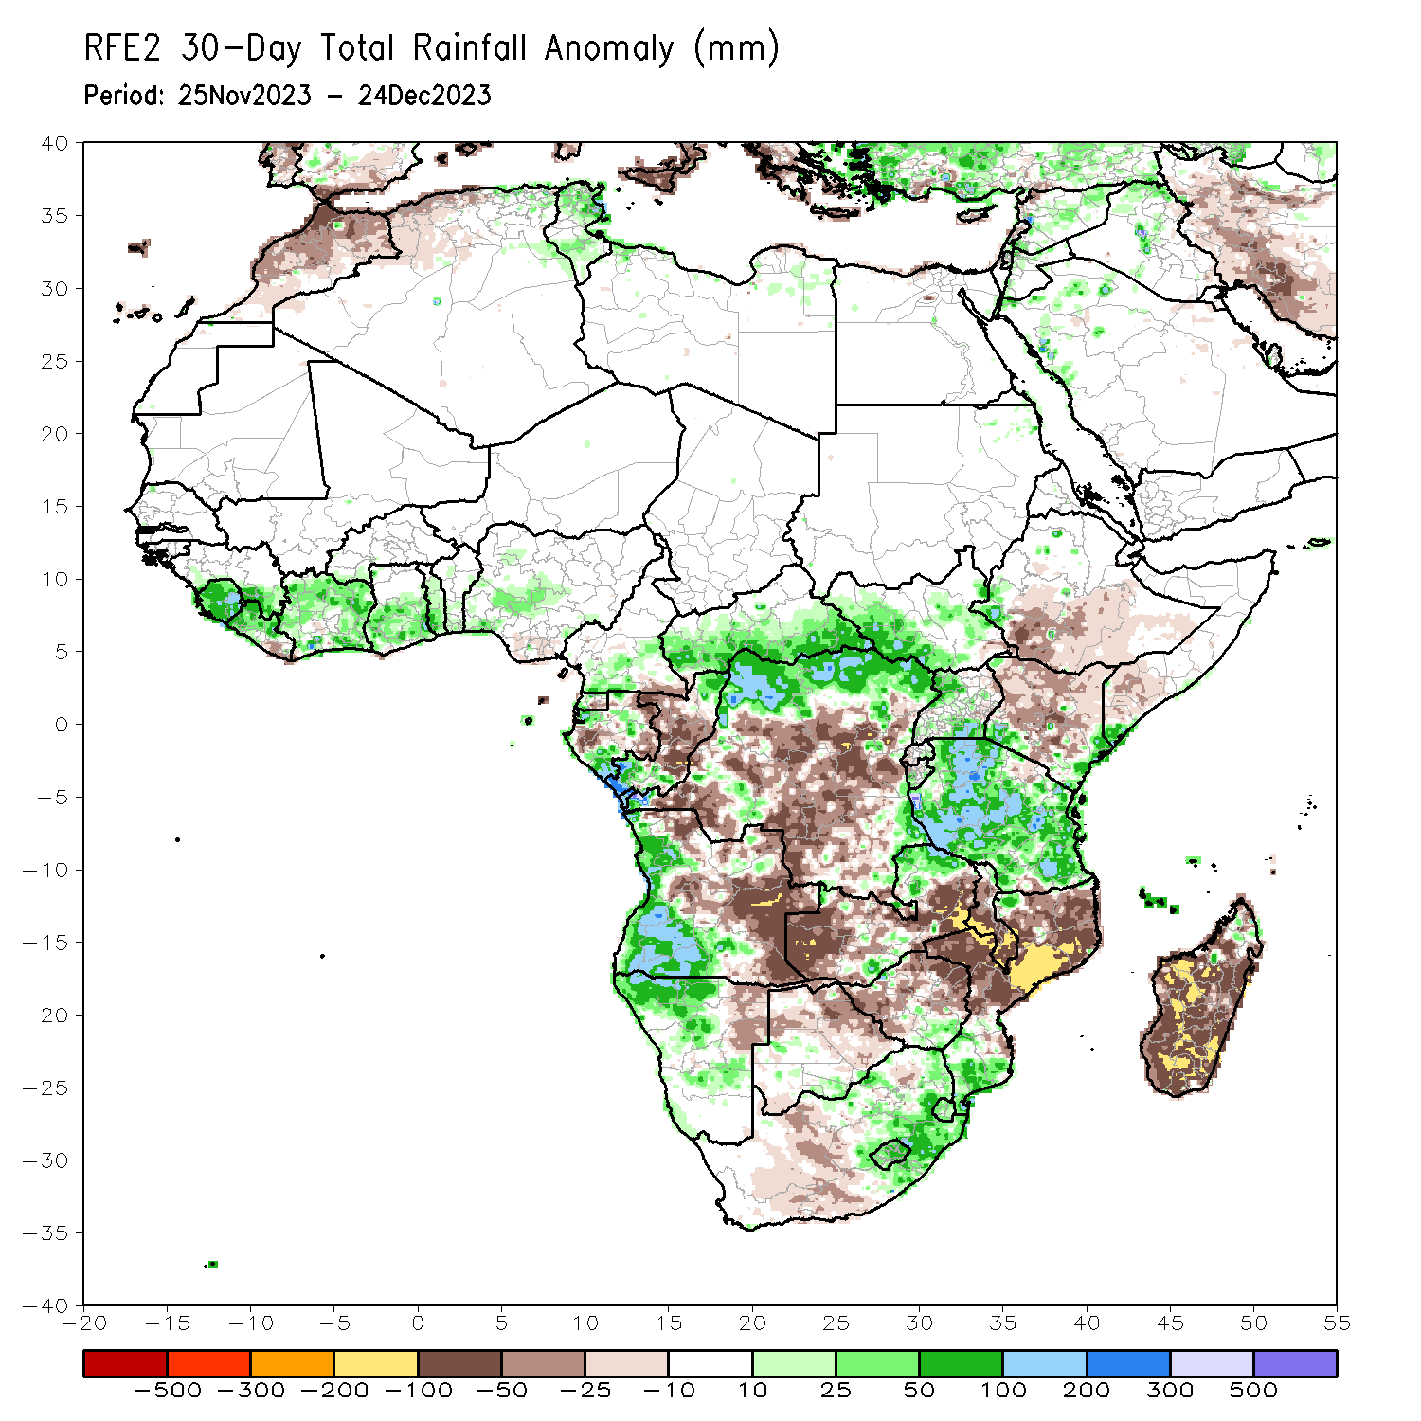
Rainfall Patterns: Last 30 Days
Over the past 30 days, in East Africa, above-average rainfall was observed in many parts of Tanzania, western, southwest and central-eastern South Sudan, northwest, central and southern Uganda, southwest and eastern Kenya, southwest and eastern Burundi, eastern Rwanda, and pockets of western Ethiopia and southern Somalia. Rainfall was below-average over central and southern Ethiopia, northern, western, central and northeast Kenya, southwest Somalia, eastern Uganda, western Rwanda, and northern Burundi. In Central Africa, rainfall was above-average across western, southern, central and eastern CAR, northwest, northern, northeast and southeast DRC, southwest and eastern Cameroon, northern and western Equatorial Guinea, central and southern Gabon, and northern and southern Congo. Below-average rainfall was observed in southeast Equatorial Guinea, western and eastern Gabon, western and central Congo, southwest, central, southern and eastern DRC, and pockets of southeast Cameroon. In West Africa, rainfall was above-average over southeast Senegal, Sierra Leone, western and northern Liberia, many parts of Cote d’Ivoire, central and southern Ghana, Togo, southern Benin, and southwest and central Nigeria. Below-average rainfall was observed over eastern Liberia and pockets of southeast Nigeria. In southern Africa, above-average rainfall was observed in northwest, western and southwest Angola, northwest and central Namibia, northwestern Zambia, southeast Zimbabwe, central-southern Botswana, southern Mozambique, northeast, eastern and western-central South Africa, Lesotho and Eswatini. Below-average rainfall was observed over in northeast, central and eastern Angola, northeast Namibia, western, central and eastern parts of Zambia and Zimbabwe, northern and central Mozambique, many parts of Malawi and Madagascar, and southeast and central-southern South Africa.
Notes:
5

Slide 6
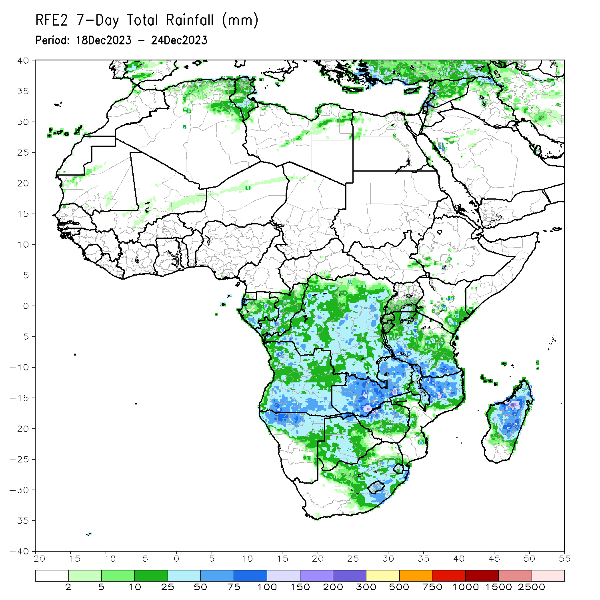
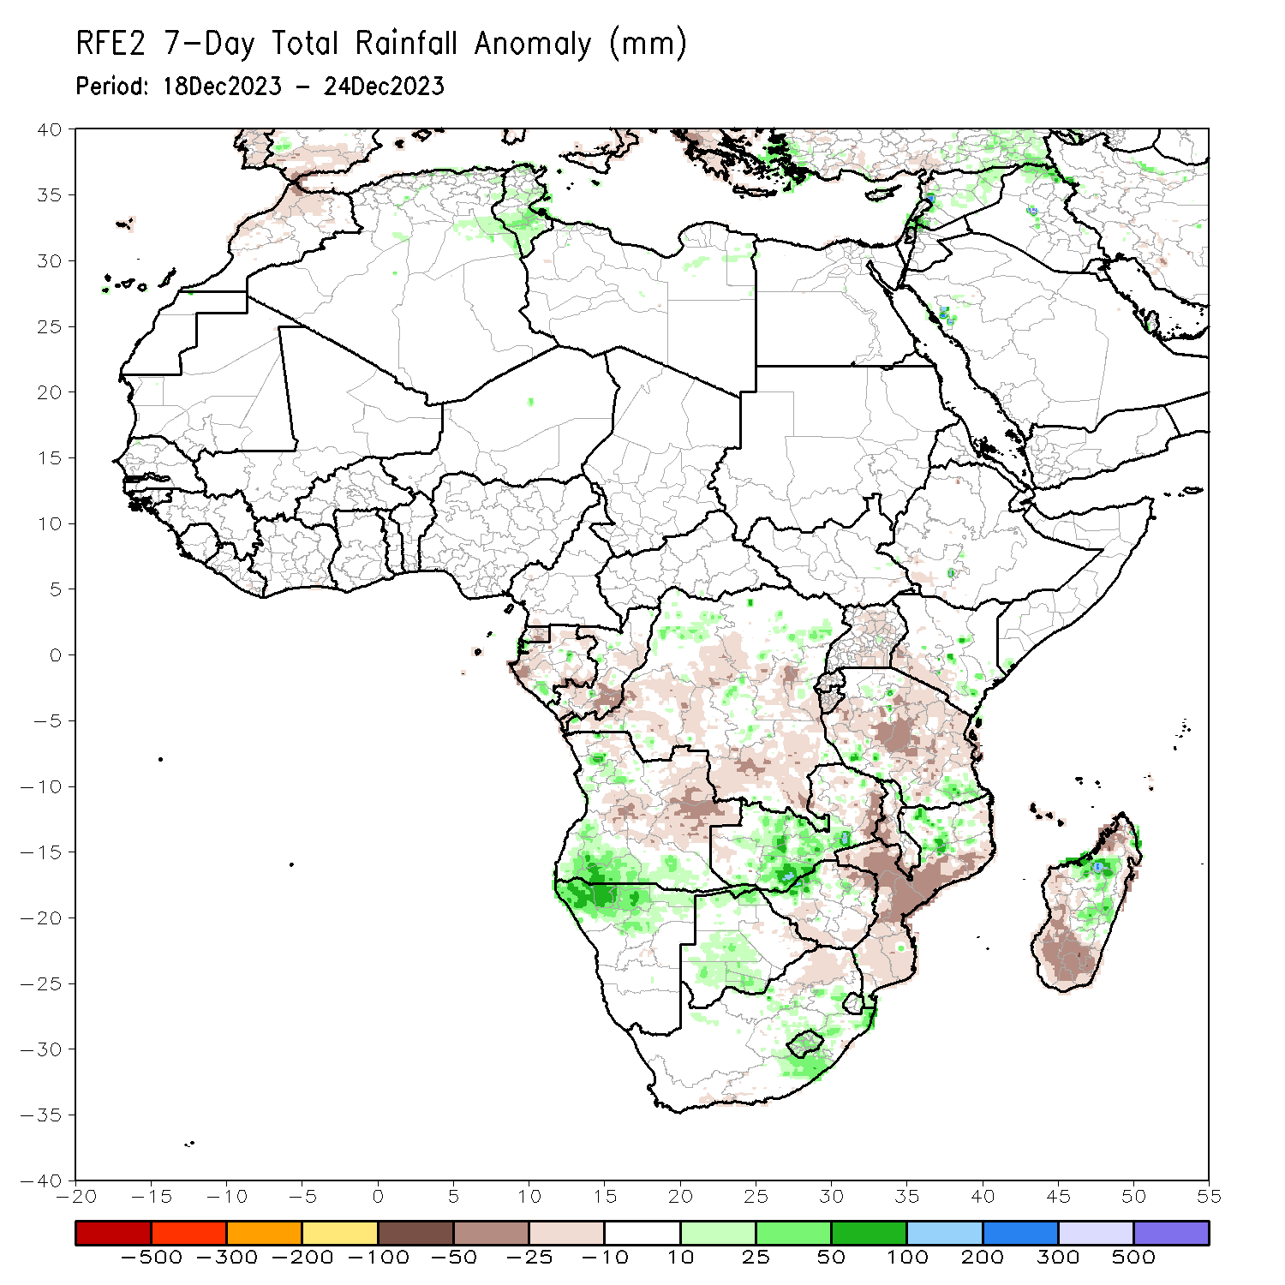
Rainfall Patterns: Last 7 Days
During the past 7 days, in East Africa, rainfall was above-average in pockets of southwest and southeastern Tanzania and pockets of central and central-eastern Kenya. Below-average rainfall was observed over western, central, central-eastern and northeastern Tanzania, Burundi, western and central Rwanda, central and southeastern Uganda, southwestern Kenya and pockets of southwest Ethiopia. In central Africa, above-average rainfall was observed over pockets of southern Gabon and pockets of northwest and northeast DRC. Rainfall was below-average over northern, central, southern and eastern Equatorial Guinea, western, northern and southeast Gabon, eastern and southern Congo, and southwestern, southern, central and southeast DRC. In West Africa, below-average rainfall was observed in pockets of the region in southwest Nigeria. In southern Africa, rainfall was above-average over western and southern Angola, northern Namibia, southern and central Zambia, northwestern Zimbabwe, northwest Mozambique, central and northeast South Africa, Lesotho, western and eastern Eswatini, and central and central-eastern Madagascar. Below-average rainfall was observed over central and eastern Angola, eastern Zambia, central and southern Malawi, central, eastern and southern Mozambique, southern and eastern Zimbabwe, northern South Africa, pockets of western Zambia, and northwest, southwest and southern Madagascar.

Slide 7
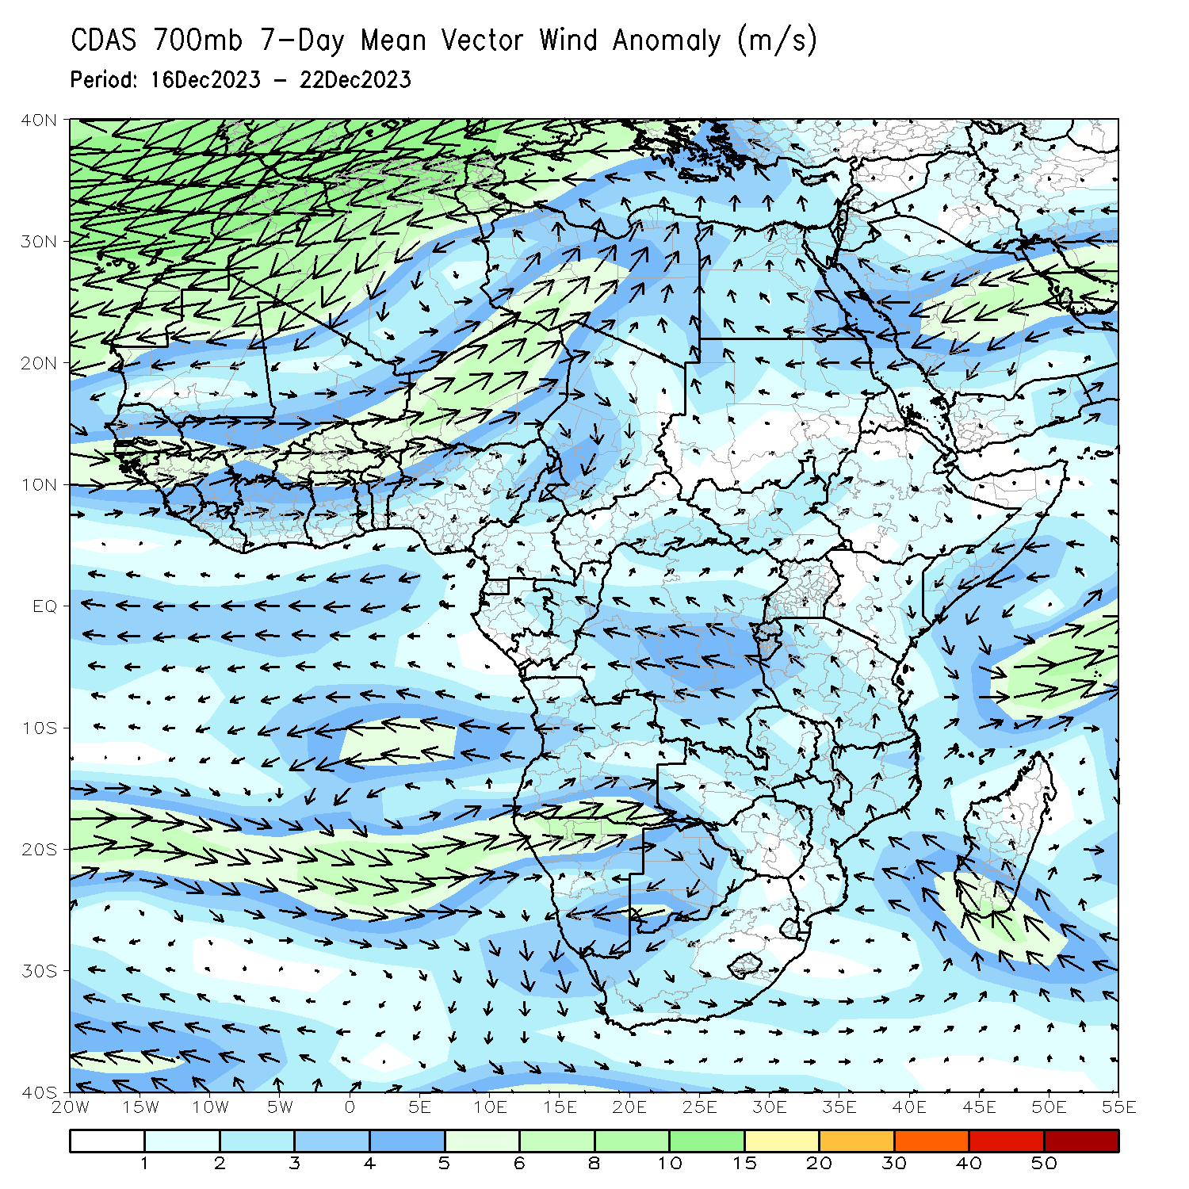
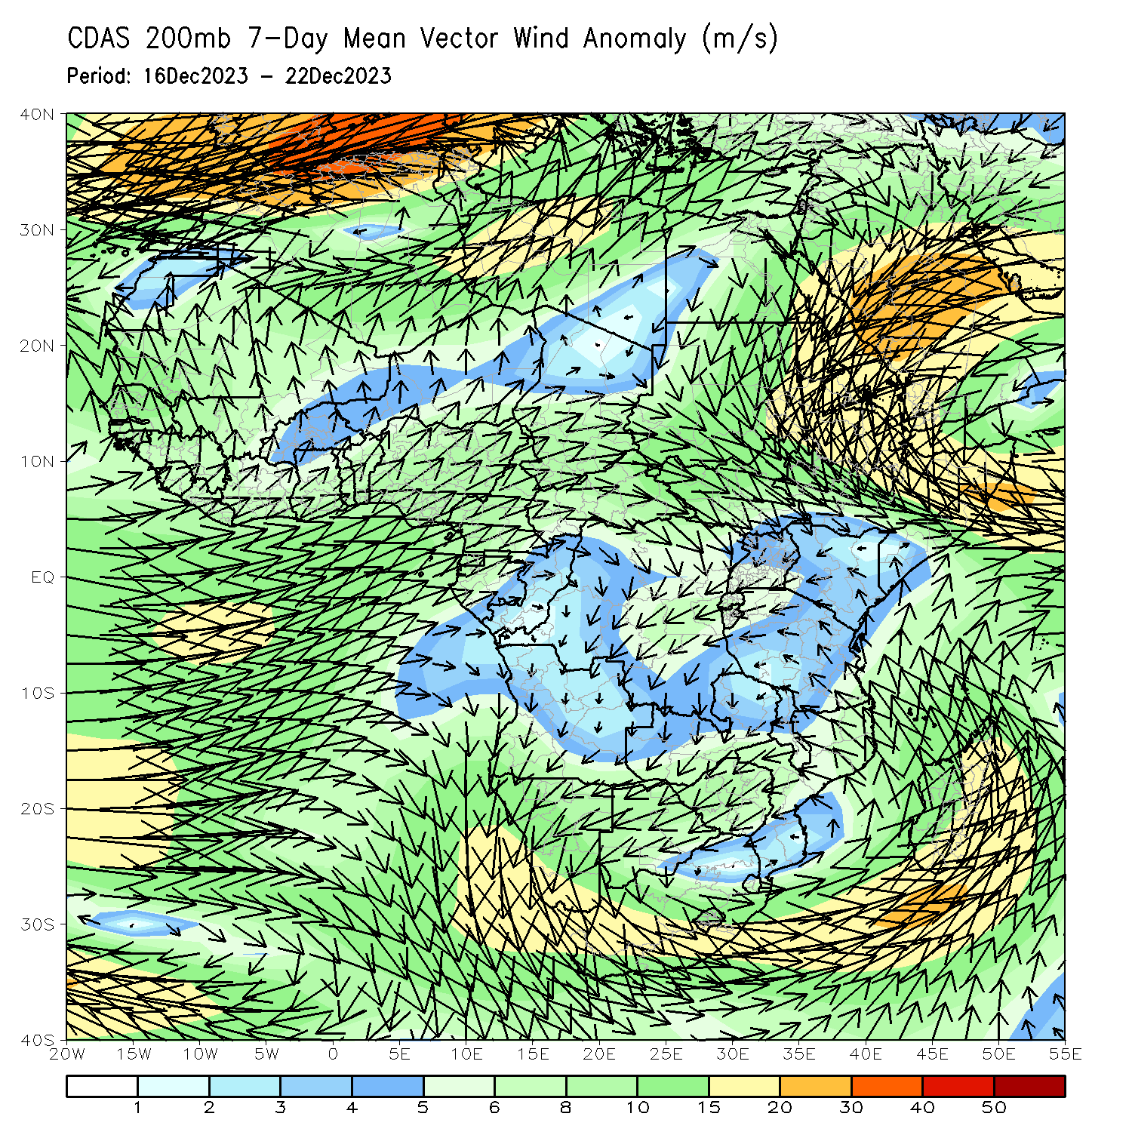
Atmospheric Circulation: Last 7 Days
At 700-hPa level (left panel), anomalous lower-level cyclonic trough over central and southern Angola, Namibia, Botswana and western Zambia may have contributed to the observed above-average rainfall in southern Angola, northern Namibia, western Botswana, and central and southern Zambia regions.

Slide 8
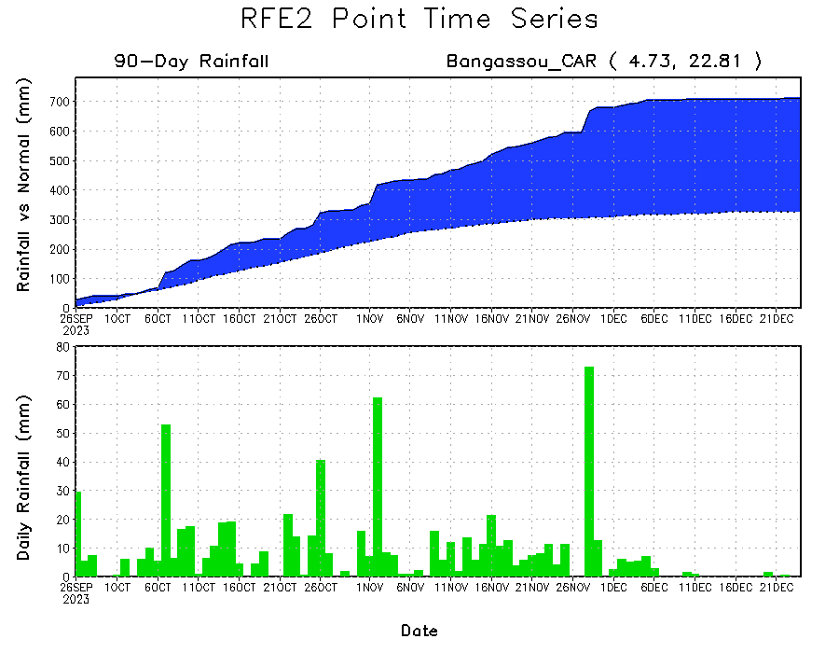
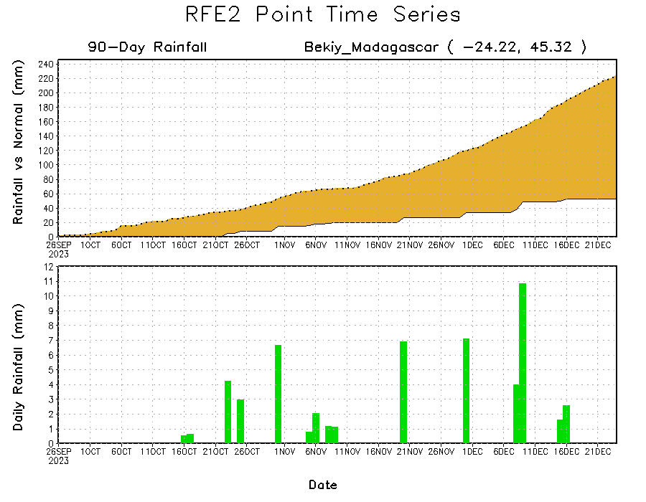
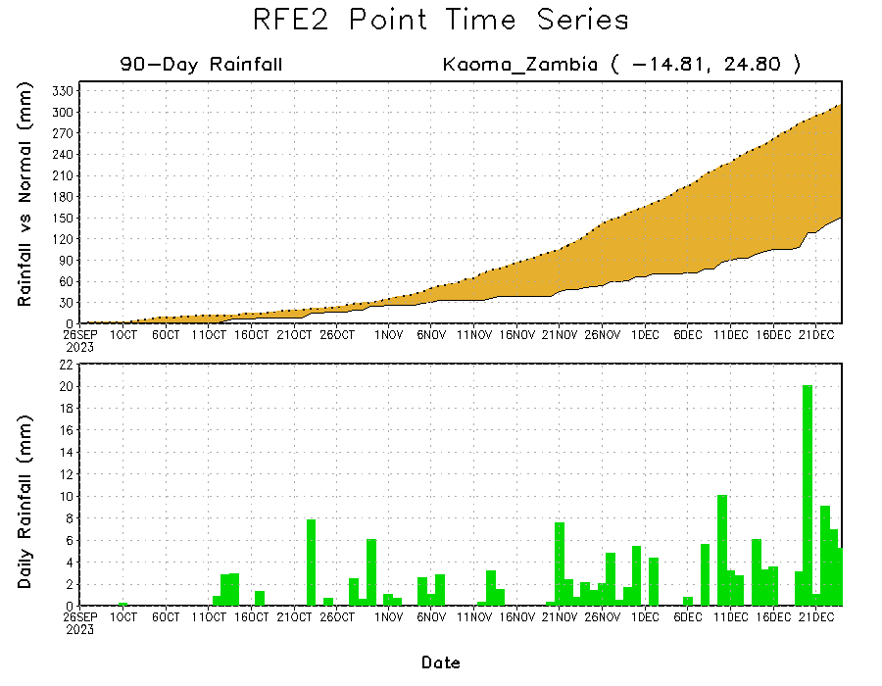
Rainfall Evolution
Daily evolution of rainfall over the last 90 days at selected locations shows a growing dryness over parts of western Zambia (bottom left) and southwest Madagascar (bottom right). Seasonal total rainfall remained above-average over southern CAR due to the moderate to heavy rainfall fell in southern CAR during 01 Oct – 06Dec 2023 (top right).

Slide 9
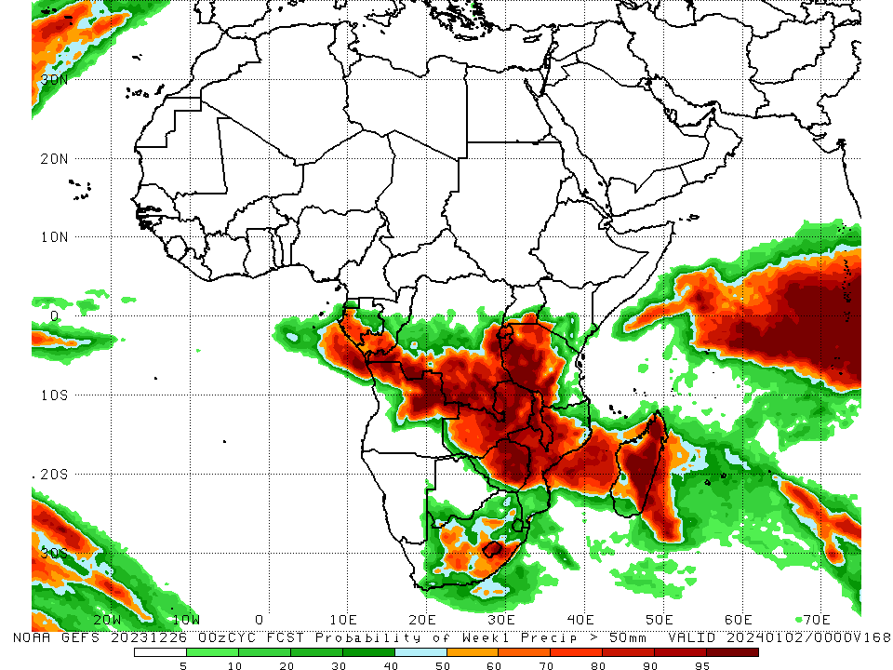
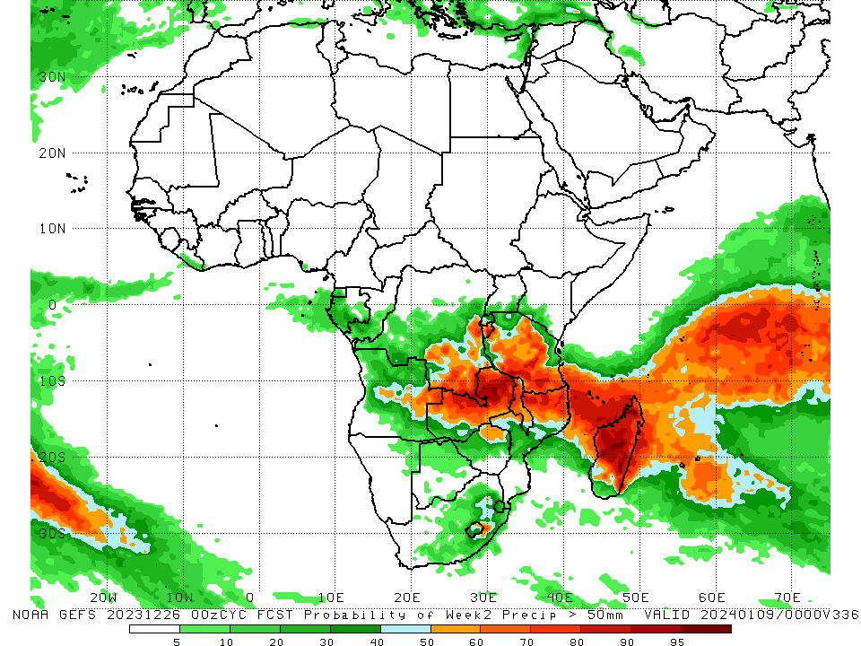
NCEP GEFS Model Forecasts Non-Bias Corrected Probability of precipitation exceedance
Week-1, Valid: 27 Dec 2023 – 02 Jan 2024
Week-2, Valid: 03 – 09 Jan 2024
For week-1 (left panel) the GEFS forecasts indicate a moderate to high chance (over 70%) for rainfall to exceed 50 mm over western and southern Gabon, southern Congo, southwest, southern and southeast DRC, Rwanda, Burundi, northwest, western, central and southwest Tanzania, northern and northeast Angola, northern, central, southern and eastern regions of Zambia and Zimbabwe, Malawi, central Mozambique, eastern South Africa, Lesotho, and central, northern, eastern and western Madagascar. For week-2 (right panel), the GEFS forecasts indicate a moderate to high chance (over 70%) for rainfall to exceed 50 mm over southern and southeast DRC, Burundi, central, southern and southeast Tanzania, eastern Angola, northern, central, southern and eastern Zambia, northern and central Malawi, northern Mozambique, northern, eastern, central and western Madagascar, and pockets of region near border of eastern Lesotho and South Africa.
Notes:
9

Slide 10
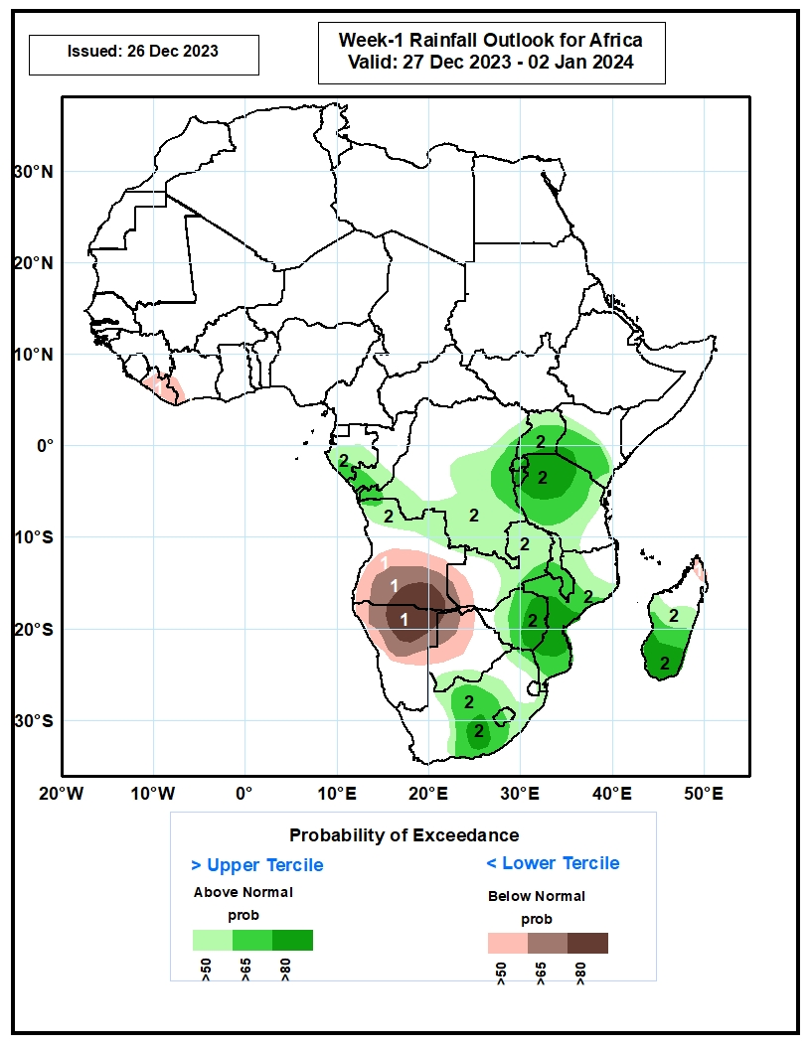
Week-1 Precipitation Outlooks
27 Dec 2023 – 02 Jan 2024
The probabilistic forecasts call for above 50% chance for weekly total rainfall to be below-average (below the lower tercile) over Liberia, western part of Cote d’Ivoire, central and southern Angola, western Zambia, northern and central Namibia, western and central Botswana, and northern part of Madagascar. There is above 80% chance for below-average rainfall over southern part of Angola, and northern part of Namibia.
The probabilistic forecasts call for above 50% chance for weekly rainfall to be above-average (above the upper tercile) over central and southern part of Gabon, southern Congo, central and southern parts of DR Congo, Rwanda, Burundi, Uganda, western and central parts of Kenya, much of Tanzania, central and eastern Zambia, Malawi, much of Mozambique, much of Zimbabwe, southern part of Botswana, central and eastern parts of South Africa, Lesotho, and central and southern Madagascar. There is above 80% chance for above-average rainfall over southwestern Kenya, eastern Rwanda, eastern Burundi, northwestern Tanzania, central and southern parts of Mozambique, eastern Zimbabwe, south-central South Africa, and southern part of Madagascar.
Notes:
10

Slide 11
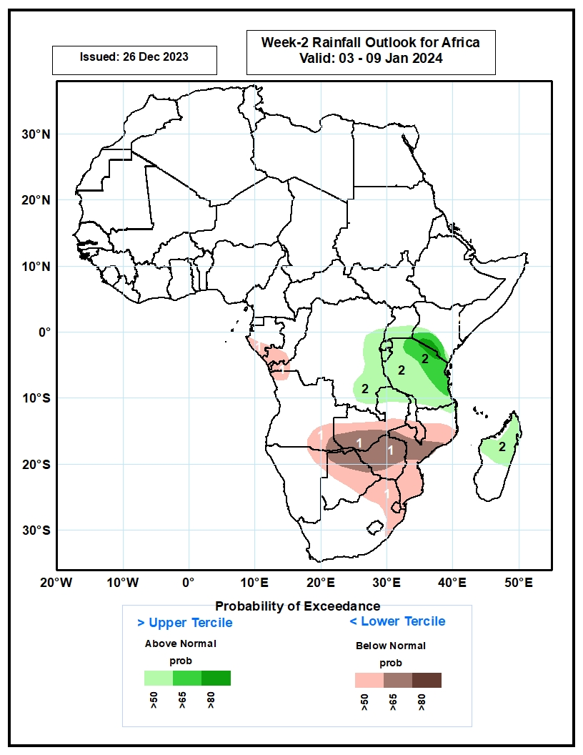
Week-2 Precipitation Outlooks
03 – 09 Jan 2024
The probabilistic forecasts call for above 50% chance for weekly total rainfall to be below-average (below the lower tercile) over southern Gabon, southern Congo, western DR Congo, northwestern and southeastern parts of Angola, central and southern Zambia, central and southern Malawi, much of Mozambique, northern and central Botswana, Zimbabwe, northern South Africa, and Eswatini. There is above 65% chance for below-average rainfall over southeastern Angola, southern Zambia, central Mozambique, northern Botswana, and much of Zimbabwe.
The probabilistic forecasts call for above 50% chance for weekly rainfall to be above-average (above the upper tercile) over eastern DR Congo, southern Uganda, Rwanda, Burundi, Tanzania, southern Kenya, northern Zambia, and northern and central parts of Madagascar. There is above 80% chance for above-average rainfall over southwestern Kenya, and north-central Tanzania.
Notes:
11

Slide 12
Summary
Over the past 30 days, in East Africa, above-average rainfall was observed in many parts of Tanzania, western, southwest and central-eastern South Sudan, northwest, central and southern Uganda, southwest and eastern Kenya, southwest and eastern Burundi, eastern Rwanda, and pockets of western Ethiopia and southern Somalia. Rainfall was below-average over central and southern Ethiopia, northern, western, central and northeast Kenya, southwest Somalia, eastern Uganda, western Rwanda, and northern Burundi. In Central Africa, rainfall was above-average across western, southern, central and eastern CAR, northwest, northern, northeast and southeast DRC, southwest and eastern Cameroon, northern and western Equatorial Guinea, central and southern Gabon, and northern and southern Congo. Below-average rainfall was observed in southeast Equatorial Guinea, western and eastern Gabon, western and central Congo, southwest, central, southern and eastern DRC, and pockets of southeast Cameroon. In West Africa, rainfall was above-average over southeast Senegal, Sierra Leone, western and northern Liberia, many parts of Cote d’Ivoire, central and southern Ghana, Togo, southern Benin, and southwest and central Nigeria. Below-average rainfall was observed over eastern Liberia and pockets of southeast Nigeria. In southern Africa, above-average rainfall was observed in northwest, western and southwest Angola, northwest and central Namibia, northwestern Zambia, southeast Zimbabwe, central-southern Botswana, southern Mozambique, northeast, eastern and western-central South Africa, Lesotho and Eswatini. Below-average rainfall was observed over in northeast, central and eastern Angola, northeast Namibia, western, central and eastern parts of Zambia and Zimbabwe, northern and central Mozambique, many parts of Malawi and Madagascar, and southeast and central-southern South Africa.
During the past 7 days, in East Africa, rainfall was above-average in pockets of southwest and southeastern Tanzania and pockets of central and central-eastern Kenya. Below-average rainfall was observed over western, central, central-eastern and northeastern Tanzania, Burundi, western and central Rwanda, central and southeastern Uganda, southwestern Kenya and pockets of southwest Ethiopia. In central Africa, above-average rainfall was observed over pockets of southern Gabon and pockets of northwest and northeast DRC. Rainfall was below-average over northern, central, southern and eastern Equatorial Guinea, western, northern and southeast Gabon, eastern and southern Congo, and southwestern, southern, central and southeast DRC. In West Africa, below-average rainfall was observed in pockets of the region in southwest Nigeria. In southern Africa, rainfall was above-average over western and southern Angola, northern Namibia, southern and central Zambia, northwestern Zimbabwe, northwest Mozambique, central and northeast South Africa, Lesotho, western and eastern Eswatini, and central and central-eastern Madagascar. Below-average rainfall was observed over central and eastern Angola, eastern Zambia, central and southern Malawi, central, eastern and southern Mozambique, southern and eastern Zimbabwe, northern South Africa, pockets of western Zambia, and northwest, southwest and southern Madagascar.
The Week-1 outlook calls for above-average rainfall in Gabon, central and southern Congo, western, central, eastern and southern DRC, central and southern parts of Uganda and Kenya, Rwanda, Burundi, northern, western and central Tanzania, northern Angola, central, northern, southern and eastern Zambia, Malawi, central and southern Mozambique, central, northern, eastern and southeastern Zimbabwe, southern Botswana, western, central and eastern South Africa, Lesotho, and central, southern and eastern Madagascar. In contrast, there is an increased chance for below-average across southern and southeast Angola, northern Namibia, western Zambia, northern and eastern Botswana, northern South Africa, southeastern Tanzania, northeastern Mozambique, central, southern and eastern Liberia, and southern parts of Cote d’Ivoire and Ghana. The Week-2 outlook calls for above-normal rainfall in central and eastern DRC, pockets of southern regions of Uganda and Kenya, Rwanda, Burundi, Tanzania, Malawi, northern, central and eastern Zambia, northern Mozambique, southern Botswana, western, central and eastern South Africa, Lesotho, Eswatini, northern, western, central and eastern Madagascar, eastern Sierra Leone, and western Liberia. In contrast, there is an increased chance for below-average in central and southern Gabon, northern, eastern and southern Congo, pockets of southwest DRC, northern, central and southern Angola, northern, central and eastern Namibia, southern Zambia, central and southern parts of Zimbabwe and Mozambique, northern South Africa, pockets of northern and eastern Botswana, southern Madagascar and southeast Kenya.

