Slide 1
The African Monsoon Recent Evolution and Current Status Include Week-1 and Week-2 Outlooks
Update prepared
02 January 2024
For more information, visit:
http://www.cpc.ncep.noaa.gov/products/Global_Monsoons/African_Monsoons/precip_monitoring.shtml

Slide 2
Outline
Highlights
Recent Evolution and Current Conditions
NCEP GEFS Forecasts
Summary

Slide 3
Highlights: Last 7 Days
During the past 7 days, in East Africa, rainfall was above-average in western Tanzania, Rwanda, Burundi, southern and parts of central Uganda, southwestern and southeastern Kenya, and parts of southwestern Somalia. Below-average rainfall was observed over parts of south-central Kenya and eastern and southern Tanzania. In central Africa, above-average rainfall was observed over central, southeastern, and south-central DRC, southern Congo, parts of western Gabon, and western Equatorial Guinea. Rainfall was below-average over eastern Gabon, central Congo, and parts of northern and southeastern DRC. In West Africa, rainfall was near normal, as little to no rainfall fell. In southern Africa, rainfall was above-average over northeastern and northwestern Angola, southern and eastern Zambia, central and southern Malawi, most of Zimbabwe, southeastern and southwestern Botswana, northwestern, central, and soutahern Mozambique, much of South Africa, Lesotho, Eswatini, and southern and parts of eastern Madagascar. Below-average rainfall was observed over parts of central and southern Angola, northern Namibia, parts of northwestern Zambia, northwestern Mozambique, pockets of northern and central Botswana, and northwestern and central Madagascar.
The Week-1 outlook calls for above-average rainfall in central and northeastern Angola, south-central and southeastern DRC, northern and central Zambia, northern Malawi, most of Tanzania, Rwanda, Burundi, northern Mozambique, Comoros, and northern, eastern, central, and southern Madagascar. In contrast, there is an increased chance for below-average across eastern portions of the coastal Gulf of Guinea region, Equatorial Guinea, Gabon, Congo, southwestern DRC, western and southeastern Angola, southwestern Zambia, Zimbabwe, northern and eastern Botswana, northeastern Namibia, eastern South Africa, Eswatini, southern and central Mozambique, and west-central Madagascar. The Week-2 outlook calls for above-normal rainfall in parts of southeastern DRC, central Angola, northwestern and southeastern Zambia, central Malawi, south-central South Africa, Lesotho, northwestern Mozambique, parts of northern Tanzania, Comoros, and northern, western, and parts of southern Madagascar. In contrast, there is an increased chance for below-average in coastal Liberia, western Gabon, southern Congo, southwestern DRC, northern and southwestern Angola, northwestern Namibia, southern Zimbabwe, eastern Botswana, northeastern South Africa, Eswatini, southern and central Mozambique, southwestern Tanzania, northeastern Zambia, and parts of central Madagascar.

Slide 4
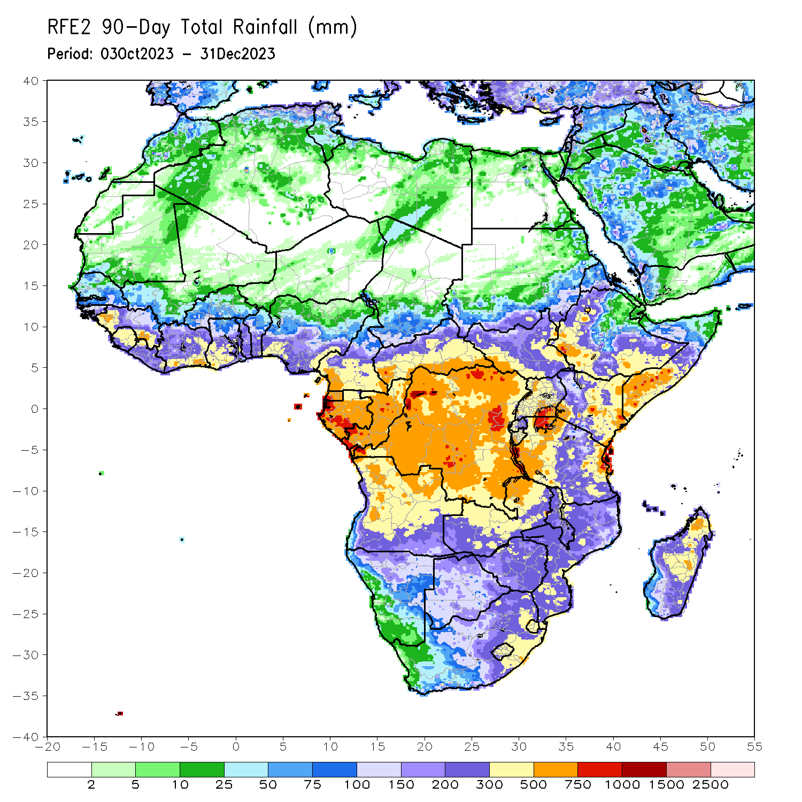
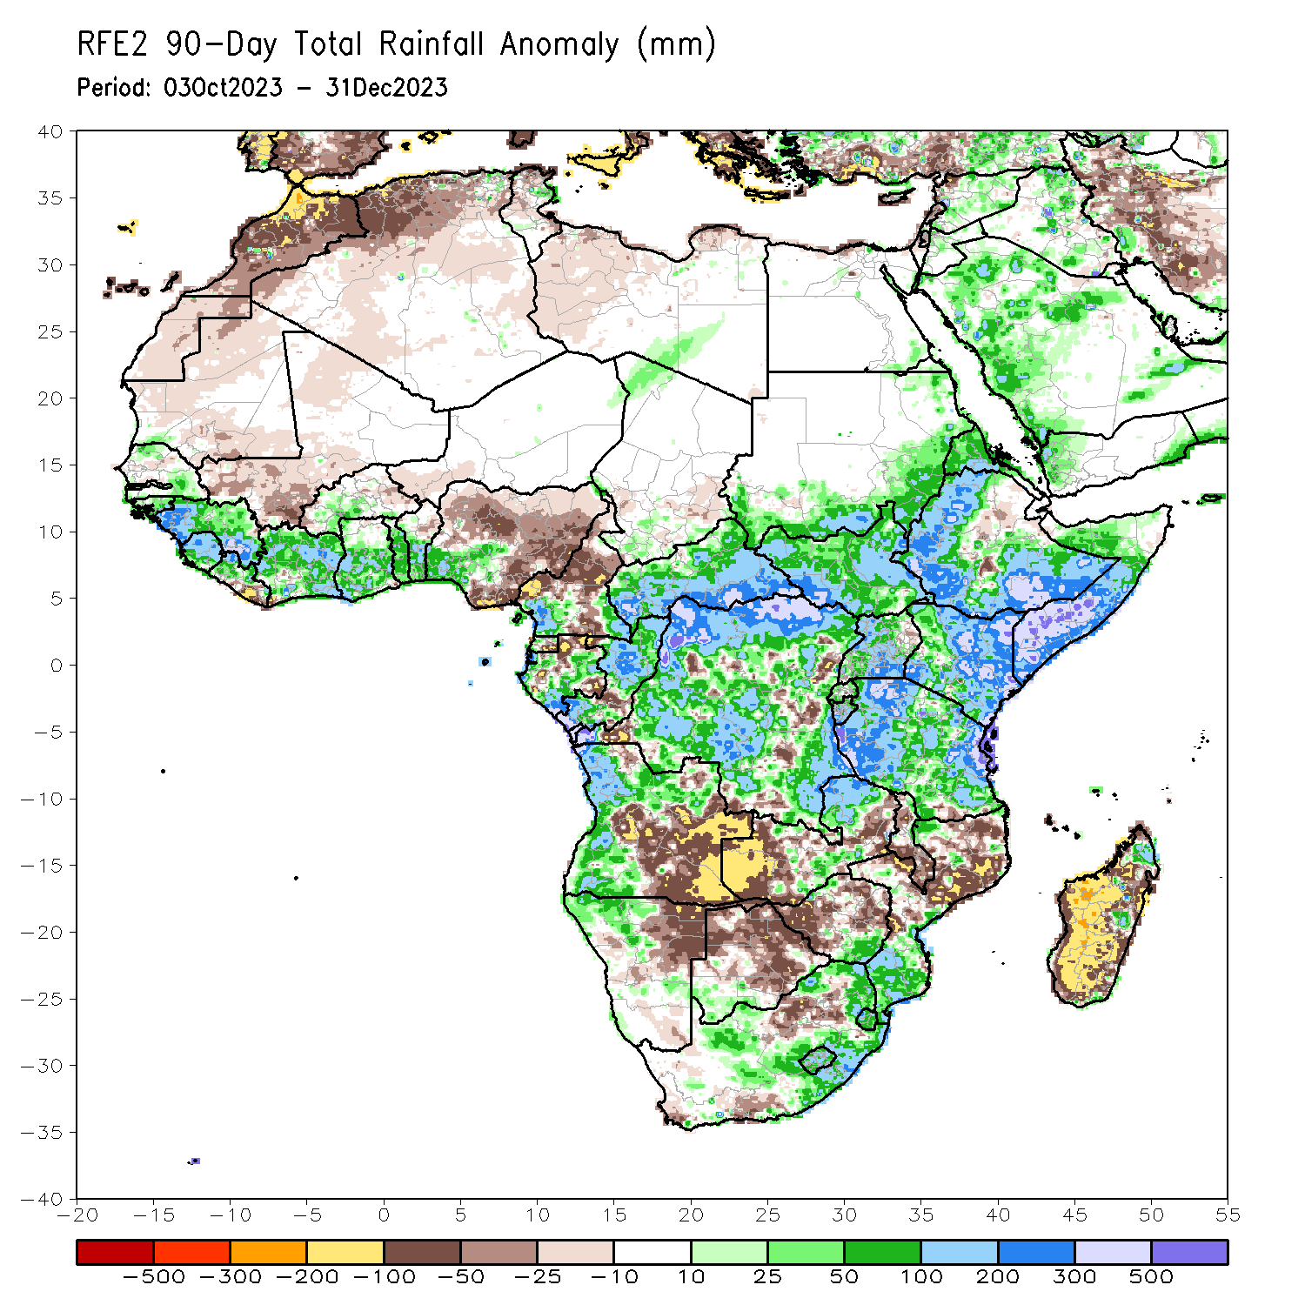
Rainfall Patterns: Last 90 Days
Over the past 90 days, in East Africa, above-average rainfall was observed in many parts of South Sudan, Kenya, Tanzania, Burundi, eastern and western Rwanda, Uganda, southern and eastern Sudan, western and central Eritrea, northern, western, southern and western Ethiopia, and southern, central, and western Somalia. Rainfall was below-average over parts of central Ethiopia, central Rwanda, pockets of south-central Tanzania, and pockets of northeastern Uganda. In Central Africa, rainfall was above-average in many parts of CAR, northern, most of DRC, northern, central, and southern Congo, east-central, western, and south-central Gabon, northwestern and southwestern Chad, western and northern Equatorial Guinea, and pockets of southwestern and southeastern Cameroon. Rainfall was below-average over northern, central, and south-central Cameroon, southern Equatorial Guinea, northern and southeastern Gabon, south-central and northwestern Congo, southeastern Chad, and pockets of southwestern, central, and eastern DRC. In West Africa, rainfall was above-average over northern and southern Senegal, Guinea-Bissau, Guinea, Sierra Leone, western and northern Liberia, many parts of Cote d’Ivoire and Togo, central, central and southern Benin, central and southern Ghana, southern Burkina Faso, and southwestern Nigeria. Below-average rainfall was observed over central Senegal, Gambia, southeastern and northern Mauritania, western Mali, western and eastern Burkina Faso, far southwestern Cote d’Ivoire, southeastern Liberia, southwestern Niger, and central, eastern, northern, and south-central Nigeria. In southern Africa, above-average rainfall was observed over western and much of northern Angola, northwestern Namibia, northeastern and parts of central Zambia, southeastern Zimbabwe, southwestern Botswana, southern and far northwestern Mozambique, eastern and parts of central South Africa, Eswatini, Lesotho, and pockets of northern and east-central Madagascar. Below-average rainfall was observed over much of eastern and parts of central Angola, northeastern Namibia, western and eastern Zambia, much of central and northern Botswana, much of western, northern, central, and eastern Zimbabwe, southwestern and parts of north-central South Africa, central and northern Mozambique, much of Malawi, and western, southern, central and eastern Madagascar.
Notes:
4

Slide 5
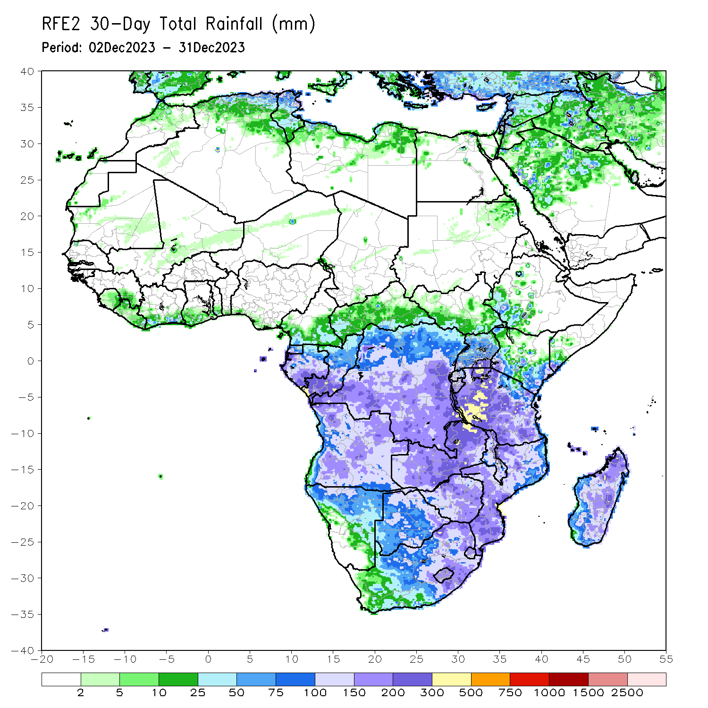
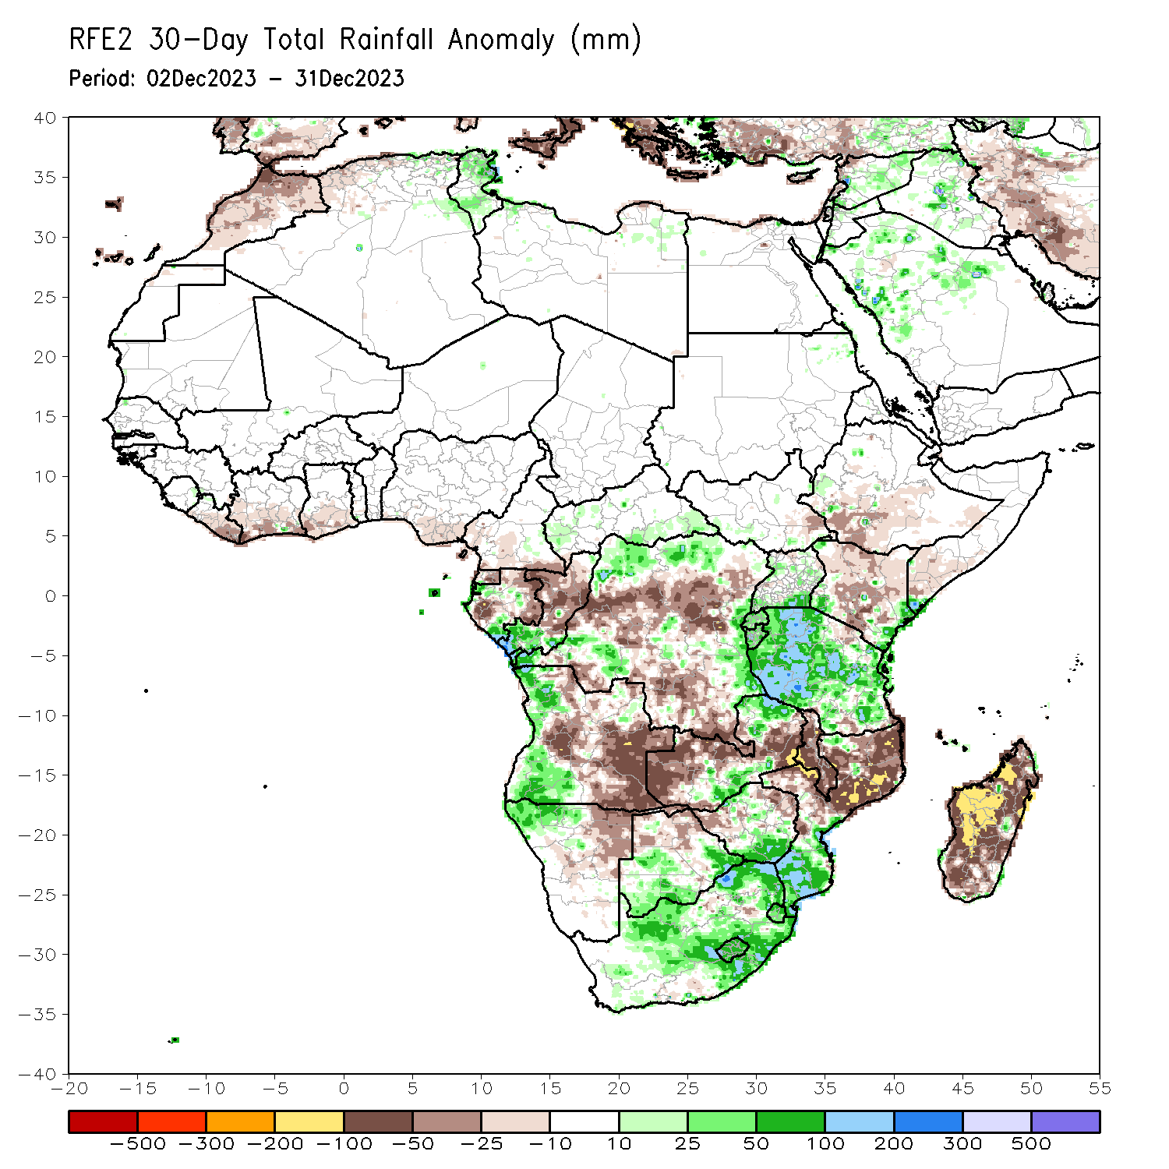
Rainfall Patterns: Last 30 Days
Over the past 30 days, in East Africa, above-average rainfall was observed in many parts of Tanzania, parts of central and southern Uganda, southwestern and southeastern Kenya, Burundi, Rwanda, pockets of western Ethiopia, and far southeastern Somalia. Rainfall was below-average over central and southwestern Ethiopia, northern, central, and south-central Kenya, southwestern Somalia, southeastern South Sudan, and parts of northeastern and south-central Tanzania. In Central Africa, rainfall was above-average across western and southeastern CAR, northwestern, north-central, southwestern, and southeastern DRC, central and southwestern Gabon, and southern Congo. Below-average rainfall was observed in central and eastern Equatorial Guinea, west-central and eastern Gabon, parts of northern and central Congo, much of southern and central DRC, and southern Cameroon. In West Africa, rainfall was below-average from Liberia to southern Nigeria. In southern Africa, above-average rainfall was observed in western Angola, northwestern Namibia, south-central and northeastern Zambia, southern and parts of northwestern Mozambique, southern and northwestern Zimbabwe, southern Botswana, Lesotho, Eswatini, and eastern and central South Africa. Below-average rainfall was observed in central and eastern Angola, western, central, and southeastern Zambia, western and northeastern Zimbabwe, northern Botswana, northeastern Namibia, central and northern Mozambique, Malawi, and most of Madagascar.
Notes:
5

Slide 6
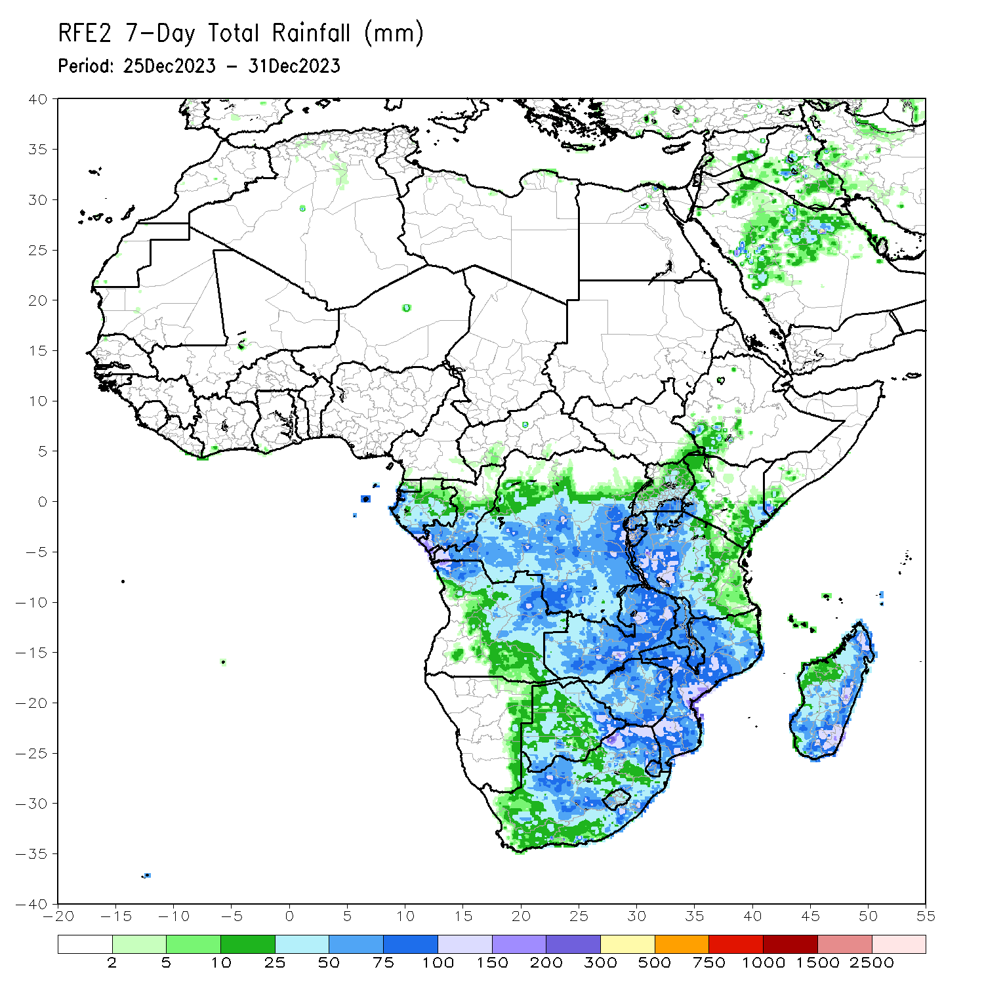
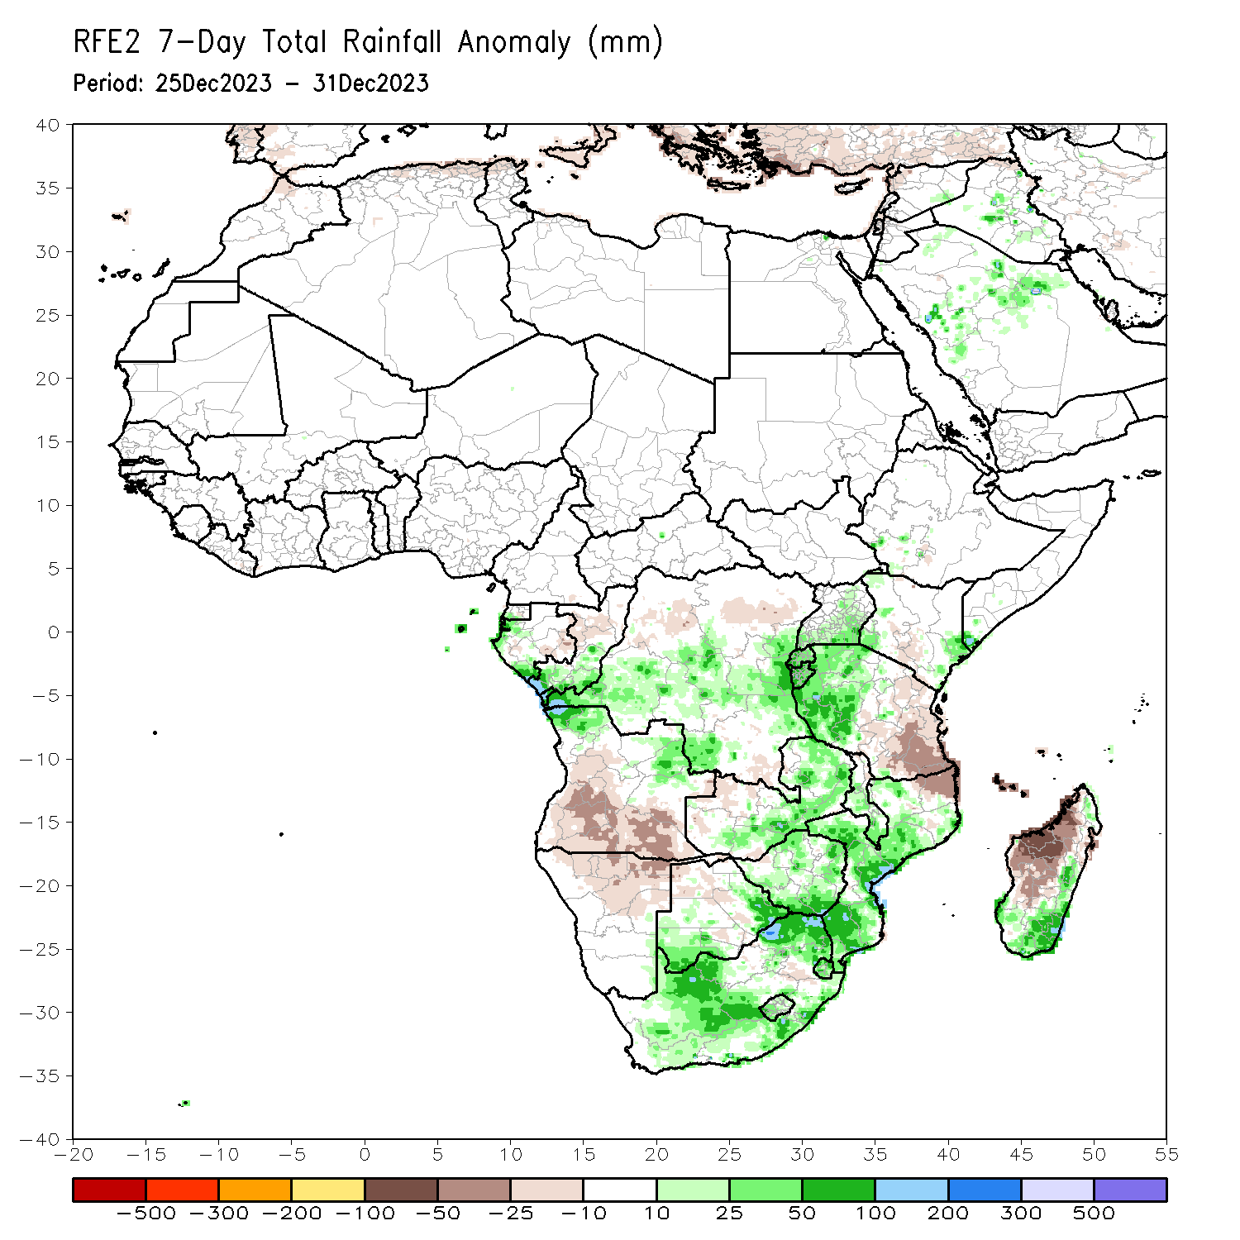
Rainfall Patterns: Last 7 Days
During the past 7 days, in East Africa, rainfall was above-average in western Tanzania, Rwanda, Burundi, southern and parts of central Uganda, southwestern and southeastern Kenya, and parts of southwestern Somalia. Below-average rainfall was observed over parts of south-central Kenya and eastern and southern Tanzania. In central Africa, above-average rainfall was observed over central, southeastern, and south-central DRC, southern Congo, parts of western Gabon, and western Equatorial Guinea. Rainfall was below-average over eastern Gabon, central Congo, and parts of northern and southeastern DRC. In West Africa, rainfall was near normal, as little to no rainfall fell. In southern Africa, rainfall was above-average over northeastern and northwestern Angola, southern and eastern Zambia, central and southern Malawi, most of Zimbabwe, southeastern and southwestern Botswana, northwestern, central, and soutahern Mozambique, much of South Africa, Lesotho, Eswatini, and southern and parts of eastern Madagascar. Below-average rainfall was observed over parts of central and southern Angola, northern Namibia, parts of northwestern Zambia, northwestern Mozambique, pockets of northern and central Botswana, and northwestern and central Madagascar.

Slide 7
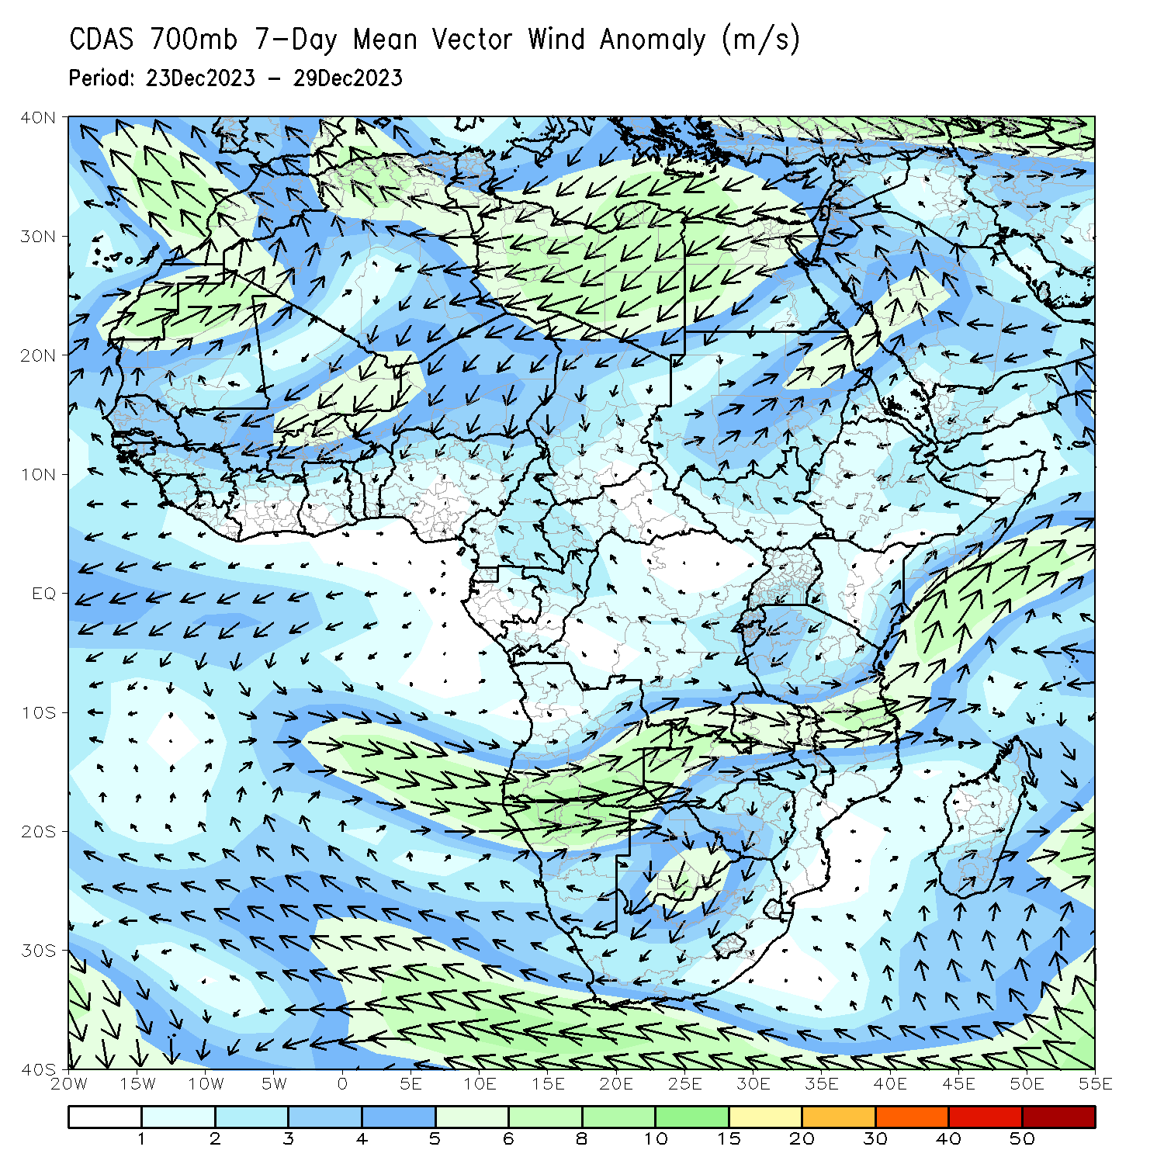
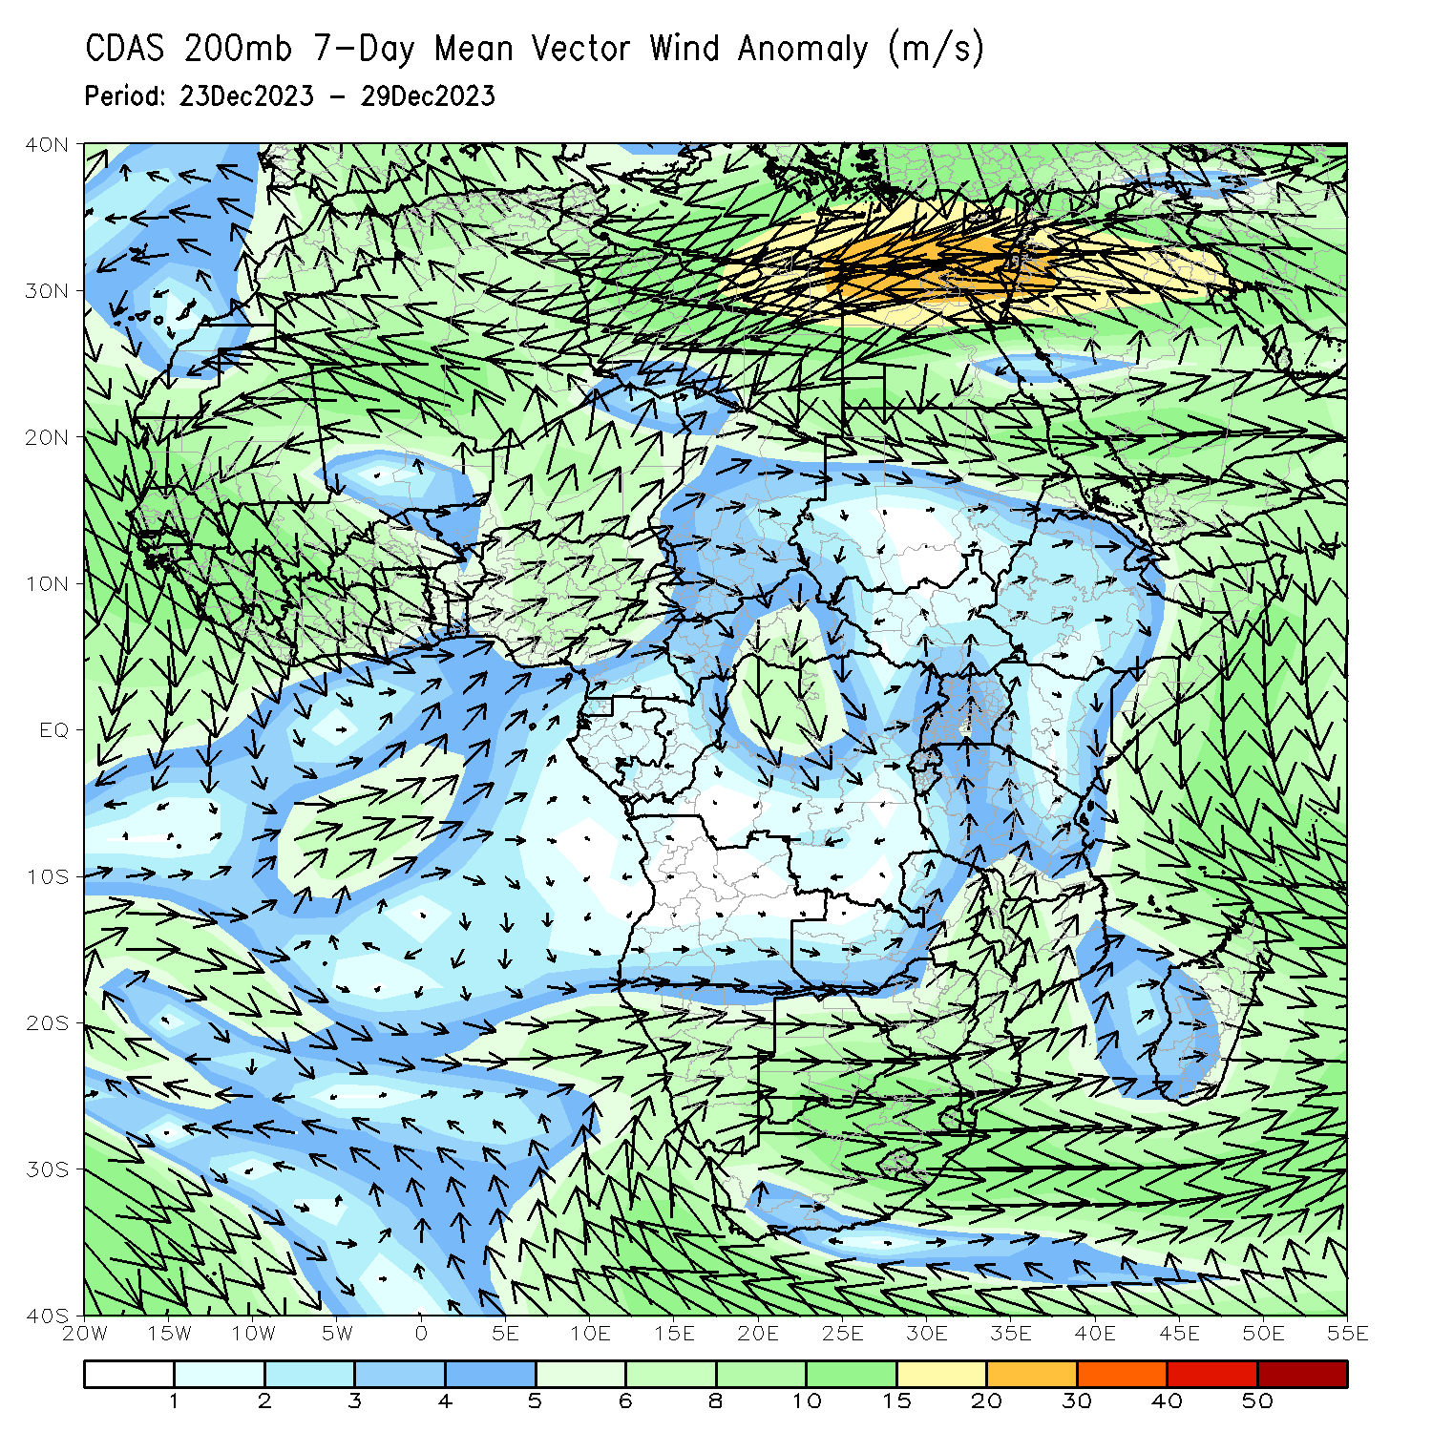
Atmospheric Circulation: Last 7 Days
At 700-hPa level (left panel), the anomalous lower-level cyclonic trough over Namibia (along with upper-level divergence) may have contributed to the observed above-average rainfall in central portions of South Africa.

Slide 8
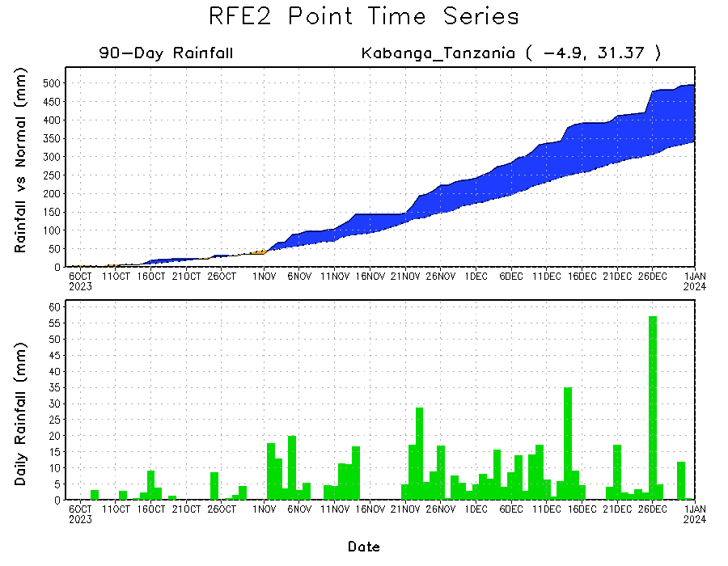
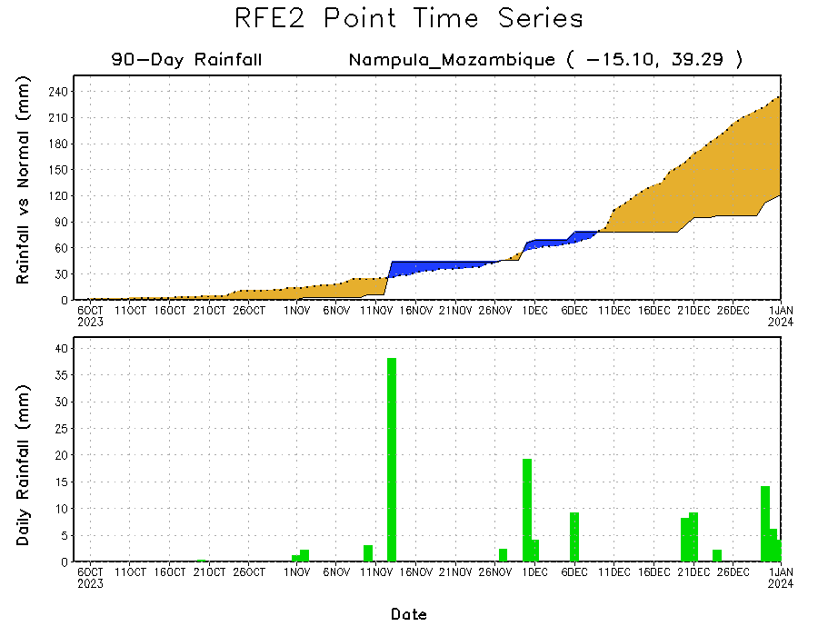
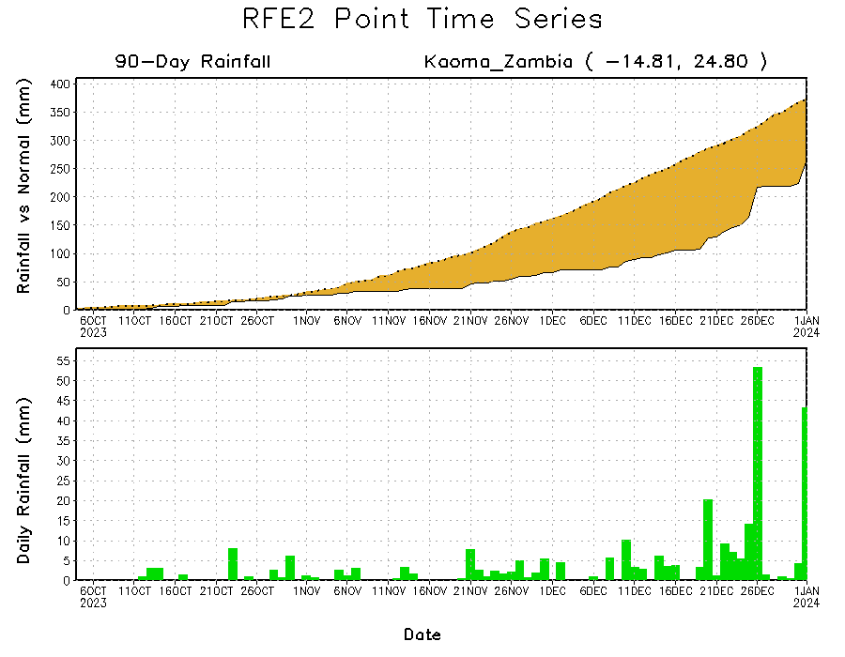
Rainfall Evolution
Daily evolution of rainfall over the last 90 days at selected locations shows a continuing (yet smaller) deficits over parts of western Zambia (bottom left) and northeastern Mozambique (bottom right). Seasonal total rainfall remained above-average over northwestern Tanzania due to the recent moderate to heavy rainfall (top right).

Slide 9
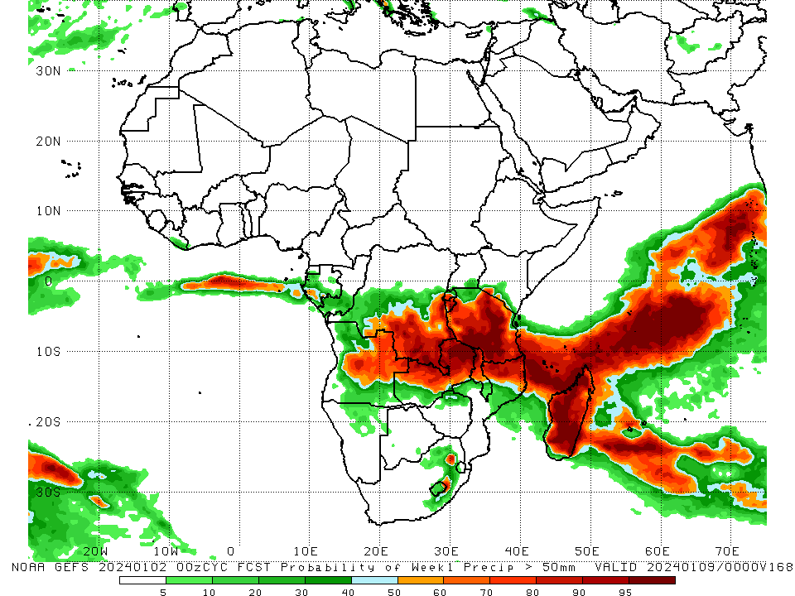
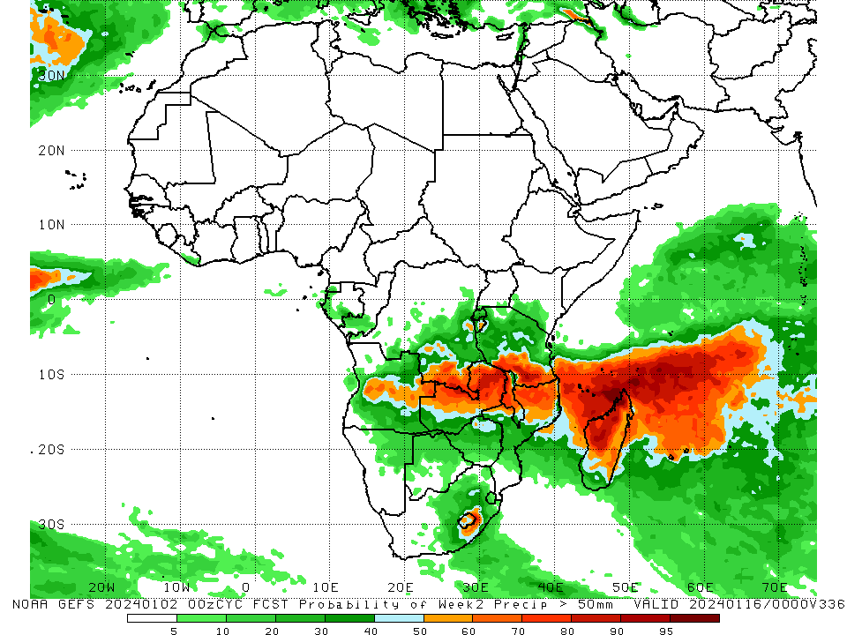
NCEP GEFS Model Forecasts Non-Bias Corrected Probability of precipitation exceedance
Week-1, Valid: 03 – 09 Jan 2024
Week-2, Valid: 10 – 16 Jan 2024
For week-1 (left panel) the GEFS forecasts indicate a moderate to high chance (over 70%) for rainfall to exceed 50 mm over southeastern and east-central DRC, southwestern Rwanda, most of Burundi, central and northeastern Angola, northern and central Zambia, northeastern, northwestern, central, and southern Tanzania, northern and parts of central Malawi, northern Mozambique, parts of eastern South Africa, Comoros, and most of Madagascar. For week-2 (right panel), the GEFS forecasts indicate a moderate to high chance (over 70%) for rainfall to exceed 50 mm over east-central Angola, southeastern DRC, northern Zambia, northwestern and west-central Malawi, northern Mozambique, southern Tanzania, parts of southeastern South Africa, and west-central and northwestern Madagascar.
Notes:
9

Slide 10
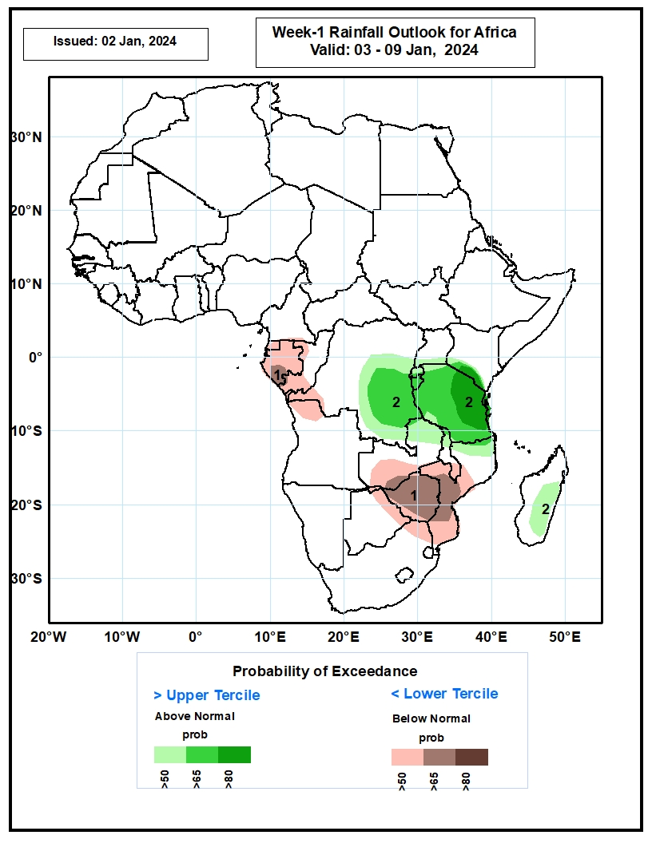
Week-1 Precipitation Outlooks
03 – 09 Jan 2024
The probabilistic forecasts call for above 50% chance for weekly total rainfall to be below-normal (below the lower tercile) over Equatorial Guinea, Gabon, southern Congo, western DRC, northwestern Angola, southern Zambia, Zimbabwe,, central and southern Mozambique, and northeastern South Africa. There is above 65% chance for below-normal rainfall over parts of Gabon, Zimbabwe, and central Mozambique.
The probabilistic forecasts call for above 50% chance for weekly rainfall to be above-normal (above the upper tercile) over eastern DRC, Tanzania, and eastern Madagascar . There is above 65% chance for above-normal rainfall over eastern Tanzania.
Notes:
10

Slide 11
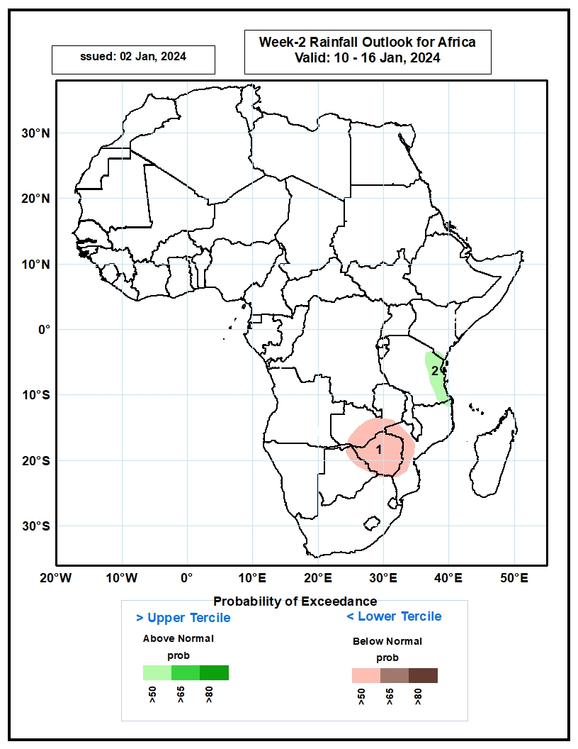
Week-2 Precipitation Outlooks
10 – 16 Jan 2024
The probabilistic forecasts call for above 50% chance for weekly total rainfall to be below-normal (below the lower tercile) over southern Zambia, much of Zimbabwe and western Mozambique.
The probabilistic forecasts call for above 50% chance for weekly rainfall to be above-normal (above the upper tercile) over the far eastern Tanzania.
Notes:
11

Slide 12
Summary
Over the past 30 days, in East Africa, above-average rainfall was observed in many parts of Tanzania, parts of central and southern Uganda, southwestern and southeastern Kenya, Burundi, Rwanda, pockets of western Ethiopia, and far southeastern Somalia. Rainfall was below-average over central and southwestern Ethiopia, northern, central, and south-central Kenya, southwestern Somalia, southeastern South Sudan, and parts of northeastern and south-central Tanzania. In Central Africa, rainfall was above-average across western and southeastern CAR, northwestern, north-central, southwestern, and southeastern DRC, central and southwestern Gabon, and southern Congo. Below-average rainfall was observed in central and eastern Equatorial Guinea, west-central and eastern Gabon, parts of northern and central Congo, much of southern and central DRC, and southern Cameroon. In West Africa, rainfall was below-average from Liberia to southern Nigeria. In southern Africa, above-average rainfall was observed in western Angola, northwestern Namibia, south-central and northeastern Zambia, southern and parts of northwestern Mozambique, southern and northwestern Zimbabwe, southern Botswana, Lesotho, Eswatini, and eastern and central South Africa. Below-average rainfall was observed in central and eastern Angola, western, central, and southeastern Zambia, western and northeastern Zimbabwe, northern Botswana, northeastern Namibia, central and northern Mozambique, Malawi, and most of Madagascar.
During the past 7 days, in East Africa, rainfall was above-average in western Tanzania, Rwanda, Burundi, southern and parts of central Uganda, southwestern and southeastern Kenya, and parts of southwestern Somalia. Below-average rainfall was observed over parts of south-central Kenya and eastern and southern Tanzania. In central Africa, above-average rainfall was observed over central, southeastern, and south-central DRC, southern Congo, parts of western Gabon, and western Equatorial Guinea. Rainfall was below-average over eastern Gabon, central Congo, and parts of northern and southeastern DRC. In West Africa, rainfall was near normal, as little to no rainfall fell. In southern Africa, rainfall was above-average over northeastern and northwestern Angola, southern and eastern Zambia, central and southern Malawi, most of Zimbabwe, southeastern and southwestern Botswana, northwestern, central, and soutahern Mozambique, much of South Africa, Lesotho, Eswatini, and southern and parts of eastern Madagascar. Below-average rainfall was observed over parts of central and southern Angola, northern Namibia, parts of northwestern Zambia, northwestern Mozambique, pockets of northern and central Botswana, and northwestern and central Madagascar.
The Week-1 outlook calls for above-average rainfall in central and northeastern Angola, south-central and southeastern DRC, northern and central Zambia, northern Malawi, most of Tanzania, Rwanda, Burundi, northern Mozambique, Comoros, and northern, eastern, central, and southern Madagascar. In contrast, there is an increased chance for below-average across eastern portions of the coastal Gulf of Guinea region, Equatorial Guinea, Gabon, Congo, southwestern DRC, western and southeastern Angola, southwestern Zambia, Zimbabwe, northern and eastern Botswana, northeastern Namibia, eastern South Africa, Eswatini, southern and central Mozambique, and west-central Madagascar. The Week-2 outlook calls for above-normal rainfall in parts of southeastern DRC, central Angola, northwestern and southeastern Zambia, central Malawi, south-central South Africa, Lesotho, northwestern Mozambique, parts of northern Tanzania, Comoros, and northern, western, and parts of southern Madagascar. In contrast, there is an increased chance for below-average in coastal Liberia, western Gabon, southern Congo, southwestern DRC, northern and southwestern Angola, northwestern Namibia, southern Zimbabwe, eastern Botswana, northeastern South Africa, Eswatini, southern and central Mozambique, southwestern Tanzania, northeastern Zambia, and parts of central Madagascar.

