Slide 1
The African Monsoon Recent Evolution and Current Status Include Week-1 and Week-2 Outlooks
Update prepared
11 March 2024
For more information, visit:
http://www.cpc.ncep.noaa.gov/products/Global_Monsoons/African_Monsoons/precip_monitoring.shtml

Slide 2
Outline
Highlights
Recent Evolution and Current Conditions
NCEP GEFS Forecasts
Summary

Slide 3
Highlights: Last 7 Days
During the past 7 days, in East Africa, rainfall was above-average in southwestern, central-eastern and northeastern Ethiopia, central, southern and southeastern Uganda, southwestern and southeastern Kenya, northwestern and central-eastern Tanzania. Rainfall was below average in many parts of Rwanda and Burundi, western and southeastern Tanzania, and some parts of southwestern South Sudan. In central Africa, rainfall was above-average in central and southern Cameroon, western and central Congo, western and eastern Gabon, pockets of region in northwestern CAR, and some regions in northern, southern, central-eastern and western DRC. Rainfall was below-average in Equatorial Guinea, central Gabon, southern and southeastern DRC, and southwestern, northwestern, central and eastern DRC. In West Africa, rainfall was above-average in southern Liberia, southern, central and northern Cote d’Ivoire, and southeastern Ghana, southern parts of Togo and Benin, and southwestern and southeastern Nigeria. Rainfall was below-average in pockets of region in eastern Guinea, southern Ghana, and southern Nigeria. In southern Africa, rainfall was above-average in central Malawi, northern Mozambique, southwestern, southern and southeastern Madagascar, and pockets of regions in eastern Angola, northwestern and eastern Zambia and southern Africa. Rainfall was below-average across central, southern and southwestern Angola, northern and central-eastern Namibia, western, central, northern and eastern Botswana, southern Zambia, many parts of Zimbabwe, central and southern Mozambique, northern South Africa, Eswatini, northern Lesotho, and central and northern Madagascar.
The Week-1 outlook calls for above-average rainfall in central and southern Mozambique, eastern Zimbabwe, central Angola, southern Cameroon, central and northern Cote d’Ivoire and Ghana, and pockets of regions in central Ethiopia. In contrast, there is an increased chance for below-average in many parts of southern Africa, Madagascar, DRC, Uganda, Rwanda, Burundi, Kenya, central-southern Ethiopia, and central, northern and eastern Tanzania. The Week-2 outlook calls for above-normal rainfall in many parts of central Africa, western and northern Angola, southeastern Namibia, central South Africa, Eswatini, and western Cote d’Ivoire. In contrast, there is an increased chance for below-average in southeastern Angola, northeastern Namibia, many parts of Zambia, Botswana, Malawi and Mozambique, Zimbabwe, Madagascar, southern South Africa, northern Ghana, Togo, central and southern Benin, central and southern Nigeria, southwestern and central Cameroon, and some parts of eastern Ethiopia.

Slide 4
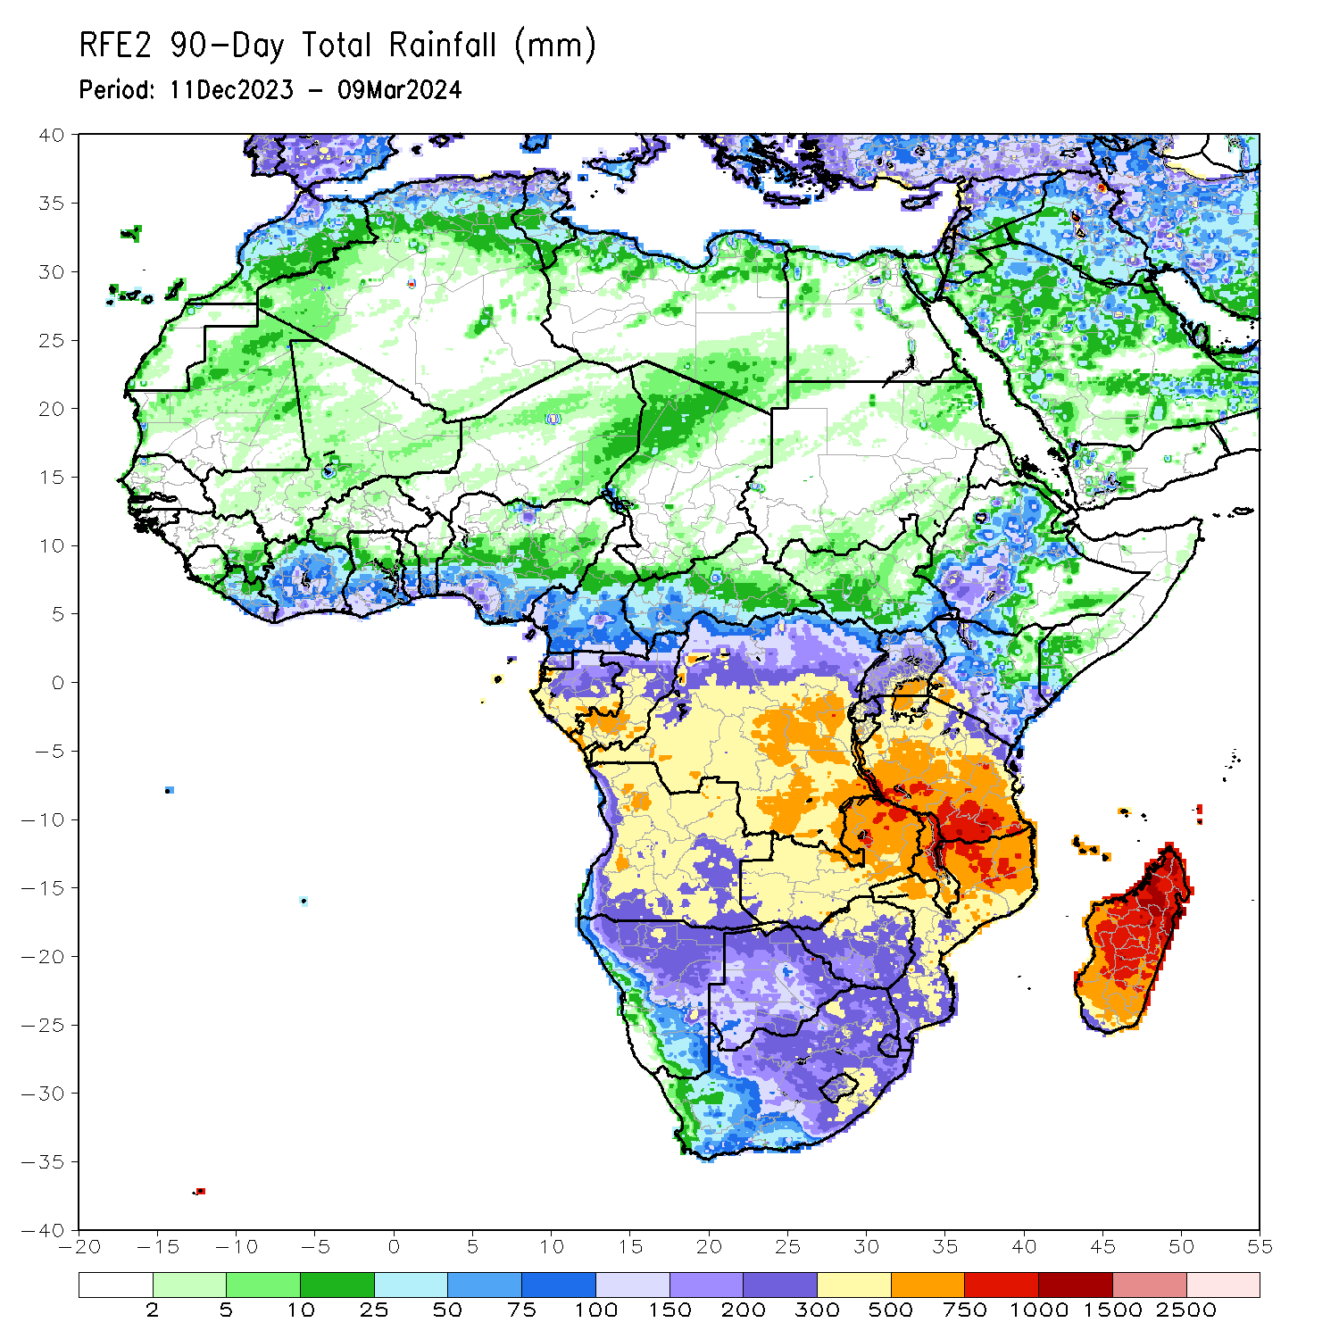
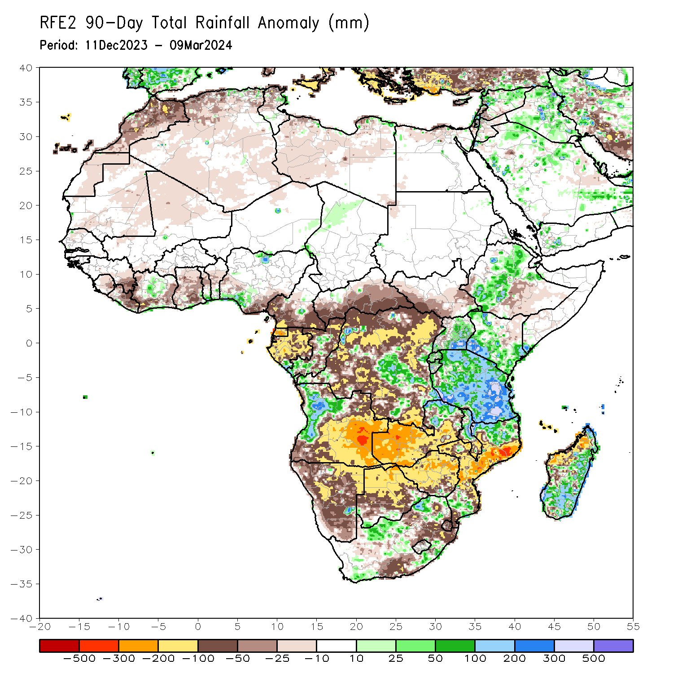
Rainfall Patterns: Last 90 Days
Over the past 90 days, in East Africa, rainfall was above-average in parts of northeastern, central and southwestern Ethiopia, northern, central, southern and eastern Uganda, and northwestern, western, southern and southeastern Kenya, many prats of Tanzania and Rwanda, western, northern and eastern Burundi and pockets of region in southern Somalia. Rainfall was below-average in western, southwestern, central and eastern South Sudan, central-southern Ethiopia, western Somalia, and northeastern and central-eastern Kenya. In Central Africa, rainfall was above-average in some regions in central DRC and southern Congo. Rainfall was below-average in western and southern Cameroon, Equatorial Guinea, many parts of Gabon, central and northern Congo, western, southern, central and eastern CAR, and many parts of northern, western, northeastern and southern DRC. In West Africa, rainfall was above-average in central Cote d’Ivoire, pockets of region in southern Togo and Benin, and pockets of region in southwestern and northern Nigeria. Rainfall was below-average in northern Senegal, northern, central, and eastern Sierra Leone, eastern Guinea, may parts of Liberia and Ghana, western, southwestern and eastern Cote d’Ivoire, central parts of Togo and Benin, southeastern Nigeria, northern Mali, and central-eastern Mauritania. In southern Africa, rainfall was above-average over western Angola, northern Zambia, northern and eastern Malawi, some regions in northern and southern Mozambique, some parts of western and eastern South Africa, and southern, central and eastern Madagascar. Rainfall was below-average across southern, central, eastern and northeastern Angola, many parts of Namibia, Botswana, Zimbabwe and Eswatini, western, central, southern and eastern Zambia, southern Malawi, and eastern, central and western Mozambique, some parts of central, northeastern and southeastern South Africa, western Lesotho, Eswatini, and western Madagascar.
Notes:
4

Slide 5
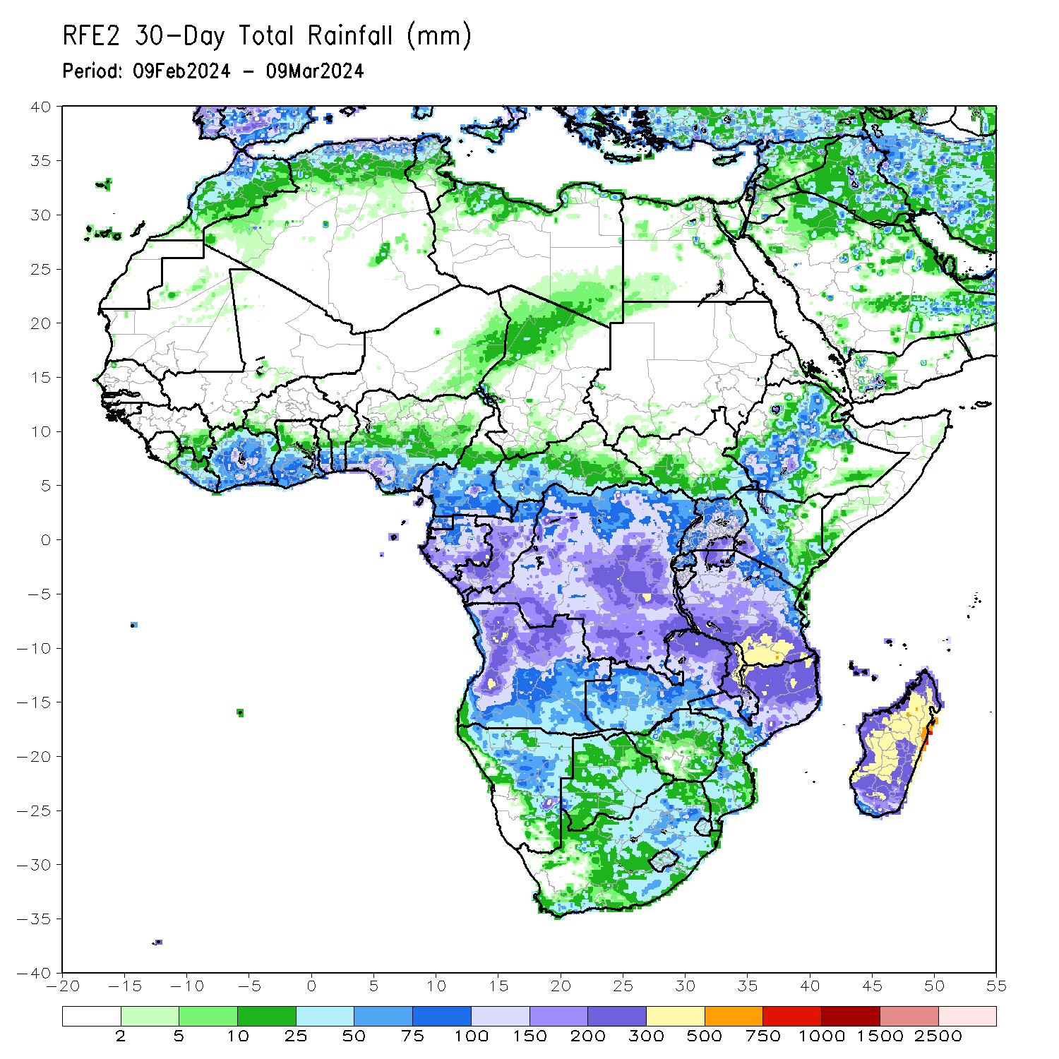
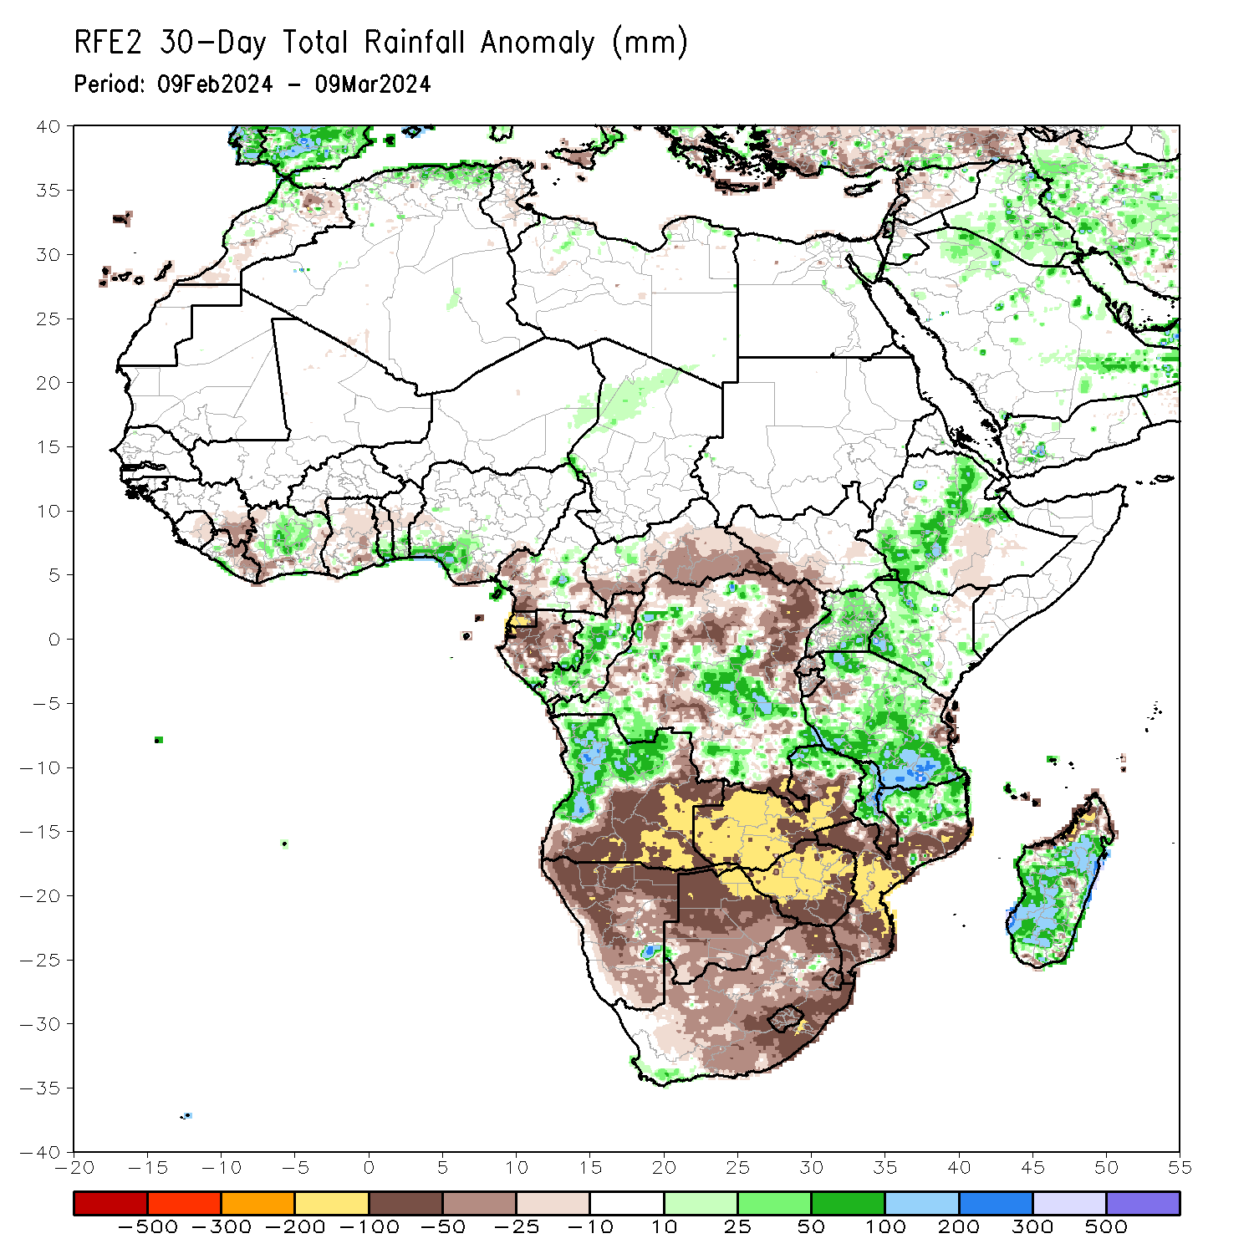
Rainfall Patterns: Last 30 Days
Over the past 30 days, in East Africa, rainfall was above-average in southwestern, central and northeastern Ethiopia, Uganda, northwestern, western, central and southern Kenya, northern, central, southwestern, southern and southeastern Tanzania, and pockets of eastern South Sudan. Rainfall was below-average in western South Sudan, some parts of central-southern Ethiopia, northeastern Kenya, Rwanda, Burundi, and some regions in western and eastern Tanzania. In Central Africa, rainfall was above-average over southwestern and central DRC, central and southern Congo, and pockets of central Cameroon and eastern Gabon. Rainfall was below-average in western and southeastern Cameroon, Equatorial Guinea, western central and northern Gabon, northern Congo, southwestern, southern, central and eastern CAR, and northern-central, eastern, and southern DRC. In West Africa, rainfall was above-average in southern Liberia, central and northern Cote d’Ivoire, southern parts of Togo and Benin, southwestern Nigeria. Rainfall was below-average in eastern Guinea, northeastern Sierra Leone, northern and eastern Liberia, western and southeastern Cote d’Ivoire, central and southern Ghana, central parts of Togo and Benin, and southeastern Nigeria. In southern Africa, rainfall was above-average in western and northern Angola, some parts of northern Zambia and northern Mozambique, northern and central Malawi, and northeastern, central, western and southern Madagascar. Rainfall was below-average in southern, southeastern and eastern Angola, many parts of Namibia, Botswana and South Africa, western, southern, central and eastern Zambia, Zimbabwe, Lesotho, Eswatini, southern Malawi, central, western, southern and eastern Mozambique, and northwestern Madagascar.
Notes:
5

Slide 6
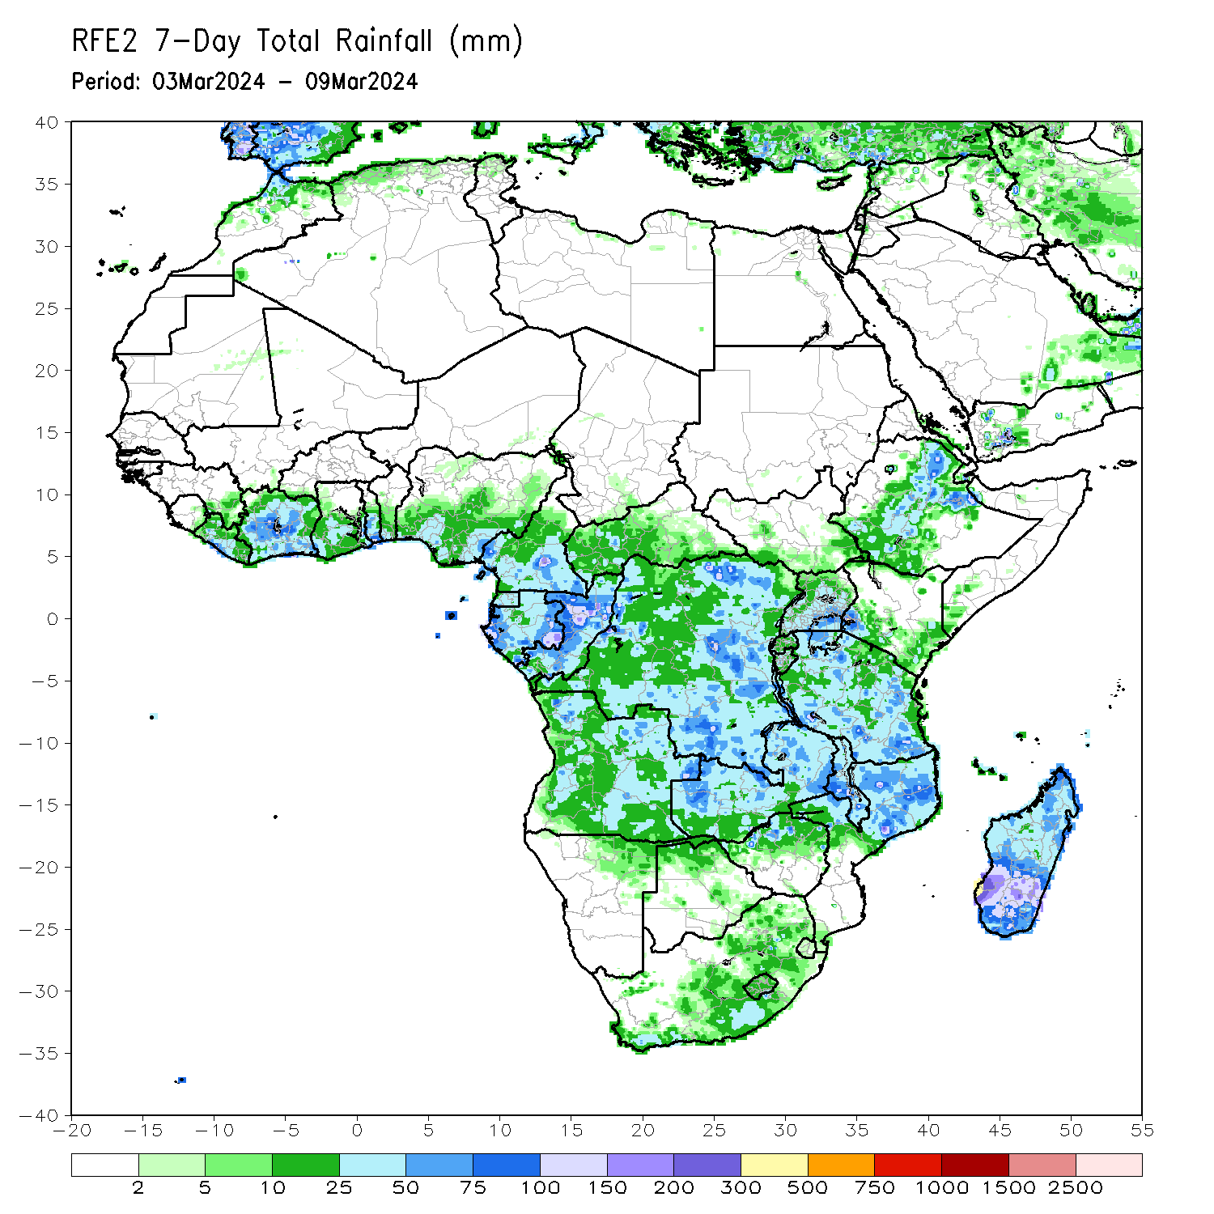
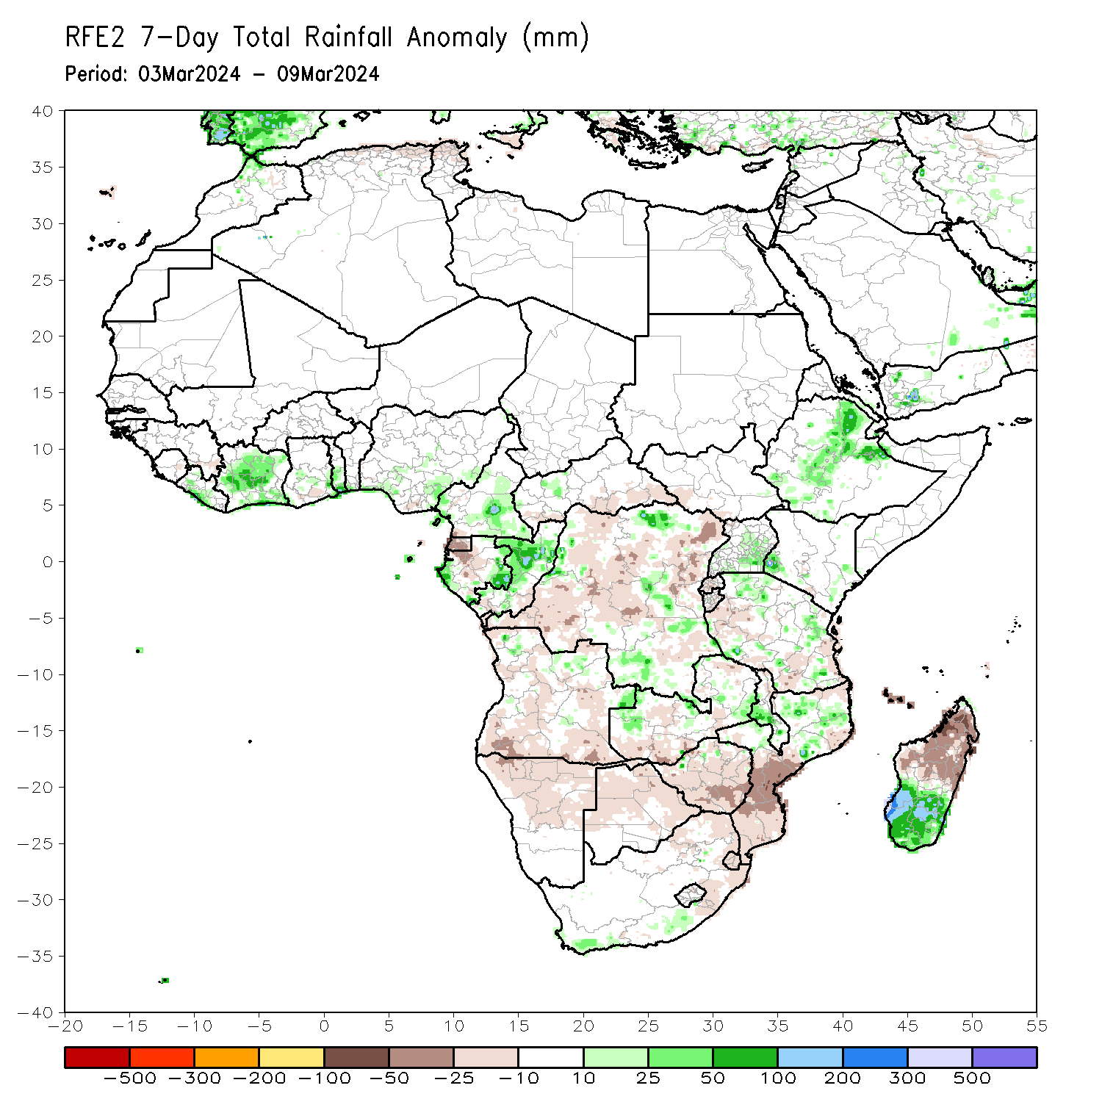
Rainfall Patterns: Last 7 Days
During the past 7 days, in East Africa, rainfall was above-average in southwestern, central-eastern and northeastern Ethiopia, central, southern and southeastern Uganda, southwestern and southeastern Kenya, northwestern and central-eastern Tanzania. Rainfall was below average in many parts of Rwanda and Burundi, western and southeastern Tanzania, and some parts of southwestern South Sudan. In central Africa, rainfall was above-average in central and southern Cameroon, western and central Congo, western and eastern Gabon, pockets of region in northwestern CAR, and some regions in northern, southern, central-eastern and western DRC. Rainfall was below-average in Equatorial Guinea, central Gabon, southern and southeastern DRC, and southwestern, northwestern, central and eastern DRC. In West Africa, rainfall was above-average in southern Liberia, southern, central and northern Cote d’Ivoire, and southeastern Ghana, southern parts of Togo and Benin, and southwestern and southeastern Nigeria. Rainfall was below-average in pockets of region in eastern Guinea, southern Ghana, and southern Nigeria. In southern Africa, rainfall was above-average in central Malawi, northern Mozambique, southwestern, southern and southeastern Madagascar, and pockets of regions in eastern Angola, northwestern and eastern Zambia and southern Africa. Rainfall was below-average across central, southern and southwestern Angola, northern and central-eastern Namibia, western, central, northern and eastern Botswana, southern Zambia, many parts of Zimbabwe, central and southern Mozambique, northern South Africa, Eswatini, northern Lesotho, and central and northern Madagascar.

Slide 7
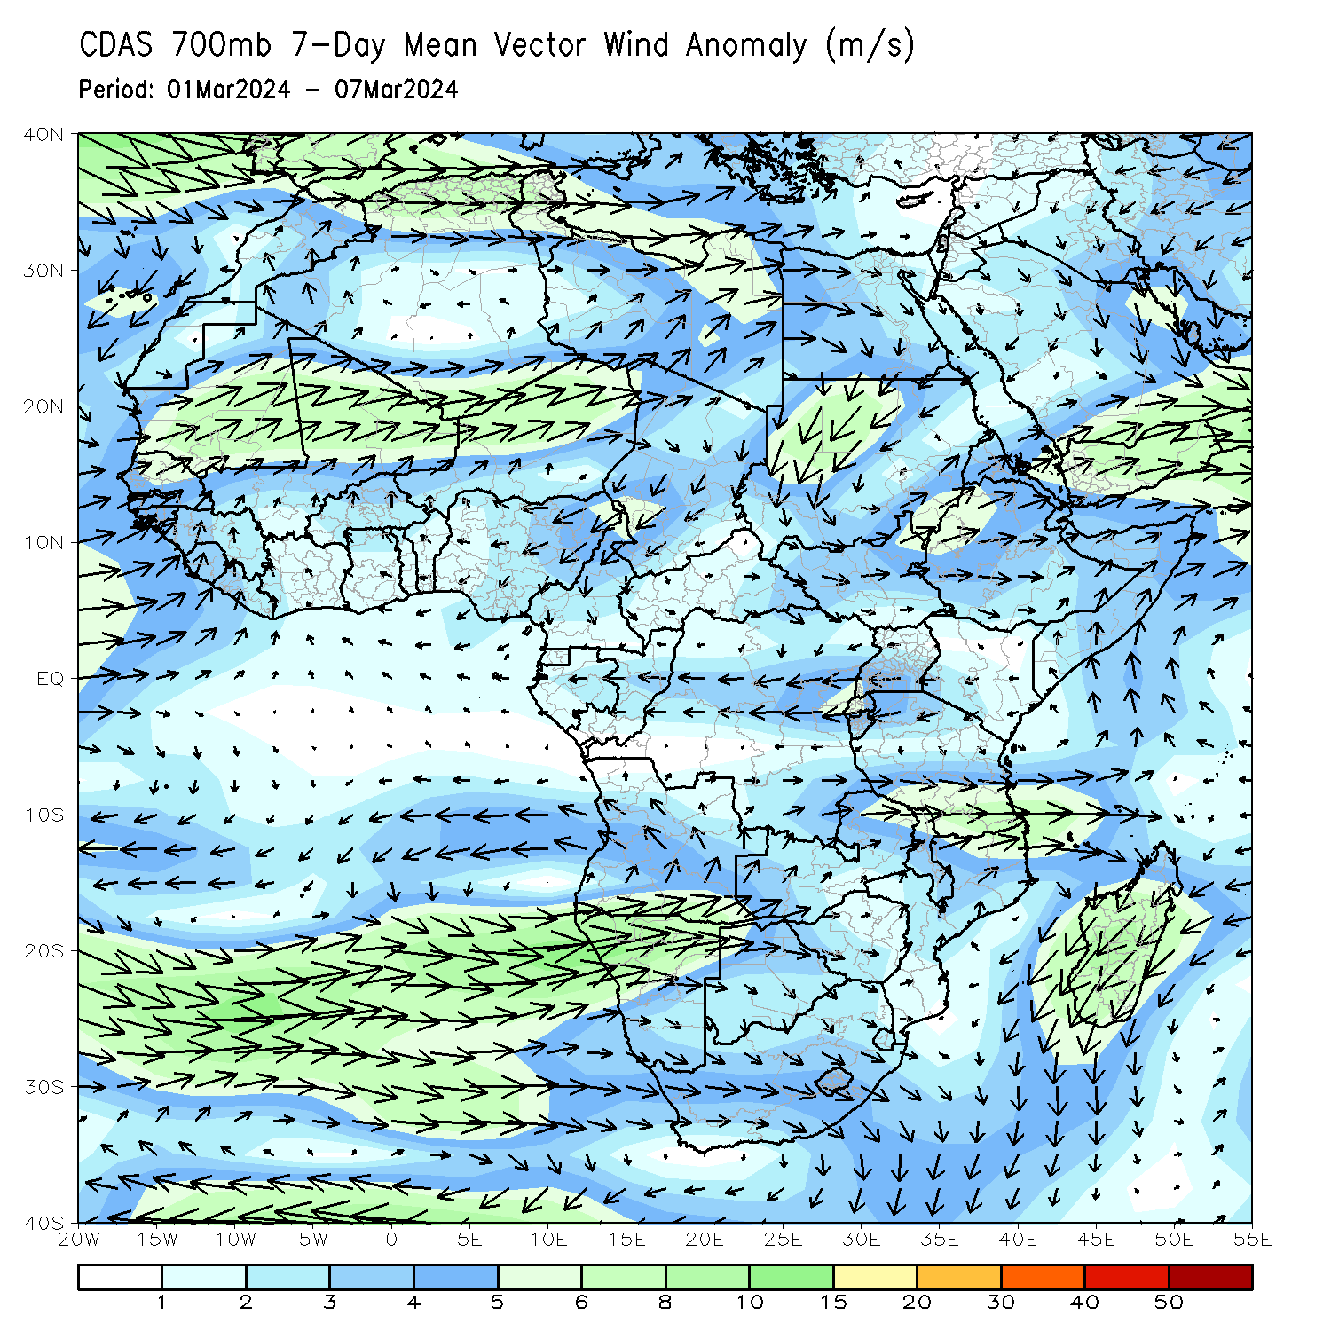
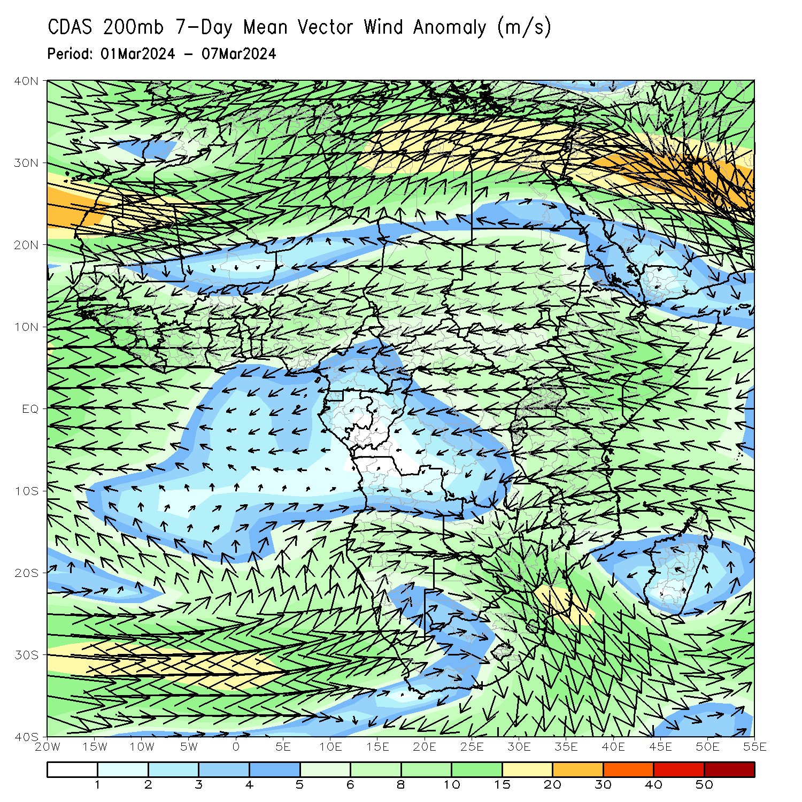
Atmospheric Circulation: Last 7 Days
At 700-hPa level (left panel), anomalous lower-level wind convergence may contributed to the observed above-average rainfall in southern Madagascar. An area of anti-cyclonic circulation at 700hPa (left panel) was observed across Angola and northern Namibia that may have contributed to the observed below-average rainfall in southern and central Angola and northern Namibia.

Slide 8
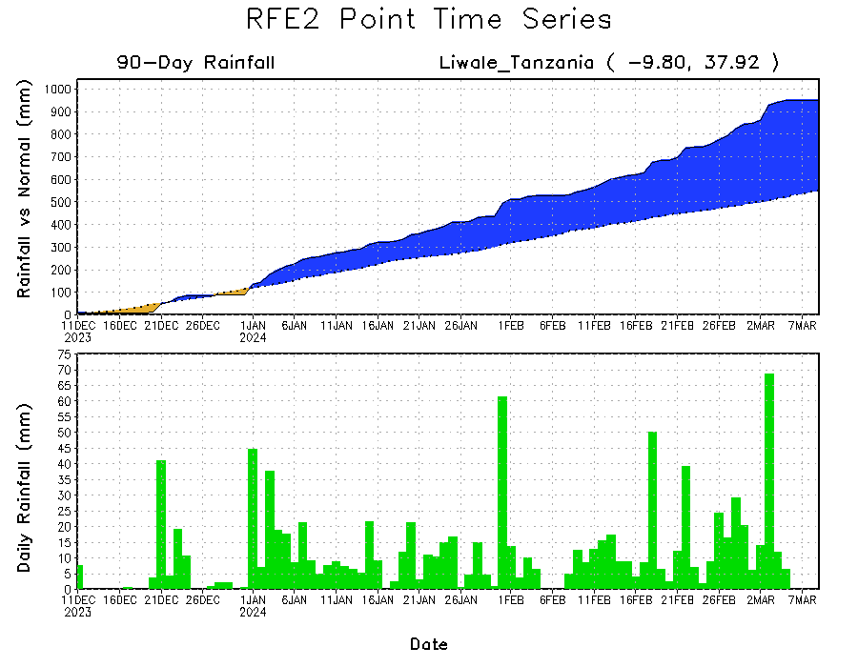
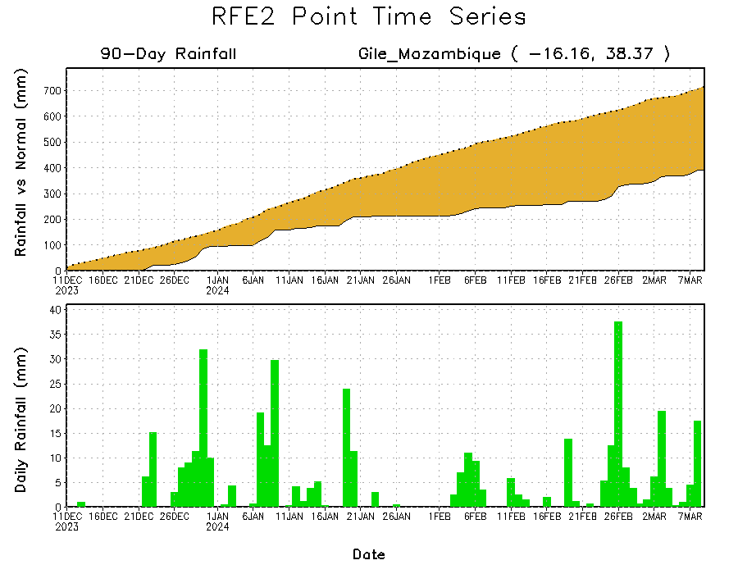
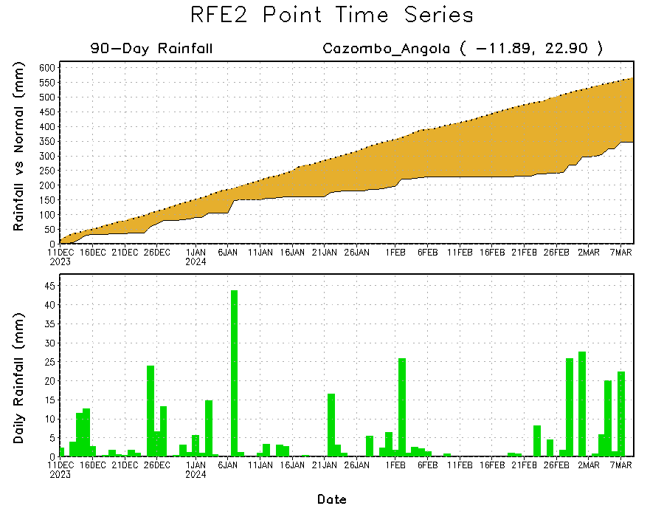
Rainfall Evolution
Daily evolution in rainfall at selected locations over the past 90 days shows growing deficits over parts of eastern Angola (bottom left) and central-eastern Mozambique (bottom right). Conversely, rainfall surpluses persist in central, southern and eastern Tanzania due to heavy and above-average rainfall during last 2 months (top right).

Slide 9
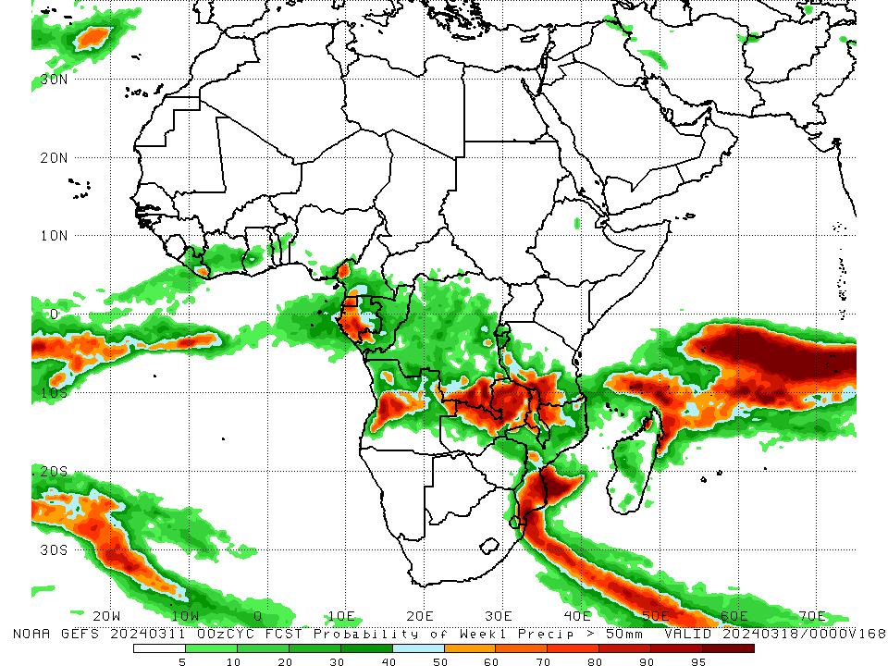
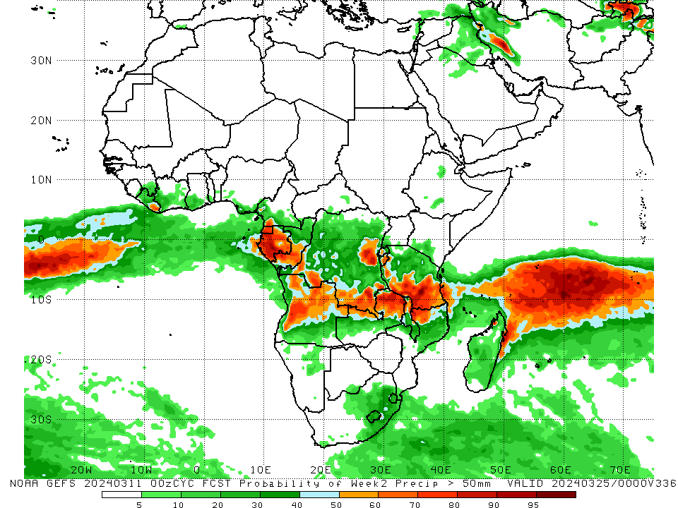
NCEP GEFS Model Forecasts Non-Bias Corrected Probability of precipitation exceedance
Week-1, Valid: 12 – 18 Mar 2024
Week-2, Valid: 19 – 25 Mar 2024
For week-1 (left panel) the GEFS forecasts indicate a moderate to high chance (over 70%) for rainfall to exceed 50 mm across Equatorial Guinea, western and southern Gabon, western-central Angola, southeastern DRC, southwestern Tanzania, northwestern and southern Mozambique, northwestern, northern and eastern Zambia, western and northern Malawi, and pockets of northern Madagascar. For week-2 (right panel), the GEFS forecasts indicate a moderate to high chance (over 70%) for rainfall to exceed 50 mm over Equatorial Guinea, Gabon, southwestern Congo, western-central Angola, pockets of regions in eastern, southwestern and southeastern DRC, northern Zambia, southwestern and southern Tanzania, and northwestern Mozambique.
Notes:
9

Slide 10
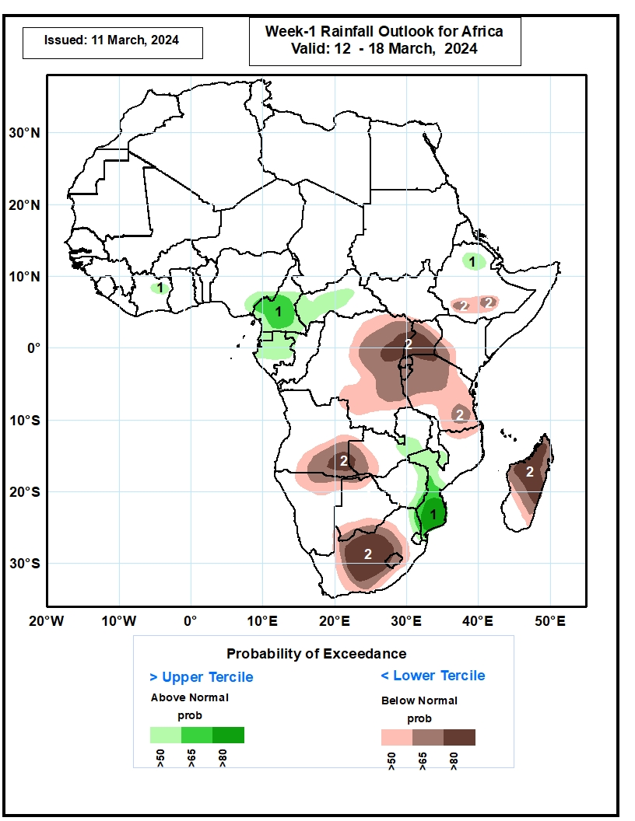
Week-1 Precipitation Outlooks
12 – 18 Mar 2024
The probabilistic forecasts call for above 50% chance for weekly rainfall to be above-normal (above the upper tercile) over northeastern Cote d’Ivoire, western and central CAR, southern Cameroon, northern Gabon, Equatorial Guinea, northern Ethiopia, central Zambia, southern Malawi, and western Mozambique. There is above 80% chance for above-normal rainfall over southern Mozambique.
The probabilistic forecasts call for above 50% chance for weekly total rainfall to be below-normal (below the lower tercile) over southern Ethiopia, eastern DRC, Uganda, Rwanda, Burundi, much of Tanzania, westernmost Kenya, northern Madagascar, southeastern Angola, northern Namibia, western Zambia, northern and southern Botswana, and central South Africa. There is above 80% chance for below-normal rainfall over northeastern DRC, southern Uganda, northernmost Tanzania, southeastern Angola, central South Africa, and northern Madagascar.
Notes:
10

Slide 11
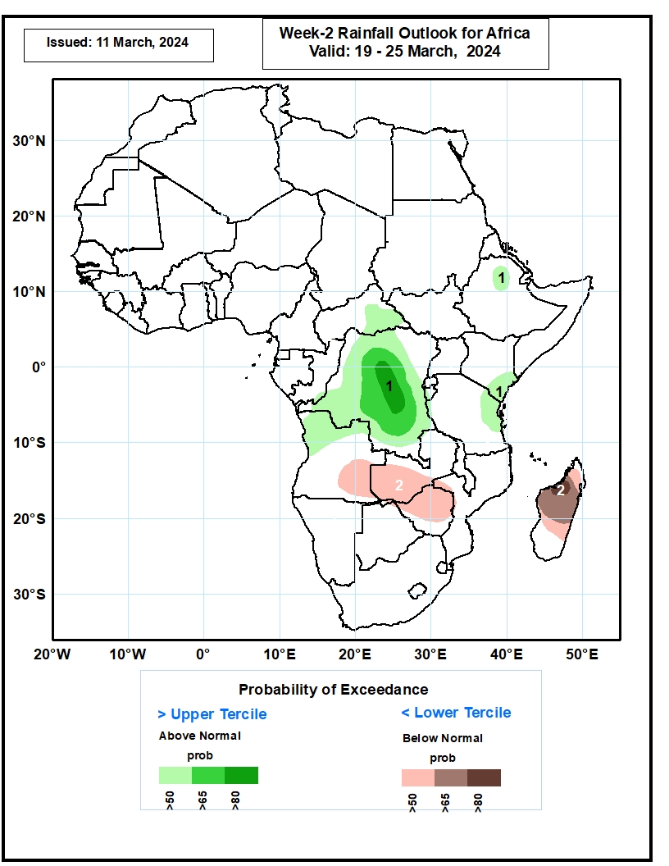
Week-2 Precipitation Outlooks
19 – 25 Mar 2024
The probabilistic forecasts call for above 50% chance for weekly rainfall to be above-normal (above the upper tercile) over much of DRC, eastern CAR, northern Angola, southeastern Kenya, eastern Tanzania, and northern Ethiopia. There is above 80% chance for above-normal rainfall over central DRC.
The probabilistic forecasts call for above 50% chance for weekly total rainfall to be below-normal (below the lower tercile) over southeastern Angola, southern Zambia, northern and central Zimbabwe and northern and central Madagascar. There is above 80% chance for below-normal rainfall over northeastern Madagascar.
Notes:
11

Slide 12
Summary
Over the past 30 days, in East Africa, rainfall was above-average in southwestern, central and northeastern Ethiopia, Uganda, northwestern, western, central and southern Kenya, northern, central, southwestern, southern and southeastern Tanzania, and pockets of eastern South Sudan. Rainfall was below-average in western South Sudan, some parts of central-southern Ethiopia, northeastern Kenya, Rwanda, Burundi, and some regions in western and eastern Tanzania. In Central Africa, rainfall was above-average over southwestern and central DRC, central and southern Congo, and pockets of central Cameroon and eastern Gabon. Rainfall was below-average in western and southeastern Cameroon, Equatorial Guinea, western central and northern Gabon, northern Congo, southwestern, southern, central and eastern CAR, and northern-central, eastern, and southern DRC. In West Africa, rainfall was above-average in southern Liberia, central and northern Cote d’Ivoire, southern parts of Togo and Benin, southwestern Nigeria. Rainfall was below-average in eastern Guinea, northeastern Sierra Leone, northern and eastern Liberia, western and southeastern Cote d’Ivoire, central and southern Ghana, central parts of Togo and Benin, and southeastern Nigeria. In southern Africa, rainfall was above-average in western and northern Angola, some parts of northern Zambia and northern Mozambique, northern and central Malawi, and northeastern, central, western and southern Madagascar. Rainfall was below-average in southern, southeastern and eastern Angola, many parts of Namibia, Botswana and South Africa, western, southern, central and eastern Zambia, Zimbabwe, Lesotho, Eswatini, southern Malawi, central, western, southern and eastern Mozambique, and northwestern Madagascar.
During the past 7 days, in East Africa, rainfall was above-average in southwestern, central-eastern and northeastern Ethiopia, central, southern and southeastern Uganda, southwestern and southeastern Kenya, northwestern and central-eastern Tanzania. Rainfall was below average in many parts of Rwanda and Burundi, western and southeastern Tanzania, and some parts of southwestern South Sudan. In central Africa, rainfall was above-average in central and southern Cameroon, western and central Congo, western and eastern Gabon, pockets of region in northwestern CAR, and some regions in northern, southern, central-eastern and western DRC. Rainfall was below-average in Equatorial Guinea, central Gabon, southern and southeastern DRC, and southwestern, northwestern, central and eastern DRC. In West Africa, rainfall was above-average in southern Liberia, southern, central and northern Cote d’Ivoire, and southeastern Ghana, southern parts of Togo and Benin, and southwestern and southeastern Nigeria. Rainfall was below-average in pockets of region in eastern Guinea, southern Ghana, and southern Nigeria. In southern Africa, rainfall was above-average in central Malawi, northern Mozambique, southwestern, southern and southeastern Madagascar, and pockets of regions in eastern Angola, northwestern and eastern Zambia and southern Africa. Rainfall was below-average across central, southern and southwestern Angola, northern and central-eastern Namibia, western, central, northern and eastern Botswana, southern Zambia, many parts of Zimbabwe, central and southern Mozambique, northern South Africa, Eswatini, northern Lesotho, and central and northern Madagascar.
The Week-1 outlook calls for above-average rainfall in central and southern Mozambique, eastern Zimbabwe, central Angola, southern Cameroon, central and northern Cote d’Ivoire and Ghana, and pockets of regions in central Ethiopia. In contrast, there is an increased chance for below-average in many parts of southern Africa, Madagascar, DRC, Uganda, Rwanda, Burundi, Kenya, central-southern Ethiopia, and central, northern and eastern Tanzania. The Week-2 outlook calls for above-normal rainfall in many parts of central Africa, western and northern Angola, southeastern Namibia, central South Africa, Eswatini, and western Cote d’Ivoire. In contrast, there is an increased chance for below-average in southeastern Angola, northeastern Namibia, many parts of Zambia, Botswana, Malawi and Mozambique, Zimbabwe, Madagascar, southern South Africa, northern Ghana, Togo, central and southern Benin, central and southern Nigeria, southwestern and central Cameroon, and some parts of eastern Ethiopia.

