Slide 1
The African Monsoon Recent Evolution and Current Status Include Week-1 and Week-2 Outlooks
Update prepared
18 March 2024
For more information, visit:
http://www.cpc.ncep.noaa.gov/products/Global_Monsoons/African_Monsoons/precip_monitoring.shtml

Slide 2
Outline
Highlights
Recent Evolution and Current Conditions
NCEP GEFS Forecasts
Summary

Slide 3
Highlights: Last 7 Days
During the past 7 days, in East Africa, rainfall was above-average in southwestern and central Ethiopia, central Eritrea, and pockets of regions in southeastern Kenya, northeastern and northwestern Tanzania and eastern Sudan. Rainfall was below average in many parts of Uganda, Rwanda and Burundi, western, central, northern, southern and eastern Tanzania, southwestern Kenya, southern South Sudan, and pockets of the region in southern Ethiopia. In central Africa, rainfall was above-average in western Gabon, some parts of central and southern CAR, and northeastern and southern DRC. Rainfall was below-average in Equatorial Guinea, central and southern Gabon, southern Cameroon, northern, eastern, central and southern Congo, southwestern CAR, and western-central, southwestern and eastern DRC. In West Africa, rainfall was above-average in pockets of region in southeastern Guinea and northern Liberia, southern Ghana, central and southern Togo, and western-central Nigeria. Rainfall was below-average in central and southern Cote d’Ivoire, southern Liberia, and southern Nigeria. In southern Africa, rainfall was above-average in western-central and eastern Angola, central and southern Zambia, southern Malawi, central, western and southern Mozambique, Eswatini, and pockets of region in northern and eastern Namibia, western Botswana, eastern Zimbabwe, and southeastern Madagascar. Rainfall was below-average in northern and southeastern Angola, western and northern Zambia, northeastern and central-eastern Namibia, northern, southwestern, central and southeastern Botswana, western Zimbabwe, northern Mozambique, western and central South Africa, Lesotho, and many parts of Madagascar.
The Week-1 outlook calls for above-average rainfall in Equatorial Guinea, Gabon, Congo, DRC, Rwanda, Burundi, Tanzania, northern Angola, and central South Africa. In contrast, there is an increased chance for below-average in many parts of southern Africa, Madagascar, Toga, central and southern Benin, southern parts of Nigeria and Cameroon, western CAR, Uganda, western, central and northern Kenya, central-eastern and southern Ethiopia, and southwestern Somalia. The Week-2 outlook calls for above-normal rainfall in many parts of central Africa, central Ethiopia, eastern Kenya, northern Angola, central South Africa, and Lesotho. In contrast, there is an increased chance for below-average in many parts of southern Africa, western and southern Madagascar, Sierra Leone, Liberia, western and northern Cote d’Ivoire, and central Uganda.

Slide 4
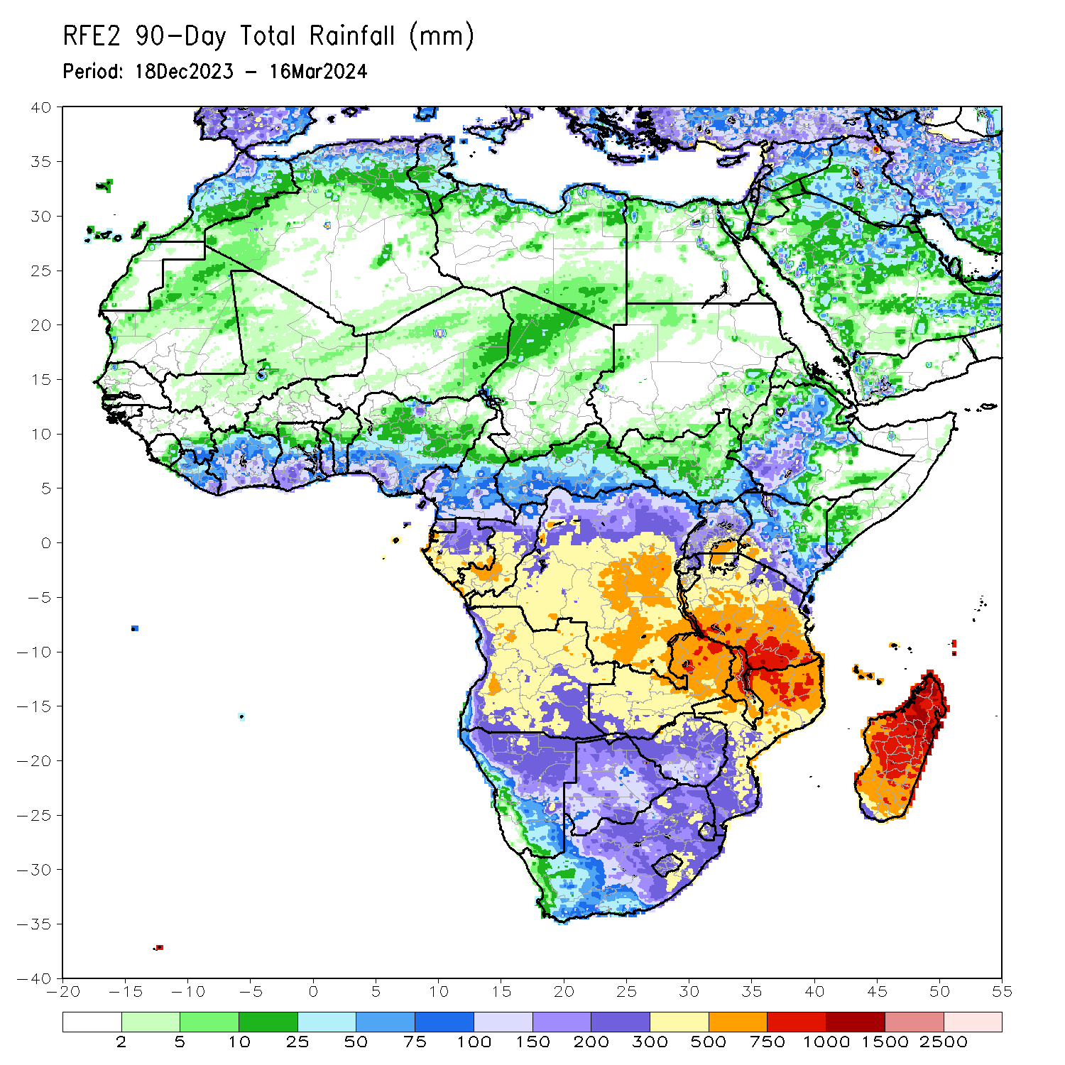
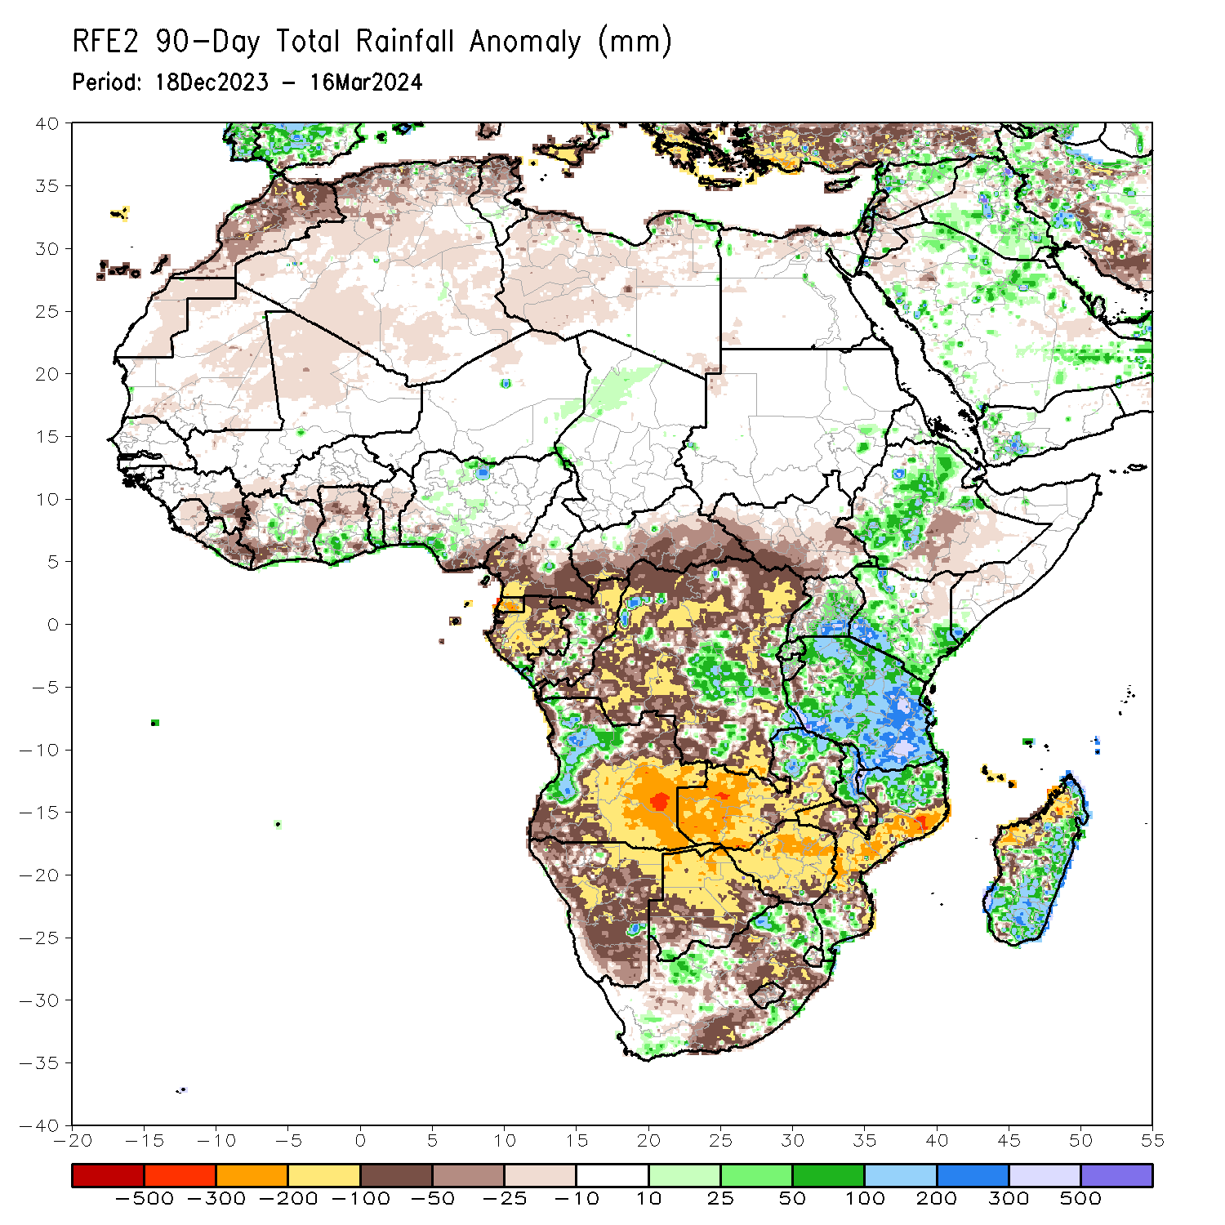
Rainfall Patterns: Last 90 Days
Over the past 90 days, in East Africa, rainfall was above-average in parts of northeastern, central and southwestern Ethiopia, central Eritrea, northern-central, southern and eastern Uganda, northwestern, southwestern, central, southern and southeastern Kenya, many prats of Tanzania and Rwanda, western, and northern Burundi and pockets of region in southern Somalia. Rainfall was below-average in western, southern, central and eastern South Sudan, central-southern Ethiopia, western Somalia, northeastern Kenya, and pockets of region in western Tanzania and southern Burundi. In Central Africa, rainfall was above-average in some regions in central DRC and central Congo, and pockets of region in southern Gabon. Rainfall was below-average in western and southern Cameroon, Equatorial Guinea, and many parts of Gabon, northern and southern Congo, western, southern, central and eastern CAR, and many parts of northern, western, northeastern, southwestern and southern DRC. In West Africa, rainfall was above-average in central Cote d’Ivoire, southern parts of Ghana and Togo, and pockets of region in southwestern and northern Nigeria. Rainfall was below-average in eastern Guinea, Sierra Leone, central and eastern Liberia, western, southern and eastern Cote d’Ivoire, northern parts of Ghana, Togo and Benin, southeastern Nigeria, northern Mali, and central-eastern Mauritania. In southern Africa, rainfall was above-average over western Angola, northern Zambia, northern and eastern Malawi, some regions in northern and southern Mozambique, some parts of western and southeastern South Africa, and southern, central and eastern Madagascar. Rainfall was below-average across southern, central, eastern and northeastern Angola, many parts of Namibia, Botswana, Zimbabwe and Lesotho, western, central, southern and eastern Zambia, southern Malawi, and eastern, central and western Mozambique, some parts of western, central and eastern South Africa, central-southeastern Eswatini, and western Madagascar.
Notes:
4

Slide 5
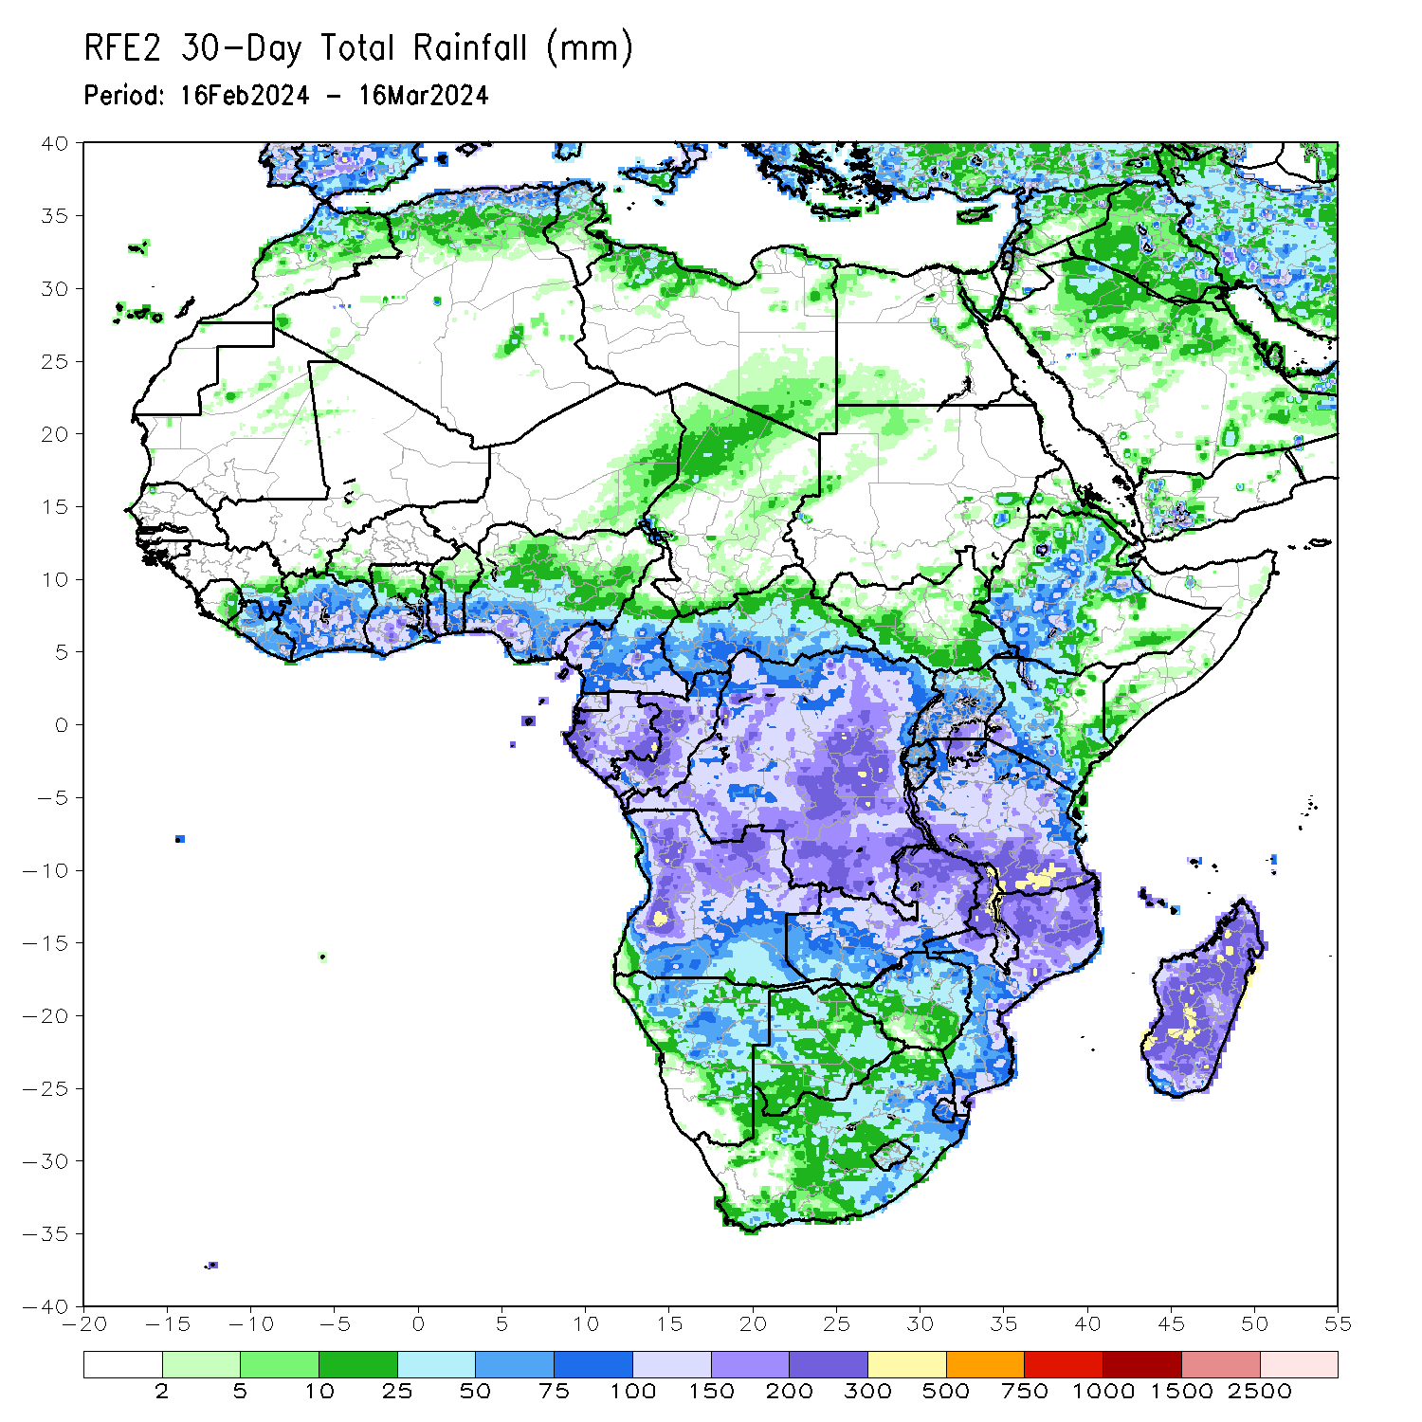
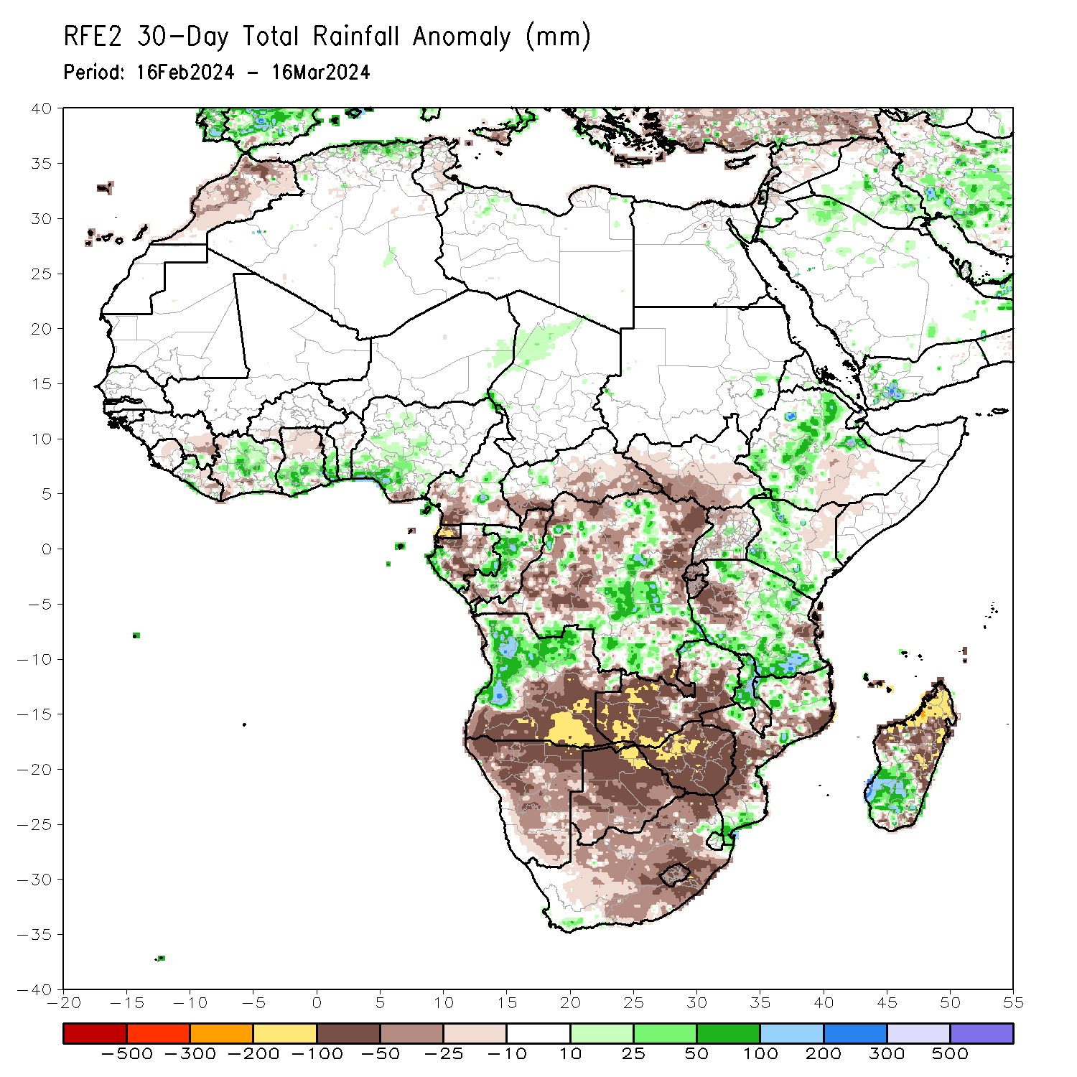
Rainfall Patterns: Last 30 Days
Over the past 30 days, in East Africa, rainfall was above-average in southwestern, central and northeastern Ethiopia, central Eritrea, northwestern, western-central and southern Kenya, northern, central, southwestern and southern Tanzania, and pockets of region in central and southeastern Uganda and eastern Sudan. Rainfall was below-average in western, central-eastern, and southern South Sudan, northern and western Uganda, some parts of southern Ethiopia, northeastern Kenya, Rwanda, Burundi, and some regions in western and eastern Tanzania. In Central Africa, rainfall was above-average in some parts of western and eastern Gabon, western Congo, central Cameroon, some parts of central, southern and southeastern DRC, and northwestern Chad. Rainfall was below-average in southern Cameroon, Equatorial Guinea, central and southern Gabon, northern Congo, southwestern, southern, central and eastern CAR, and western-central, northwestern, northeastern and eastern DRC. In West Africa, rainfall was above-average in central and northern Cote d’Ivoire, southern parts of Ghana, Togo and Benin, and southwestern and central Nigeria. Rainfall was below-average in eastern parts of Guinea and Liberia, central and northeastern Sierra Leone, southwestern Cote d’Ivoire, northern Ghana, and pockets of region in southeastern Nigeria. In southern Africa, rainfall was above-average in western and northern Angola, some parts of northern Zambia, northern and central Malawi, pockets of region in northwestern and southeastern Mozambique, central and northern Eswatini, and southwestern and southern Madagascar. Rainfall was below-average in southern, southeastern and eastern Angola, many parts of Namibia, Botswana and South Africa, western, southern, central and eastern Zambia, Zimbabwe, Lesotho, southern Malawi, western, central and eastern Mozambique, and northwestern, northern and eastern Madagascar.
Notes:
5

Slide 6
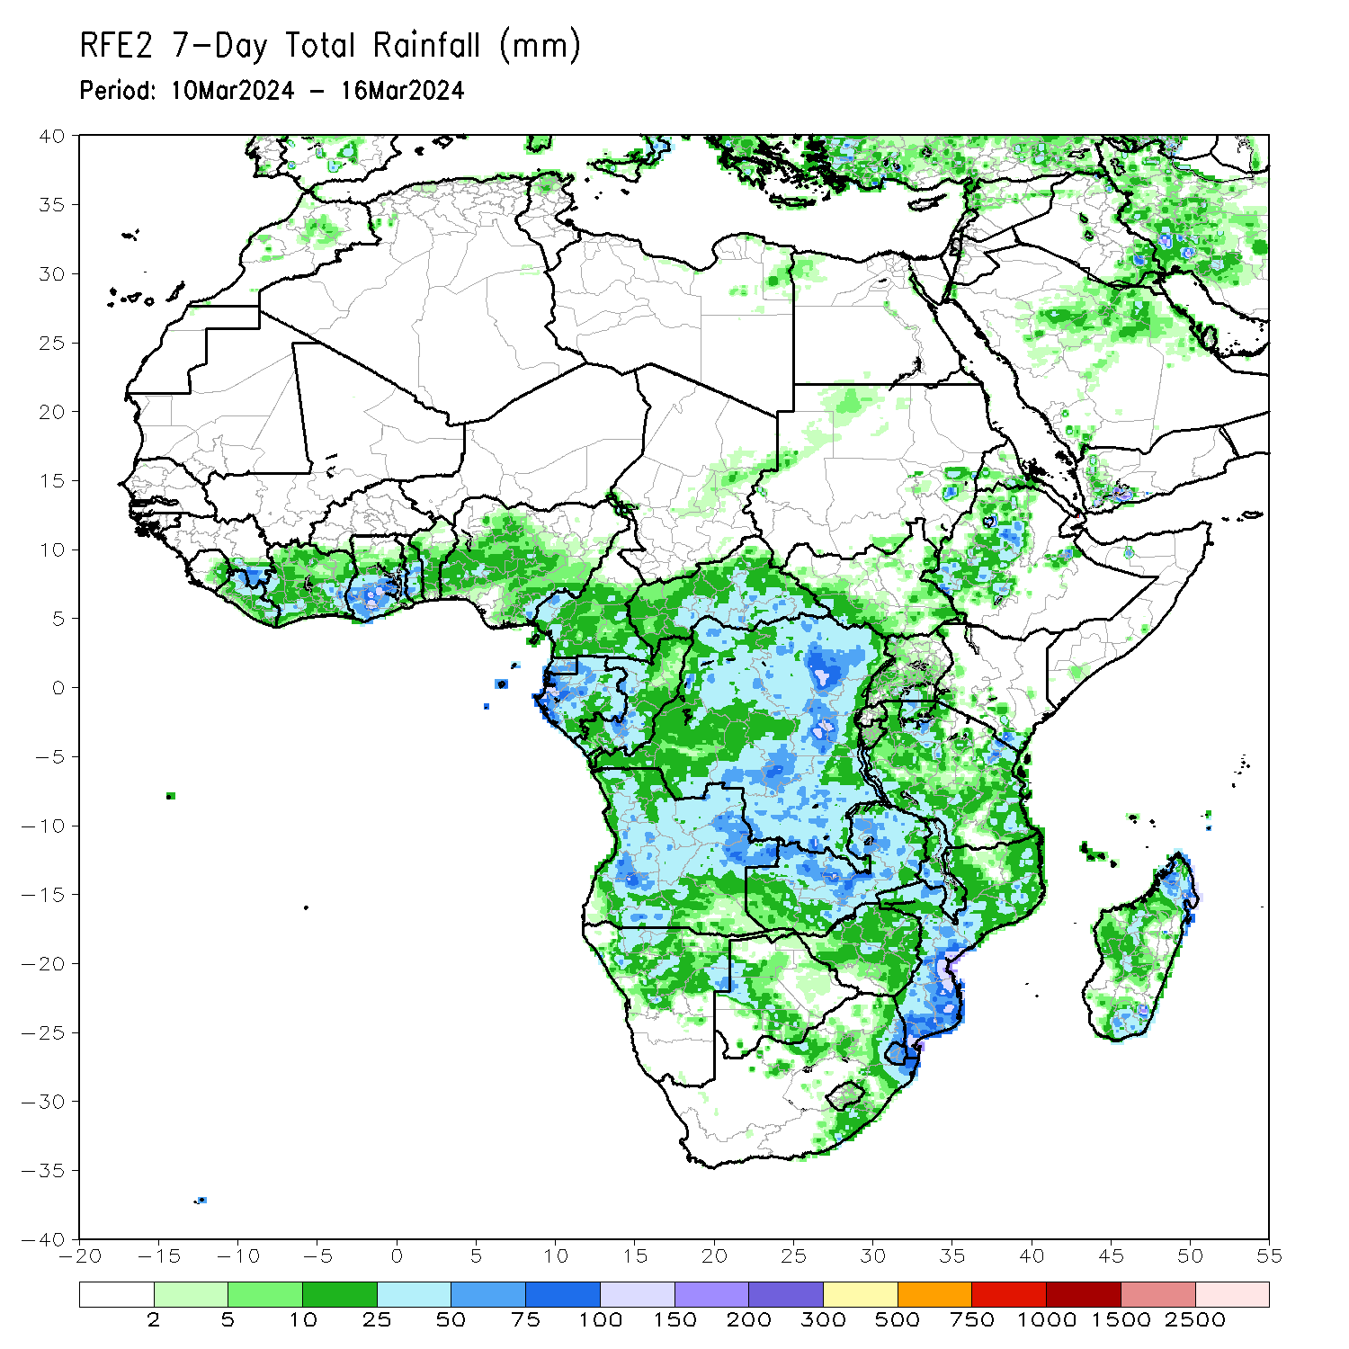
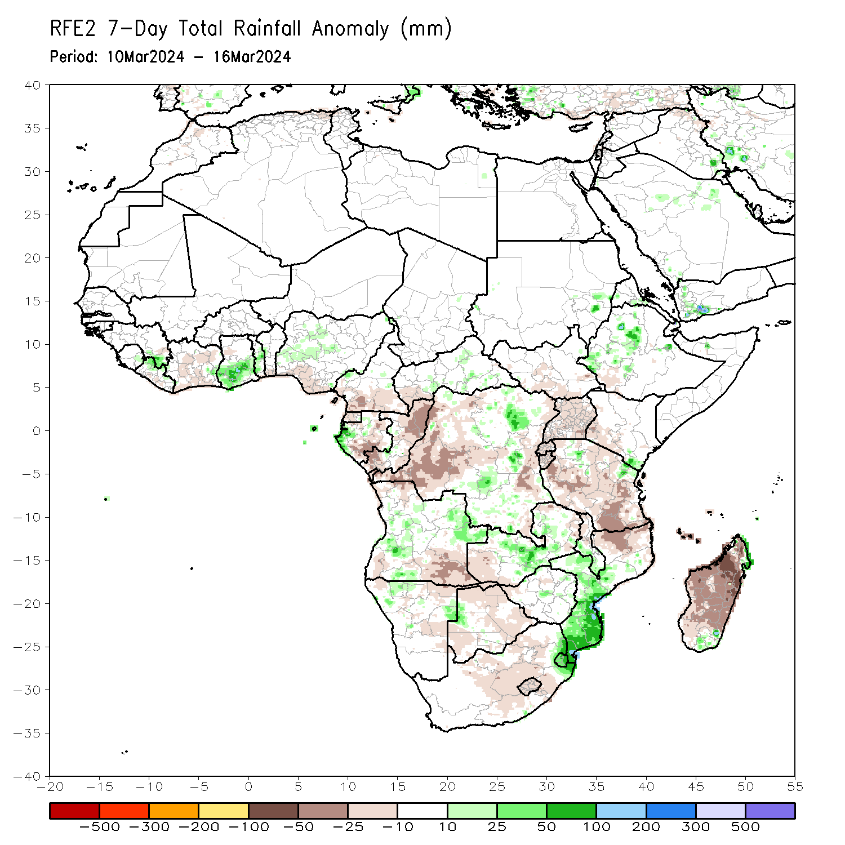
Rainfall Patterns: Last 7 Days
During the past 7 days, in East Africa, rainfall was above-average in southwestern and central Ethiopia, central Eritrea, and pockets of regions in southeastern Kenya, northeastern and northwestern Tanzania and eastern Sudan. Rainfall was below average in many parts of Uganda, Rwanda and Burundi, western, central, northern, southern and eastern Tanzania, southwestern Kenya, southern South Sudan, and pockets of the region in southern Ethiopia. In central Africa, rainfall was above-average in western Gabon, some parts of central and southern CAR, and northeastern and southern DRC. Rainfall was below-average in Equatorial Guinea, central and southern Gabon, southern Cameroon, northern, eastern, central and southern Congo, southwestern CAR, and western-central, southwestern and eastern DRC. In West Africa, rainfall was above-average in pockets of region in southeastern Guinea and northern Liberia, southern Ghana, central and southern Togo, and western-central Nigeria. Rainfall was below-average in central and southern Cote d’Ivoire, southern Liberia, and southern Nigeria. In southern Africa, rainfall was above-average in western-central and eastern Angola, central and southern Zambia, southern Malawi, central, western and southern Mozambique, Eswatini, and pockets of region in northern and eastern Namibia, western Botswana, eastern Zimbabwe, and southeastern Madagascar. Rainfall was below-average in northern and southeastern Angola, western and northern Zambia, northeastern and central-eastern Namibia, northern, southwestern, central and southeastern Botswana, western Zimbabwe, northern Mozambique, western and central South Africa, Lesotho, and many parts of Madagascar.

Slide 7
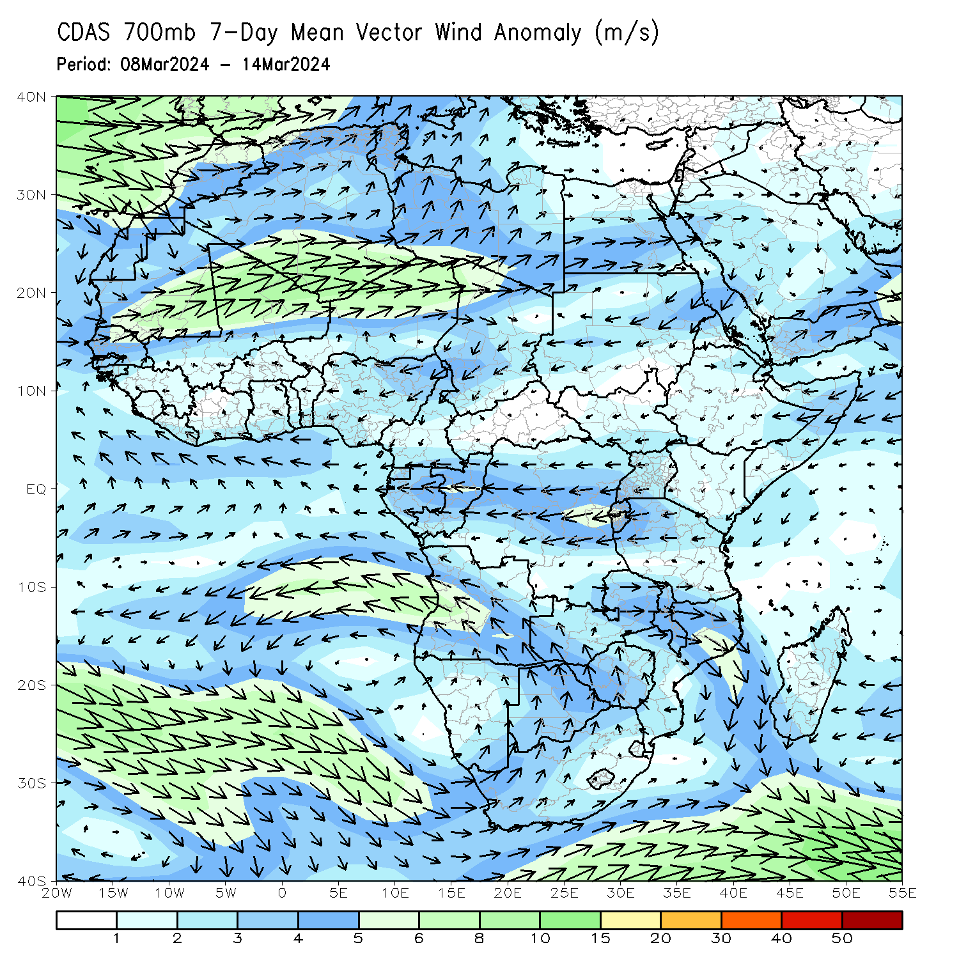
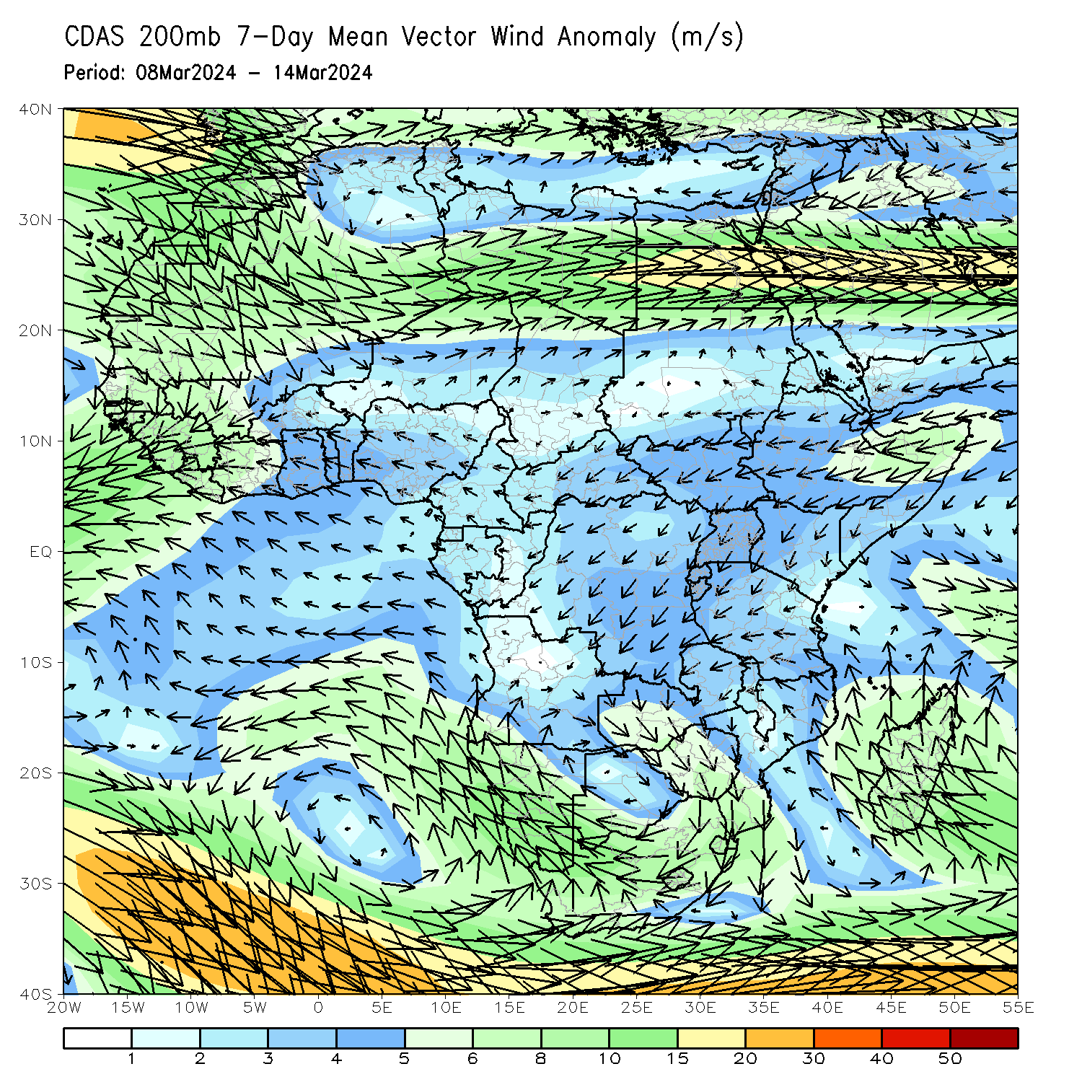
Atmospheric Circulation: Last 7 Days
At 700-hPa level (left panel), an area of lower-level cyclonic circulation was observed across Mozambique, Malawi, and eastern parts of Zimbabwe and Zambia that may have contributed to the observed above-average rainfall in Mozambique, southern Malawi, and eastern Zimbabwe. An area of anti-cyclonic circulation at 700hPa (left panel) was observed across southern and western South Africa, Namibia, western Botswana, and southern Angola that may have contributed to the observed below-average rainfall in western and central South Africa, southern, central and northern Botswana, central-eastern Namibia and southeastern Angola.

Slide 8
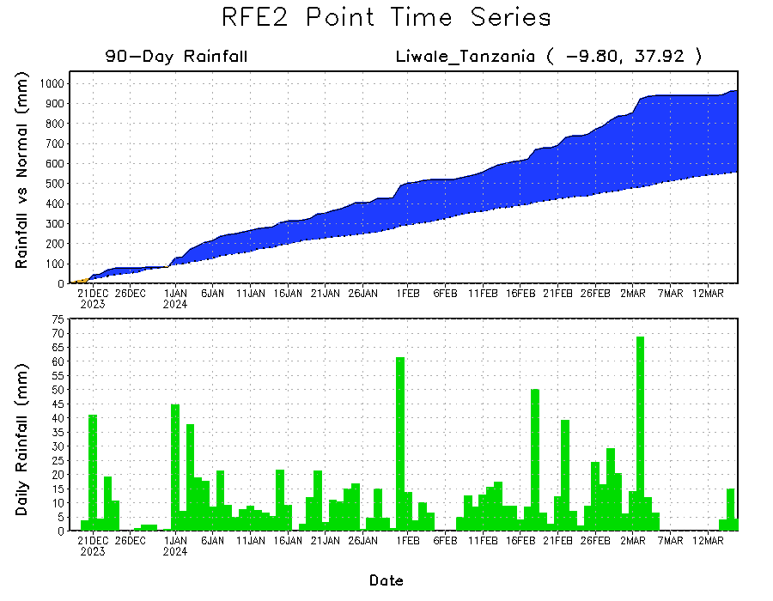
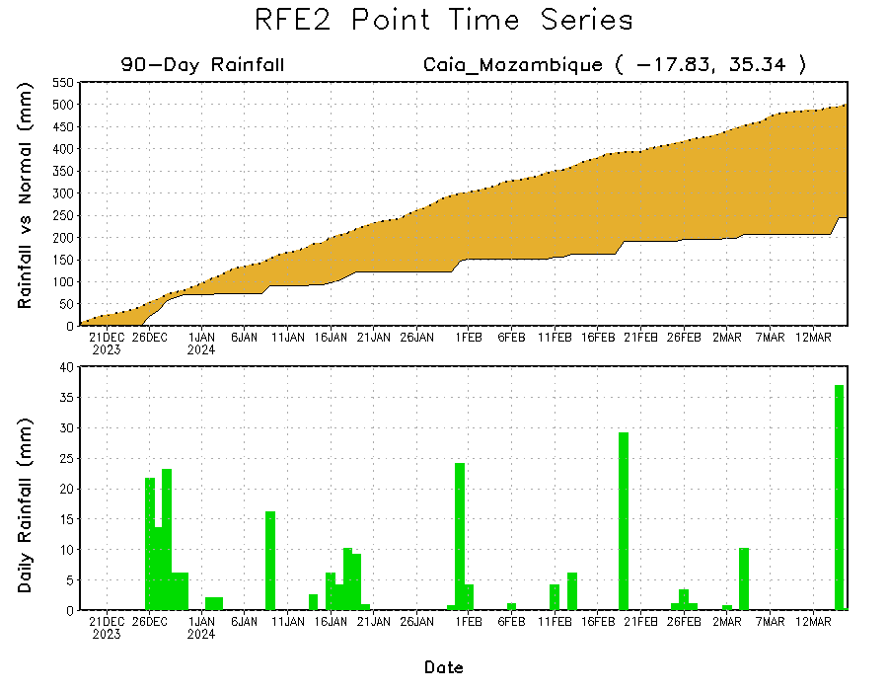
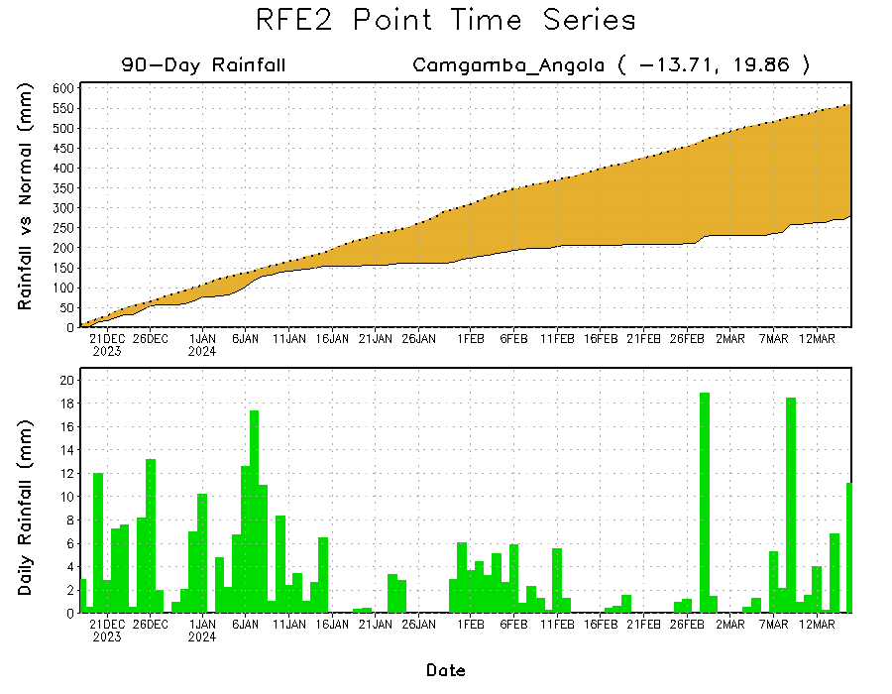
Rainfall Evolution
Daily evolution in rainfall at selected locations over the past 90 days shows growing deficits over parts of eastern Angola (bottom left) and central-eastern Mozambique (bottom right). Conversely, rainfall surpluses persist in central, southern and eastern Tanzania due to heavy and above-average rainfall during last 2 months (top right).

Slide 9
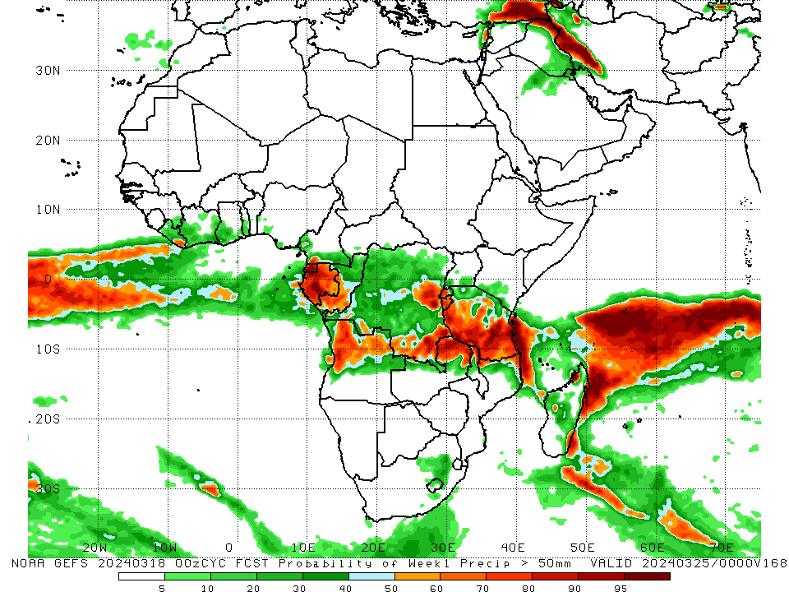
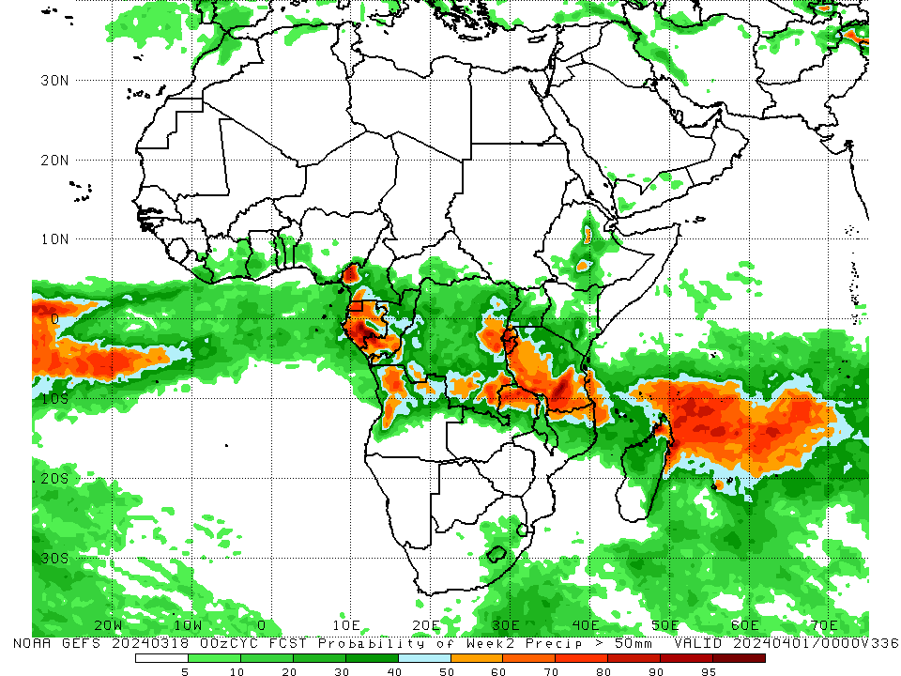
NCEP GEFS Model Forecasts Non-Bias Corrected Probability of precipitation exceedance
Week-1, Valid: 19 – 25 Mar 2024
Week-2, Valid: 26 Mar – 01 Apr 2024
For week-1 (left panel) the NCEP GEFS indicates a moderate to high chance (over 70%) for rainfall to exceed 50 mm over Equatorial Guinea, Gabon, southwestern Congo, some parts of northern and western-central Angola, southeastern and eastern DRC, western and central Rwanda, Burundi, western, central-southern and eastern Tanzania, northern parts of Zambia and Malawi, and some regions in northern Mozambique and southeastern and northwestern Madagascar. For week-2 (right panel), NCEP GEFS indicates a moderate to high chance (over 70%) for rainfall to exceed 50 mm in southwestern Cameroon, Equatorial Guinea, western and southern Gabon, southwestern Congo, many parts of Rwanda and Burundi, pockets of region in eastern and southeastern DRC, western and southern Tanzania, northern Zambia and pockets of northwestern Madagascar.
Notes:
9

Slide 10
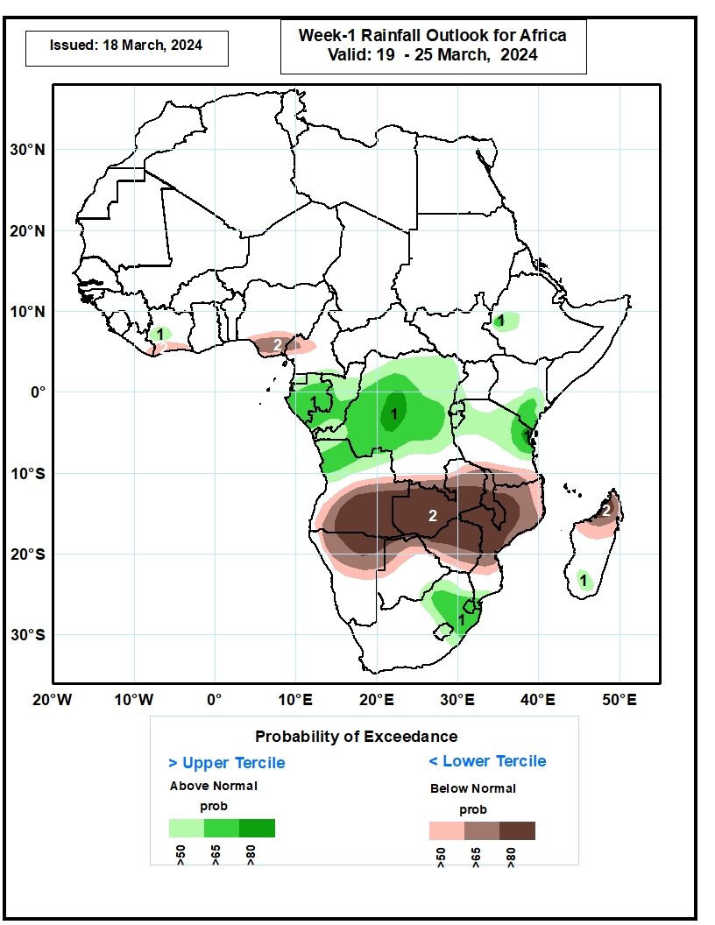
Week-1 Precipitation Outlooks
19 – 25 Mar 2024
The probabilistic forecasts call for above 50% chance for weekly rainfall to be above-normal (above the upper tercile) over west-central Cote d’Ivoire, Equatorial Guinea, Gabon, Congo, northern Angola, DRC, northern Tanzania, southern Kenya, west-central Ethiopia, eastern South Africa, Lesotho, southernmost Mozambique, and southern Madagascar. There is above 80% chance for above-normal rainfall over central DRC and northeastern Tanzania.
The probabilistic forecasts call for above 50% chance for weekly total rainfall to be below-normal (below the lower tercile) over southern Cote d’Ivoire, southern Nigeria, western Cameroon, southern Angola, northern Namibia, Zambia, northern Botswana, Zimbabwe, Malawi, and northern and central Mozambique, and northern Madagascar. There is above 80% chance for below-normal rainfall over southern Angola, northern Namibia, Zambia, southern Malawi, northern Zimbabwe, and central Mozambique.
Notes:
10

Slide 11
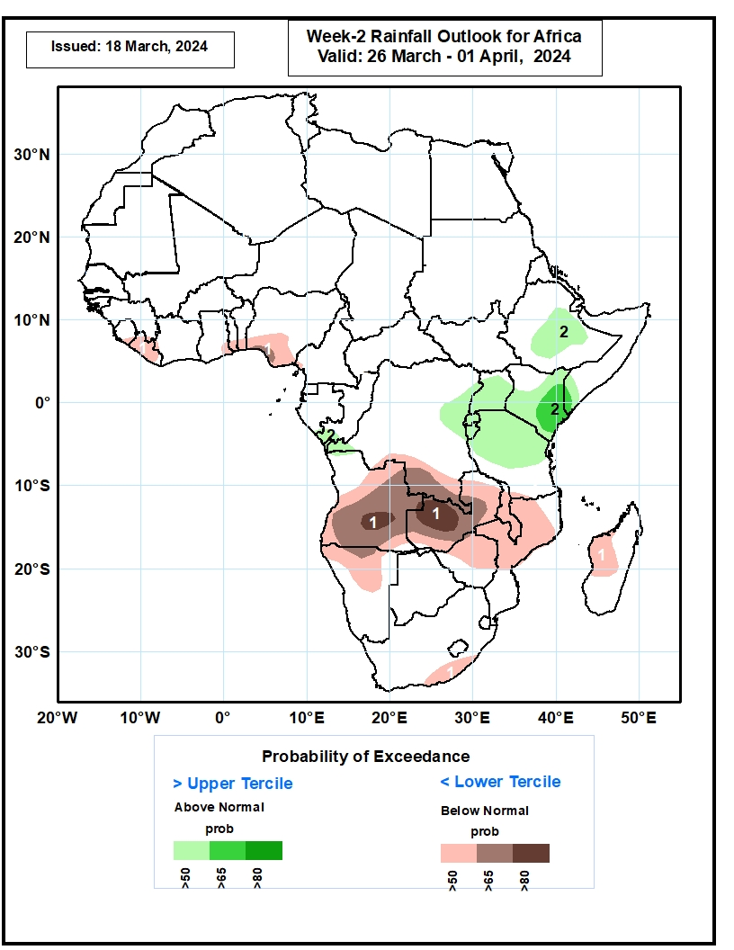
Week-2 Precipitation Outlooks
26 Mar – 01 Apr 2024
The probabilistic forecasts call for above 50% chance for weekly rainfall to be below-normal (below the lower tercile) over Liberia, southeastern Ghana, southern Togo, southern Benin, southern Nigeria, much of Angola, northern Namibia, southern DRC, much of Zambia, northern Zimbabwe, northern Mozambique, western Madagascar, and southeastern South Africa. There is above 80% chance for below-normal rainfall over southern Angola and western Zambia.
The probabilistic forecasts call for above 50% chance for weekly total rainfall to be above-normal (above the upper tercile) over southern Congo, westernmost and east-central DRC, Uganda Rwanda, Burundi, northern Tanzania, much of Kenya, southwestern Somalia, and central Ethiopia. There is above 65% chance for above-normal rainfall over southeastern Kenya and westernmost Somalia.
Notes:
11

Slide 12
Summary
Over the past 30 days, in East Africa, rainfall was above-average in southwestern, central and northeastern Ethiopia, central Eritrea, northwestern, western-central and southern Kenya, northern, central, southwestern and southern Tanzania, and pockets of region in central and southeastern Uganda and eastern Sudan. Rainfall was below-average in western, central-eastern, and southern South Sudan, northern and western Uganda, some parts of southern Ethiopia, northeastern Kenya, Rwanda, Burundi, and some regions in western and eastern Tanzania. In Central Africa, rainfall was above-average in some parts of western and eastern Gabon, western Congo, central Cameroon, some parts of central, southern and southeastern DRC, and northwestern Chad. Rainfall was below-average in southern Cameroon, Equatorial Guinea, central and southern Gabon, northern Congo, southwestern, southern, central and eastern CAR, and western-central, northwestern, northeastern and eastern DRC. In West Africa, rainfall was above-average in central and northern Cote d’Ivoire, southern parts of Ghana, Togo and Benin, and southwestern and central Nigeria. Rainfall was below-average in eastern parts of Guinea and Liberia, central and northeastern Sierra Leone, southwestern Cote d’Ivoire, northern Ghana, and pockets of region in southeastern Nigeria. In southern Africa, rainfall was above-average in western and northern Angola, some parts of northern Zambia, northern and central Malawi, pockets of region in northwestern and southeastern Mozambique, central and northern Eswatini, and southwestern and southern Madagascar. Rainfall was below-average in southern, southeastern and eastern Angola, many parts of Namibia, Botswana and South Africa, western, southern, central and eastern Zambia, Zimbabwe, Lesotho, southern Malawi, western, central and eastern Mozambique, and northwestern, northern and eastern Madagascar.
During the past 7 days, in East Africa, rainfall was above-average in southwestern and central Ethiopia, central Eritrea, and pockets of regions in southeastern Kenya, northeastern and northwestern Tanzania and eastern Sudan. Rainfall was below average in many parts of Uganda, Rwanda and Burundi, western, central, northern, southern and eastern Tanzania, southwestern Kenya, southern South Sudan, and pockets of the region in southern Ethiopia. In central Africa, rainfall was above-average in western Gabon, some parts of central and southern CAR, and northeastern and southern DRC. Rainfall was below-average in Equatorial Guinea, central and southern Gabon, southern Cameroon, northern, eastern, central and southern Congo, southwestern CAR, and western-central, southwestern and eastern DRC. In West Africa, rainfall was above-average in pockets of region in southeastern Guinea and northern Liberia, southern Ghana, central and southern Togo, and western-central Nigeria. Rainfall was below-average in central and southern Cote d’Ivoire, southern Liberia, and southern Nigeria. In southern Africa, rainfall was above-average in western-central and eastern Angola, central and southern Zambia, southern Malawi, central, western and southern Mozambique, Eswatini, and pockets of region in northern and eastern Namibia, western Botswana, eastern Zimbabwe, and southeastern Madagascar. Rainfall was below-average in northern and southeastern Angola, western and northern Zambia, northeastern and central-eastern Namibia, northern, southwestern, central and southeastern Botswana, western Zimbabwe, northern Mozambique, western and central South Africa, Lesotho, and many parts of Madagascar.
The Week-1 outlook calls for above-average rainfall in Equatorial Guinea, Gabon, Congo, DRC, Rwanda, Burundi, Tanzania, northern Angola, and central South Africa. In contrast, there is an increased chance for below-average in many parts of southern Africa, Madagascar, Toga, central and southern Benin, southern parts of Nigeria and Cameroon, western CAR, Uganda, western, central and northern Kenya, central-eastern and southern Ethiopia, and southwestern Somalia. The Week-2 outlook calls for above-normal rainfall in many parts of central Africa, central Ethiopia, eastern Kenya, northern Angola, central South Africa, and Lesotho. In contrast, there is an increased chance for below-average in many parts of southern Africa, western and southern Madagascar, Sierra Leone, Liberia, western and northern Cote d’Ivoire, and central Uganda.

