Slide 1
The African Monsoon Recent Evolution and Current Status Include Week-1 and Week-2 Outlooks
Update prepared
25 March 2024
For more information, visit:
http://www.cpc.ncep.noaa.gov/products/Global_Monsoons/African_Monsoons/precip_monitoring.shtml

Slide 2
Outline
Highlights
Recent Evolution and Current Conditions
NCEP GEFS Forecasts
Summary

Slide 3
Highlights: Last 7 Days
During the past 7 days, in East Africa, rainfall was above-average in western Ethiopia, northwestern Eritrea, pockets of southeastern Kenya, some parts of western, southern and eastern Tanzania, and western and southern Burundi. Rainfall was below average in central and southern Ethiopia, southern and southeastern South Sudan, and Uganda, many parts of Rwanda, northwestern and central Tanzania, and western Kenya. In central Africa, rainfall was above-average in western and northeastern Gabon, central and southern Congo, and southwestern, central-southern and southeastern Democratic Republic of the Congo (DRC). Rainfall was below-average in Equatorial Guinea, western and southern Cameroon, northern Congo, southwestern Central African Republic (CAR), and northwestern, central, northeastern and in for southern DRC. In West Africa, rainfall was above-average in western Cote d’Ivoire, southern Ghana and pockets of southern Mali and Nigeria. Rainfall was below-average in southeastern Liberia, central parts of Ghana, Togo and Benin, and southeastern and southwestern Nigeria. In southern Africa, rainfall was above-average in northwestern, northern and northeastern Angola, some parts of northern and Zambia and Malawi, southern and northeastern Mozambique, southeastern Namibia, some parts of southern and central South Africa, southern and central Eswatini, and pockets of southeastern Madagascar. Rainfall was below-average in southern and southeastern Angola, northern Namibia, western, central, and southern Zambia, central and southern Malawi, western, central and some parts of northern Mozambique, northern Botswana, northern, central and eastern Zimbabwe, central-eastern South Africa, Lesotho, and many parts of Madagascar.
The Week-1 outlook calls for above-average rainfall in central, northern, southern and eastern DRC, Uganda, Rwanda, Burundi, Tanzania, central and southern Ethiopia, Kenya, southern Somalia, northern Angola, central Namibia, southeastern South Africa, northeastern region of Madagascar due to tropical cyclone development, and northern Cote d’Ivoire. In contrast, there is an increased chance for below-average in many parts of southern Africa, Madagascar, and southern parts of the Gulf of Guinea Countries. The Week-2 outlook calls for above-normal rainfall in central and southern Cameroon, northern and southern Gabon, northern Congo, southern CAR, southern, eastern, and northern DRC, southern South Sudan, Uganda, Rwanda, Burundi, Tanzania, Kenya, central, southern and eastern Ethiopia, southern Somalia, northern parts of Zambia, Angola and Ghana. In contrast, there is an increased chance for below-average in many parts of southern Africa, Madagascar, southern parts of the Gulf of Guinea Countries.

Slide 4
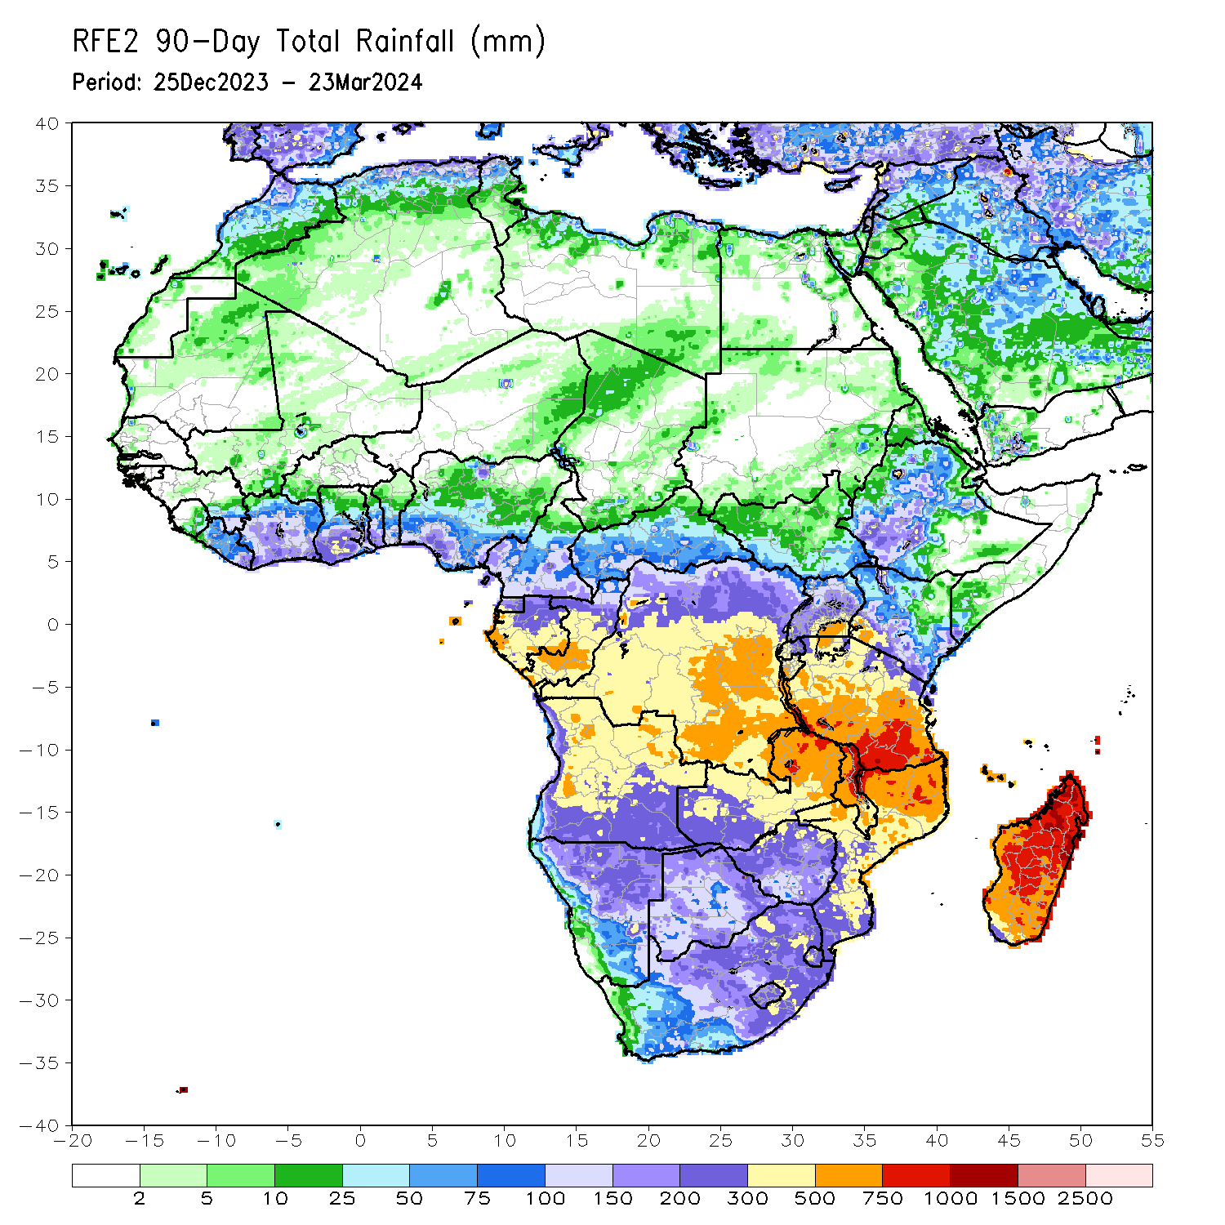
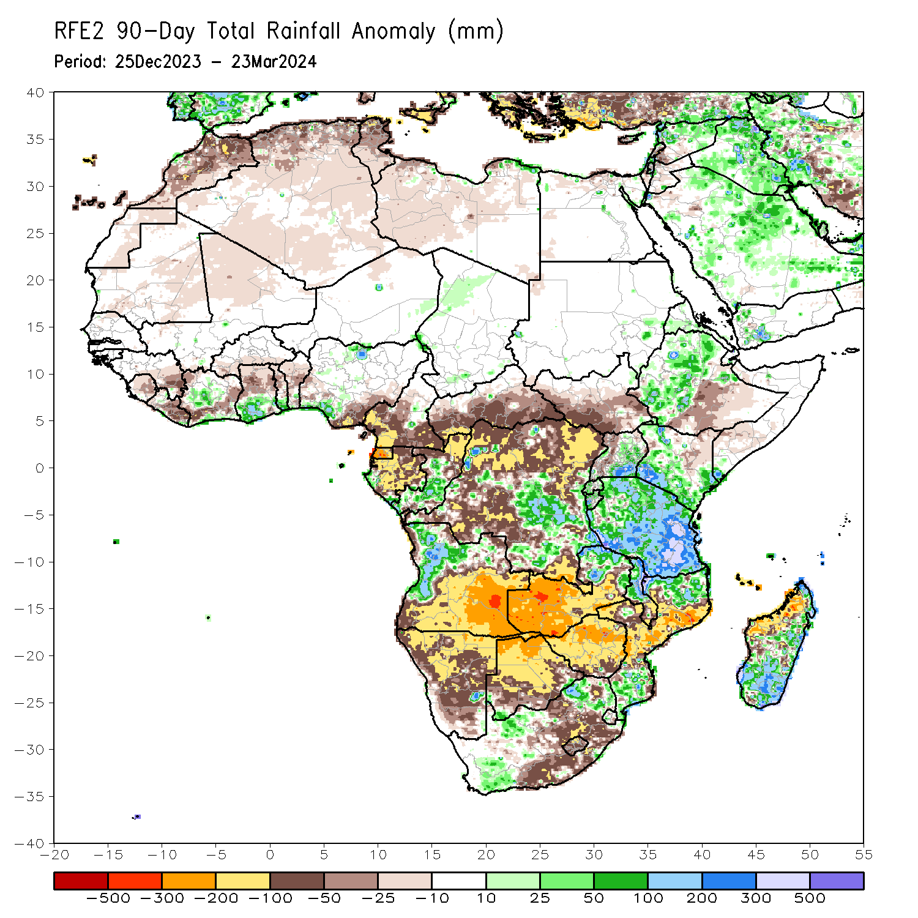
Rainfall Patterns: Last 90 Days
Over the past 90 days, in East Africa, rainfall was above-average in parts of northern, western-central and southwestern Ethiopia, northwestern and central Eritrea, northwestern, southern and southeastern Kenya, central and southeastern Uganda, many parts of Tanzania and Burundi, western and eastern Rwanda, and pockets of southern Somalia. Rainfall was below-average in western, southern, central and eastern South Sudan, central-southern Ethiopia, western Somalia, and central-northeastern Kenya. In Central Africa, rainfall was above-average in some regions in central and southeastern Democratic Republic of the Congo (DRC), western and central Congo, and pockets of region in southern Gabon. Rainfall was below-average in western and southern Cameroon, Equatorial Guinea, and many parts of Gabon, northern Congo, western, southern, central and eastern Central African Republic (CAR), and many parts of northern, western, northeastern, southwestern and southern DRC. In West Africa, rainfall was above-average in central Cote d’Ivoire, southern parts of Ghana and Togo, and pockets of region in southern and northern Nigeria. Rainfall was below-average in eastern Guinea, Sierra Leone, central and eastern Liberia, western, southern and eastern Cote d’Ivoire, northern parts of Ghana, Togo and Benin, southern Burkina Faso, southeastern Nigeria, northern Mali, and central-eastern Mauritania. In southern Africa, rainfall was above-average over western Angola, northern Zambia, northern and central Malawi, some regions in northern and southern Mozambique, some parts of northern, southwestern and southeastern South Africa, and southern, central and eastern Madagascar. Rainfall was below-average across southern, central, and eastern Angola, many parts of Namibia, Botswana, Zimbabwe and Lesotho, western, central, southern and eastern Zambia, southern Malawi, and eastern, central and western Mozambique, some parts of western-central and eastern South Africa, central-southeastern Eswatini, and western Madagascar.
Notes:
4

Slide 5
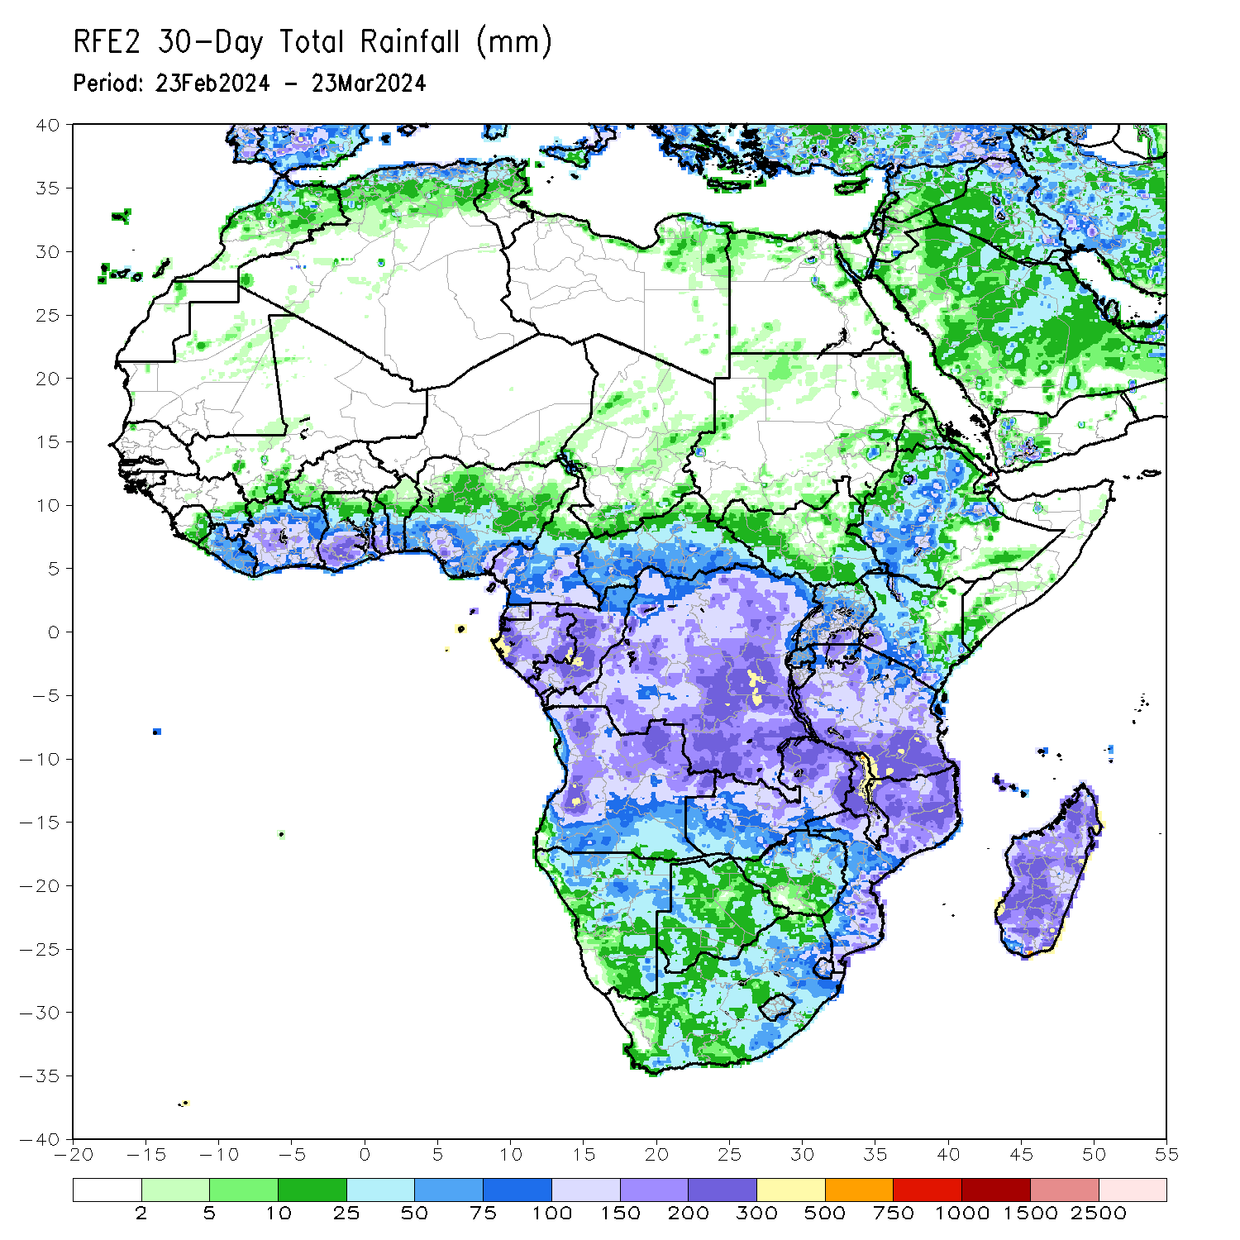
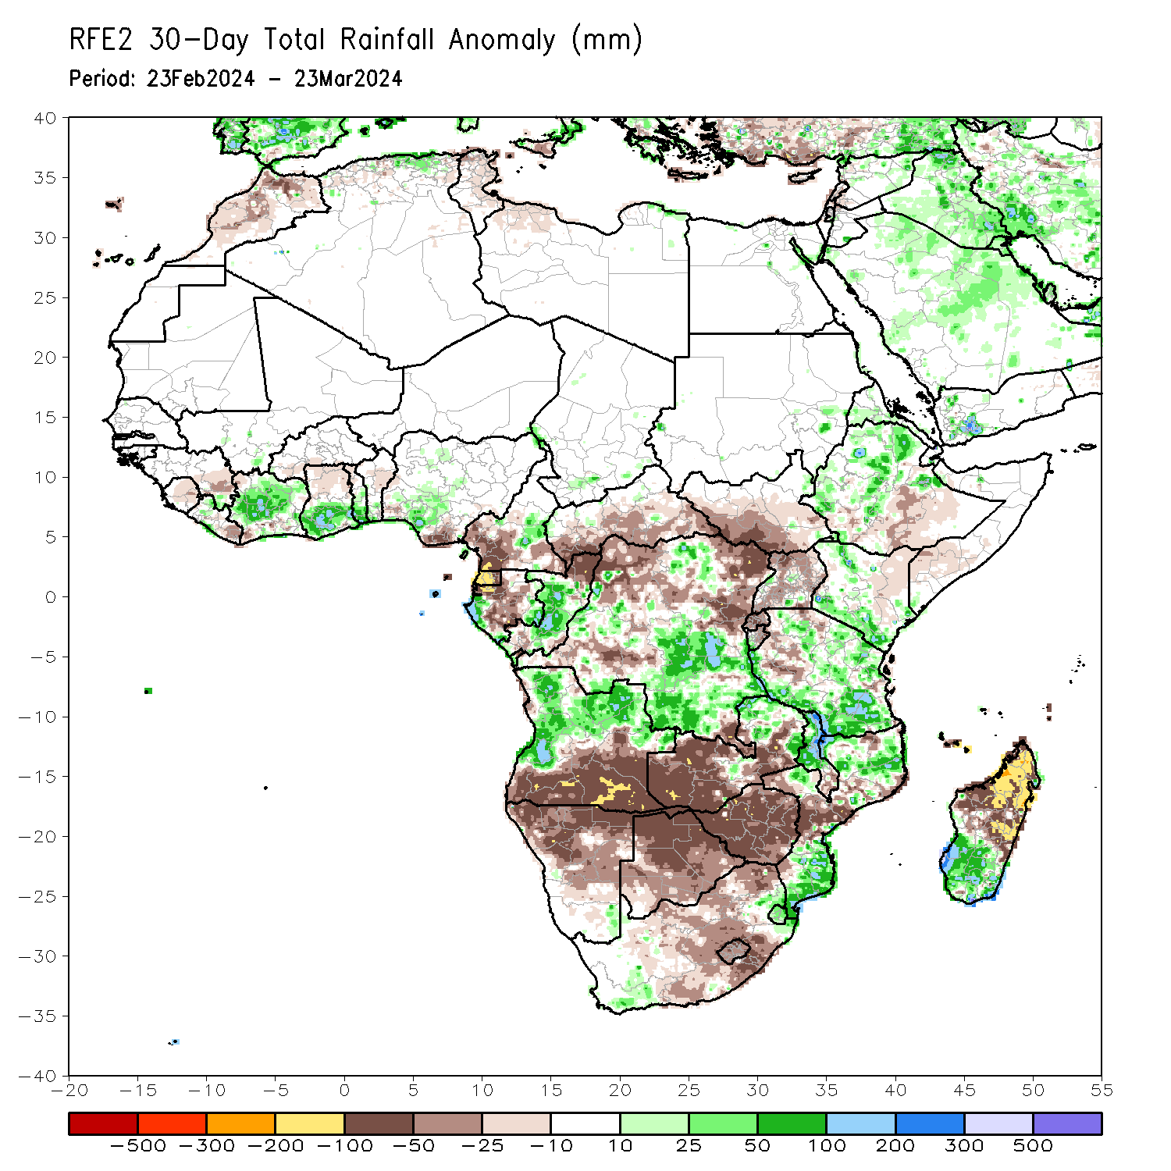
Rainfall Patterns: Last 30 Days
Over the past 30 days, in East Africa, rainfall was above-average in northern, western and central Ethiopia, northwestern and central Eritrea, northwestern, central and southern Kenya, many parts of northern, central, southwestern, southern and eastern Tanzania, and pockets of region in eastern Sudan and southwestern Burundi. Rainfall was below-average in western, central-eastern, and southern South Sudan, many parts of northern, central-eastern and southwestern Uganda, southern-central Ethiopia, northeastern Kenya, Rwanda, northern and eastern Burundi, and some regions in western Tanzania. In Central Africa, rainfall was above-average in some parts of western Gabon, western and central Congo, central-eastern Cameroon, and some parts of central, southern and southeastern DRC. Rainfall was below-average in southern Cameroon, Equatorial Guinea, central and southern Gabon, northern Congo, southwestern, southern, central and eastern CAR, and northwestern, northeastern, southwestern and eastern DRC. In West Africa, rainfall was above-average in western-central and northern Cote d’Ivoire, southern parts of Ghana, Togo and Benin, northwestern Liberia, and southern Nigeria. Rainfall was below-average in eastern parts of Guinea, central and northern Sierra Leone, eastern Liberia, southwestern Cote d’Ivoire, northern parts of Ghana and Togo, central Benin, southwestern Burkina Faso, and southeastern Nigeria. In southern Africa, rainfall was above-average in many parts of western, northern and northeastern Angola, some parts of northern Zambia, northern and central Malawi, and some parts of northern and southeastern Mozambique, Eswatini, southeastern South Africa, and southwestern and southern Madagascar. Rainfall was below-average in southern and southeastern Angola, northern, central and eastern Namibia, Botswana, and Zimbabwe, many parts of western, southern and central Zambia, central Mozambique, southern Malawi, northwestern, western, central and eastern South Africa, Lesotho, and northwestern, northern and central-eastern Madagascar.
Notes:
5

Slide 6
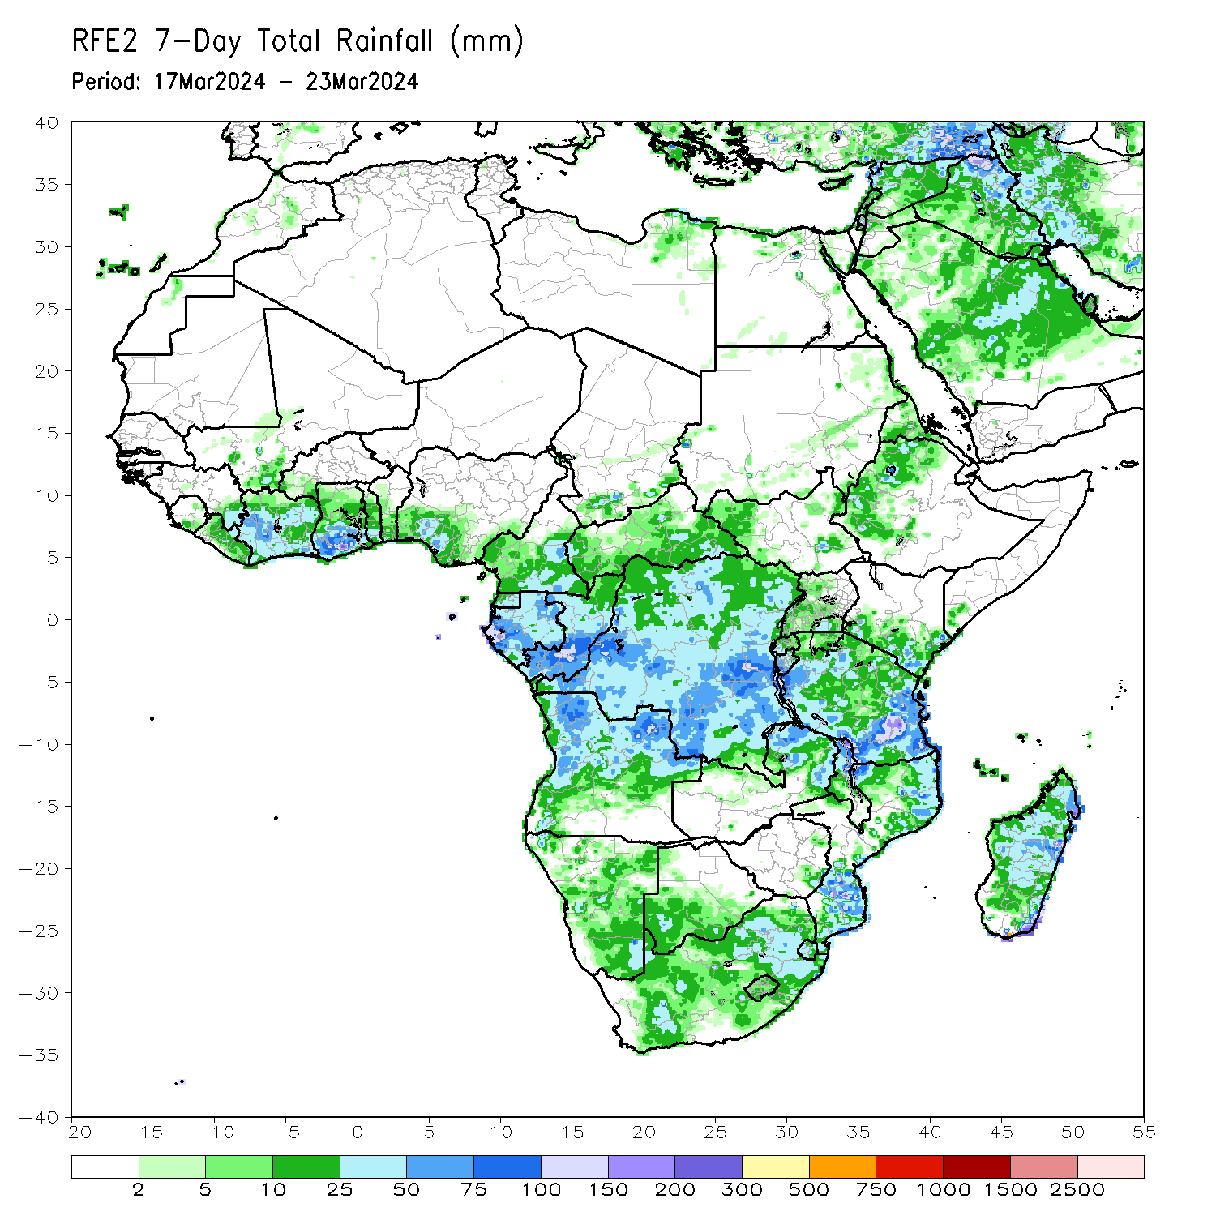
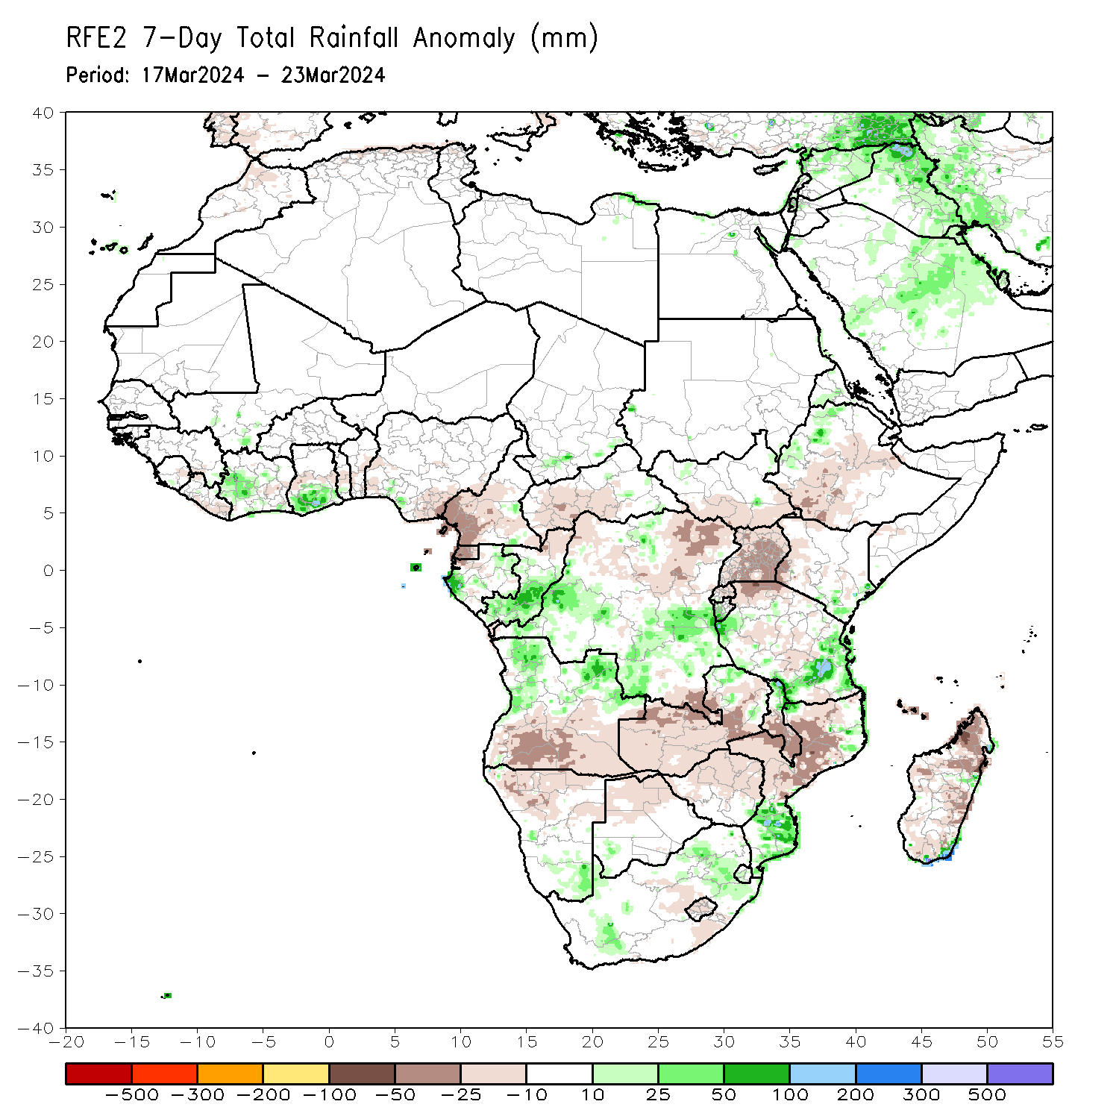
Rainfall Patterns: Last 7 Days
During the past 7 days, in East Africa, rainfall was above-average in western Ethiopia, northwestern Eritrea, pockets of southeastern Kenya, some parts of western, southern and eastern Tanzania, and western and southern Burundi. Rainfall was below average in central and southern Ethiopia, southern and southeastern South Sudan, and Uganda, many parts of Rwanda, northwestern and central Tanzania, and western Kenya. In central Africa, rainfall was above-average in western and northeastern Gabon, central and southern Congo, and southwestern, central-southern and southeastern Democratic Republic of the Congo (DRC). Rainfall was below-average in Equatorial Guinea, western and southern Cameroon, northern Congo, southwestern Central African Republic (CAR), and northwestern, central, northeastern and in for southern DRC. In West Africa, rainfall was above-average in western Cote d’Ivoire, southern Ghana and pockets of southern Mali and Nigeria. Rainfall was below-average in southeastern Liberia, central parts of Ghana, Togo and Benin, and southeastern and southwestern Nigeria. In southern Africa, rainfall was above-average in northwestern, northern and northeastern Angola, some parts of northern and Zambia and Malawi, southern and northeastern Mozambique, southeastern Namibia, some parts of southern and central South Africa, southern and central Eswatini, and pockets of region in southeastern Madagascar. Rainfall was below-average in southern and southeastern Angola, northern Namibia, western, central, and southern Zambia, central and southern Malawi, western, central and some parts of northern Mozambique, northern Botswana, northern, central and eastern Zimbabwe, central-eastern South Africa, Lesotho, and many parts of Madagascar.

Slide 7
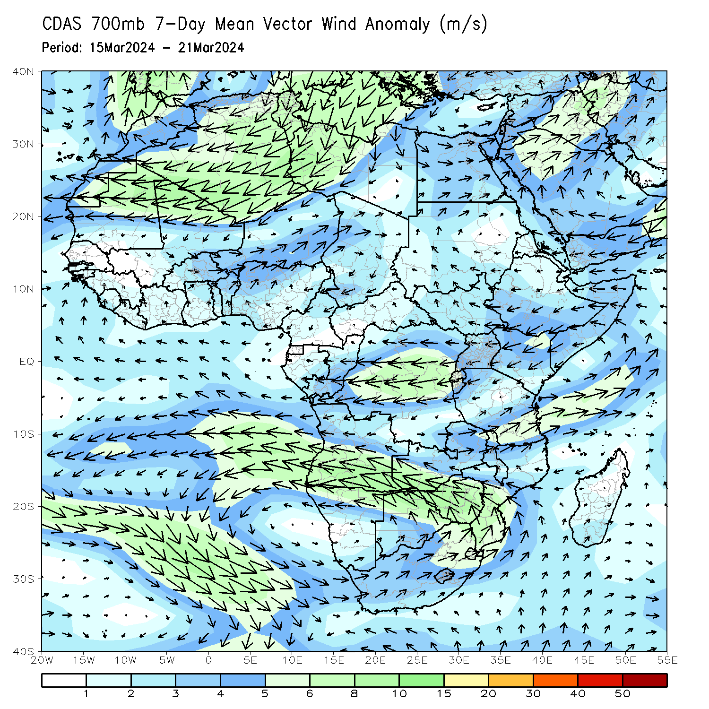
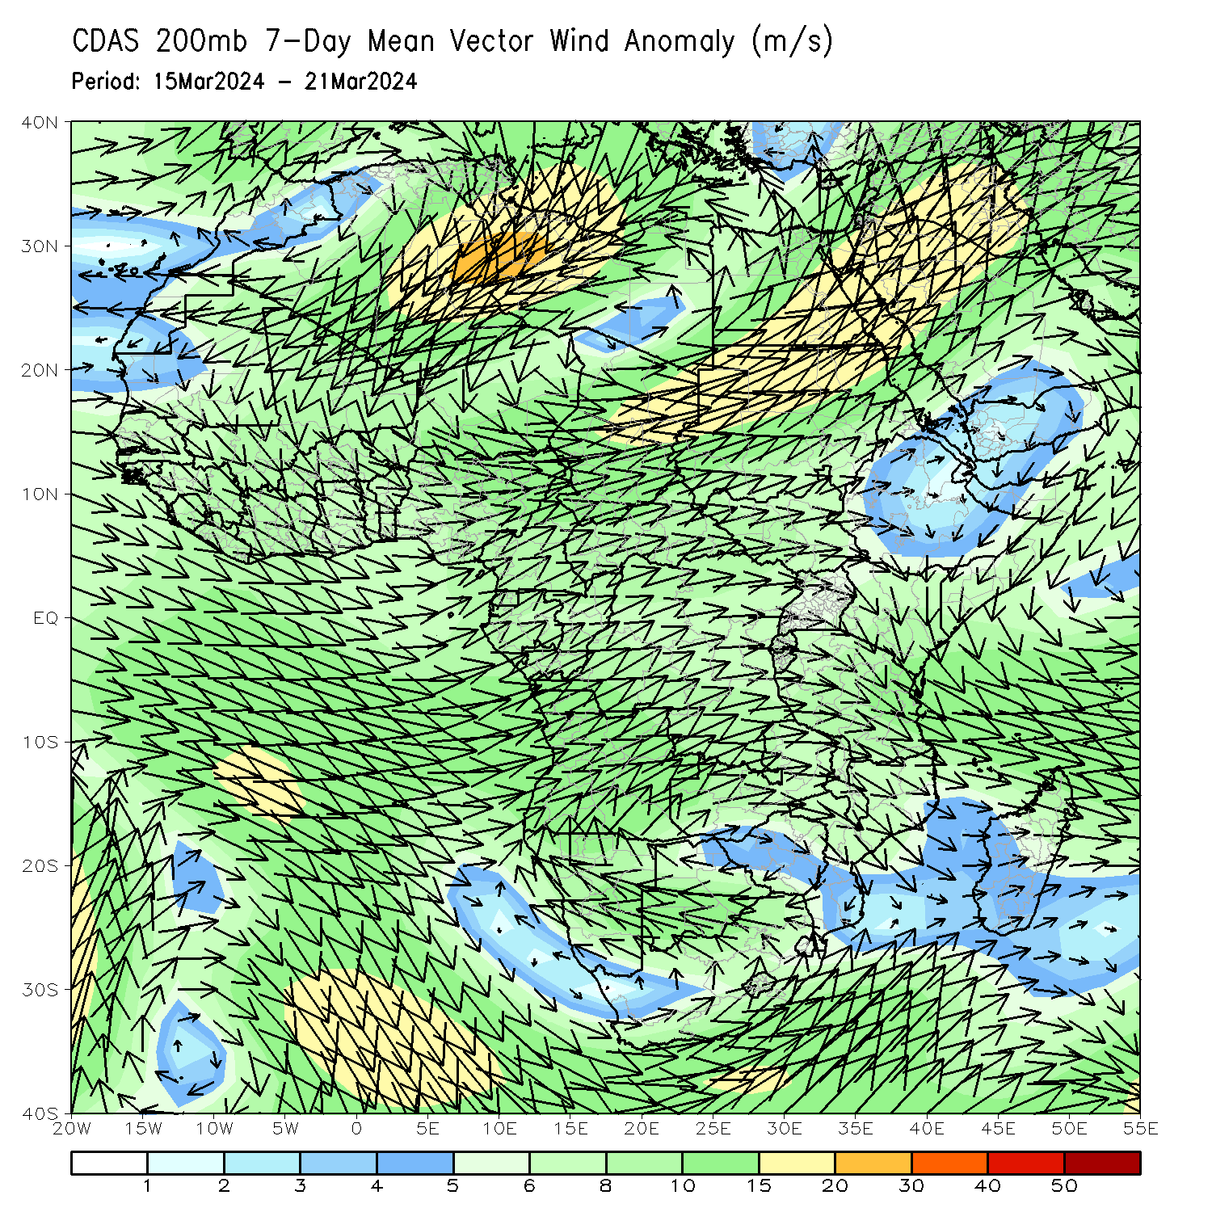
Atmospheric Circulation: Last 7 Days
At 700-hPa level (left panel), an area of anti-cyclonic circulation at 700hPa (left panel) was observed across South Africa that may have contributed to the observed below-average rainfall in southern Angola, northern parts of Namibia and Botswana, western, central and southern Zambia, and central and northern Zimbabwe, southern Malawi, and western Mozambique. Anomalous wind convergence at 700hPa across central and southern Congo, northern Angola, and western DRC may have contributed to the observed rainfall increases across central and southern Congo, northern Angola, and western DRC.

Slide 8
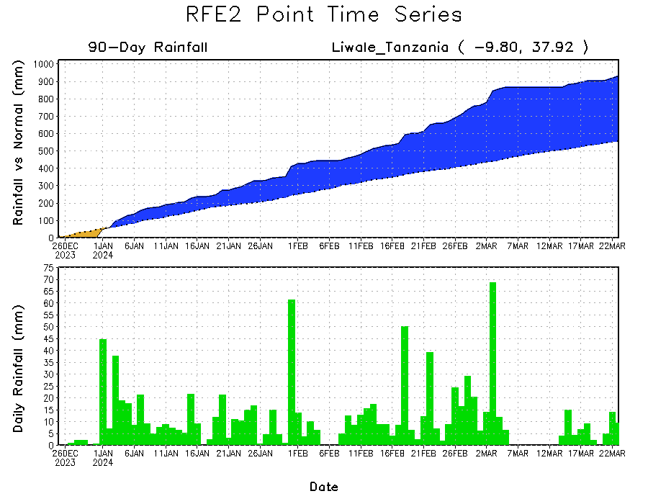
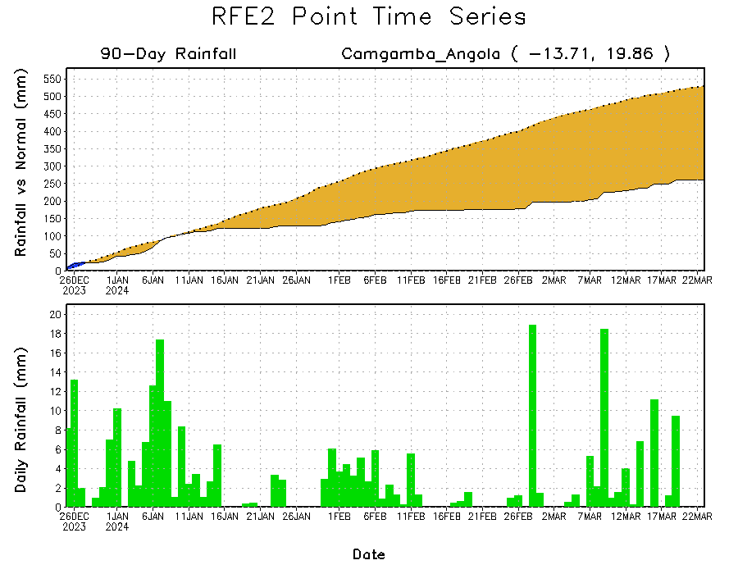
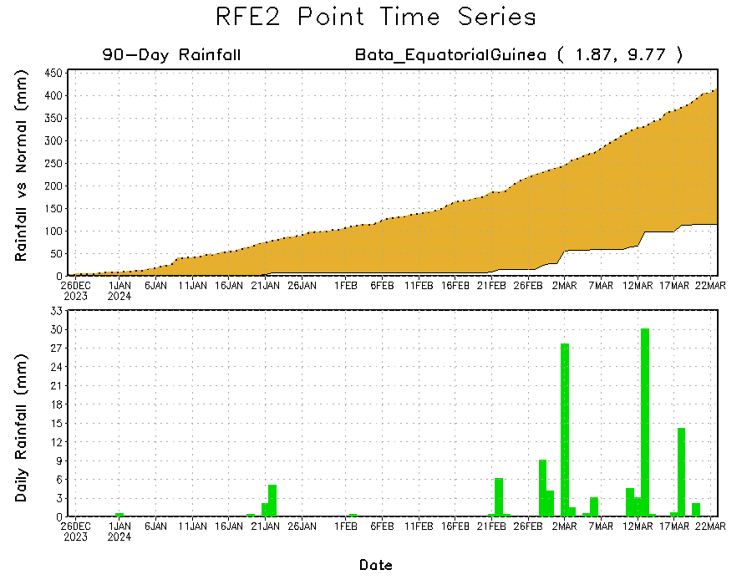
Rainfall Evolution
Daily evolution in rainfall at selected locations over the past 90 days shows growing deficits over much of Equatorial Guinea (bottom left) and eastern Angola (bottom right). Conversely, rainfall surpluses persist in central, southern and eastern Tanzania due to heavy and above-average rainfall during last 2 months (top right).

Slide 9
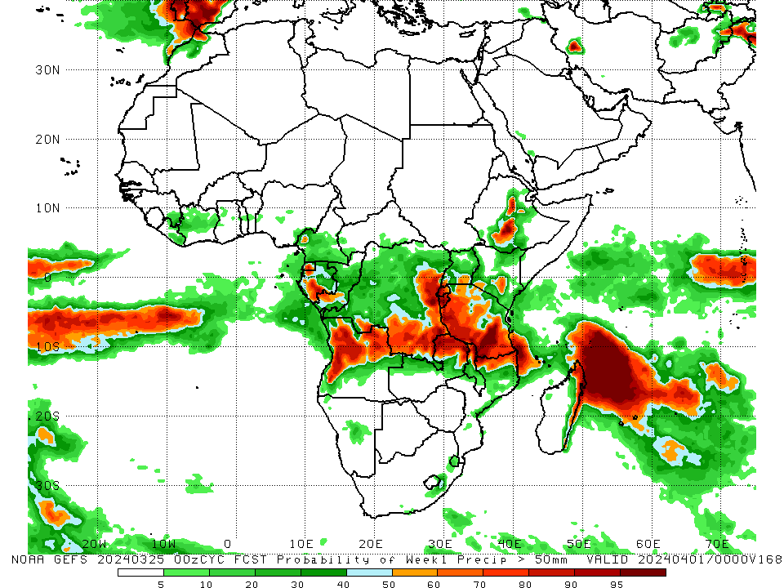
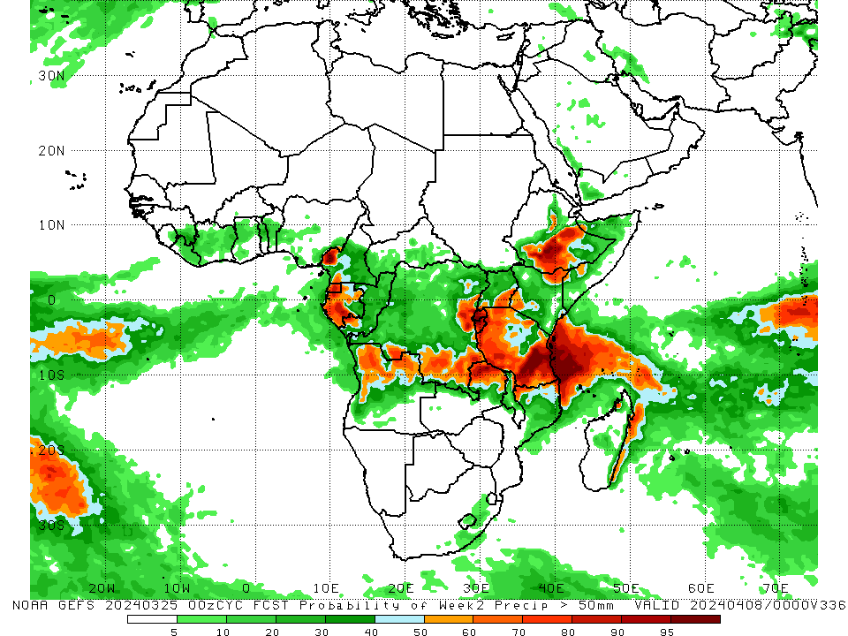
NCEP GEFS Model Forecasts Non-Bias Corrected Probability of precipitation exceedance
Week-1, Valid: 26 Mar – 01 Apr 2024
Week-2, Valid: 02 Apr – 08 Apr 2024
For week-1 (left panel) the NCEP GEFS indicates a moderate to high chance (over 70%) for rainfall to exceed 50 mm over Equatorial Guinea, southern Gabon, western, central and northeastern Angola, southern and eastern DRC, Rwanda, Burundi, western, southern and southeastern Tanzania, northern parts of Zambia, Malawi and Mozambique, northern and eastern Madagascar and central-southern Ethiopia. For week-2 (right panel), NCEP GEFS indicates a moderate to high chance (over 70%) for rainfall to exceed 50 mm in southwestern Cameroon, Equatorial Guinea, western and southern Gabon, southwestern Congo, southern, eastern and southeastern DRC, Rwanda, Burundi, western, northwestern, southern and eastern Tanzania, northern Zambia, central and southern Ethiopia, and northeastern Kenya.
Notes:
9

Slide 10
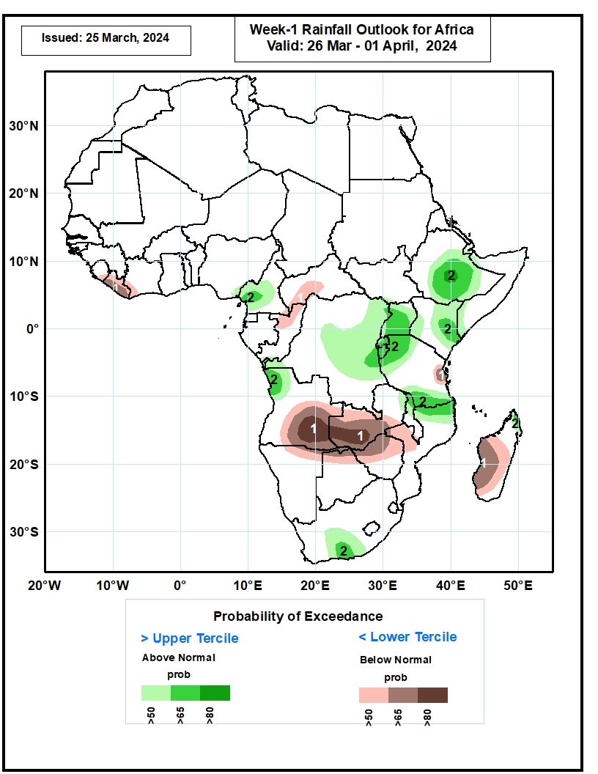
Week-1 Precipitation Outlooks
26 Mar – 01 Apr 2024
The probabilistic forecasts call for above 50% chance for weekly total rainfall to be below-normal (below the lower tercile) over southern Sierra Leone, Liberia, western Cote d’Ivoire, southern and central CAR, northern Congo, east-central Tanzania, southern Angola, northern Namibia, Zambia, northern Botswana, Zimbabwe, western Mozambique, and southern Madagascar. There is above 80% chance for below-normal rainfall over southern Angola and western Zambia.
The probabilistic forecasts call for above 50% chance for weekly rainfall to be above-normal (above the upper tercile) over southern Cameroon, northwestern Angola, westernmost and eastern DRC, Uganda, Rwanda, Burundi, northern and southern Tanzania, northern Malawi, northern Mozambique, central Ethiopia, eastern Kenya, south-central South Africa, and northernmost Madagascar. There is above 80% chance for above-normal rainfall over central Ethiopia.
Notes:
10

Slide 11
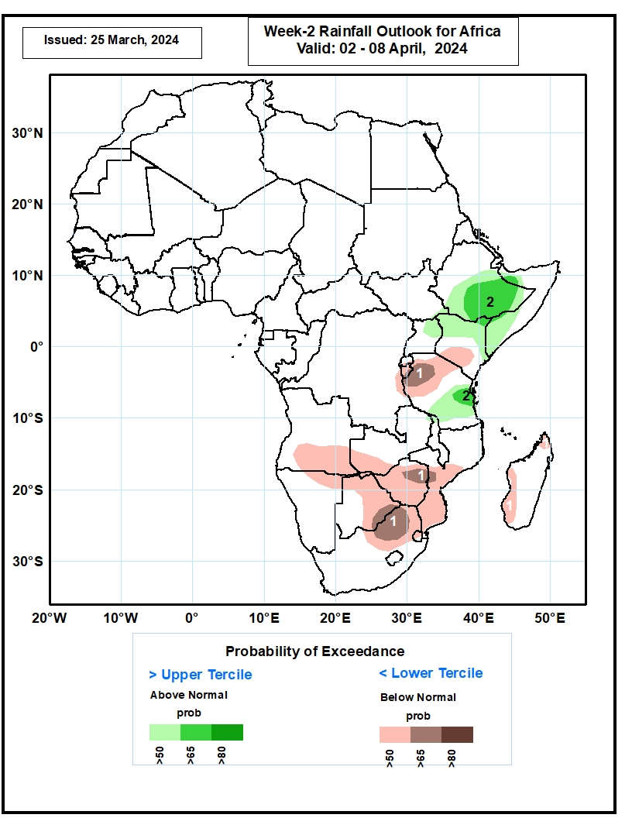
Week-2 Precipitation Outlooks
02 – 08 Apr 2024
The probabilistic forecasts call for above 50% chance for weekly rainfall to be below-normal (below the lower tercile) over Burundi, northern Tanzania, southern Kenya, southern Angola, northern Namibia, southwest Zambia, Zimbabwe, eastern Botswana, southern Mozambique, northeast South Africa, northern and western Madagascar. There is above 65% chance for below-normal rainfall over northern Tanzania, northeastern Zimbabwe, southeast Botswana, and northern South Africa.
The probabilistic forecasts call for above 50% chance for weekly total rainfall to be above-normal (above the upper tercile) over southern Ethiopia, northern Kenya, eastern Uganda, southern and northern Somalia, and southern Tanzania. There is above 65% chance for above-normal rainfall over southern Ethiopia and eastern Tanzania.
Notes:
11

Slide 12
Summary
Over the past 30 days, in East Africa, rainfall was above-average in northern, western and central Ethiopia, northwestern and central Eritrea, northwestern, central and southern Kenya, many parts of northern, central, southwestern, southern and eastern Tanzania, and pockets of region in eastern Sudan and southwestern Burundi. Rainfall was below-average in western, central-eastern, and southern South Sudan, many parts of northern, central-eastern and southwestern Uganda, southern-central Ethiopia, northeastern Kenya, Rwanda, northern and eastern Burundi, and some regions in western Tanzania. In Central Africa, rainfall was above-average in some parts of western Gabon, western and central Congo, central-eastern Cameroon, and some parts of central, southern and southeastern DRC. Rainfall was below-average in southern Cameroon, Equatorial Guinea, central and southern Gabon, northern Congo, southwestern, southern, central and eastern CAR, and northwestern, northeastern, southwestern and eastern DRC. In West Africa, rainfall was above-average in western-central and northern Cote d’Ivoire, southern parts of Ghana, Togo and Benin, northwestern Liberia, and southern Nigeria. Rainfall was below-average in eastern parts of Guinea, central and northern Sierra Leone, eastern Liberia, southwestern Cote d’Ivoire, northern parts of Ghana and Togo, central Benin, southwestern Burkina Faso, and southeastern Nigeria. In southern Africa, rainfall was above-average in many parts of western, northern and northeastern Angola, some parts of northern Zambia, northern and central Malawi, and some parts of northern and southeastern Mozambique, Eswatini, southeastern South Africa, and southwestern and southern Madagascar. Rainfall was below-average in southern and southeastern Angola, northern, central and eastern Namibia, Botswana, and Zimbabwe, many parts of western, southern and central Zambia, central Mozambique, southern Malawi, northwestern, western, central and eastern South Africa, Lesotho, and northwestern, northern and central-eastern Madagascar.
During the past 7 days, in East Africa, rainfall was above-average in western Ethiopia, northwestern Eritrea, pockets of southeastern Kenya, some parts of western, southern and eastern Tanzania, and western and southern Burundi. Rainfall was below average in central and southern Ethiopia, southern and southeastern South Sudan, and Uganda, many parts of Rwanda, northwestern and central Tanzania, and western Kenya. In central Africa, rainfall was above-average in western and northeastern Gabon, central and southern Congo, and southwestern, central-southern and southeastern Democratic Republic of the Congo (DRC). Rainfall was below-average in Equatorial Guinea, western and southern Cameroon, northern Congo, southwestern Central African Republic (CAR), and northwestern, central, northeastern and in for southern DRC. In West Africa, rainfall was above-average in western Cote d’Ivoire, southern Ghana and pockets of southern Mali and Nigeria. Rainfall was below-average in southeastern Liberia, central parts of Ghana, Togo and Benin, and southeastern and southwestern Nigeria. In southern Africa, rainfall was above-average in northwestern, northern and northeastern Angola, some parts of northern and Zambia and Malawi, southern and northeastern Mozambique, southeastern Namibia, some parts of southern and central South Africa, southern and central Eswatini, and pockets of region in southeastern Madagascar. Rainfall was below-average in southern and southeastern Angola, northern Namibia, western, central, and southern Zambia, central and southern Malawi, western, central and some parts of northern Mozambique, northern Botswana, northern, central and eastern Zimbabwe, central-eastern South Africa, Lesotho, and many parts of Madagascar.
The Week-1 outlook calls for above-average rainfall in central, northern, southern and eastern DRC, Uganda, Rwanda, Burundi, Tanzania, central and southern Ethiopia, Kenya, southern Somalia, northern Angola, central Namibia, southeastern South Africa, northeastern region of Madagascar due to tropical cyclone development, and northern Cote d’Ivoire. In contrast, there is an increased chance for below-average in many parts of southern Africa, Madagascar, and southern parts of the Gulf of Guinea Countries. The Week-2 outlook calls for above-normal rainfall in central and southern Cameroon, northern and southern Gabon, northern Congo, southern CAR, southern, eastern, and northern DRC, southern South Sudan, Uganda, Rwanda, Burundi, Tanzania, Kenya, central, southern and eastern Ethiopia, southern Somalia, northern parts of Zambia, Angola and Ghana. In contrast, there is an increased chance for below-average in many parts of southern Africa, Madagascar, southern parts of the Gulf of Guinea Countries.

