Slide 1
The African Monsoon Recent Evolution and Current Status Include Week-1 and Week-2 Outlooks
Update prepared
08 April 2024
For more information, visit:
http://www.cpc.ncep.noaa.gov/products/Global_Monsoons/African_Monsoons/precip_monitoring.shtml

Slide 2
Outline
Highlights
Recent Evolution and Current Conditions
NCEP GEFS Forecasts
Summary

Slide 3
Highlights: Last 7 Days
During the past 7 days, in East Africa, rainfall was above-average in southwestern, southern and central-northeastern Ethiopia, central and southern Eritrea, southern Djibouti, western, southern, central, northeastern and eastern South Sudan, northern, central, eastern, southwestern and southeastern Kenya, southern Somalia, northern, western, central and southern Uganda, northwestern, western and eastern Tanzania, many parts of Rwanda and Burundi, and pockets of southwestern Sudan. Rainfall was below average in some parts of central and southeastern Tanzania. In central Africa, rainfall was above-average in many parts of Central African Republic (CAR), parts of northern, central, northeastern and southern Democratic Republic of Congo (DRC), southeastern Cameroon, northeastern Gabon and central Congo. Rainfall was below-average in Equatorial Guinea, southwestern Cameroon, central Gabon, some parts of southern Congo and southwestern DRC. In West Africa, rainfall was above-average in eastern Guinea, southern Mal, northwestern Cote d’Ivoire, western Burkina Faso, and some parts of northern and southeastern Ghana and southern Togo. Rainfall was below-average in eastern Liberia, central, southern and southeastern Cote d’Ivoire, southwestern Ghana, and southeastern Nigeria. In southern Africa, rainfall was above-average in northeastern Angola, southern Mozambique, central and eastern South Africa, northern and southern Lesotho, and some regions in eastern Namibia, southwestern Botswana and southeastern Madagascar. Rainfall was below-average in northwestern and western Angola, central, southwestern and eastern Zambia, central and southern Malawi, northern and central Mozambique, northern Botswana, and northern, western, central and northeastern Madagascar.
The Week-1 outlook calls for above-average rainfall in central and eastern Angola, Zambia, Malawi, central Mozambique, central-eastern Zimbabwe, central-eastern South Africa, Lesotho, central Madagascar, southern DRC, many parts of Tanzania and Kenya, southern Somalia, central and eastern Liberia, Cote d’Ivoire, central and southern parts of Ghana, Togo and Benin. In contrast, there is an increased chance for below-average in central Cameroon, CAR, southern Gabon, Congo, northern and western DRC, western and central-eastern South Sudan, central and eastern Ethiopia, central and northern Somalia, Djibouti, northwestern and southwestern Angola, northern and eastern Namibia, western Botswana, and Sierra Leone. The Week-2 outlook calls for above-normal rainfall in southeastern Cameroon, northern parts of Gabon and Congo, central DRC, western Ethiopia, western-central Tanzania, northern Mozambique, central and eastern Madagascar. In contrast, there is an increased chance for below-average in many parts of southern Africa, southeastern Ethiopia, many parts of Uganda and Rwanda, southern DRC, and some parts of the Gulf of Guinea Countries.

Slide 4
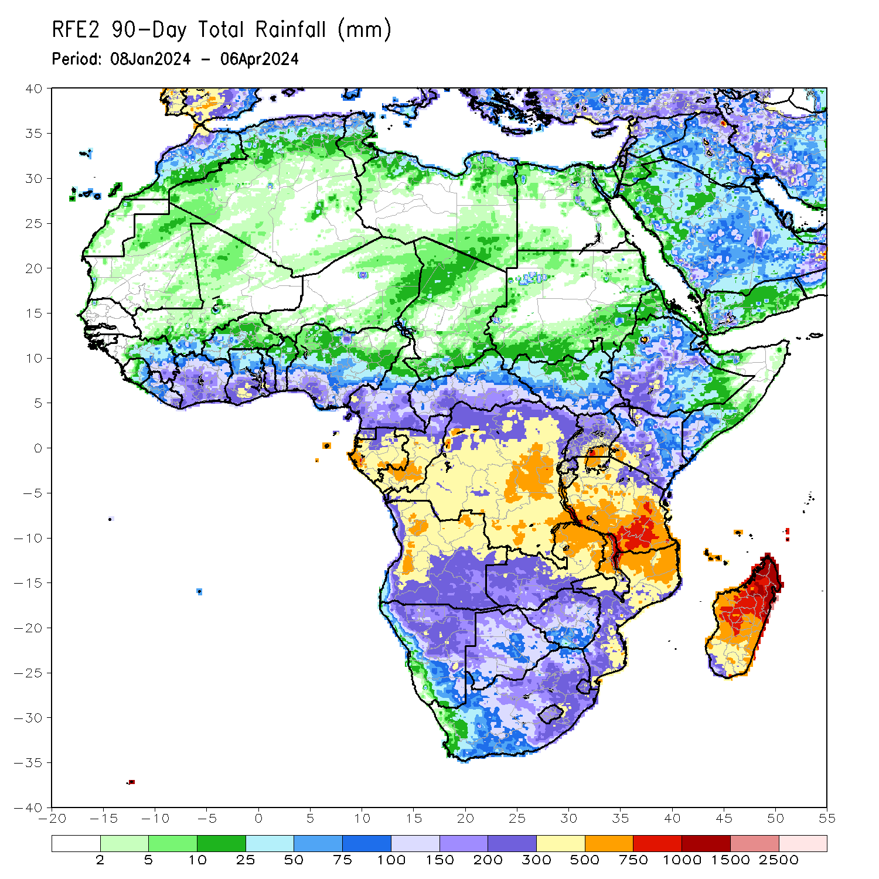
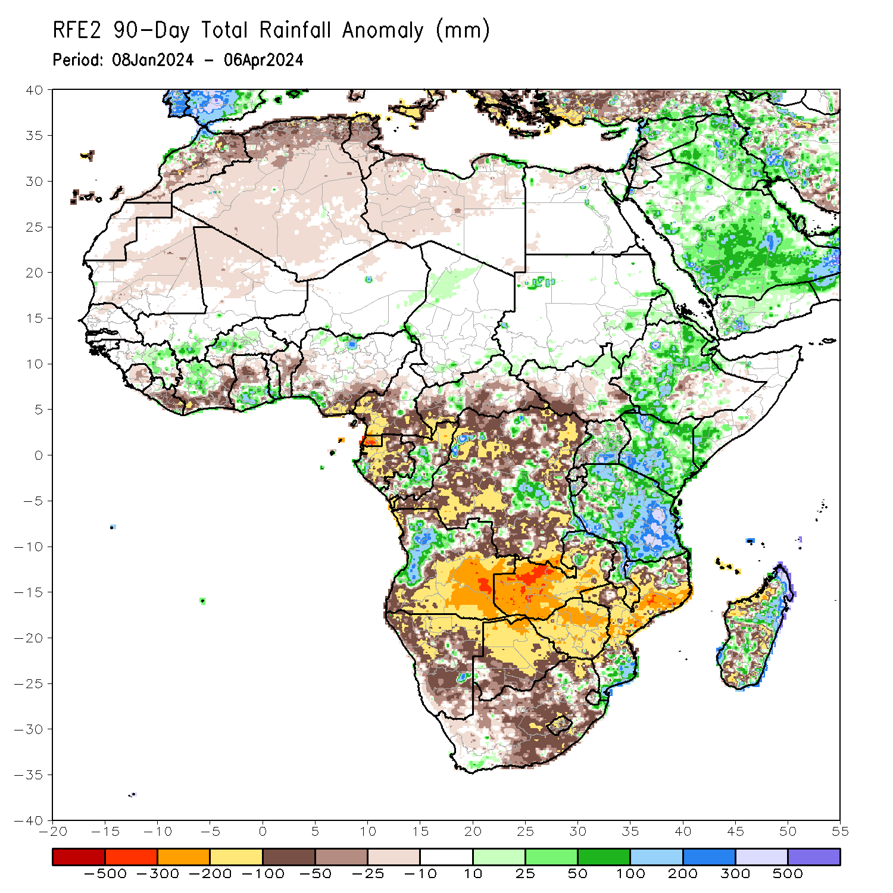
Rainfall Patterns: Last 90 Days
Over the past 90 days, in East Africa, rainfall was above-average in parts of northern, central and southwestern Ethiopia, Eritrea, Djibouti, southern Somali, Kenya, norther, central, eastern, southern, northwestern and southwestern Tanzania, western Burundi, central-northern and southeastern Uganda, and some regions in northern South Sudan and eastern Sudan. Rainfall was below-average in western, southern, and central-eastern South Sudan, central-southern Ethiopia, and central Somalia, parts of western Uganda, central Rwanda, eastern Burundi, and pockets of western Tanzania. In Central Africa, rainfall was above-average in some regions in central and southeastern Democratic Republic of the Congo (DRC), central Congo, and pockets of western Gabon and western Chad. Rainfall was below-average in western and southern Cameroon, Equatorial Guinea, and many parts of Gabon, northern and southeastern Congo, western, southern, central and southeastern parts of Central African Republic (CAR), and many parts of northern, western, northeastern, eastern and southern DRC. In West Africa, rainfall was above-average in eastern Guinea, northern-central Cote d’Ivoire, southern Mali, and western-central Burkina Faso, southern parts of Ghana and Togo, and pockets of southern and northern Nigeria. Rainfall was below-average in Sierra Leone, central and eastern Liberia, southern and eastern Cote d’Ivoire, western-central and eastern Ghana, central and eastern Benin, southern Burkina Faso, southeastern and western Nigeria, northern Mali, and central Mauritania. In southern Africa, rainfall was above-average over west-central Angola, eastern Malawi, and southern Mozambique, pockets of northern Zambia and southeastern South Africa, eastern Eswatini, and northern and central-eastern Madagascar. Rainfall was below-average across southern, central, northwestern, and eastern Angola, many parts of Namibia and Botswana, Zimbabwe, western, central, southern and some parts of northern Zambia, southern Malawi, western, central and eastern Mozambique, western, central, eastern and northwestern South Africa, Lesotho, western Eswatini, and western and parts of central-southern Madagascar.
Notes:
4

Slide 5
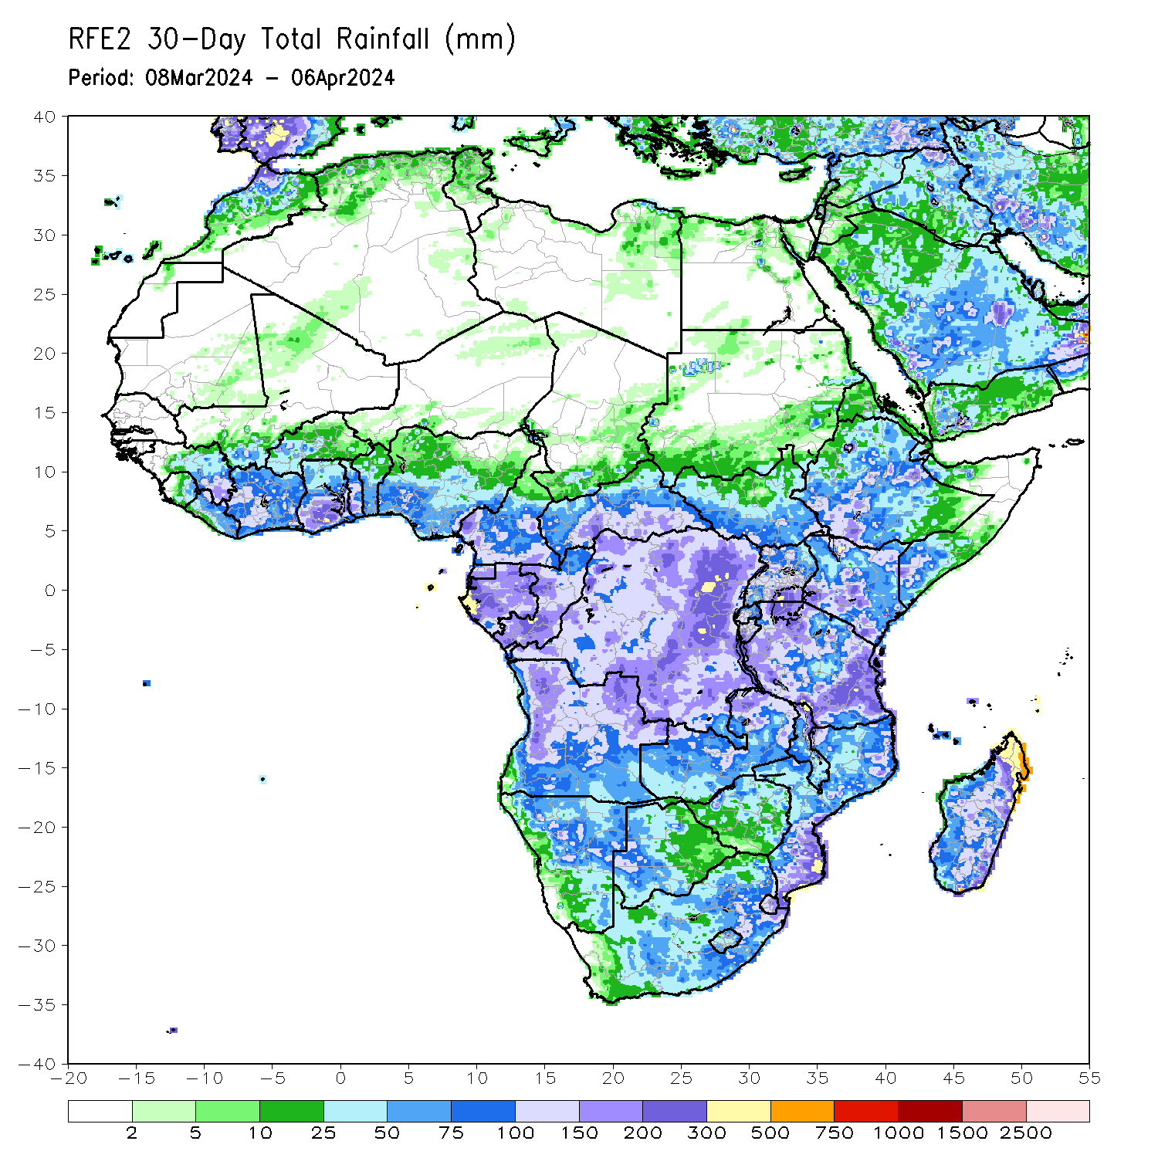
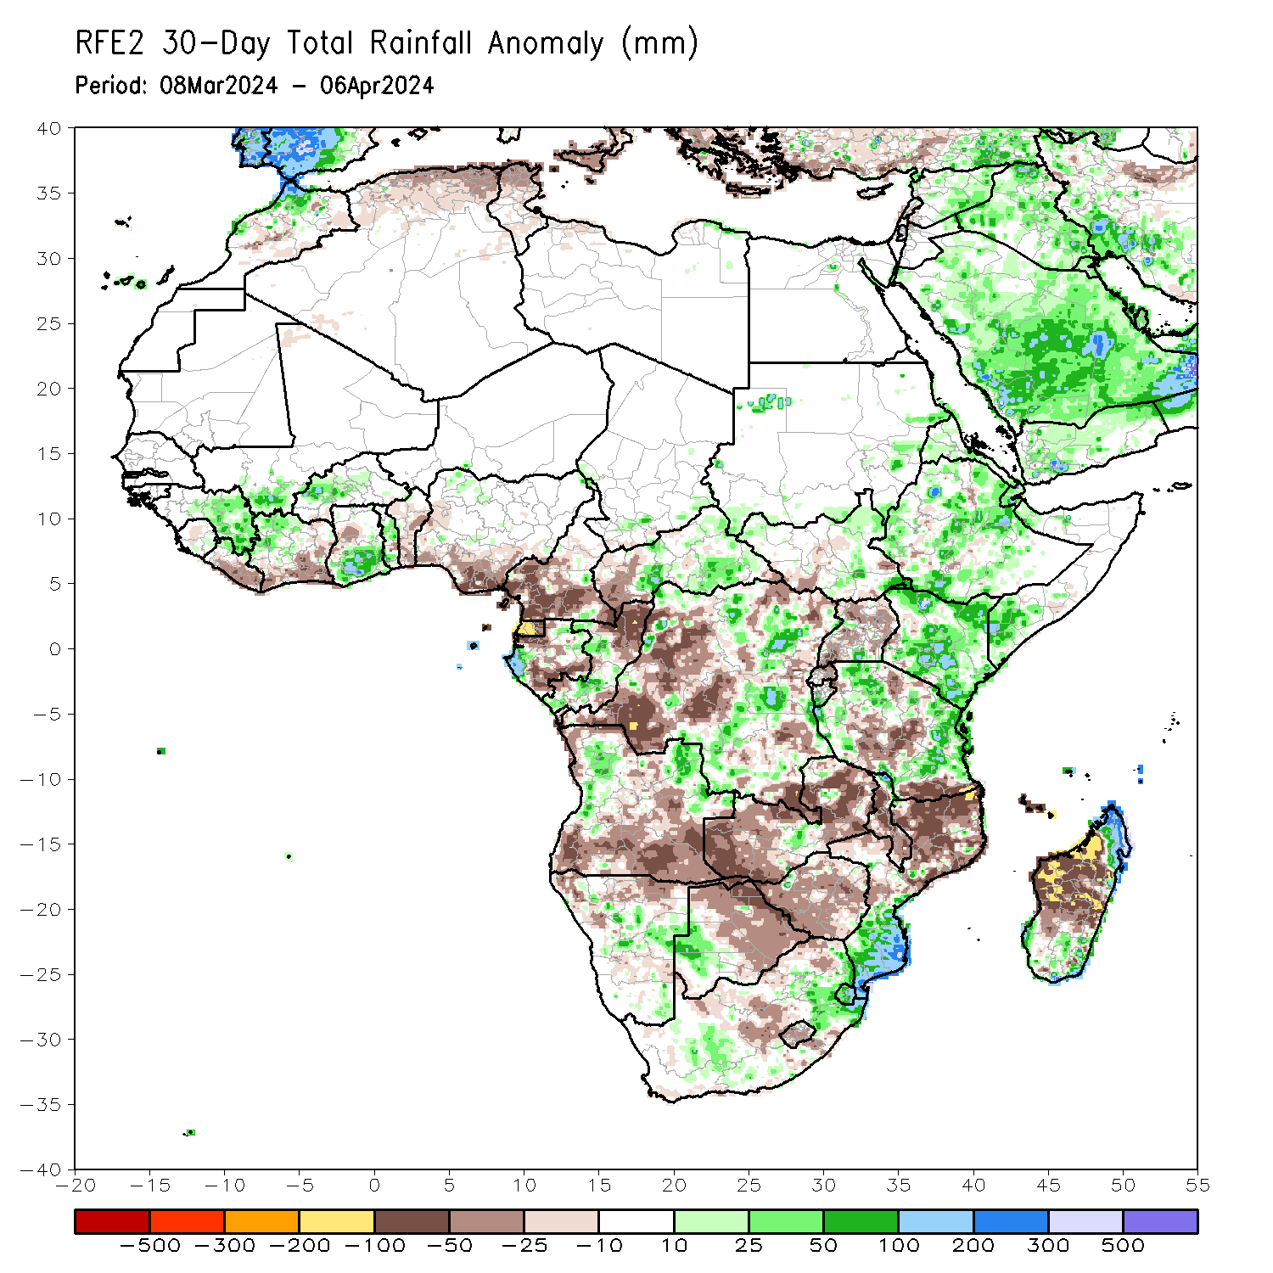
Rainfall Patterns: Last 30 Days
Over the past 30 days, in East Africa, rainfall was above-average in many parts of northern, western, central and southern Ethiopia, Eritrea, Djibouti, and southern Somalia, northern, northwestern, central, southern and eastern Kenya, northwestern, western and central-eastern Tanzania, northeastern, northwestern and central South Sudan, some parts of southern and eastern Sudan, southern Burundi, and pockets of southern Uganda. Rainfall was below-average in southwestern-central South Sudan, many parts of northern, central, eastern and southern Uganda, much of Rwanda, and northern Burundi, and some parts of northern, central and southern Tanzania. In Central Africa, rainfall was above-average in some parts of western and northeastern Gabon, some parts of central and southern Congo, southern and eastern CAR, and some parts of northwestern, central and southern DRC. Rainfall was below-average in western and southern Cameroon, Equatorial Guinea, central and southern Gabon, northern Congo, western CAR, and many parts of western, northeastern, and southeastern DRC. In West Africa, rainfall was above-average in eastern Guinea, southern Mali, northern Liberia, northwestern Cote d’Ivoire, western-central Burkina Faso, southern Ghana, central and southern Togo, and pockets of northwestern Nigeria. Rainfall was below-average in central Sierra Leone, southern and eastern Liberia, southern and eastern Cote d’Ivoire, western Ghana, central and southern Benin, and western, southwestern and southeastern Nigeria. In southern Africa, rainfall was above-average in some parts of western and northeastern Angola, central-eastern Namibia, western Botswana, pockets of region in central Zambia and northern Malawi, southern Mozambique, Eswatini, northeastern and southern South Africa, and northern and southeastern Madagascar. Rainfall was below-average in southern, central, southeastern, and far northwestern Angola, northern Namibia, northern, eastern, central and southeastern Botswana, western, northern and eastern Zambia, many parts of Zimbabwe, western, central and southern Malawi, northern and northeastern Mozambique, central South Africa, Lesotho, and many parts of western and central Madagascar.
Notes:
5

Slide 6
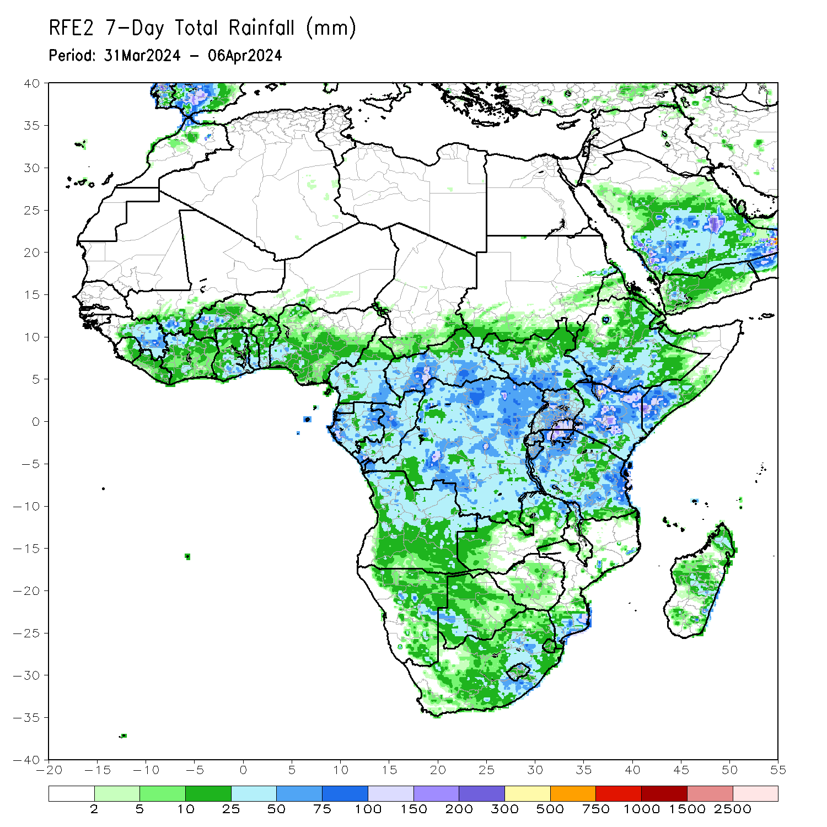
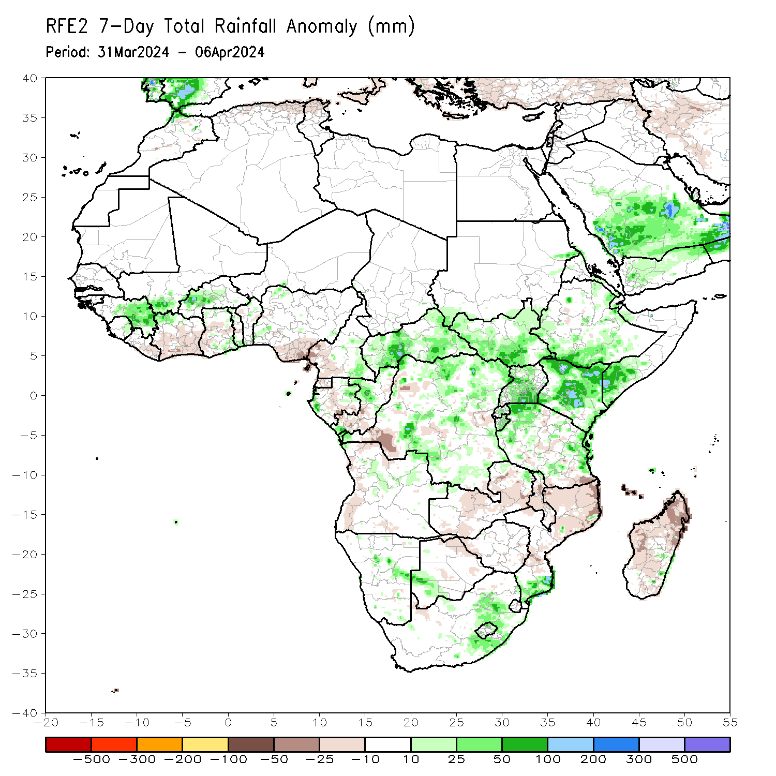
Rainfall Patterns: Last 7 Days
During the past 7 days, in East Africa, rainfall was above-average in southwestern, southern and central-northeastern Ethiopia, central and southern Eritrea, southern Djibouti, western, southern, central, northeastern and eastern South Sudan, northern, central, eastern, southwestern and southeastern Kenya, southern Somalia, northern, western, central and southern Uganda, northwestern, western and eastern Tanzania, many parts of Rwanda and Burundi, and pockets of southwestern Sudan. Rainfall was below average in some parts of central and southeastern Tanzania. In central Africa, rainfall was above-average in many parts of Central African Republic (CAR), parts of northern, central, northeastern and southern Democratic Republic of Congo (DRC), southeastern Cameroon, northeastern Gabon and central Congo. Rainfall was below-average in Equatorial Guinea, southwestern Cameroon, central Gabon, some parts of southern Congo and southwestern DRC. In West Africa, rainfall was above-average in eastern Guinea, southern Mal, northwestern Cote d’Ivoire, western Burkina Faso, and some parts of northern and southeastern Ghana and southern Togo. Rainfall was below-average in eastern Liberia, central, southern and southeastern Cote d’Ivoire, southwestern Ghana, and southeastern Nigeria. In southern Africa, rainfall was above-average in northeastern Angola, southern Mozambique, central and eastern South Africa, northern and southern Lesotho, and some regions in eastern Namibia, southwestern Botswana and southeastern Madagascar. Rainfall was below-average in northwestern and western Angola, central, southwestern and eastern Zambia, central and southern Malawi, northern and central Mozambique, northern Botswana, and northern, western, central and northeastern Madagascar.

Slide 7
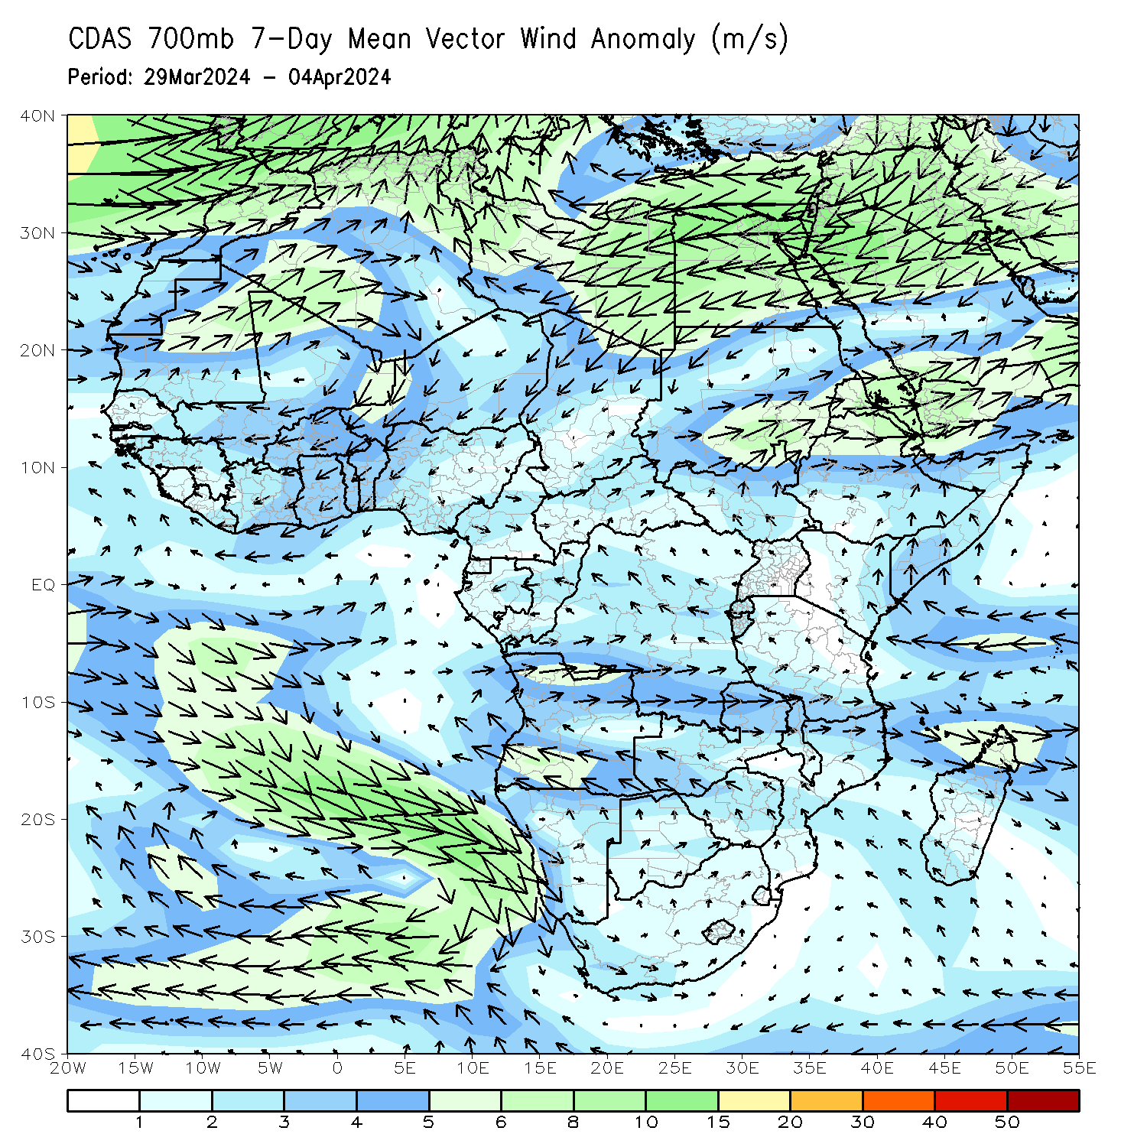
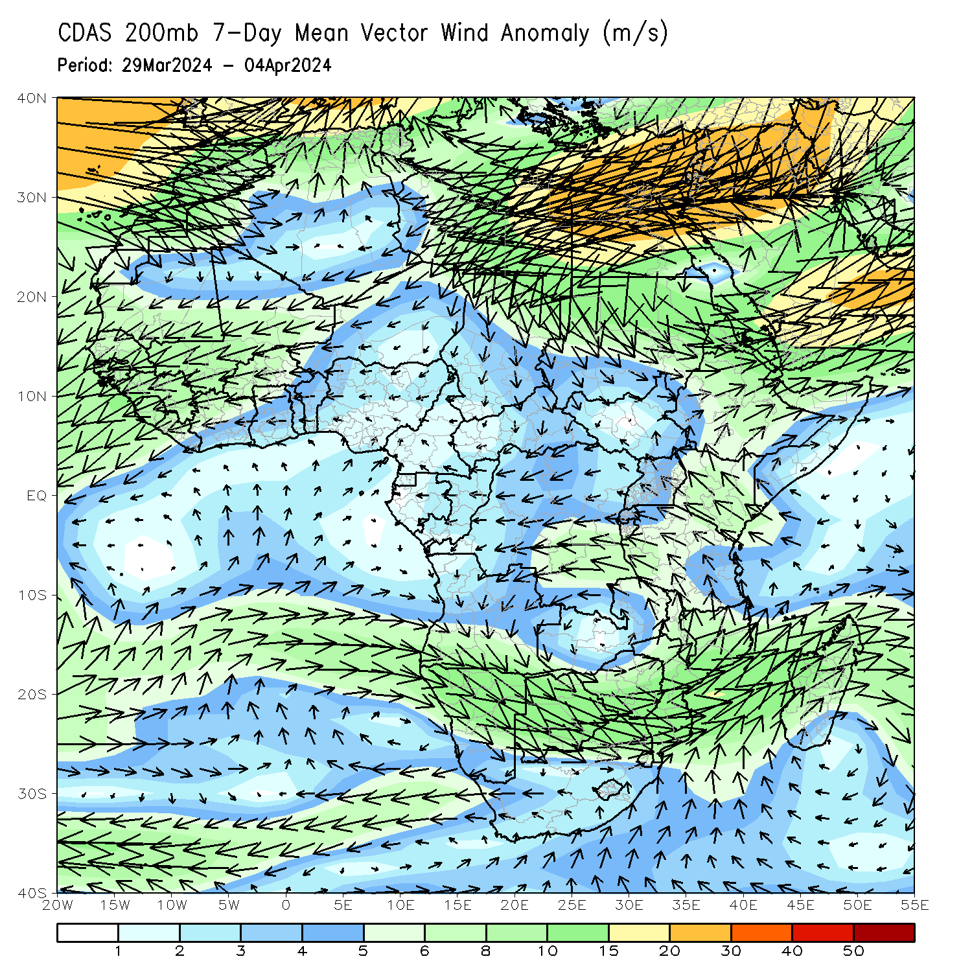
Atmospheric Circulation: Last 7 Days
At 700-hPa level (left panel), anomalous wind convergence across South Sudan may have contributed to the observed rainfall increases across South Sudan region. At 200-hPa (right panel), area of upper level divergence was observed in eastern portions of Africa may have contributed to the observed above-average rainfall across Uganda, Kenya and northern Tanzania regions.

Slide 8
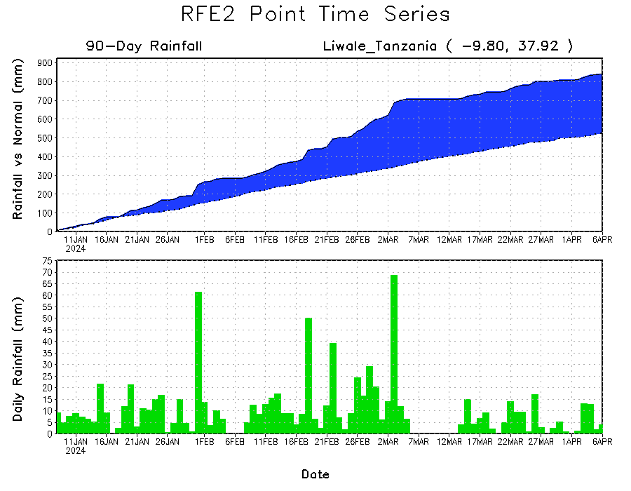
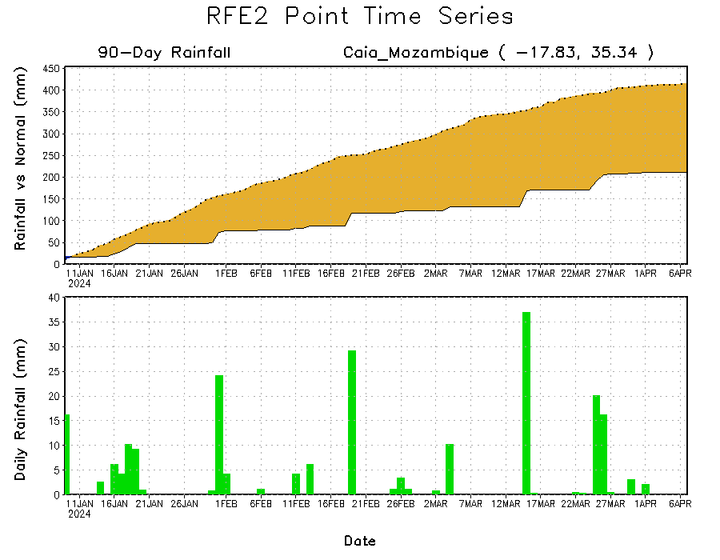
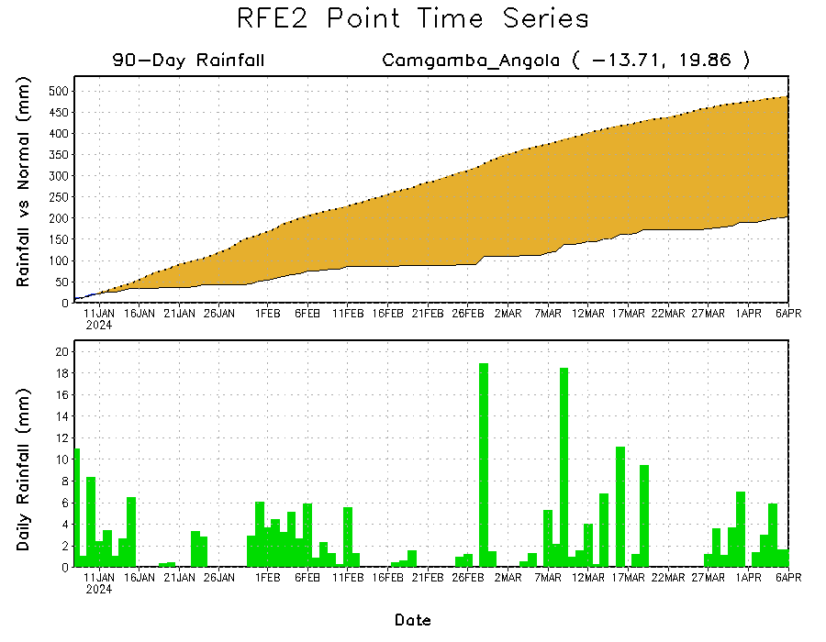
Rainfall Evolution
Daily evolution in rainfall at selected locations over the past 90 days shows growing deficits over eastern Angola (bottom left) and central Mozambique (bottom right). Conversely, rainfall surpluses persist in central, southern, and eastern Tanzania due to heavy and above-average rainfall during last 3 months (top right).

Slide 9
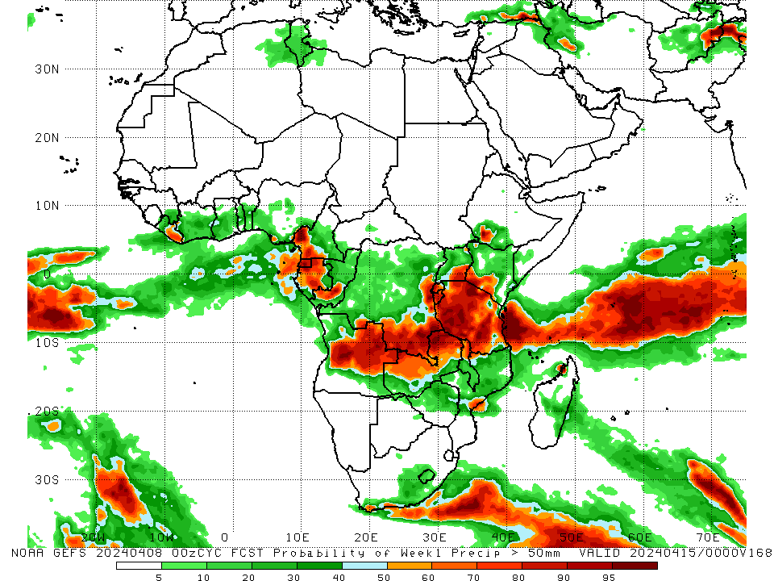
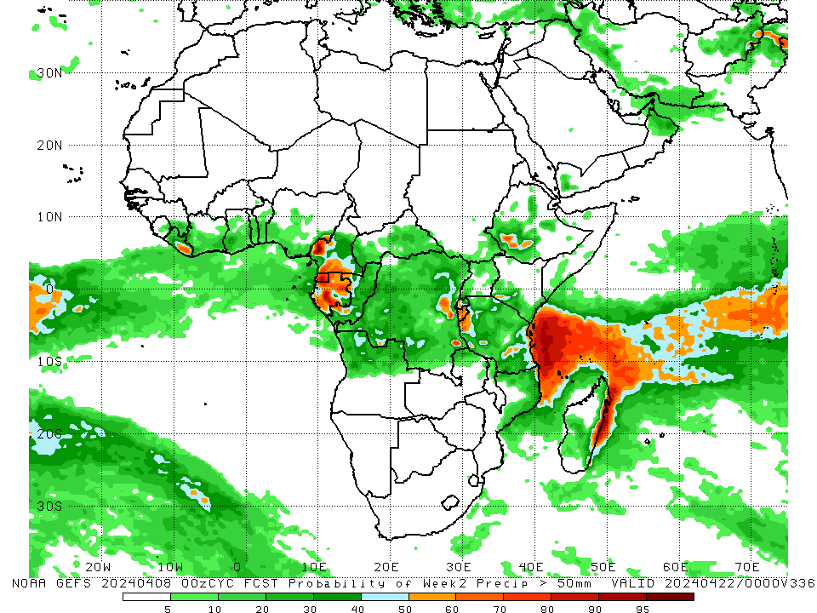
NCEP GEFS Model Forecasts Non-Bias Corrected Probability of precipitation exceedance
Week-1, Valid: 09 – 15 Apr 2024
Week-2, Valid: 16 – 22 Apr 2024
For week-1 (left panel) the NCEP GEFS indicates a moderate to high chance (over 70%) for rainfall to exceed 50 mm over Equatorial Guinea, southwestern Cameroon, northern and central Gabon, southwestern Congo, southern and eastern DRC, Rwanda, Burundi, Tanzania, southeastern Uganda, southwestern Kenya, western-central and eastern Angola, northern and northwestern Zambia, northern Malawi, eastern Liberia, and pockets of regions in southern Ethiopia, eastern Mozambique and northwestern Madagascar. For week-2 (right panel), NCEP GEFS indicates a moderate to high chance (over 70%) for rainfall to exceed 50 mm in Equatorial Guinea, southwestern and southern Cameroon, northern and southern Congo, Burundi, pockets of southwestern Ethiopia, eastern Liberia and eastern Madagascar.
Notes:
9

Slide 10
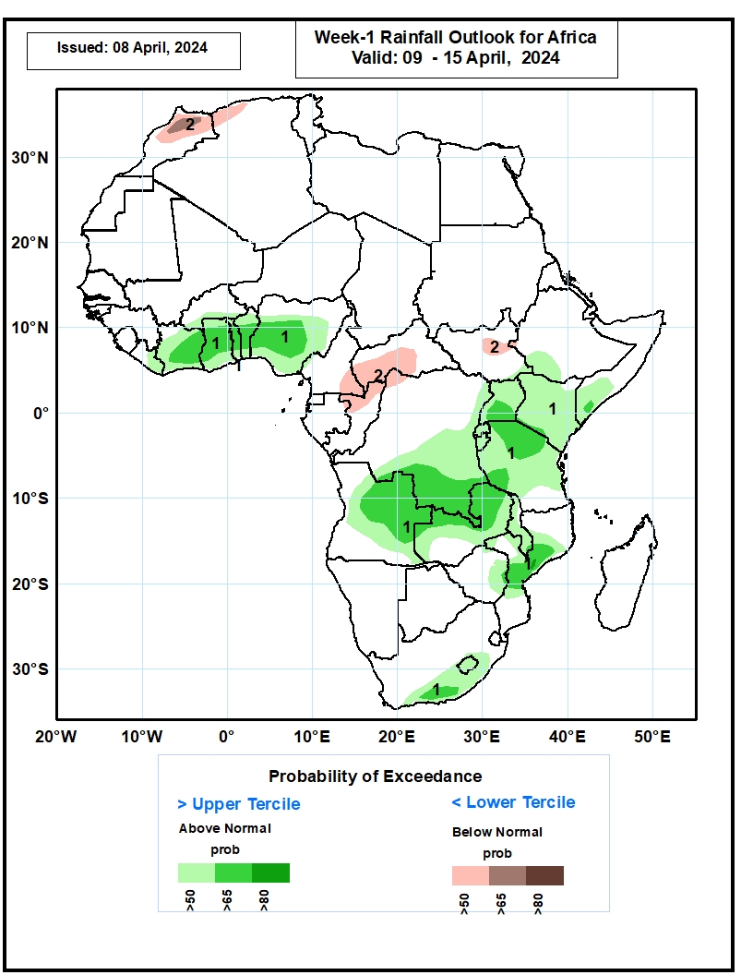
Week-1 Precipitation Outlooks
09 – 15 Apr 2024
The probabilistic forecasts call for above 50% chance for weekly rainfall to be above-normal (above the upper tercile) over parts of the Gulf of Guinea, southeastern South Africa and Lesotho, central Mozambique, central and eastern Angola, southern DRC, northern Zambia, much of Tanzania, Burundi, Rwanda, Uganda, Kenya, southern Somalia and a few places over southwestern Ethiopia. Enhanced probabilities (>65%) for above normal weekly rainfall extend across Cote d’Ivoire, Ghana, Togo, and Benin in the Gulf of Guinea and covers eastern Angola, southern DRC, northern Zambia, central Mozambique, northeastern Tanzania and southern Uganda in Southern and eastern Africa.
The probabilistic forecasts call for above 50% chance for weekly total rainfall to be below-normal (below the lower tercile) over parts of northern morocco and parts of Algeria, southwestern parts of CAR and bordering areas of Cameroon and Congo. Probabilities are enhanced (>65%) for below normal rainfall at few places in northeastern Morocco.
Notes:
10

Slide 11
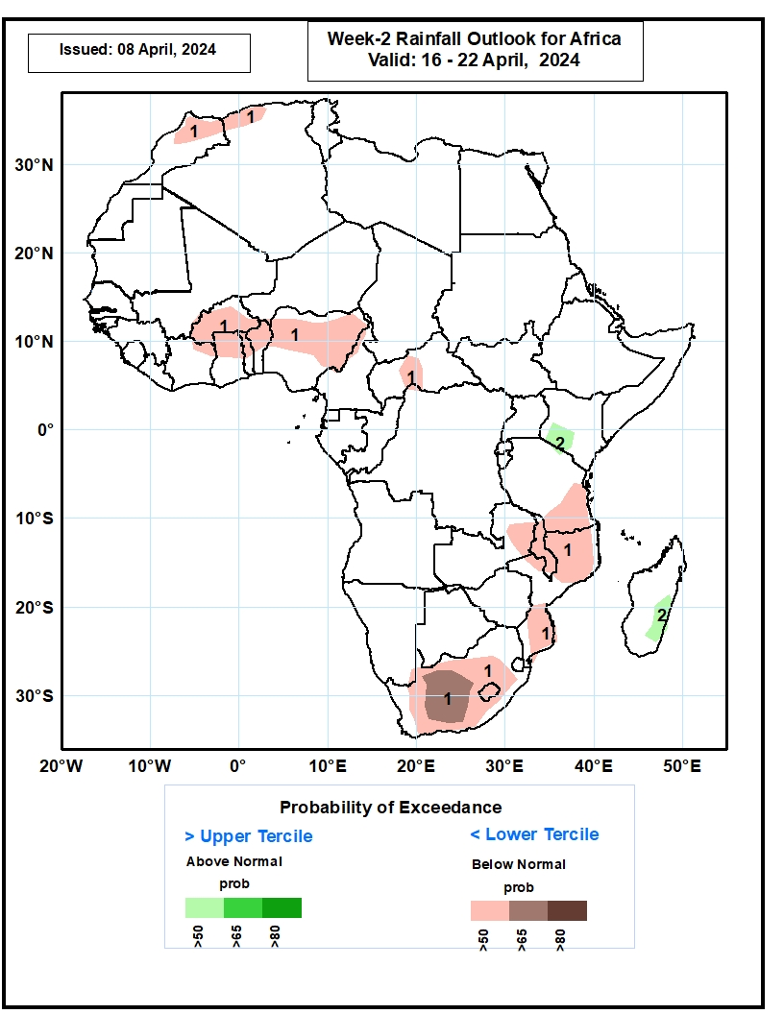
Week-2 Precipitation Outlooks
16 – 22 Apr 2024
The probabilistic forecasts call for above 50% chance for weekly rainfall to be below-normal (below the lower tercile) over parts of Morocco and Algeria, Burkina Faso and bordering areas of Cote d’Ivoire, Ghana, Togo, and Benin, and norther Nigeria, central CAR, southern Africa and Lesotho, southern and northern Mozambique, eastern Zambia, Malawi, and southern Tanzania. Central parts of South Africa are predicted to have enhanced probabilities exceeding 65% for below normal weekly rainfall.
The probabilistic forecasts call for above 50% chance for weekly rainfall to be above-normal (above the upper tercile) over southwestern Kenya and eastern Madagascar.
Notes:
11

Slide 12
Summary
Over the past 30 days, in East Africa, rainfall was above-average in many parts of northern, western, central and southern Ethiopia, Eritrea, Djibouti, and southern Somalia, northern, northwestern, central, southern and eastern Kenya, northwestern, western and central-eastern Tanzania, northeastern, northwestern and central South Sudan, some parts of southern and eastern Sudan, southern Burundi, and pockets of southern Uganda. Rainfall was below-average in southwestern-central South Sudan, many parts of northern, central, eastern and southern Uganda, much of Rwanda, and northern Burundi, and some parts of northern, central and southern Tanzania. In Central Africa, rainfall was above-average in some parts of western and northeastern Gabon, some parts of central and southern Congo, southern and eastern CAR, and some parts of northwestern, central and southern DRC. Rainfall was below-average in western and southern Cameroon, Equatorial Guinea, central and southern Gabon, northern Congo, western CAR, and many parts of western, northeastern, and southeastern DRC. In West Africa, rainfall was above-average in eastern Guinea, southern Mali, northern Liberia, northwestern Cote d’Ivoire, western-central Burkina Faso, southern Ghana, central and southern Togo, and pockets of northwestern Nigeria. Rainfall was below-average in central Sierra Leone, southern and eastern Liberia, southern and eastern Cote d’Ivoire, western Ghana, central and southern Benin, and western, southwestern and southeastern Nigeria. In southern Africa, rainfall was above-average in some parts of western and northeastern Angola, central-eastern Namibia, western Botswana, pockets of region in central Zambia and northern Malawi, southern Mozambique, Eswatini, northeastern and southern South Africa, and northern and southeastern Madagascar. Rainfall was below-average in southern, central, southeastern, and far northwestern Angola, northern Namibia, northern, eastern, central and southeastern Botswana, western, northern and eastern Zambia, many parts of Zimbabwe, western, central and southern Malawi, northern and northeastern Mozambique, central South Africa, Lesotho, and many parts of western and central Madagascar.
During the past 7 days, in East Africa, rainfall was above-average in southwestern, southern and central-northeastern Ethiopia, central and southern Eritrea, southern Djibouti, western, southern, central, northeastern and eastern South Sudan, northern, central, eastern, southwestern and southeastern Kenya, southern Somalia, northern, western, central and southern Uganda, northwestern, western and eastern Tanzania, many parts of Rwanda and Burundi, and pockets of southwestern Sudan. Rainfall was below average in some parts of central and southeastern Tanzania. In central Africa, rainfall was above-average in many parts of Central African Republic (CAR), parts of northern, central, northeastern and southern Democratic Republic of Congo (DRC), southeastern Cameroon, northeastern Gabon and central Congo. Rainfall was below-average in Equatorial Guinea, southwestern Cameroon, central Gabon, some parts of southern Congo and southwestern DRC. In West Africa, rainfall was above-average in eastern Guinea, southern Mal, northwestern Cote d’Ivoire, western Burkina Faso, and some parts of northern and southeastern Ghana and southern Togo. Rainfall was below-average in eastern Liberia, central, southern and southeastern Cote d’Ivoire, southwestern Ghana, and southeastern Nigeria. In southern Africa, rainfall was above-average in northeastern Angola, southern Mozambique, central and eastern South Africa, northern and southern Lesotho, and some regions in eastern Namibia, southwestern Botswana and southeastern Madagascar. Rainfall was below-average in northwestern and western Angola, central, southwestern and eastern Zambia, central and southern Malawi, northern and central Mozambique, northern Botswana, and northern, western, central and northeastern Madagascar.
The Week-1 outlook calls for above-average rainfall in central and eastern Angola, Zambia, Malawi, central Mozambique, central-eastern Zimbabwe, central-eastern South Africa, Lesotho, central Madagascar, southern DRC, many parts of Tanzania and Kenya, southern Somalia, central and eastern Liberia, Cote d’Ivoire, central and southern parts of Ghana, Togo and Benin. In contrast, there is an increased chance for below-average in central Cameroon, CAR, southern Gabon, Congo, northern and western DRC, western and central-eastern South Sudan, central and eastern Ethiopia, central and northern Somalia, Djibouti, northwestern and southwestern Angola, northern and eastern Namibia, western Botswana, and Sierra Leone. The Week-2 outlook calls for above-normal rainfall in southeastern Cameroon, northern parts of Gabon and Congo, central DRC, western Ethiopia, western-central Tanzania, northern Mozambique, central and eastern Madagascar. In contrast, there is an increased chance for below-average in many parts of southern Africa, southeastern Ethiopia, many parts of Uganda and Rwanda, southern DRC, and some parts of the Gulf of Guinea Countries.

