Slide 1
The African Monsoon Recent Evolution and Current Status Include Week-1 and Week-2 Outlooks
Update prepared
5 February 2024
For more information, visit:
http://www.cpc.ncep.noaa.gov/products/Global_Monsoons/African_Monsoons/precip_monitoring.shtml

Slide 2
Outline
Highlights
Recent Evolution and Current Conditions
NCEP GEFS Forecasts
Summary

Slide 3
Highlights: Last 7 Days
During the past 7 days, in East Africa, rainfall was above-average in Tanzania, pocket areas in west-central Ethiopia, part of Rwanda, part of Burundi, southeastern Uganda, and southwestern Kenya. In central Africa, above-average rainfall was observed over western Gabon, south-central Congo, part of central and eastern DRC. Rainfall was below-average over northern and southern DRC. In West Africa, rainfall was near-average over most places of the region. In southern Africa, rainfall was above-average western Angola, Namibia, part of western South Africa, northern Zambia, northern and southern Mozambique, and northeastern Madagascar. Below-average rainfall was observed over eastern Angola, most of Zambia, central, and southern Malawi, Zimbabwe, northern Botswana, western and north-central Mozambique, Eswatini, eastern South Africa, western, central, and southern Madagascar.
The Week-1 outlook calls for above-average rainfall in central and southwestern Ethiopia, southern Uganda, Rwanda, northwestern Tanzania, parts of western DRC, western Angola, part of northwest Namibia, and part of northeastern South Africa. In contrast, there is an increased chance for below-average rainfall across coastal portions of the Gulf of Guinea region, northern Gabon, northern DRC, southern Cameroon, southeastern Angola, western and southern Zambia, southern Malawi, northern Zimbabwe, western, central, and southeastern Mozambique, part of northern Botswana, southern South Africa, and Lesotho. The Week-2 outlook primarily calls for above-average rainfall across the western parts of Central Africa, central and southwestern Ethiopia, western Angola, eastern Zambia, Malawi, southern Tanzania, northern Mozambique, Eswatini, and part of northeastern South Africa. Below-average rainfall is, however, expected in southeastern Angola, western and southern Zambia, northeastern Namibia, northwestern Botswana, northern Zimbabwe, part of western Mozambique, northwestern and southern Madagascar.

Slide 4
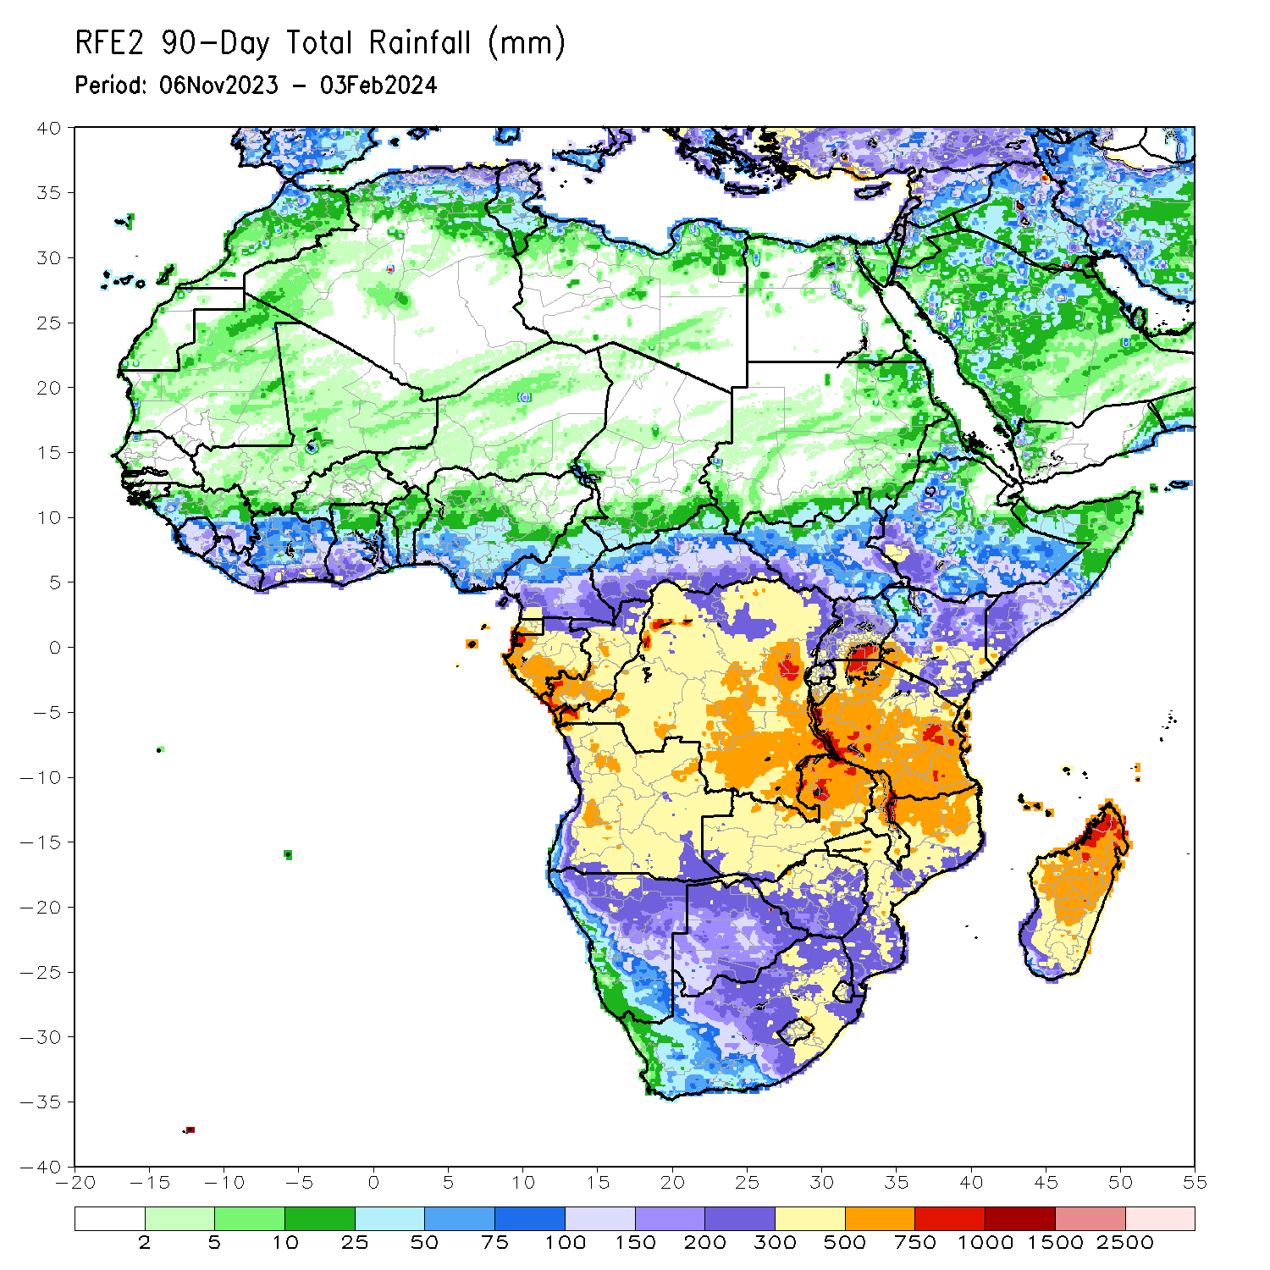
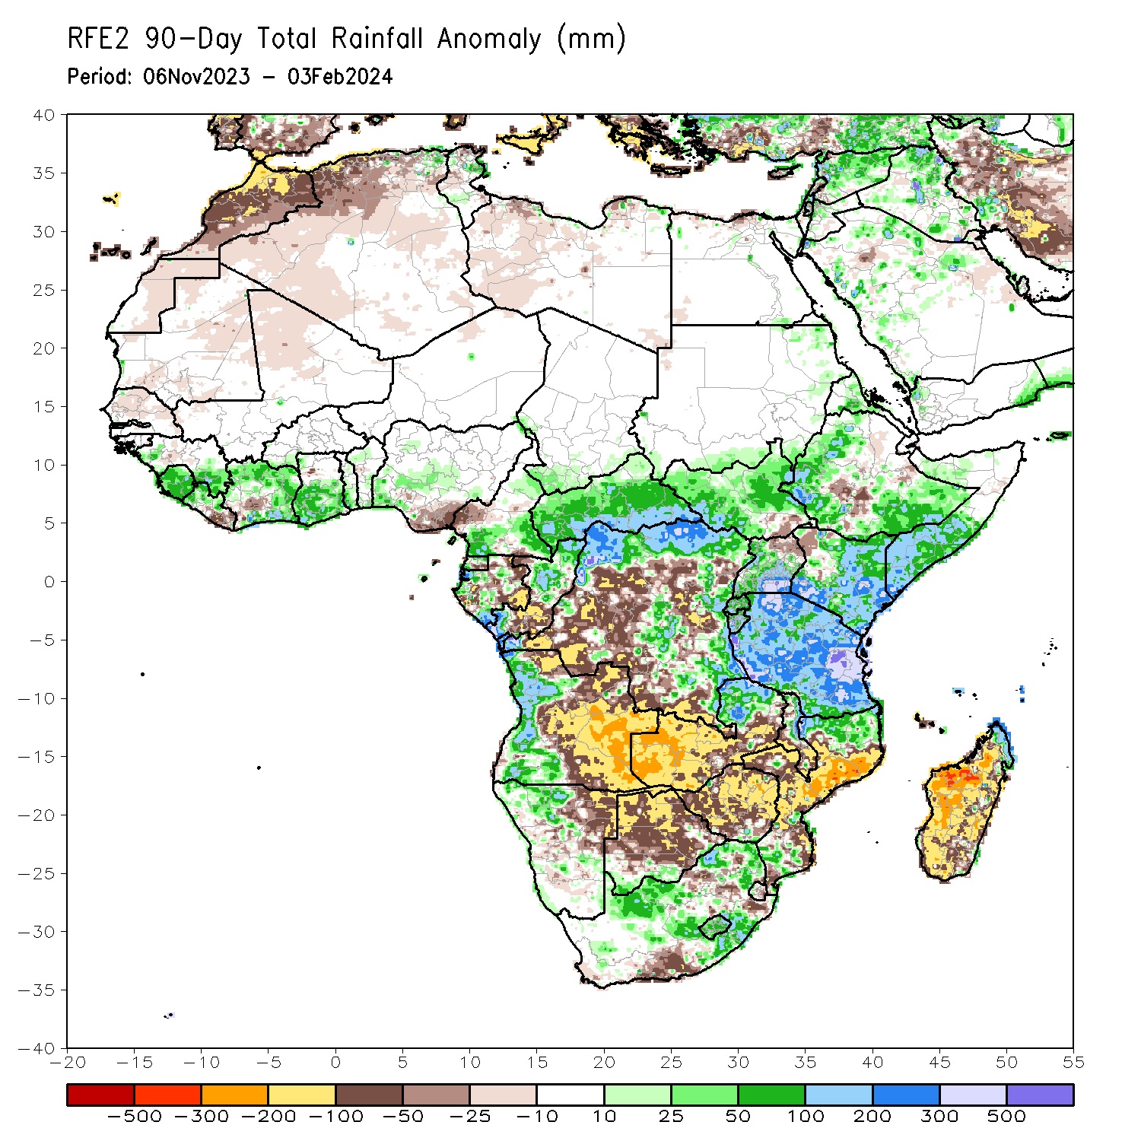
Rainfall Patterns: Last 90 Days
Over the past 90 days, in East Africa, above-average rainfall was observed in South Sudan, Kenya, Tanzania, Burundi, Rwanda, Uganda, central Eritrea, western, and southern Ethiopia, southern, central, and western Somalia. Rainfall was below-average over parts of central Ethiopia and southeastern South Sudan. In Central Africa, rainfall was above-average in CAR, much of northern, eastern, and central DRC, northern, central, and southwestern Congo, parts of central, northwestern, and south-central Gabon, western and northern Equatorial Guinea, southern Chad, and southwestern and eastern Cameroon. Rainfall was below-average over west-central Cameroon, northern, west-central, and eastern Gabon, south-central Congo, and pockets of southern and central DRC. In West Africa, rainfall was above-average over western and southeastern Guinea, Sierra Leone, western and north-central Liberia, many parts of Cote d’Ivoire, southern Ghana, southern Togo, and southwestern, and parts of central Nigeria. Below-average rainfall was observed over parts of southwestern Cote d’Ivoire, central Guinea, south-central and southeastern Liberia, and southern Nigeria. In southern Africa, above-average rainfall was observed over most of western Angola, northwestern Namibia, northern Zambia, southern, parts of west-central, and northern Mozambique, eastern and parts of central South Africa, Lesotho, northern, and central parts of Malawi, and coastal northeastern Madagascar. Below-average rainfall was observed over much of eastern, central, and parts of northern Angola, northeastern, central, and southeastern Namibia, western, central, and parts of southeastern Zambia, much of central and northern Botswana, most of Zimbabwe, southern and parts of northeastern South Africa, central and southeastern Mozambique, parts of southern Malawi, and much of southern and central Madagascar.
Notes:
4

Slide 5
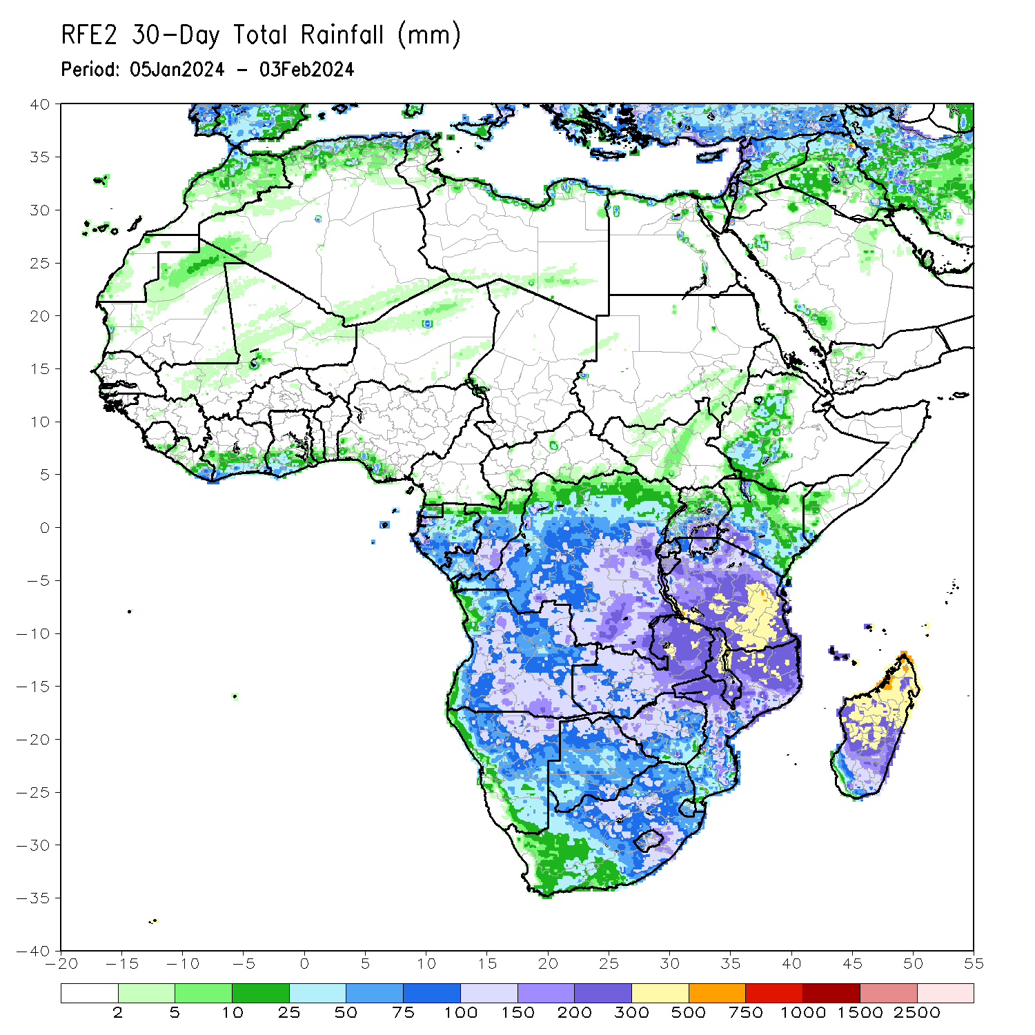
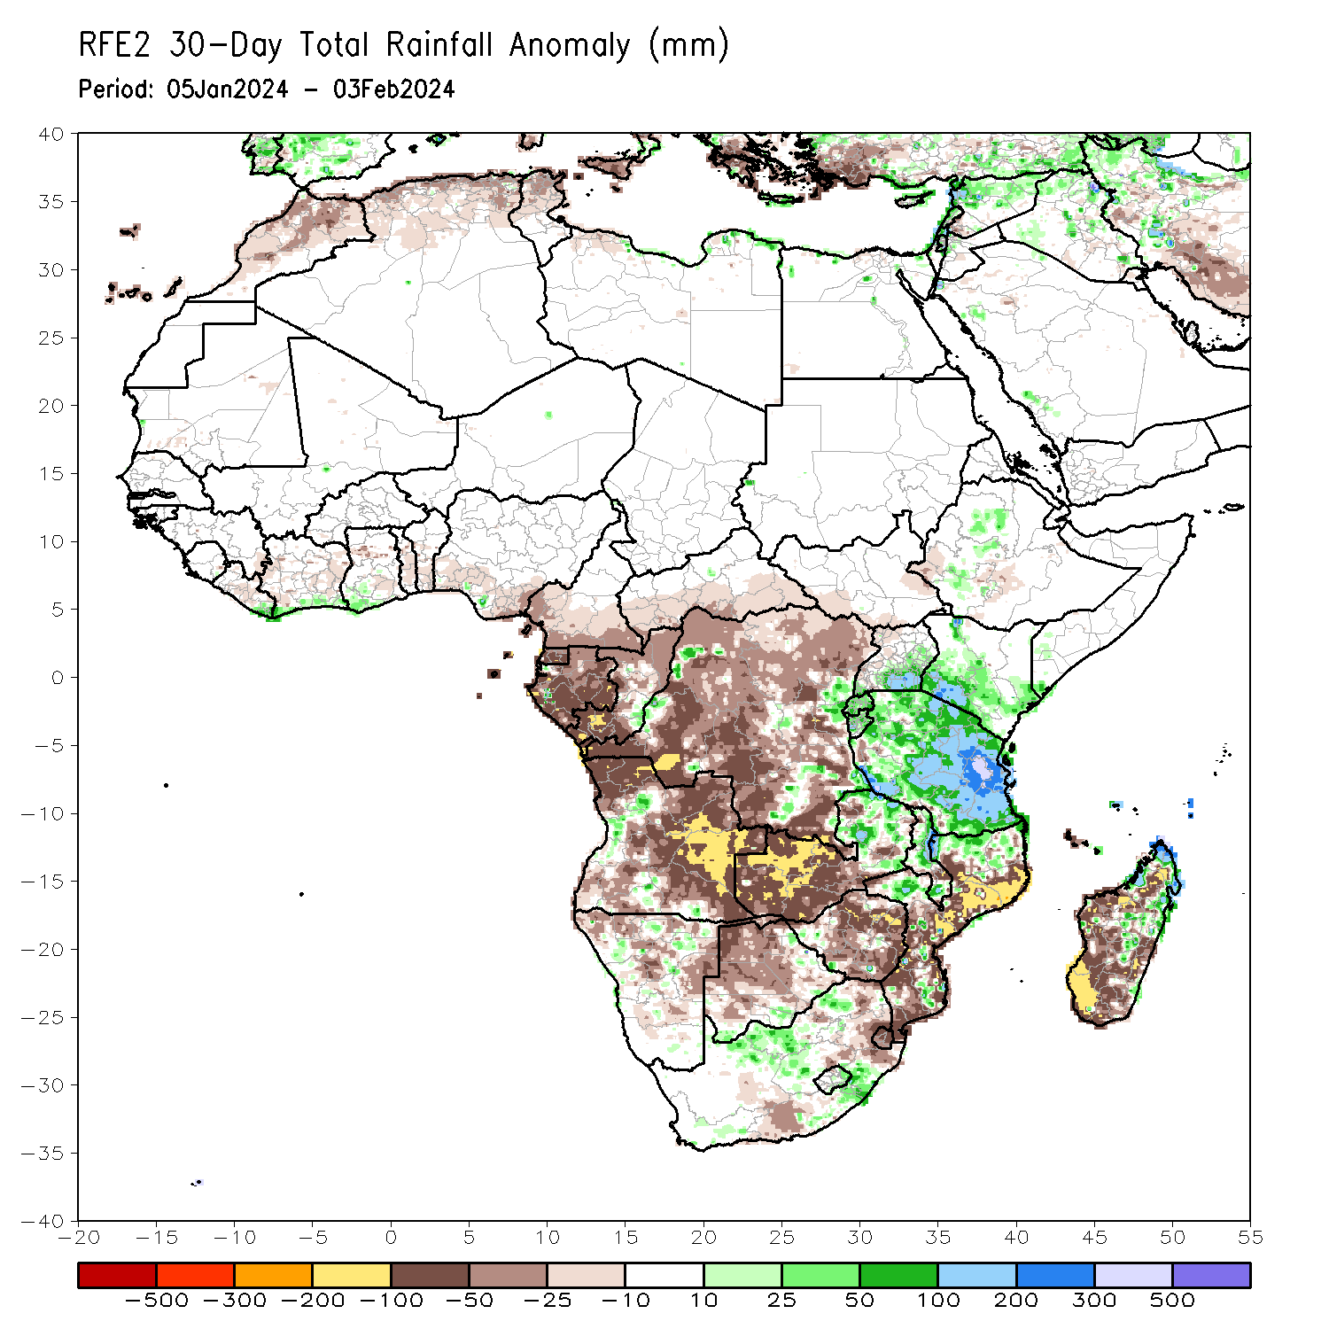
Rainfall Patterns: Last 30 Days
Over the past 30 days, in East Africa, above-average rainfall was observed in many parts of Tanzania, parts of east-central and southern Uganda, southern and northwestern Kenya, northern and central Burundi, Rwanda, far southeastern Somalia, and pockets of southwestern Ethiopia. Rainfall was below-average over southwestern South Sudan and parts of central and western Ethiopia. In Central Africa, rainfall was above-average across parts of central, eastern, and southeastern DRC. Below-average rainfall was observed in Equatorial Guinea, most of Gabon, most of Congo, much of DRC, southern CAR, and southern Cameroon. In West Africa, rainfall was above-average from coastal areas of eastern Liberia to southwestern Ghana. Rainfall was below average in central Liberia, parts of Ghana, and southwestern and south-central Nigeria. In southern Africa, above-average rainfall was observed in pockets of north-central and east-central Namibia, eastern Zambia, west-central and parts of northern Mozambique, northeastern Zimbabwe, parts of southern Botswana, eastern and southern Lesotho, southeastern and central South Africa, Malawi, and southern, east-central, and far northern Madagascar. Below-average rainfall was observed in Angola, western Zambia, northern Namibia, northern and western Botswana, central and eastern Zimbabwe, eastern South Africa, southern and central Mozambique, Eswatini, and far southwestern, west-central, and parts of northern Madagascar.
Notes:
5

Slide 6
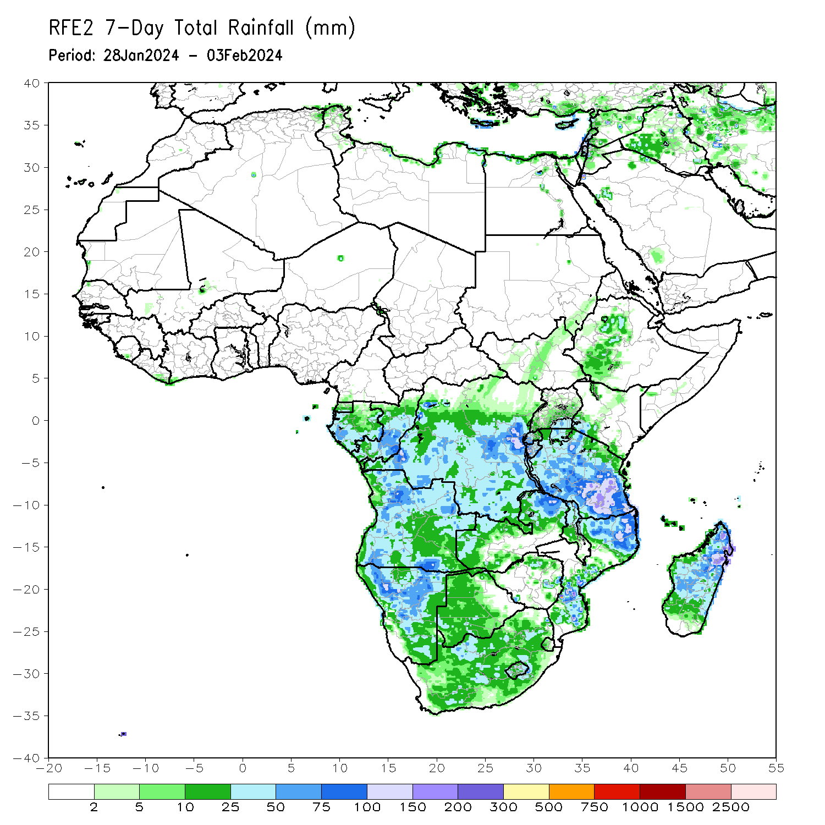
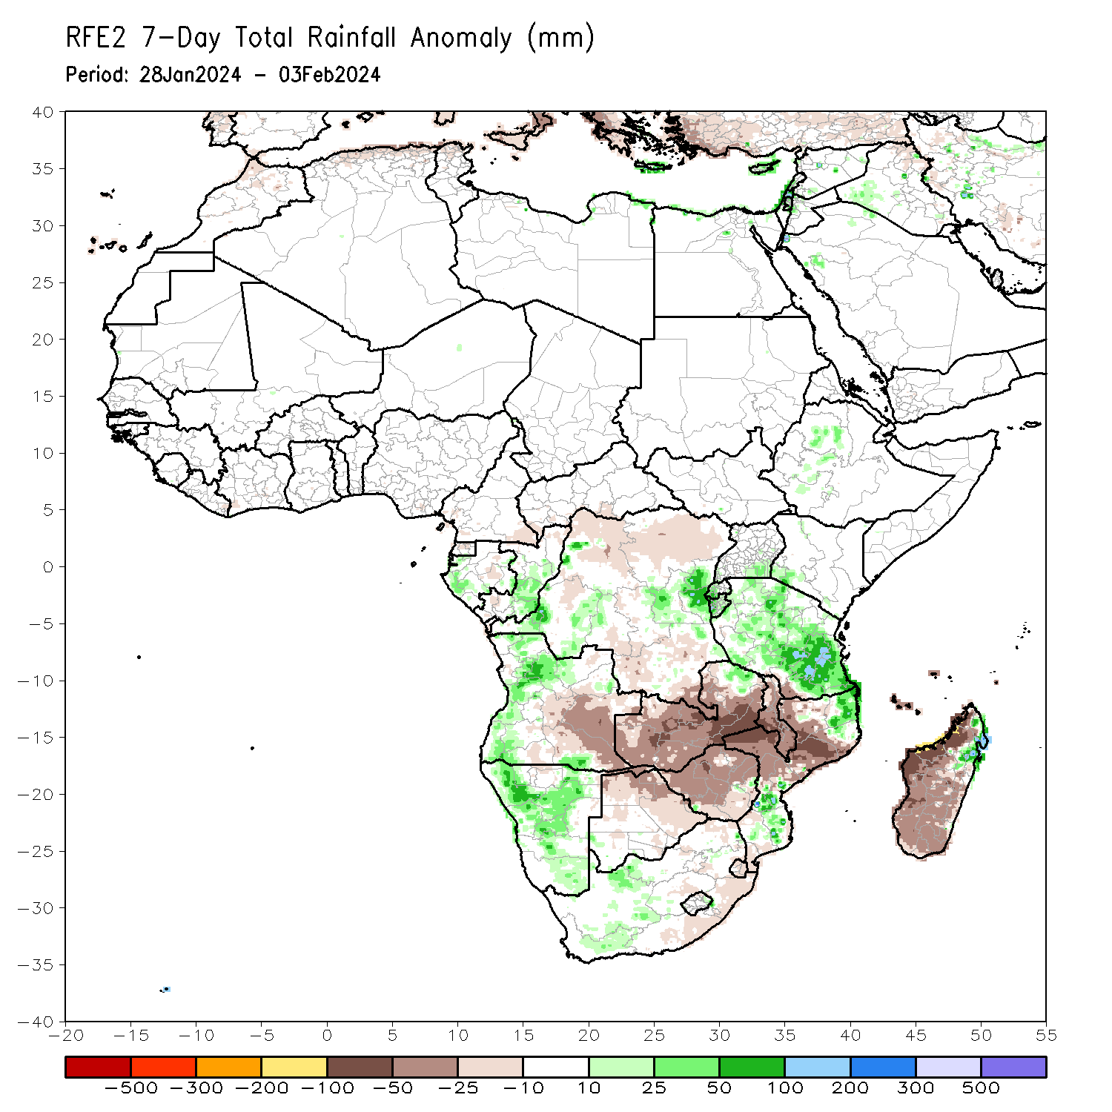
Rainfall Patterns: Last 7 Days
During the past 7 days, in East Africa, rainfall was above-average in many parts of west-central Ethiopia southeastern Uganda, western Rwanda, western Burundi, and most places in Tanzania. In central Africa, above-average rainfall was observed over pockets central DRC, parts of western Gabon, and parts of central Congo. Rainfall was below-average over parts of northern and southern DRC, Congo. In West Africa, rainfall was near-normal over most of the region. In southern Africa, rainfall was above-average over pockets of northeastern Zambia, western Angola, most places in Namibia, northeastern and south-central Mozambique, western South Africa, and northeastern Madagascar. Below-average rainfall was observed over eastern Angola, most of Zambia, Malawi, Zimbabwe, northern Botswana, western and north-central Mozambique, parts of Lesotho, Eswatini, eastern South Africa, and most of western and southern Madagascar.

Slide 7
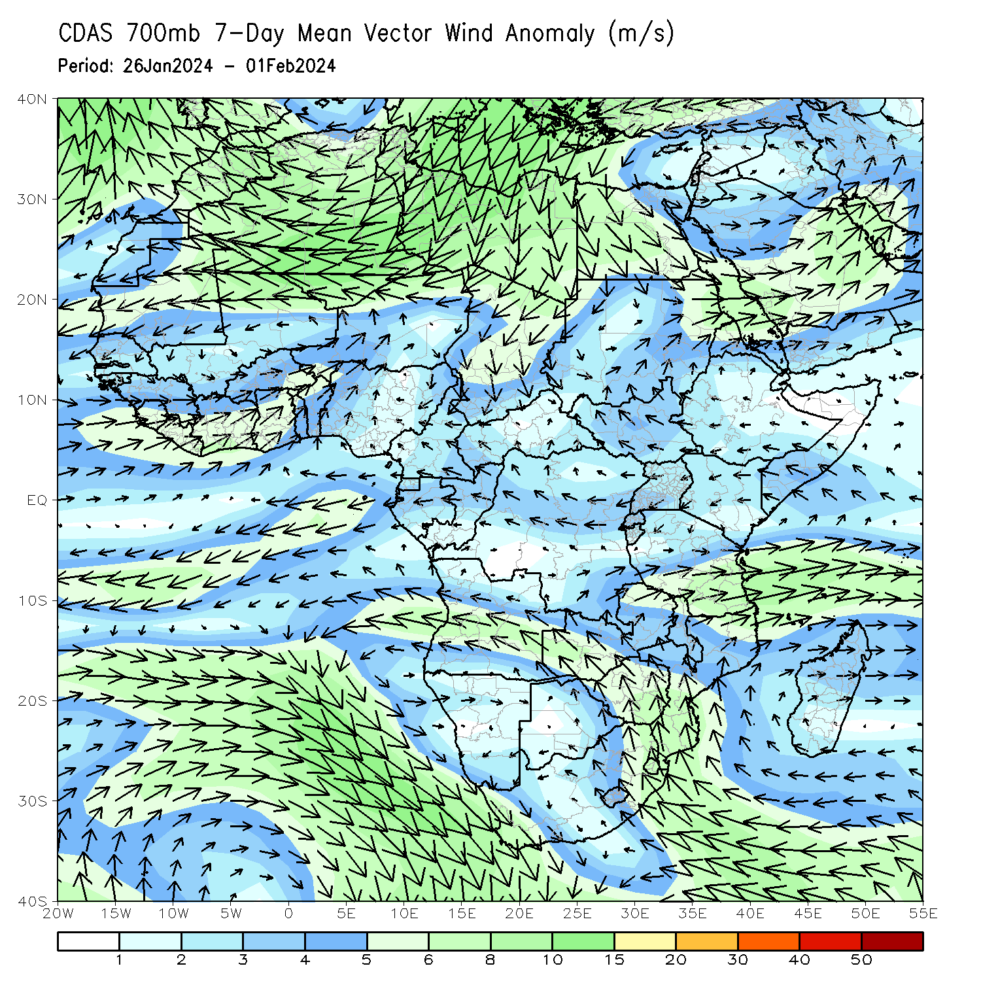
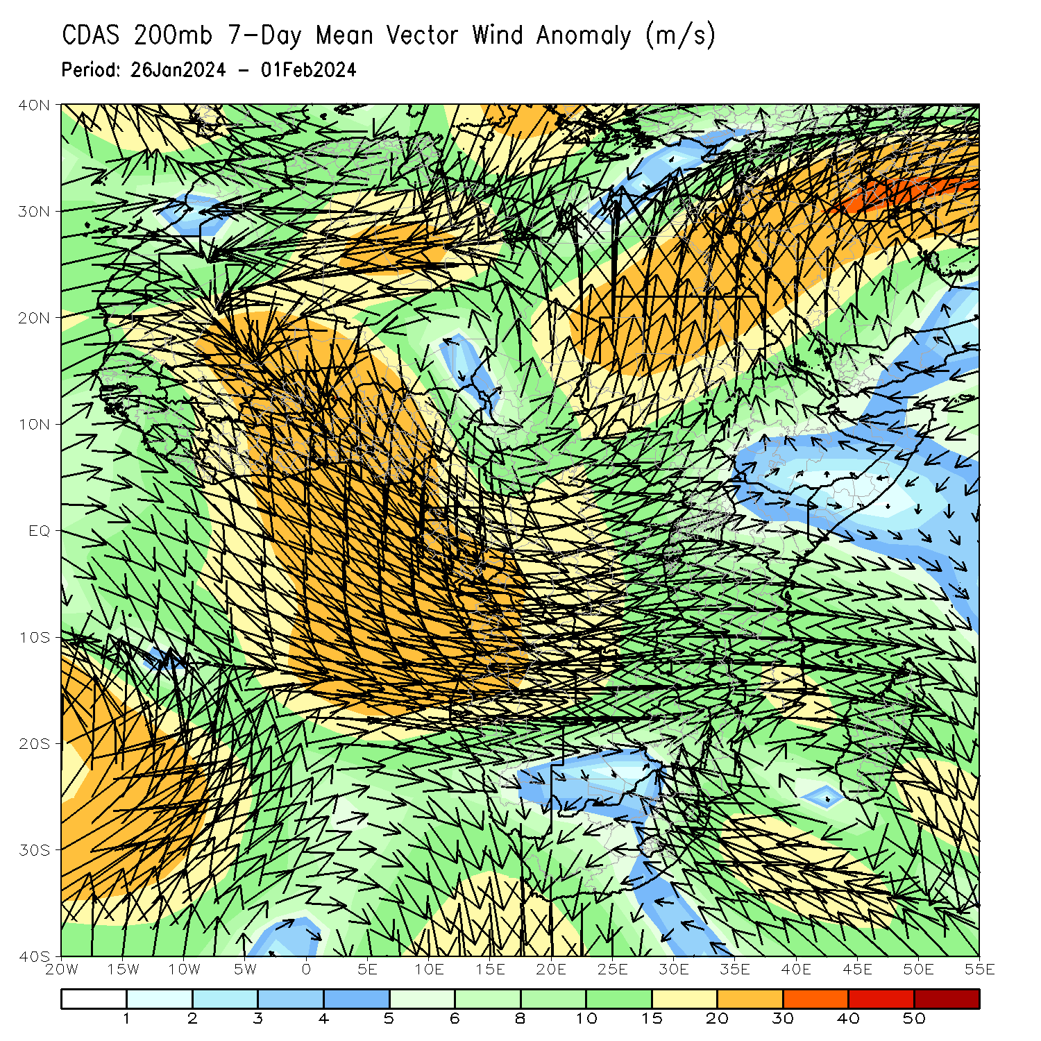
Atmospheric Circulation: Last 7 Days
At 700-hPa level (left panel), the anomalous lower-level convergence near Tanzania may have contributed to the observed above-average rainfall in the region. At 200-hPa level (right panel), anomalous upper-level convergence near Zambia, Zimbabwe, and part of Mozambique may have contributed to the below-average rainfall in the region.

Slide 8
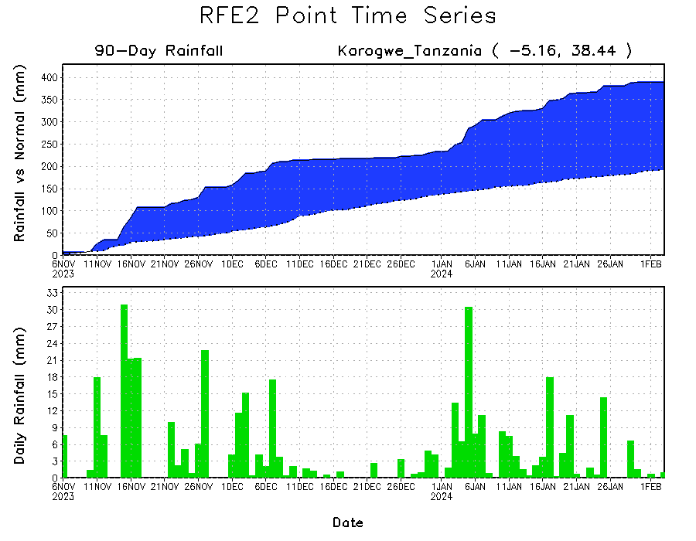
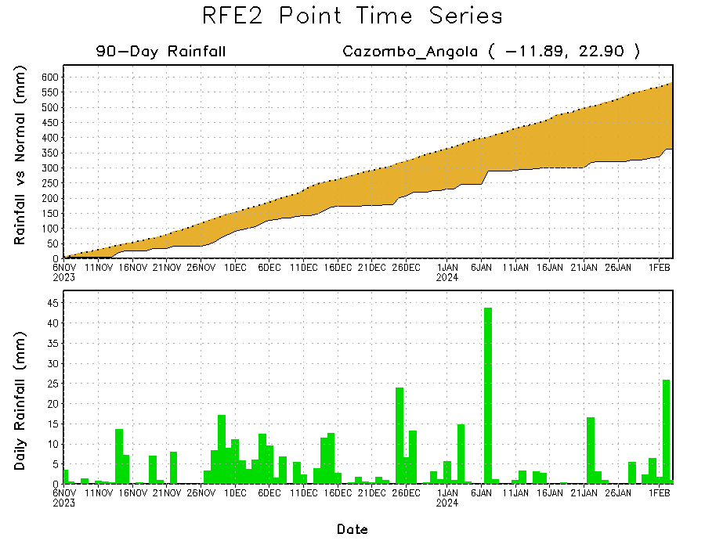
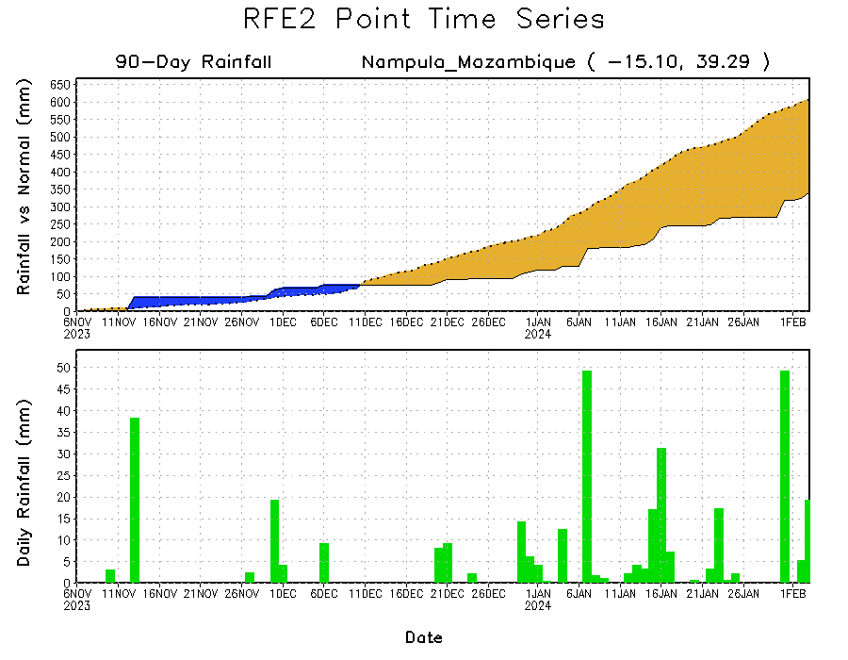
Rainfall Evolution
Daily evolution of rainfall over the last 90 days at selected locations shows a growing deficits over parts of east-central Angola (bottom left) and northeastern Mozambique (bottom right). Rainfall surpluses continued over northeastern Tanzania due to the recent moderate rainfall (top right).

Slide 9
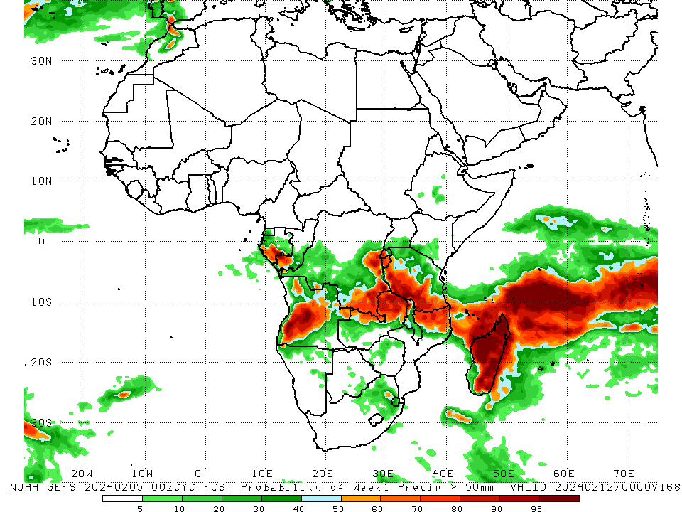
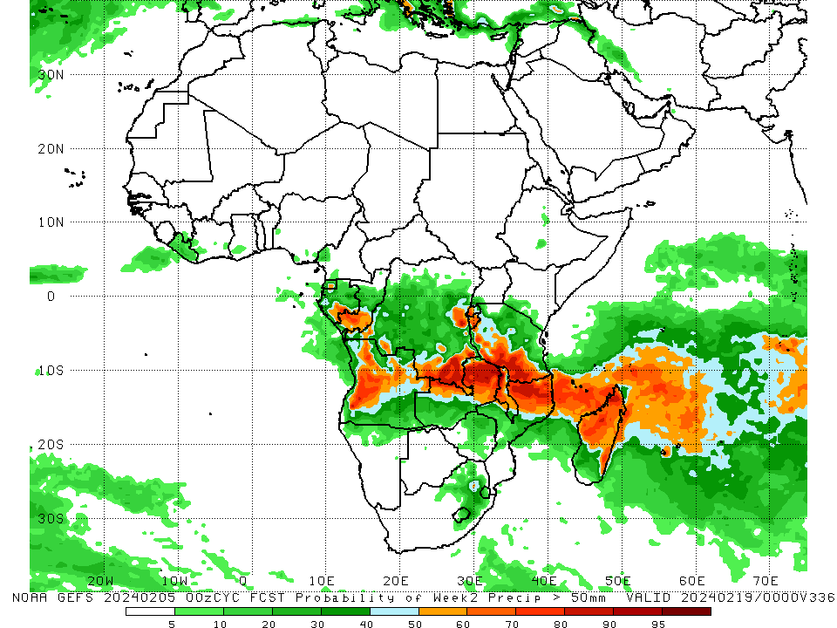
NCEP GEFS Model Forecasts Non-Bias Corrected Probability of precipitation exceedance
Week-1, Valid: 06 – 12 Feb 2024
Week-2, Valid: 13 – 19 Feb 2024
For week-1 (left panel) the GEFS forecasts indicate a moderate to high chance (over 70%) for rainfall to exceed 50 mm over southern Gabon, southwestern Congo, western and southern Tanzania, central and southwestern Angola, southern and eastern DRC, Burundi, Rwanda, northern Zambia, northern Mozambique, parts of northern Malawi, and much of Madagascar. For week-2 (right panel), the GEFS forecasts indicate a moderate to high chance (over 70%) for rainfall to exceed 50 mm over parts of southern Gabon, southwestern Congo, southern Tanzania, northern Mozambique, Malawi, northern and eastern Zambia, southern and eastern DRC, central Angola, Rwanda, Burundi, northern, central, and eastern Madagascar.
Notes:
9

Slide 10
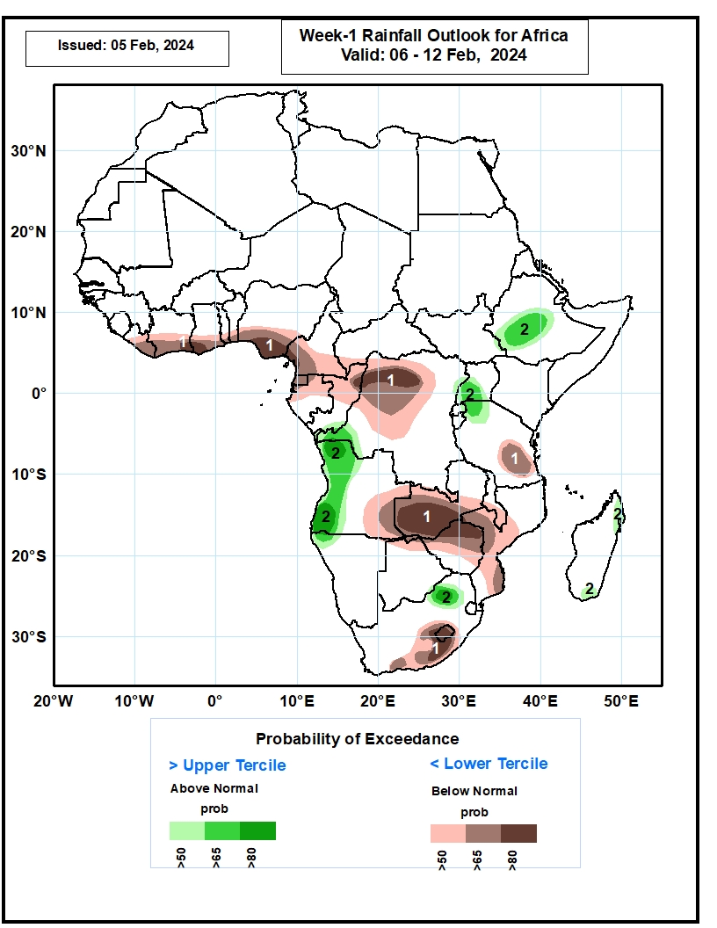
Week-1 Precipitation Outlooks
06 – 12 Feb 2024
1. The probabilistic forecasts call for above 50% chance for weekly total rainfall to be below-normal (below the lower tercile) over much of Liberia, southern Cote d’Ivoire, southern Ghana, southern Togo, southern Benin, southern Nigeria, southern Cameroon, Equatorial Guinea, northern Gabon, northern and central Congo, western and central parts of DR Congo, eastern Tanzania, eastern Angola, western and central Zambia, southern Malawi, northern Botswana, much of Zimbabwe, central and southern Mozambique, southern South Africa, and Lesotho. There is above 80% chance for below-normal rainfall over southeastern Cote d’Ivoire, southwestern Ghana, southern Nigeria, southwestern Cameroon, northern Congo, northwestern DR Congo, western Zambia, northern Zimbabwe, southern South Africa, and much of Lesotho.
2. The probabilistic forecasts call for above 50% chance for weekly rainfall to be above-normal (above the upper tercile) over western DR Congo, western Angola, southern Uganda, northwestern Tanzania, central and southwestern parts of Ethiopia, northern South Africa, and northern and southern parts of Madagascar. There is above 80% chance for above-normal rainfall over northwestern and southwestern Angola, and northern South Africa.
Notes:
10

Slide 11
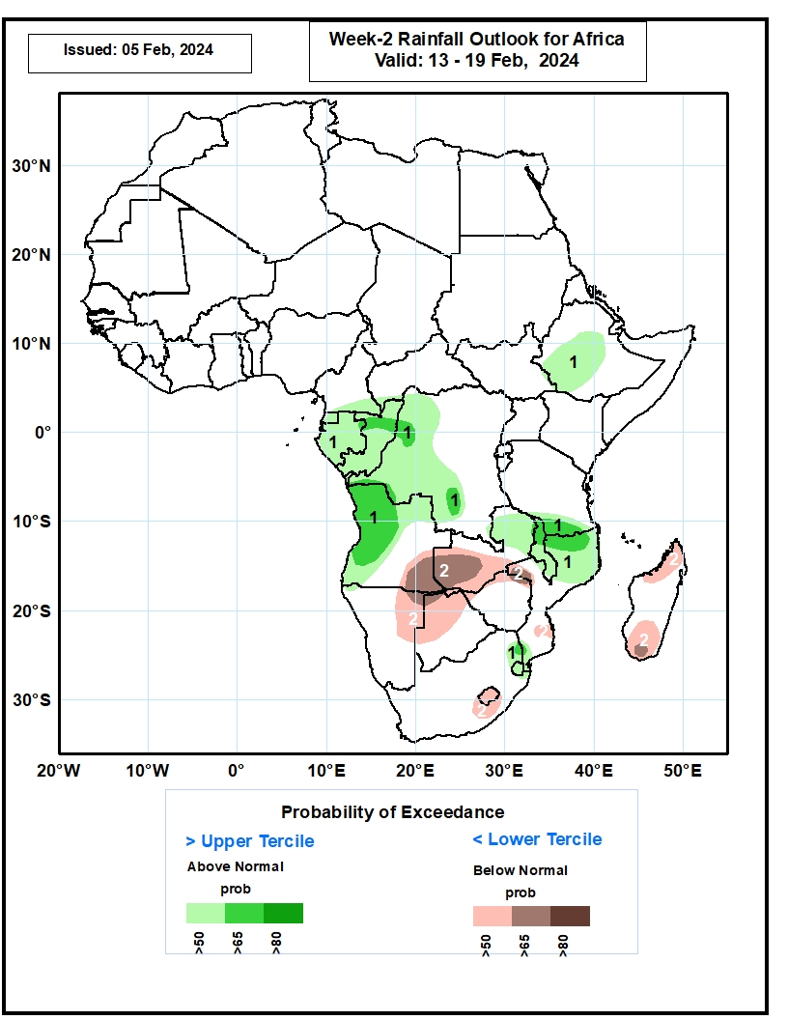
Week-2 Precipitation Outlooks
13 – 19 Feb 2024
1. The probabilistic forecasts call for above 50% chance for weekly rainfall to be above-normal (above the upper tercile) over southern Cameroon, Equatorial Guinea, Gabon, Congo, western and central parts of DR Congo, western and northern Angola, central and southwestern Ethiopia,
northern Zambia, Malawi, southern Tanzania, northern Mozambique, northeastern South Africa, and Eswatini. There is above 65% chance for above-normal rainfall over northern Congo, northwestern and southern parts of DR Congo, western and central Angola, southern Tanzania,
northern Malawi, northern Mozambique, and northeastern South Africa.
2. The probabilistic forecasts call for above 50% chance for weekly total rainfall to be below-normal (below the lower tercile) over eastern Angola, western and central Zambia, eastern Namibia, northern and central Botswana, northern Zimbabwe, western and southern parts of Mozambique, central South Africa, Lesotho, and northern and southern parts of Madagascar. There is above 65% chance for below normal rainfall over southeastern Angola, western Zambia, northeastern Namibia, northern Botswana, western Mozambique, and south-central Madagascar.
Notes:
11

Slide 12
Summary
Over the past 30 days, in East Africa, above-average rainfall was observed in many parts of Tanzania, parts of east-central and southern Uganda, southern and northwestern Kenya, northern and central Burundi, Rwanda, far southeastern Somalia, and pockets of southwestern Ethiopia. Rainfall was below-average over southwestern South Sudan and parts of central and western Ethiopia. In Central Africa, rainfall was above-average across parts of central, eastern, and southeastern DRC. Below-average rainfall was observed in Equatorial Guinea, most of Gabon, most of Congo, much of DRC, southern CAR, and southern Cameroon. In West Africa, rainfall was above-average from coastal areas of eastern Liberia to southwestern Ghana. Rainfall was below average in central Liberia, parts of Ghana, and southwestern and south-central Nigeria. In southern Africa, above-average rainfall was observed in pockets of north-central and east-central Namibia, eastern Zambia, west-central and parts of northern Mozambique, northeastern Zimbabwe, parts of southern Botswana, eastern and southern Lesotho, southeastern and central South Africa, Malawi, and southern, east-central, and far northern Madagascar. Below-average rainfall was observed in Angola, western Zambia, northern Namibia, northern and western Botswana, central and eastern Zimbabwe, eastern South Africa, southern and central Mozambique, Eswatini, and far southwestern, west-central, and parts of northern Madagascar.
During the past 7 days, in East Africa, rainfall was above-average in many parts of west-central Ethiopia southeastern Uganda, western Rwanda, western Burundi, and most places in Tanzania. In central Africa, above-average rainfall was observed over pockets central DRC, parts of western Gabon, and parts of central Congo. Rainfall was below-average over parts of northern and southern DRC, Congo. In West Africa, rainfall was near-normal over most of the region. In southern Africa, rainfall was above-average over pockets of northeastern Zambia, western Angola, most places in Namibia, northeastern and south-central Mozambique, western South Africa, and northeastern Madagascar. Below-average rainfall was observed over eastern Angola, most of Zambia, Malawi, Zimbabwe, northern Botswana, western and north-central Mozambique, parts of Lesotho, Eswatini, eastern South Africa, and most of western and southern Madagascar.
The Week-1 outlook calls for above-average rainfall in central and southwestern Ethiopia, southern Uganda, Rwanda, northwestern Tanzania, parts of western DRC, western Angola, part of northwest Namibia, and part of northeastern South Africa. In contrast, there is an increased chance for below-average rainfall across coastal portions of the Gulf of Guinea region, northern Gabon, northern DRC, southern Cameroon, southeastern Angola, western and southern Zambia, southern Malawi, northern Zimbabwe, western, central, and southeastern Mozambique, part of northern Botswana, southern South Africa, and Lesotho. The Week-2 outlook primarily calls for above-average rainfall across the western parts of Central Africa, central and southwestern Ethiopia, western Angola, eastern Zambia, Malawi, southern Tanzania, northern Mozambique, Eswatini, and part of northeastern South Africa. Below-average rainfall is, however, expected in southeastern Angola, western and southern Zambia, northeastern Namibia, northwestern Botswana, northern Zimbabwe, part of western Mozambique, northwestern and southern Madagascar.

