Slide 1
The Asian-Australian Monsoon System: Recent Evolution, Current Status and Prediction
Update prepared by
Climate Prediction Center / NCEP
October 16, 2017
For more information, visit: http://www.cpc.ncep.noaa.gov/products/Global_Monsoons/Asian_Monsoons/Asian_Monsoons.shtml

Slide 2
Outline
Recent Rainfall and Current Conditions
Monsoon Prediction
Summary
Climatology

Slide 3
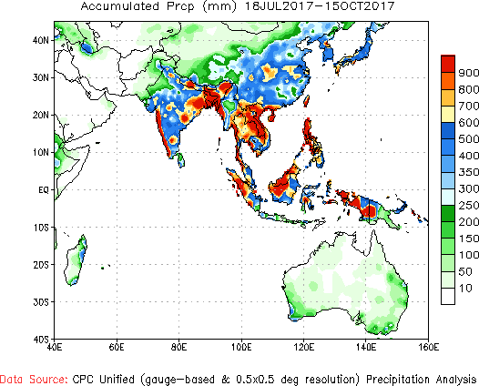
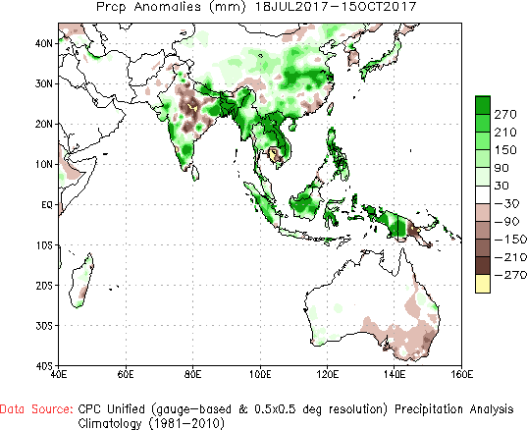
Precip Patterns: Last 90 Days
For the past 90 days, below normal rainfall deficits remain in general over parts of northern & central India, Koreas, Japan, coastal eastern China, Papua New Guinea, and parts of south eastern Australia. Elsewhere the monsoon rainfall is at normal to above normal levels.

Slide 4
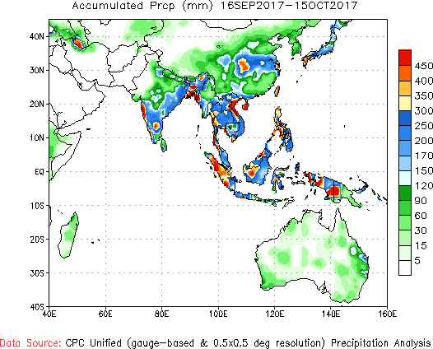
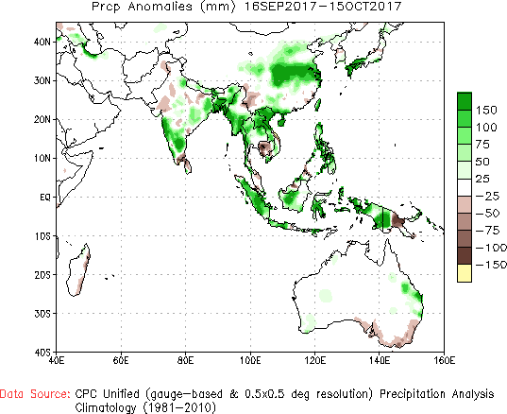
Precip Patterns: Last 30 Days
For the past 30 days, neutral to mild below normal rainfall deficits are noted over northern and north central India, but larger deficits are noted over southeastern coast of southern peninsular India, parts of Cambodia, southern Vietnam, Papua New Guinea, and south eastern coastal Australia. Elsewhere the rainfall amounts are near normal to above normal.

Slide 5
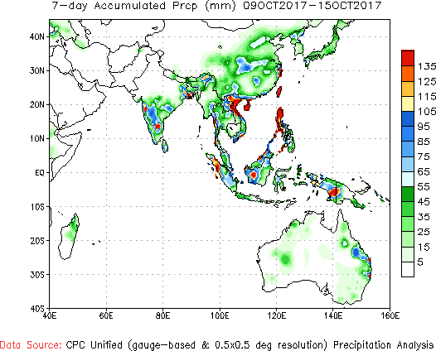
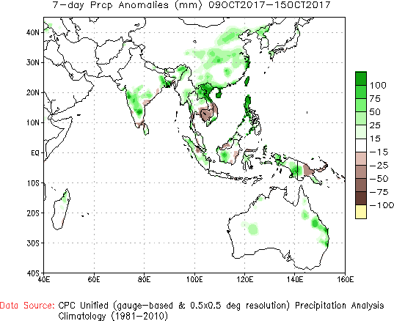
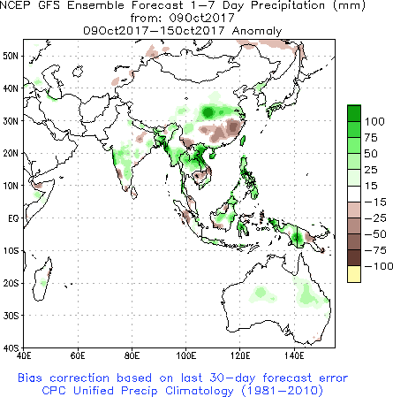
Precip Patterns: Last 7 Days
In this past week, the observed rainfall amounts have generally been mostly positive everywhere across the region, except over Cambodia, Vietnam and Papua New Guinea. .

Slide 6
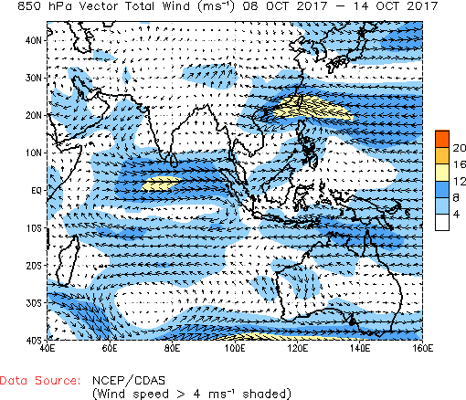
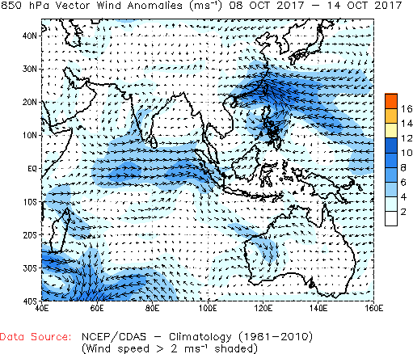
Atmospheric Circulation
Generally these CDAS maps are two days behind. But sometimes, as it is today, due to technical issues, these maps are further behind.

Slide 7
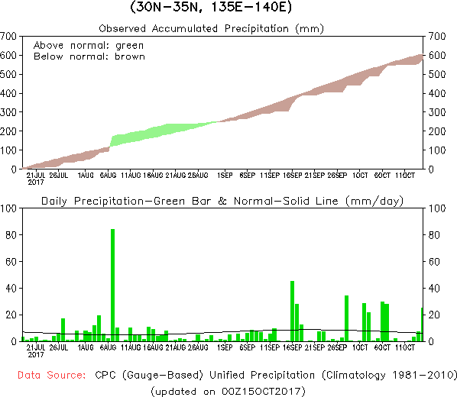
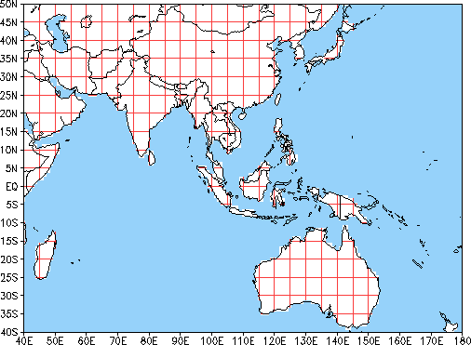
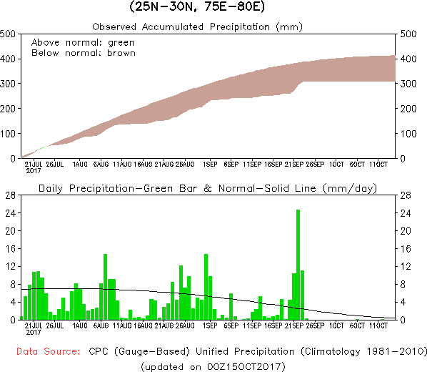
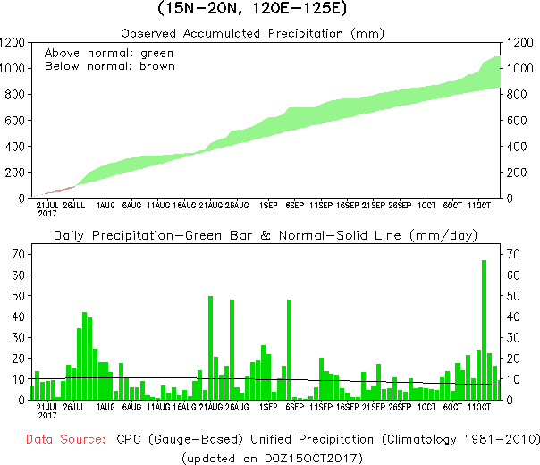
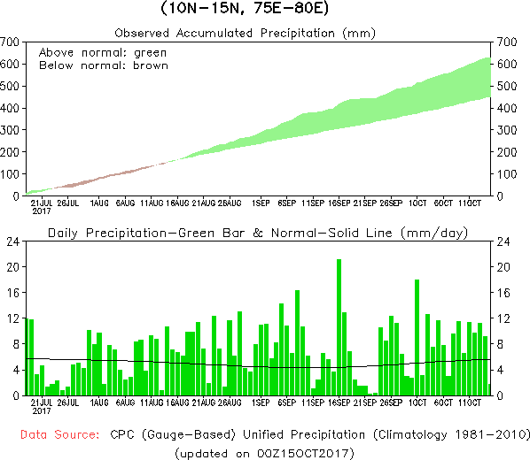
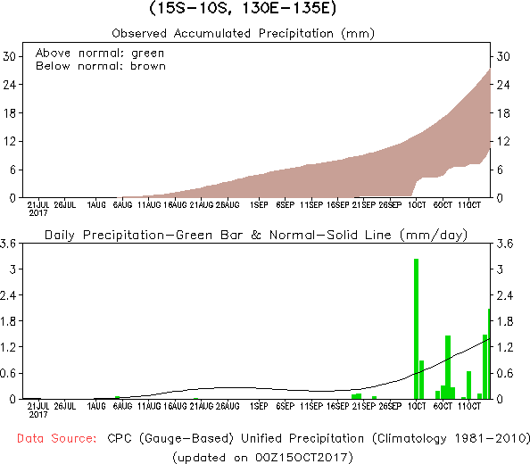
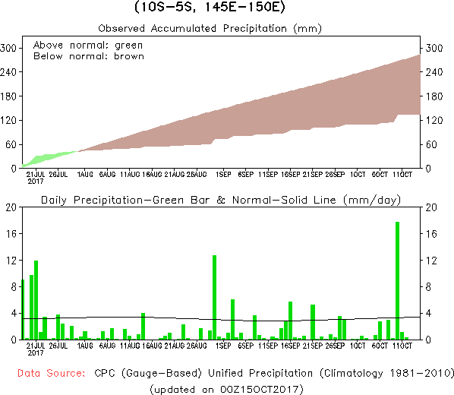
Rainfall Time Series over 5x5 lat-lon boxes
The time series of precipitation over the various regions is pretty much consistent with the spatial maps shown earlier.

Slide 8
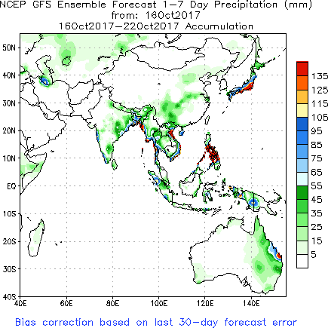
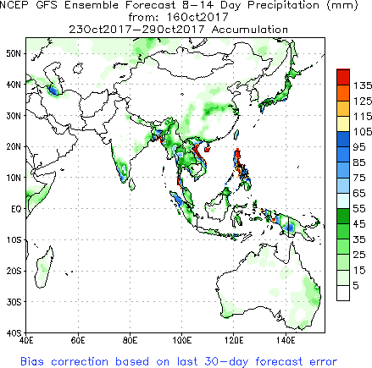
NCEP/GFS Model Forecasts
Accumulated Precip. for Week 1 & Week 2
Week-1
Week-2

Slide 9
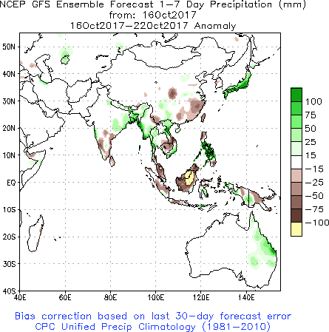
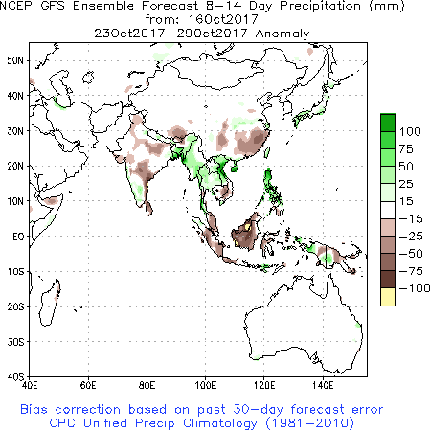
NCEP/GFS Model Forecasts
Bias-Corrected Precip. Anom. for Week 1 & Week 2
Week-1
Week-2

Slide 10
Summary
For the past 90 days, below normal rainfall deficits remain in general over parts of northern & central India, Koreas, Japan, coastal eastern China, Papua New Guinea, and parts of south eastern Australia. Elsewhere the monsoon rainfall is at normal to above normal levels. For the past 30 days, neutral to mild below normal rainfall deficits are noted over northern and north central India, but larger deficits are noted over southeastern coast of southern peninsular India, parts of Cambodia, southern Vietnam, Papua New Guinea, and south eastern coastal Australia. Elsewhere the rainfall amounts are near normal to above normal.
In this past week, the observed rainfall amounts have generally been mostly positive everywhere across the region, except over Cambodia, Vietnam and Papua New Guinea. In the upcoming two weeks, the NCEP GFS model generally predicts below normal rainfall over much of the whole region, except over parts of northeast India, Burma, Vietnam, the Philippines and some eastern parts of Australia.

Slide 11
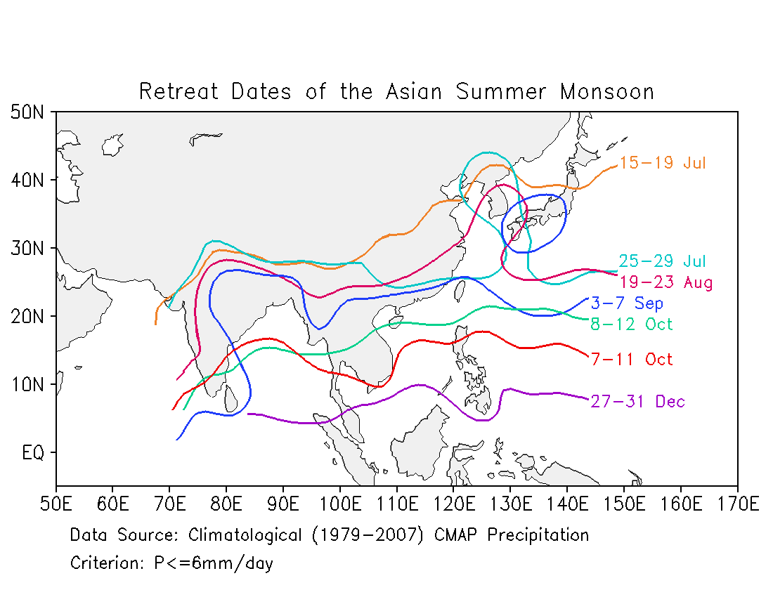
Demise of the Asian Monsoon

Slide 12
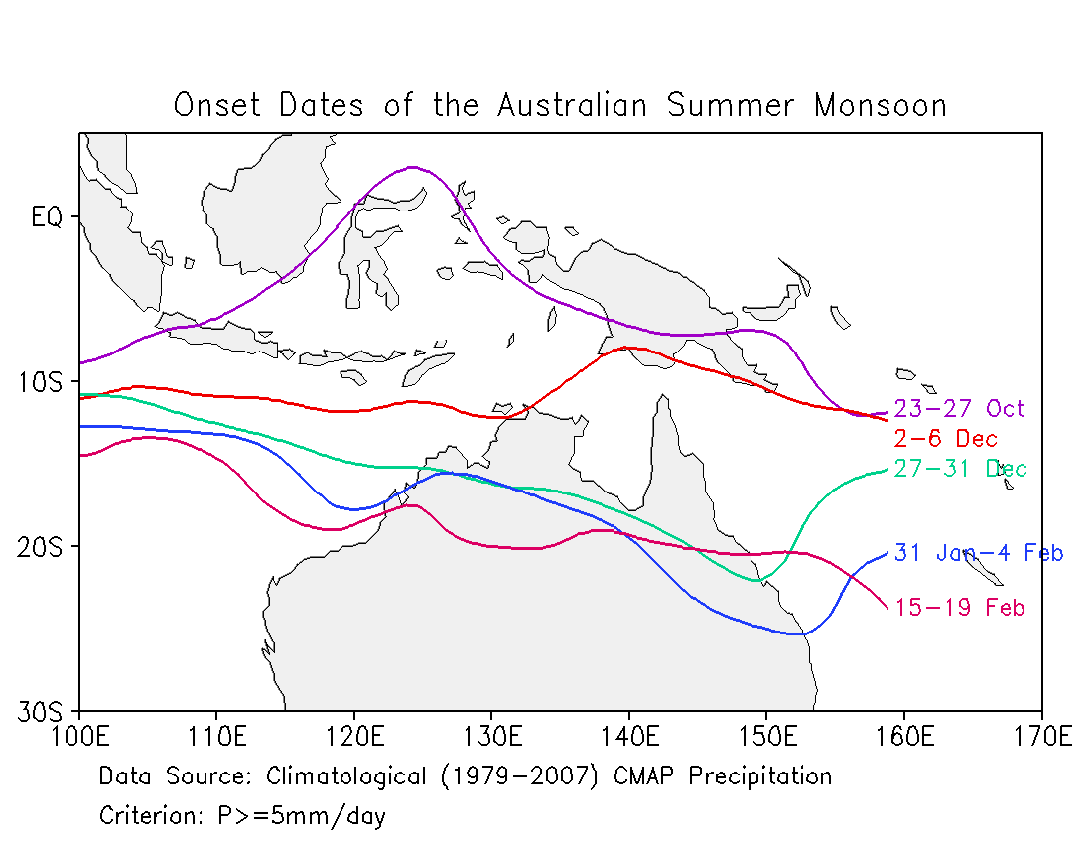
Onset of the Australian Monsoon

Slide 13
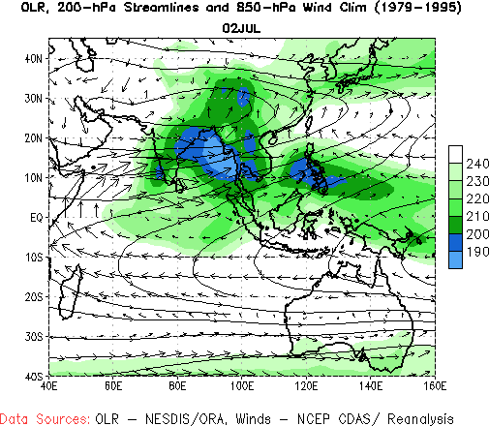
Climatology

