Slide 1
Generating Week-2 Real Time Forecasts, Valid 11 – 17 October 2019
Group Name/Number First WMO RCC-Washington Training Workshop Washington DC, USA, 30 September 2019 – 4 October 2019

Slide 2
Run the Script
1. On your Cygwin/Linux terminal, change your directory to the subseaon folder:
cd subseason
2. Run the script for the area of interest of your group:
bash plot_all.sh ‘west’ ‘east’ ‘south’ ‘north’
Where ‘west’ and ‘east’ are the western and eastern extent of your area of interest in your group (in degrees) respectively, while ‘south’ and ‘north’ are the southern and northern extent.
e.g, a test run for Central America and the Caribbean Region:
bash plot_all.sh -120 -40 0 35 (example)
Note: longitudes in the western hemisphere and latitudes in the southern hemisphere have negative values.

Slide 3
Run Output
Depending on your Internet browser security setting, a webpage with your test run output should popup automatically:
You will use figures from the web page, later during the exercise

Slide 4
Generate a Blank Country Map
Use the command below to generate a blank country map.
bash blank_map.sh ‘west’ ‘east’ ‘south’ ‘north’
Where ‘west’ and ‘east’ are the western and eastern extent of your area of interest in your group (in degrees) respectively, while ‘south’ and ‘north’ are the southern and northern extent.
You may use your file explorer to locate the blank country map
For Cygwin users, under
C:/cycgwin64/home/your_user_name/subseason/blank_map.png
You will use this map to draw forecast polygons, later during the exercise

Slide 5
Week-1/2 Forecast Process
Active MJO
Phase diagrams and composites
Yes
Consensus Forecast, Polygons and Text Description
No
Circulation Anomalies
Forecast Discussion
Assess its possible Impact
Raw Rainfall Anomalies
No
Active Tropical Cyclone
Yes
Bias Corrected / Reg Calibrated

Slide 6
Week-1/2 Forecast Tools
Active MJO?
Active tropical cyclone/Hurricane/typhoon activity?
Significant SST and circulation anomaly patterns?

Slide 7
200-hPa Velocity Potential Anomaly
https://www.cpc.ncep.noaa.gov/products/precip/CWlink/ir_anim_monthly.shtml
Green shade indicates areas of upper level divergence and convection or precipitation at surface. Brown contours indicate areas of upper level convergence or subsidence and suppressed precipitation at surface.

Slide 8
Wheeler-Hendon Index - Forecasts
GFS/GEFS
Statistical
CFSv2
https://www.cpc.ncep.noaa.gov/products/precip/CWlink/MJO/combphase_noCFSfull.gif
https://www.cpc.ncep.noaa.gov/products/precip/CWlink/MJO/statphase_full.gif
https://www.cpc.ncep.noaa.gov/products/precip/CWlink/MJO/CLIVAR/CFSO_phase_small.gif
ECMWF
JMAN
CMET
https://www.cpc.ncep.noaa.gov/products/precip/CWlink/MJO/CLIVAR/ECMF_phase_MANOM_51m_small.gif
https://www.cpc.ncep.noaa.gov/products/precip/CWlink/MJO/CLIVAR/JMAN_phase_51m_small.gif
https://www.cpc.ncep.noaa.gov/products/precip/CWlink/MJO/CLIVAR/CANM_phase_20m_small.gif

Slide 9
Evolution of MJO-related anomalies
Initial date: 2 October 2019
Red shade indicate areas
of suppressed convection
Blue shade indicate areas
of enhanced convection
https://www.cpc.ncep.noaa.gov/products/precip/CWlink/MJO/spatial_olrmap_full.gif
1 - 5 days ave. Forecast
6-10 days ave. Forecast
11-15 days ave. Forecast

Slide 10
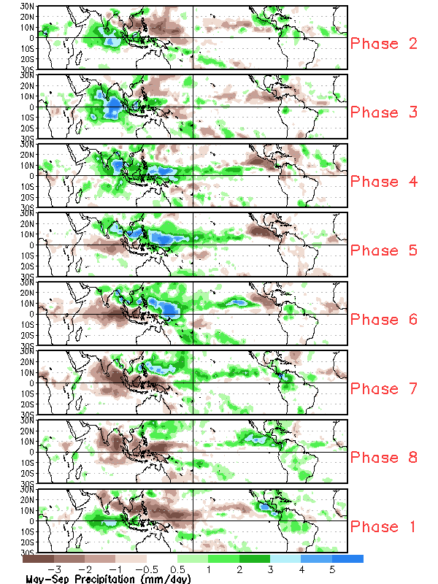
MJO Rainfall Composites – Global Tropics
Precipitation Anomalies (May - Sep)
http://www.cpc.ncep.noaa.gov/products/precip/CWlink/MJO/plot_pcp_tvalue_8pan_maysep.gif (May - Sep Season)
http://www.cpc.ncep.noaa.gov/products/precip/CWlink/MJO/plot_pcp_tvalue_8pan_novmar.gif (Nov - Mar Season)

Slide 11
Week2, MJO Contribution?
Do the MJO predictions suggest enhanced/suppressed rainfall over your country?

Slide 12
NCEP GEFS Wind and Divergence Anomaly Forecast Week-2, Valid: 11 - 17 October, 2019
850-hPa or 700-hPa
200-hPa

Slide 13
NCEP GEFS/CFSv2, Precip forecasts for Week-2, Valid: 11 - 17 October, 2019
Two-category Probabilistic Forecast - Raw
Two-category Probabilistic Forecast – Reg - Calibrated
Ensemble Mean Anomaly
GEFS
CFSv2

Slide 14
NCEP GEFS/CFSv2, 2m Temp. forecasts for Week-2, Valid: 11 - 17 October, 2019
Two-category Probabilistic Forecast - Raw
Two-category Probabilistic Forecast – Reg - Calibrated
Ensemble Mean Anomaly
GEFS
CFSv2

Slide 15
GEFS Week-2 Exceedance Probability, Valid: 11 - 17 October, 2019
>25mm
>50mm
>100mm

Slide 16
Week-2 Rainfall, Convergence of Evidence?
Wet
MJO ->
Lower/upper-level wind/divergence anomalies ->
Rainfall Model Guidance ->
Exceedance Probability ->
Dry
MJO ->
Lower/upper-level wind/divergence anomalies ->
Rainfall Model Guidance ->
Exceedance Probability ->

Slide 17
Week-2 2m Temp., Convergence of Evidence?
Cool
MJO?
Lower/upper-level wind/divergence anomalies ->
2m Temperature Model Guidance ->
Warm
MJO?
Lower/upper-level wind/divergence anomalies ->
2m Temperature Model Guidance ->

Slide 18
Week-2 Rainfall Outlook, 11 – 17 October 2019
.
Forecast: Reason.
Forecast: Reason.
Forecast: Reason.
Insert your blank map here
Use the ppt oval drawing tool to draw forecast polygons
Blue, for above-average rainfall and
Red for below-average rainfall
Forecast: Reason.

Slide 19
Week-2, 2m Temp Outlook, 11 – 17 October 2019
.
Forecast: Reason.
Forecast: Reason.
Forecast: Reason.
Insert your blank map here
Use the ppt oval drawing tool to draw forecast polygons
Red, for above-average temperature and
Blue for below-average temperature
Forecast: Reason.

