Slide 1
CFSv2 Forecast Skills for Sub-seasonal Anomalies
September 2020

Slide 2
Data
Ensemble forecasts from CFSv2 operational forecasts
  Every day 16 members 45-day forecasts;
  20110501—20200430;
Variables:
  Precipitation (Prec) and 2-meter temperature (T2m)
Verification data:
  Prec, the CPC unified daily gauge precipitation analysis (ftp://ftp.cpc.ncep.noaa.gov/precip/CPC_UNI_PRCP/);
  T2m, the CPC global daily mean surface temperature (ftp://ftp.cpc.ncep.noaa.gov/precip/PEOPLE/wd52ws/global_temp/);
Skill measurements:
  Anomaly correlation skill, Root mean square error (RMSE), and Standard deviation (STDV) at 1-day-lead;

Slide 3
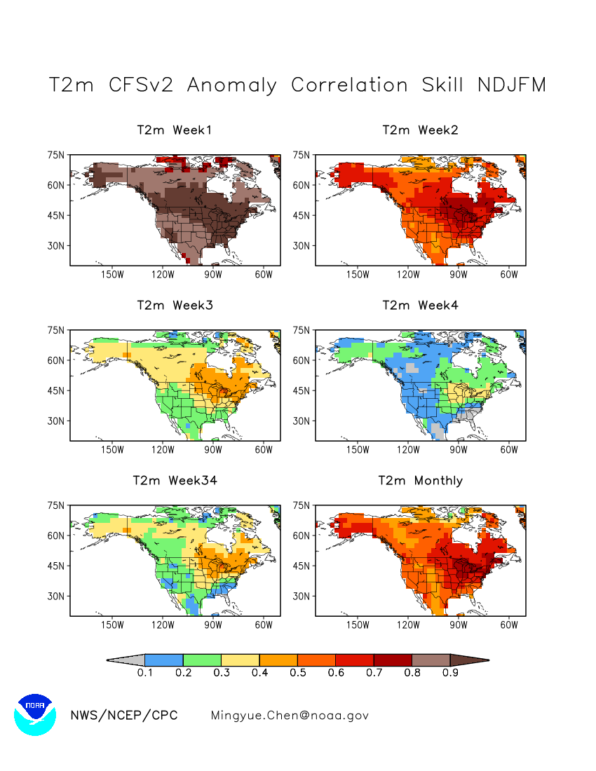

Slide 4
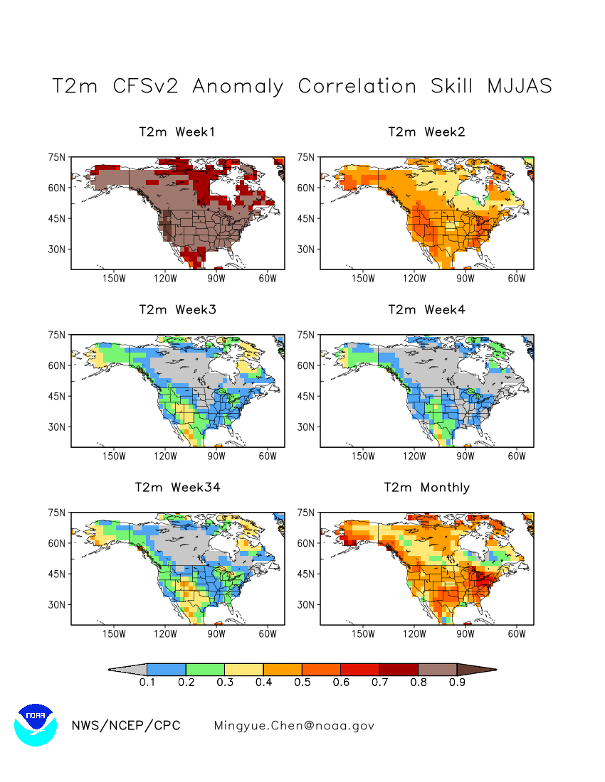

Slide 5
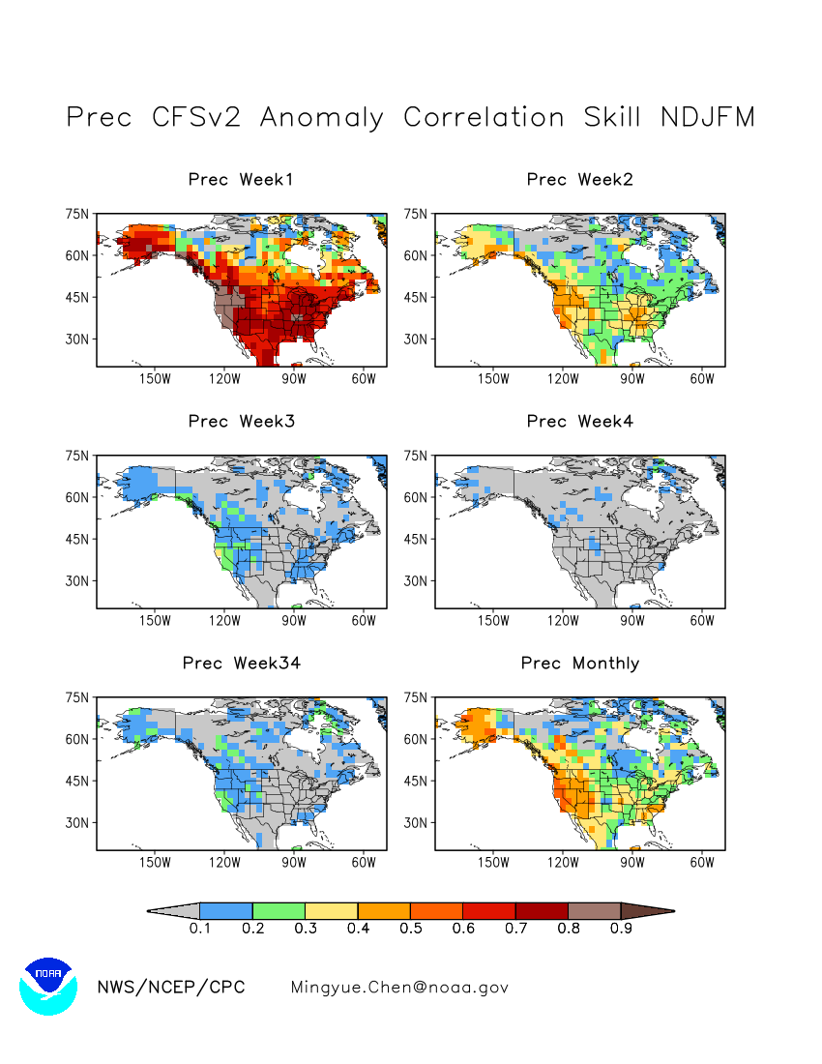

Slide 6
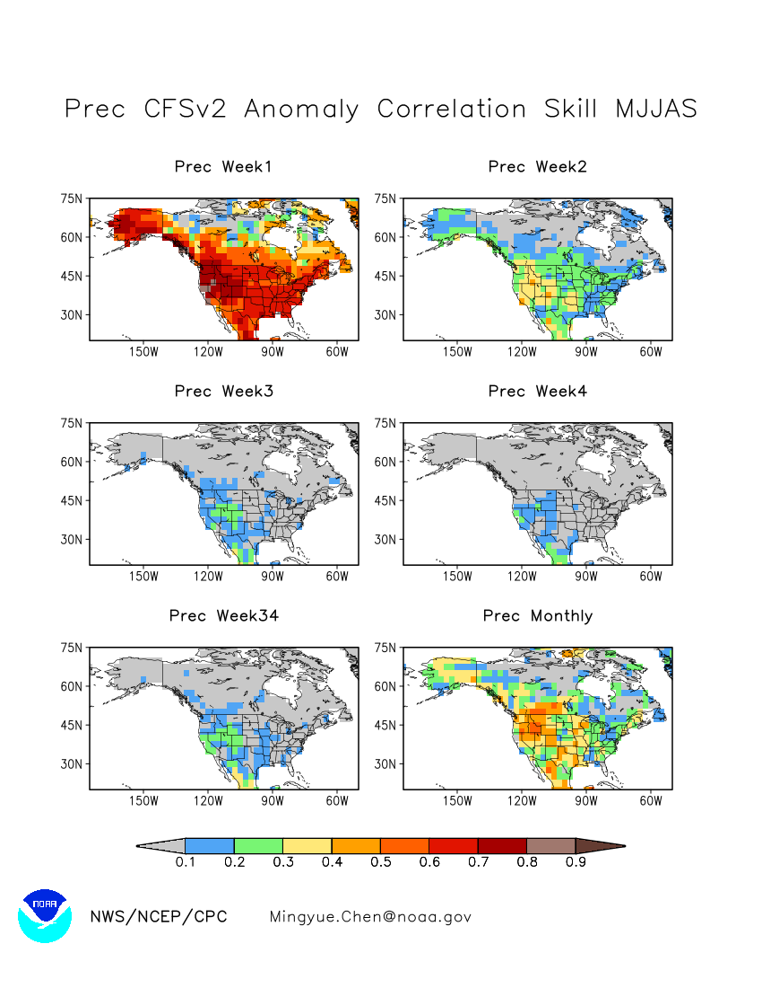

Slide 7
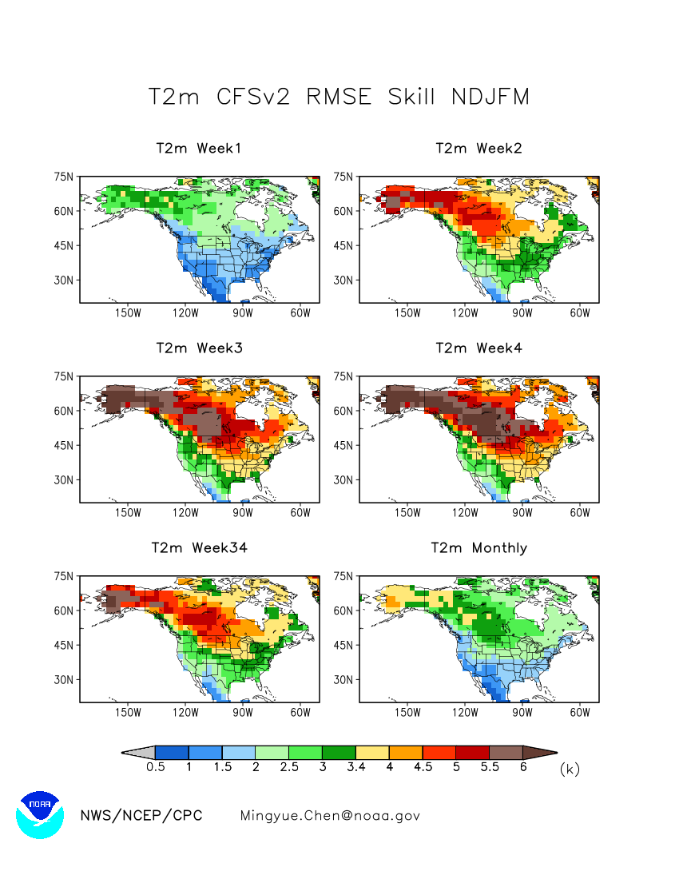

Slide 8
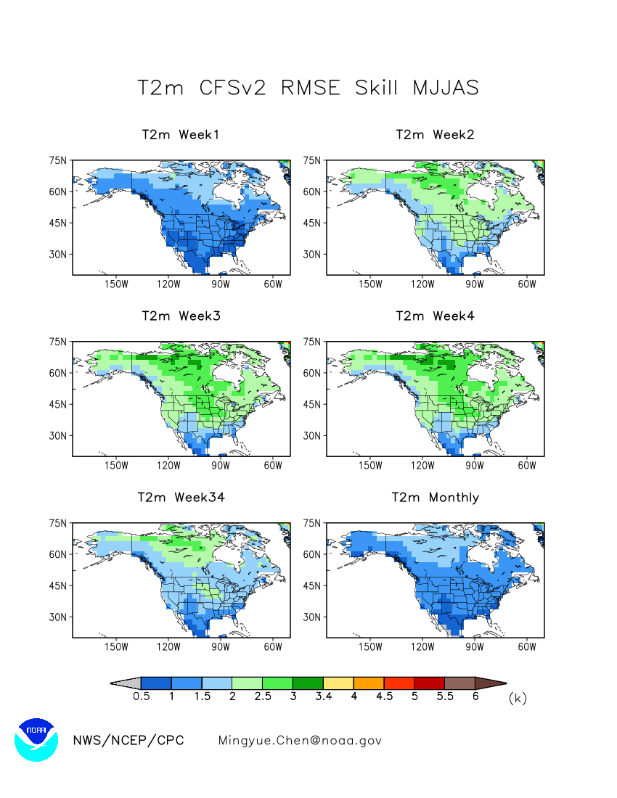

Slide 9
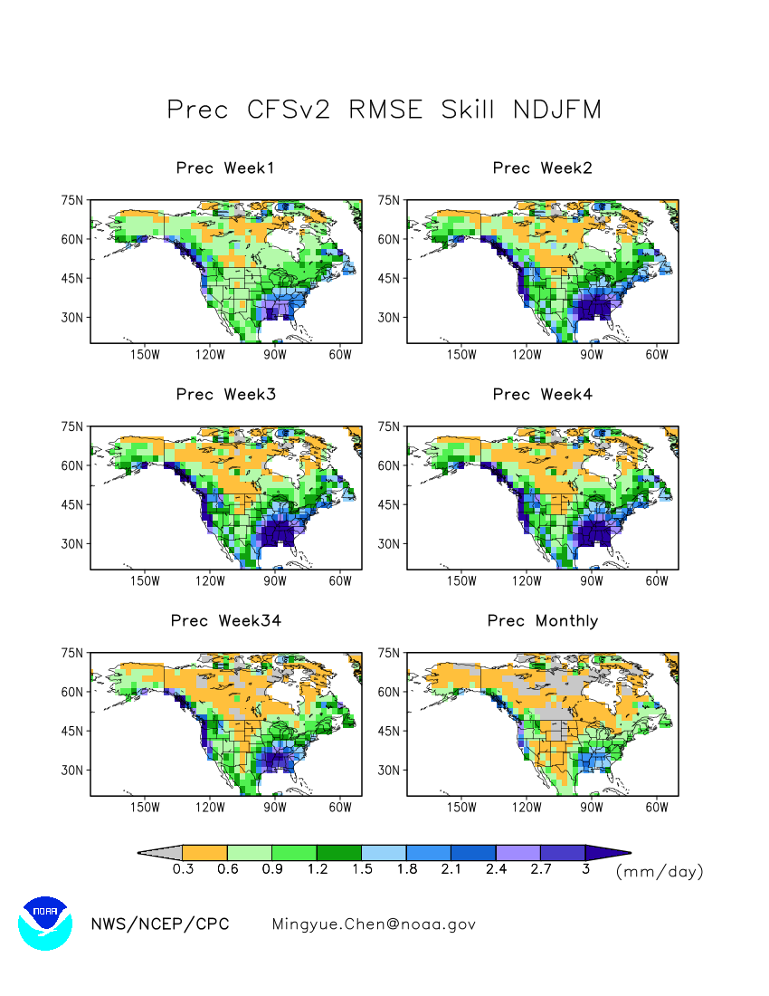

Slide 10
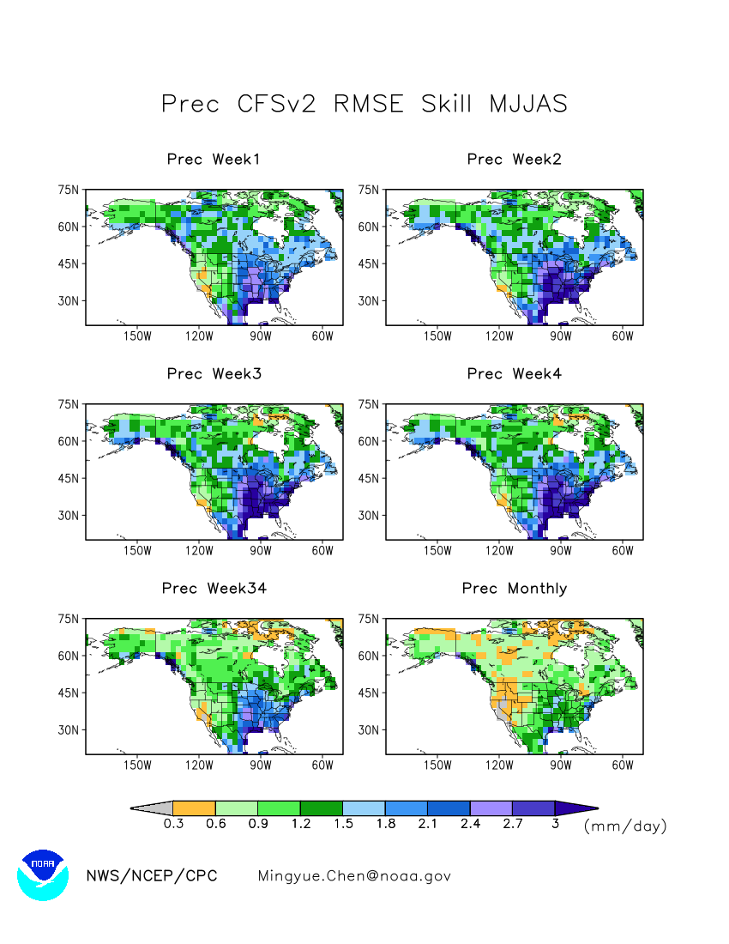

Slide 11
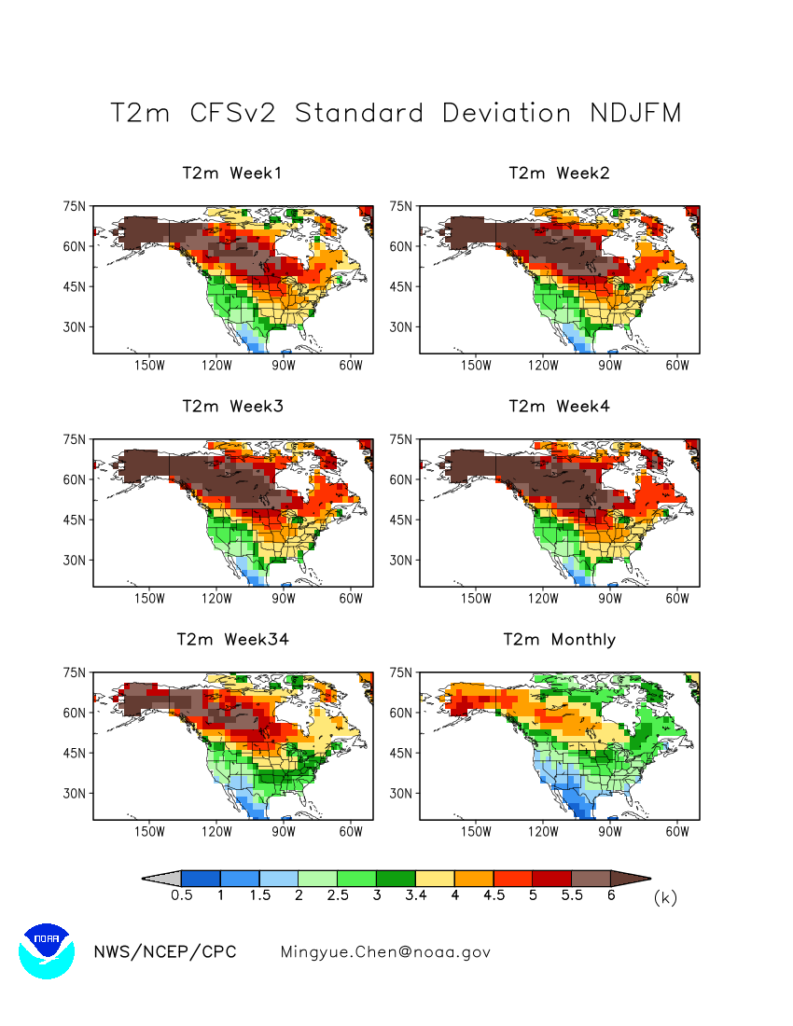

Slide 12
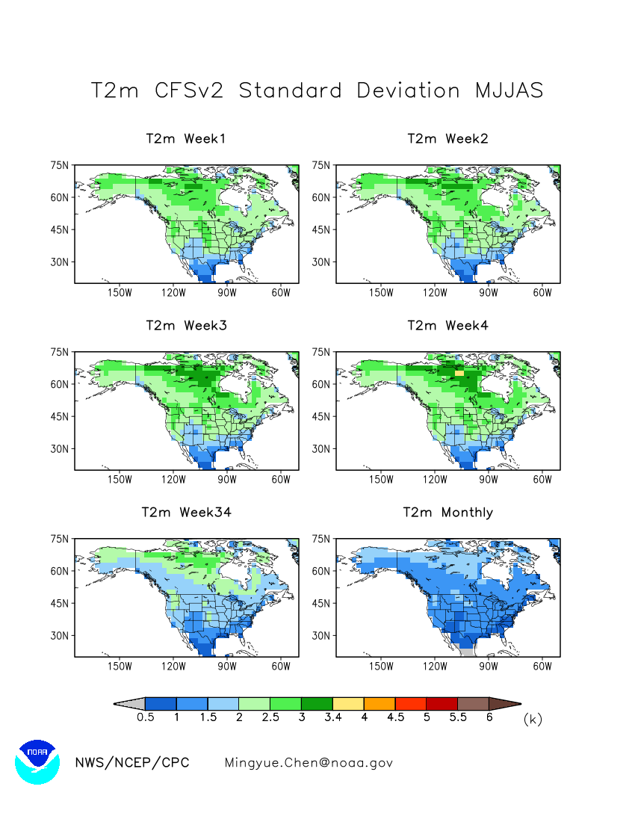

Slide 13
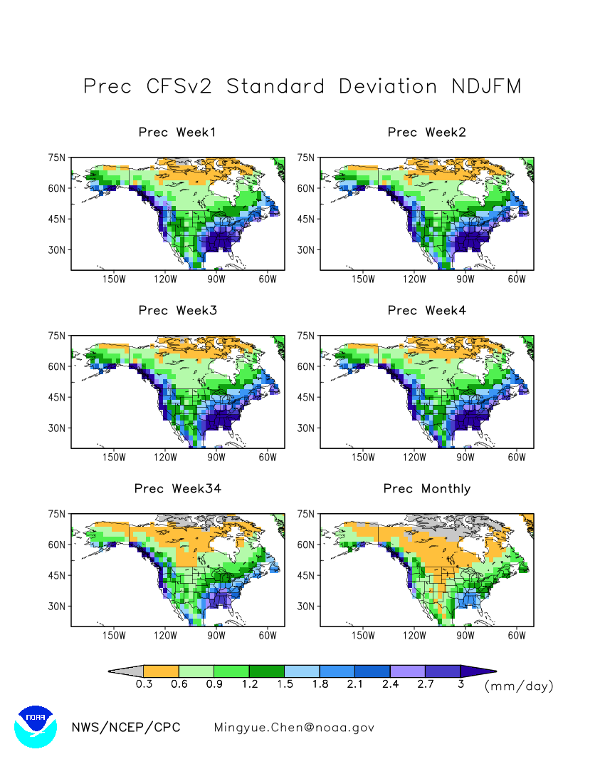

Slide 14
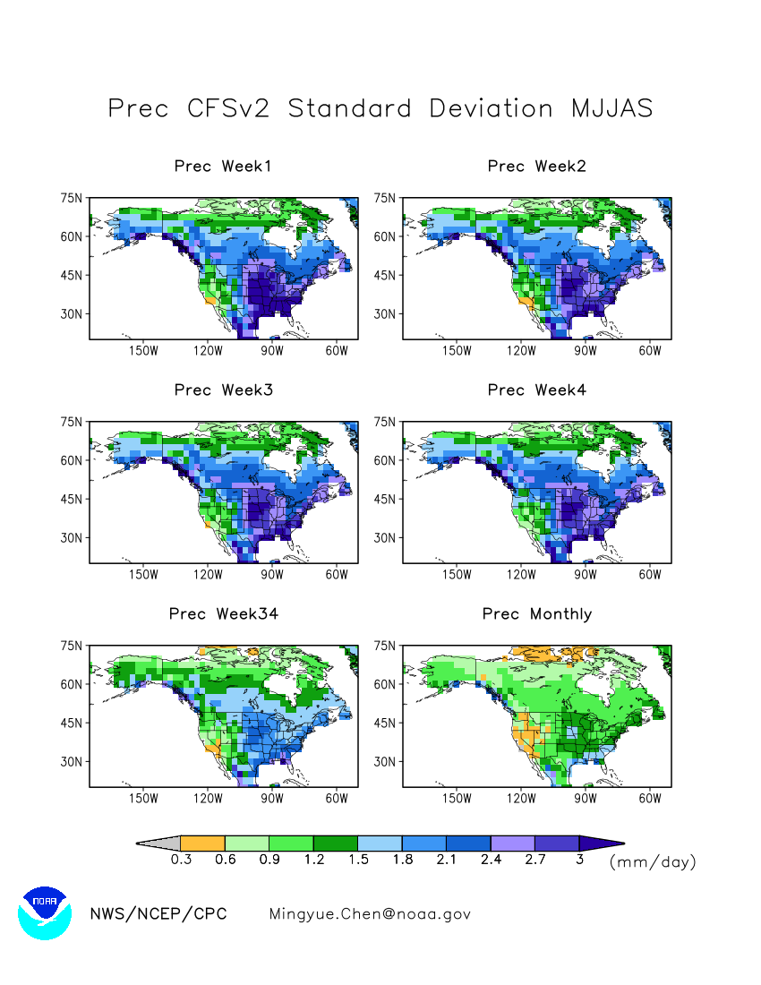

Slide 15
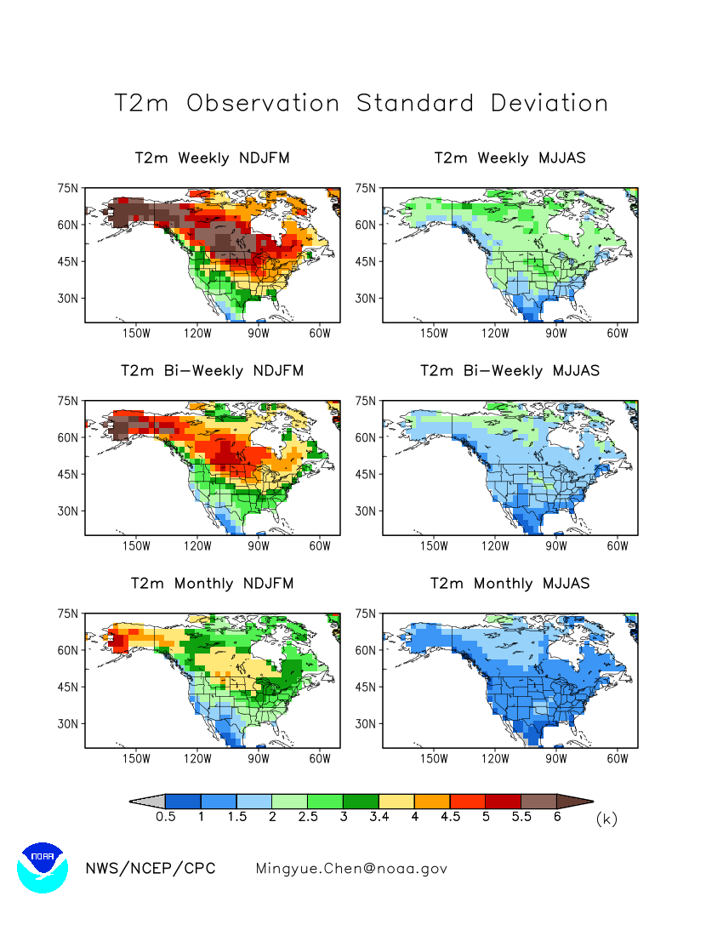

Slide 16
