Slide 1
Assessment of CFSv2 hindcast (seasonal mean)
CPC/NCEP/NOAA
Jan 2011

Slide 2
Forecast & observation data
Assessment of the CFSv2 seasonal forecasts
Compare the forecast correlation skill, Rmse, and Standard deviation from CFSv2 & CFSv1(current version)
Forecast members
CFSv2 20 members
CFSv1 15 members
Reforecast period
CFSv2 1982-2009
CFSv1 1981-2006
Climatology
CFSv2 climOne, 1982-2009
CFSv2 climTwo, 1982-1998, 1999-2009
CFSv1 1981-2006
Variables: SST, T2m, Precipitation
Observations
OI SST
CAMS surface temperature
CAMS-OPI rainfall

Slide 3
Sea Surface Temperature (SST)

Slide 4
Nino3.4 SST seasonal mean forecast correlation skill

Slide 5
Nino3.4 SST seasonal mean forecast RMSE (K)

Slide 6
Nino3.4 SST seasonal mean forecast Standard Deviation (K)

Slide 7
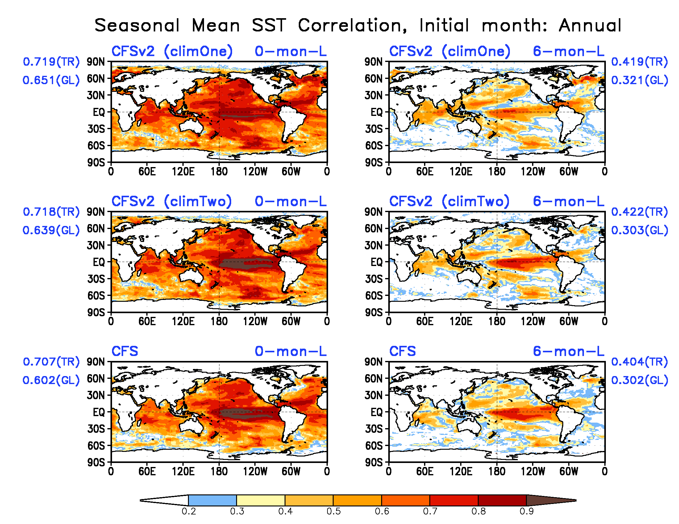
SST seasonal mean forecast correlation skill
CFSv2 shows better skills over some regions at extra-tropics, and over the ocean basins other than the tropical E. Pacific;
CFSv2 skills are increased at the tropical E. Pacific with two climatology anomalies.

Slide 8
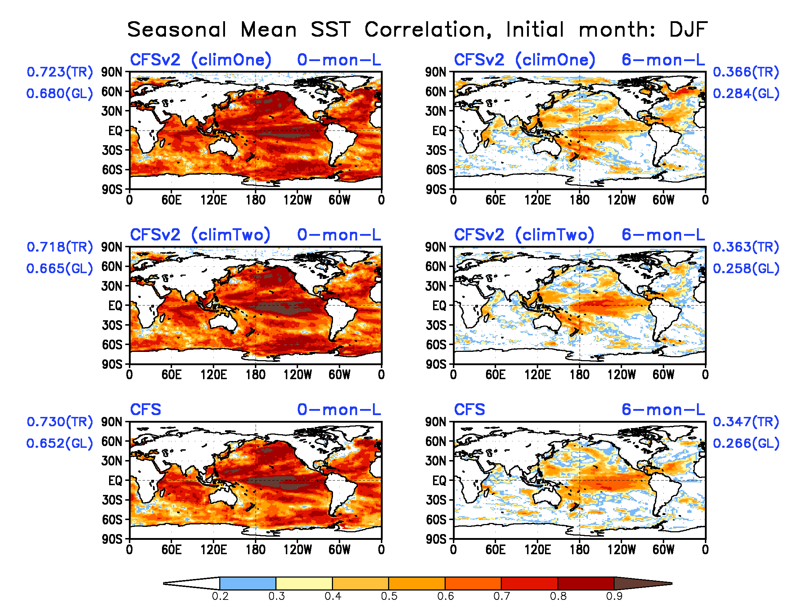
SST seasonal mean forecast correlation skill

Slide 9
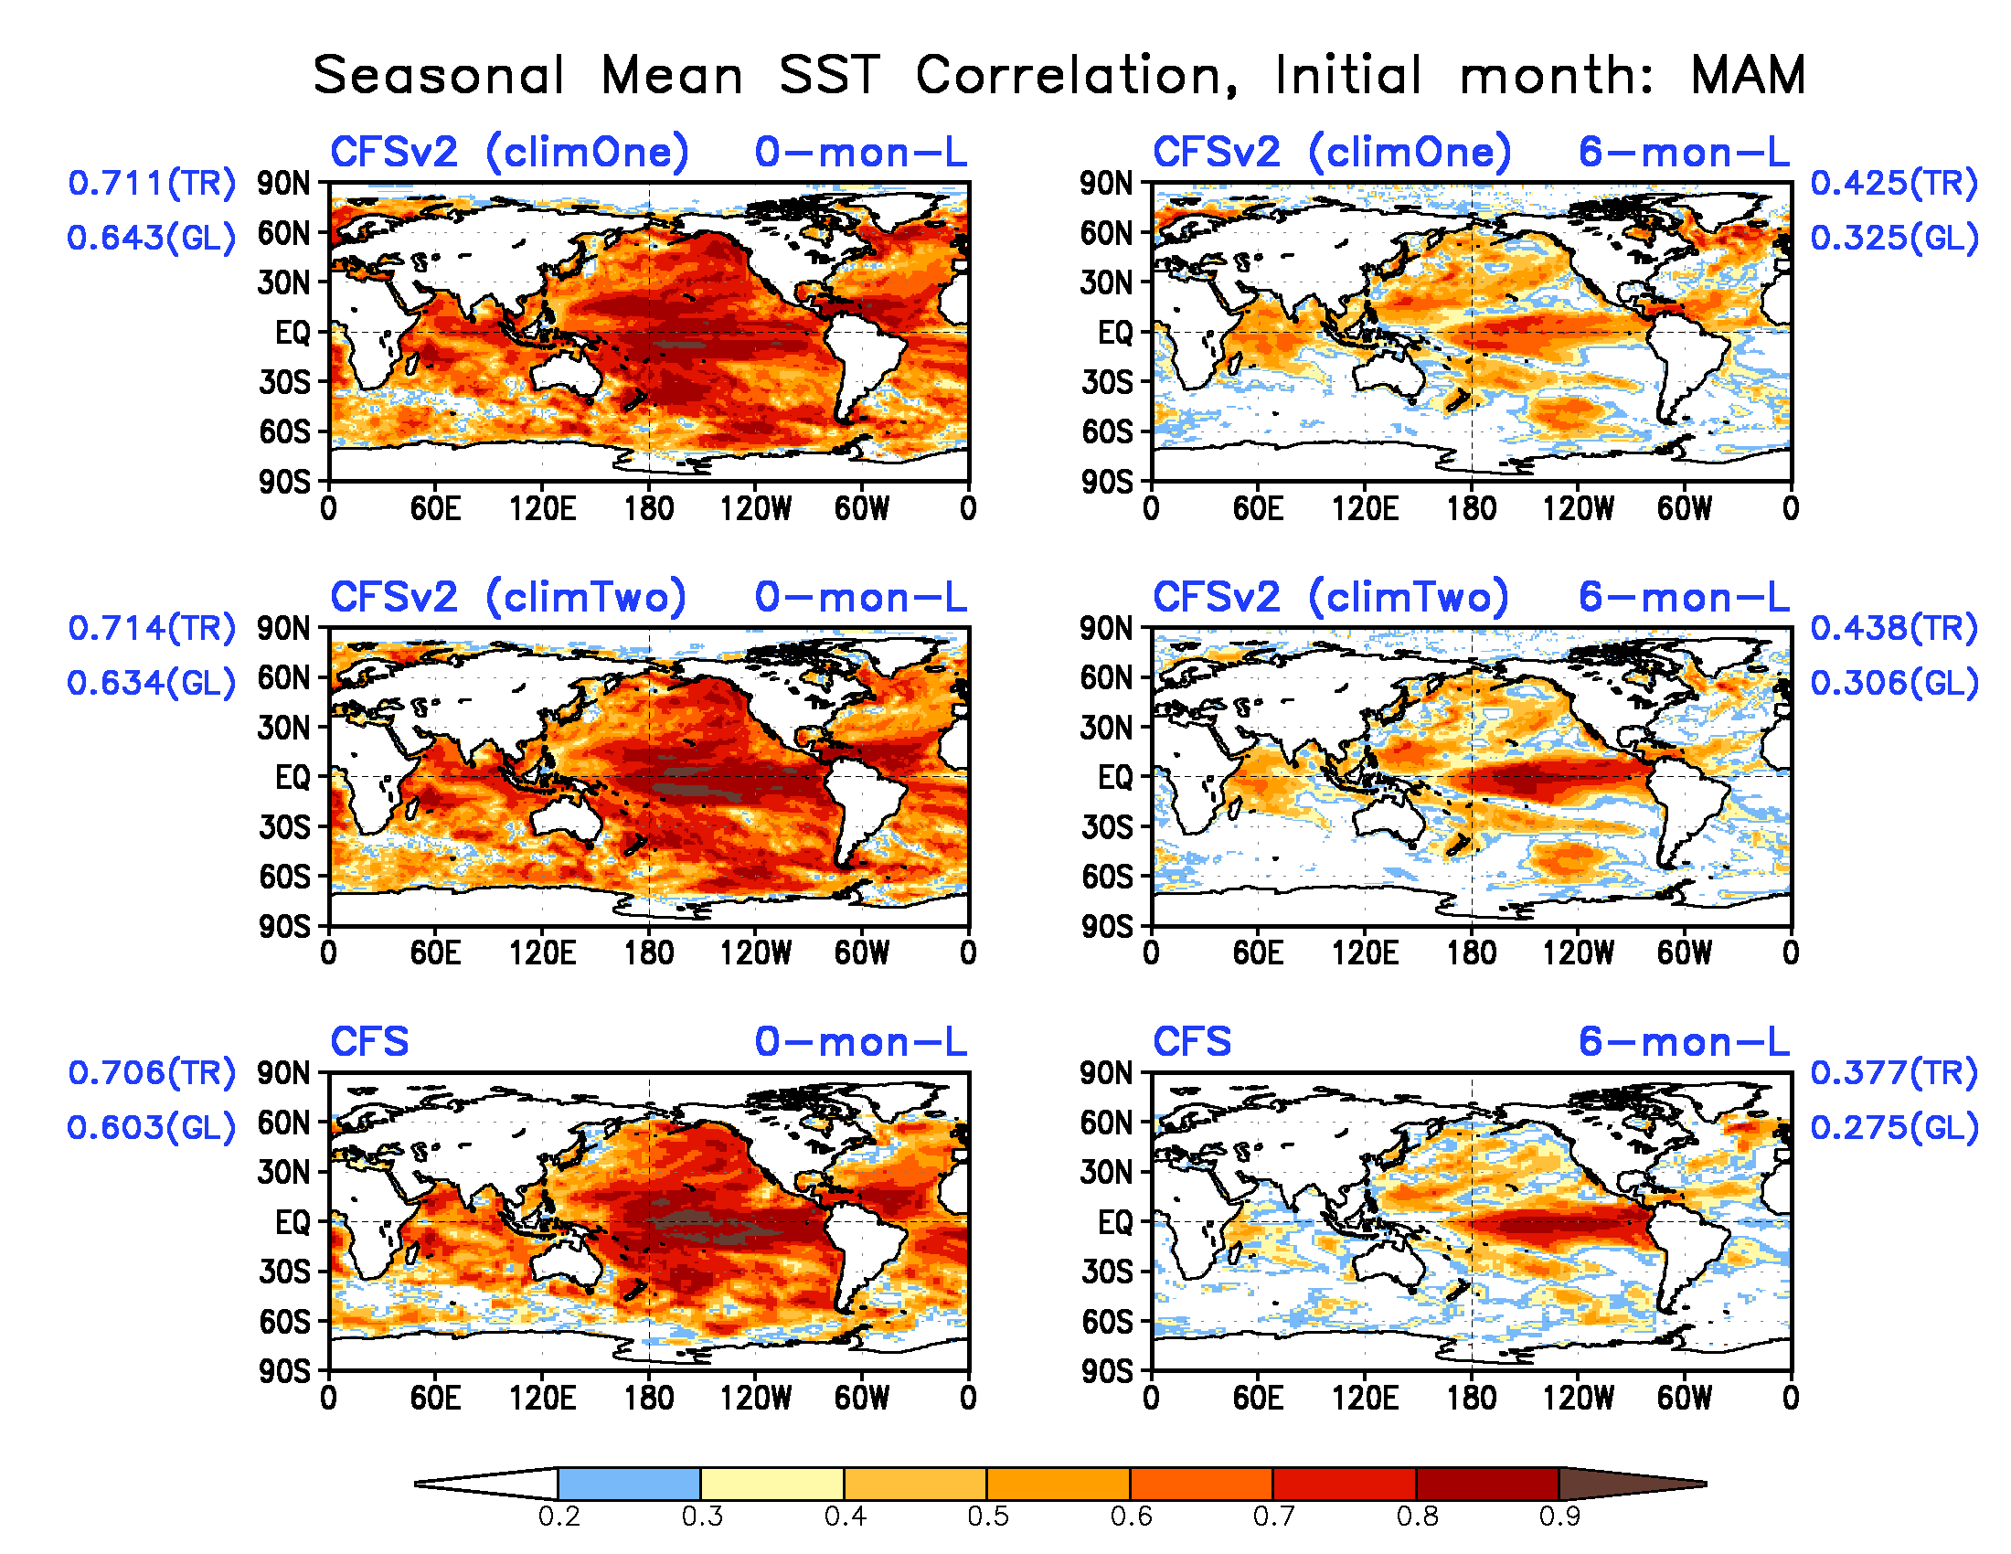
SST seasonal mean forecast correlation skill

Slide 10
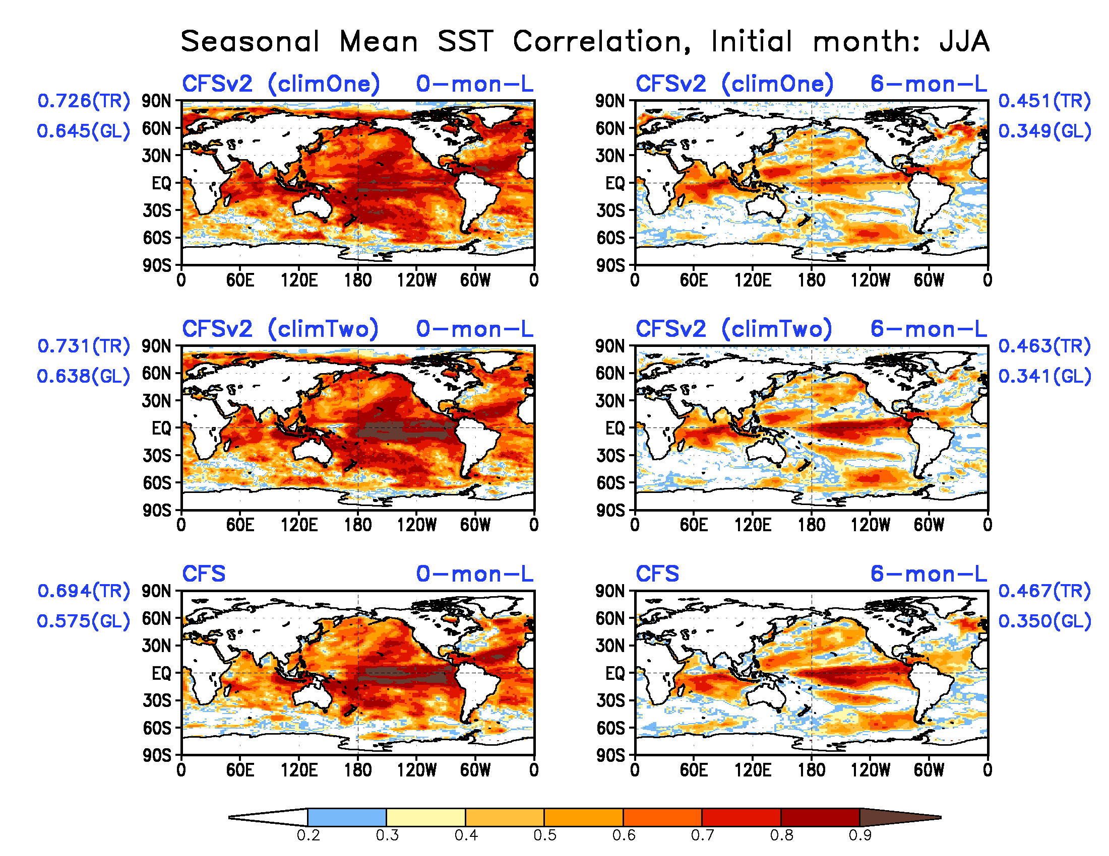
SST seasonal mean forecast correlation skill

Slide 11
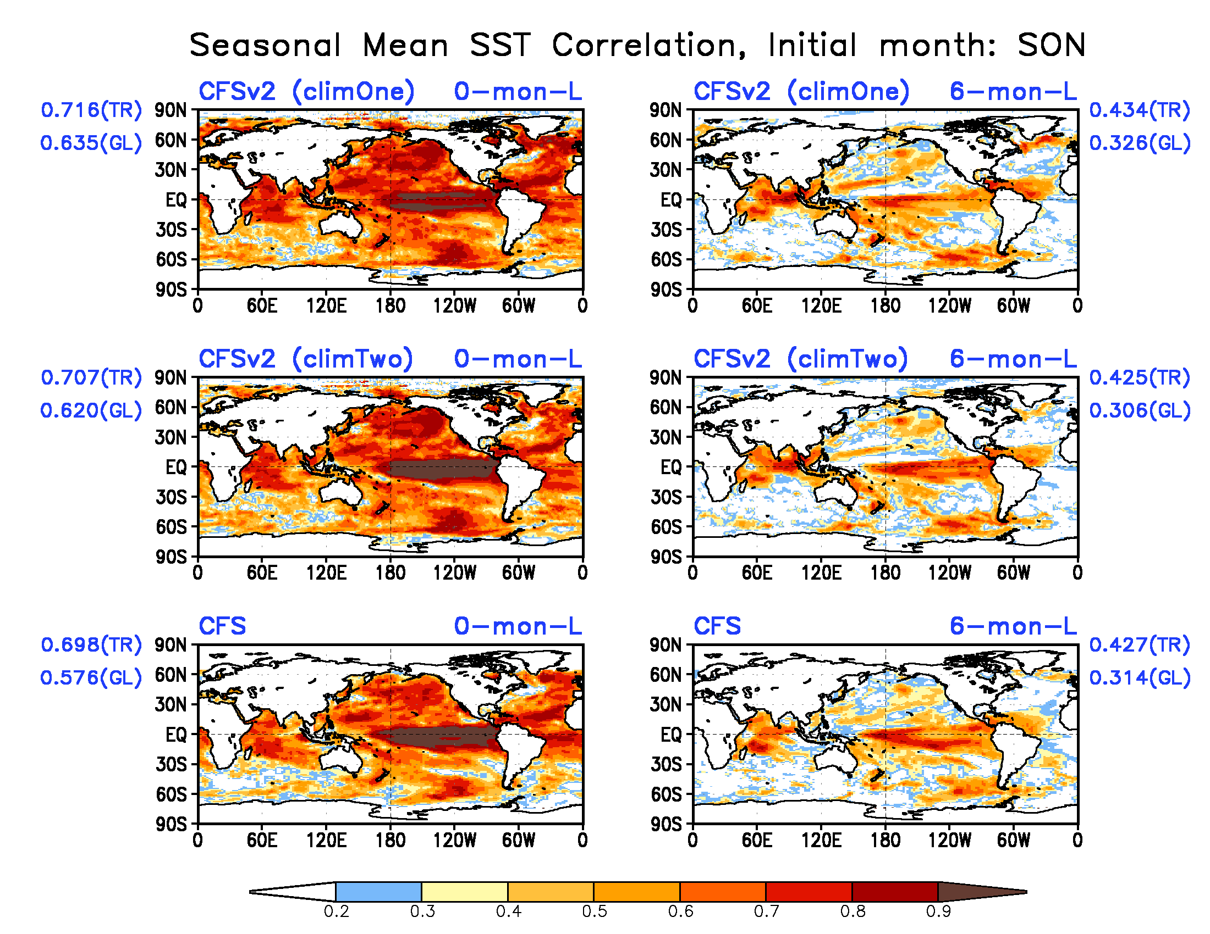
SST seasonal mean forecast correlation skill

Slide 12
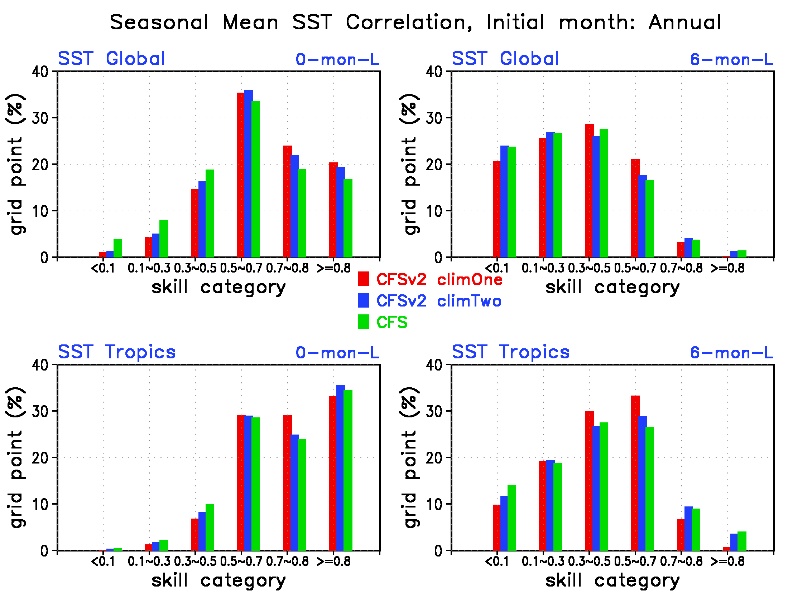
SST seasonal mean forecast correlation skill
CFSv2 shows more ocean areas with high skill (>0.5) globally

Slide 13
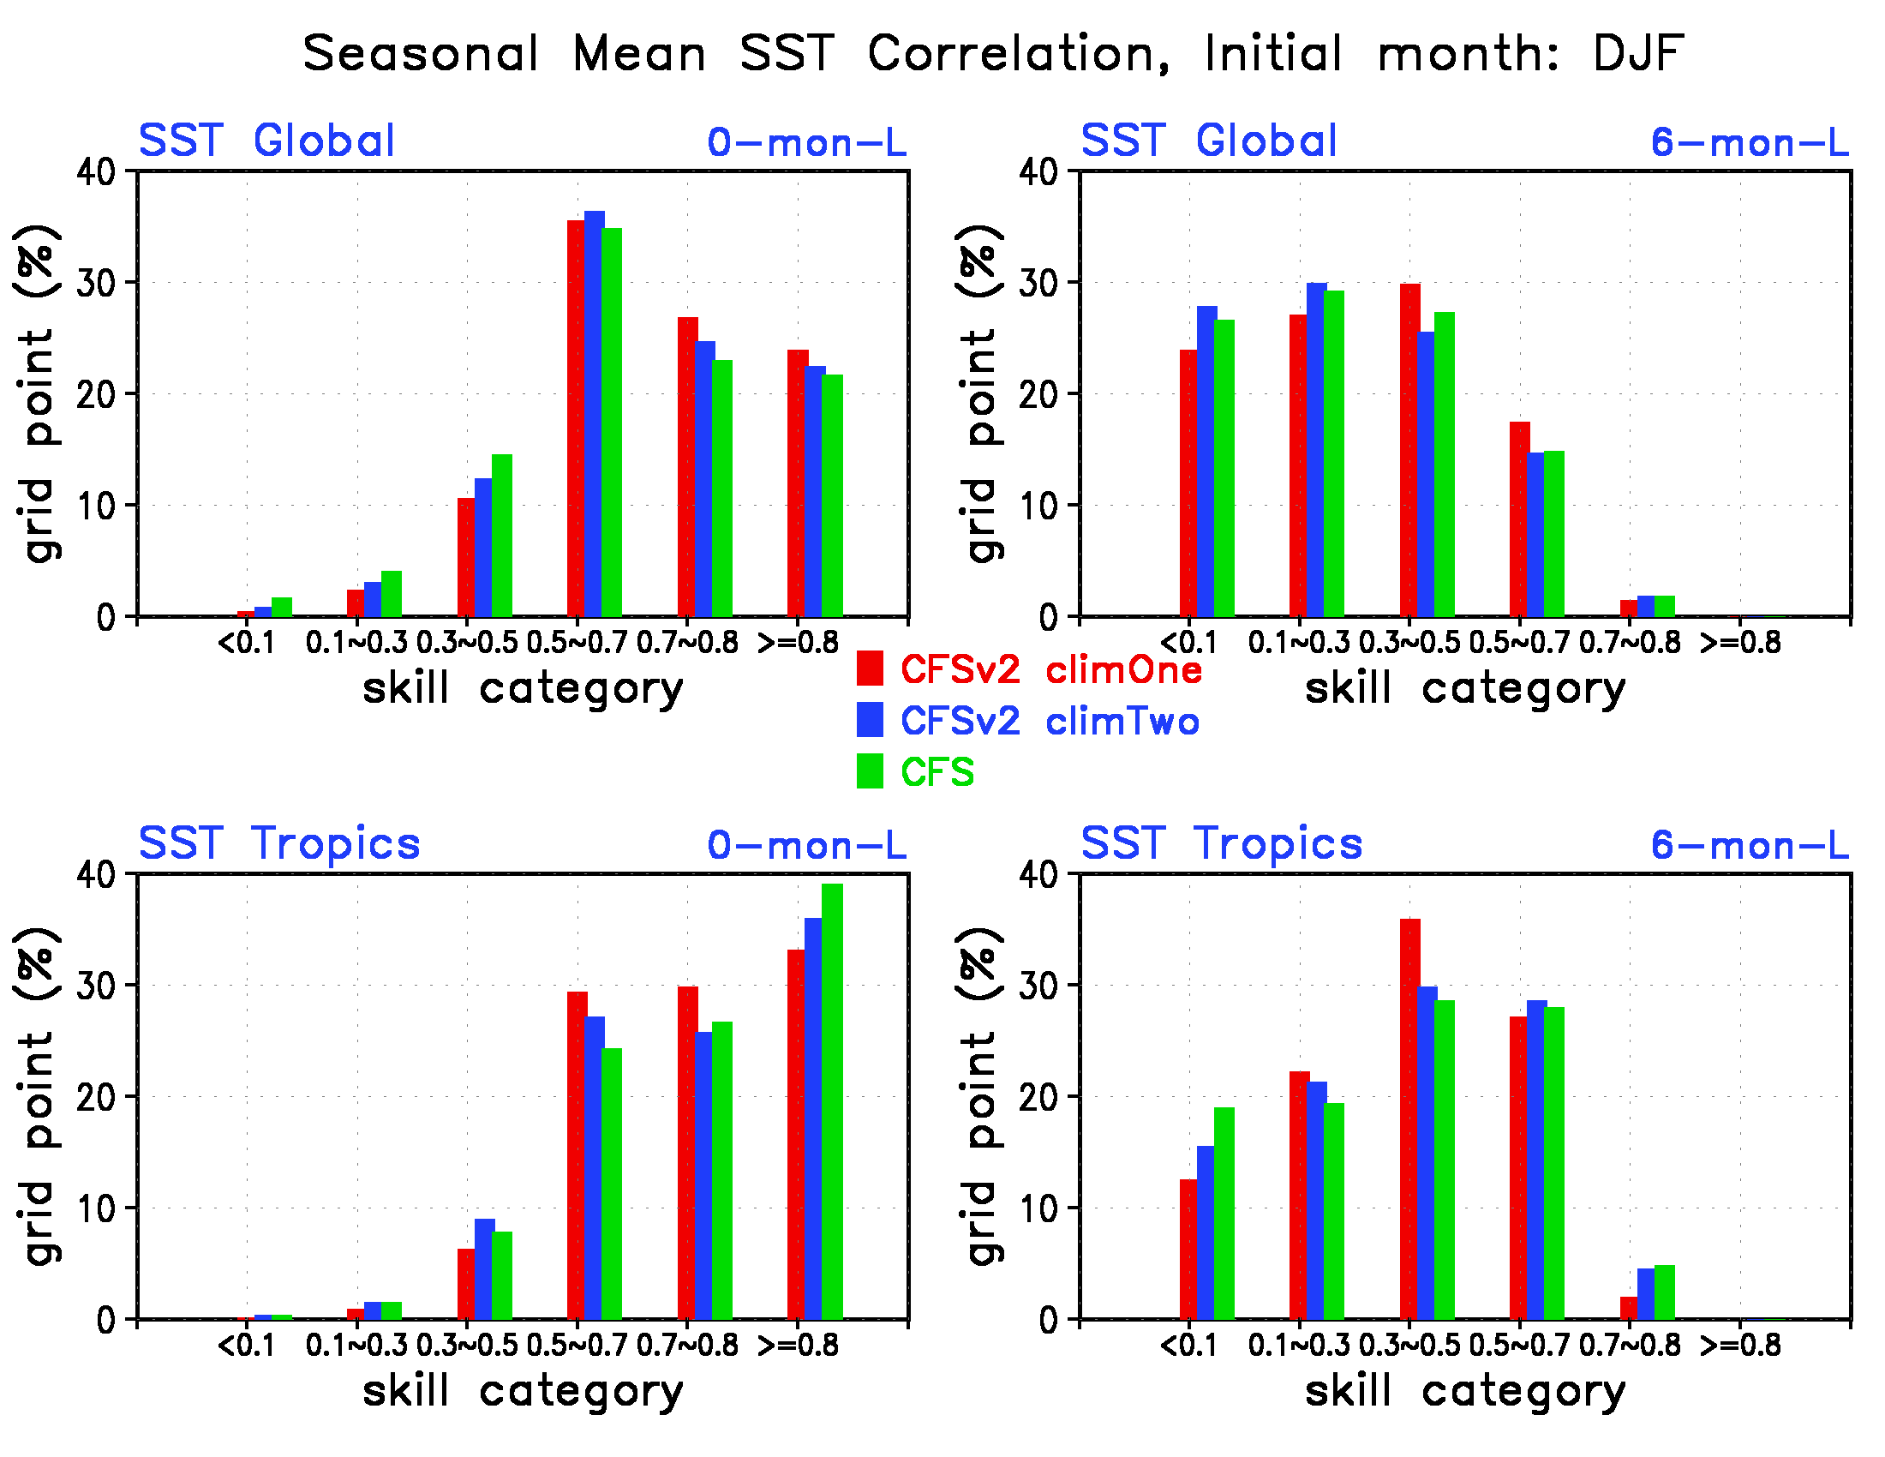
SST seasonal mean forecast correlation skill

Slide 14
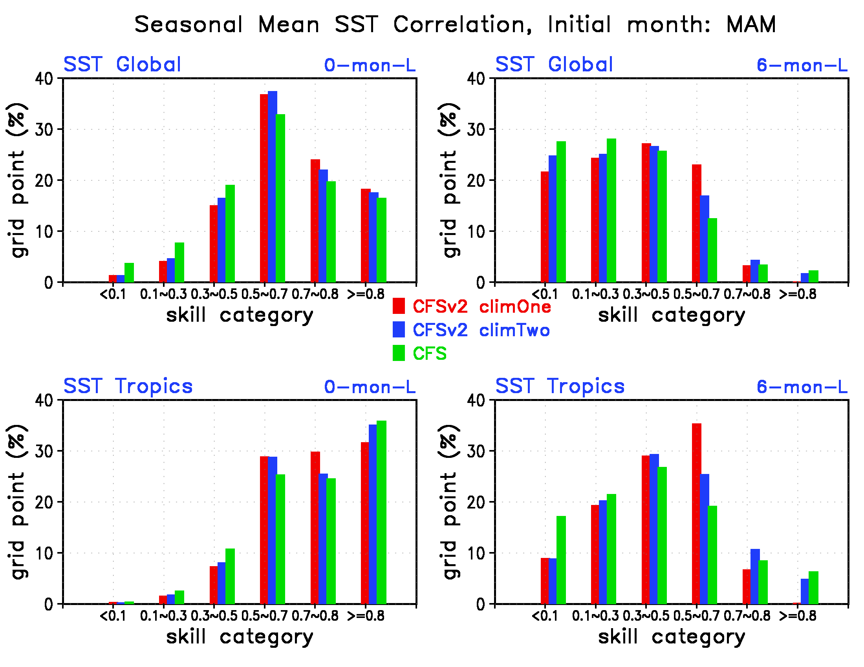
SST seasonal mean forecast correlation skill

Slide 15
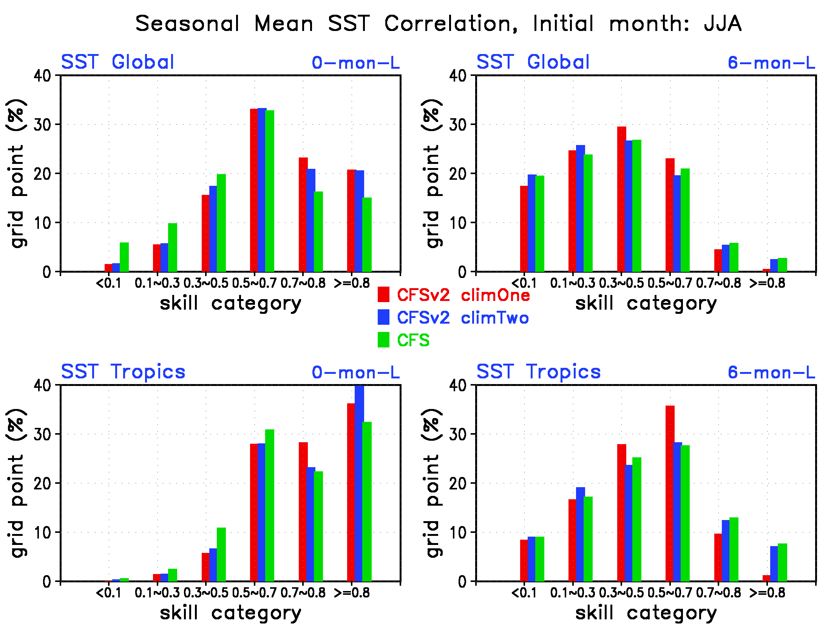
SST seasonal mean forecast correlation skill
CFSv2 has more areas with high skill (>0.7) globally and over tropics
Two climatology CFSv2 show more areas with skill higher than 0.8 over tropics

Slide 16
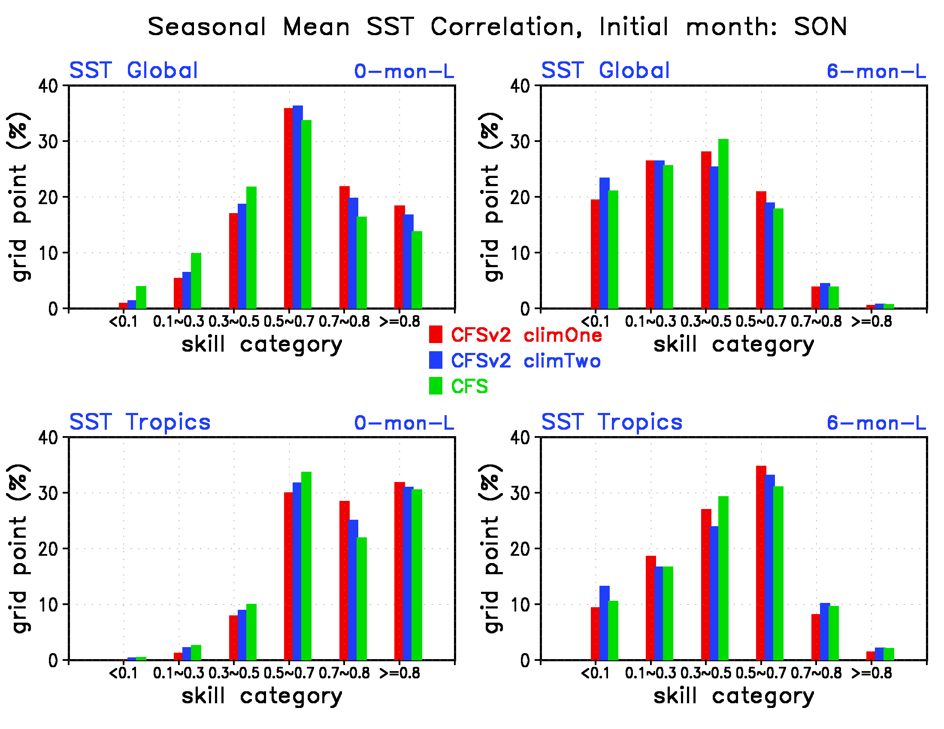
SST seasonal mean forecast correlation skill

Slide 17
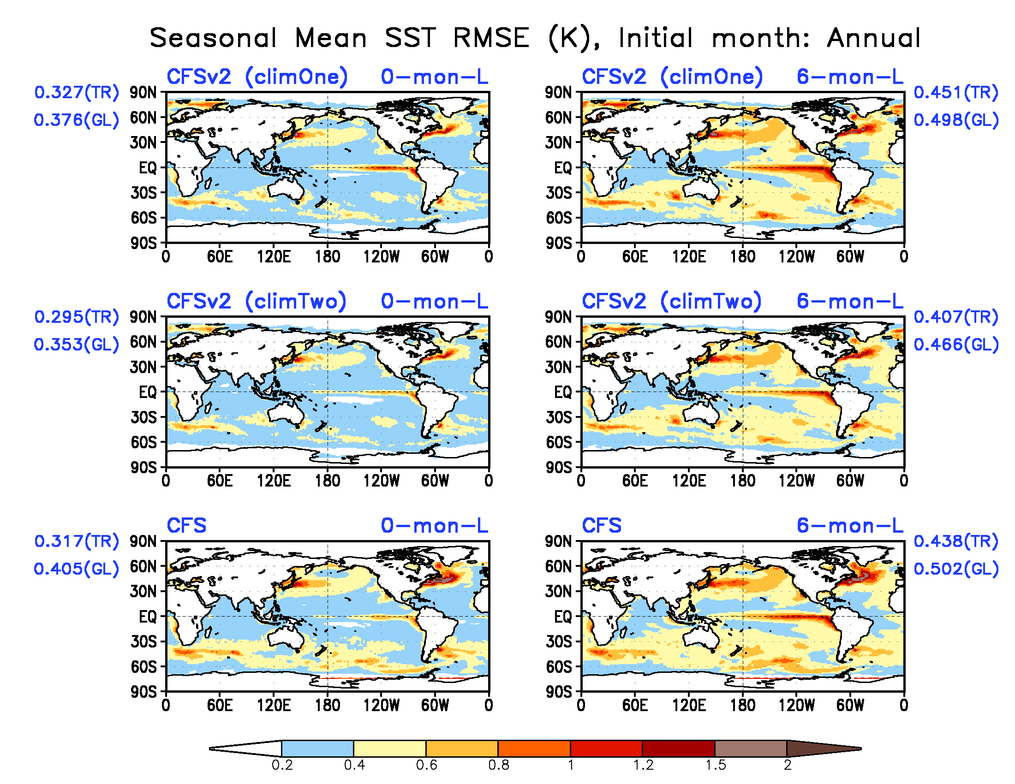
SST seasonal mean forecast RMSE (K)
Two climatology CFSv2 shows less RMSE globally and over tropics

Slide 18
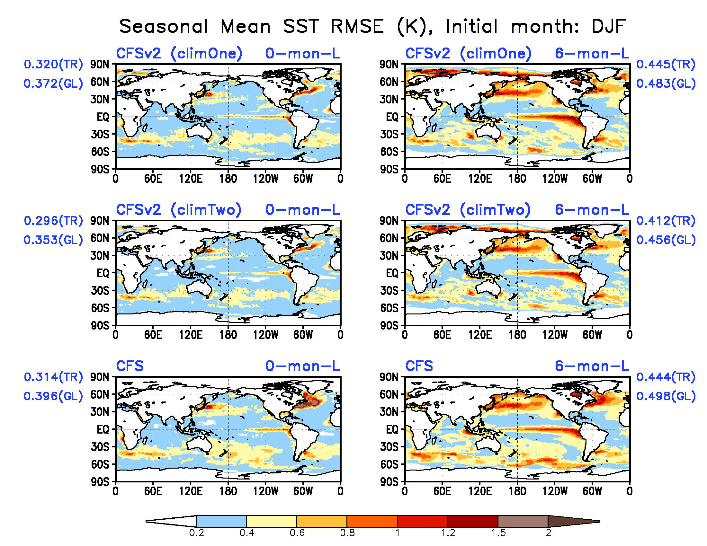
SST seasonal mean forecast RMSE (K)

Slide 19
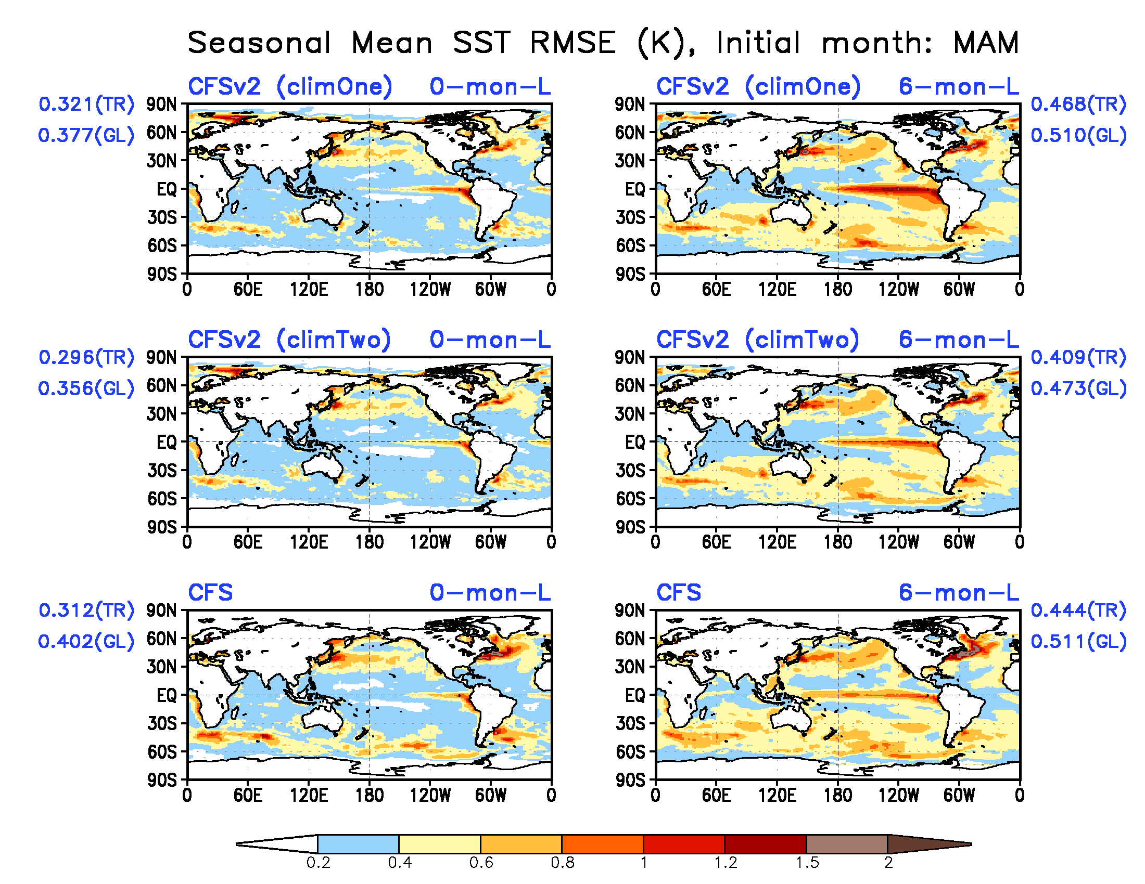
SST seasonal mean forecast RMSE (K)

Slide 20
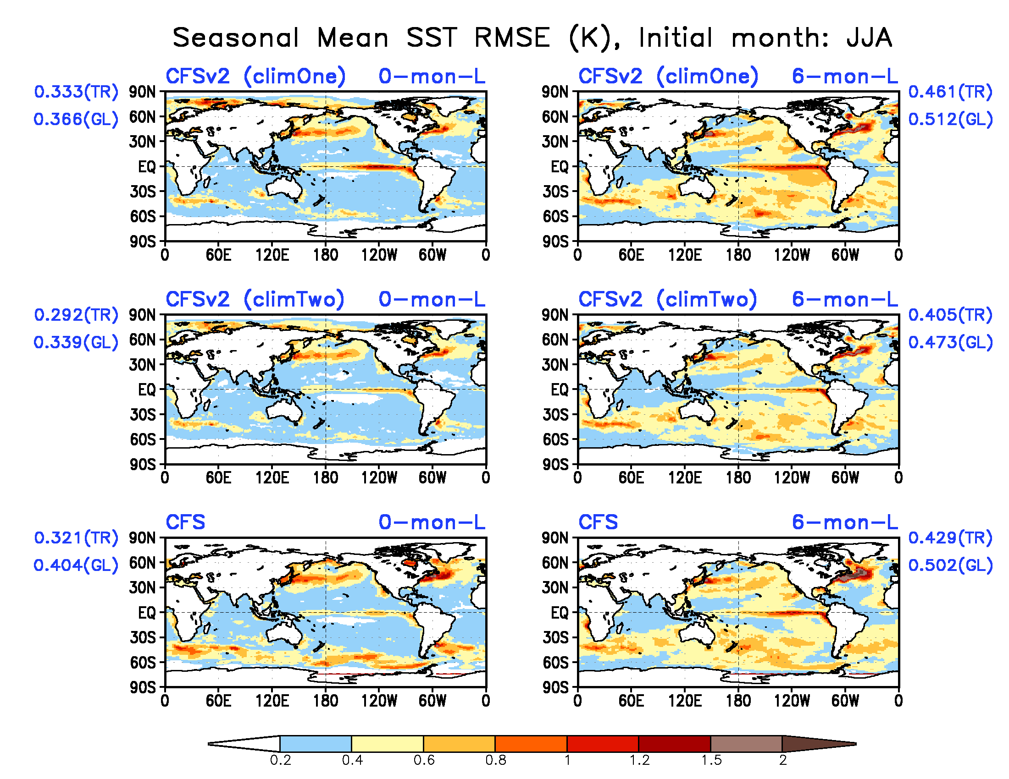
SST seasonal mean forecast RMSE (K)

Slide 21
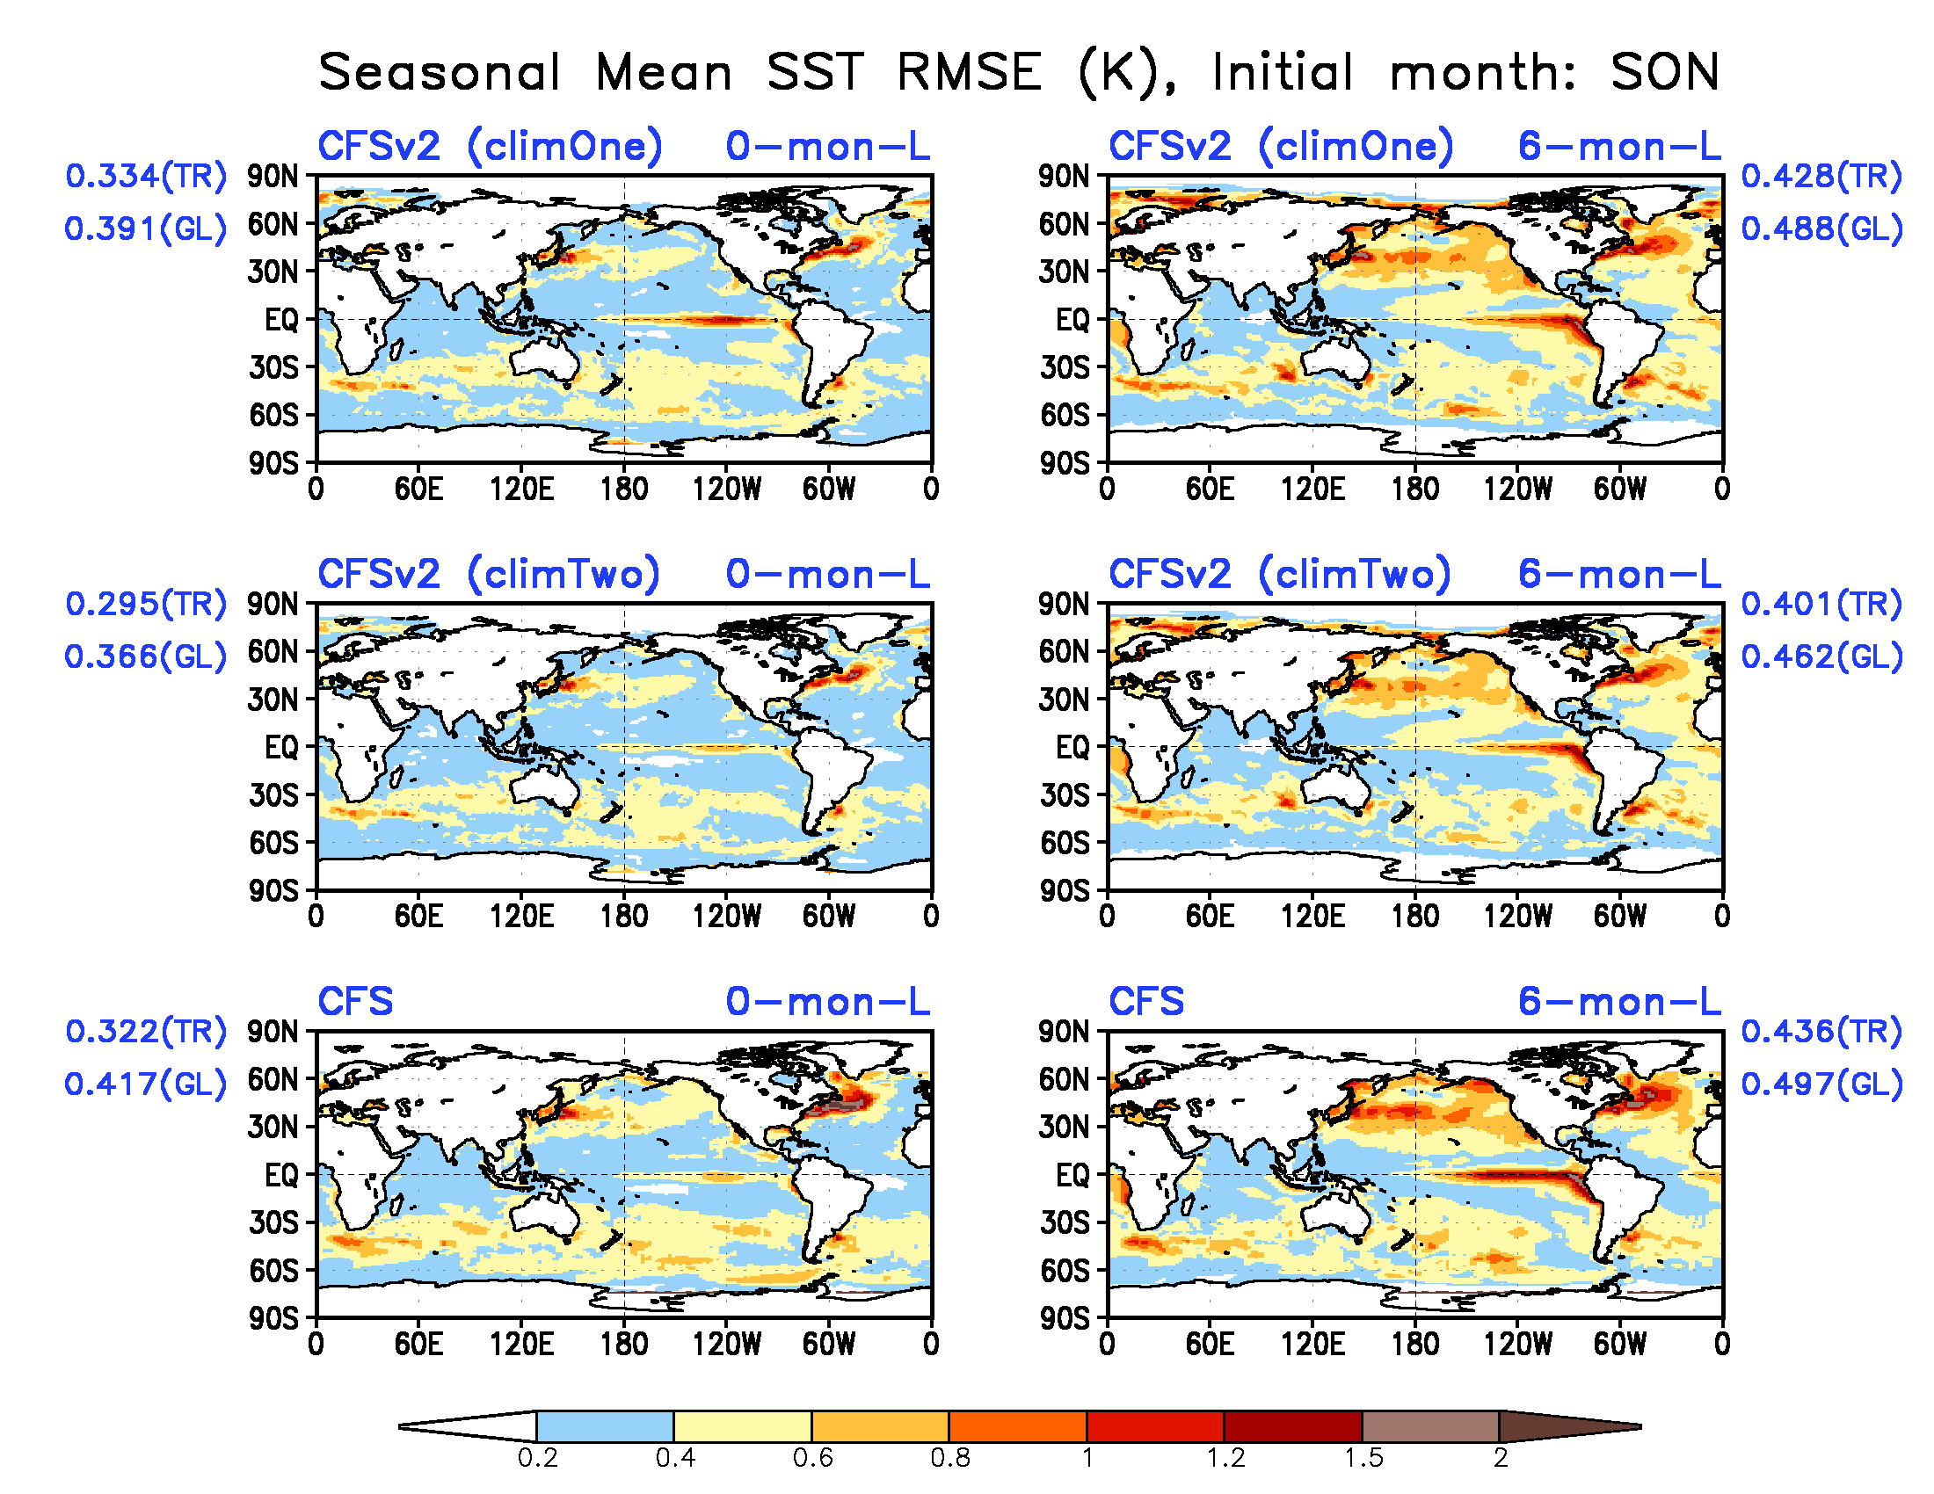
SST seasonal mean forecast RMSE (K)

Slide 22
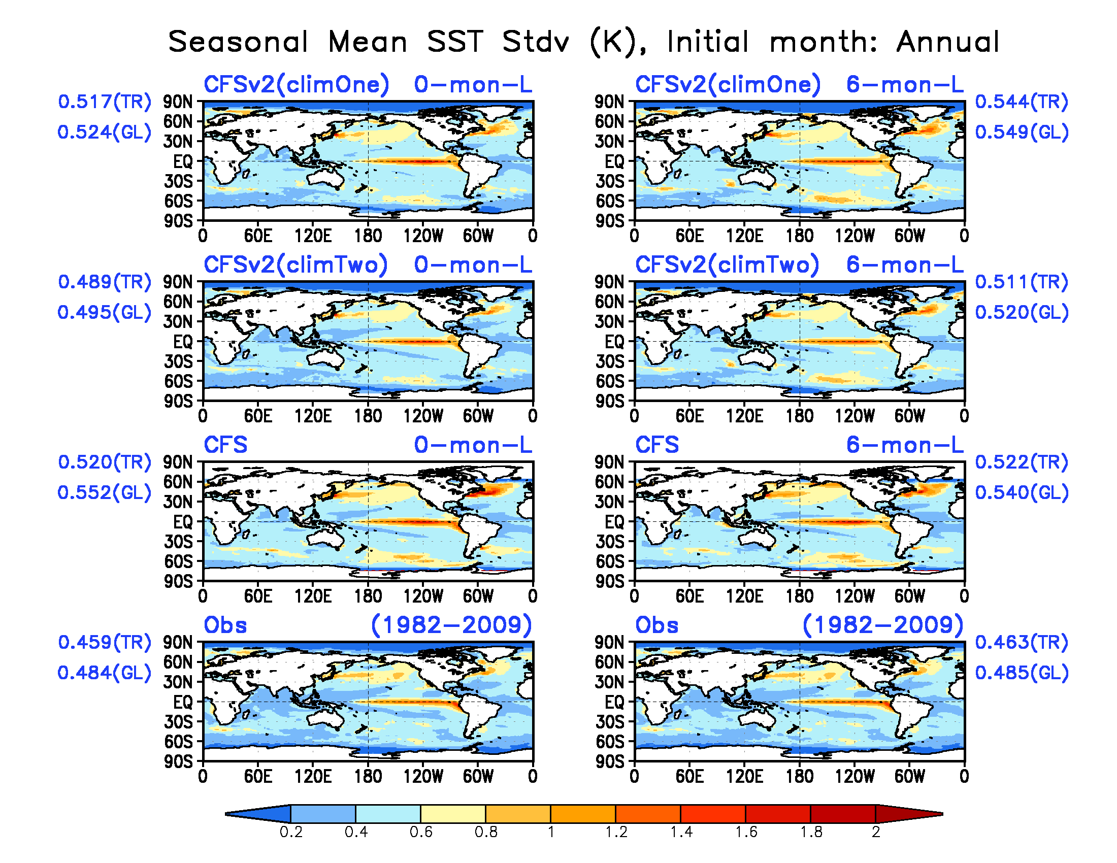
SST seasonal mean forecast Standard Deviation (K)

Slide 23
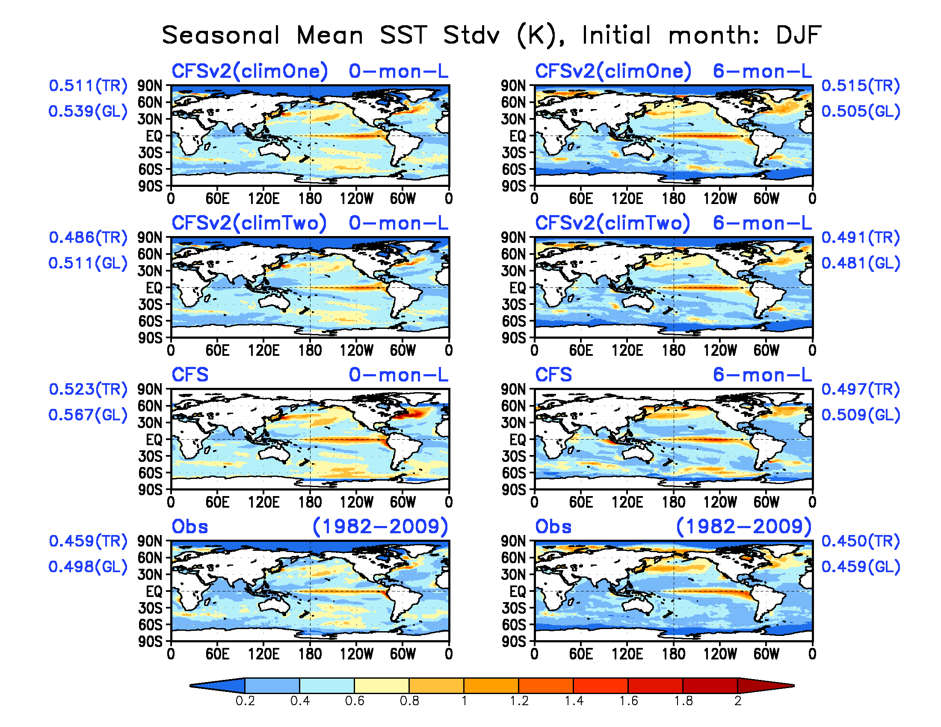
SST seasonal mean forecast Standard Deviation (K)

Slide 24
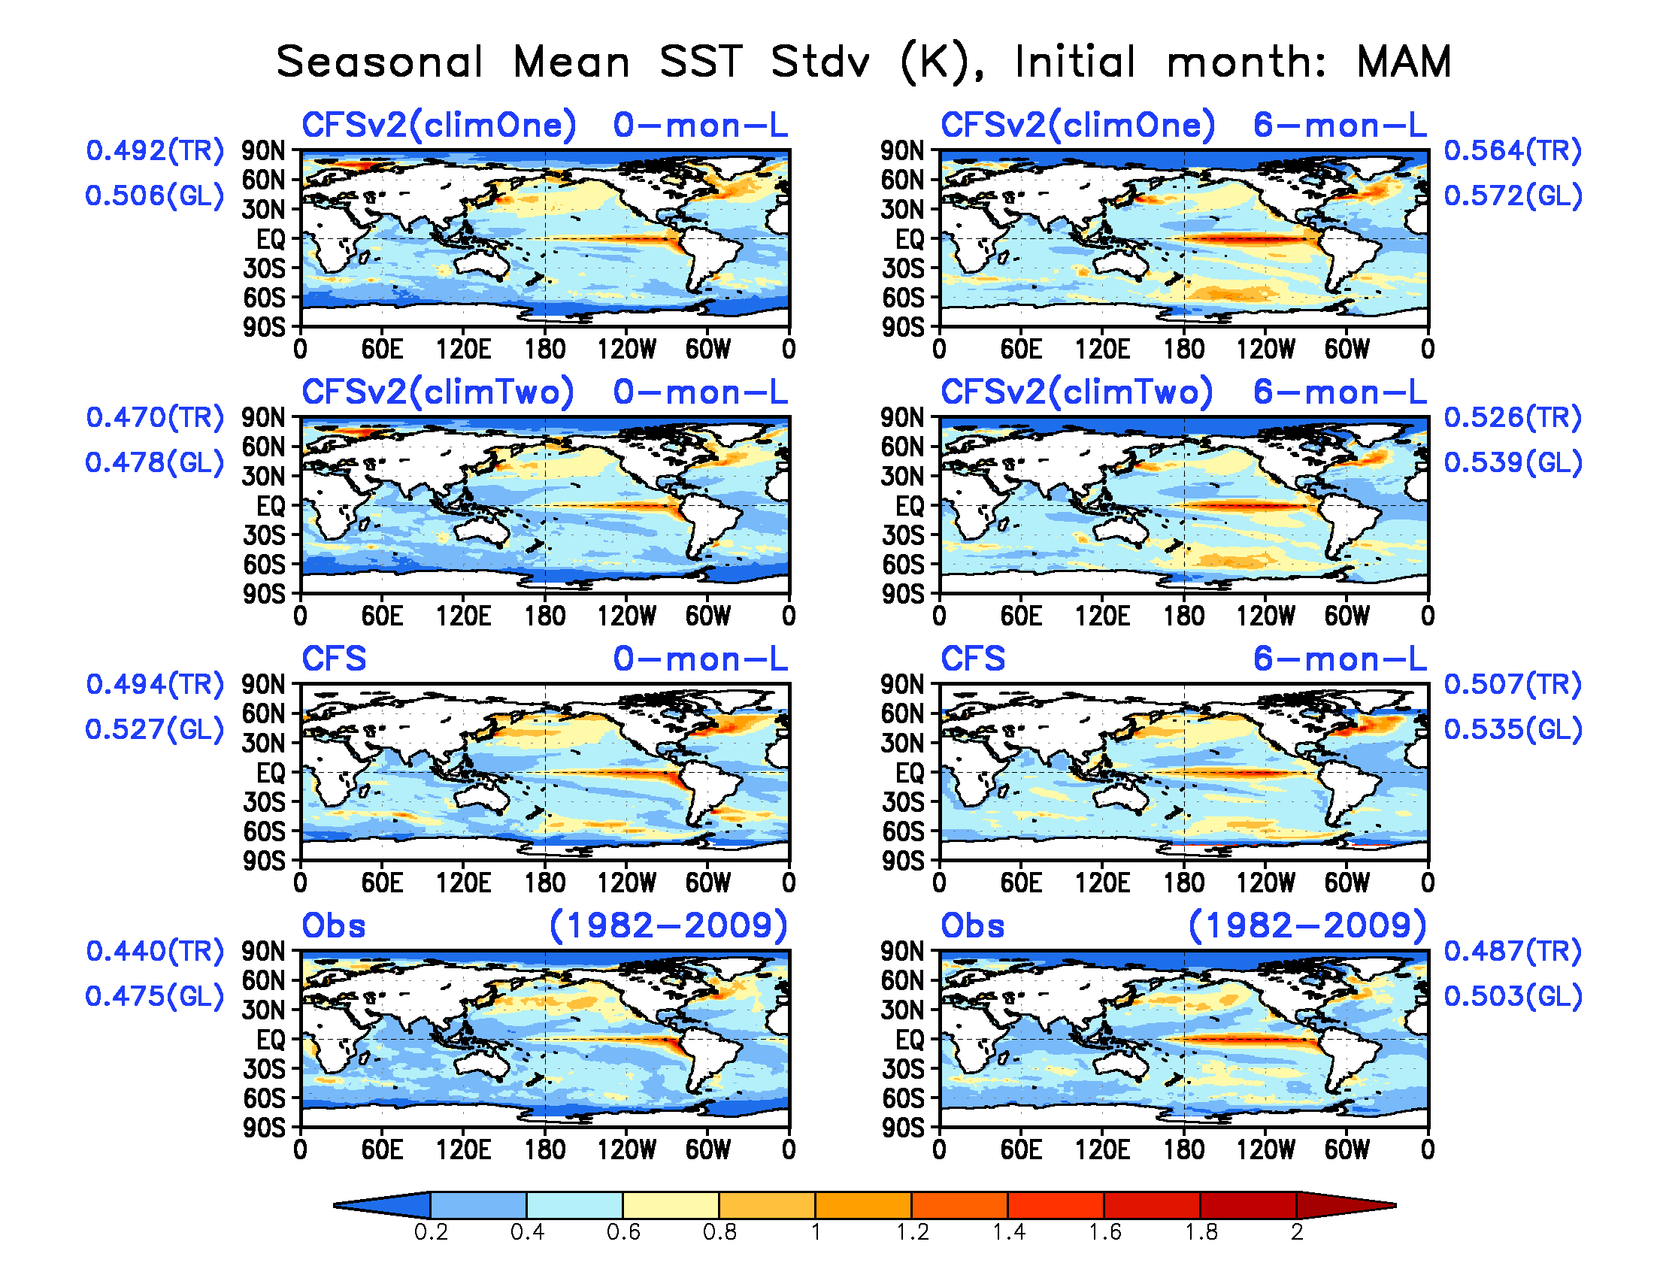
SST seasonal mean forecast Standard Deviation (K)

Slide 25
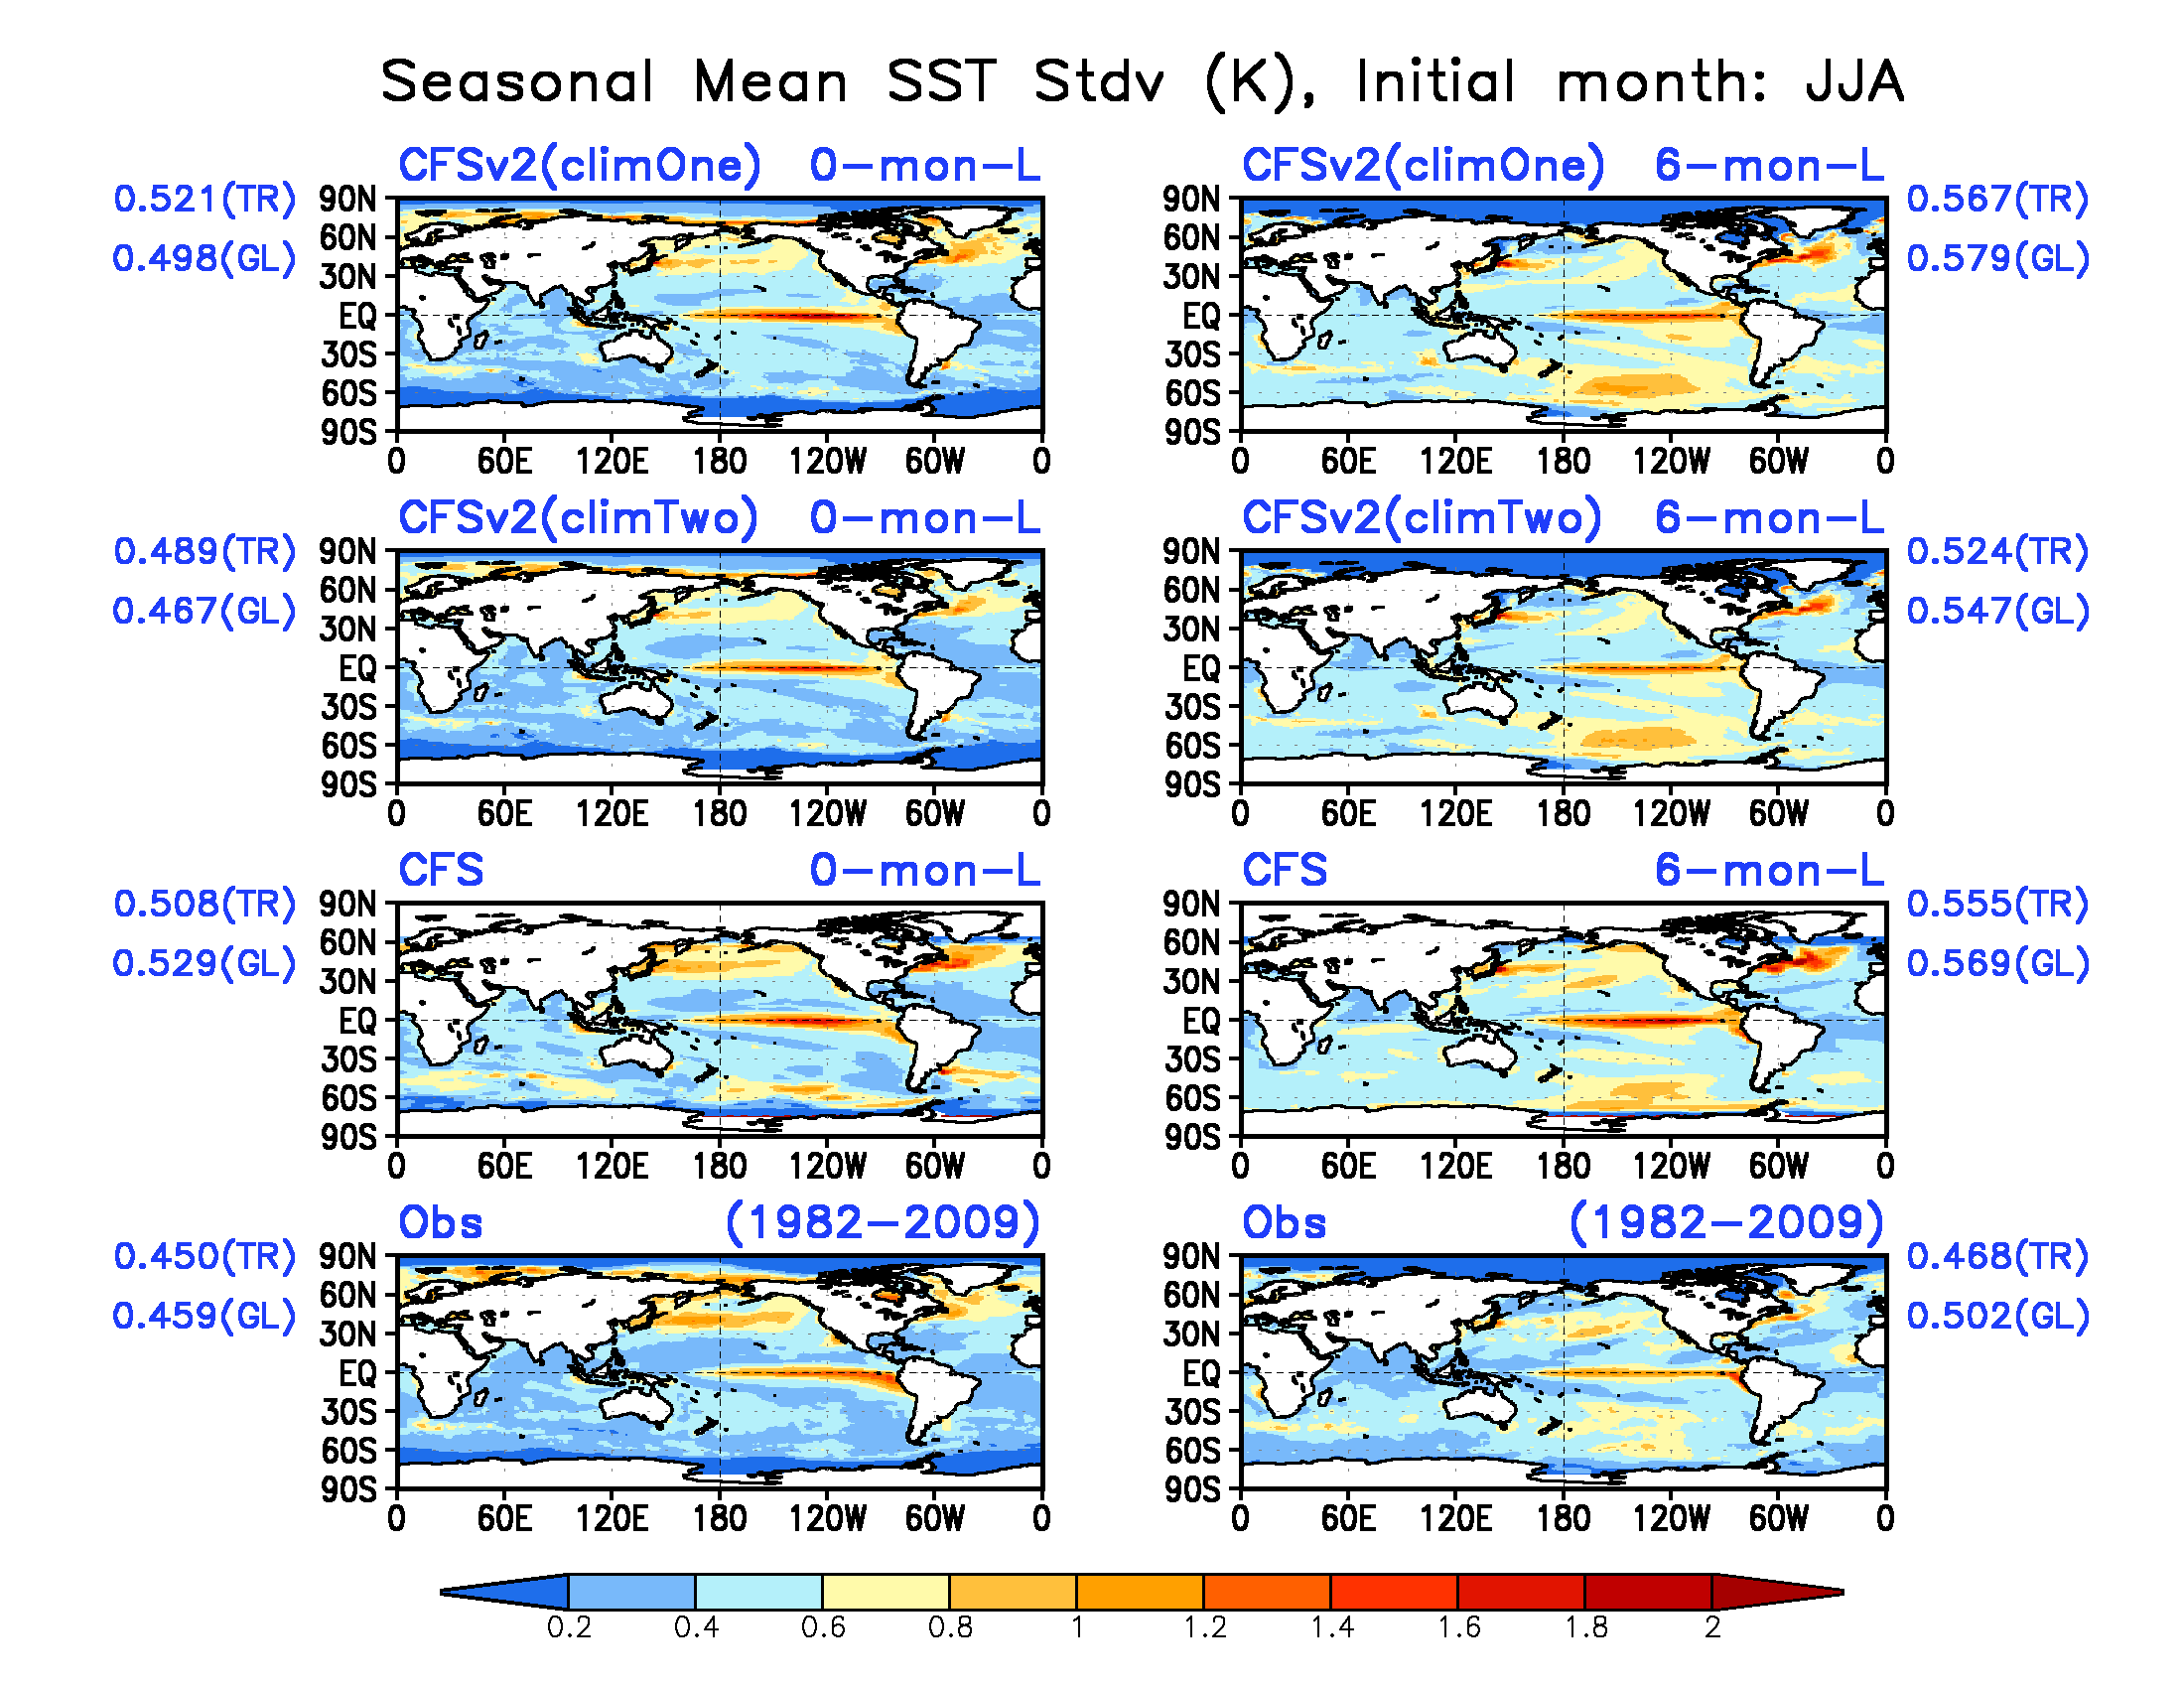
SST seasonal mean forecast Standard Deviation (K)

Slide 26
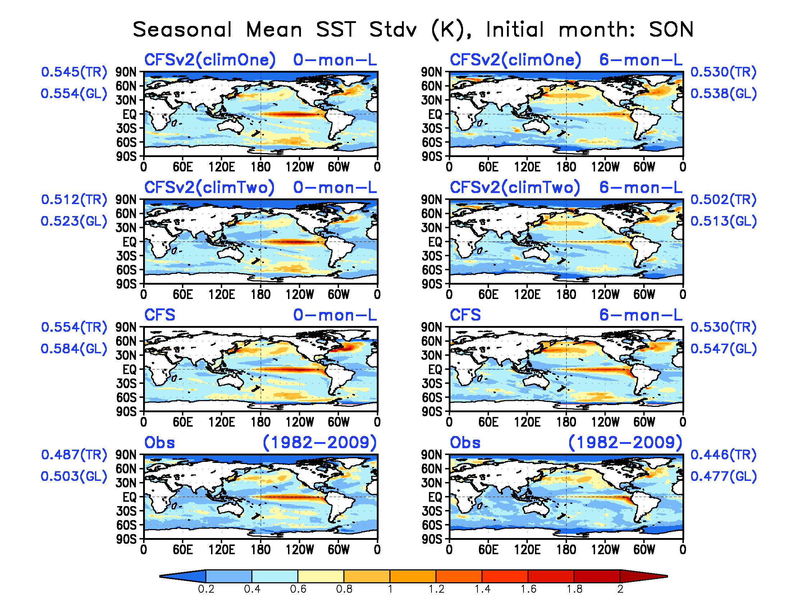
SST seasonal mean forecast Standard Deviation (K)

Slide 27
Precipitation (Prec)

Slide 28
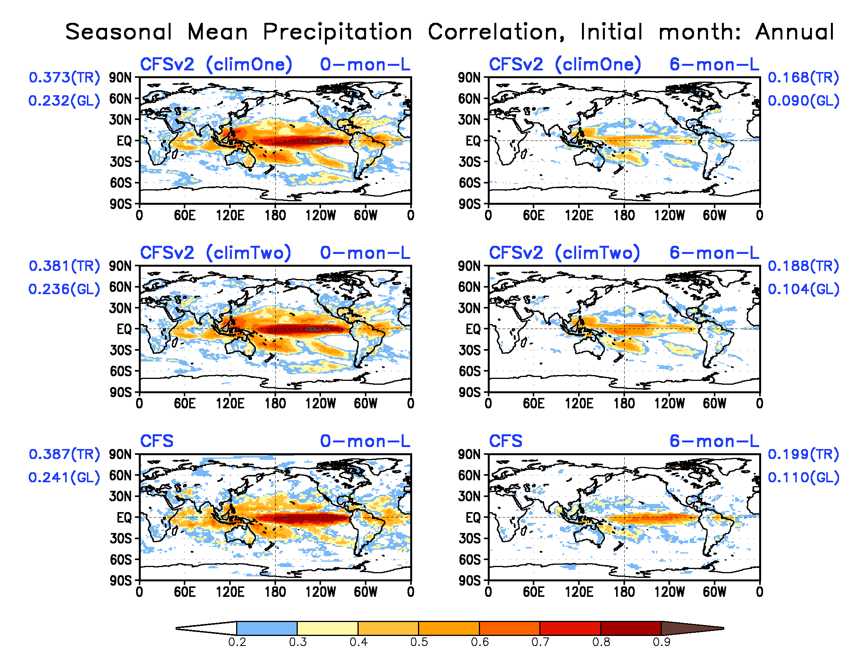
Precipitation seasonal mean forecast correlation skill
CFSv2 & CFS show similar skills;
Two climatology CFSv2 shows slight better skills in general

Slide 29
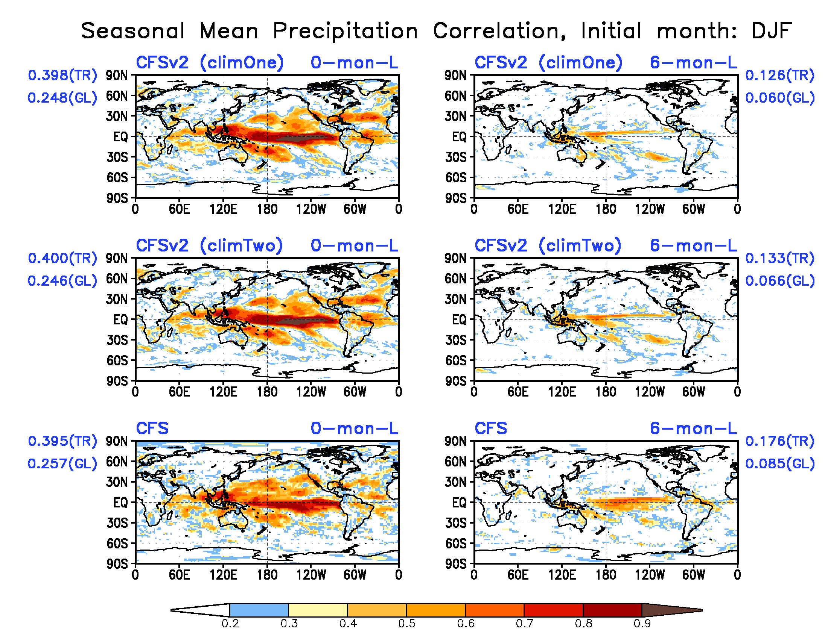
Precipitation seasonal mean forecast correlation skill
CFSv2 shows better skills than CFS over tropics

Slide 30
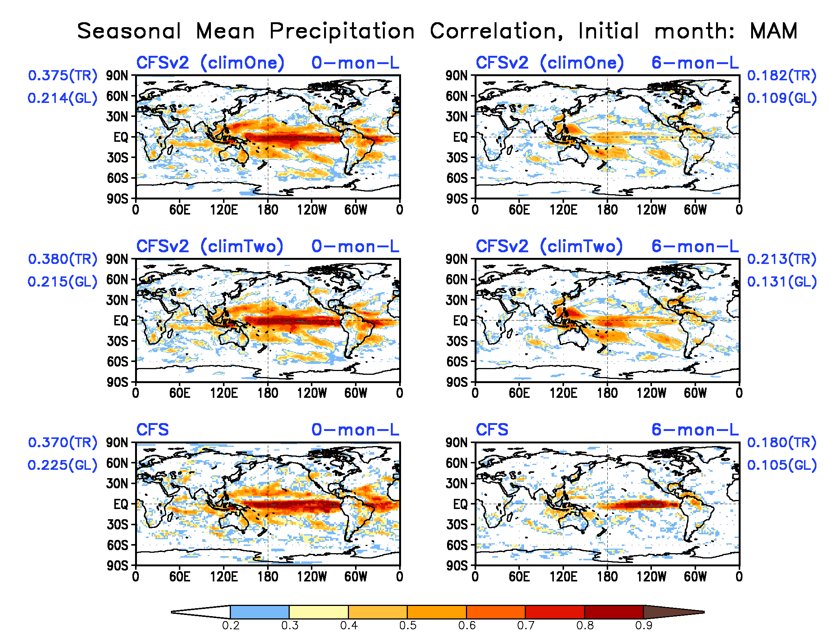
Precipitation seasonal mean forecast correlation skill

Slide 31
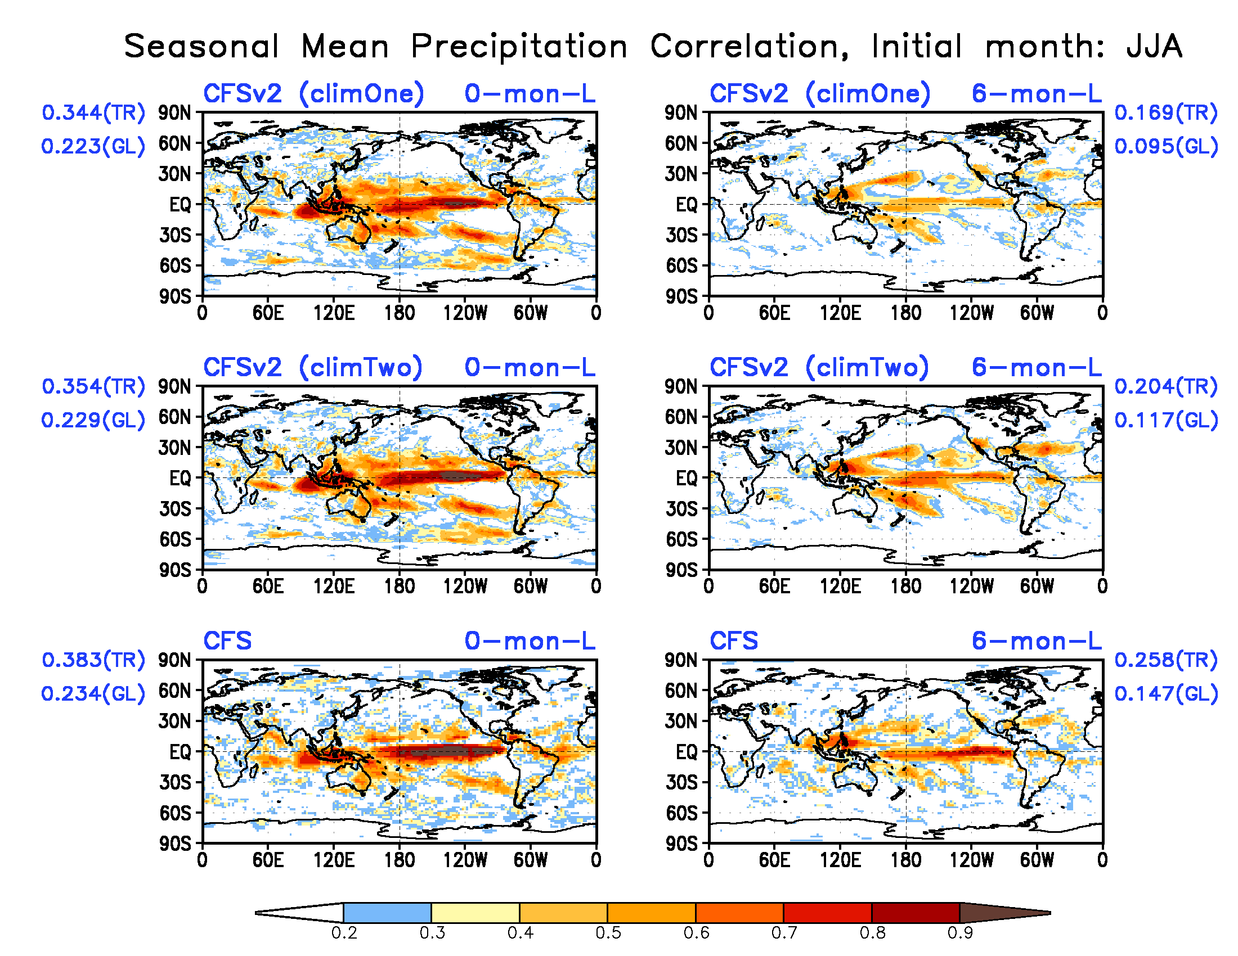
Precipitation seasonal mean forecast correlation skill

Slide 32
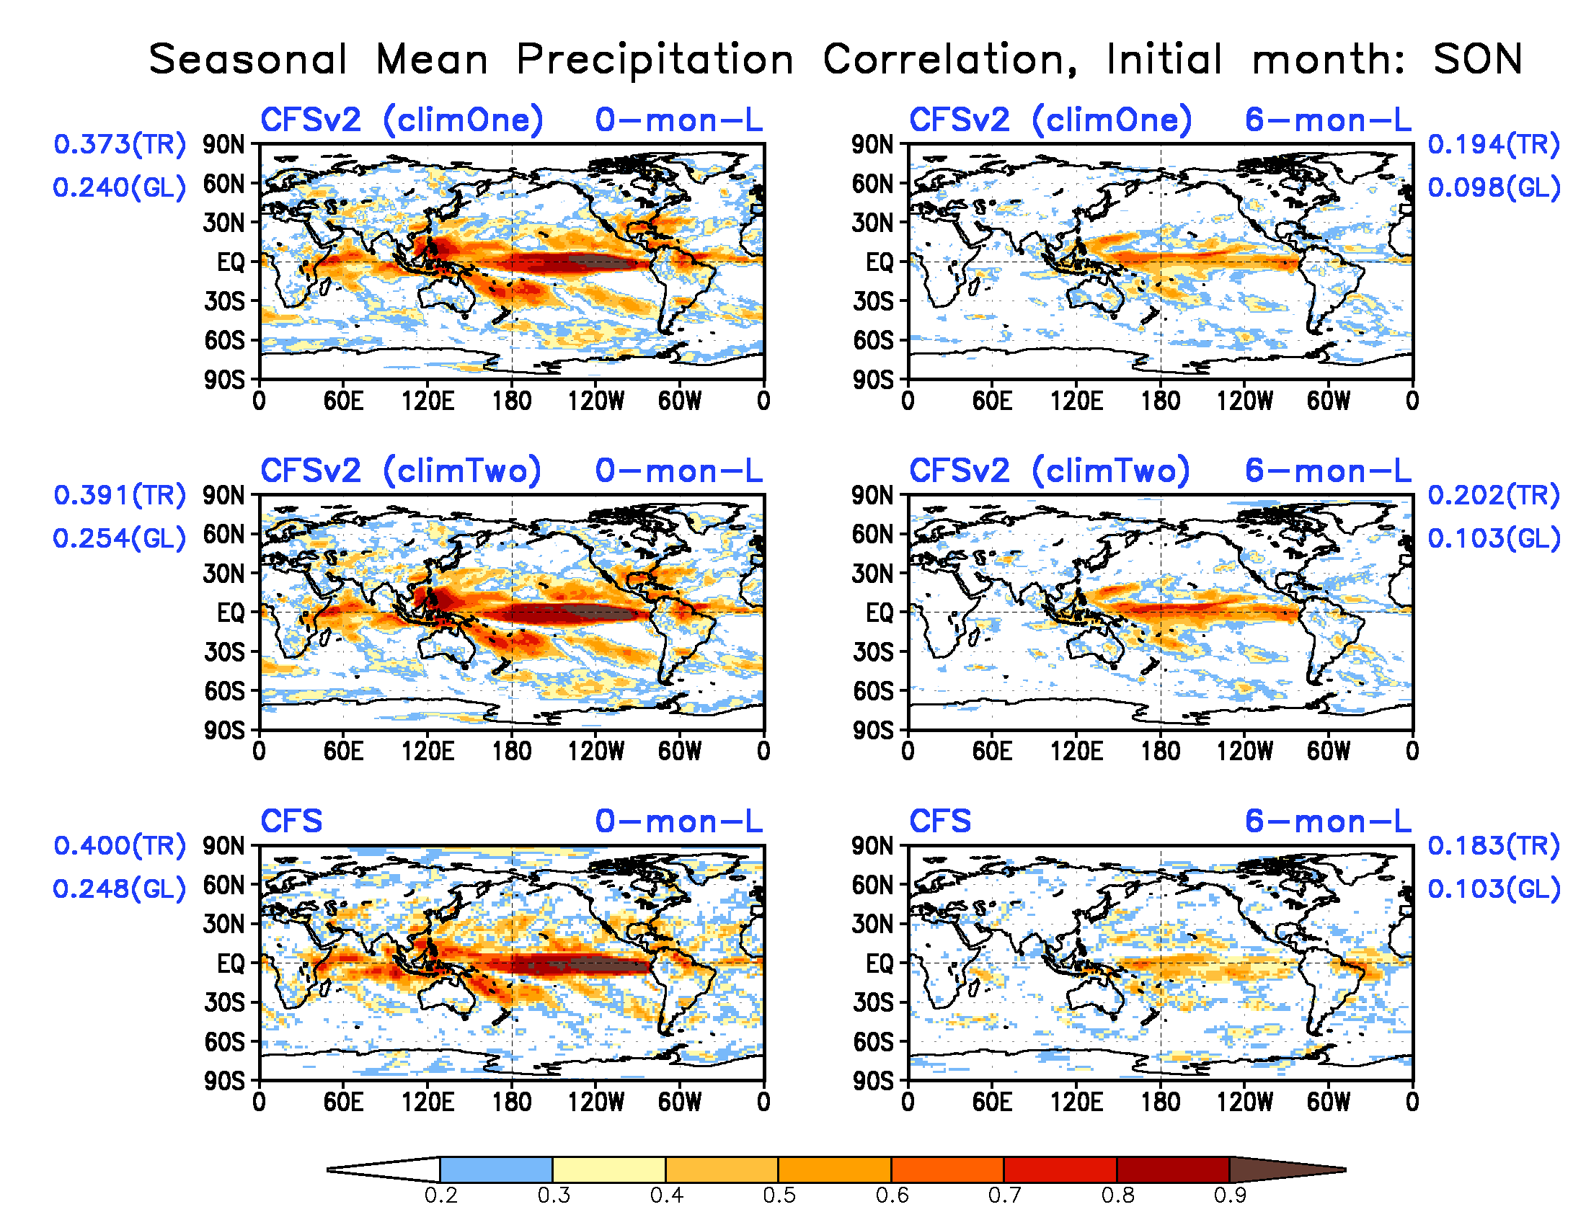
Precipitation seasonal mean forecast correlation skill

Slide 33
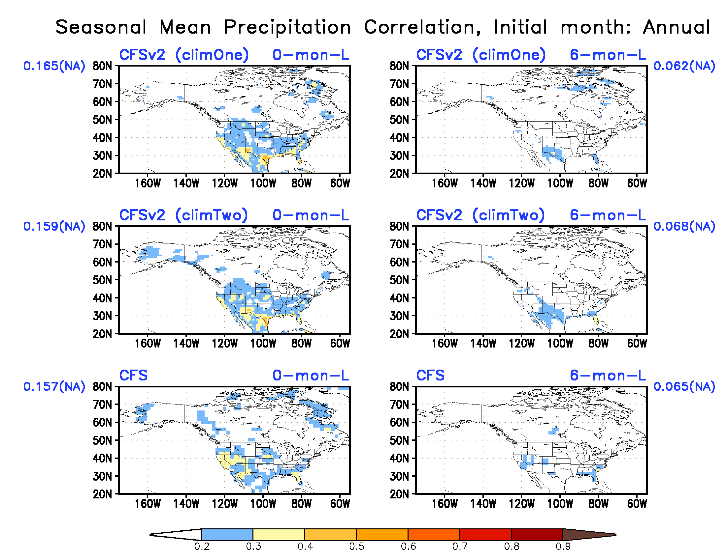
Precipitation seasonal mean forecast correlation skill
CFSv2 shows better skills over southern part of US
Two climatology CFSv2 did not improve the skills

Slide 34
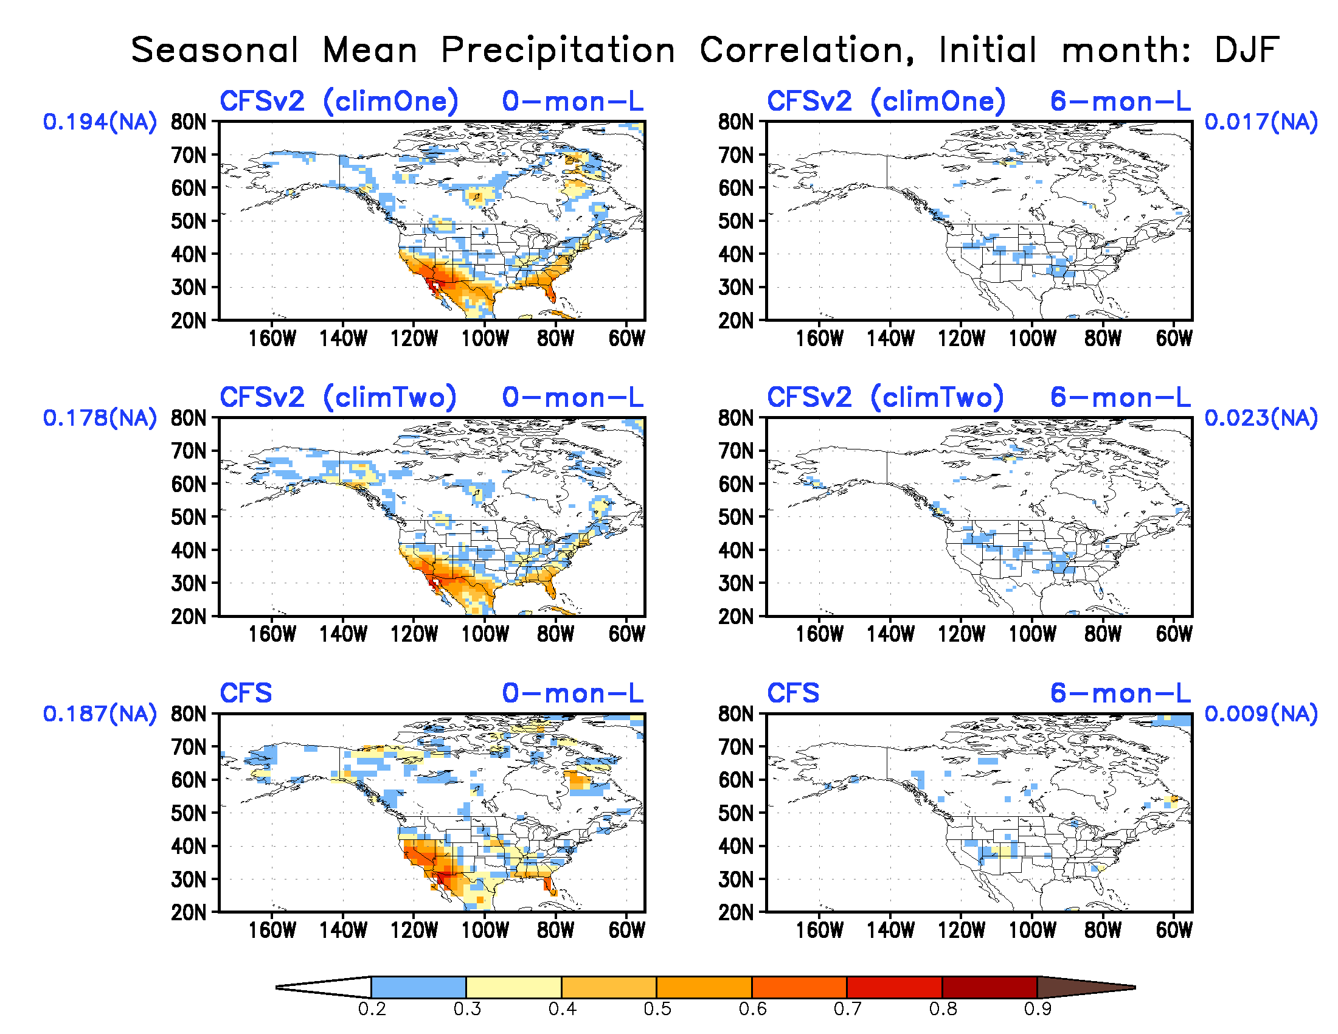
Precipitation seasonal mean forecast correlation skill

Slide 35
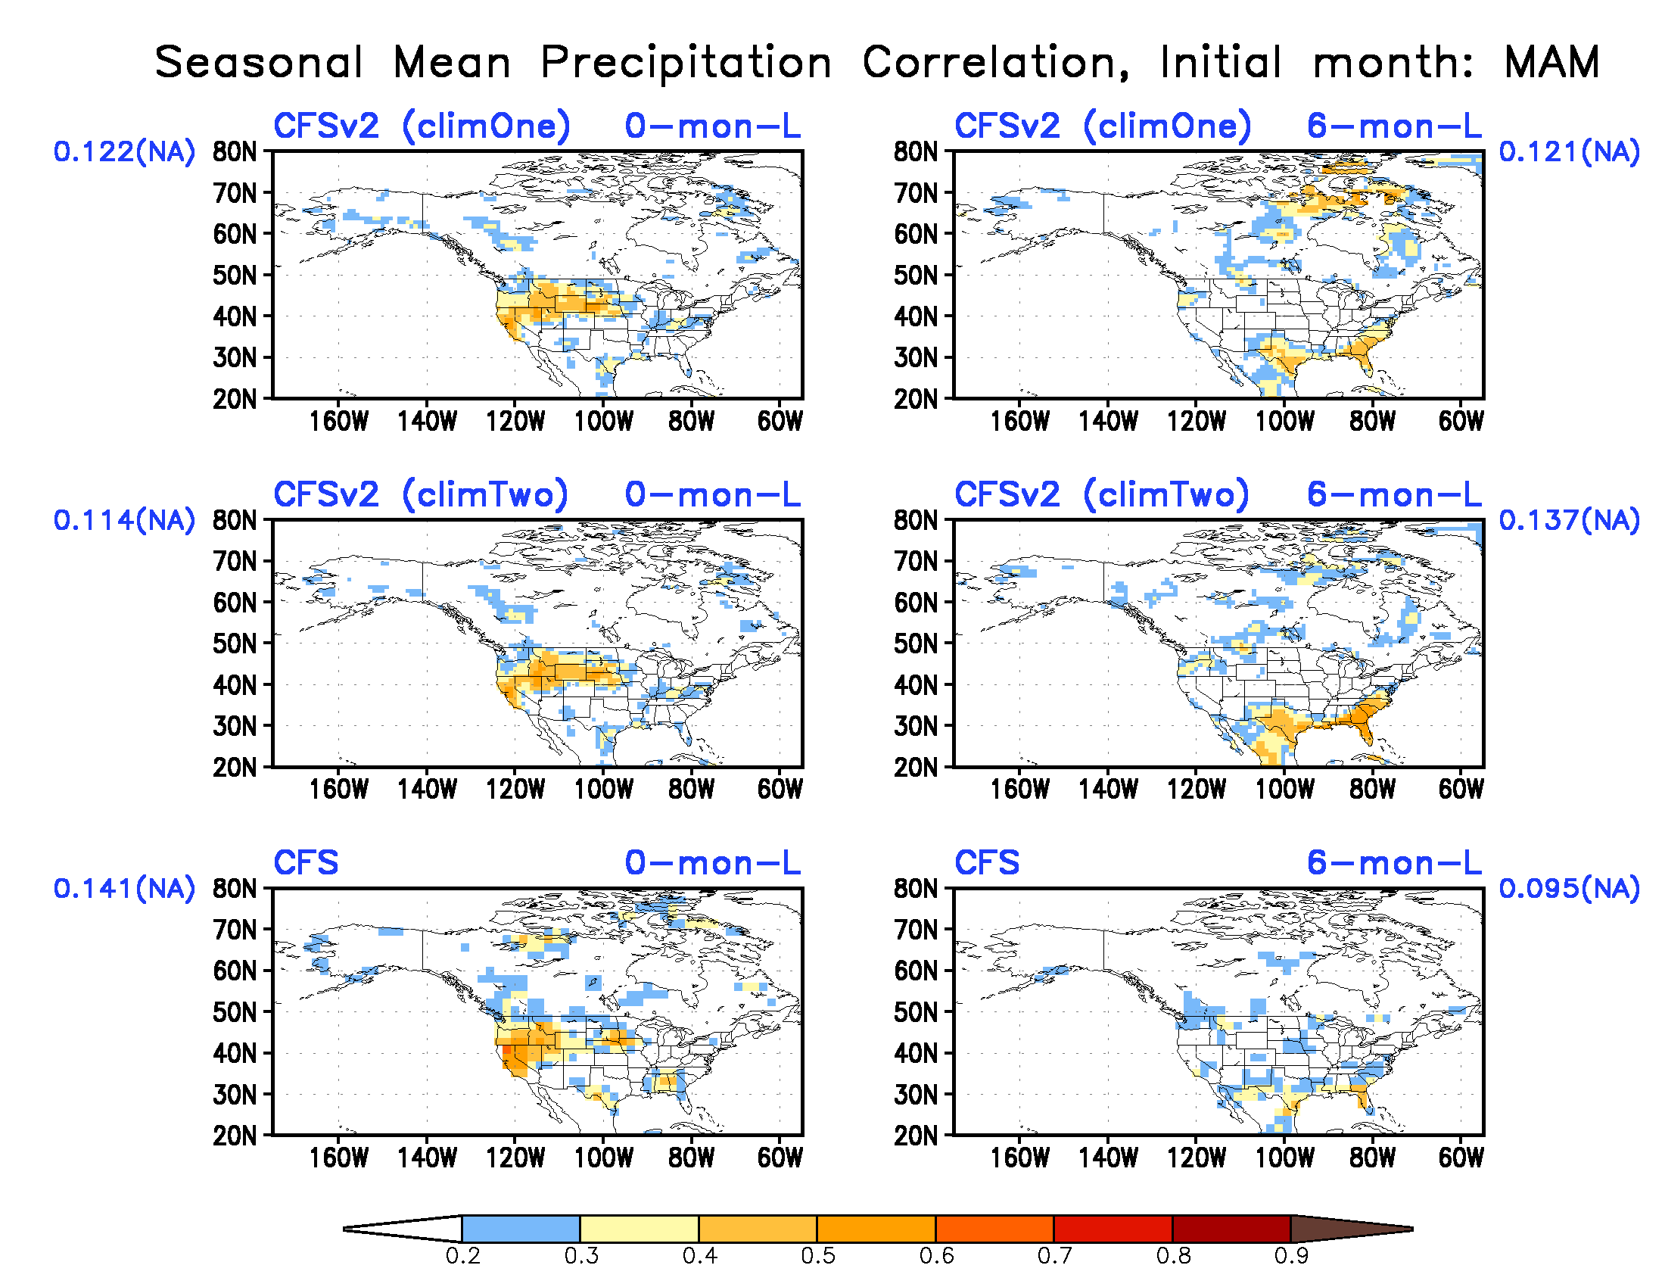
Precipitation seasonal mean forecast correlation skill

Slide 36
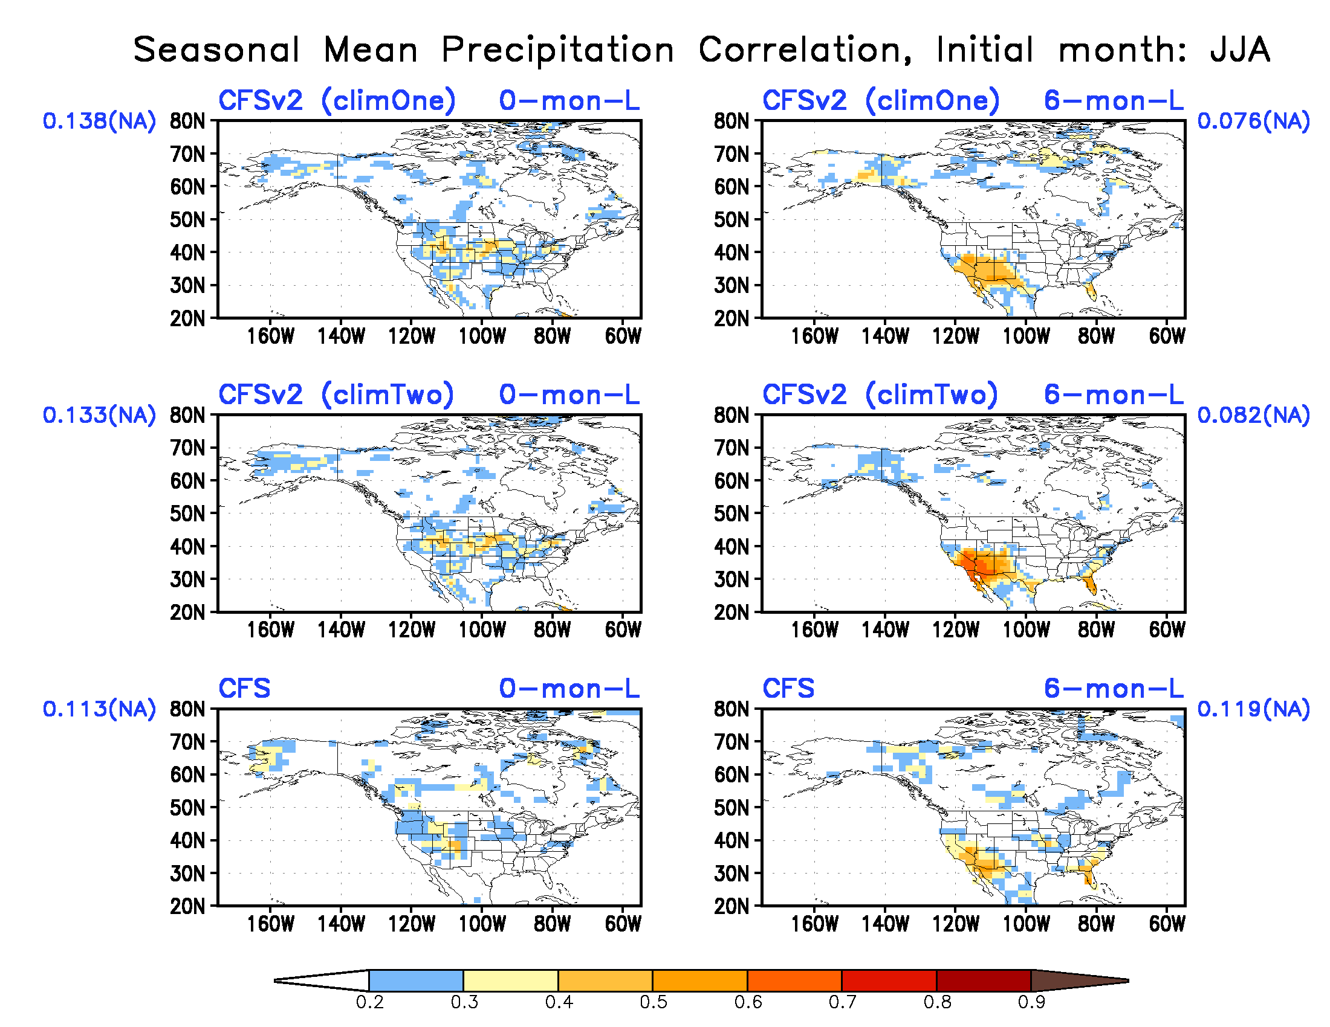
Precipitation seasonal mean forecast correlation skill

Slide 37
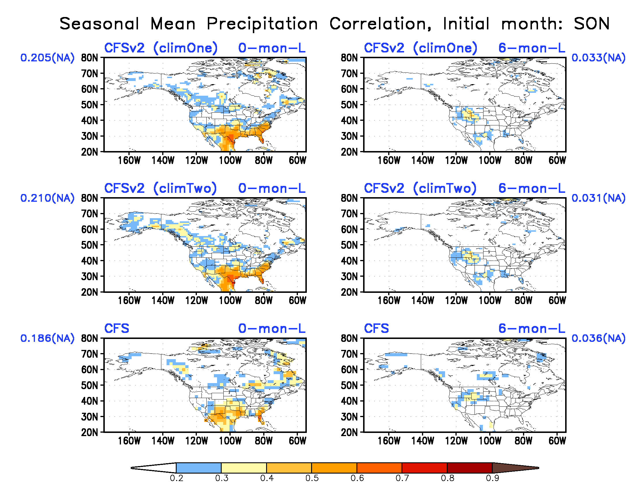
Precipitation seasonal mean forecast correlation skill

Slide 38
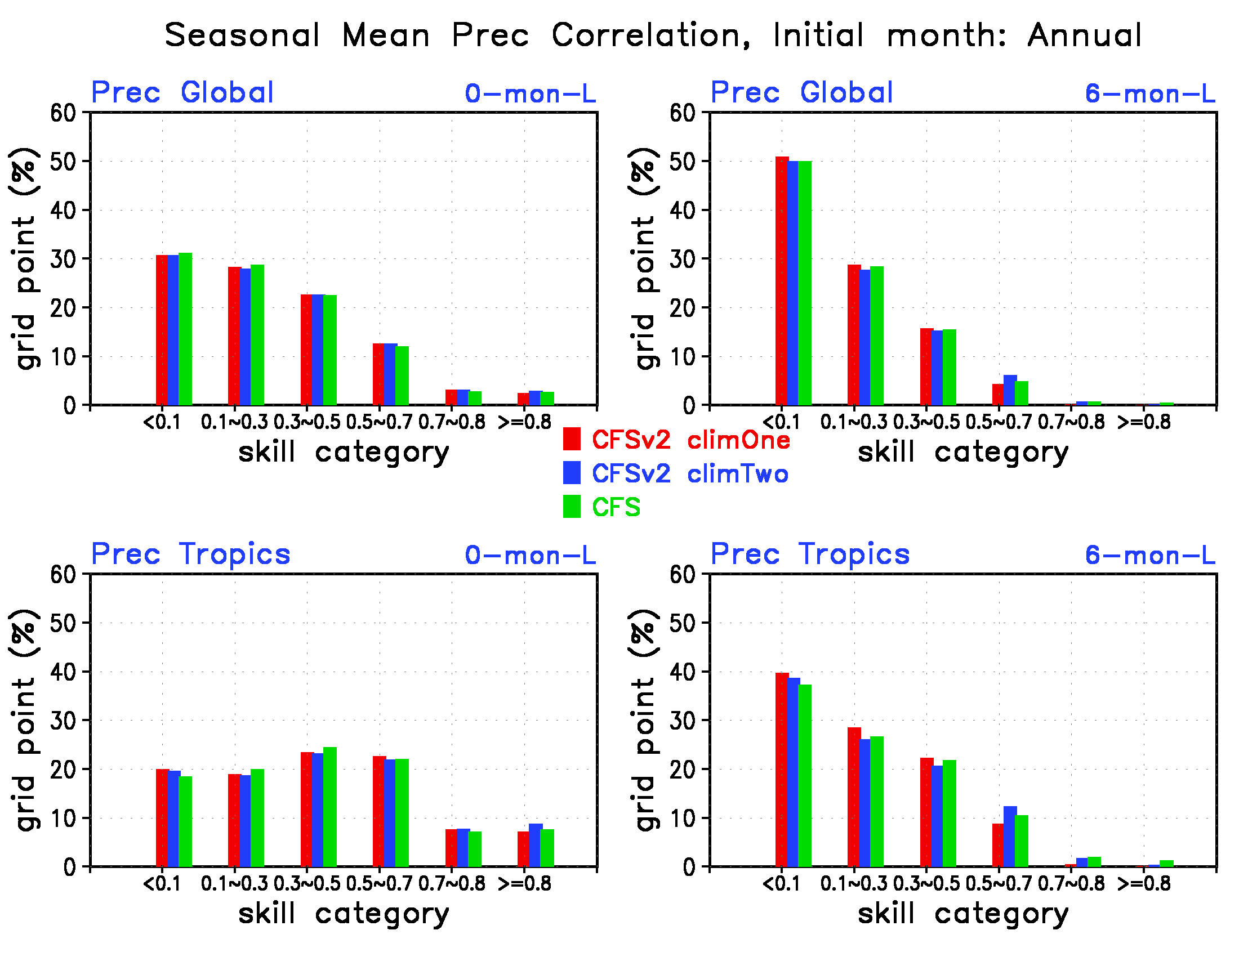
Precipitation seasonal mean forecast correlation skill

Slide 39
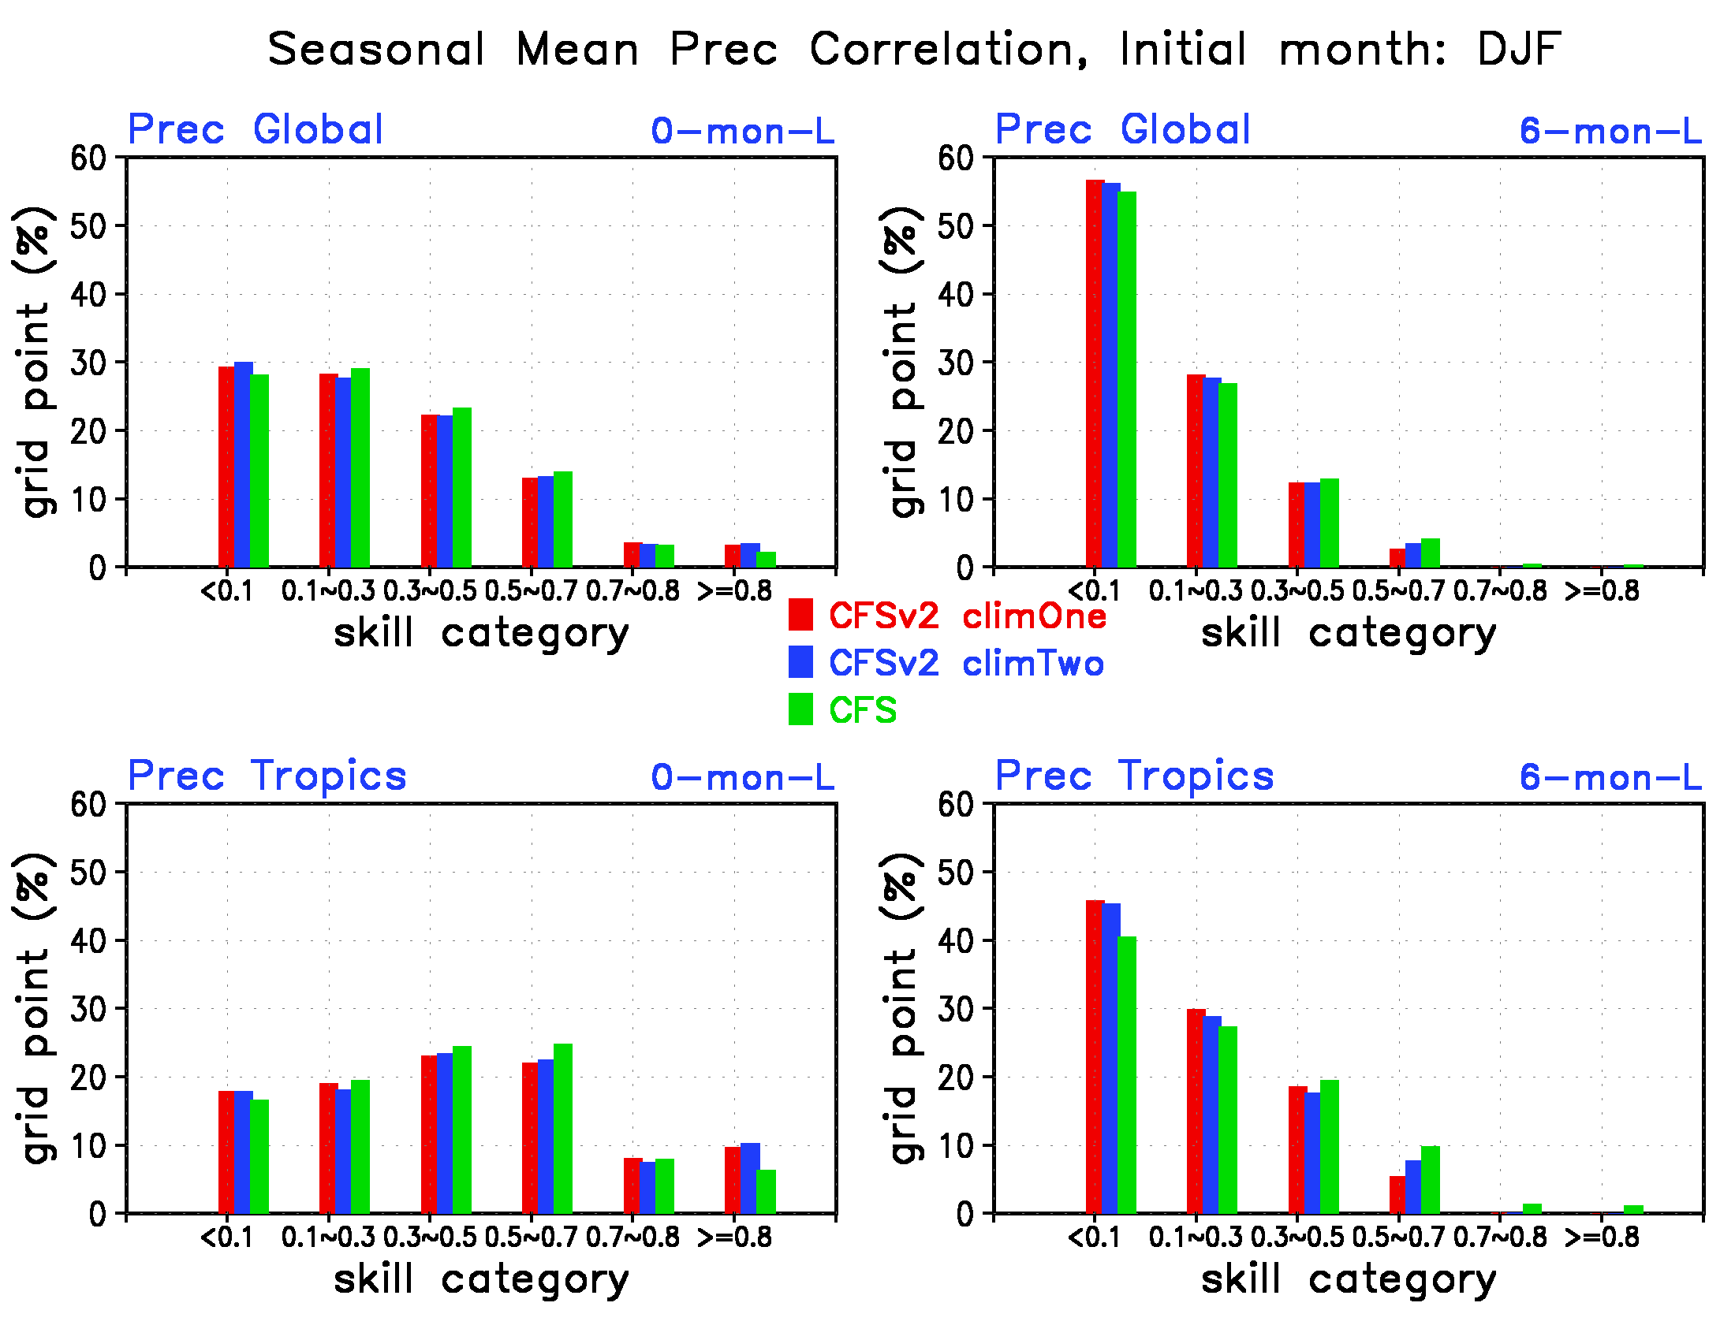
Precipitation seasonal mean forecast correlation skill

Slide 40
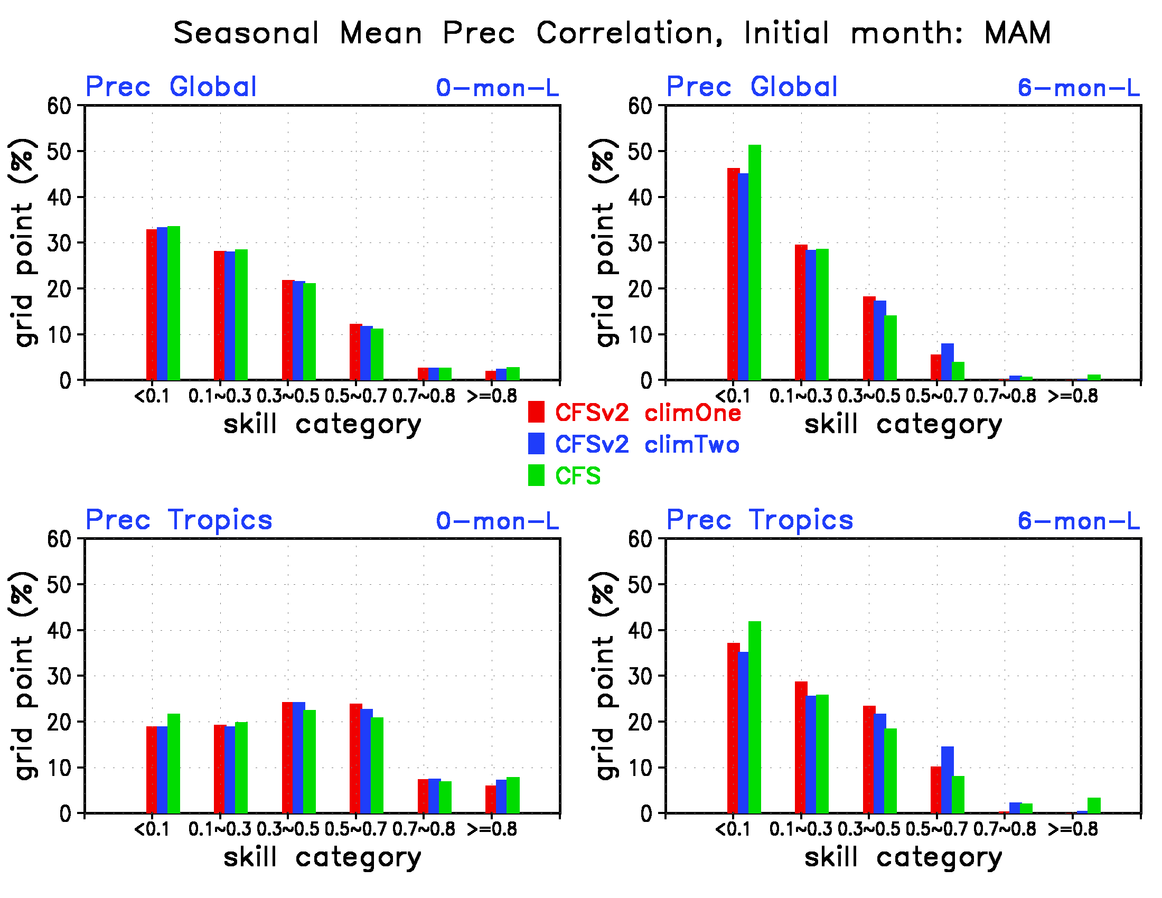
Precipitation seasonal mean forecast correlation skill

Slide 41
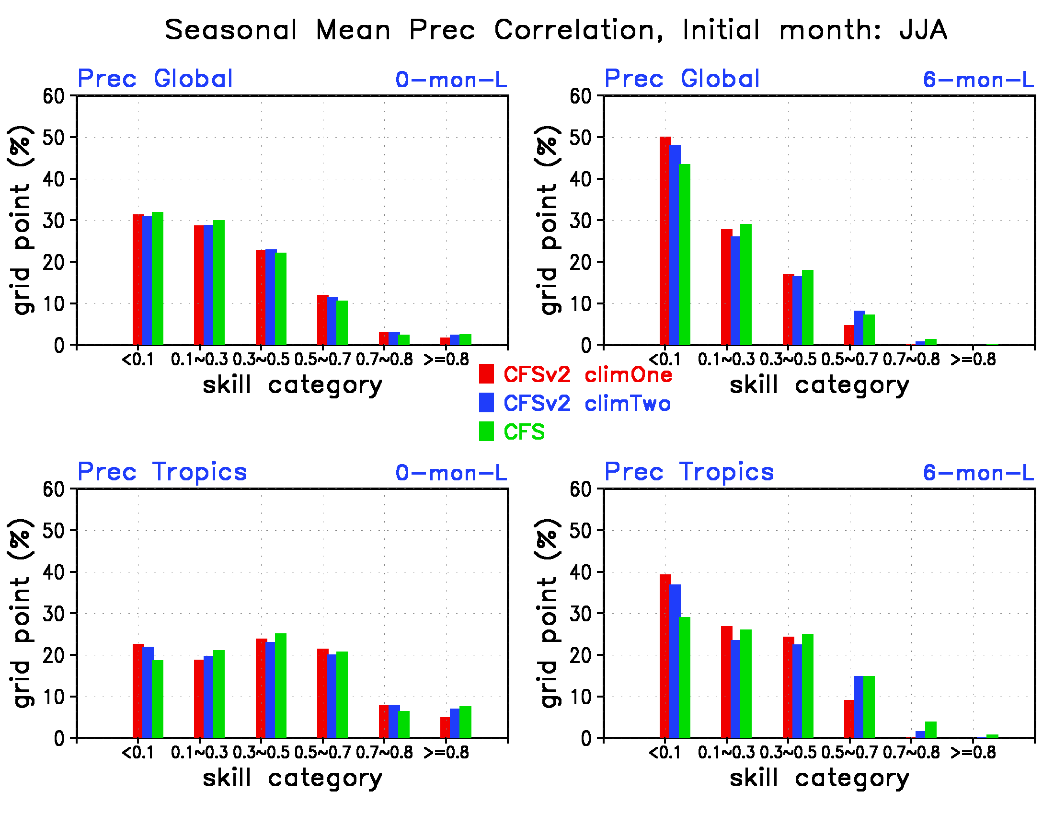
Precipitation seasonal mean forecast correlation skill

Slide 42
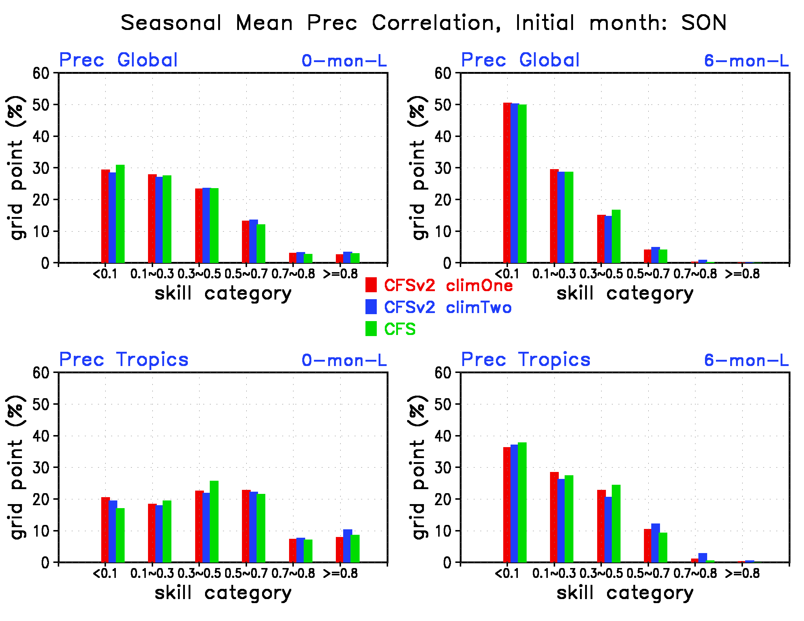
Precipitation seasonal mean forecast correlation skill

Slide 43
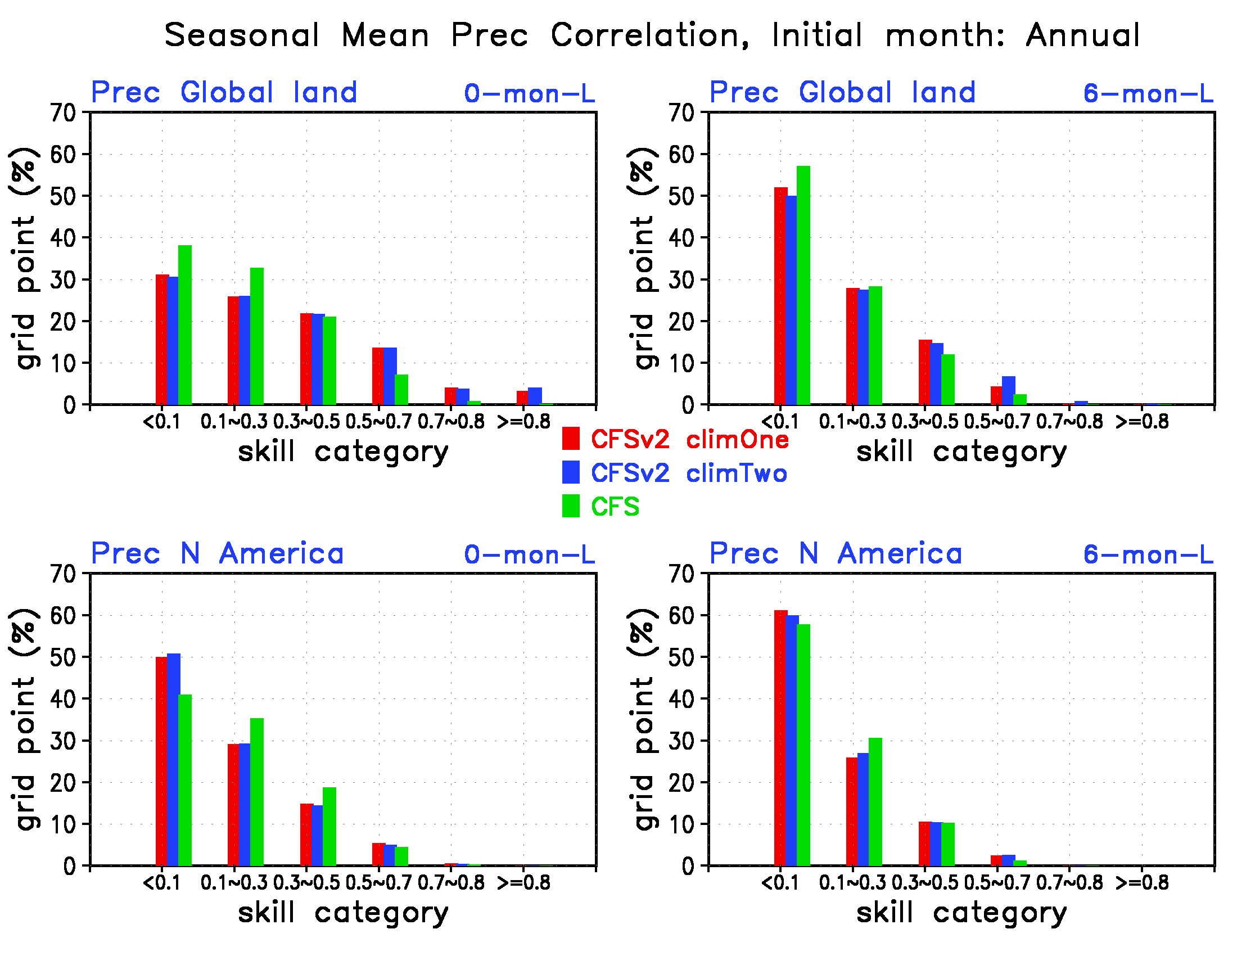
Precipitation seasonal mean forecast correlation skill
CFSv2 has more land area with high skills (>0.5) globally

Slide 44
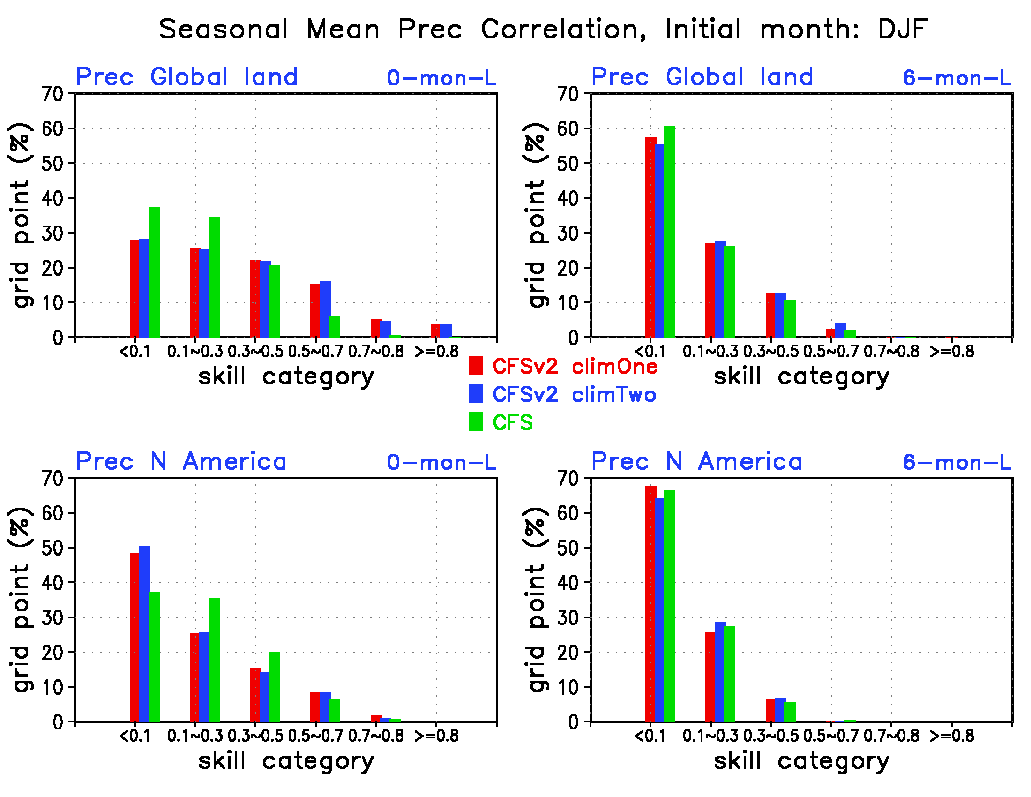
Precipitation seasonal mean forecast correlation skill

Slide 45
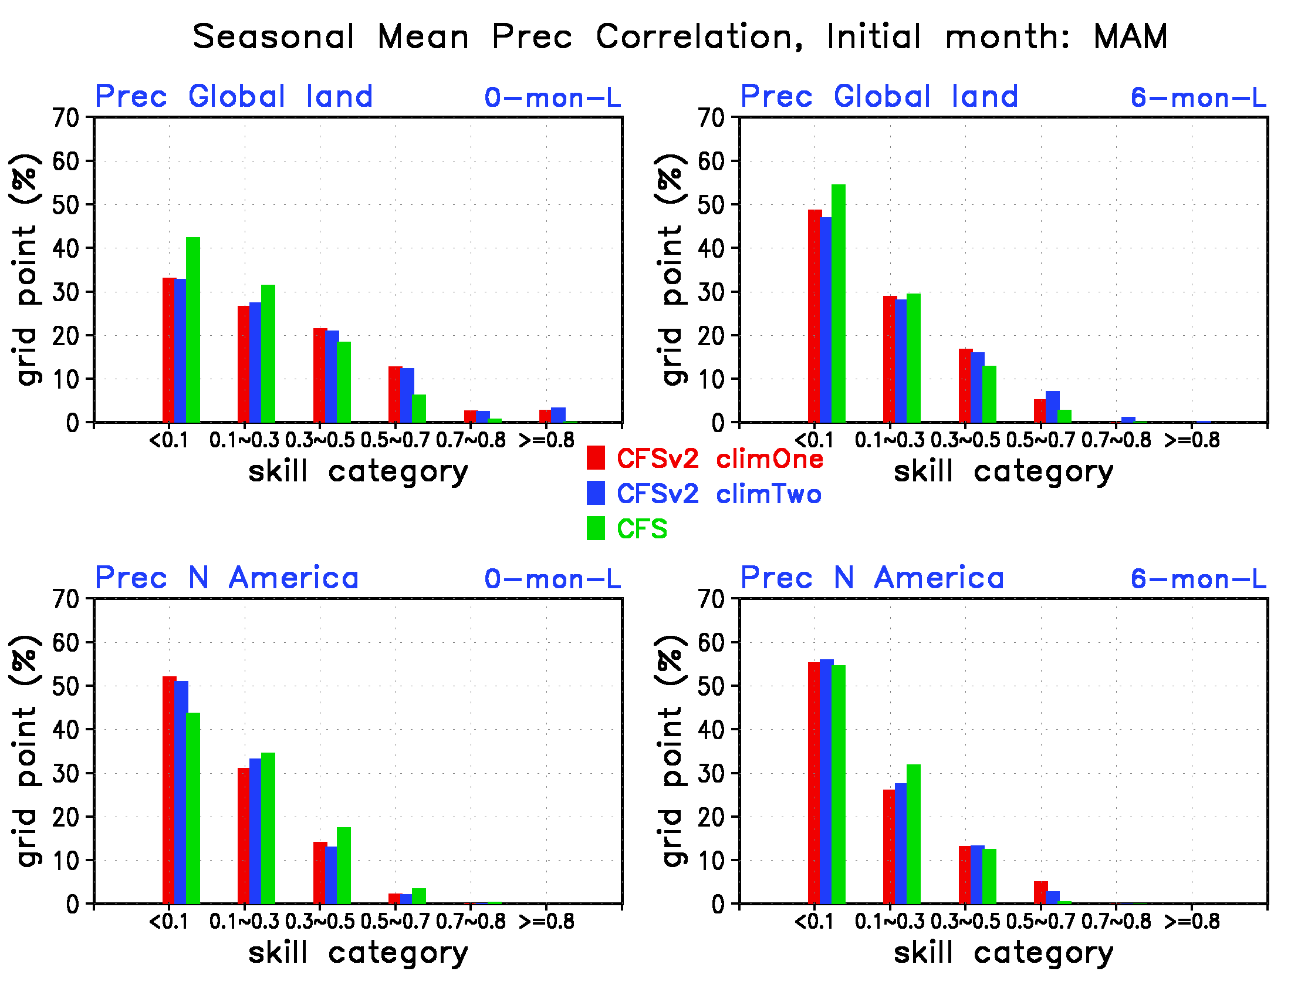
Precipitation seasonal mean forecast correlation skill

Slide 46
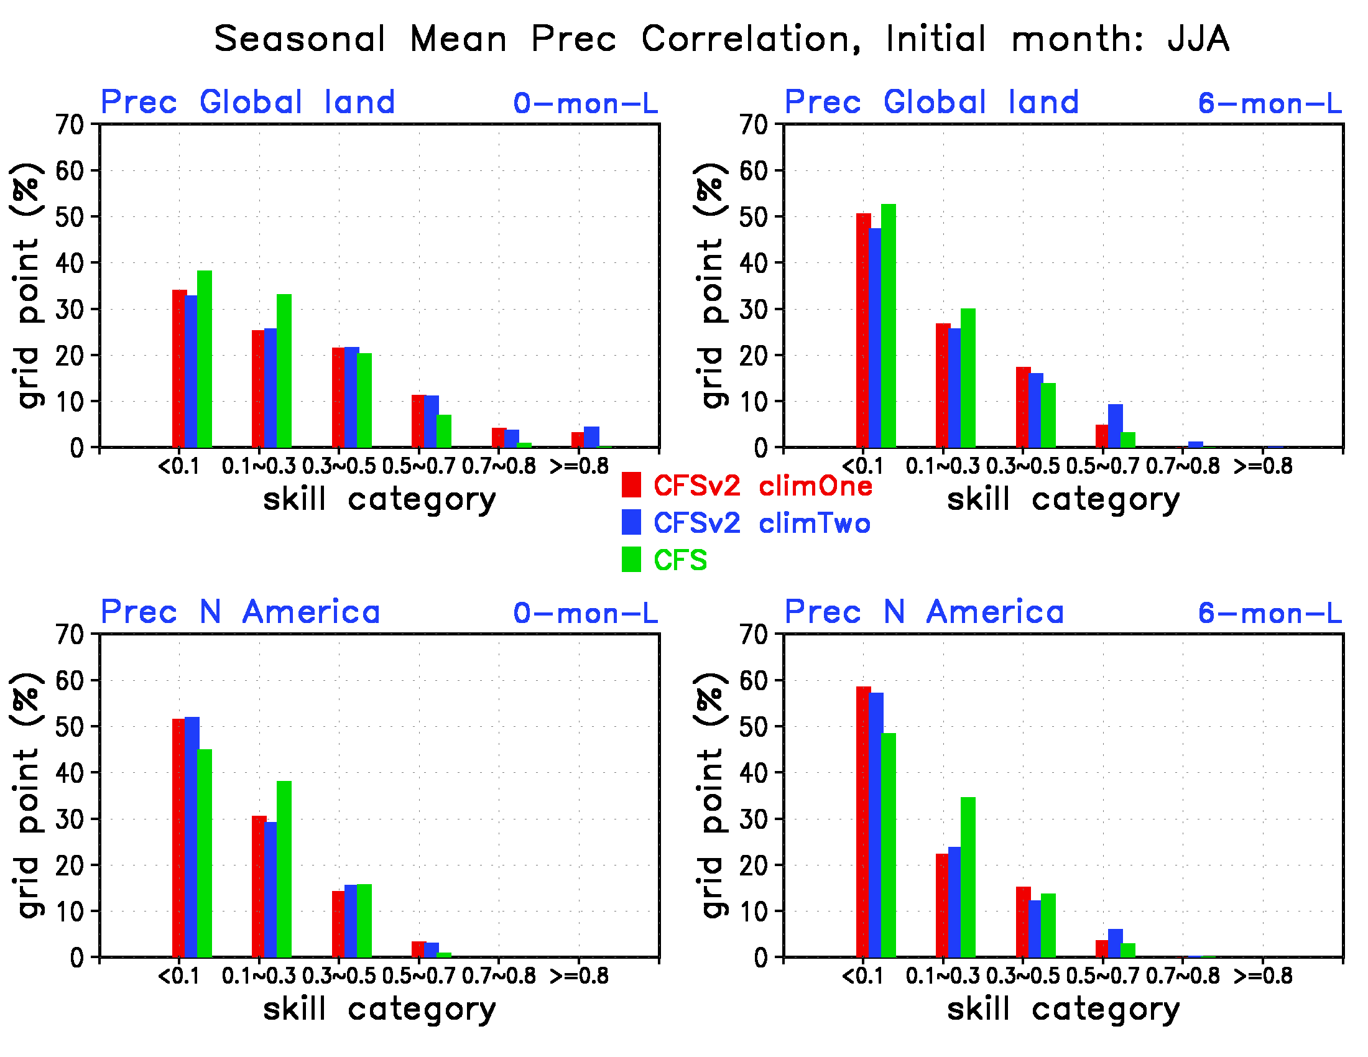
Precipitation seasonal mean forecast correlation skill

Slide 47
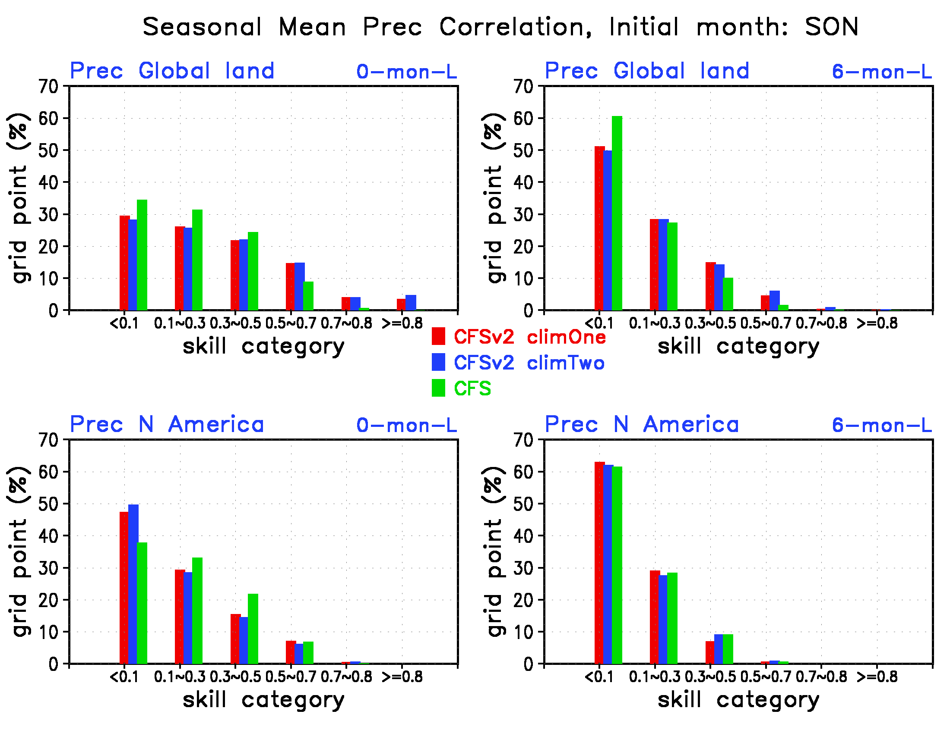
Precipitation seasonal mean forecast correlation skill

Slide 48
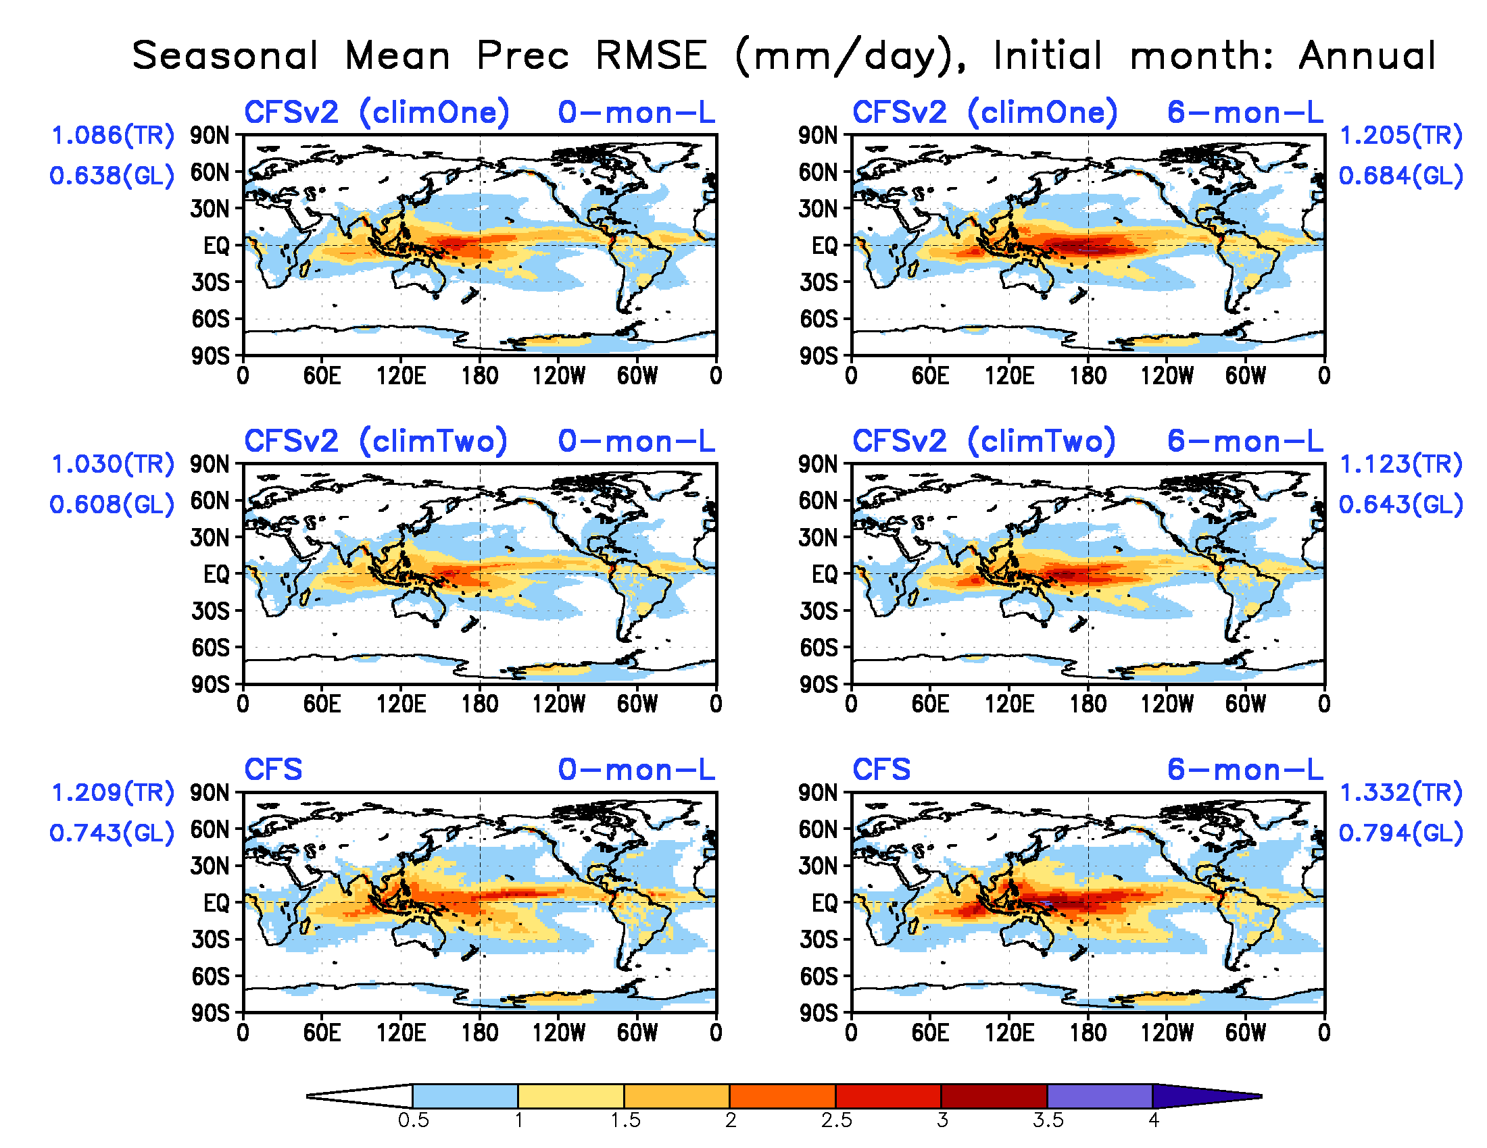
Precipitation seasonal mean forecast RMSE (mm/day)
CFSv2 shows less RMSE than CFS globally and over tropics

Slide 49
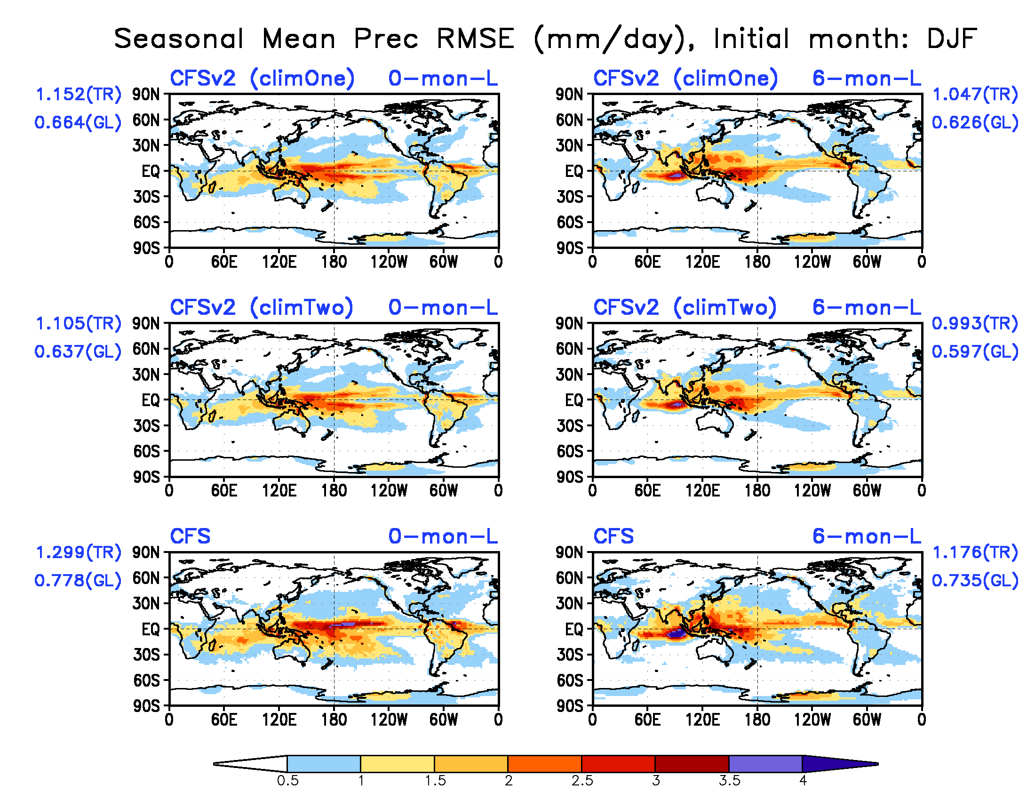
Precipitation seasonal mean forecast RMSE (mm/day)

Slide 50
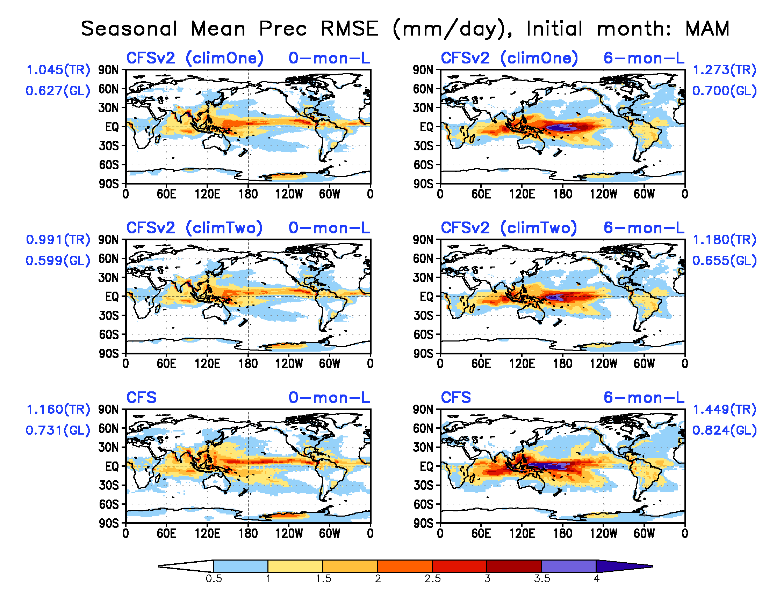
Precipitation seasonal mean forecast RMSE (mm/day)

Slide 51
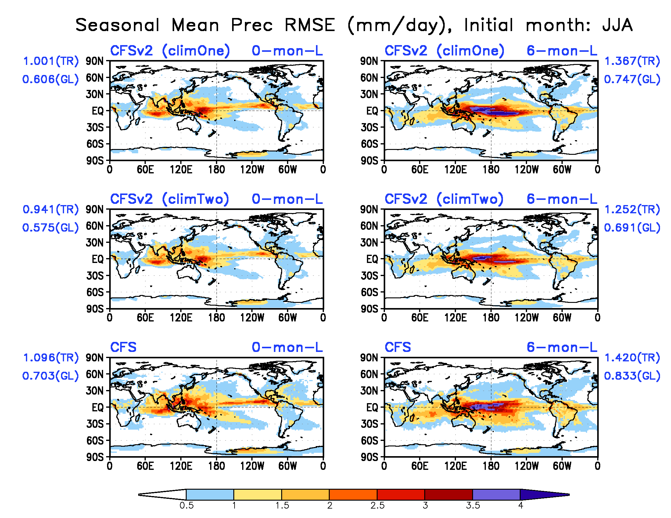
Precipitation seasonal mean forecast RMSE (mm/day)

Slide 52
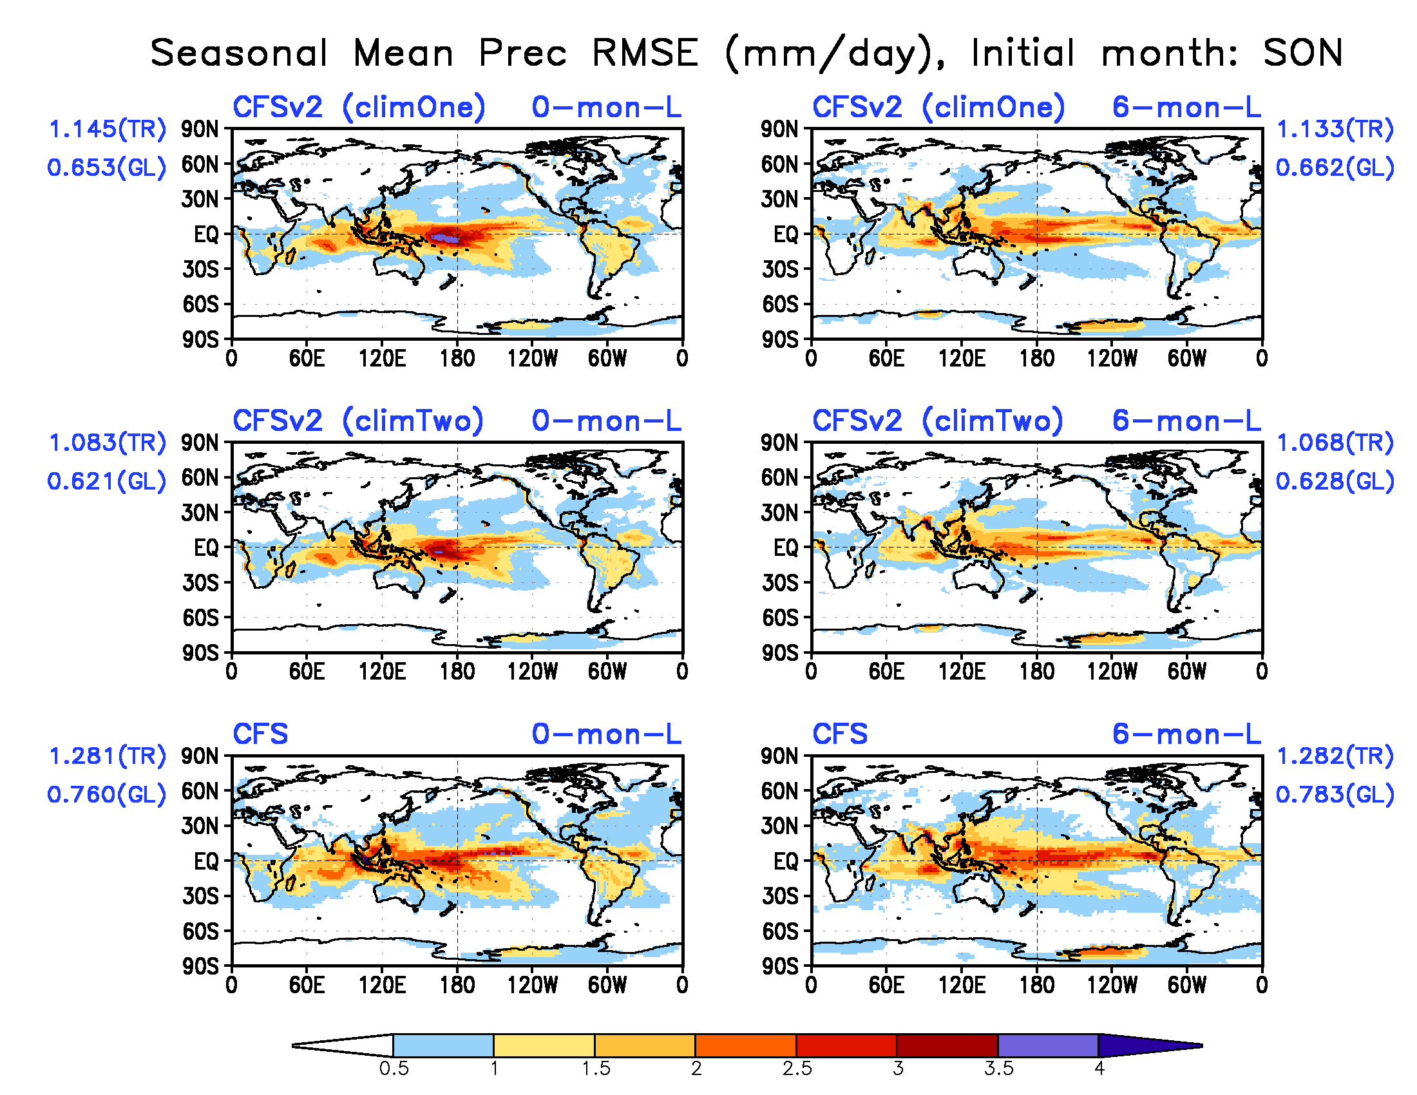
Precipitation seasonal mean forecast RMSE (mm/day)

Slide 53
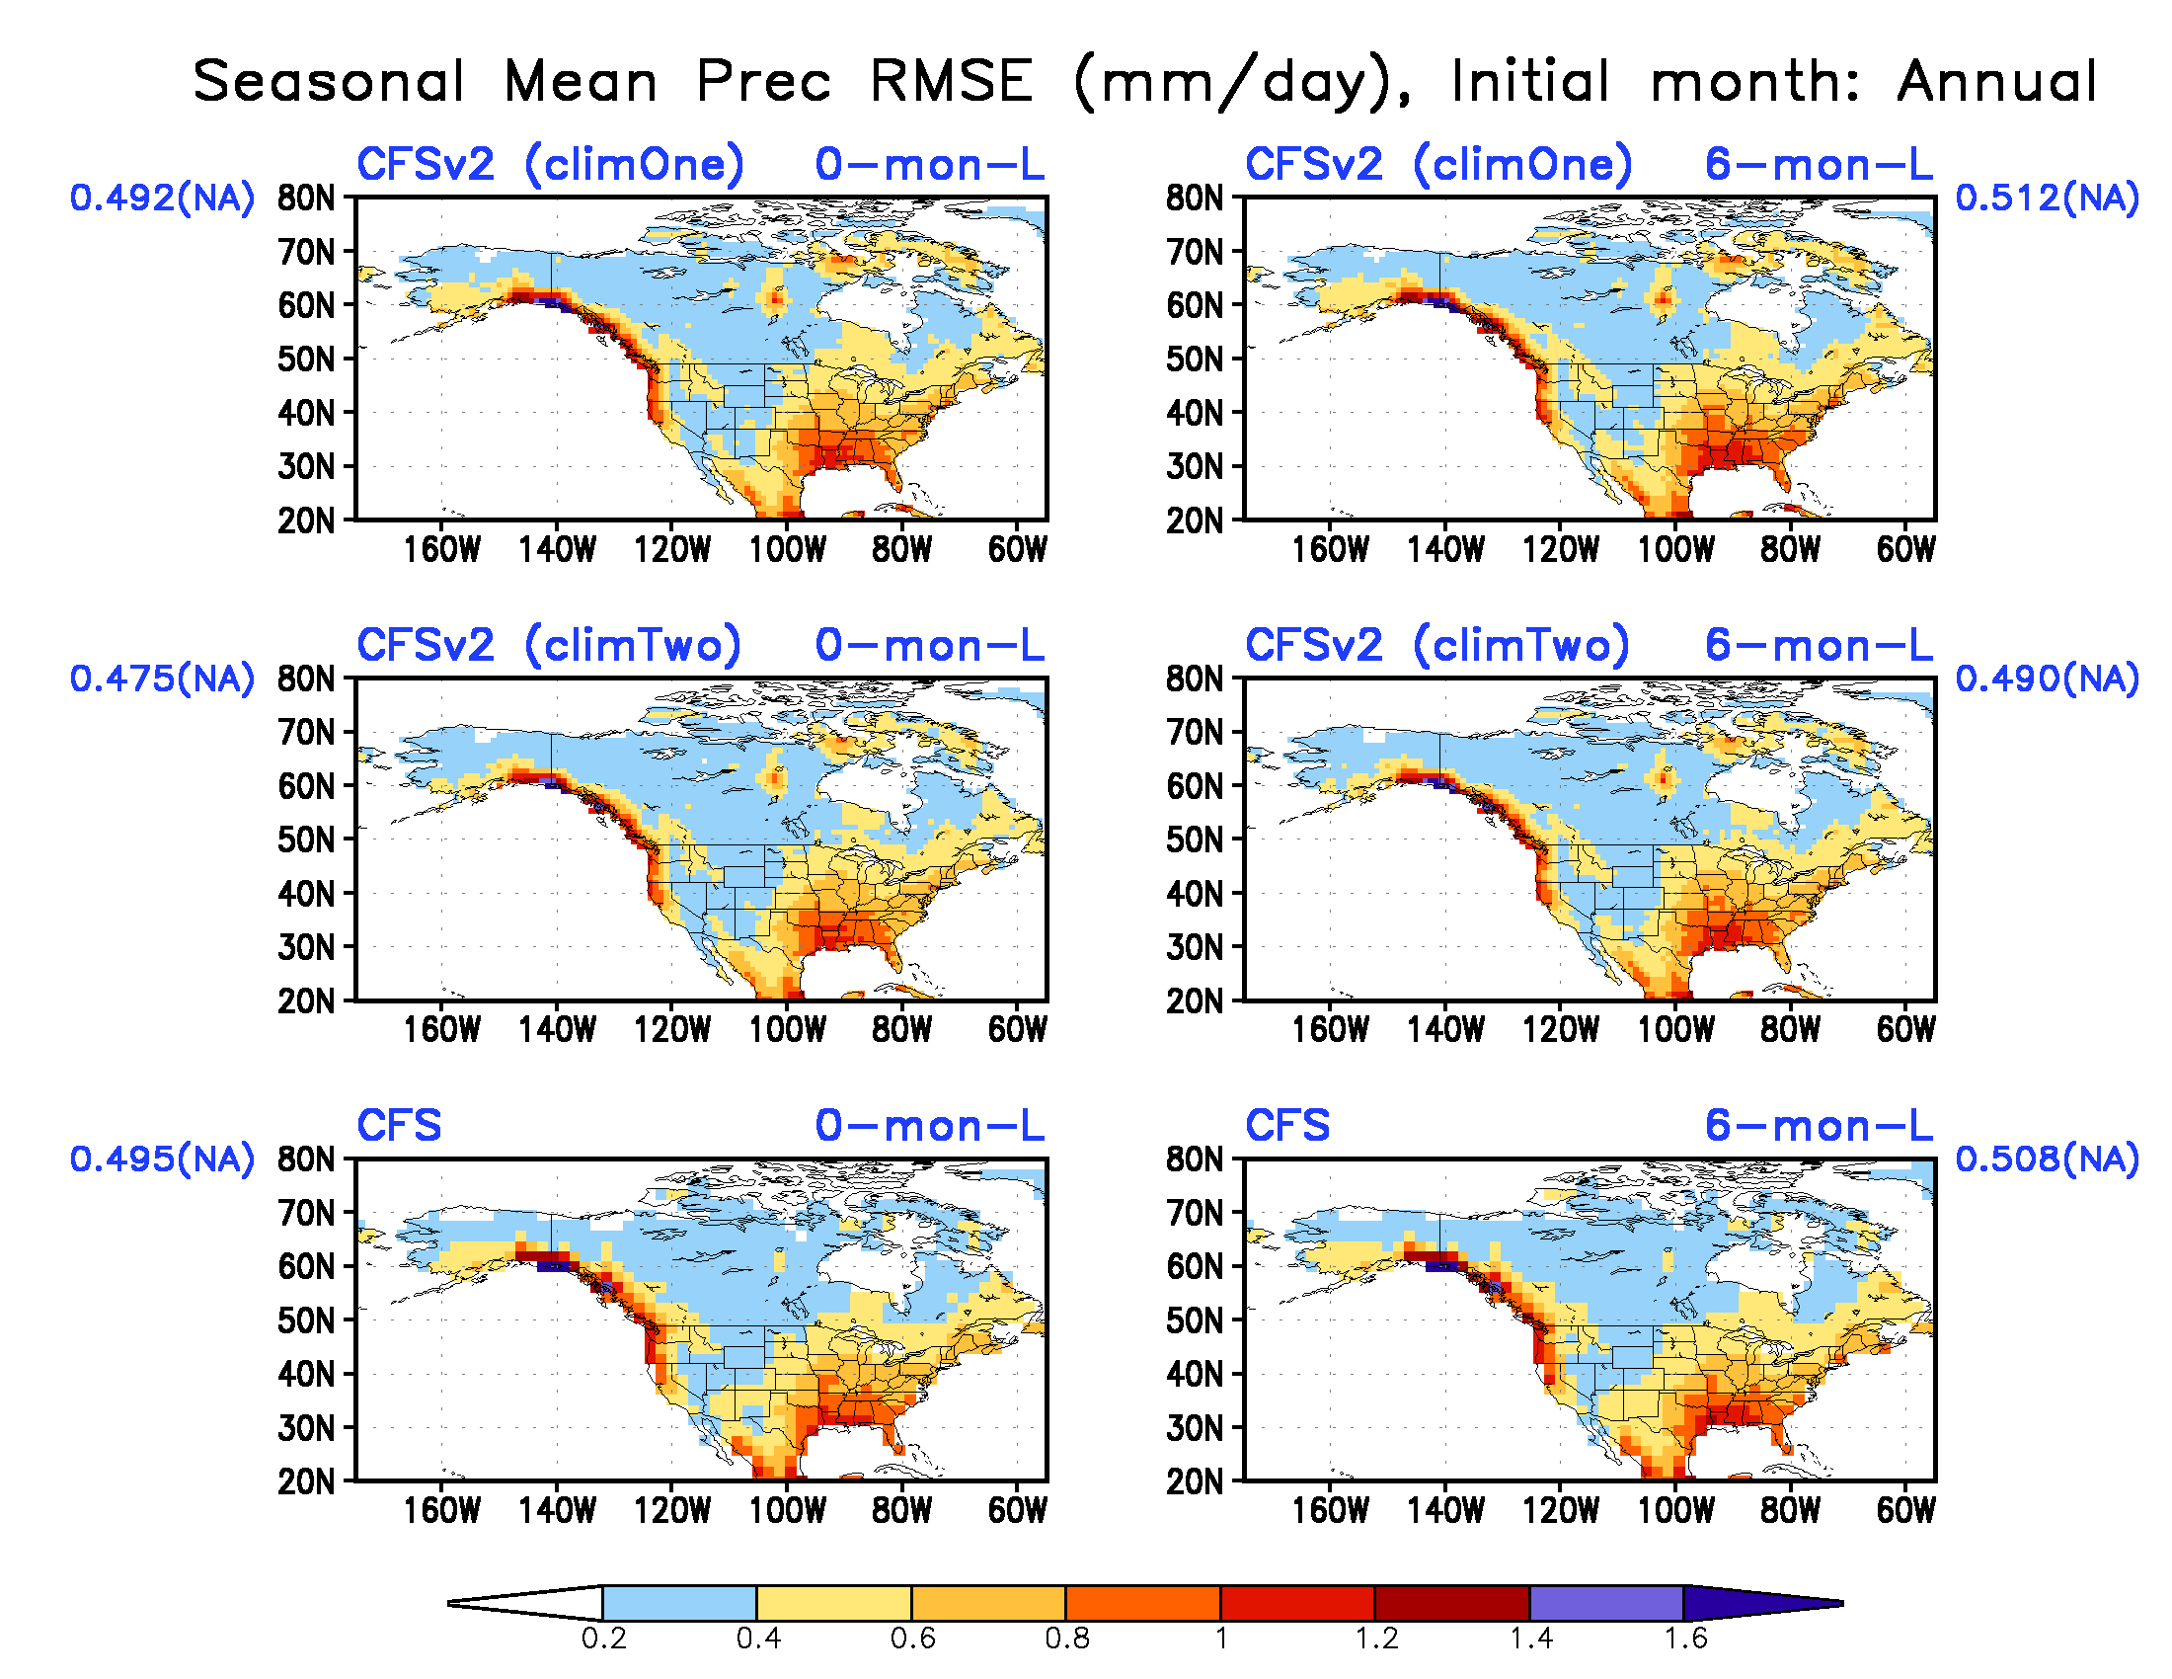
Precipitation seasonal mean forecast RMSE (mm/day)
Two climatology CFSv2 shows less RMSE

Slide 54
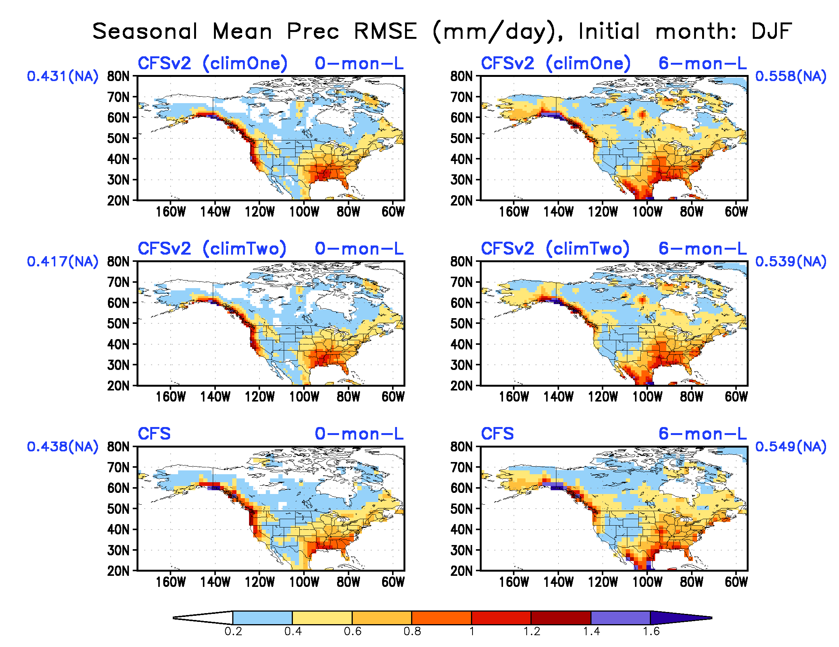
Precipitation seasonal mean forecast RMSE (mm/day)

Slide 55
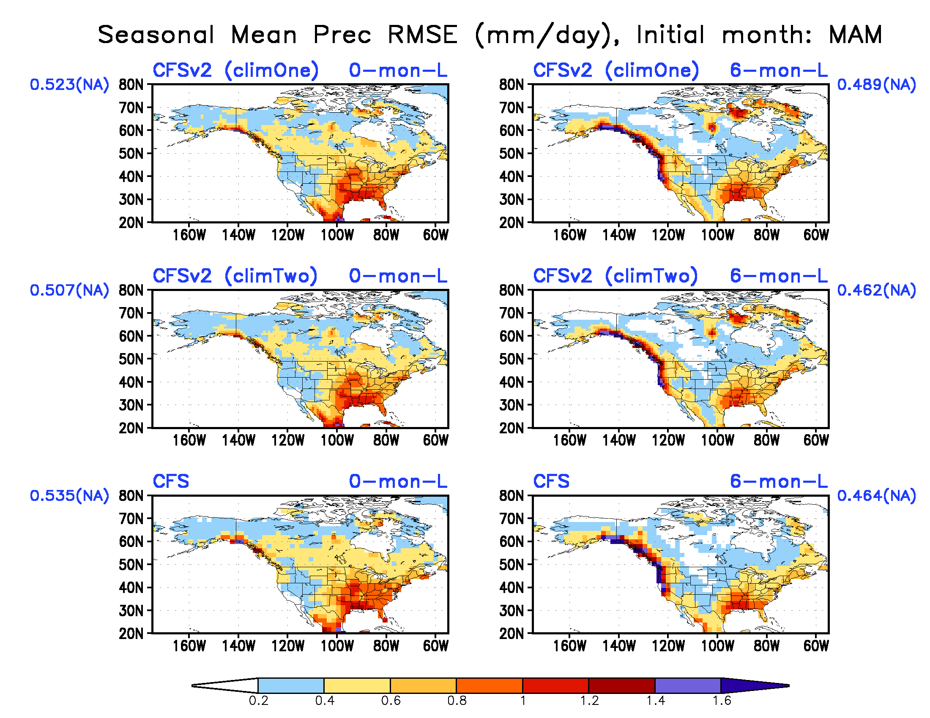
Precipitation seasonal mean forecast RMSE (mm/day)

Slide 56
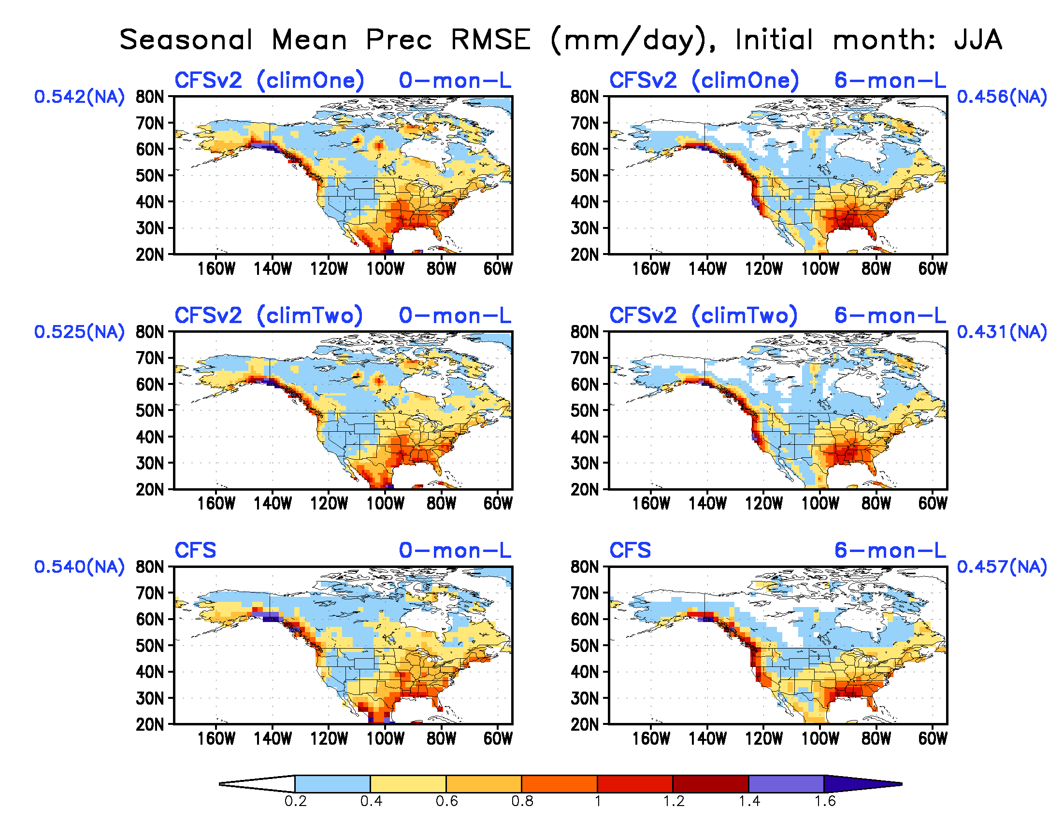
Precipitation seasonal mean forecast RMSE (mm/day)

Slide 57
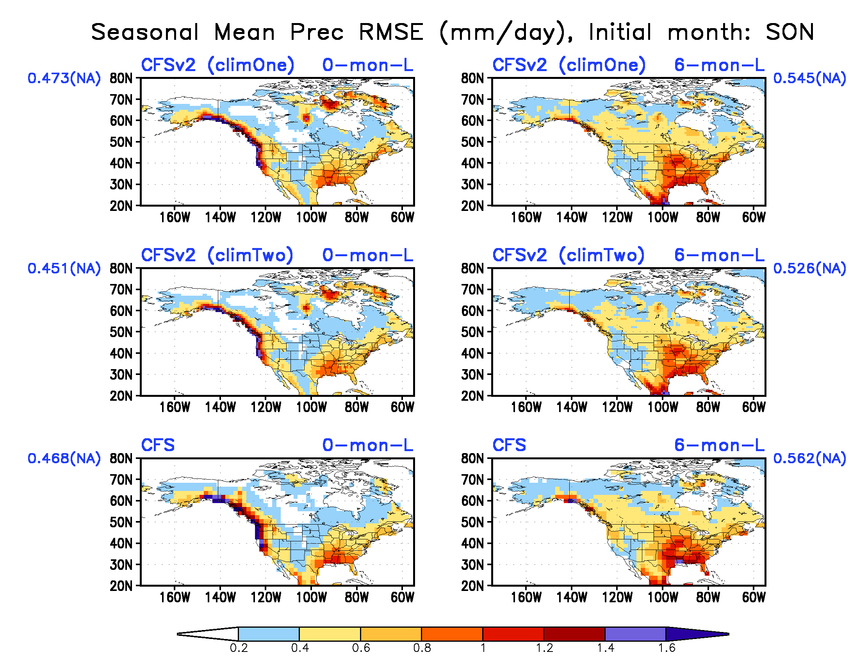
Precipitation seasonal mean forecast RMSE (mm/day)

Slide 58
Precipitation seasonal mean forecast Standard Deviation (mm/day)

Slide 59
Precipitation seasonal mean forecast Standard Deviation (mm/day)

Slide 60
Precipitation seasonal mean forecast Standard Deviation (mm/day)

Slide 61
Precipitation seasonal mean forecast Standard Deviation (mm/day)

Slide 62
Precipitation seasonal mean forecast Standard Deviation (mm/day)

Slide 63
Precipitation seasonal mean forecast Standard Deviation (mm/day)

Slide 64
Precipitation seasonal mean forecast Standard Deviation (mm/day)

Slide 65
Precipitation seasonal mean forecast Standard Deviation (mm/day)

Slide 66
Precipitation seasonal mean forecast Standard Deviation (mm/day)

Slide 67
Precipitation seasonal mean forecast Standard Deviation (mm/day)

Slide 68
2 Meter Temperature (T2m)

Slide 69
T2m seasonal mean forecast correlation skill
CFSv2 shows higher skills than CFS;
Two climatology CFSv2 reduces the skills

Slide 70
T2m seasonal mean forecast correlation skill

Slide 71
T2m seasonal mean forecast correlation skill

Slide 72
T2m seasonal mean forecast correlation skill

Slide 73
T2m seasonal mean forecast correlation skill

Slide 74
T2m seasonal mean forecast correlation skill
CFSv2 shows higher skills than CFS;
Two climatology CFSv2 reduces the skills

Slide 75
T2m seasonal mean forecast correlation skill

Slide 76
T2m seasonal mean forecast correlation skill

Slide 77
T2m seasonal mean forecast correlation skill

Slide 78
T2m seasonal mean forecast correlation skill

Slide 79
T2m seasonal mean forecast correlation skill
CFSv2 has more areas with high skills (>0.5) than CFS;
Two climatology CFSv2 reduces the areas with high skills

Slide 80
T2m seasonal mean forecast correlation skill

Slide 81
T2m seasonal mean forecast correlation skill

Slide 82
T2m seasonal mean forecast correlation skill

Slide 83
T2m seasonal mean forecast correlation skill

Slide 84
T2m seasonal mean forecast RMSE (K)
CFSv2 shows less RMSE than CFS globally and over tropics
Two climatology CFSv2 reduces the RMSE

Slide 85
T2m seasonal mean forecast RMSE (K)

Slide 86
T2m seasonal mean forecast RMSE (K)

Slide 87
T2m seasonal mean forecast RMSE (K)

Slide 88
T2m seasonal mean forecast RMSE (K)

Slide 89
T2m seasonal mean forecast RMSE (K)
CFSv2 shows less RMSE than CFS globally and over tropics
Two climatology CFSv2 reduces the RMSE

Slide 90
T2m seasonal mean forecast RMSE (K)

Slide 91
T2m seasonal mean forecast RMSE (K)

Slide 92
T2m seasonal mean forecast RMSE (K)

Slide 93
T2m seasonal mean forecast RMSE (K)

Slide 94
T2m seasonal mean forecast Standard Deviation (K)

Slide 95
T2m seasonal mean forecast Standard Deviation (K)

Slide 96
T2m seasonal mean forecast Standard Deviation (K)

Slide 97
T2m seasonal mean forecast Standard Deviation (K)

Slide 98
T2m seasonal mean forecast Standard Deviation (K)

Slide 99
T2m seasonal mean forecast Standard Deviation (K)

Slide 100
T2m seasonal mean forecast Standard Deviation (K)

Slide 101
T2m seasonal mean forecast Standard Deviation (K)

Slide 102
T2m seasonal mean forecast Standard Deviation (K)

Slide 103
T2m seasonal mean forecast Standard Deviation (K)

Slide 104
Forecast of surface air temperature warming trend from CFSv2

Slide 105
Forecast of surface air temperature warming trend from CFSv2

Slide 106
Summary
SST
CFSv2 shows better skills than CFSv1 over some regions at extra-tropics and over the ocean basins other than the tropical E. Pacific.
CFSv2 shows more reasonably the seasonal variations of standard deviation.
CFSv2 skill are increased over the tropical E. Pacific when using two climatology anomalies
Precipitation
CFSv2 shows similar skill level and pattern with CFSv1 in generally, slight better skill over N. America.
Two climatology anomalies did not improve the CFSv2 skill.
T2m
CFSv2 shows better skill over all regions including N. America.
CFSv2 shows reasonably the warming trend of surface air temperature.
CFSv2 skills are reduced when using two climatology anomalies.

