Slide 1


Impact of Snowpack on NCEP Weeks 3-4 Forecasts
Xubin Zeng, William Scheftic, Jorge Arevalo , Joshua Welty
University of Arizona, Tucson, AZ
NCEP Partners: Yuejian Zhu and Wei Li at EMC
Yun Fan at CPC
30 July 2020
NWS/OSTI 2018 2018 FFO Projects

Slide 2

Outline
Impact of snow water equivalent (SWE) on the EMC GEFS weeks 1-5 forecasts
GEFS initialization and forecasts of SWE are poor;
GEFS forecast SWE errors may be corrected using a two-stage method;
More efforts are needed to better initialize SWE for GEFS
(b) Implementation of snowpack treatment into the CPC Leaky Bucket (LB) model for drought monitoring over CONUS

Slide 3
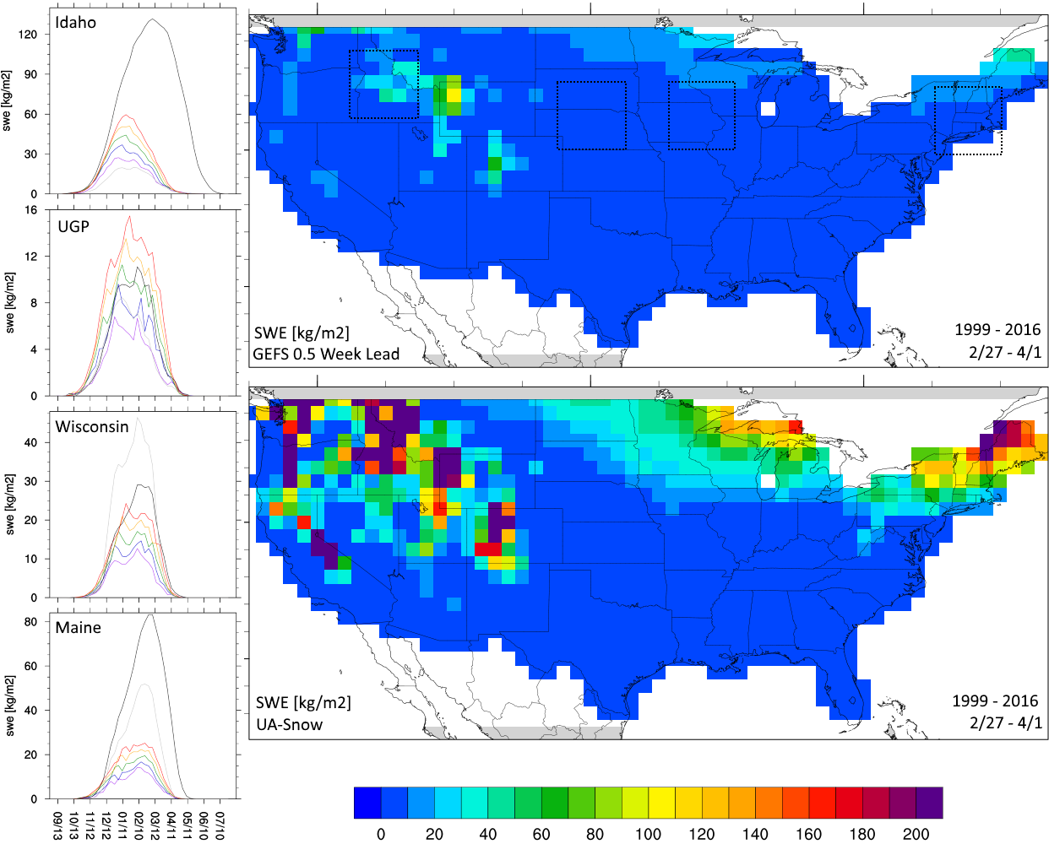
GEFS Deficiencies in Forecasting SWE
SWE maps:
GEFS in week 1 (close to initial condition) significantly underestimates SWE climatology
Seasonal cycles
GEFS SWE for weeks 1-5 forecasts (color lines) was all underestimated over most areas, compared with UA data (black line).
Week 5 SWE (red) is more realistic than Week 1 (purple) forecast.
ERA-Interim (gray) SWE is also poor.

Slide 4
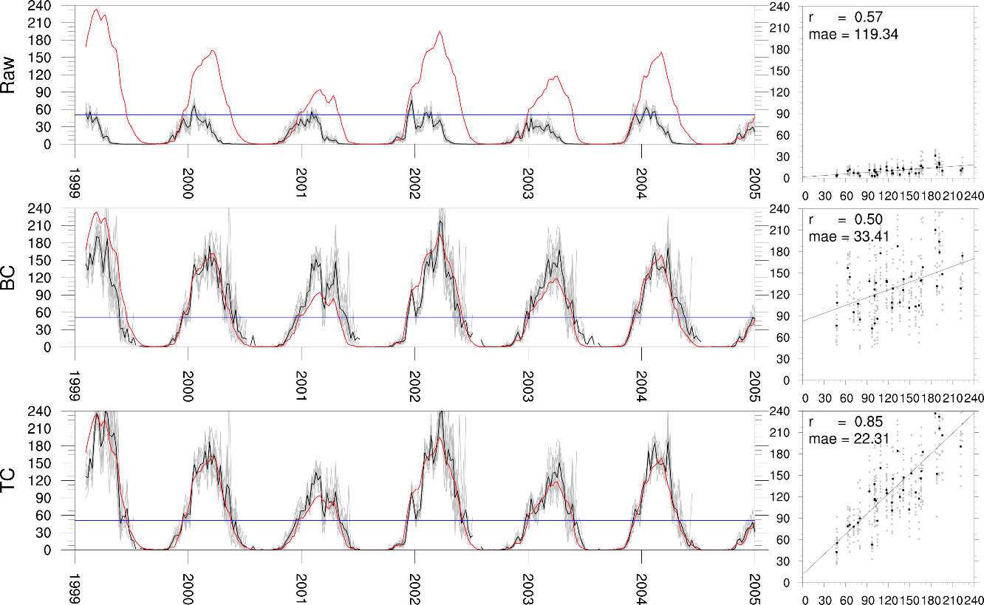
2-stage bias correction
GEFS week 3 ensemble forecasts over the Pacific NW region underestimate SWE compared to UA data (red).
Quantile matching reduces the bias and mean absolute error (MAE).
Teleconnections adjustment further improves MAE and correlation.
Note: cross-validated results, scatterplot is week of April 2nd forecasts.
Notes:
Weekly time-series (left) of SWE from 1999 to 2005 for GEFS week 3 forecast ensemble mean (black) and ensemble members (grey) over the Pacific NW region compared to UA-Snow (red) as well as scatterplots (right) between the UA-Snow (x-axis) and GEFS ensemble mean (black) and members (grey) (y-axis). The top row (Raw) represents the original GEFS forecast, the middle row (BC) is the 1st stage of bias-correction using quantile matching, and the bottom row (BC2) is the 2nd stage of bias-correction through the teleconnections adjustment.

Slide 5
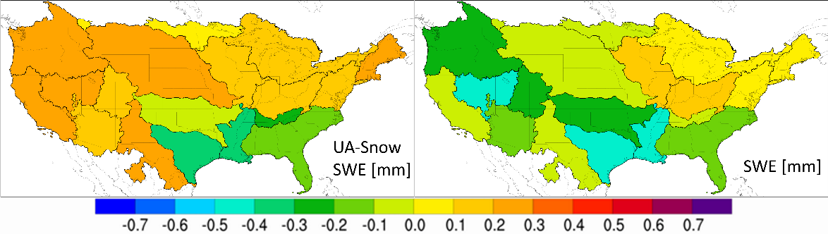
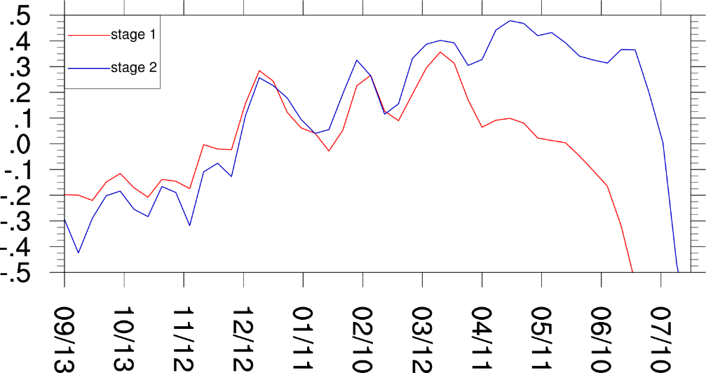
Impacts of 2-stage bias correction
UA SWE data for correction (top left) lead to better results than ERA-Int (top right)
Stage 2 shows biggest SWE improvement during snowmelt period.
Impacts on T and P are more limited (not shown)
Note: cross-validated results
Implication: longer reforecast period is preferable.
Ranked probability skill score (RPSS) for the bias-corrected GEFS Weeks 3-4 forecasts valid for 2/27-4/1
RPSS for GEFS Weeks 3-4 forecasts over Pacific NW

Slide 6
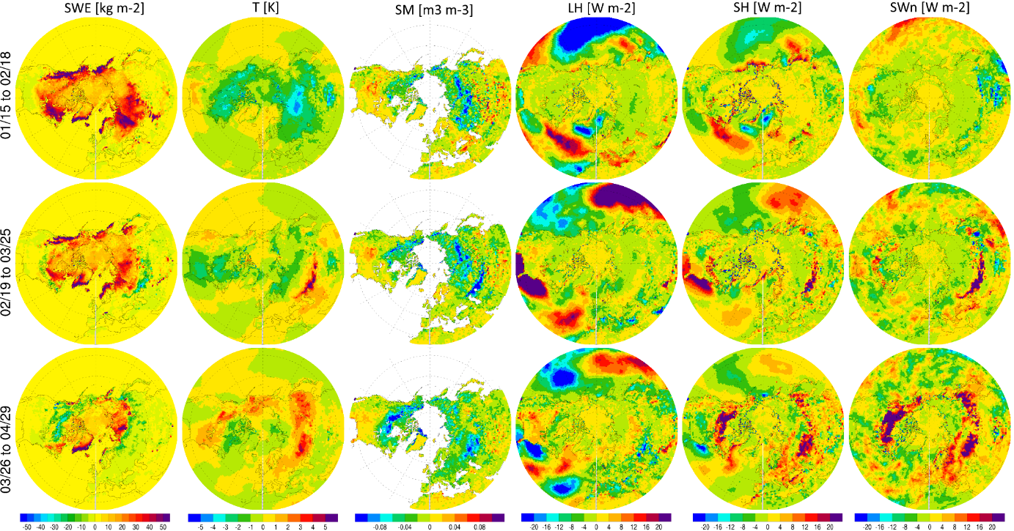
Weeks 3-4 forecast sensitivity to different SWE initializations
More SWE leads to lower T.
SWE impact on solar radiation, latent and sensible heat fluxes becomes stronger in spring
Soil moisture response is more regionalized
SWE has teleconnection impact on ocean surface LH, SH, and SWn
Implication: More comprehensive efforts for SWE initialization in GEFS is needed.
(Wk5Exp – GEFS) differences in Weeks 3-4 forecasts
Wk5Exp: Using week 5 SWE as the initial SWE condition
Notes:
During peak snowpack period Wk5Exp has consisitently more SWE. As snowmelts we actually less SWE with the Wk5Exp.
2m T over land is less where there more SWE and vice-versa. Also, some areas of eastern NA and eastern Asia have increased 2m T in late period in areas where snow had melted off earlier.
SM difference are more regional with Russia and N. Canada showing less SM and U.S. and S. Canada showing increased SM.
LH/SH/SWn have limited differences over land during peak snow period but larger differences as snow melts with higher SWn/SH where Wk5Exp SWE has melted earlier. Higher LH is seen over much of U.S. and S. Canada in Wk5Exp.

Slide 7
Outline
(a) Impact of snow water equivalent (SWE) on the EMC GEFS weeks 1-5 forecasts
(b) Implementation of snowpack treatment into the CPC Leaky Bucket (LB) model for drought monitoring over CONUS
LB with snowpack (or LBS) simulates SWE better than the Noah land model as used in EMC operational models;
Snowpack improves the soil moisture simulation and drought monitoring over CONUS

Slide 8
Snowpack treatment for the CPC Leaky Bucket Model
CPC uses the Leaky Bucket (LB) model to diagnose soil moisture (SM) from T and P.
Standardized SM anomalies are used to define US-DM drought categories.
It has been operational at CPC for two decades over CONUS: for monitoring (using CPC T and P) and prediction (based on GEFS)
Snowpack has been neglected in LB and most drought indices
We have developed the snowpack treatment for LB with the same T and P forcing, as calibrated with PRISM T and P data and UA SWE data
Notes:
Snowpack is important for GEFS forecasts. It is also important for post-processing at CPC. In particular, CPC using the LB for drought monitoring based on daily T and P.

Slide 9
Evaluation of LBS (i.e., LB with snowpack)
Compared to Noah/NLDAS-2, LBS (forced by PRISM T and P data) performs
much better over Western U.S.
slightly better in eastern U.S.
Compared to Noah/NLDAS-2, LBS (forced by NLDAS-2 T and P data) performs
better over Western U.S.
comparably over Eastern U.S.
LBS forced by PRISM (middle) and CPC (bottom) versus Noah/NLDAS2

Slide 10
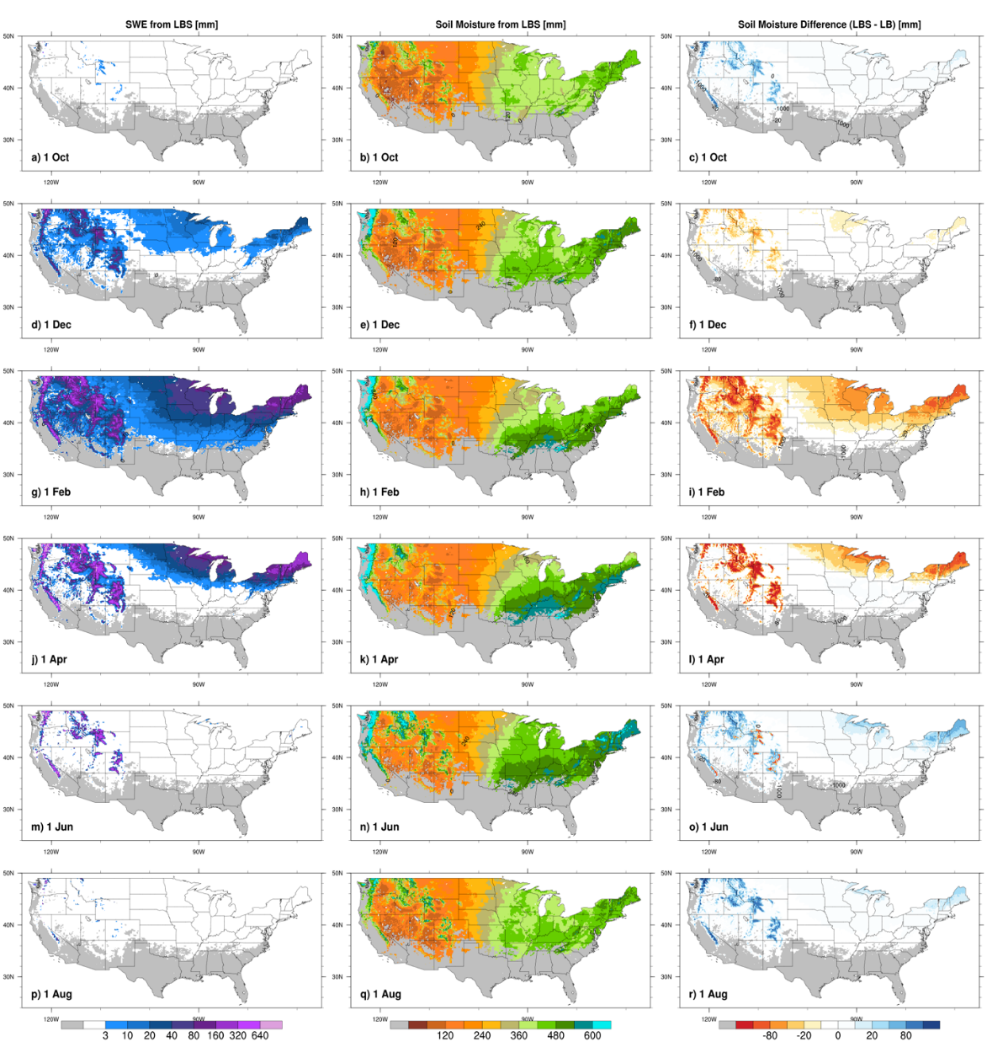
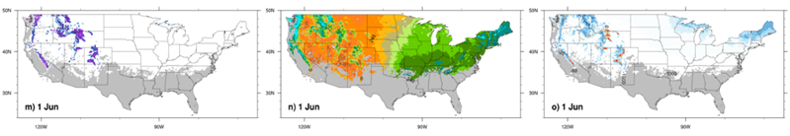
Snowpack effects on soil moisture in LBS
LBS SWE LBS soil moisture (LBS-LB) soil moisture
SM decreases during snow accumulation
SM increases during snow melting
This leads to the shift in the annual cycle of SM
SM increase could last until next season in some areas (not shown).

Slide 11
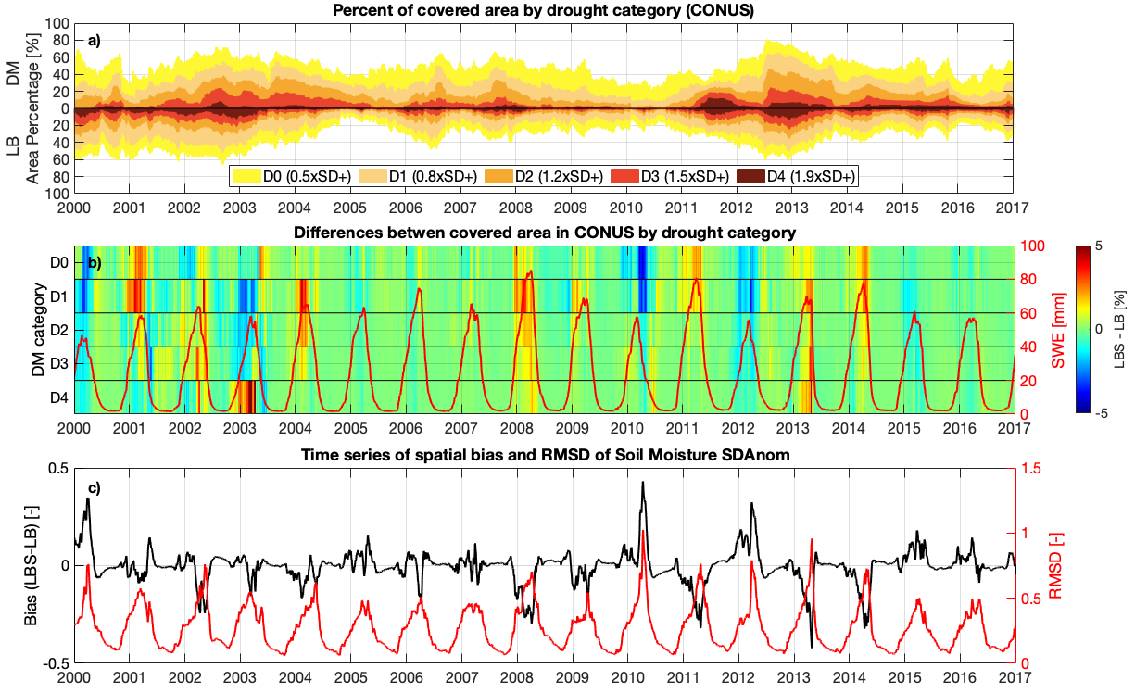
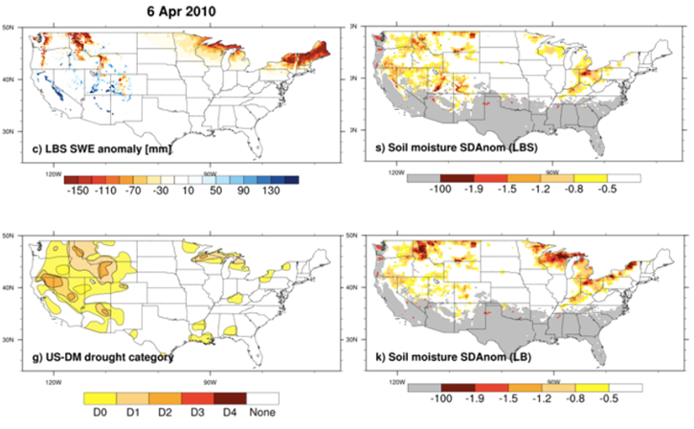
Snowpack impact on drought monitoring
Over CONUS (top figure)
Overall, the operational LB soil moisture (SM) standardized anomalies (SDAnoms) can reasonably mimic the temporal variability of areal coverage of the U.S. Drought Monitor categories.
LBS results are similar to LB, with differences of more than 5% for some categories during some periods (not shown).
Regionally (bottom figure)
LB overestimated the drought severity over some regions
LBS significantly reduced these overestimations, leading to more consistent drought categories with the USDM
Implication: The CPC Leaky Bucket Model with our snowpack treatment can be used for global drought monitoring

Slide 12
Impact of snowpack on NCEP Weeks 3-4 Forecasts
PI: Xubin Zeng
Capstone delivery, outcome, accomplishments:
Implemented snowpack treatment into the CPC Leaky Bucket (LB) model for CONUS and global drought monitoring (R2O success)
Assessed the impact of snow water equivalent on the EMC GEFS weeks 1-5 forecasts
LB overestimated the drought severity over some regions, which is significantly reduced with the snowpack treatment
30 July 2020
NWS/OSTI 2018 2018 FFO Projects

